Slide 1



DATA3 Single-Salt Campaign Analysis
Data Validation, Parameter Bounds, and Estimability
Data validation
70,101 / 70,101
audited data points GOOD
13 single-salt sheets
Parameter bounds
Same membrane → same box,
salt changes the fit, not the bound
Mass-per-vial pattern
$Δπ(t)$ drives $J_{w}(t)$
Now explained — no model fit needed
DATA3 vs published contour:
σ flat → identifiability gap
Keshav Kasturi Rangan · Dowling Group · University of Notre Dame
Collaborator briefing · May 27, 2026
DATA3 Single-Salt Status — May 27, 2026
1

Slide 2
1. Measured Data → Model Inputs: Loader Fidelity Audit
70,101 / 70,101 data points GOOD
13 single-salt sheets · 0 warnings · 0 bad
Source: DATA3_loader_fidelity_audit_2026-05-27.xlsx
Loader transformations (single documented formula per variable)
Variable | Transformation | Audit
Time (s) | 1:1 preserved | OK
Mass (g) | Per-vial baseline subtracted | OK
Pressure (psi) | 1:1 preserved | OK
Retentate Temp | 1:1 preserved | OK
Retentate Cond | EC25 temperature compensation | OK
Permeate Temp | 1:1 preserved | OK
Permeate Cond | EC25 + tube-transit time shift | OK
Vial Swap | 1:1 preserved (used to slice vials) | OK
ICP (cV_avg per vial) | Dilution × molar mass per vial | OK
What the audit verifies
• Read raw Excel directly with pandas — no library code in the path
• Load via lib.loadxlsx → data_stru
• Apply documented transformations to raw data, then compare row-by-row
• 1 % relative + absolute-floor tolerance per data point
• ICP sidebar, calibration points, header metadata
Take-away: The audit XLSX (shown in meeting) is the formal evidence — every point is either preserved or transformed by a formula.
DATA3 Single-Salt Status — May 27, 2026
2

Slide 3
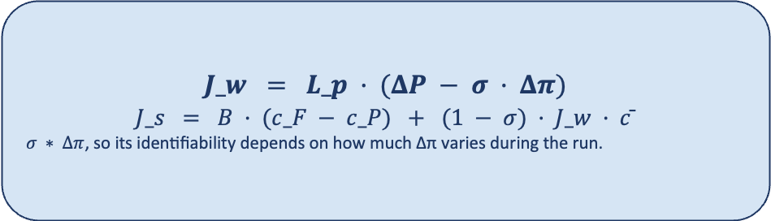
2. Physical Bounds on L_p, B, σ — Does B Change with Salt?
Same membrane → same box.
Salt changes the fitted value,
not the bound itself.
Published parameter box — used across all 13 single-salt sheets
Parameter | Bound | Why this range
L_p | [0.5, 50] L/(m²·hr·bar) | Membrane water permeability
B | [0, 30] μm/s | Solute-permeability term
σ | [0, 1] dimensionless | Reflection coefficient — physically bounded
Per-parameter reasoning
• σ ∈ [0, 1] for any salt — it is a reflection coefficient, physically bounded.
• L_p is a membrane property (water permeability) — independent of the salt.
• B is the most likely to move with salt (currently using the same bounds).
When to revisit the bounds:
• Different membrane, or
• A very different salt family, or
• A different model form (e.g. exchanged B parametrization).
$$J_w = L_p · (ΔP − σ · Δπ)$$
, so its identifiability depends on how much Δπ varies during the run.
Take-away: σ is bounded by physics; L_p should be independent of the salt, but what should I do with B?
DATA3 Single-Salt Status — May 27, 2026
3

Slide 4
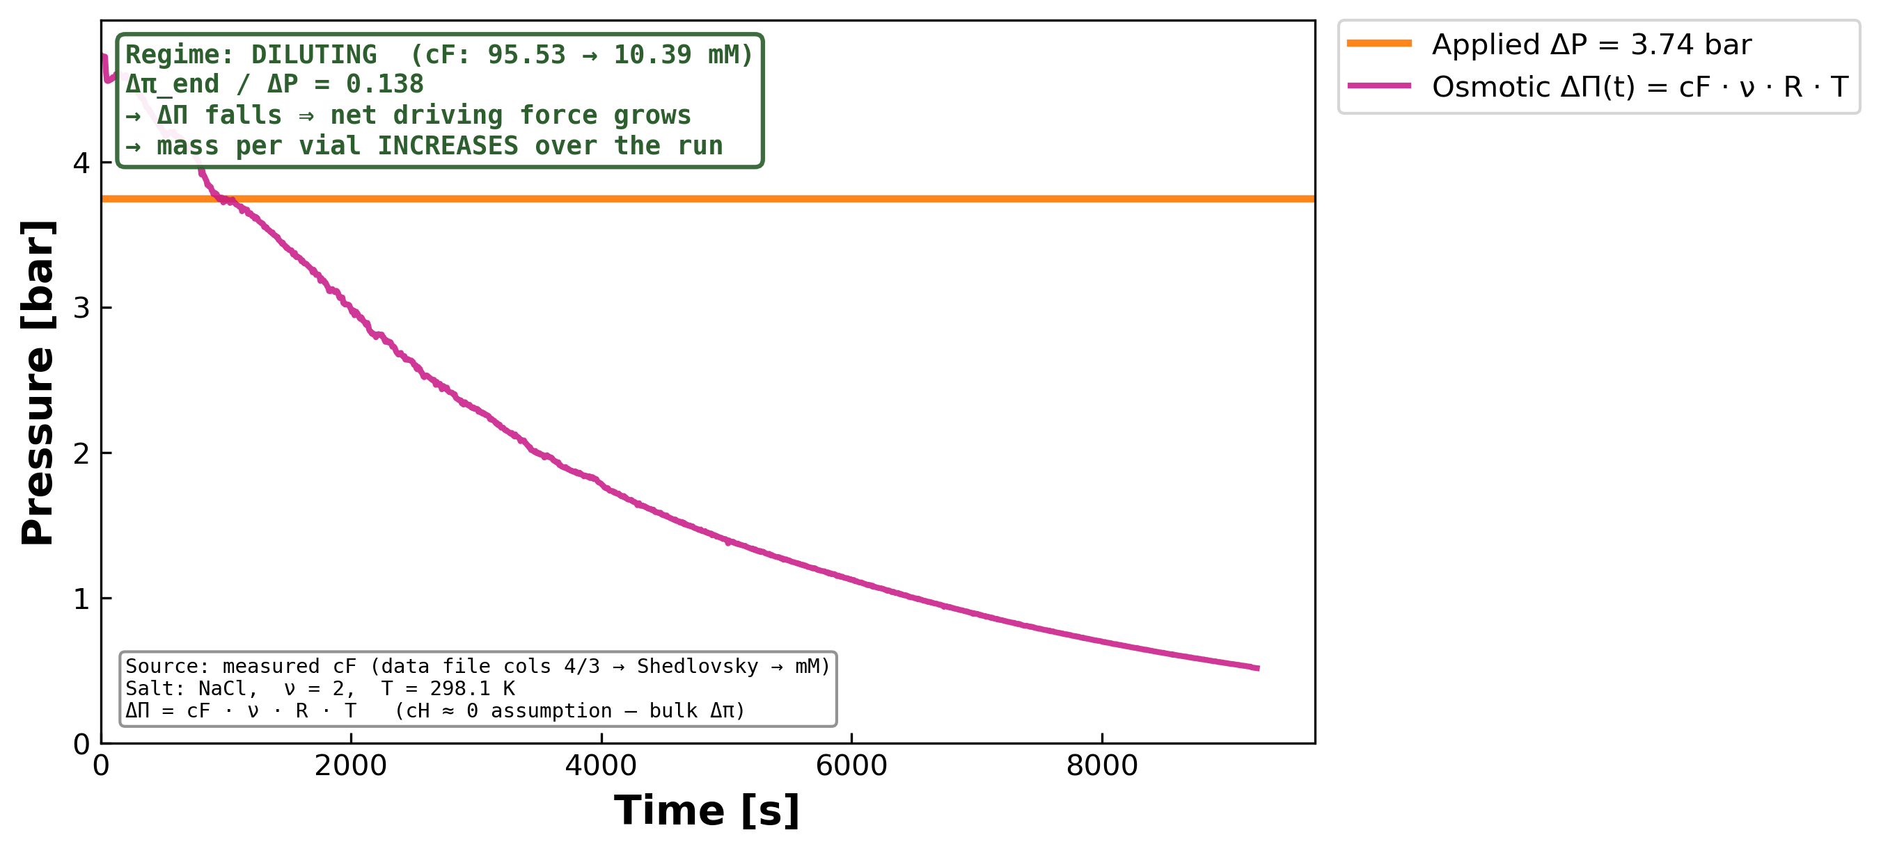
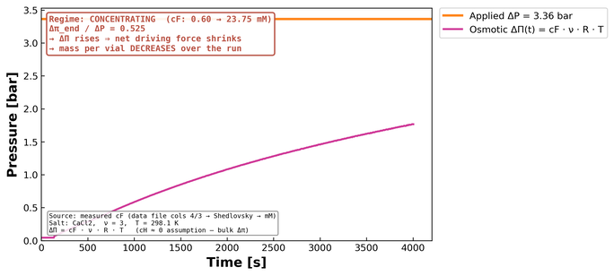
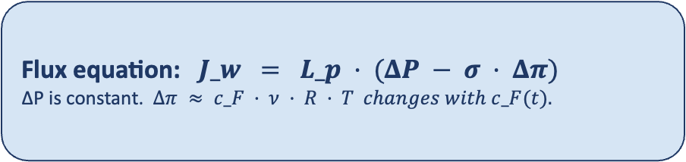
3. Mass-per-Vial Pattern is Explained by ΔP − σ·Δπ
MC3.07.22.24_SNaCl — diluting run (Δπ_initial > ΔP)
Flux equation: $J_w = L_p · (ΔP − σ · Δπ)$
ΔP is constant. $Δπ ≈ c_F · ν · R · T changes with c_F(t).$
Predicted mass-per-vial pattern (no model fit required)
Regime | c_F(t) | Δπ(t) | ΔP − σ·Δπ | Mass per vial
Concentrating | rises | rises | shrinks | decreases
Diluting | falls | falls | grows | increases
Take-away: The slope of mass per vial across the run is the direct signature of Δπ in the concentrating/diluting regime.
Orange ΔP constant · magenta Δπ(t) built from measured c_F — pure data, no fit.
DATA3 Single-Salt Status — May 27, 2026
4

Slide 5
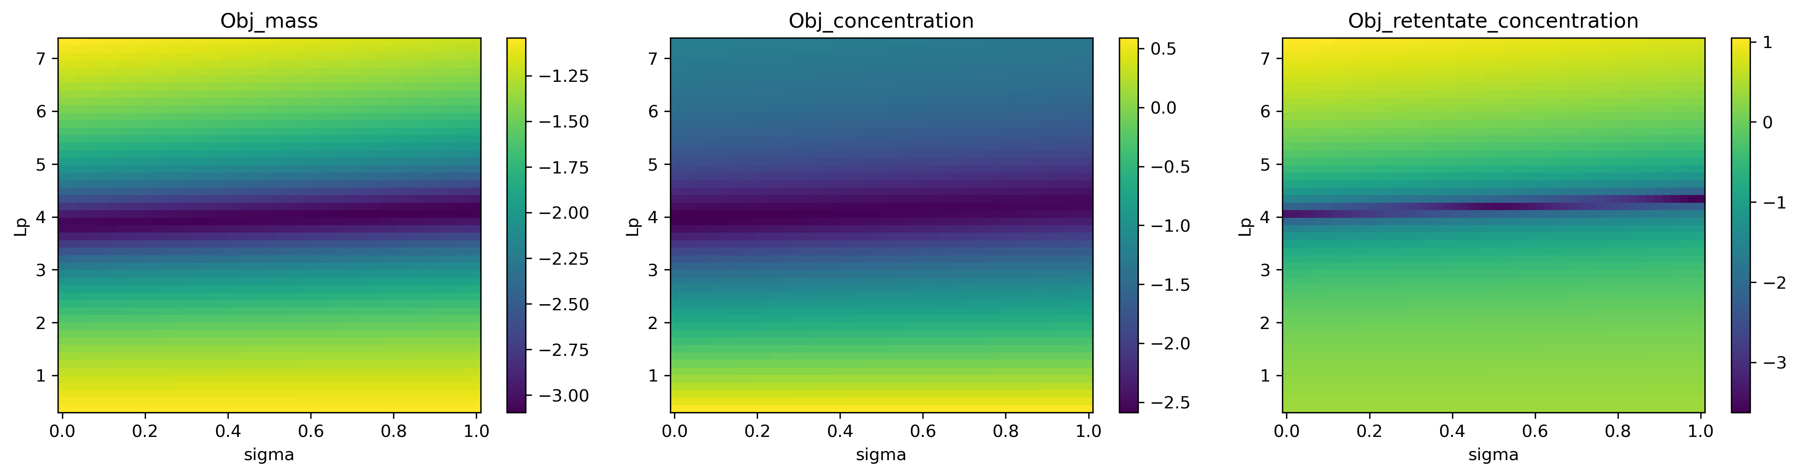
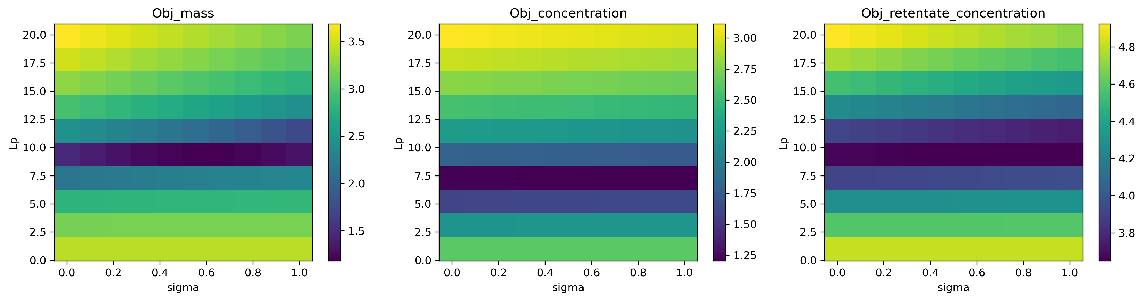
4. Workflow Reproduces Published Contour — DATA3 σ Stays Flat
Published-paper reproduction (DATA1 / KCl filtration) — byte-equivalent
Same workflow on DATA3: MC2.05.07.24_NaCl
Sharp dark band on L_p ≈ 4 → L_p well identified
Bands run horizontal across σ → σ is unidentifiable
L_p has a range of 8–10 → too wide a range
Why estimability is harder in DATA3 — same model, different driving force
• σ multiplies Δπ in the flux equation. When Δπ stays small over the run (concentrating runs at low c_F), σ has almost no leverage on J_w.
• DATA3 single-salt sheets are short and stay near steady-state c_F → contour is flat in σ → optimizer pins σ at a bound.
• I will need to look across experiments to observe behavior where σ is varied.
Take-away: Published reproduction confirms the workflow is correct.
DATA3 Single-Salt Status — May 27, 2026
5

Slide 6
5. Summary · What I'd Like to Discuss
1 · Data integrity
• 70,101 / 70,101 GOOD
• 40/40 metadata ✓
• Calibration R² 0.99–0.999
• Audit XLSX is the deliverable
2 · Bounds
• L_p ∈ [0.5, 50]
• B ∈ [0, 30]
• σ ∈ [0, 1] (physics-fixed)
• Same box for all 13 sheets
3 · Pattern + estimability
• Mass-per-vial slope = Δπ signature
• Published contour reproduces
• DATA3 σ-band flat → identifiability
gap is experimental, not code
Open questions
• Is the published bound on B ([0, 30] μm/s) still appropriate for the DATA3 salts (NaCl, CaCl₂, LaCl₃), or do we revisit?
• On the diluting sheet MC3.SNaCl, the data already shows Δπ > ΔP at t = 0 — do we lean on that sheet as the σ-identifying anchor for the campaign?
DATA3 Single-Salt Status — May 27, 2026
6

