Slide 1
Membrane Transport Identifiability
σ × B WSSE contours across seven response channels
NF270 nanofiltration · DATA3 · square forward-solve slice at fixed Lₚ
Keshav Kasturirangan
· NF270_MC2 · CaCl₂ · LaCl₃ · NaCl · 2026-06-30

Slide 2
How to read these contours
Each experiment is summarized by one figure of seven panels. In every panel the hydraulic permeability Lₚ is pinned at its well-identified optimum, and the solute-permeability B and reflection coefficient σ are swept on a grid.
At every (σ, B) node the model DAE is solved ONCE as a square forward problem (no per-node optimization — a slice, not a profile likelihood), and the weighted sum-of-squared error (WSSE) for each response channel is evaluated.
What to look for
The seven response channels
▲ red marker = the channel's optimum (minimum WSSE).
Lines = log₁₀ WSSE level curves; tightly spaced = sharply constrained.
A narrow valley in the B-direction = B is well identified.
Level curves nearly flat along σ = σ is weakly constrained — the expected σ–B non-identifiability.
1 · Mass per vial
2 · ICP retentate concentration
3 · ICP permeate concentration
4 · Conductivity probe — retentate (σ-space)
5 · Conductivity probe — permeate (σ-space)
6 · Conductivity-derived retentate conc.
7 · Conductivity-derived permeate conc.
Channels 4–7 (new) map concentration↔conductivity via the Shedlovsky converter.

Slide 3
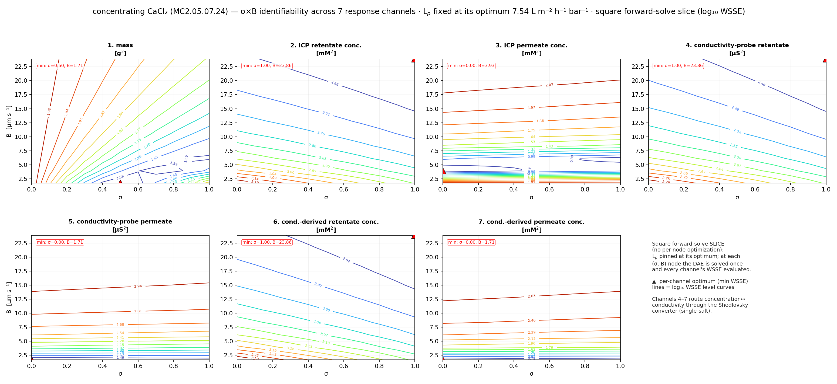
Concentrating CaCl₂
MC2.05.07.24_CaCl₂
Lₚ = 7.54 · fit σ = 1.0, B = 5.71 µm s⁻¹
Sharp valley in B across channels; the optimum sits at high σ with a gentle σ-gradient — σ is the soft direction.

Slide 4
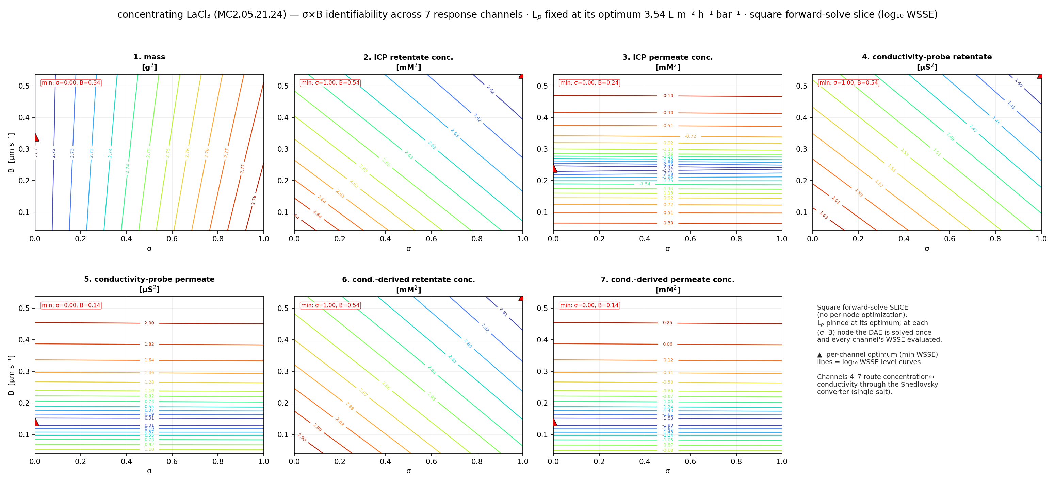
Concentrating LaCl₃
MC2.05.21.24_LaCl₃
Lₚ = 3.54 · fit σ = 0.0, B = 0.32 µm s⁻¹
The least-identified sheet: shallow, diagonal level curves — B small and σ rails to the boundary, so both are weakly pinned.

Slide 5
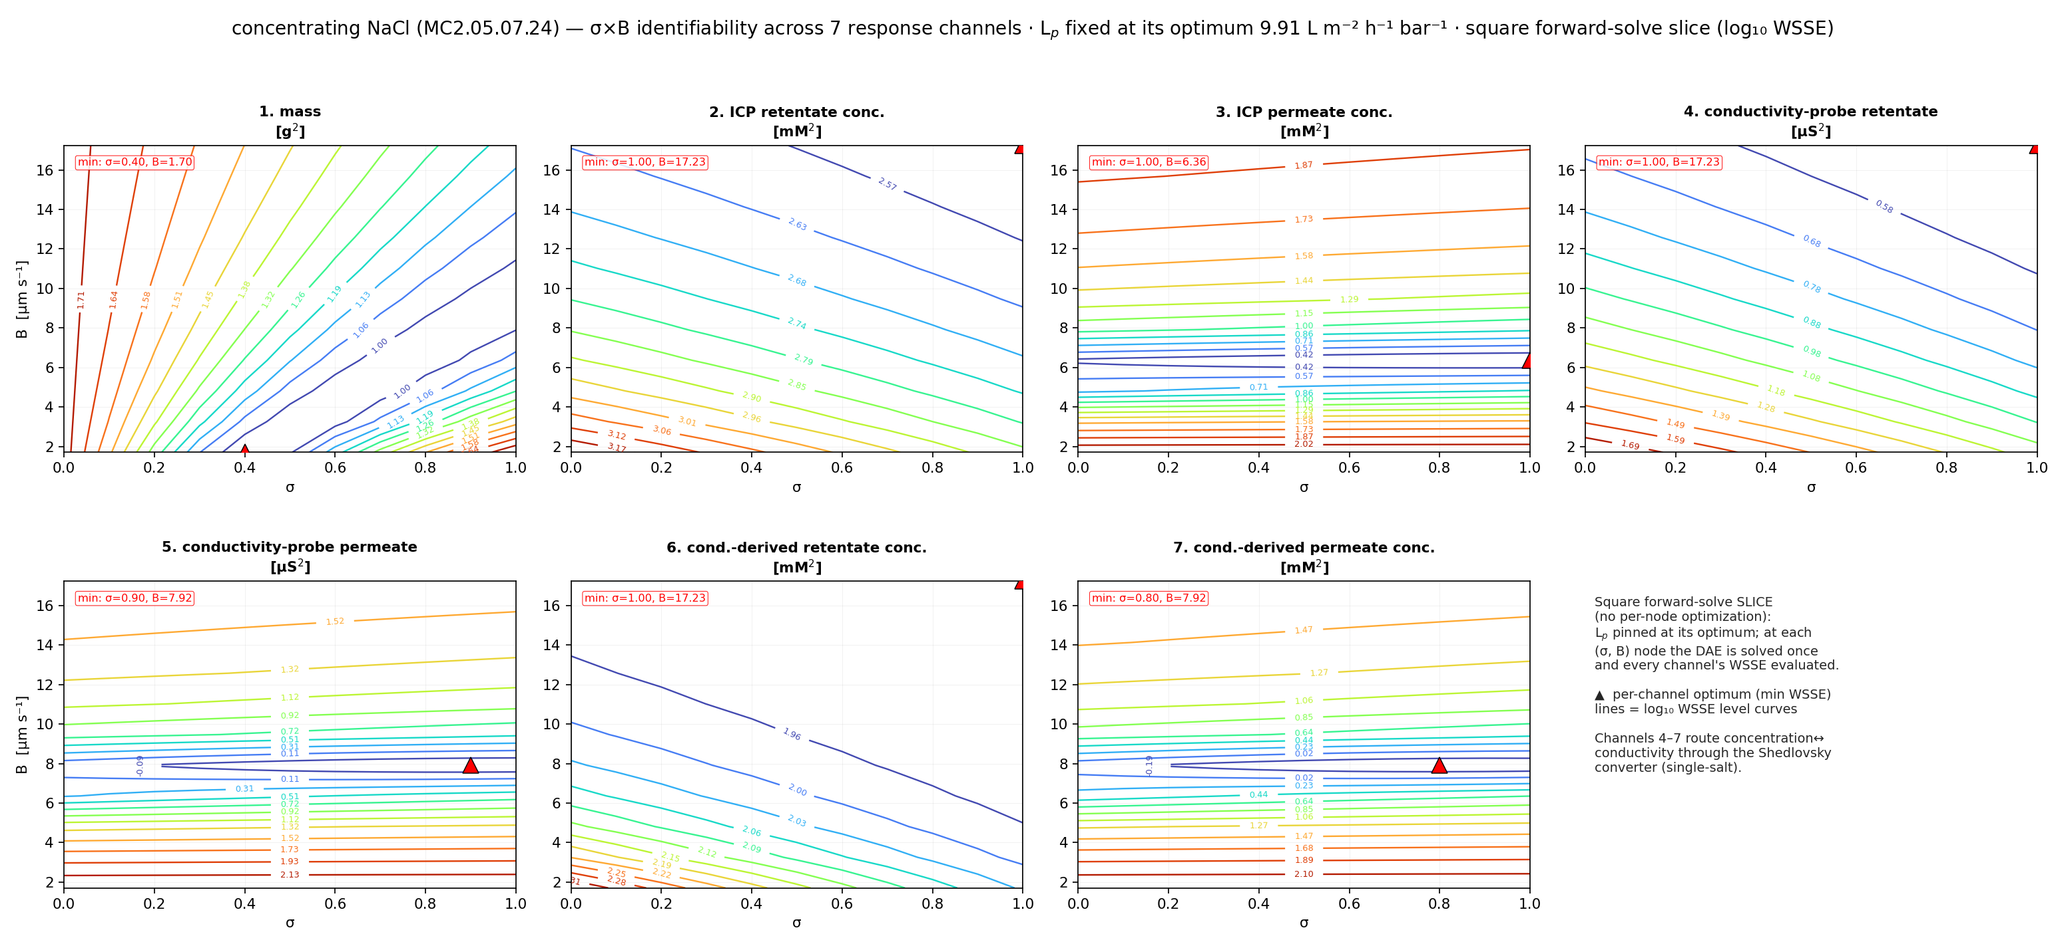
Concentrating NaCl
MC2.05.07.24_NaCl
Lₚ = 9.91 · fit σ = 1.0, B = 10.0 µm s⁻¹
Best-behaved case: every channel's optimum lands near σ = 1, B ≈ 10, with the conductivity channels echoing the ICP/mass picture.

Slide 6
Beyond constant B: B(c) coefficient contours
Does letting the solute permeability vary with the interfacial concentration cᵢₙ change identifiability? Each shape coefficient gets its OWN contour — βₖ × σ — in place of the single B × σ.
Linear
Quadratic
Cubic
Saturating
B(c) = β₀ + β₁·c
B(c) = β₀ + β₁·c + β₂·c²
B(c) = β₀ + β₁·c + β₂·c² + β₃·c³
B(c) = B∞·(1 − e^(−c/c*))
β₀×σ, β₁×σ
β₀×σ, β₁×σ, β₂×σ
β₀…β₃ × σ
B∞×σ, c*×σ
Method (unchanged): square forward-solve slice.
At each (βₖ, σ) node, Lₚ and every OTHER coefficient are held at the form's fitted (warm-start) values, so the model has zero free parameters and the DAE is solved ONCE — no per-node optimization.
Blank regions = the pinned coefficients drive B(c) out of the physical range, so no feasible square solve exists there. That feasibility boundary is itself informative.

Slide 7
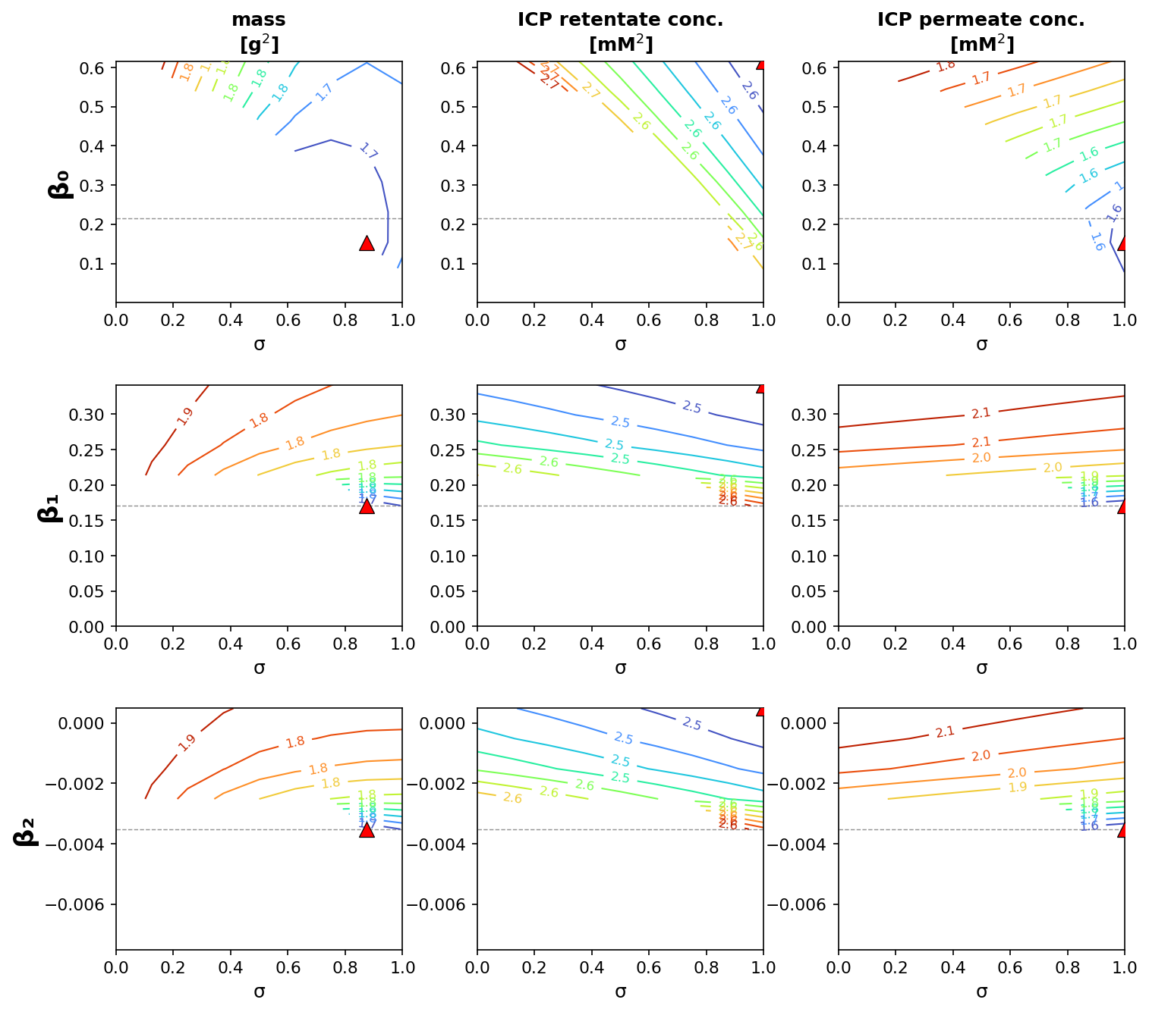
Concentrating CaCl₂ — quadratic B(c)
warm-start fit: β₀ = 0.22, β₁ = 0.17, β₂ = −0.004
Reading the grid
Rows = the three shape coefficients. Columns = three core channels (mass, ICP retentate, ICP permeate). ▲ = optimum; – – = fitted value.
β₀ (the c→0 intercept) has a clear minimum — it is the well-constrained coefficient.
β₁, β₂ show the same shape as constant B: a valley across the coefficient, much flatter along σ.
Feasible only in a band around the fit; outside it B(c) leaves the physical range.
full 7-channel × 4-form contours: per-experiment A4 PDF

Slide 8
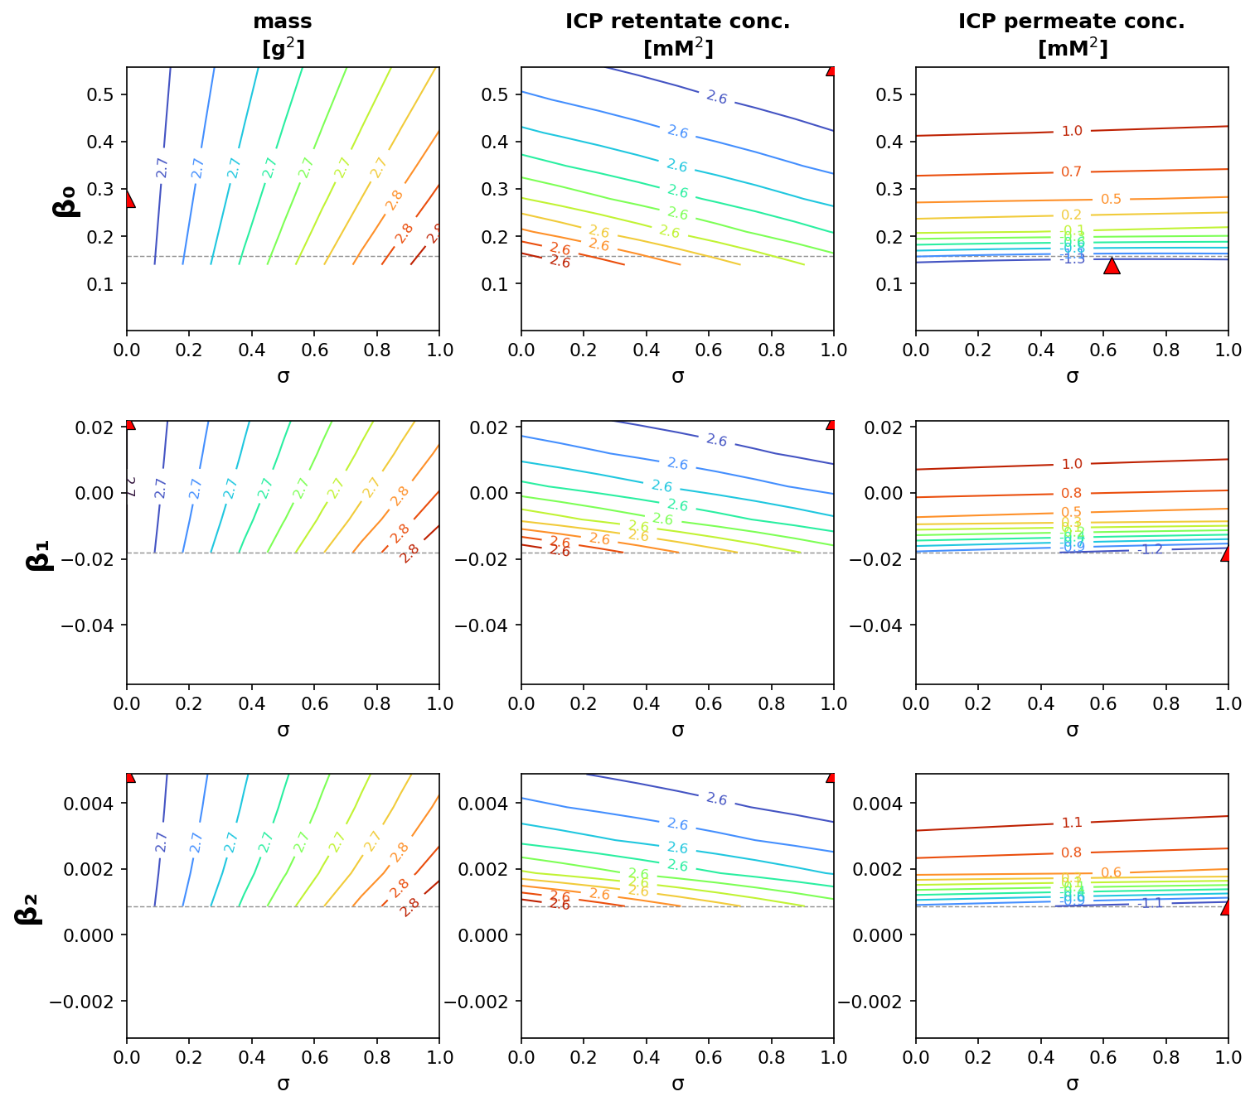
Concentrating LaCl₃ — quadratic B(c)
warm-start fit: β₀ = 0.16, β₁ = −0.018, β₂ = 0.0009
Reading the grid
Rows = the three shape coefficients. Columns = three core channels (mass, ICP retentate, ICP permeate). ▲ = optimum; – – = fitted value.
The poorly-identified salt: shallow, gently-sloped level curves in every coefficient.
Optima sit near the σ boundary — σ is essentially unconstrained here.
Smallest feasible region of the three (low B, high valence).
full 7-channel × 4-form contours: per-experiment A4 PDF

Slide 9
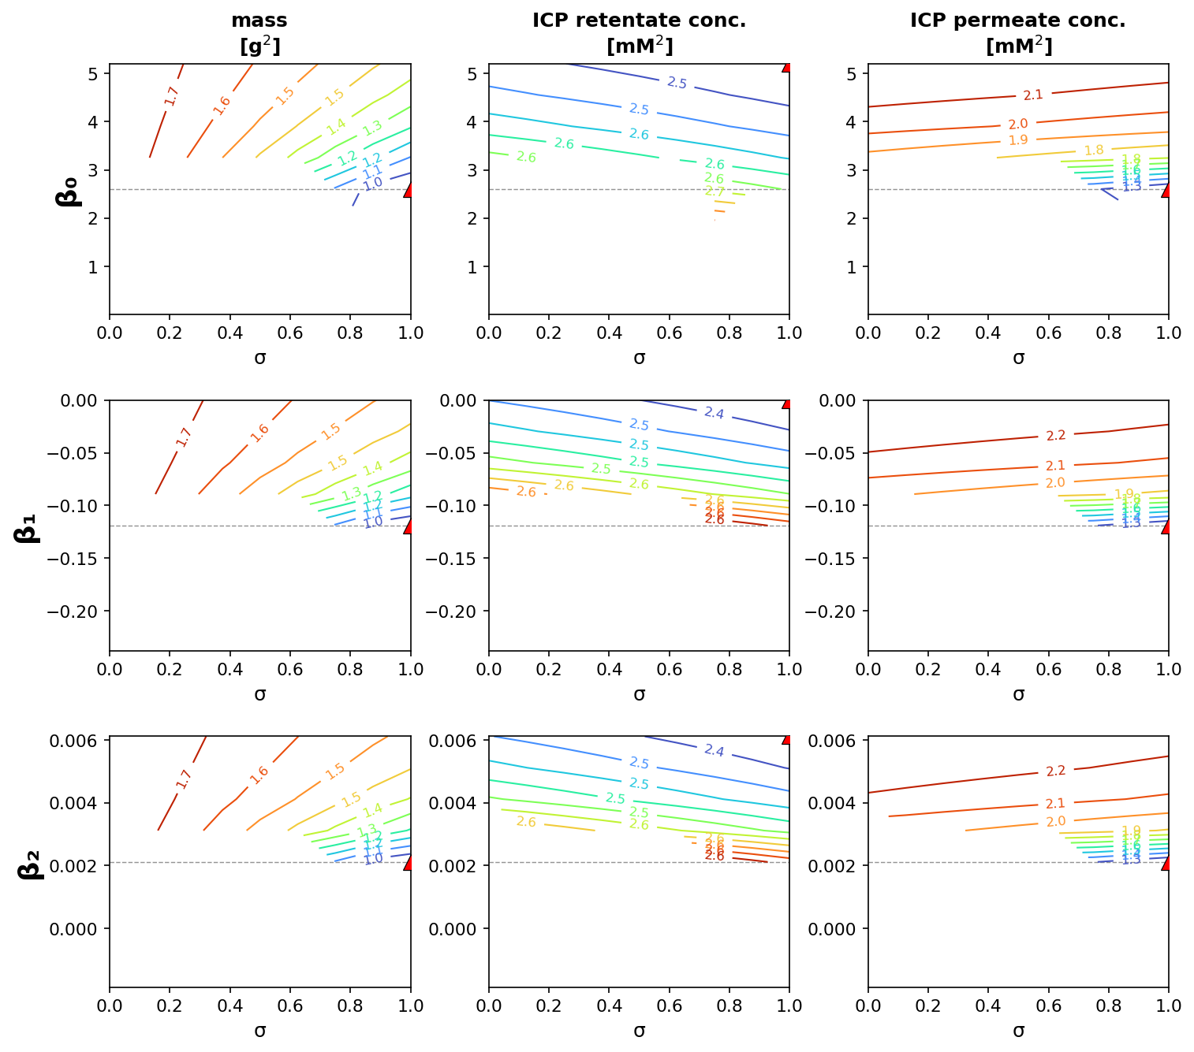
Concentrating NaCl — quadratic B(c)
warm-start fit: β₀ = 2.60, β₁ = −0.12, β₂ = 0.002
Reading the grid
Rows = the three shape coefficients. Columns = three core channels (mass, ICP retentate, ICP permeate). ▲ = optimum; – – = fitted value.
Best-behaved: sharp valleys, every coefficient's optimum lands near σ = 1.
β₀ dominates (large intercept); β₁, β₂ are small corrections.
The conductivity channels (in the A4 PDF) echo this same picture.
full 7-channel × 4-form contours: per-experiment A4 PDF

Slide 10
What the B(c) contours show
Concentration-dependence does not restore σ.
Every coefficient shows the same flat-along-σ valley as constant B — adding B(c) flexibility sharpens the coefficients, not σ.
The coefficients are feasibility-constrained.
Off-optimum coefficient values push B(c) negative / out of range, so there is no square solve — a tight implicit bound visible as the blank region around each fit.
Cubic is over-parameterized — salt-dependent.
For NaCl the cubic B(cIn) goes strongly negative across the run and is essentially un-sliceable; CaCl₂ / LaCl₃ tolerate it. Supports keeping B(c) low-order.
The saturating knee c* is weakly identified.
For LaCl₃ the c* contours are nearly vertical (flat in c*) — the saturation scale is barely constrained by the data.

Slide 11
Discussion points
B is well identified; σ is not.
In every channel the valley is narrow along B but nearly flat along σ — the single-experiment σ–B non-identifiability holds channel-by-channel, even with Lₚ pinned.
The new conductivity channels add data, not identifiability.
Channels 4–7 use the continuous probe traces (~hundreds of points per vial vs. one ICP point) yet show the same σ-flatness — more data on the same soft direction doesn't break the degeneracy.
Identifiability tracks rejection regime.
NaCl/CaCl₂ (high σ) give sharper valleys; LaCl₃ (σ ≈ 0, tiny B) is the shallowest — consistent with the high-Péclet plateau argument.
Method note.
Square forward-solve slice at fixed Lₚ (no per-node optimization); conductivity↔concentration via the existing Shedlovsky converter. A profile-likelihood version is the rigorous next step (Task 9).

