Slide 1
Unified-Only Published Figure Comparison
This deck includes only figures whose regenerated counterparts come from the current unified workflow. Included: - DATA2 img-008, img-009, img-010 - DATA1 img-005 Excluded for now: - DATA2 img-007 - DATA1 img-004, img-006, img-007, img-008

Slide 2
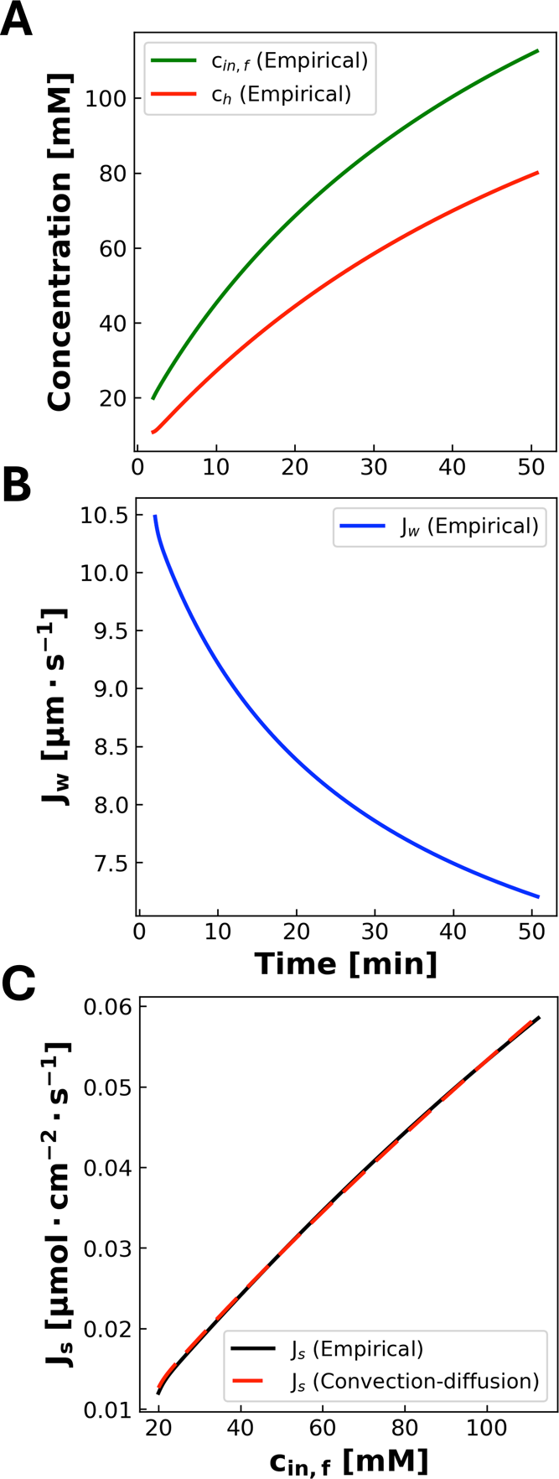
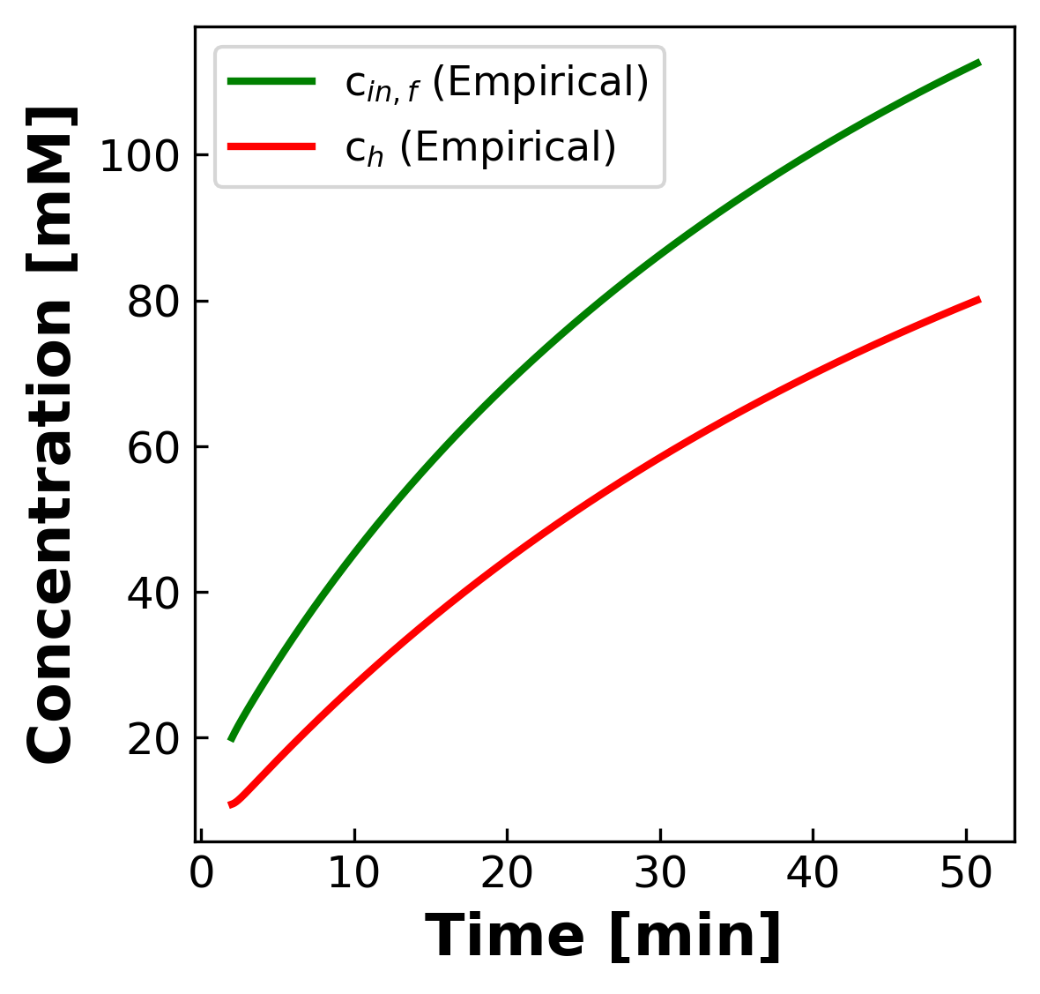
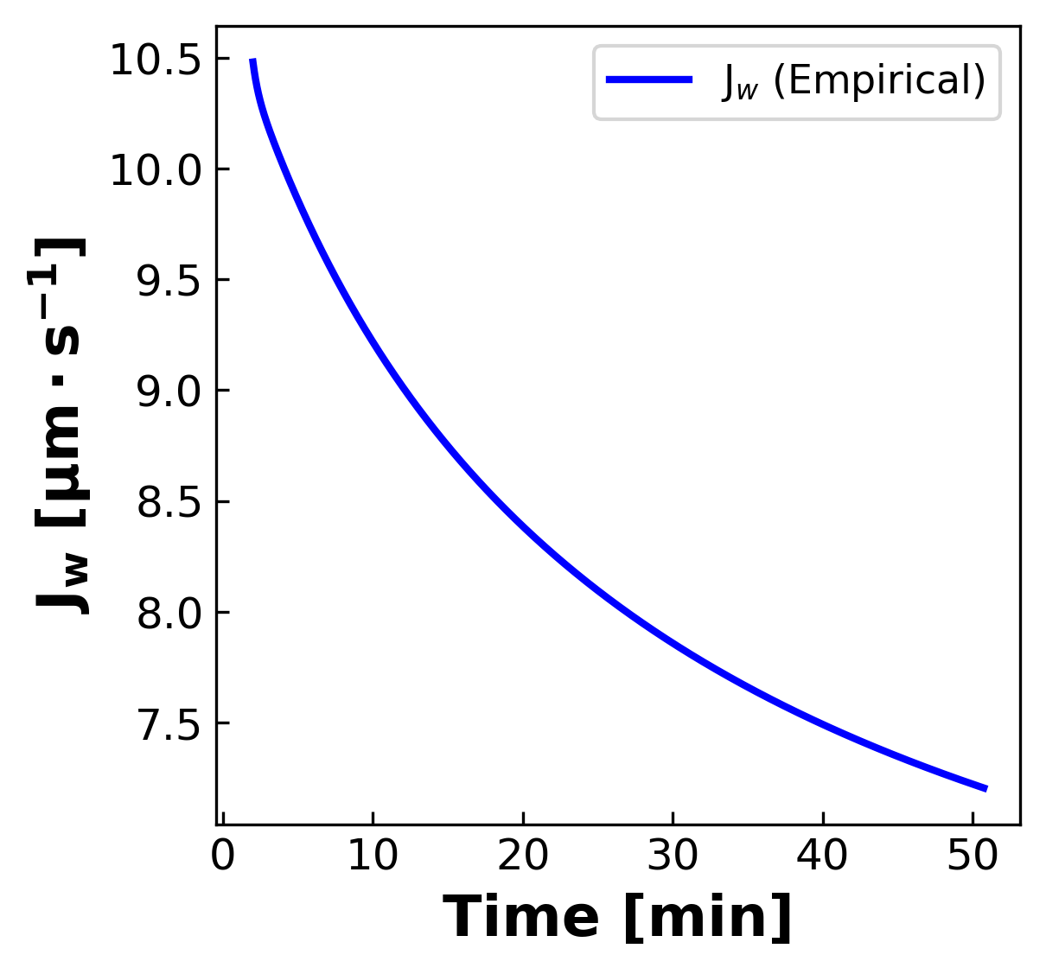
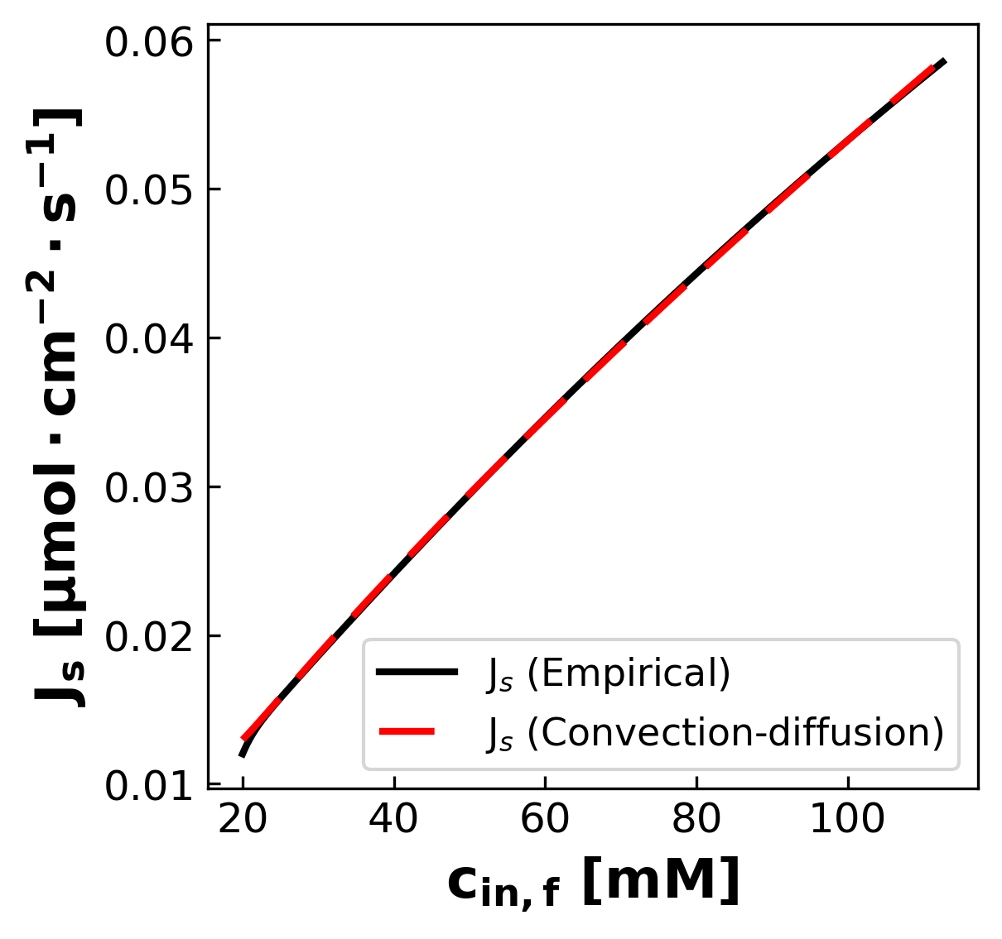
DATA2 Published img-008 vs Unified Regenerated
Published
Unified Regenerated
Unified output reproduces the three published panels: concentration vs time, Jw vs time, and Js vs cin,f.

Slide 3
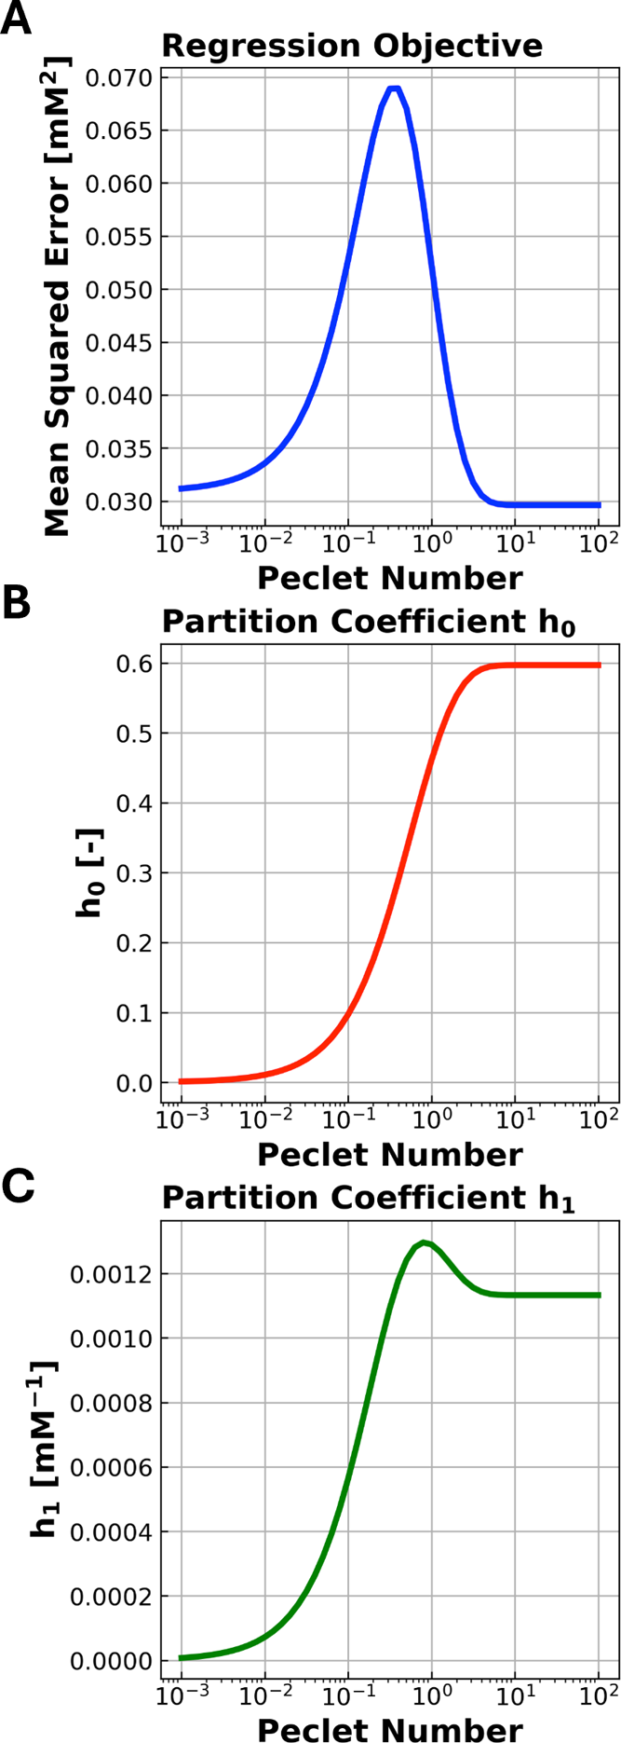
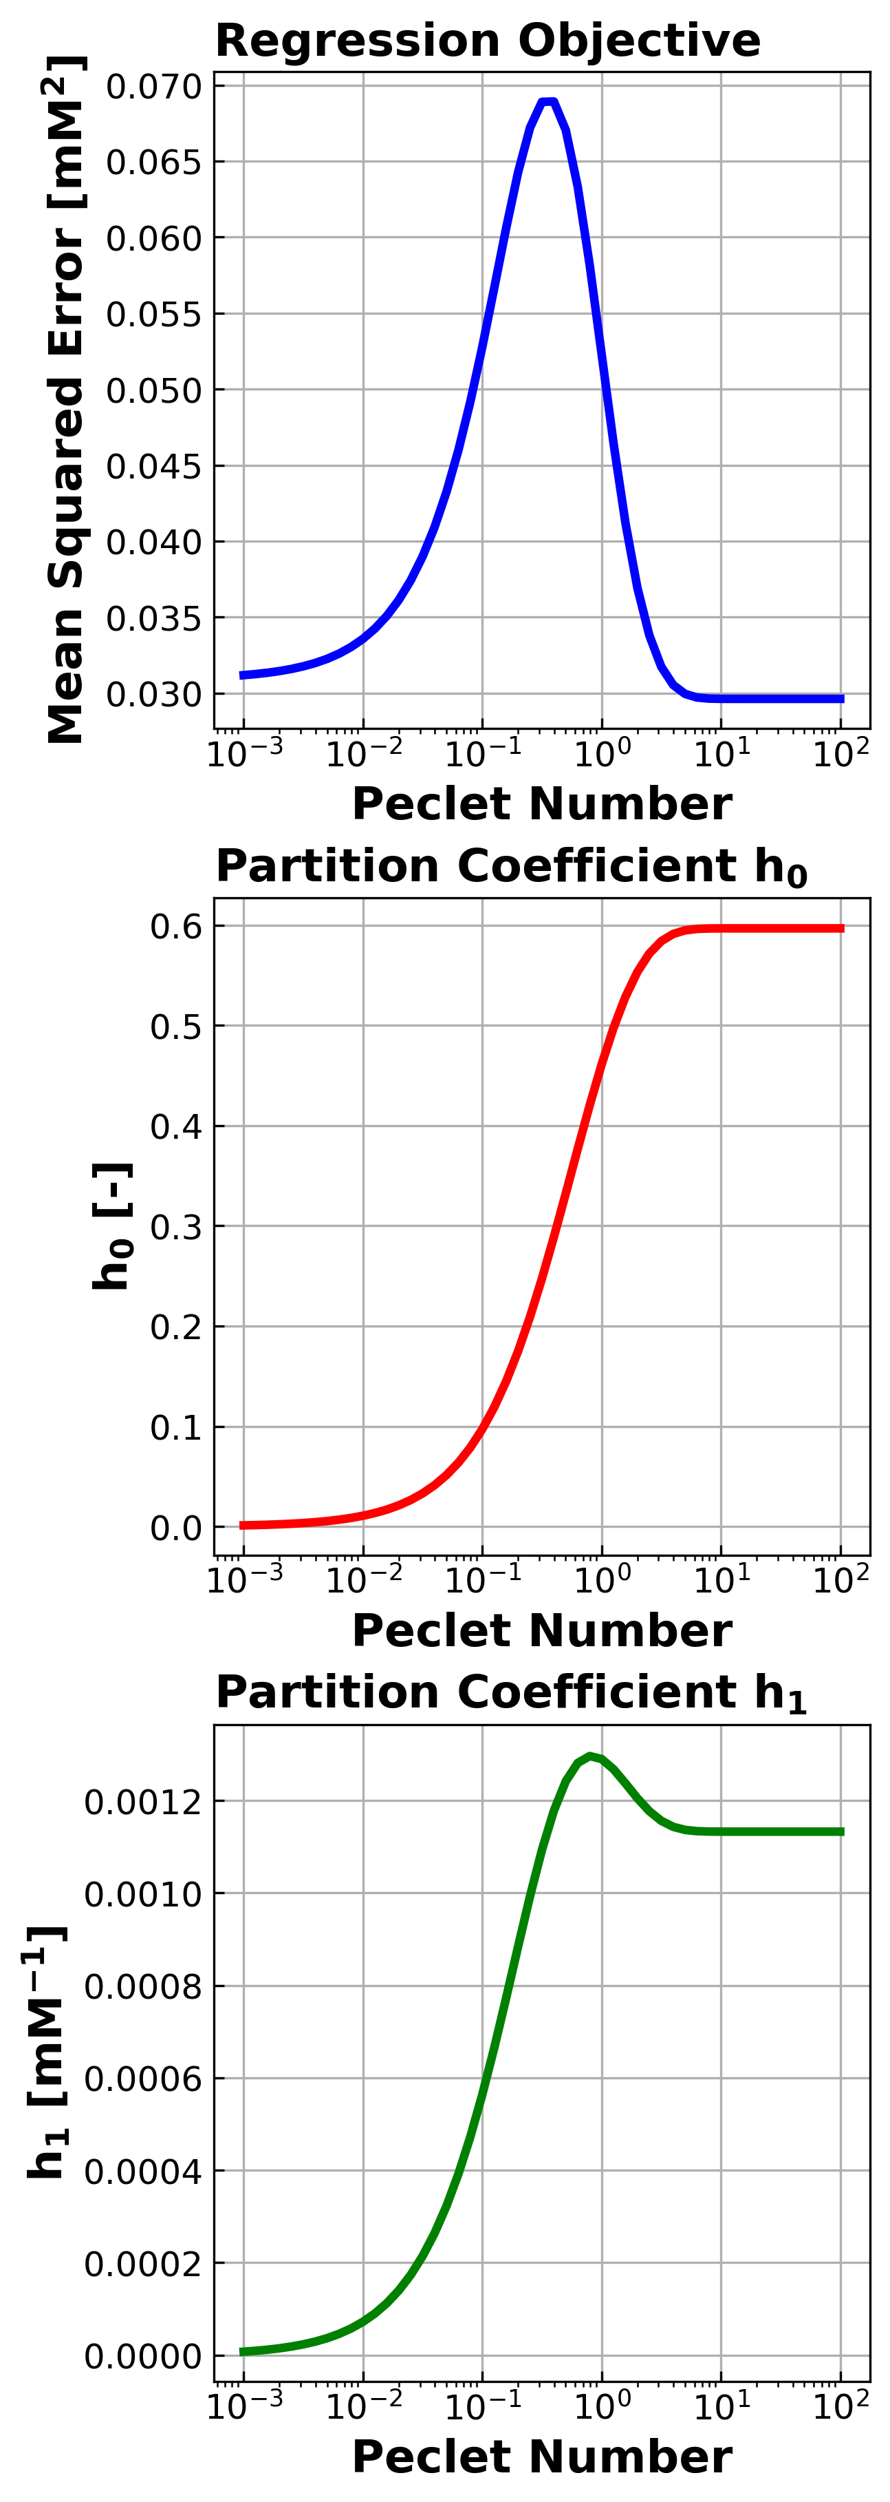
DATA2 Published img-009 vs Unified Regenerated
Published
Unified Regenerated
Unified output reproduces the partition-sensitivity contour figure.

Slide 4
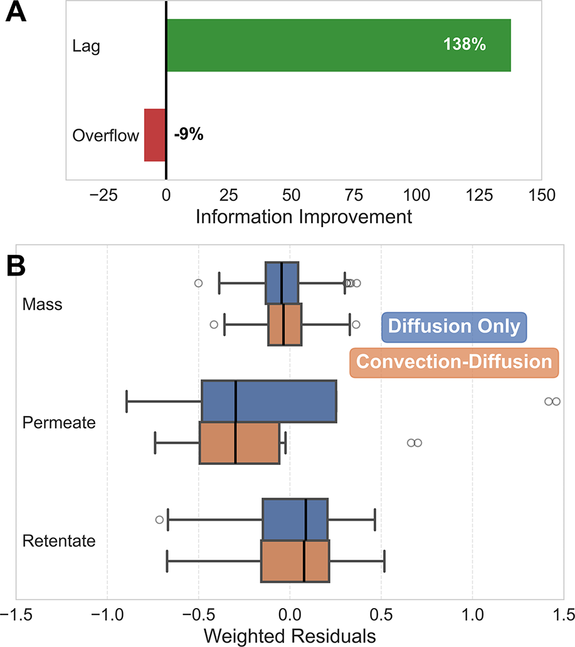
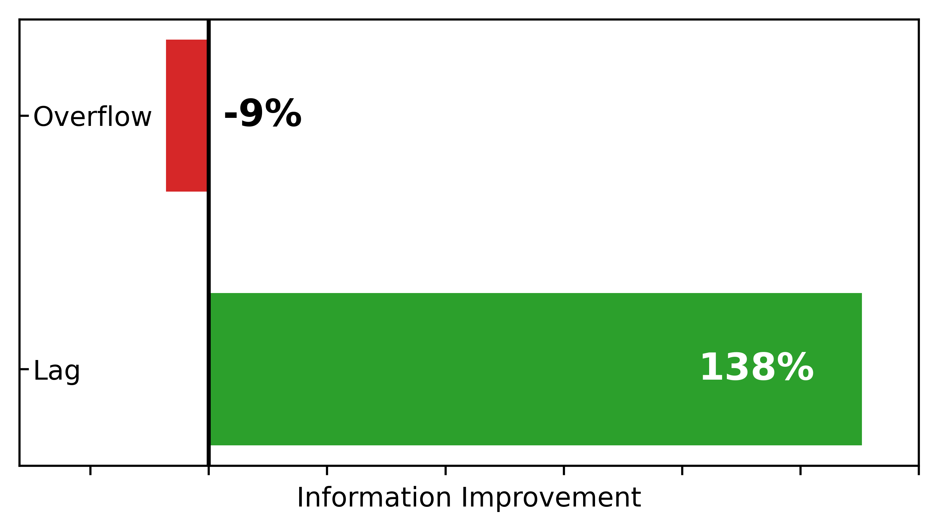
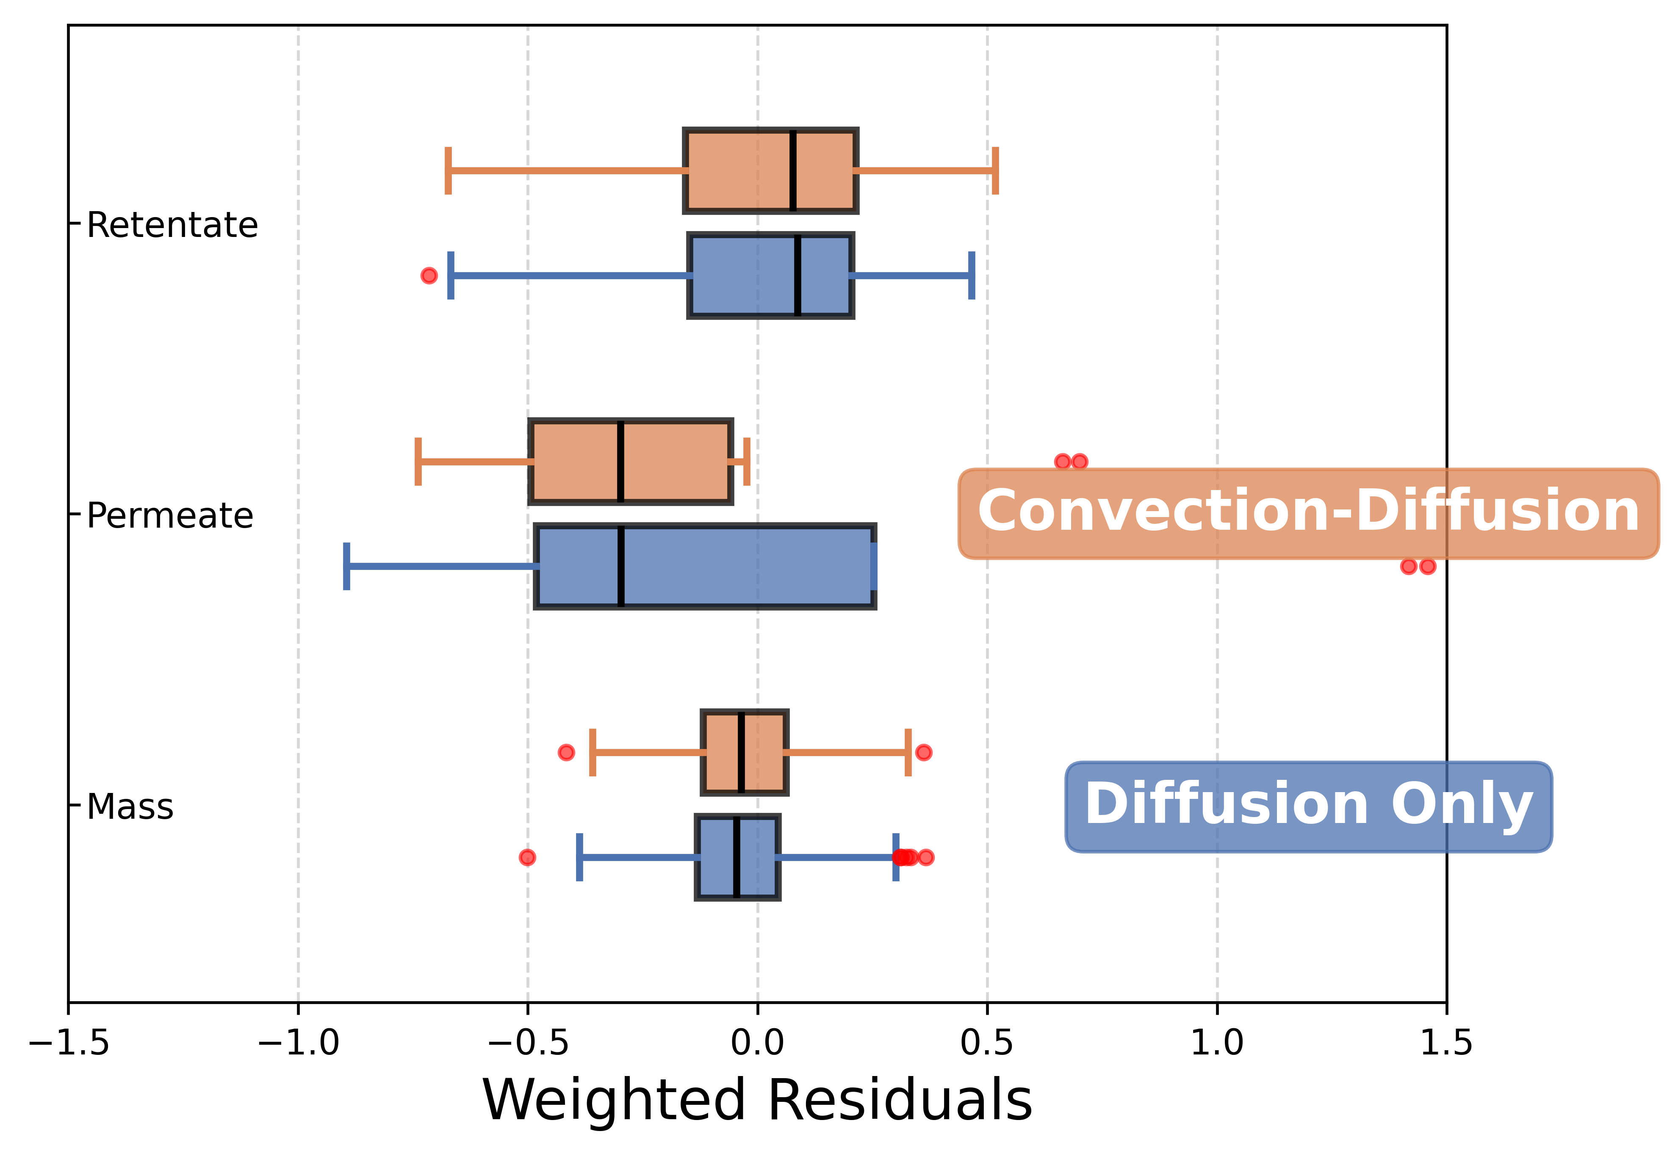
DATA2 Published img-010 vs Unified Regenerated
Published
Unified Regenerated
Unified output reproduces the startup-information panel and the concentrating residuals boxplot.

Slide 5
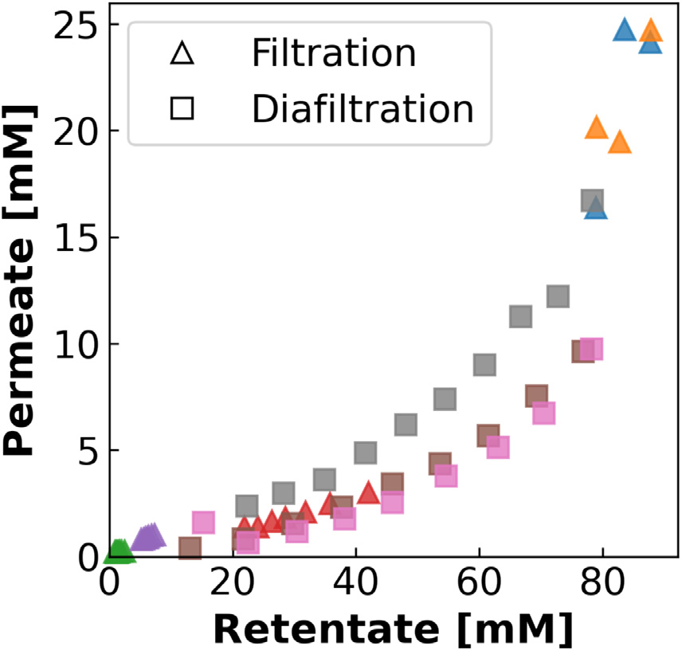
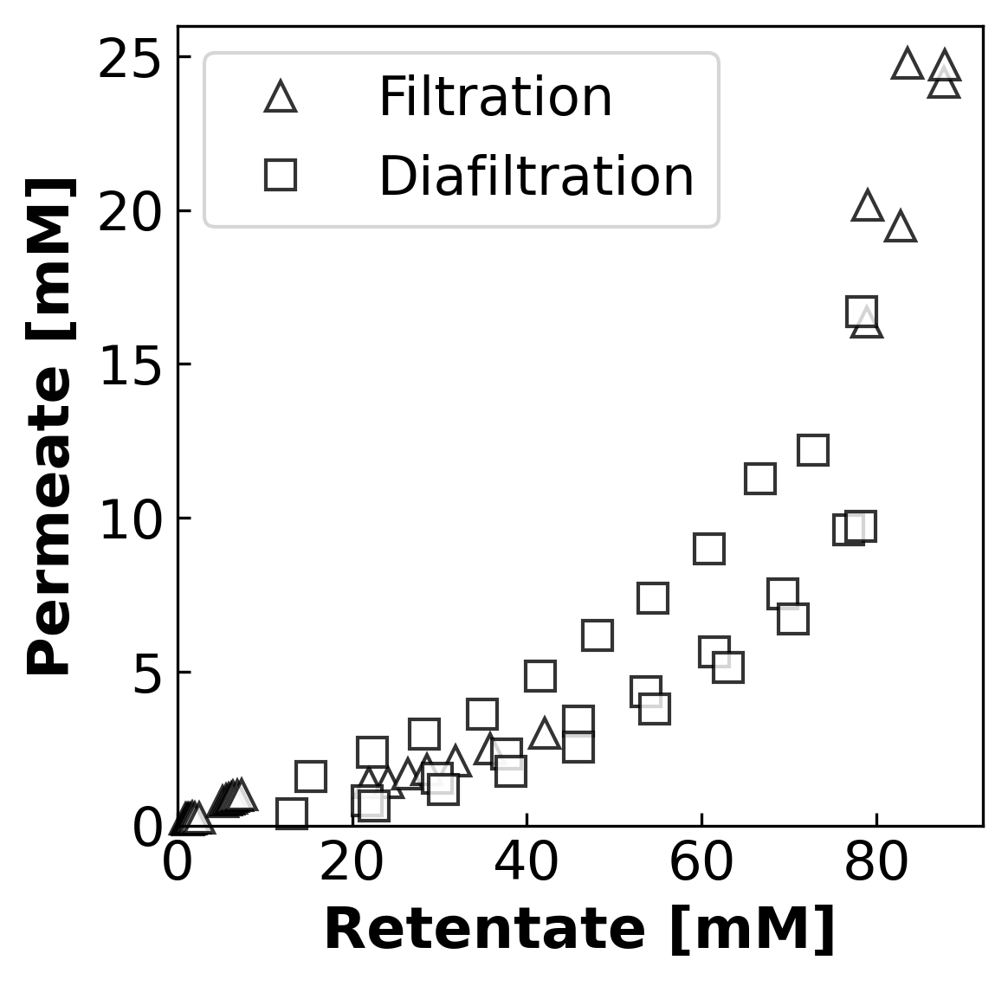
DATA1 Published img-005 vs Unified Regenerated
Published
Unified Regenerated
Unified output reproduces the concentration-range figure.

Slide 6
Published Figures Still Missing Exact Unified Matches
DATA2 img-007.png DATA1 img-004.jpg DATA1 img-006.jpg DATA1 img-007.jpg DATA1 img-008.jpg These should not be presented as unified-regenerated yet. Only the four comparison slides in this deck are exact unified-output matches.

