Slide 1
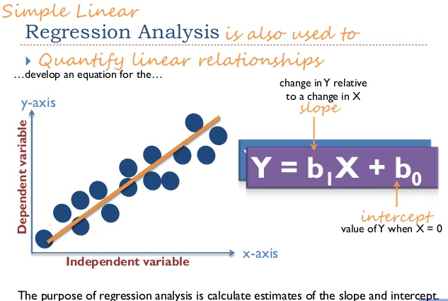
Linear Regression

Slide 2
Introduction
“statistical technique of modeling the relationship between variables”
Simple linear regression, we model the relationship between two variables: a dependent variable, denoted by Y, and an independent variable, denoted by X
A firm may be interested in estimating the relationship between advertising and sales.

Slide 3
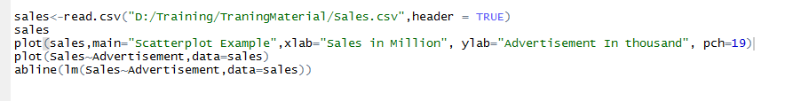
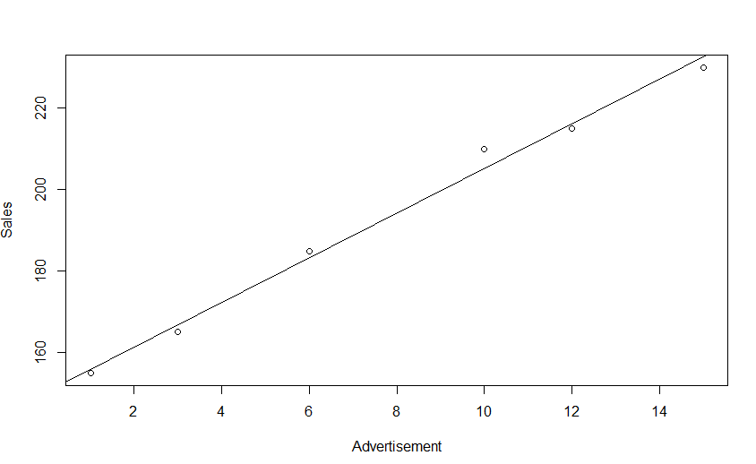
Sales | Advertisement
155 | 1
185 | 6
210 | 10
165 | 3
215 | 12
230 | 15

Slide 4
What is a Statistical Model ?
Data (Sample or Population)
Statistical Model
Systematic Component
+
Errors

Slide 5
Building a Statistical model
Formulate a hypothesis, assumptions and regression formula
Estimate the relevant parameters from the dataset.
Estimate the residuals and conduct a test of acceptance
Deploy and use the model for decision making.

Slide 6
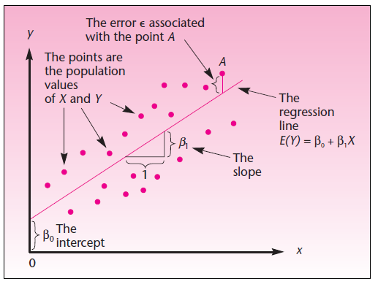
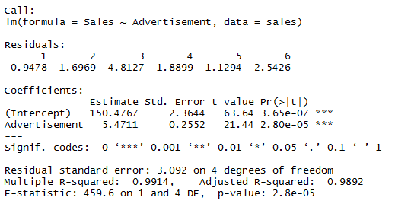
Revisiting the Sales - Advertisement

Slide 7

Revisiting the Sales - Advertisement
Sales | Advertisement
155 | 1
185 | 6
210 | 10
165 | 3
215 | 12
230 | 15
Sales =5.4711*Advertisement +150.4767

Slide 8
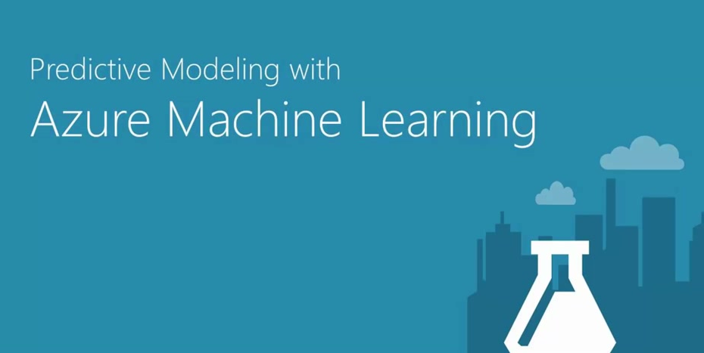
Azure ML Demonstration.

