Slide 1
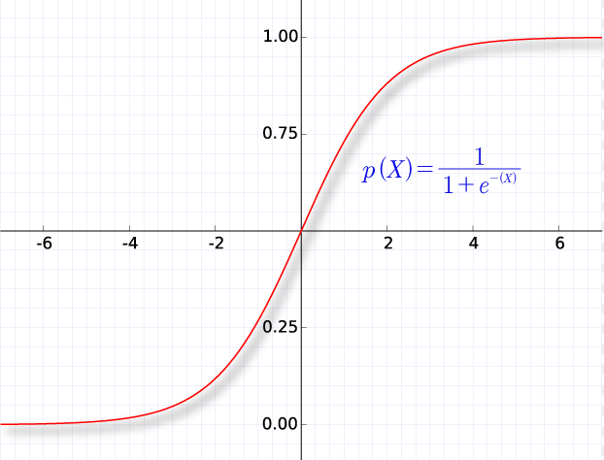
Logistic Regression

Slide 2
Introduction
“logistic regression is a statistical technique of modeling the probability of occurrence of an event depending on the values of independent variable which could be continuous or discrete in nature.”
Lets take a case:
In India, the CIBIL (Credit Information Bureau (India) Limited) credit score ranges from 300 to 900. The closer you are to 900, the more confidence the credit institution will have in your ability to repay the loan and hence, the better the chances of your application getting approved. Anything above 750 is considered a good credit score.
Lets say you are looking for a home loan and you carry a CBIL score of 760. You are interested in knowing your chances of getting the loan approved. Over the internet you are able to retrieve a data set of individuals with scores and their approval status.

Slide 3
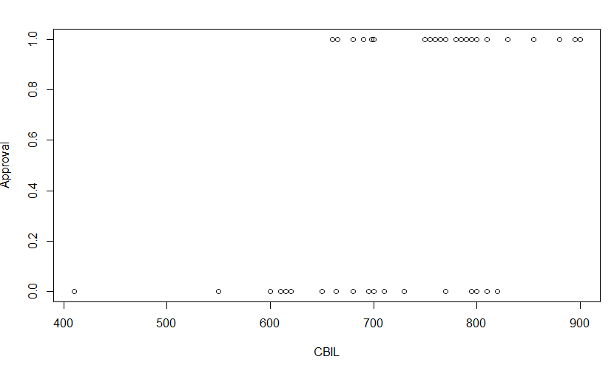
Logistic Model
Develop a model which predicts the probability for a given CBIL score the chances of the loan being approved. Consider a threshold of 0.7 or 70% to consider the loan being approved.
Input your score of 780 into the model to determine your chances of loan being approved.

Slide 4
Logistic Model
Model -> Estimate -> Predict -> Classify
Approved
Model
Not Approved

Slide 5
Why not linear Statistical Model ?
Simple linear regression is one continuous variable evaluating another.
Multiple linear regression is again linear regression with multiple dependent variables.
Logistics regression predicts dependent variable which is dichotomous in nature.
The dependent variable ranges between 0 – 1.
It predicts probability from 0 to 1. and based on a decided threshold we classify the out come into 0 (Not approved) or 1 (approved) categories.

Slide 6
Probability Re-visited
Probability of an event is = Chance of its Occurrence/All possible Outcomes
Example- What is the probability of a 1 on a fair roll of dice.
Possible values of a dice = {1,2,3,4,5,6} = 6
Probability of a 1 = {1}/{1,2,3,4,5,6} = 1/6 = 0.1667 or 16.67 %
ODDS
Odds is the chance of an event occurring Vs not occurring
On a roll of dice, if p is the probability of getting a 6, Simply put Odds of getting a 6 = p/(1-p)
P = 1/6
1-p = 1-1/6 = 5/6
Odds = 1/6 / 5/6 = 1/5 = 0.20 or 20 %

Slide 7
Probability Re-visited
ODDS Ratio: As the name suggests, it’s the probability of odds of occurrence of two events.
ODDS Ratio of 6 in a roll of dice Vs a 2 or 6 ?
As we had calculated the odds for a 6 = 1/5 = 0.2
Let’s calculate for a 2 or 6
p = {2,6}/{1,2,3,4,5,6} = 1/3
1-p = 1-1/3 = 2/3 There for ODDS for 2 or 6 = 1/3 / 2/3 = ½ or 0.5
Odds Ratio = 0.5/0.2 = 2.5
Hence we conclude that the probability of getting a 2 or a 6 is 2.5 times greater then getting just a 6

Slide 8
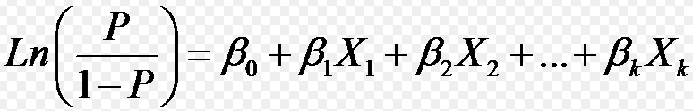
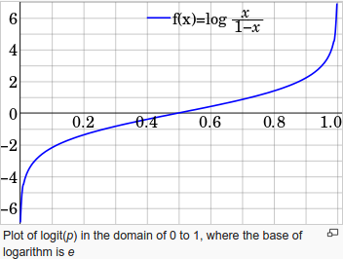
Link Logit

Slide 9
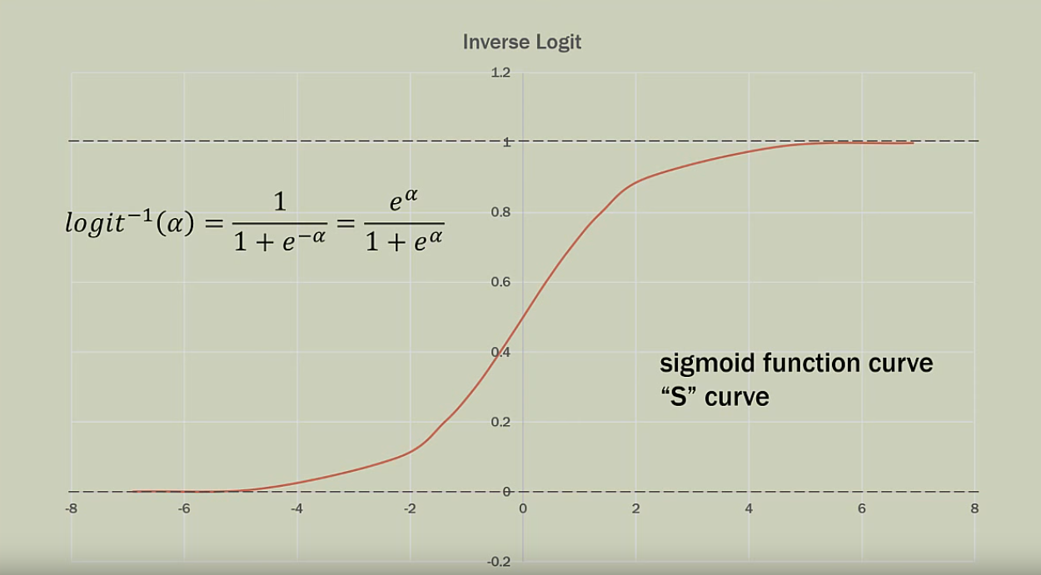
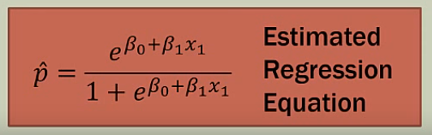
Inverse Logit

Slide 10
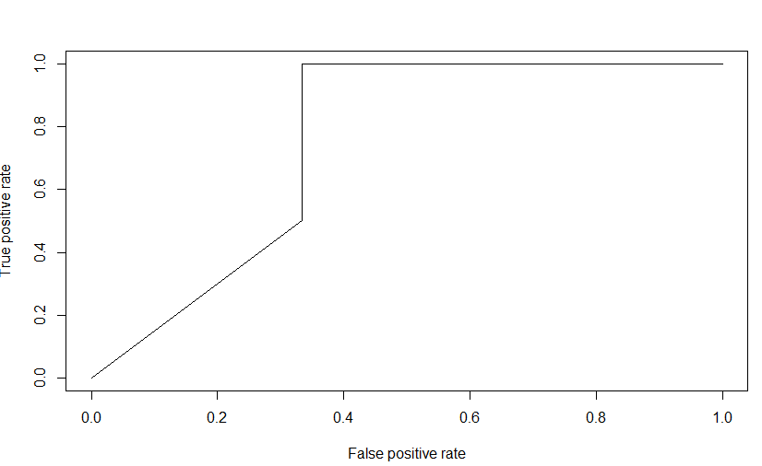
Running in R
cbil<-read.csv("D:/Training/TraningMaterial/CBIL.csv",header = TRUE)
cbil
with(cbil,plot(CBIL,Approval))
train <- cbil[1:45,]
test <- cbil[46:50,]
model <- glm(Approval ~CBIL,family=binomial(link='logit'),data=train)
summary(model)
p <- predict(model, newdata=test, type="response")
pr <- prediction(p, test$Approval)
prf <- performance(pr, measure = "tpr", x.measure = "fpr")
plot(prf)
auc <- performance(pr, measure = "auc")
auc <- auc@y.values[[1]]
Auc

