Slide 1
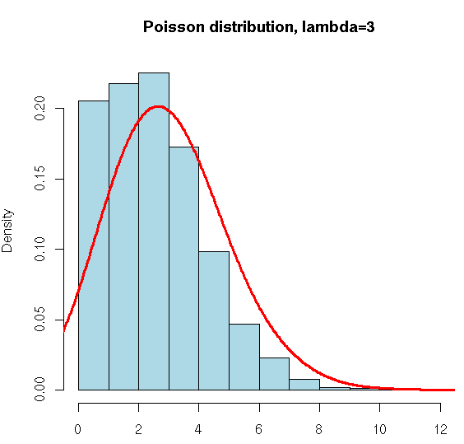
Poisson Regression

Slide 2
Introduction
In statistics, Poisson regression is a generalized linear model form of regression analysis used to model count data.
Poisson regression assumes the response variable Y has a Poisson distribution, and assumes the logarithm of its expected value can be modeled by a linear combination of unknown parameters.
A Poisson regression model is sometimes known as a log-linear model.
Assumption - Mean and variance are equal

Slide 3
Poisson regression – Poisson regression is often used for modeling count data. Poisson regression has a number of extensions useful for count models.
Negative binomial regression – Negative binomial regression can be used for over-dispersed count data, that is when the conditional variance exceeds the conditional mean. It can be considered as a generalization of Poisson regression since it has the same mean structure as Poisson regression and it has an extra parameter to model the over-dispersion. If the conditional distribution of the outcome variable is over-dispersed, the confidence intervals for Negative binomial regression are likely to be narrower as compared to those from a Poisson regression.
Zero-inflated regression model – Zero-inflated models attempt to account for excess zeros. In other words, two kinds of zeros are thought to exist in the data, “true zeros” and “excess zeros”. Zero-inflated models estimate two equations simultaneously, one for the count model and one for the excess zeros.

Slide 4
5 Assumptions
1. Your dependent variable consists of count data.
2. You have one or more independent variables, which can be measured on a continuous, ordinal or nominal/dichotomous scale. Ordinal and nominal/dichotomous variables can be broadly classified as categorical variables.
3. You should have independence of observations.
4. The distribution of counts (conditional on the model) follow a Poisson distribution. i.e. observed and expected counts should be equal (or very similar)
5. The mean and variance of the model are identical.

Slide 5
Hands on Demo..

