Slide 1
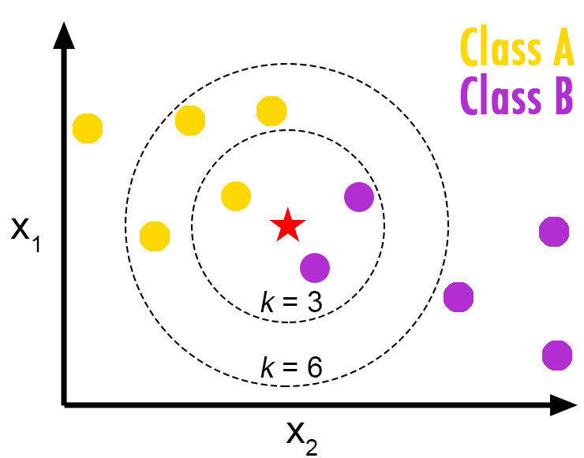
k - Nearest Neighbor Classification

Slide 2
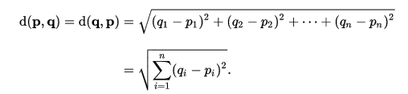
Concept
K Nearest is instance based lazy learning method of classification. Simplest of machine learning algorithms, it provides a classification based on the distances of the labeled data w.r.t the unlabeled.
A commonly used distance metric for continuous variables is Euclidean distance.
For discrete variables, such as for text classification the overlap metric (or Hamming distance) would be employed.

Slide 3

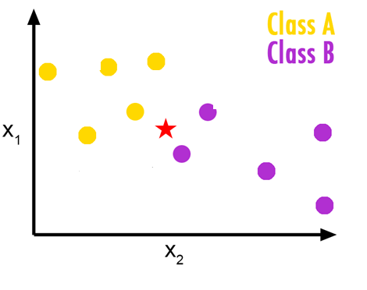
Class A or Class B ?

Slide 4
“Birds of same feather flock together.”
Nearest neighbor - for a given data point, takes the closest data point from the training data set and predicts the class or label.

Slide 5
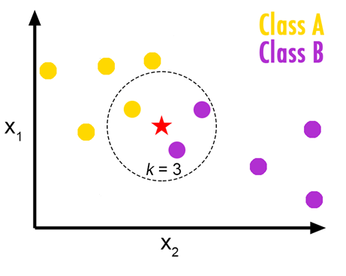
Lets define a flock size of 3. It simply means the majority vote for 3 data points.
The algorithm simply sorts all the data points in ascending order of its distance from the unlabeled data point.
For a value k = 3 it picks the first 3 data points and decides the class label of the unknown based on the majority.

Slide 6

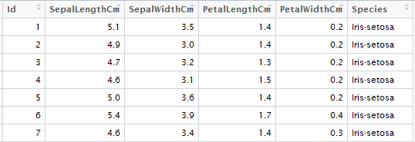
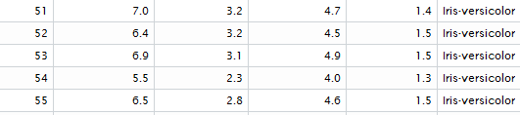
Illustration
Work on IRIS dataset :
50 observations each for 3 species of flowers
IRIS Sentosa
IRIS Virginica
IRIS Verisicolor
We have been provided their 4 features.

Slide 7
kNN Classifier
Data explorations
Feature selection
Test and Train data Sampling
K Value selection
Model Scoring
Model Evaluation
Model Selection
Hands on Demo ..

Slide 8
Pick the right K
Usually the SQRT of the training sample observations
However analysis, timely retraining is required for the best scoring results.
Drawbacks
Sensitive to outliers
Lazy supervised learning algorithm, not prejudged
Expensive execution time

Slide 9
Thank you!

