Slide 1
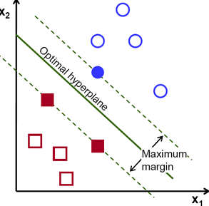
Support Vector Machines-SVM

Slide 2
Concept
Support vector machine is a discriminative algorithm, a classifier which is defined by creating a hyperplane. The hyperplane takes a training dataset and classifies them with an optimal plane.
Can be considered a optimization problem
Where the idea is to minimize the distances of the closest data points
And maximizes the distance of the decision boundary from these closest points to form an optimal hyperplane.

Slide 3
Decision Boundary ?
What exactly is the decision boundary given by the logistic regression ?
Most of us get confused with the “S”igmoid curve.
Now to predict in logistic regression you decide a particular score “cutoff” for the probabilities, above which your prediction will be 1 or 0 otherwise. Lets say that cutoff is c. so your decision process will be a straight line.
No matter what dependent and predicted values you chose, it’s a straight line classifying a 0 from a 1 irrespective.
SVM on the other hand - works by projecting your feature space into kernel space and making the classes linearly separable. An easier explanation to that process would be that SVM adds an extra dimension to your feature space in a way that makes classes linearly separable. This planar decision boundary when projected back to original feature space emulates non linear decision boundary.

Slide 4
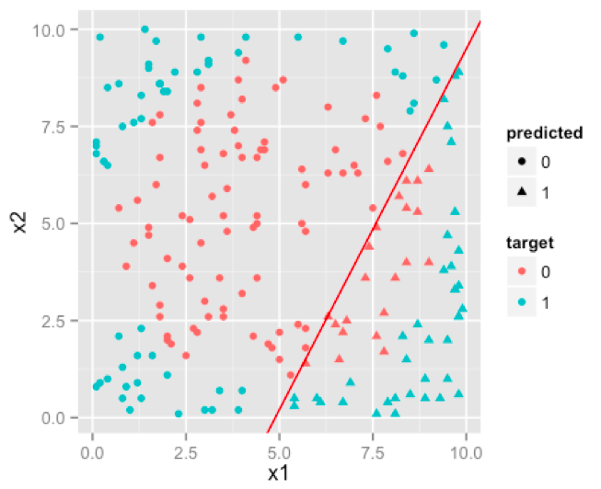
Logistic Regression

Slide 5
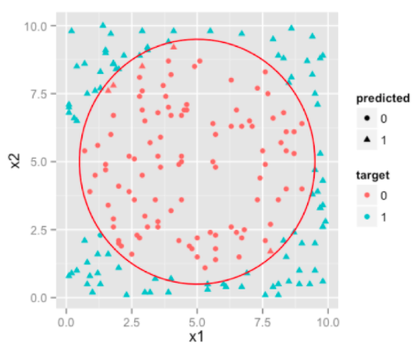
SVM

Slide 6
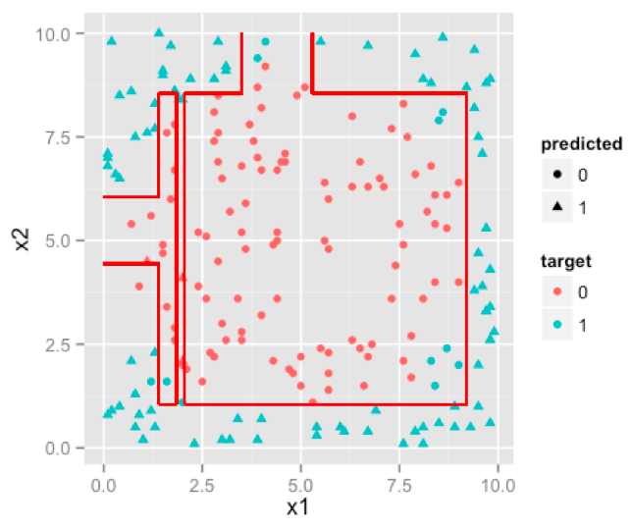
A Decision Tree.

Slide 7

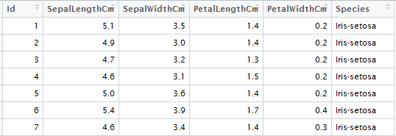
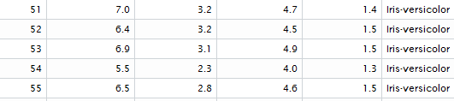
Illustration Hands on
Work on IRIS dataset :
50 observations each for 3 species of flowers
IRIS Sentosa
IRIS Virginica
IRIS Verisicolor
We have been provided their 4 features.

Slide 8
Thank you!

