Slide 1
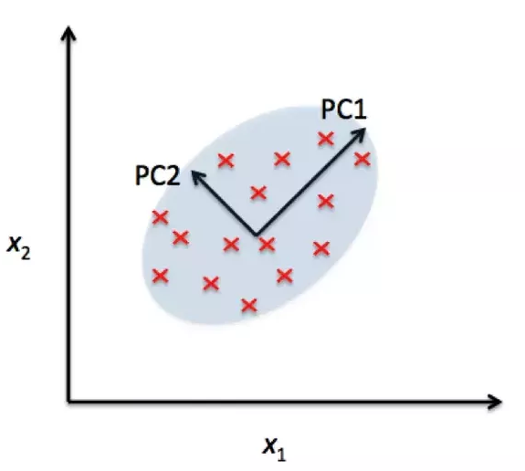
Principal Component Analysis - PCA

Slide 2
Introduction
Principal component analysis (PCA) is a statistical procedure that uses an orthogonal transformation to convert a set of observations of possibly correlated variables into a set of values of linearly uncorrelated variables called principal components (or sometimes, principal modes of variation)
The number of principal components is less than or equal to the smaller of the number of original variables or the number of observations. This transformation is defined in such a way that the first principal component has the largest possible variance (that is, accounts for as much of the variability in the data as possible), and each succeeding component in turn has the highest variance possible under the constraint that it is orthogonal to the preceding components. The resulting vectors are an uncorrelated orthogonal basis set.
PCA is sensitive to the relative scaling of the original variables.

Slide 3
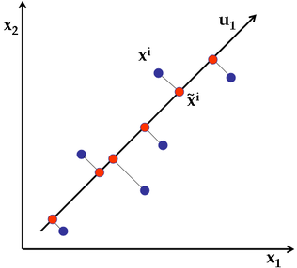

Slide 4
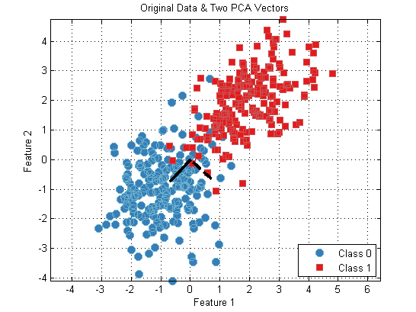

Slide 5
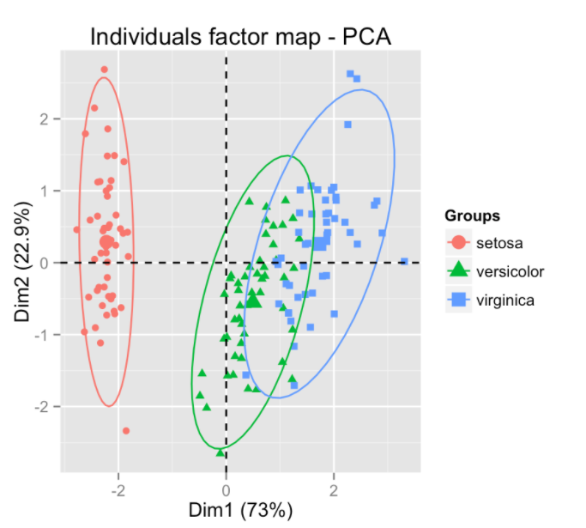

Slide 6
PCA for unsupervised learning. Hands on..

Slide 7
PCA for supervised learning. Hands on..

