Slide 1
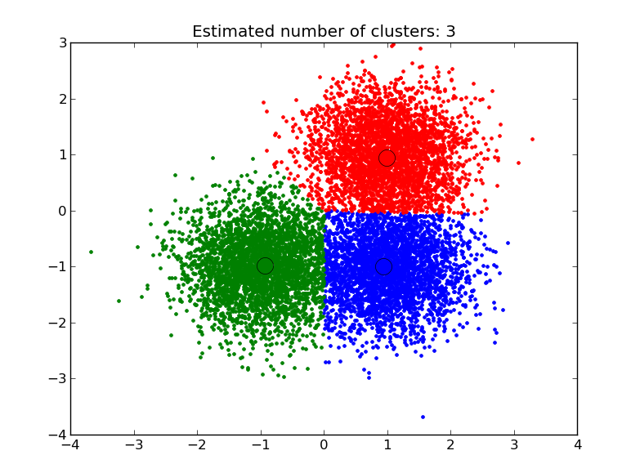
Clustering

Slide 2
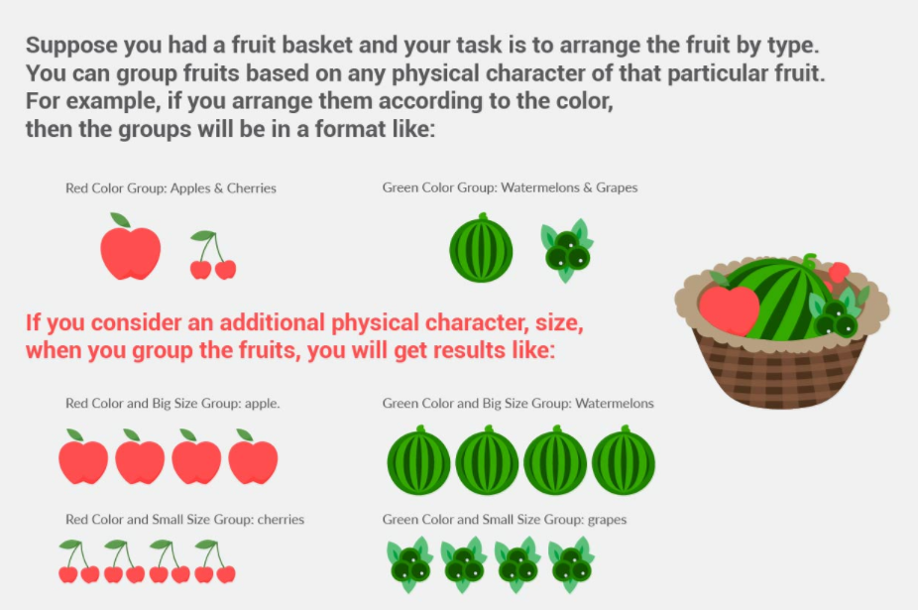
Introduction

Slide 3
Types of Clustering
Centroid based models - These are iterative clustering algorithms in which the notion of similarity is derived by the closeness of a data point to the centroid of the clusters. K-Means clustering algorithm is a popular algorithm that falls into this category. In these models, the no. of clusters required at the end have to be mentioned beforehand, which makes it important to have prior knowledge of the dataset. These models run iteratively to find the local optima.
Connectivity models: As the name suggests, these models are based on the notion that the data points closer in data space exhibit more similarity to each other than the data points lying farther away. These models can follow two approaches. In the first approach, they start with classifying all data points into separate clusters & then aggregating them as the distance decreases. In the second approach, all data points are classified as a single cluster and then partitioned as the distance increases. Also, the choice of distance function is subjective. These models are very easy to interpret but lacks scalability for handling big datasets. Examples of these models are hierarchical clustering algorithm and its variants.

Slide 4
K-Means Clustering
K means is an iterative clustering algorithm that aims to find local maxima in each iteration.
Specify the desired number of clusters K : Let us choose k=2 for these 5 data points.

Slide 5
K-Means Clustering
Randomly assign each data point to a cluster : Let’s assign three points in cluster 1 shown using yellow color and two points in cluster 2 shown using white color

Slide 6
K-Means Clustering
Compute cluster centroids : The centroid of data points in the yellow cluster is shown using yellow cross and those in white cluster using white cross.

Slide 7
K-Means Clustering
Re-assign each point to the closest cluster centroid.

Slide 8
K-Means Clustering
Re-compute cluster centroids : Now, re-computing the centroids for both the clusters.
Repeat steps 4 and 5 until no improvements are possible : Similarly, we’ll repeat the 4th and 5th steps until we’ll reach global optima. When there will be no further switching of data points between two clusters for two successive repeats.

Slide 9
Hands on k-Means Clustering

Slide 10
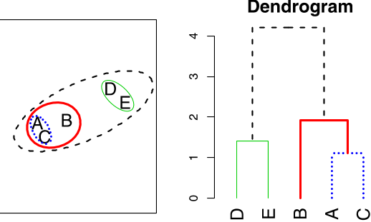
Hierarchal Clustering
Builds hierarchy of clusters.
The two nearest clusters are merged into a single clusters.
The process terminates once there is a single cluster.
The results of hierarchical clustering can be shown using dendrogram. The dendrogram can be interpreted as:

Slide 11
Hierarchical clustering are:
This algorithm has been implemented above using bottom up approach.
It is also possible to follow top-down approach starting with all data points assigned in the same cluster and recursively performing splits till each data point is assigned a separate cluster.
The decision of merging two clusters is taken on the basis of closeness of these clusters. There are multiple metrics for deciding the closeness of two clusters :
Euclidean distance: ||a-b||₂ = √(Σ(a_{i}-b_{i}))
Squared Euclidean distance: ||a-b||₂² = Σ((a_{i}-b_{i})²)
Manhattan distance: ||a-b||₁ = Σ|a_{i}-b_{i}|
Maximum distance:||a-b||_{INFINITY} = max_{i}|a_{i}-b_{i}|
Mahalanobis distance: √((a-b)^{T} S⁻¹ (-b)) {where, s : covariance matrix}

Slide 12
A
B
D
C
E
F

Slide 13
A
B
C
D
E
F
AB
CD
CD,E
AB,CD,E
AB,CD,E,F

Slide 14
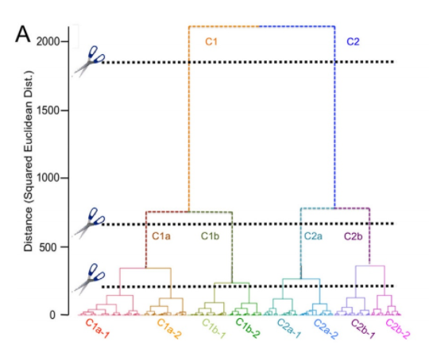
Defining Clusters

Slide 15
Hands on Hierarchical Clustering

