Slide 1
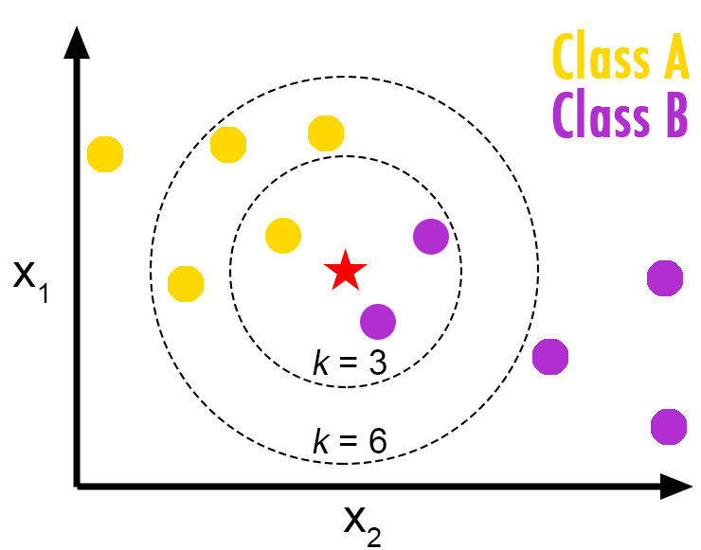
k - Nearest Neighbor Classification

Slide 2
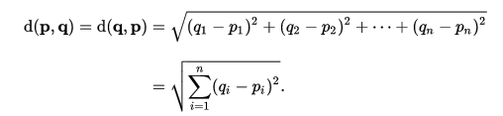
Concept
K Nearest is instance based lazy learning method of classification. Simplest of machine learning algorithms, it provides a classification based on the distances of the labeled data w.r.t the unlabeled.
A commonly used distance metric for continuous variables is Euclidean distance.
For discrete variables, such as for text classification the overlap metric (or Hamming distance) would be employed.

Slide 3

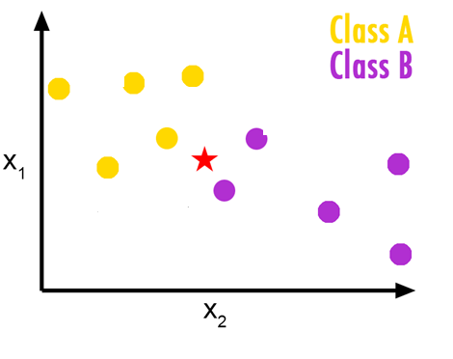
Class A or Class B ?

Slide 4
“Birds of same feather flock together.”
Nearest neighbor - for a given data point, takes the closest data point from the training data set and predicts the class or label.

Slide 5
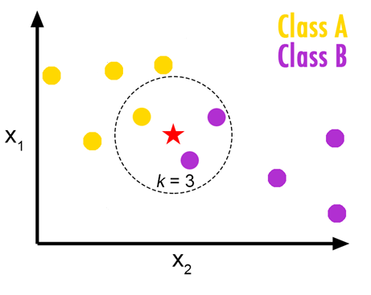
Lets define a flock size of 3. It simply means the majority vote for 3 data points.
The algorithm simply sorts all the data points in ascending order of its distance from the unlabeled data point.
For a value k = 3 it picks the first 3 data points and decides the class label of the unknown based on the majority.

Slide 6
kNN Classifier
Data explorations
Feature selection
Test and Train data Sampling
K Value selection
Model Scoring
Model Evaluation
Model Selection
Hands on Demo ..

Slide 7
Pick the right K
Usually the SQRT of the training sample observations
However analysis, timely retraining is required for the best scoring results.
Drawbacks
Sensitive to outliers
Lazy supervised learning algorithm, not prejudged
Expensive execution time

Slide 8
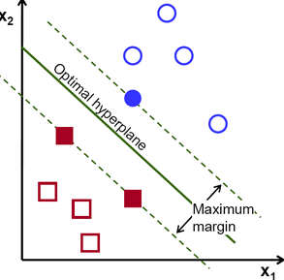
Support Vector Machines-SVM

Slide 9
Concept
Support vector machine is a discriminative algorithm, a classifier which is defined by creating a hyperplane. The hyperplane takes a training dataset and classifies them with an optimal plane.
Can be considered a optimization problem
Where the idea is to minimize the distances of the closest data points
And maximizes the distance of the decision boundary from these closest points to form an optimal hyperplane.

Slide 10

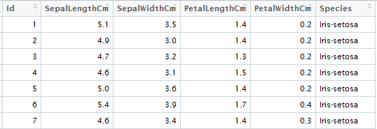
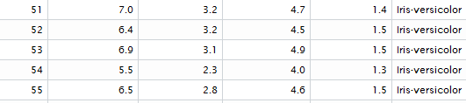
Illustration
Work on IRIS dataset :
50 observations each for 3 species of flowers
IRIS Sentosa
IRIS Virginica
IRIS Verisicolor
We have been provided their 4 features.

Slide 11
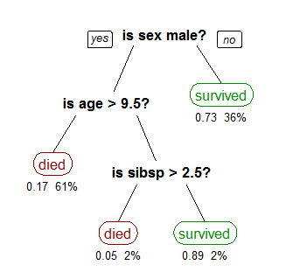
Decision Tree

Slide 12
Introduction
Decision tree learning uses a decision tree (as a predictive model) to go from observations about an item (represented in the branches) to conclusions about the item's target value (represented in the leaves).
It is one of the predictive modelling approaches used in statistics, data mining and machine learning. Tree models where the target variable can take a discrete set of values are called classification trees; in these tree structures, leaves represent class labels and branches represent conjunctions of features that lead to those class labels. Decision trees where the target variable can take continuous values (typically real numbers) are called regression trees.

Slide 13
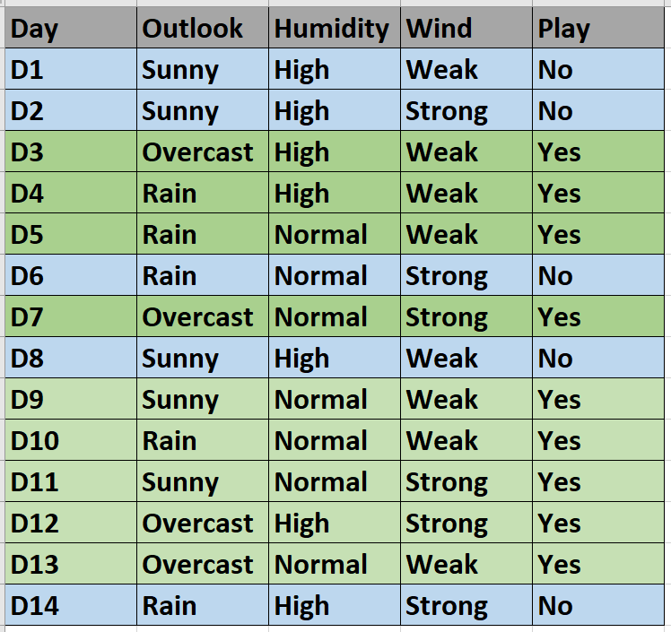
Predict if John will play tennis
Training Data - 9 Yes 5 No

Slide 14
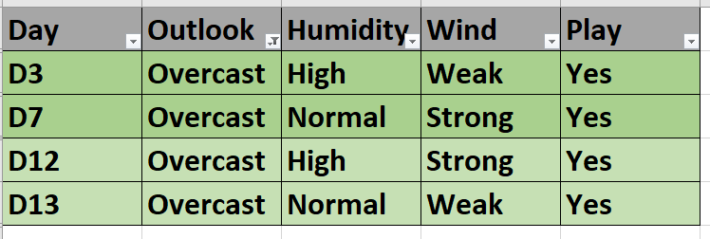
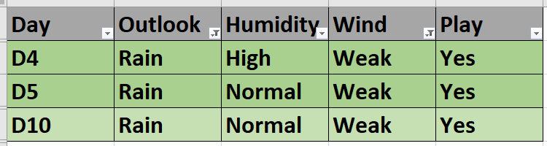
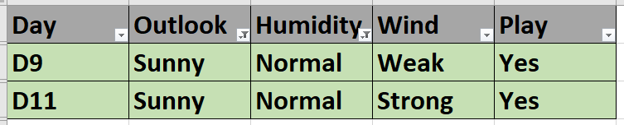
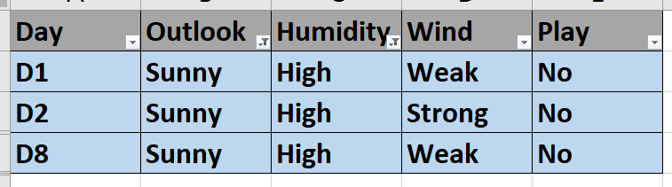
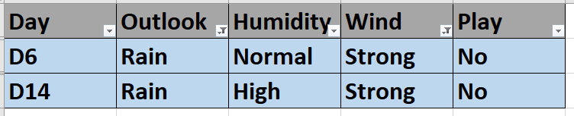
Outlook
Rain
Sunny
Overcast
Wind
Humidity
Weak
Normal
Strong
High

Slide 15


Outlook
Rain
Sunny
Overcast
Wind
Humidity
Weak
Normal
Strong
High

Slide 16
Outlook
Rain
Sunny
Overcast
Wind
Humidity
Weak
Normal
Strong
High

Slide 17
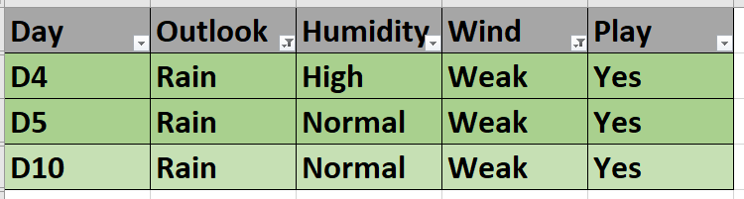
Outlook
Rain
Sunny
Overcast
Wind
Humidity
Weak
Normal
Strong
High

Slide 18
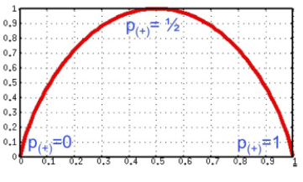
Which attribute to split on ?
Outlook
Wind
9 Yes/5 NO
9 Yes/5 NO
Sunny
Overcast
Weak
Rain
6 Yes/2 NO
Strong
2 Yes/3 NO
4 Yes/0 NO
3 Yes/2 NO
3 Yes/3 NO
Pick the attribute with highest purity:

Slide 19
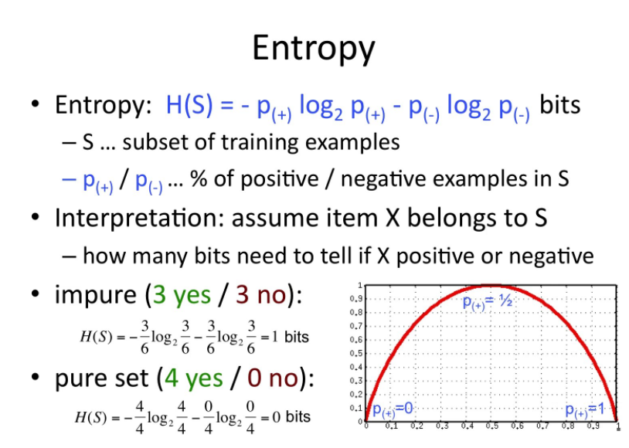

Slide 20
ID3 Algorithm – Ross Quinlan 1983
1.) Pick the best node/attribute for splitting based on purity
2.) Decision attribute
3.) For each value of the picked attribute, create child node
4.) Split training examples for these child nodes
5.)For each child node/subset:
if subset is pure: STOP
else: split(child_node,{subset training data})

Slide 21
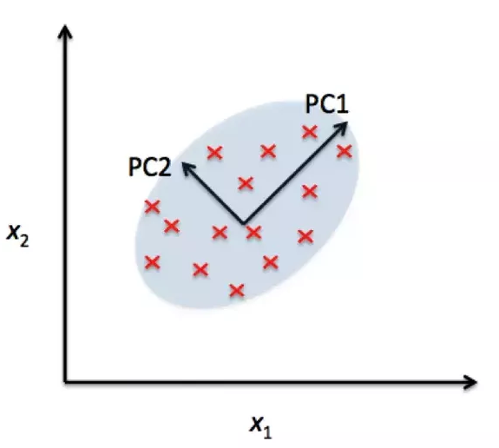
Principal Component Analysis - PCA

Slide 22
Introduction
Principal component analysis (PCA) is a statistical procedure that uses an orthogonal transformation to convert a set of observations of possibly correlated variables into a set of values of linearly uncorrelated variables called principal components (or sometimes, principal modes of variation)
The number of principal components is less than or equal to the smaller of the number of original variables or the number of observations. This transformation is defined in such a way that the first principal component has the largest possible variance (that is, accounts for as much of the variability in the data as possible), and each succeeding component in turn has the highest variance possible under the constraint that it is orthogonal to the preceding components. The resulting vectors are an uncorrelated orthogonal basis set.
PCA is sensitive to the relative scaling of the original variables.

Slide 23
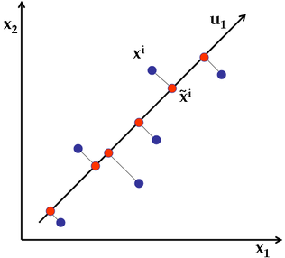

Slide 24
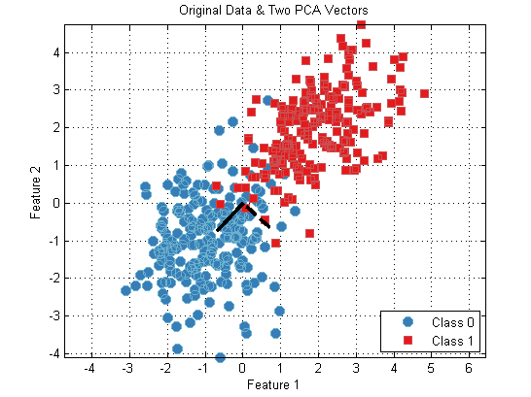

Slide 25
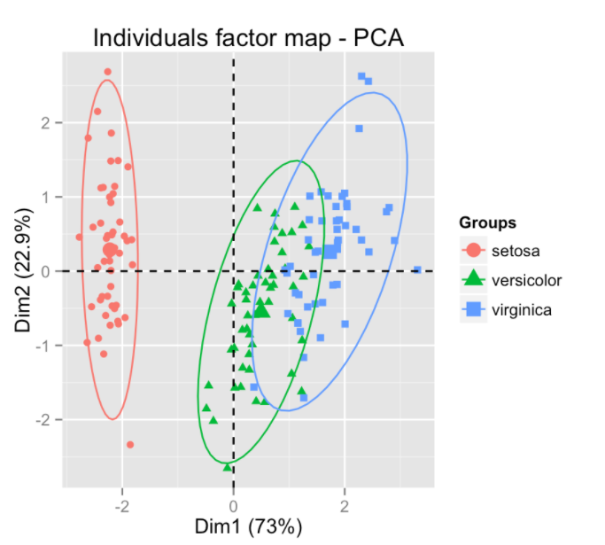

Slide 26
Thank you!

