Slide 1
C++20
Features

Slide 2
C++ has a tradition of introducing new improvements and features in every 3 years in the form of a standard. With the last standard having released in 2017 as C++ 17, C++20 is going to be the latest standard.
Below here are some major features in C++ 20 :
C++ Concepts library
3-way comparisons
Map contains
Range-based for loop
New identifiers ( import, module)
Calendar and time zone library
Std::string functions
Array bounded/unbounded
std::to_array
Likely and unlikely attributes

Slide 3
3-way comparisons
The three-way comparison operator expressions is of the form :
lhs <=> rhs

Slide 4
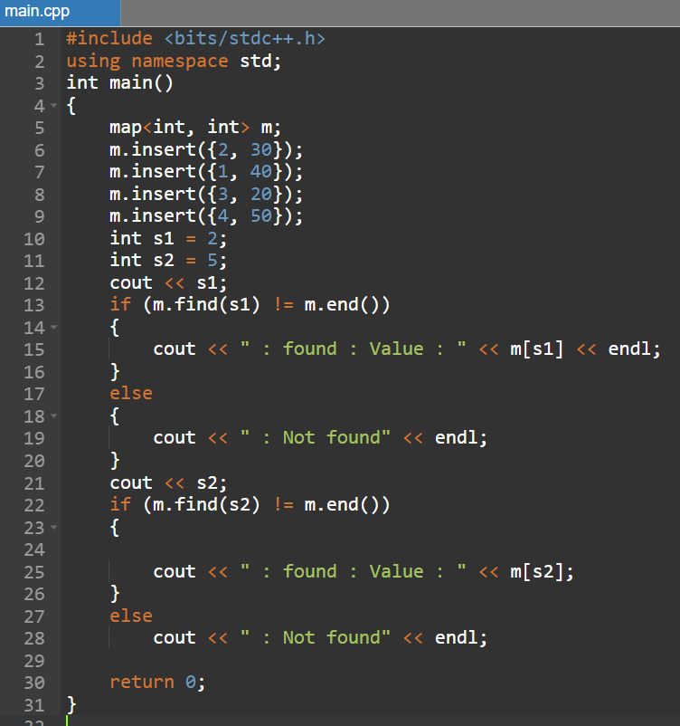
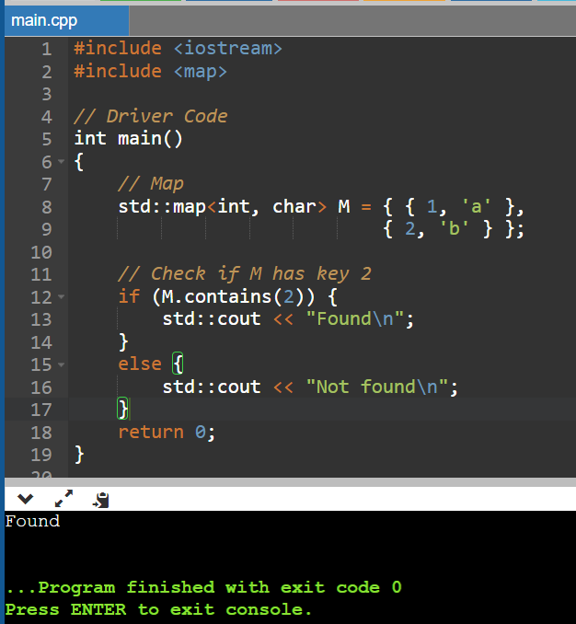
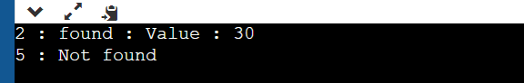
Map/Set contains:
It gives a much easier way to check if a key is present in the associative container(set or map) in C++20. It replaces the find build in function.
Before
After

Slide 5
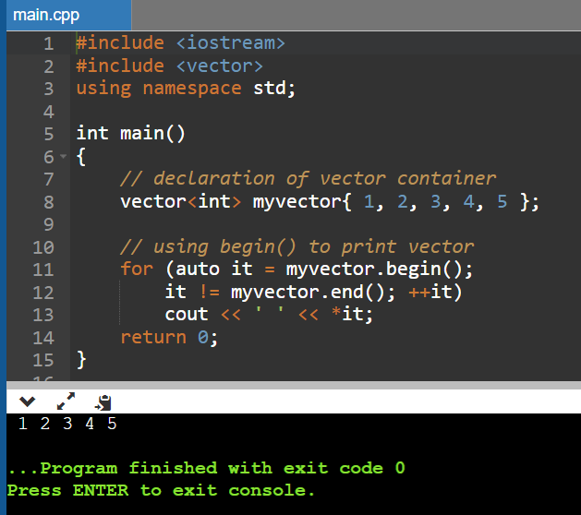
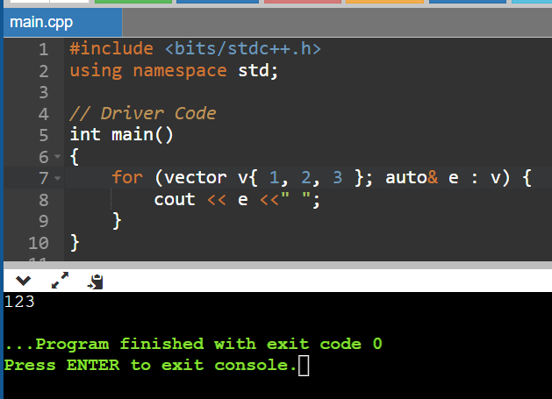
Range-based for loop with Initialization:
The range-based for loop changed in C++17 to allow the begin() and end() expressions to be of different types and in C++20, an init-statement is introduced for initializing the variables in the loop-scope. It allows us to initialize the container we wish to loop through in the range-declaration itself.
Before
After

Slide 6
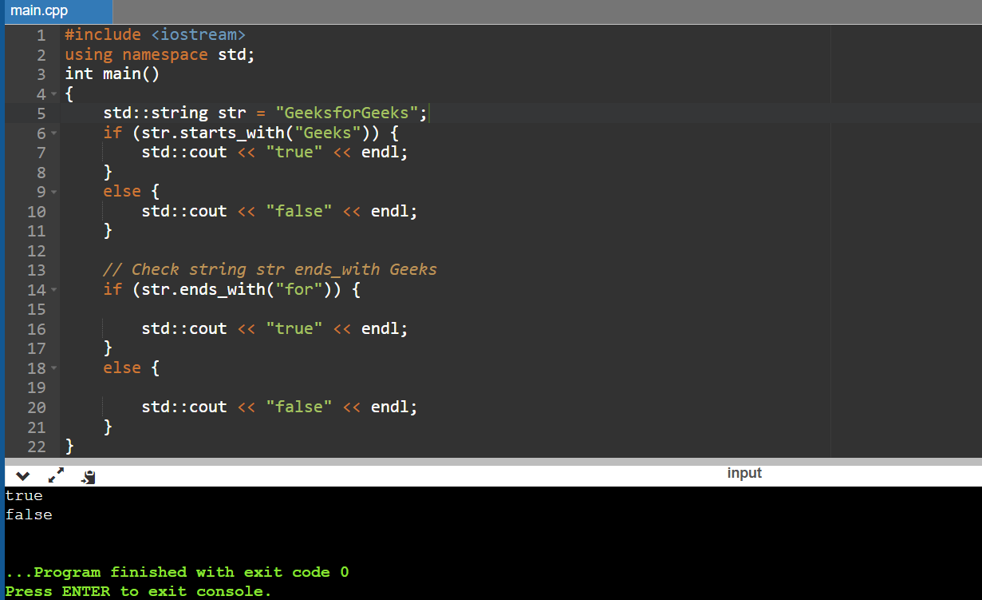
std::string functions:
ends_with(“suffix”): Checks if the string ends with the given suffix. starts_with(“prefix”) :Checks if the string view starts with the given prefix.

