Slide 1
AWS – CodeBuild
By
Keshav Kummari

Slide 2
AWS – CodeBuild
CodeBuild – CodeBuild is amanaged build service that can compile your source code, run unit tests, and produce deployment artifacts.
Build and test code with continuous scaling Only pay for the build time you use
Benefits of CodeBuild:
Fully managed by AWS
On-demand – AWS scales with your needs
Pre-configured environments for many popular programming languages.
CodeBuild Concepts:
Build Project: Defines how CodeBuild will run a build and answers questions like:
Where is the source code?
What build environment to use?
What build commands to run?
Where to store the output of the build?

Slide 3
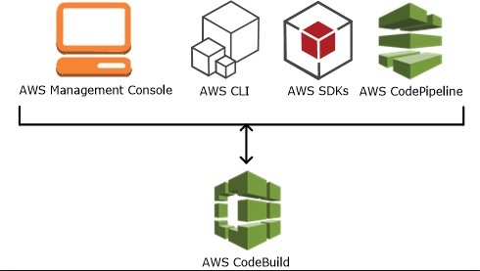
Continue….
Build Environment – The Operating System language runtime, and tools that CodeBuild uses for the build
Build Specification – A YAML file that describes the collection of commands and settings for CodeBuild to run a build.

Slide 4
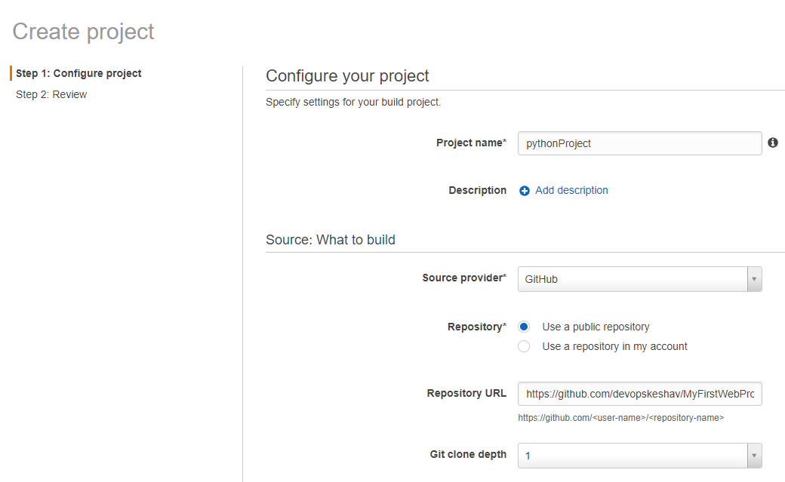
Fill required fields and click on continue

Slide 5
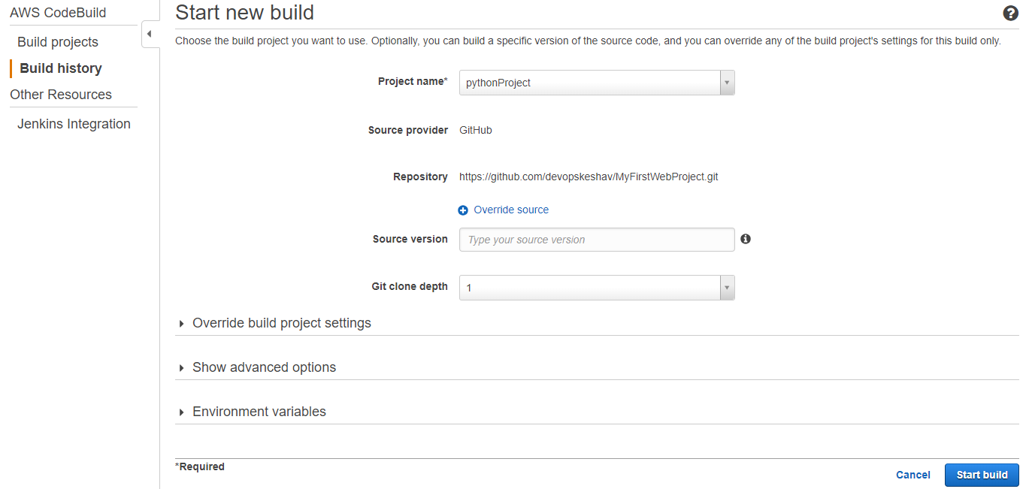
Now click on “Start Build”

Slide 6
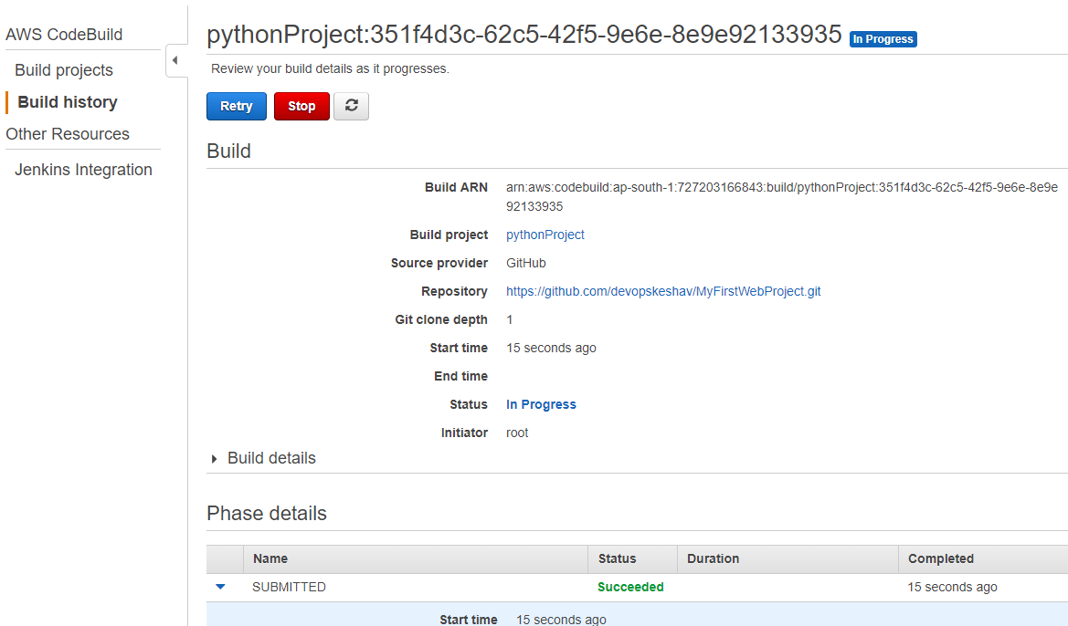
Build is under progress…

Slide 7
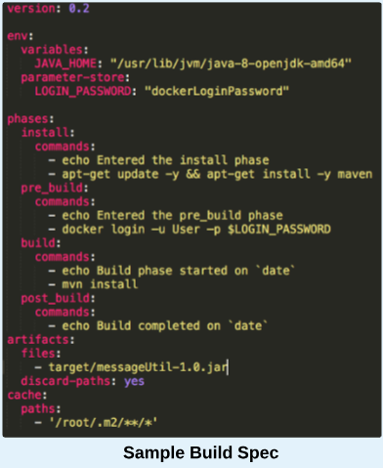
Sample Java Build

