Slide 1
AWS - CodeDeploy
By
Keshav Kummari

Slide 2
AWS - CodeDeploy
CodeDeploy – Automates deployments of your applications to EC2, Lambda, and even on-premises environments.
Deploy your applications in a fast, consistent, and reliable way.
Benefits of CodeDeploy:
Automated Deployments
Minimize Downtime
Stop the Rollback
Centralized Control

Slide 3
Deployment Types
In-place deployment:
The existing servers are updated with the new version of an application
Blue/Green deployment(EC2):
New application versions are deployed on a new set of instances
Traffic is routed from old to new instances
If there are failures, the application can fall back to the older deployment version
Blue/Green Deployment(Lambda):
Traffic is shifted from one lambda version to another, this can happen in multiple ways:

Slide 4
Canary:
A percentage of traffic is shifted to the new version
CodeDeploy then waits for a specified time and shifts the rest of the traffic it it sees no errors.
Linear:
Traffic is shifted in equal increments with an equal number of minutes between each increment.
All at once:
Traffic is immediately and completely shifted to the new version of the Lambda function.

Slide 5
CodeDeploy Hooks
CodeDeploy AppSepc File:
Lambda Deployments:
Which functions to deploy
Which functions to use as validation tests
EC2/On-Premises Deployments:
What to install (From S3 or Github)
What lifecycle events hooks to run in response to deployment lifecycle events
Lifecycle Hooks:
Available hooks depend on the deployment type
Hooks allow arbitrary scripts to run during your deployment process
Typical examples include:
BeforeInstall
AfterInstall
ApplicationStart
ApplicationStop
ValidateService

Slide 6
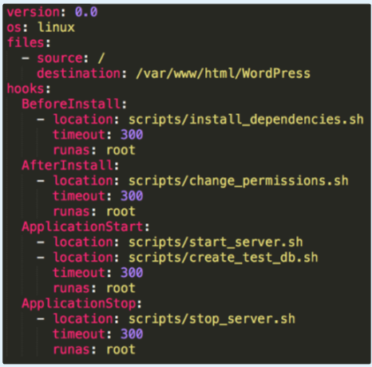

Slide 7
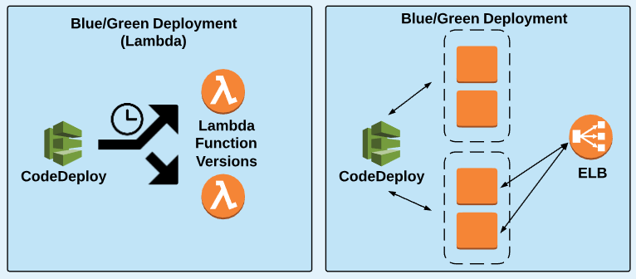
CodeDeploy Examples

Slide 8
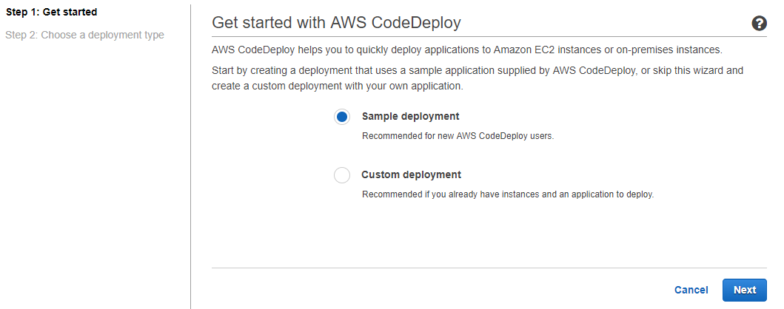
Click on “Sample Deployment” and click on “Next”

Slide 9
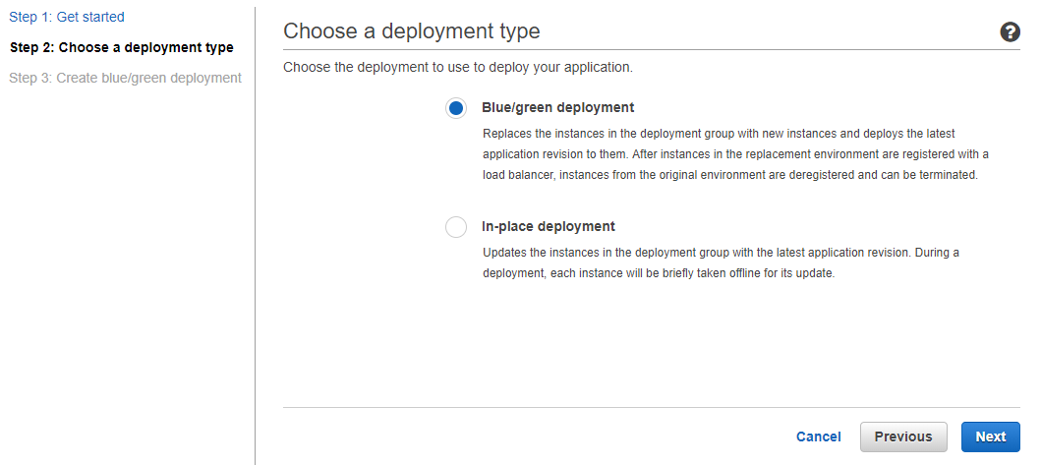
Let’s select “Blue/Green Deployment”

Slide 10
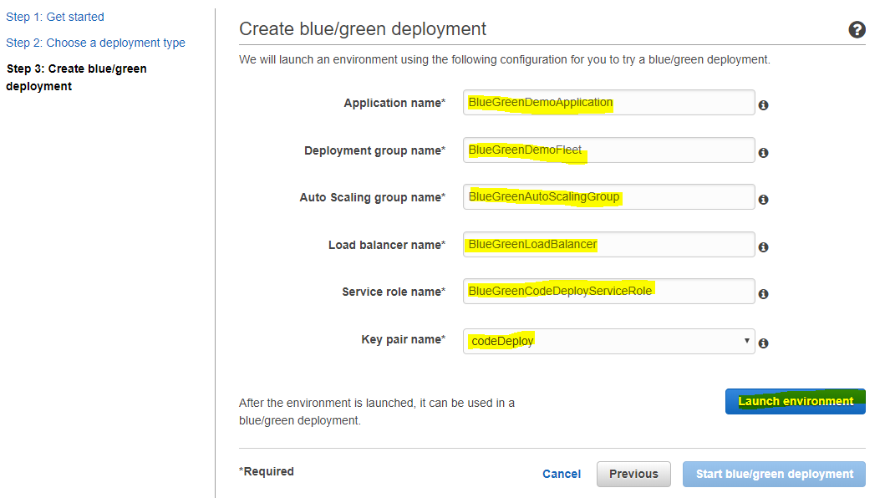
Fill the required fields and click on “Launch environment”

Slide 11
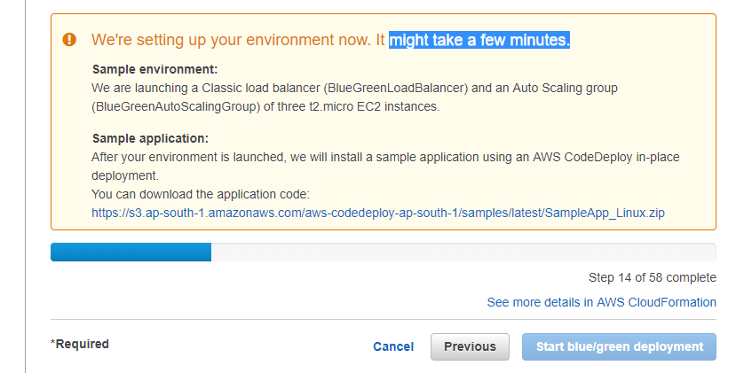
It’s under process…

Slide 12
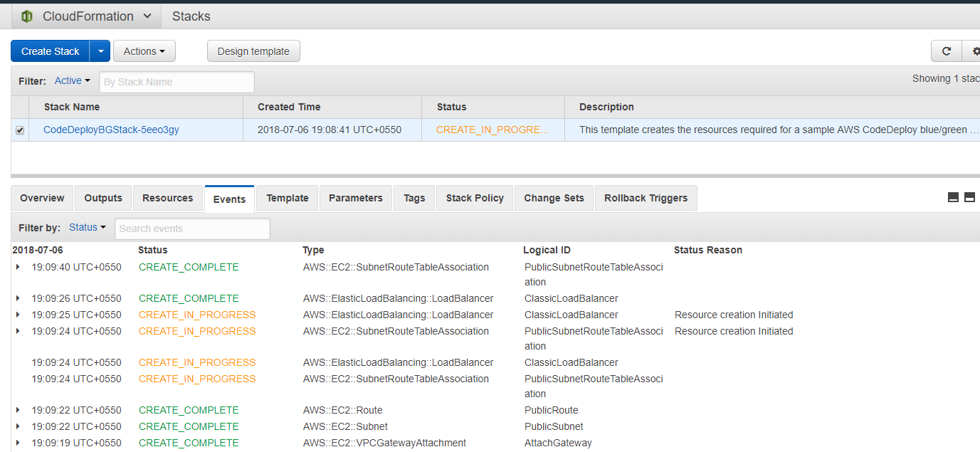
CloudFormation is under process..

Slide 13
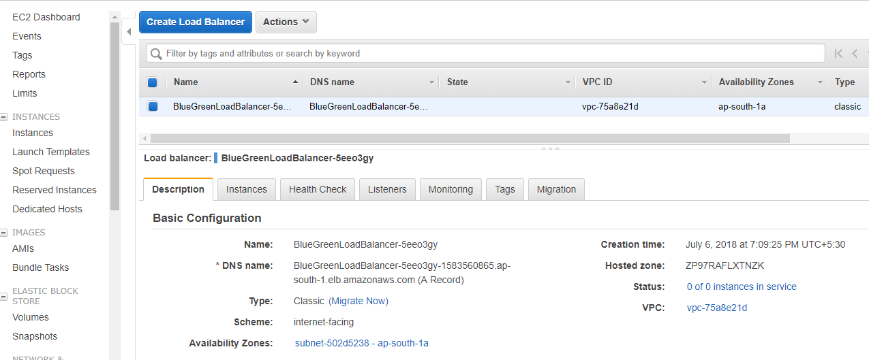
ELB Details

Slide 14
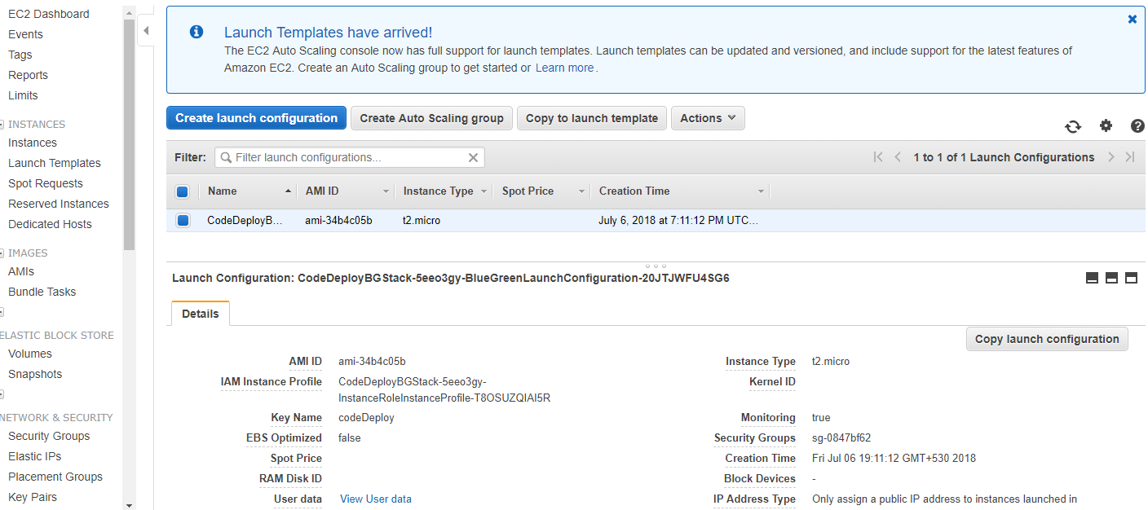
Launch Configuration Info

Slide 15
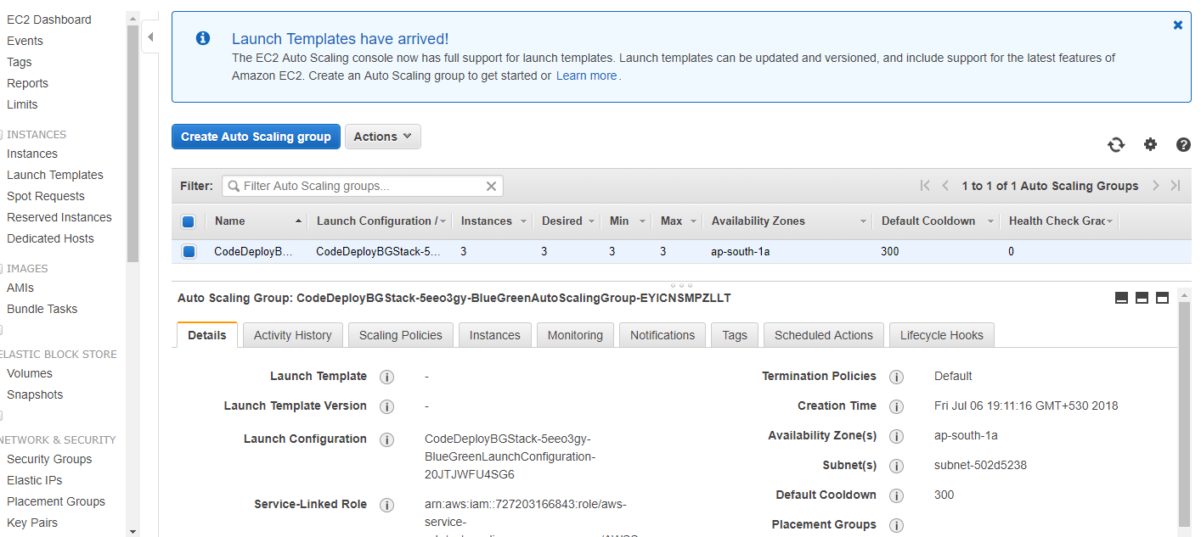
Auto Scaling Details

Slide 16
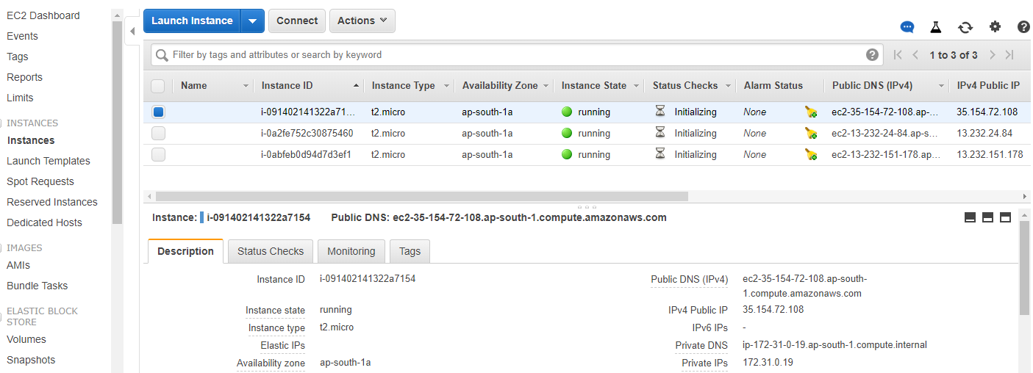
EC2 Instance Info

Slide 17
Thank you!

