Slide 1
AWS - CodePipeline
By
Keshav Kummari

Slide 2
AWS CodePipeline
Visualize and automate the different stages of your software release process, and watch your code go.
A Continuous delivery service that can model, visualize and automate your software release process.
Benefits of CodePipeline:
Automate release processes – Source Repository through build, test and deploy
Consistent release process – Define the set of steps before new changes are released
Real-Time status of the process – View alerts, retry actions, manually rerun any pipelines

Slide 3
Tooling integrations for:
Source Control – S3, CodeCommit, GitHub
Build – AWS CodeBuild, CloudBees, Jenkins, SolanoCI, TeamCity, Gitlab
Test – CodeBuild, HOE StormRunner Load, BlazeMeter, Nouvola, Runscope, Ghost Inspector
Deploy – CloudFormation, CodeDeploy, ECS, Elastic Beanstalk, OpsWorks Stacks, Xebialabs

Slide 4
CodePipeline Concepts
Pipelines – Are a workflow that describes how software changes go through release processes
Artifacts – Files or changes that will be worked on by the actions and stages in the pipeline
Stages – Pipelines are broken up into stages, for example:
Build Stage – Where the code is built and tests are run
Deployment stage – Updates deployed to environments
Actions – Stages contain at least one action, these actions take some action on artifacts and will have artifacts as either an input an output or both
Transitions – The progressing from one stage to another inside of a pipeline

Slide 5
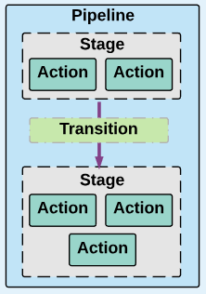
AWS - CodePipeline

Slide 6
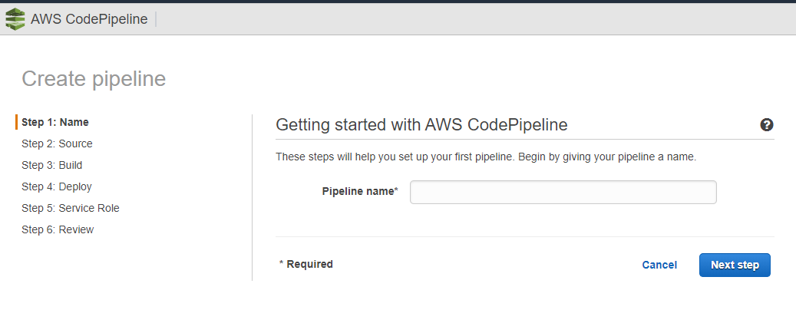
Give any name and click on “Next Step”

Slide 7
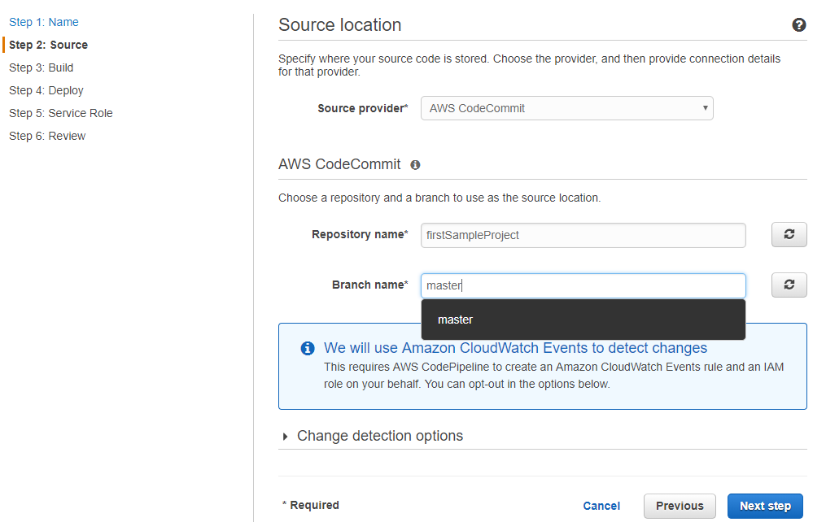
Source Code From?

Slide 8
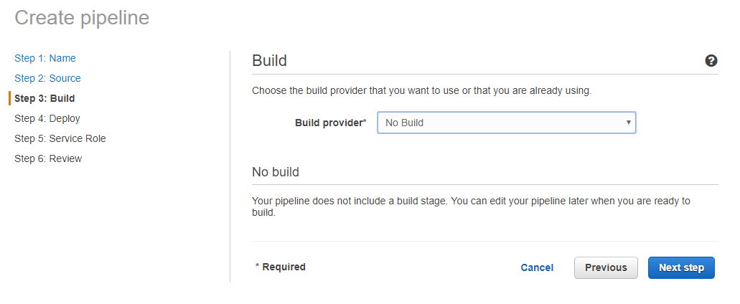

Slide 9
