Slide 1
AWS - CodeStar
By
Keshav Kummari

Slide 2
CodeStar
An AWS Service for creating, managing and working with AWS projects.
Benefits and Features:
Project templates for various projects and programming languages
Helps manage users and the access they require to interact with AWS services(Saves you from having to create and manage IAM policies)
Integrate some IDE’s with CodeStar
Visualize and Collaborate on your projects in the same place:
Application activity metrics like CPU utilization
Jira Issue tracking
Commit history and changes
Continuous deployment details

Slide 3
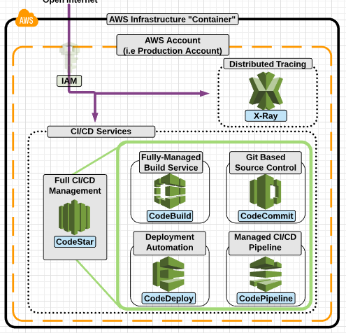
CodeStar integrates with other AWS services:
CodeCommit
CodeBuild
CodeDeploy
CodePipeline
CloudWatch

Slide 4
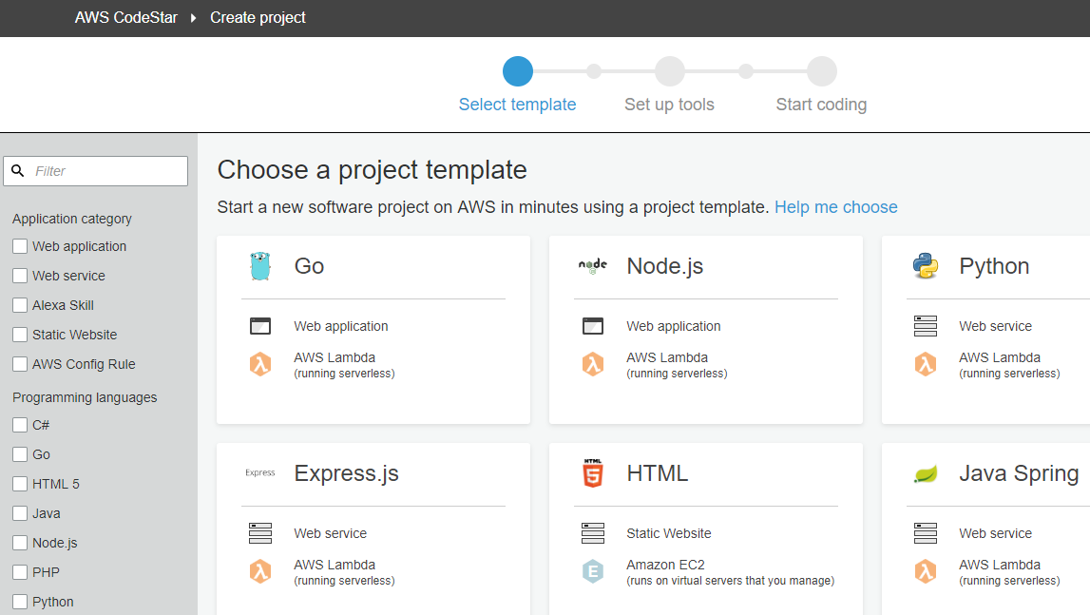

Slide 5
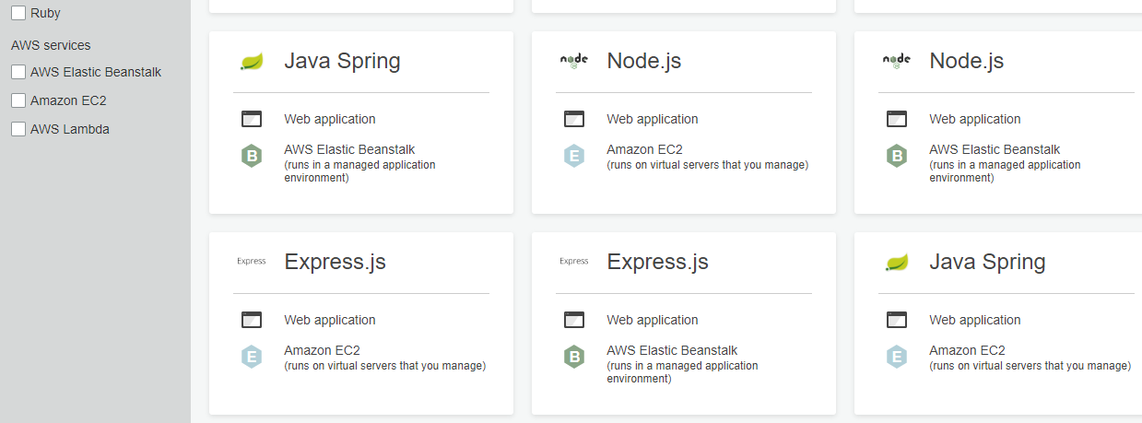

Slide 6
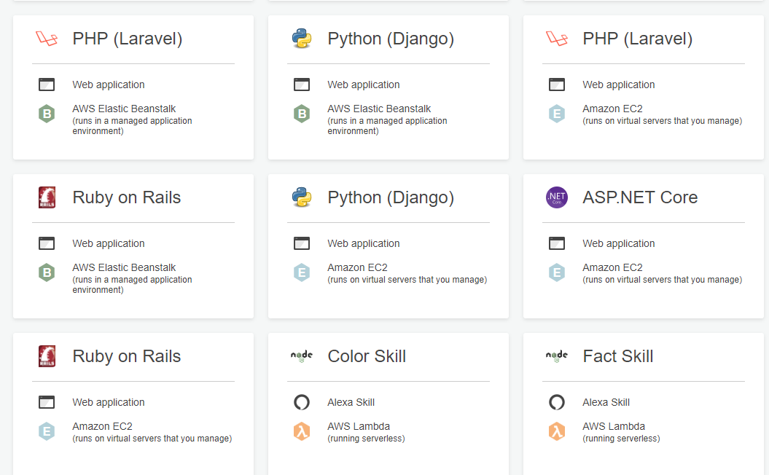

Slide 7
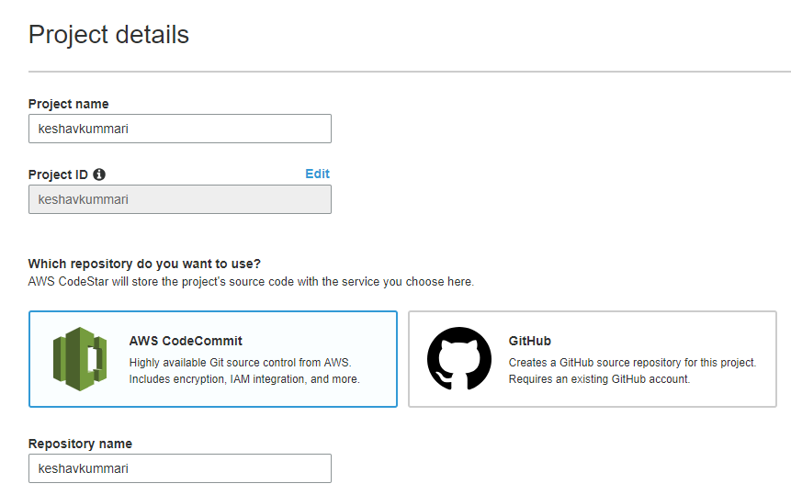
Select any project – i.e. HTML

Slide 8
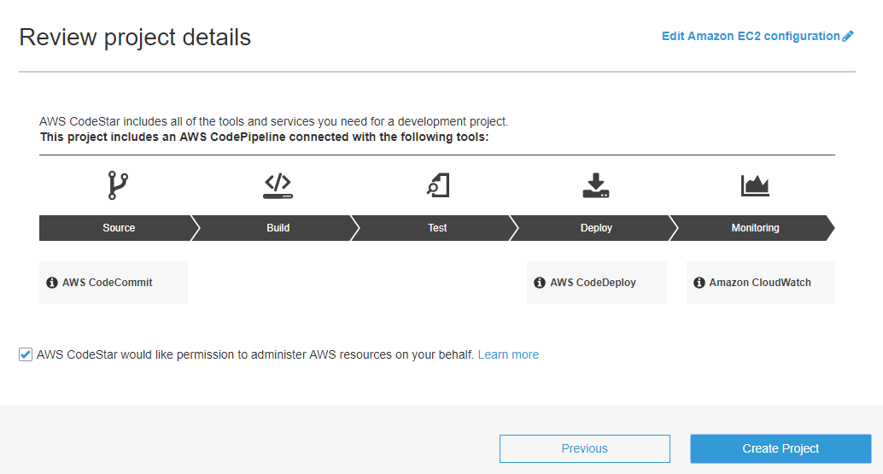
Project Details

