Slide 1
AWS - CodeCommit
By
Keshav Kummari

Slide 2
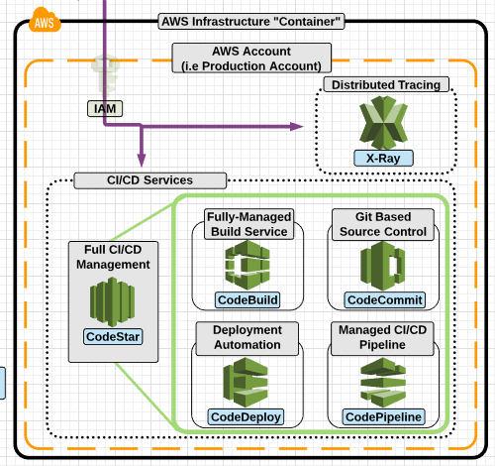
AWS - CodeCommit

Slide 3
AWS - CodeCommit
Create secure repositories for sharing your code in the cloud.
AWS CodeCommit is a managed, secure, and scalable source control service that hosts private Git repositories.
Benefits of CodeCommit:
Fully managed by Aws
Stored encrypted and secured in AWS
Collaborate on Code
No limits on file types or the size of your repositories
Integrate with other AWS services
Migrate to CodeCommit from other git repositories
Use the same git workflows you are familiar with

Slide 4
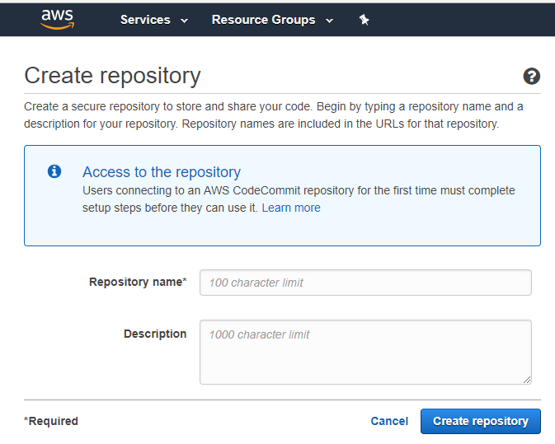
Create your own private Code Repo

Slide 5
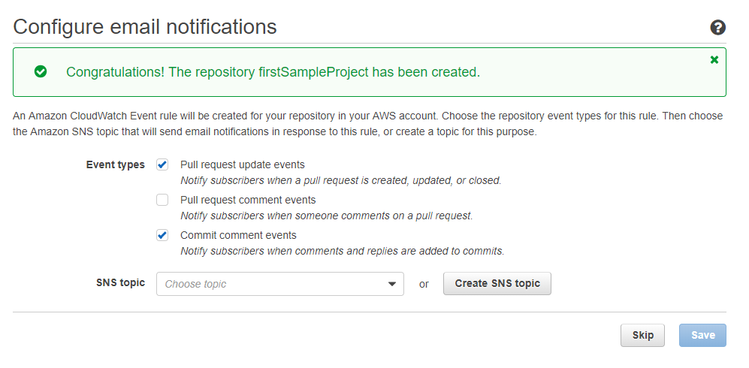
Add required things and click on Save and continue

Slide 6
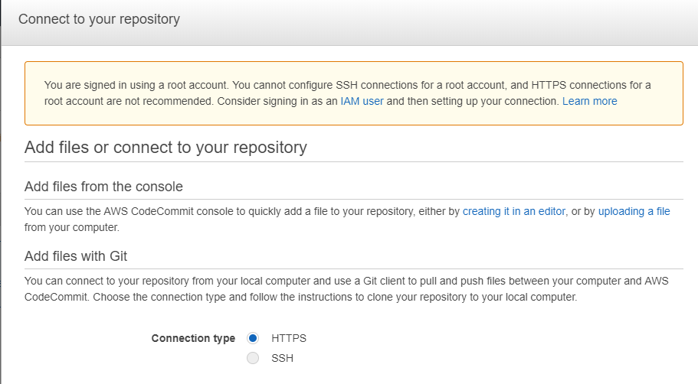
Configure the Repo Type

Slide 7
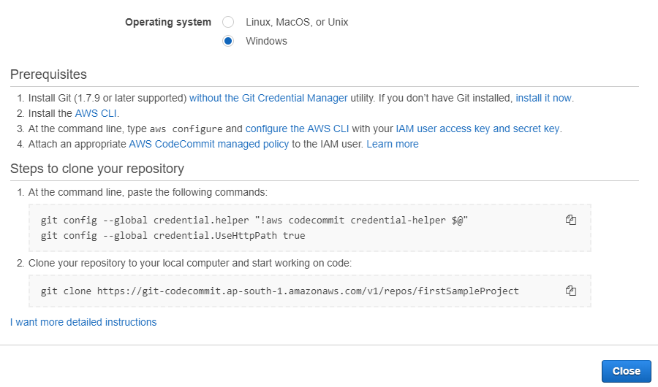
Click on “Close”

Slide 8
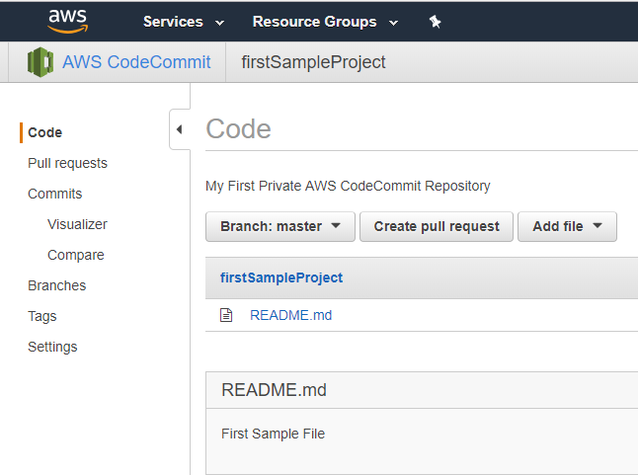
Create a file and cross check the Git functionality

Slide 9
Thank you so much!

