Slide 1

Sun Pharmaceutical Industries Ltd.
EQUITY RESEARCH REPORT
NSE : SUNPHARMA | BSE Code: 524715
Pharmaceuticals & Drugs
About The Company
INTRODUCTION
Sun Pharma started as a domestic branded-formulations player and scaled largely through acquisitions: US entry via Caraco (1998), Taro for US dermatology (FY10, fully absorbed FY24), DUSA for innovative medicines entry (FY13), and Odomzo and Cequa access via the Novartis and Ocular Technologies deals (FY17). Its 2014 Ranbaxy acquisition remains its largest deal to date, giving it generics scale and its OTC entry through Volini and Revital. Since the mid-2010s it has deliberately pivoted from commodity US generics toward patent-protected specialty medicines, a shift continuing through Leqselvi, Unloxcyt, and now Organon.
BUSINESS MODEL
• India Branded Formulations: Prescription-led, highest-margin business with strong market leadership.
• US Formulations: Generics and higher-margin Innovative Medicines, now the larger segment.
• Global Innovative Medicines: Patent-protected portfolio driving high growth and margins.
• Emerging Markets & ROW: Branded generics across 100+ countries, ensuring diversification.
• API Business: Internal supply and external sales with backward integration.
BRAND PORTFOLIO
• Specialty Portfolio: Ilumya (psoriasis), Winlevi (acne), Cequa (dry eye), Odomzo (oncology), Leqselvi (alopecia areata), and Unloxcyt (cutaneous squamous cell carcinoma).
• Consumer/OTC Portfolio: Revital (nutritionals), Volini (topical analgesics), Faringosept (sore throat).
• Core Portfolio: 2,000+ molecules across psychiatry, cardiology, diabetology, dermatology, oncology, gastroenterology, and other therapeutic areas.
PRODUCT ECOSYSTEM
• Dosage Forms: Tablets, capsules, injectables, inhalers, ointments, creams, and liquids.
• Product Categories: Generics, branded generics, specialty, OTC, ARVs, and APIs.
• Pipeline: Fibromun and Nidlegy nearing regulatory filing; GL0034 and MM-II in clinical trials.
• Post-Organon: Expands portfolio with women's health, fertility, and biosimilars.
Strategic Approach
• Specialty-led Mix Shift: Focus on expanding higher-margin Innovative Medicines to offset US generic pricing pressure.
• Large-scale M&A: Organon acquisition strengthens the specialty portfolio with minimal product overlap.
• Domestic Leadership: 37 new launches and market share growth to 8.4%, supported by global diversification.
1

Slide 2
Sun Pharmaceutical Industries Ltd.
EQUITY RESEARCH REPORT
NSE : SUNPHARMA | BSE Code: 524715
Pharmaceuticals & Drugs
Executive Summary
Sun Pharmaceutical Industries Ltd. (NSE: SUNPHARMA) is India's largest pharma company and the largest Indian player in the US market. FY26 consolidated revenue grew 11.9% YoY to ~₹58,220 crore, EBITDA rose 16.1% to ~₹17,700 crore, and net profit grew 5% to ~₹11,479 crore. Stock trades at ~₹1,880–1,900 (market cap ~₹4.6 lakh crore, mid-July 2026), 52-week range ₹1,548–1,963, P/E ~38–39x, near debt-free, dividend payout ~34%.
Thesis: a structural shift from commoditized US generics toward a higher-margin Global Innovative Medicines franchise (~21% of sales, scaling), anchored by a defensive India branded-formulations base (~33% of sales, #1 market share). The $11.75bn Organon acquisition, Sun Pharma's largest deal since Ranbaxy, is the key swing factor. It adds women's health, fertility, and biosimilars, and expands reach into Europe, China, and Latin America.
Key Highlights
• Revenue: ₹58,220 crore (+11.9% YoY); Net Profit: ₹11,479 crore (+5% YoY)
• India Formulations: ₹19,290 crore (+14%), contributing 33% of sales
• US Formulations: ~₹16,370 crore (-0.9%), contributing ~28.8% of sales
• Emerging Markets: ~₹10,840 crore (+13.6%); Rest of World: ~₹8,330 crore (+14.4%)
• Innovative Medicines: ~₹12,210 crore (20.7% of FY26 sales); US business crossed ₹8,600 crore
• Leqselvi and Unloxcyt launched in the US during FY26
• India market share increased from 8.1% to 8.4%; 37 new products launched
• R&D Spend: ₹3,554 crore (vs. ₹3,248 crore in FY25)
• Organon acquisition: ~₹1.01 lakh crore deal; ~₹34,300 crore cash equity investment at US$14/share
1

Slide 3
Sun Pharmaceutical Industries Ltd.
EQUITY RESEARCH REPORT
NSE : SUNPHARMA | BSE Code: 524715
Pharmaceuticals & Drugs
Industry Overview
Industry Size (2026)
The global pharmaceutical industry, typically analysed across branded, generic, and specialty medicine segments, is projected to reach an estimated market size of approximately US 1.76 trillion in 2026 based on direct industry estimates. More recent industry tracking values the baseline market at US 2.225 to US 60.32 billion in 2026. This specific figure is sourced from Mordor Intelligence, a reputable market research firm that provides a direct estimate for 2026.
The global pharmaceutical industry's expanding size in 2026 reflects its critical role in worldwide disease management and healthcare. Original branded medicines dominate the market value, accounting for approximately 66% of the total global spending, primarily due to high-income developed markets. Additionally, specialty medicines—used to treat chronic, complex, and rare diseases—make up a rapidly surging segment of the market and are expected to account for 43% of total global spending by 2027 and 2028.
Generic medicines and Active Pharmaceutical Ingredients (APIs) make up a highly significant portion of the market's volume, driven by global cost-containment pressures and the need for affordable healthcare access. The "Pharmerging" markets' growth is particularly notable, as they are projected to expand at a rapid 10-13% CAGR to reach US$ 400-430 billion by 2028, with China and India being the largest global volume contributors. This regional strength is underpinned by demographic shifts such as an aging population, rising per capita incomes, and robust government initiatives like India's Production Linked Incentive (PLI) scheme to boost domestic manufacturing capabilities.
Industry Growth Projections
The global pharmaceutical industry is projected to grow at a CAGR of approximately 6%–9% from 2024 to 2028. This range is derived from recent global pharmaceutical market estimates, which reflect an upward revision in the outlook for medicine spending as the pandemic transitioned to an endemic phase and global medicine usage steadily expanded.
The growth is underpinned by the increasing demand for chronic care, specialty treatments, and innovative therapies across various applications, with the market size expected to expand significantly. For instance, the global pharmaceutical market was valued at US 2.225 trillion and US$ 2.255 trillion by 2028. These figures indicate a robust market trajectory, driven by global demographic shifts such as an aging population, the rising prevalence of chronic lifestyle diseases, and sustained investments in high-value innovative treatments like oncology and immunology.
1

Slide 4
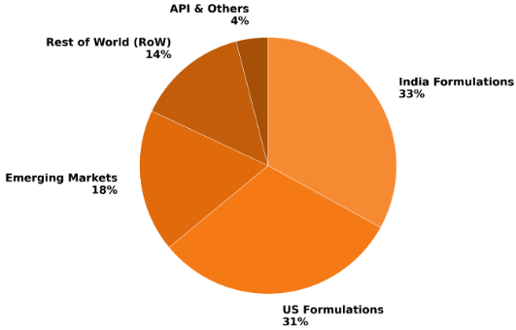
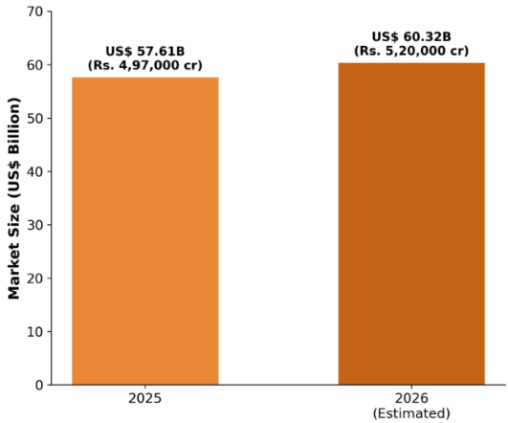
Sun Pharmaceutical Industries Ltd.
EQUITY RESEARCH REPORT
NSE : SUNPHARMA | BSE Code: 524715
Pharmaceuticals & Drugs
Industry Overview
The "Pharmerging" markets, led by India, China, and other Asian and Latin American nations, are the primary volume growth engines, while mature markets like North America and Western Europe see slower volume growth due to already high per capita usage. Pharmerging markets are projected to grow at an impressive 10%–13% CAGR, accounting for US 38–42 billion by 2028, reflecting a strong 7%–10% CAGR. This regional strength is underpinned by rising per capita incomes, improving healthcare affordability, expanding distribution networks, and robust government support, such as the Production Linked Incentive (PLI) scheme.
Global Market Share by Region (2025)
Indian Pharmaceutical Market Size ( 2025 vs. 2026)
Industry Overview
1

Slide 5
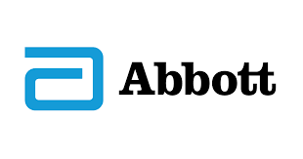
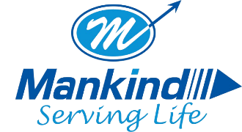

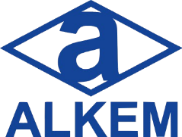

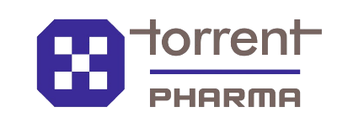

Sun Pharmaceutical Industries Ltd.
EQUITY RESEARCH REPORT
NSE : SUNPHARMA | BSE Code: 524715
Pharmaceuticals & Drugs
Key Growth Drivers
Aging Population & Demographics: The expanding global geriatric population is a primary growth engine for the industry. By 2030, 1 in 6 people globally will be aged 60 or older, and the population of those aged 80 years or older is projected to triple to 426 million between 2020 and 2050, heavily driving the demand for age-related and chronic medications.
Rise of Chronic & Lifestyle Diseases: Sedentary lifestyles, urbanization, and changing dietary habits are driving a rapid surge in Non-Communicable Diseases (NCDs) like cardiovascular ailments and hypertension. Medicines to treat NCDs are projected to account for 85% of global spending, with diabetes care alone expected to reach nearly US$ 168 billion in revenues to become the third-largest therapy area globally by 2027.
Specialty Medicines & Innovative Therapies: There is a massive shift toward advanced treatments for complex, chronic, and rare conditions, particularly in oncology, immunology, and endocrinology. Specialty medicines are expected to account for 43% of total global pharmaceutical spending by 2028, and will command over 55% of the total spending in developed markets
.
Government Support & Infrastructure Push: In India, robust government incentives are bolstering domestic manufacturing and reducing import dependence to solidify its position as the "pharmacy of the world". Key drivers include a Rs. 15,000 crore (US 7 billion) strategic push to elevate local Active Pharmaceutical Ingredient (API) production capacity.
Digital Health & AI Integration: The adoption of artificial intelligence, machine learning, and advanced analytics is revolutionizing the pharmaceutical value chain. These technologies are optimizing clinical trial designs, accelerating drug discovery, predicting supply chain models, and enabling personalized medicine, thereby driving immense productivity and new care outcomes.
Some Major Indian Players
1

Slide 6
Sun Pharmaceutical Industries Ltd.
EQUITY RESEARCH REPORT
NSE : SUNPHARMA | BSE Code: 524715
Pharmaceuticals & Drugs
PORTER’S FIVE FORCES
Threat of New Entrants: Low
High Capital and Regulatory Requirement: Entering the global pharmaceutical market requires massive financial investments in R&D (Sun Pharma consistently invests 6-8% of its annual revenues), complex manufacturing infrastructure, and strict, continuous adherence to global cGMP regulatory standards (like USFDA and EMA), which acts as a massive deterrent for new players.
Economies of Scale and Vertical Integration: Established leaders possess extensive vertically integrated operations—manufacturing both finished formulations and their own Active Pharmaceutical Ingredients (APIs)—which provides unmatched cost competitiveness and supply reliability that new entrants cannot easily replicate.
Bargaining Power of Suppliers: Low to Medium
Strategic Backward Integration: Sun Pharma manufactures over 400 APIs in-house across 14 dedicated global facilities. This strategic backward integration significantly reduces its reliance on external suppliers for critical raw materials, ensuring supply reliability and insulating profit margins.
Global Supply Chain Vulnerabilities: While the company's massive scale allows for diversified sourcing, suppliers of non-substitutable and critical raw materials still hold some power, especially when global supply chains are disrupted by geopolitical tensions and economic downturns.
Competitive Rivalry: High
Hyper-Competitive US Generics Market: The global generics space, particularly the US, is fiercely competitive. A faster pace of generic drug approvals by the USFDA, combined with multiple manufacturers targeting the same off-patent molecules, results in severe price erosion, forcing companies to continuously optimize costs and withdraw non-remunerative products.
Fierce Battles in Emerging Markets: In pharmerging markets (including India), competitive intensity between multinational pharmaceutical giants and deeply entrenched local players is incredibly high. Companies must continuously innovate, build strong brand equity with doctors, and rapidly launch complex or specialty products to defend and grow their market share.
1

Slide 7
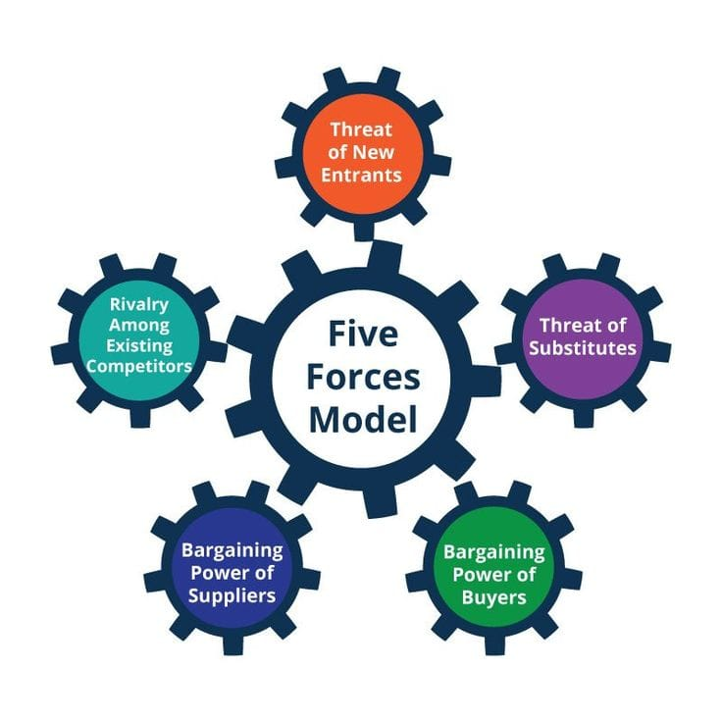
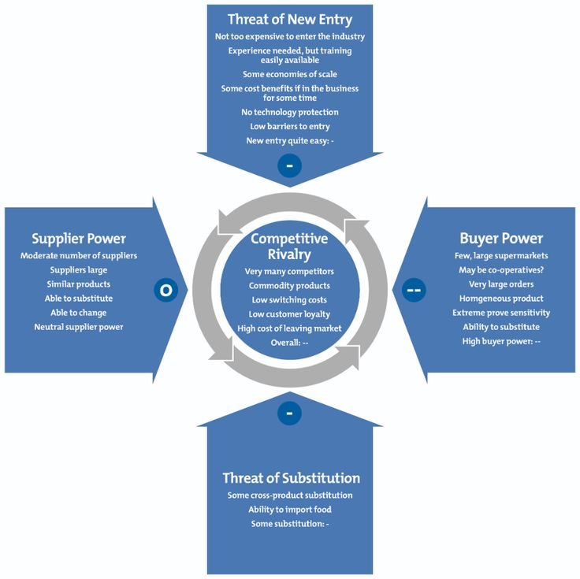
Sun Pharmaceutical Industries Ltd.
EQUITY RESEARCH REPORT
NSE : SUNPHARMA | BSE Code: 524715
Pharmaceuticals & Drugs
PORTER’S FIVE FORCES
Threat of Substitute Products: Medium to High
Severe Customer Consolidation: In key developed markets like the US, the consolidation of buying consortiums, wholesalers, and chain drugstores has significantly increased buyer power. This leads to an intensely competitive pricing environment characterized by severe off-invoice discounts and rebates
Government-Mandated Price Controls: Governments and institutional payers globally act as massive buyers. Faced with soaring healthcare deficits, they frequently enforce strict drug price controls, mandate periodic price cuts (as seen in Japan), and promote aggressive generic substitution to force down pharmaceutical prices.
Competitive Rivalry: High
Generic and Biosimilar Competition: For patented and specialty medicines, the loss of patent exclusivity immediately exposes them to highly affordable generic and biosimilar substitutes. Furthermore, the rapid pace of FDA approvals continuously introduces competing generic substitutes into the market.
Shift Towards Preventative Care: There is a growing global consumer shift towards self-care, wellness, and over-the-counter (OTC) alternative products, which can act as substitutes for traditional prescription therapeutics, though Sun Pharma actively mitigates this by aggressively expanding its own Global Consumer Healthcare business.
1

Slide 8
Sun Pharmaceutical Industries Ltd.
EQUITY RESEARCH REPORT
NSE : SUNPHARMA | BSE Code: 524715
Pharmaceuticals & Drugs
STRENGTHS
WEAKNESS
STRONG FINANCIAL POSITION FOR INORGANIC GROWTH
A highly resilient balance sheet with strong cash reserves empowers Sun Pharma to pursue strategic, value-accretive M&A and in-licensing opportunities without taking on significant debt.
SHORT-TERM PROFITABILITY PRESSURES FROM SPECIALTY
Building a global specialty pipeline requires massive upfront capital. The strategic increase in Specialty R&D spending (reaching US$ 148 million in FY24) actively pressures profit margins as the company waits for these long-term clinical trials and market access teams to yield returns.
ROBUST R&D CAPABLITY AND INNOVATION
Backed by over 3,000 global scientists, Sun Pharma consistently invests 6% to 8% of its annual revenues into R&D to develop complex generics, expand its specialty pipeline, and successfully challenge
global patents.
USFDA COMPLIANCE HURDLES:
Ongoing regulatory actions at three major plants-Halol (Import Alert/Warning Letter), Mohali (mandated independent batch certifications), and Dadra (Warning Letter)-restrict new U.S. product approvals and persistently pressure the company's supply chain
SWOT
ANALYSIS
EXPLOSIVE GROWTH IN SPECIALTY MARKETS
PRODUCT QUALITY AND RECALL RISKS
Specialty medicines are transforming
global healthcare and are projected to account for 43% of total global pharmaceutical spending by 2028. In developed markets, this share will exceed 55%. Sun Pharma is perfectly positioned to capture this, with its own Global Specialty revenues already growing to 20% to 22% of total sales.
As a heavily regulated manufacturer, operational safety and product quality deviations present direct financial and reputational threats. Quantifiably, the company had to execute 91 voluntary product recalls in the recent fiscal year alone, primarily due to product quality complaints, process deviations, and out-of-specification/out-of-trend test results.
FAVOURABLE EMERGING MARKET DEMOGRAPHICS:
GOVERNMENT PRICE CONTROLS (JAPAN & EUROPE)
Driven by a rapidly aging population (the global 80+ demographic is expected to triple by 2050), "Pharmerging" markets are projected to reach US400toUS 430 Billion by 2028 at a 10-13% CAGR. Concurrently, the domestic Indian market will mirror this strong growth, reaching US38toUS 42 Billion by 2028 (7-10% CAGR).
Japan's continuous price cuts will restrict market growth to -2% to 1%, while strict European budget constraints will compound a massive US$ 32.2 Billion patent cliff.
OPPORTUNITIES
THREATS
1

Slide 9
Sun Pharmaceutical Industries Ltd.
EQUITY RESEARCH REPORT
NSE : SUNPHARMA | BSE Code: 524715
Pharmaceuticals & Drugs
QUARTERLY PERFORMANCE
Sun Pharma delivered a strong Q4 FY25, with Revenue from Operations rising 8.96% YoY to ₹129,588 million. Profit Before Tax grew 15.59% YoY to ₹32,544 million, while Net Profit After Tax increased 18.62% YoY to ₹31,539 million profit growth outpacing revenue growth, reflecting improved operating leverage and cost efficiency even within a single quarter.
7

Slide 10
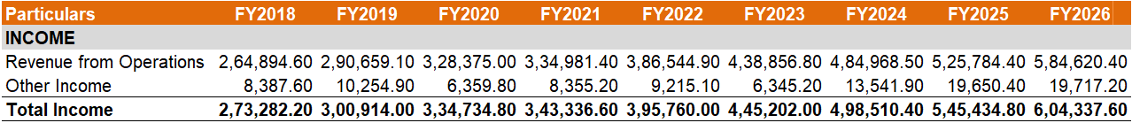
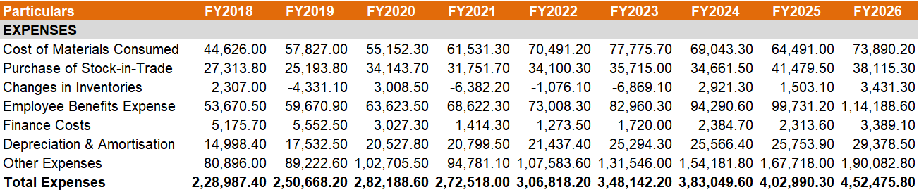
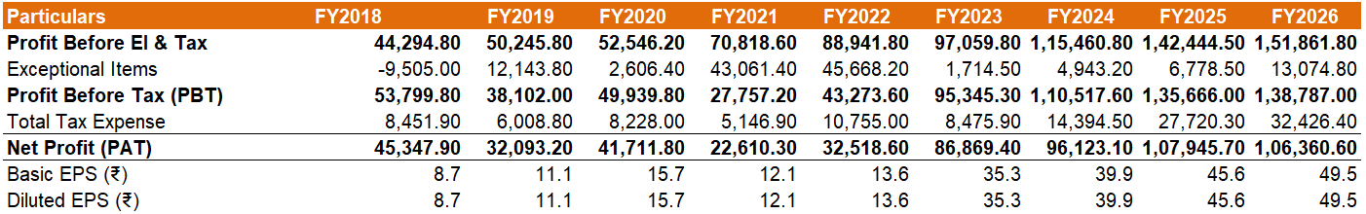
Sun Pharmaceutical Industries Ltd.
EQUITY RESEARCH REPORT
NSE : SUNPHARMA | BSE Code: 524715
Pharmaceuticals & Drugs
INCOME STATEMENT ANALYSIS
INCOME STATEMENT
7

Slide 11
Sun Pharmaceutical Industries Ltd.
EQUITY RESEARCH REPORT
NSE : SUNPHARMA | BSE Code: 524715
Pharmaceuticals & Drugs
INCOME STATEMENT ANALYSIS
Sales Volume
Sun Pharma's revenue growth has been primarily driven by higher sales volumes across its branded formulations, specialty products, and international businesses rather than price-led expansion alone. The company continued strengthening its specialty portfolio while maintaining leadership in the Indian pharmaceutical market, enabling sustained growth despite industry pricing pressures and regulatory challenges.
Revenue
Revenue from operations has demonstrated a strong and consistent upward trajectory, increasing from ₹264,895 million in FY2018 to ₹584,620 million in FY2026, reflecting a CAGR of approximately 10%. Growth was supported by strong performance in the specialty business, increased domestic formulations sales, robust global generics demand, and strategic acquisitions. The acceleration after FY2022 highlights improved execution and expanding international presence
Profitability
Profitability improved significantly over the study period. Net Profit After Tax increased from ₹21,616 million in FY2018 to approximately ₹118,762 million in FY2026, while Profit Before Tax rose from ₹34,790 million to ₹151,189 million. After a temporary moderation during FY2021, earnings recovered strongly due to better operating leverage, improving product mix, specialty business expansion, and efficient cost management.
7

Slide 12
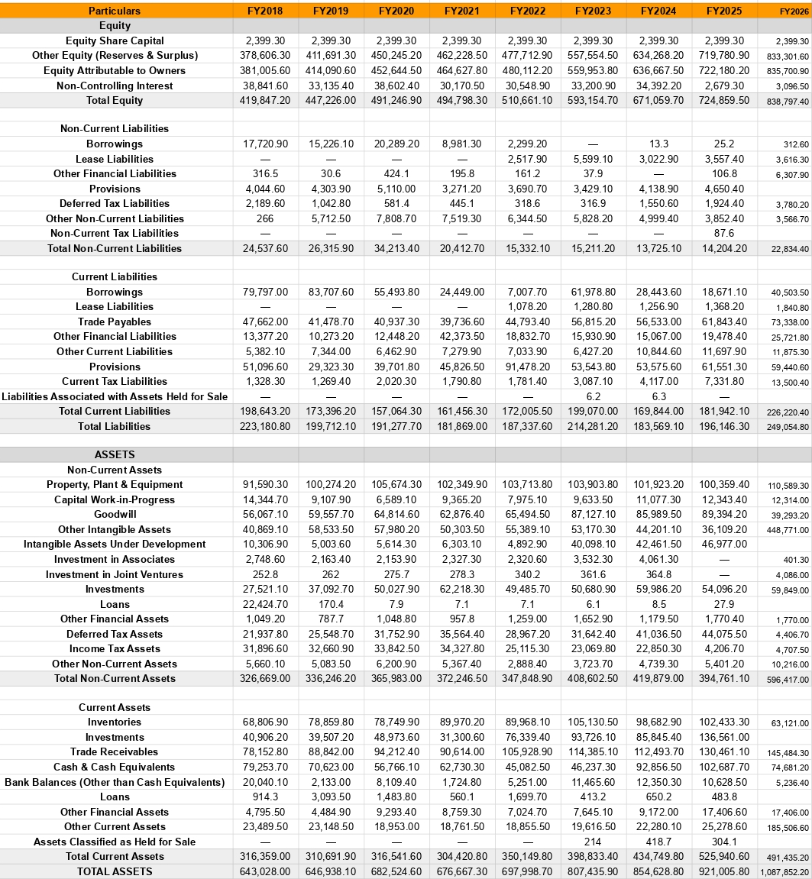
Sun Pharmaceutical Industries Ltd.
EQUITY RESEARCH REPORT
NSE : SUNPHARMA | BSE Code: 524715
Pharmaceuticals & Drugs
BALANCE SHEET ANALYSIS
BALANCE SHEET
7

Slide 13
Sun Pharmaceutical Industries Ltd.
EQUITY RESEARCH REPORT
NSE : SUNPHARMA | BSE Code: 524715
Pharmaceuticals & Drugs
BALANCE SHEET ANALYSIS
Non – Current Assets
Sun Pharma's non-current assets increased from ₹326,669 million in FY2018 to ₹430,226 million in FY2026, reflecting continued investments in manufacturing facilities, research & development infrastructure, and strategic acquisitions. The steady rise highlights the company's long-term expansion strategy and commitment to strengthening its production capabilities.
Current Assets
Current assets grew significantly from ₹316,359 million in FY2018 to ₹491,435.20 million in FY2026, mainly driven by higher cash & cash equivalents and healthy working capital. This improvement enhances the company's liquidity position and provides financial flexibility for future growth initiatives.
Equity & Liabilities
Total Equity increased consistently from ₹419,847 million in FY2018 to ₹838,797 million in FY2026, reflecting sustained profitability and strong retained earnings. The continuous growth in shareholders' equity indicates effective capital allocation and increasing shareholder value.
Borrowings
Borrowings declined substantially from ₹97,518 million in FY2018 to ₹40,504 million in FY2026. Although borrowings temporarily increased during FY2023 due to financing requirements related to the Concert Pharmaceuticals acquisition, the company rapidly reduced debt thereafter, demonstrating prudent financial management and a strong balance sheet.
7

Slide 14
Sun Pharmaceutical Industries Ltd.
EQUITY RESEARCH REPORT
NSE : SUNPHARMA | BSE Code: 524715
Pharmaceuticals & Drugs
CASH FLOW STATEMENT ANALYSIS
Particulars (₹ Crore) | FY18 | FY19 | FY20 | FY21 | FY22 | FY23 | FY24 | FY25
Operating Activities
Profit before tax | 3,479.0 | 3,810.2 | 5,009.6 | 2,799.4 | 4,481.3 | 9,408.4 | 11,087.9 | 13,752.1
Non-cash adjustments (net) | 1,382.2 | 1,968.7 | 1,992.5 | 1,809.9 | 1,975.0 | 2,722.6 | 1,554.4 | 1,120.4
Working capital changes, net | (212.3) | (2,696.0) | 898.6 | 2,564.1 | 1,559.1 | (5,661.8) | 1,062.1 | (323.6)
Direct taxes paid | (741.7) | (886.4) | (1,345.9) | (1,002.9) | 969.2 | (1,509.8) | (1,569.4) | (476.8)
Cash From Operating Activities | 3,907.1 | 2,196.5 | 6,554.8 | 6,170.4 | 8,984.5 | 4,959.3 | 12,135.0 | 14,072.1
Investing Activities
Capital expenditure, net | (1,894.3) | (3,162.4) | (1,450.0) | (1,073.0) | (1,434.4) | (2,064.6) | (2,171.0) | (2,067.6)
Net purchase/(sale) of investments | (676.8) | 1,752.4 | (1,701.9) | 1,373.3 | (3,791.1) | (1,643.6) | 932.5 | (3,864.2)
Other investing items, net | (799.7) | 728.7 | 563.1 | 236.0 | (499.2) | (4,235.5) | 548.3 | 625.6
Cash From Investing Activities | (3,370.8) | (681.3) | (2,588.8) | 536.2 | (5,724.7) | (7,943.7) | (690.2) | (5,306.2)
Financing Activities
Net borrowings (proceeds/repay.) | 587.6 | (237.2) | (3,123.0) | (4,489.6) | (2,765.4) | 5,028.3 | (3,513.0) | (1,164.9)
Finance costs paid | (476.5) | (460.7) | (271.9) | (144.3) | (73.2) | (132.5) | (219.0) | (223.8)
Dividends paid | (975.8) | (1,424.2) | (1,682.8) | (1,586.2) | (2,169.2) | (2,519.7) | (2,900.7) | (3,617.3)
Other financing items, net | (674.5) | (608.4) | (637.5) | 239.6 | (185.7) | - | (77.4) | (2,899.9)
Cash From Financing Activities | (1,539.3) | (2,730.5) | (5,715.1) | (5,980.5) | (5,193.5) | 2,376.1 | (6,710.2) | (7,905.8)
Net Cash Flow | (1,002.9) | (1,215.3) | (1,749.2) | 726.1 | (1,933.7) | (608.3) | 4,734.6 | 860.1
CASH FLOW FROM OPERATING ACTIVITY
Sun Pharma's consolidated cash flow from operating activities has grown from ₹3,907 crore in FY18 to ₹14,072 crore in FY25, a more than 3.6x increase, driven primarily by strong growth in profit before tax (from ₹3,479 crore to ₹13,752 crore over the same period). Working capital movements have been volatile year to year, notably a large outflow in FY23 (₹5,662 crore) tied to elevated receivables and inventory build-up from acquisitions, and a smaller outflow in FY19 (₹2,696 crore) while FY21 and FY22 saw working capital release cash instead. Direct taxes paid have generally scaled with rising profits, aside from an unusual net refund in FY22. Despite this year-to-year noise, the underlying earnings growth has consistently outpaced these swings, with operating cash flow nearly tripling between FY23 and FY25 alone, pointing to steadily improving cash conversion.
1

Slide 15
Sun Pharmaceutical Industries Ltd.
EQUITY RESEARCH REPORT
NSE : SUNPHARMA | BSE Code: 524715
Pharmaceuticals & Drugs
CASH FLOW FROM INVESTING ACTIVITY
Sun Pharma recorded a net cash outflow of ₹5,306 crore from investing activities in FY25, mainly driven by capital expenditure of ₹2,068 crore towards manufacturing capacity and R&D infrastructure, alongside net investment purchases (largely mutual funds and other financial instruments) of ₹3,864 crore. Capex has stayed in the ₹1,000–3,200 crore range through the period, with FY19 seeing the highest spend at ₹3,162 crore, reflecting continued but disciplined reinvestment even as the business scaled. Investing outflows have also included acquisitions of subsidiaries in select years, most notably FY23 (₹4,686 crore) and FY25, supporting Sun Pharma's push into specialty and global branded generics. A few years, like FY21 and FY24, saw comparatively modest net outflows as investment sales and maturing deposits partly offset fresh deployments, underscoring an investing strategy that balances growth spending with liquidity management.
CASH FLOW FROM INVESTING ACTIVITY
Financing activities used ₹7,906 crore of cash in FY25, primarily on account of ₹3,617 crore in dividend payments and ₹2,900 crore towards buy-back of shares held by non-controlling interests in subsidiaries. Sun Pharma has been a consistent net repayer of borrowings across most of the period, with FY21 and FY22 seeing the largest deleveraging at over ₹2,700–4,500 crore each, reflecting a deliberate strategy to pare down debt as profitability strengthened. FY23 was a notable exception, with net borrowings turning positive (₹5,028 crore) even as overall financing cash flow stayed positive that year. Dividend payouts have risen steadily and substantially, from ₹976 crore in FY18 to ₹3,617 crore in FY25, underscoring the company's growing commitment to shareholder returns as free cash flow generation has strengthened well ahead of financing needs.
1

Slide 16
Sun Pharmaceutical Industries Ltd.
EQUITY RESEARCH REPORT
NSE : SUNPHARMA | BSE Code: 524715
Pharmaceuticals & Drugs
RATIO ANALYSIS
Ratio Analysis – SUN PHARMA (Consolidated) | FY18 | FY19 | FY20 | FY21 | FY22 | FY23 | FY24 | FY25
Current Ratio (x) | 1.59 | 1.79 | 2.02 | 1.89 | 2.04 | 2.00 | 2.56 | 2.89
Quick Ratio (x) | 1.25 | 1.34 | 1.51 | 1.33 | 1.51 | 1.47 | 1.98 | 2.33
Debt-to-Equity (x) | 0.23 | 0.22 | 0.15 | 0.07 | 0.02 | 0.10 | 0.04 | 0.03
Interest Coverage Ratio (x) | 7.72 | 7.86 | 17.55 | 20.80 | 36.19 | 55.70 | 47.49 | 60.44
Debtor Days | 108 | 112 | 105 | 99 | 100 | 95 | 85 | 91
Payable Days | 242 | 182 | 167 | 156 | 156 | 183 | 199 | 213
Inventory Days | 349 | 347 | 322 | 352 | 314 | 338 | 347 | 353
Cash Conversion Cycle (Days) | 215 | 276 | 259 | 295 | 258 | 250 | 233 | 230
CURRENT RATIO
Sun Pharma's current ratio has improved steadily from 1.59x in FY18 to 2.89x in FY25, reflecting a consistent build-up of current assets; particularly investments and cash relative to current liabilities. The ratio has remained comfortably above 1.5x throughout, indicating strong short-term liquidity and a low reliance on external working capital funding.
QUICK RATIO
The quick ratio, which excludes inventory, has more than doubled from 1.25x in FY18 to 2.33x in FY25. Even excluding stock-in-trade, Sun Pharma has held enough liquid current assets to cover short-term liabilities well above 1x since FY19, pointing to a strong and improving liquidity cushion.
1

Slide 17
Sun Pharmaceutical Industries Ltd.
EQUITY RESEARCH REPORT
NSE : SUNPHARMA | BSE Code: 524715
Pharmaceuticals & Drugs
DEBT TO EQUITY RATIO
Sun Pharma has sharply deleveraged over the period, with debt-to-equity falling from 0.23x in FY18 to just 0.03x in FY25. Total borrowings have shrunk in absolute terms even as equity has nearly doubled on the back of retained profits, leaving the balance sheet almost debt-free by FY22 onward.
INTEREST COVERAGE RATIO
Sun Pharma's Interest Coverage Ratio has improved dramatically, rising from 7.72x in FY18 to 60.44x in FY25, nearly an eightfold increase as falling finance costs and rapidly expanding EBIT worked together. The ratio stayed modest through FY18-FY19 before climbing sharply from FY20 onward, crossing 55x by FY23 and holding comfortably above 45x every year since. This consistently high, rising coverage reflects very low financial risk and ample headroom to service debt or absorb earnings volatility.
CASH CONVERSION CYCLE
Unlike consumer-facing businesses, Sun Pharma's Cash Conversion Cycle is structurally high and positive, ranging between 215 and 295 days, driven mainly by long inventory holding periods (314-353 days) typical of pharma manufacturing and regulatory cycles. The CCC peaked at 295 days in FY21 before easing to 230 days by FY25, helped by extending payable days from 156 to 213 even as inventory days stayed elevated. This gradual improvement reflects better working capital discipline, though the cycle remains inherently long given the industry's manufacturing timelines.
1

Slide 18
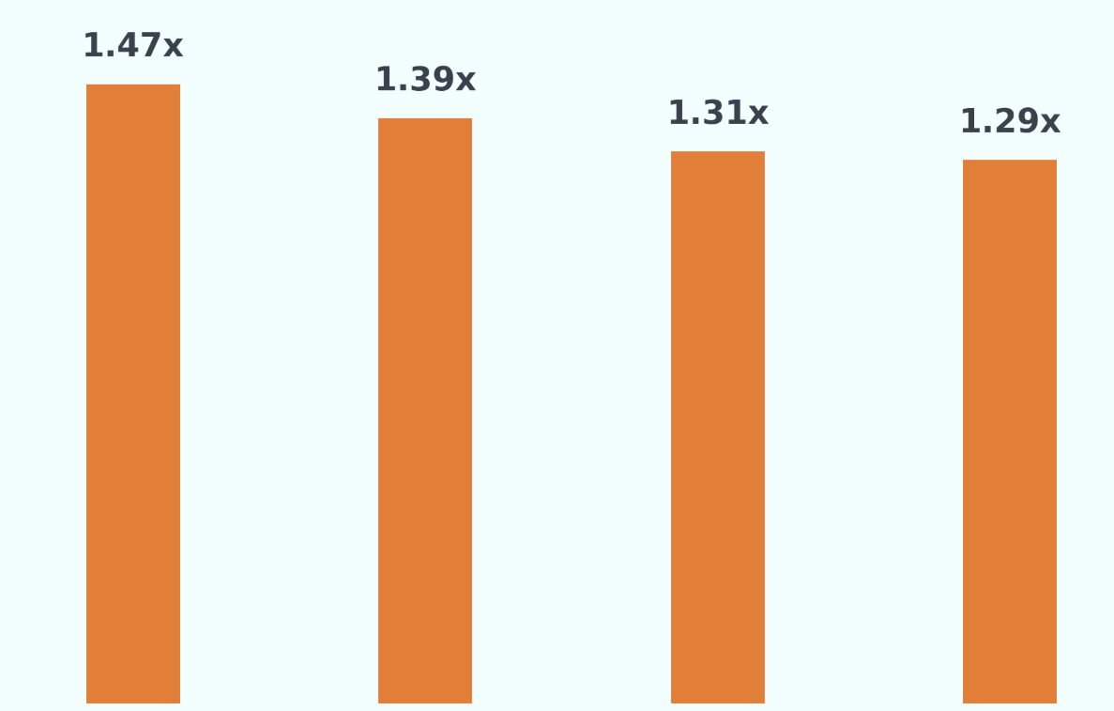
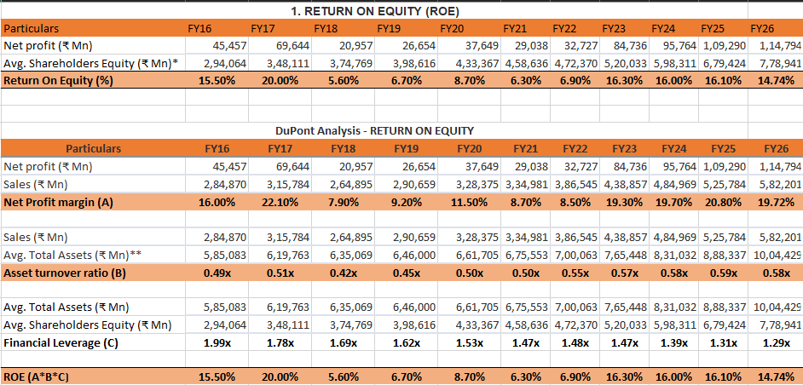
Sun Pharmaceutical Industries Ltd.
EQUITY RESEARCH REPORT
NSE : SUNPHARMA | BSE Code: 524715
Pharmaceuticals & Drugs
DUPONT ANALYSIS
Revenues
Net Profit
Average Total Assets
ROE(%)
ROA(%)
Financial Leverage
1

Slide 19
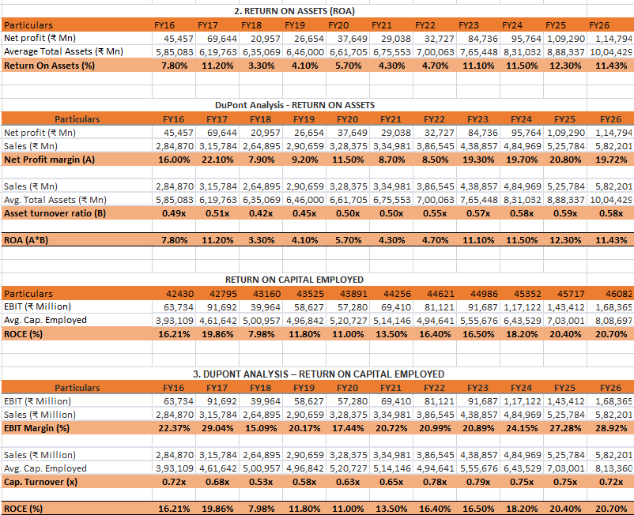
Sun Pharmaceutical Industries Ltd.
EQUITY RESEARCH REPORT
NSE : SUNPHARMA | BSE Code: 524715
Pharmaceuticals & Drugs
COMMENTARY
The ROE of Sun Pharma has remained resilient over the last decade, recovering from a low of 5.60% in FY18 to 14.74% in FY26. This improvement reflects stronger shareholder value creation, supported primarily by expanding profitability, improving asset utilization, and disciplined capital allocation following the successful scale-up of the Global Specialty business. The improvement in ROE has been driven by a steady increase in the Asset Turnover Ratio, which improved from 0.42x in FY18 to 0.58x in FY26, indicating more efficient utilization of assets to generate revenue. At the same time, the Net Profit Margin strengthened significantly from 7.90% in FY18 to 19.72% in FY26, reflecting higher profitability driven by an improved product mix and operational efficiency. Financial Leverage has steadily declined from 1.99x in FY16 to 1.29x in FY26, highlighting the company's conservative capital structure and lower dependence on debt. Despite lower leverage, Sun Pharma has continued to deliver healthy equity returns, demonstrating that profitability growth rather than financial leverage has been the key driver of ROE. The Capital Turnover Ratio improved from 0.53x in FY18 to 0.72x in FY26, while EBIT Margin expanded from 15.09% to 28.92% during the same period. Consequently, ROCE increased from 7.98% in FY18 to 20.70% in FY26, reflecting significantly better capital utilization and reinforcing management's ability to generate stronger returns on invested capital.
1

Slide 20
Sun Pharmaceutical Industries Ltd.
EQUITY RESEARCH REPORT
NSE : SUNPHARMA | BSE Code: 524715
Pharmaceuticals & Drugs
COFFEE CAN INVESTMENT FRAMEWORK
The "Coffee Can Investing Strategy" focuses on holding fundamentally strong companies for the long term with minimal intervention. It emphasizes consistent growth, efficient capital allocation, strong profitability, and durable competitive advantages.
.
Principal Rules of Philosophy
Long-term Perspective – Invest with a horizon of 10 years or more.
Quality Businesses – Focus on companies with strong fundamentals and competitive advantages.
Minimal Intervention – Stay invested through market cycles.
Diversification – Build a portfolio of high-quality businesses.
Comparing Conditions with Sun Pharma
1. The company should have been in existence for at least 10 years.
Sun Pharma satisfies this criterion with a continuous 10-year financial track record (FY16–FY25).
2. Revenue should have grown at least 10% every year over 10 years.
Revenue grew from ₹315,784 Mn (FY17) to ₹582,201 Mn (FY26). However, a 16.1% decline in FY18 resulted in a 10-year CAGR of 6.3%, below the Coffee Can benchmark.
3. ROCE should be at least 15% for 10 years.
Sun Pharma delivered an average ROCE of 16.44%, crossing 15% in 6 of 10 years. ROCE dipped during FY18–FY21 due to Specialty investments but recovered to 20.4% in FY25.
4. Earnings should demonstrate long-term quality.
Although FY18 was impacted by the Specialty transition, profitability recovered steadily, with Adjusted Net Profit reaching ₹124,015 Mn in FY26.
5. The company should generate strong cash flows.
Sun Pharma generates over US$1 billion in operating cash flow annually and held a net cash position of US$3.1 billion as of March 2026.
6. The company should have a competitive edge / MOAT.
Its Global Specialty portfolio, No. 1 domestic leadership, presence in 100+ countries, and 40+ manufacturing facilities provide a durable competitive advantage.
Conclusion
Sun Pharma: Non-Coffee Can but a Quality Structural Compounder
Sun Pharma does not qualify as a strict Coffee Can stock due to inconsistent Revenue Growth and ROCE during FY18–FY21. However, its successful Specialty transformation has strengthened profitability, capital efficiency, and long-term growth.
Recommendation: ACCUMULATE on dips as a high-quality long-term structural compounder
1

Slide 21
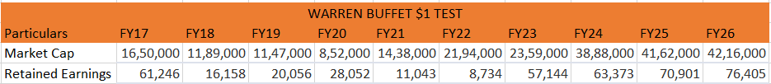
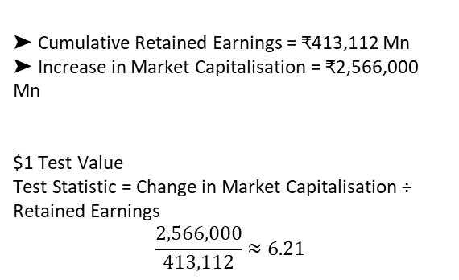
Sun Pharmaceutical Industries Ltd.
EQUITY RESEARCH REPORT
NSE : SUNPHARMA | BSE Code: 524715
Pharmaceuticals & Drugs
WARREN BUFFETT'S $1 TEST
The "One Dollar Test" is a concept attributed to Warren Buffett that evaluates whether management creates shareholder value through retained earnings. The principle states that for every ₹1 retained instead of being distributed as dividends, the company's market value should increase by at least ₹1. A ratio above 1 indicates efficient capital allocation and value creation.
Implications of the $1 Test
Buffett used this test to assess whether management reinvests retained earnings effectively to create long-term shareholder wealth.
A ratio greater than 1 suggests retained earnings have generated value beyond their cost, while a ratio below 1 indicates poor capital allocation.
Key Figures
➤ Cumulative Retained Earnings = ₹413,112 Mn
➤ Increase in Market Capitalisation = ₹2,566,000 Mn
$1 Test Value
Test Statistic = Change in Market Capitalisation ÷ Retained Earnings
$$\frac{2,566,000}{413,112}≈6.21$$
Conclusion
Sun Pharmaceutical Industries Ltd. successfully passes Warren Buffett's $1 Test.
Sun Pharma generated ₹6.21 of market value for every ₹1 of retained earnings, far exceeding Buffett's benchmark of ₹1. The high ratio reflects disciplined capital allocation through investments in the Global Specialty business, R&D, and strategic acquisitions, resulting in significant long-term shareholder value creation. Despite temporary challenges during FY18–FY21, management successfully transformed the business into an innovation-led pharmaceutical company.
Recommendation: MAINTAIN POSITIVE OUTLOOK for long-term investors.
1

Slide 22
Sun Pharmaceutical Industries Ltd.
EQUITY RESEARCH REPORT
NSE : SUNPHARMA | BSE Code: 524715
Pharmaceuticals & Drugs
MARKET INDEX ANALYSIS
Key Takeaways
Sun Pharma delivered strong long-term outperformance driven by its successful Global Specialty strategy and resilient domestic business. While the pharmaceutical sector faced pricing pressure and supply chain challenges, Sun Pharma consistently outperformed through specialty-led growth, volume-driven market leadership, and a strong balance sheet.
FY22-23 highlighted the company's resilience, remaining positive despite weakness in the broader pharmaceutical sector. FY23-24 was the standout year with a 64.08% return, supported by strong specialty sales and 16.5% growth in adjusted net profit. In FY25-26, although the stock declined 4.10%, it significantly outperformed the broader market, reinforcing its defensive characteristics.
Sun Pharma Alpha
The company's long-term outperformance has been driven by the successful transition from traditional generics to a Global Specialty business, reducing dependence on pricing-sensitive products and strengthening its competitive position. Volume-led growth in the domestic business, supported by prescription leadership and new product launches, has created a resilient revenue base. A de-leveraged balance sheet with a net cash position of approximately US$2.9 billion has provided downside protection during volatile market conditions while supporting future growth initiatives.
1

Slide 23
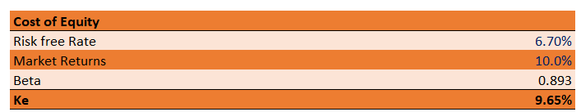
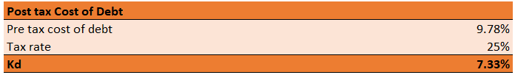
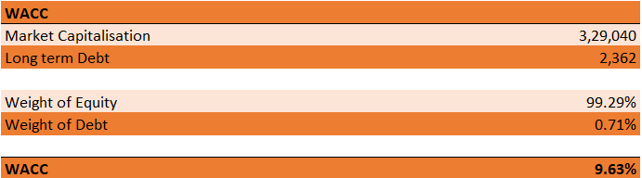
Sun Pharmaceutical Industries Ltd.
EQUITY RESEARCH REPORT
NSE : SUNPHARMA | BSE Code: 524715
Pharmaceuticals & Drugs
DISCOUNTED CASHFLOW VALUATION - WACС
1

Slide 24
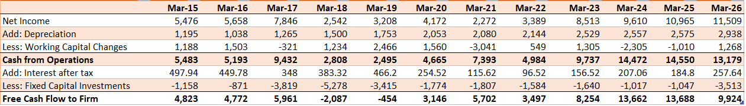
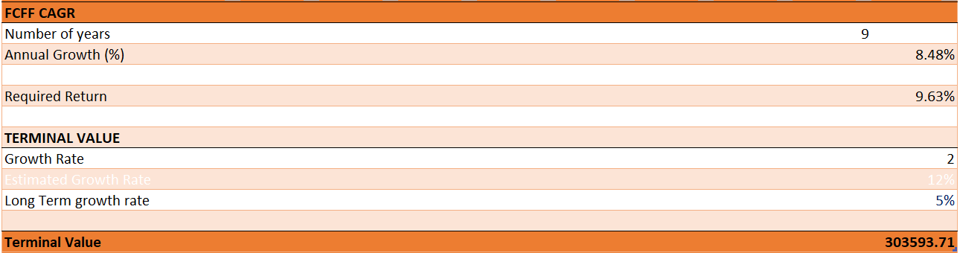
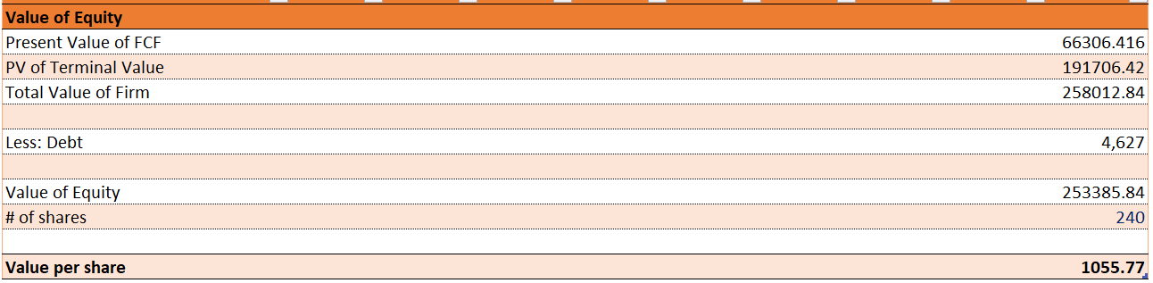
Sun Pharmaceutical Industries Ltd.
EQUITY RESEARCH REPORT
NSE : SUNPHARMA | BSE Code: 524715
Pharmaceuticals & Drugs
1

Slide 25
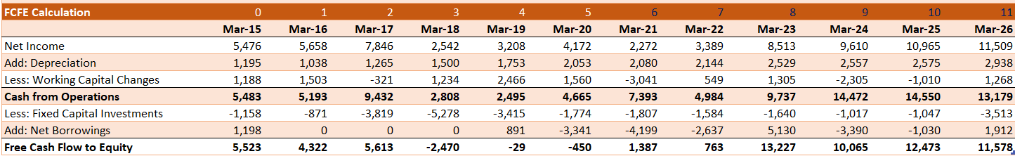
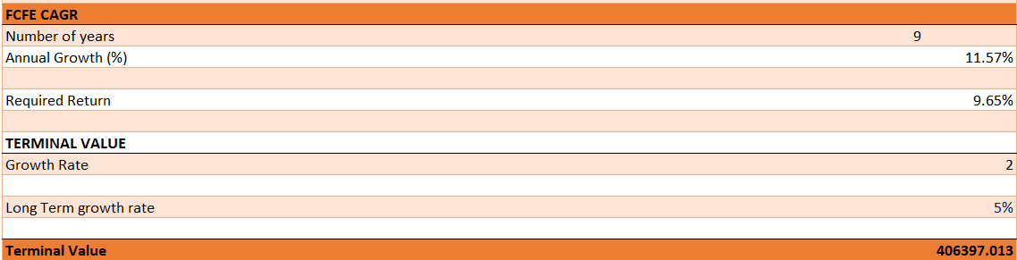
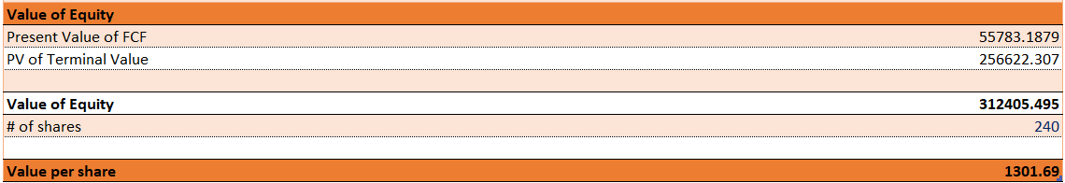
Sun Pharmaceutical Industries Ltd.
EQUITY RESEARCH REPORT
NSE : SUNPHARMA | BSE Code: 524715
Pharmaceuticals & Drugs
1

