Slide 1




Introduction to Sorted Arrays
A sorted array is a data structure where elements are arranged in a specific order, either ascending or descending. This order allows for efficient searching and retrieval of elements.
by keshav reddy

Slide 2
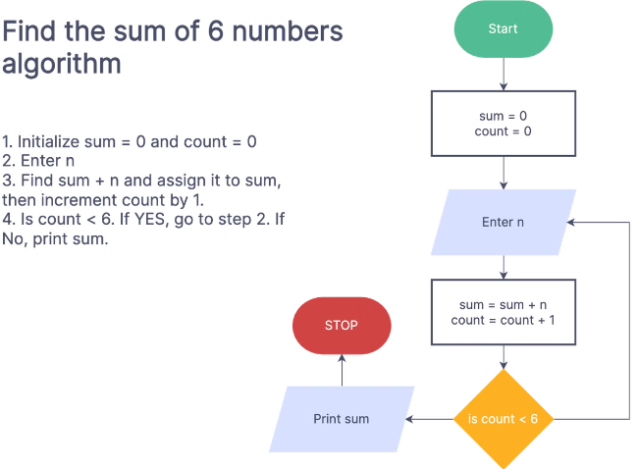
Sorting Algorithms Overview
1
Bubble Sort
2
Insertion Sort
This algorithm repeatedly steps through the list, compares adjacent elements, and swaps them if they are in the wrong order.
It iterates through the list, inserting each element at its correct position in the already sorted sublist.
3
Selection Sort
4
Merge Sort
This algorithm repeatedly selects the minimum element from the unsorted sublist and swaps it with the first element of the sublist.
This algorithm divides the list into smaller sublists, sorts them recursively, and then merges them back together.

Slide 3


Sorting through Instructions
1
Instruction Input
The user provides a series of instructions to manipulate the array.
2
Instruction Parsing
The program interprets the instructions, identifying operations and target elements.
3
Element Manipulation
The instructions are applied to the array, performing operations like swapping, inserting, or deleting elements.

Slide 4
Implementing Sorting Instructions
Instruction Set
Instruction Parsing
Array Manipulation
Define a set of instructions that can be used to manipulate the array, such as "swap," "insert," "delete," or "move."
Implement a parser that can read and interpret the instructions provided by the user, identifying the operation and the target elements.
Implement functions for each instruction that modify the array according to the parsed instructions.

Slide 5
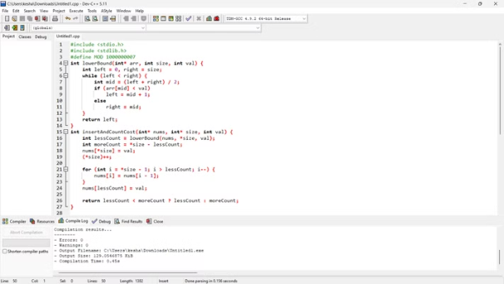
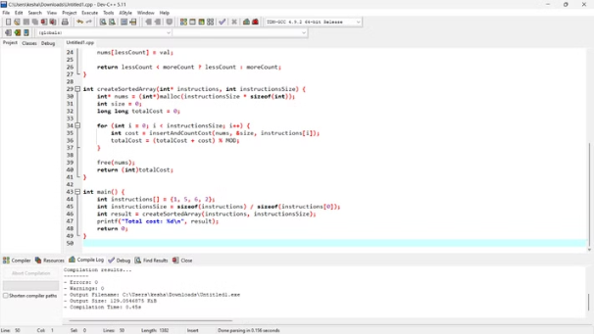
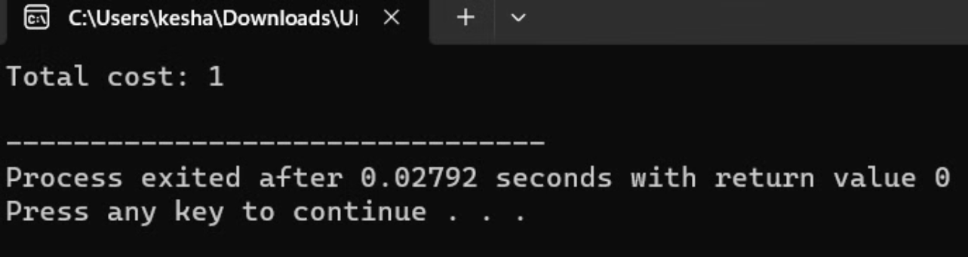
Code and Output

Slide 6




Optimizing Instruction-based Sorting
Instruction Batching
Group similar instructions together to minimize the number of array accesses.
Instruction Preprocessing
Analyze the instructions beforehand to identify potential optimizations.
Data Structure Optimization
Use efficient data structures like heaps or binary search trees to store the array and enable faster manipulation.

Slide 7
Handling Edge Cases and Errors
Empty Array
Handle the case where the input array is empty.
Invalid Instructions
Validate user input to ensure that the instructions are valid and correctly formatted.
Out-of-Bounds Access
Prevent errors that occur when trying to access elements outside the array bounds.

Slide 8




Performance Analysis of Instruction-Based Sorting
Best Case
The best-case scenario for an instruction-based sorting algorithm occurs when the input array is already sorted in ascending order. In this case, the algorithm can simply apply the given instructions without needing to perform any significant rearrangements, making the time complexity O(n), where n is the size of the array.
Worst Case
The worst-case scenario happens when the input array is in descending order, the reverse of the desired sorted state. This requires the algorithm to perform the maximum number of operations, such as repeatedly swapping or inserting elements, to sort the array. In the worst case, the time complexity of the algorithm becomes O(n^2), resulting in a significant performance impact.
Average Case
The average case refers to the typical performance of the algorithm when the input array is in a random order. In this scenario, the number of operations required to sort the array falls somewhere between the best and worst cases, with a time complexity of O(n log n). This is the expected performance for most inputs, making it a crucial metric for understanding the overall efficiency of the instruction-based sorting algorithm.

Slide 9
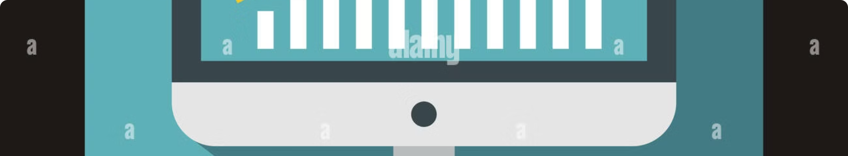
Analyzing Time and Space Complexity
Time Complexity
Space Complexity
Analyze the time taken by the algorithm to sort the array based on the number of elements.
Determine the amount of additional memory used by the algorithm, excluding the space occupied by the input array.

Slide 10


Conclusion and Key Takeaways
Instruction-based sorting allows for flexible and customizable array sorting by providing a clear and concise way to specify the desired order. By carefully considering edge cases, optimizing instructions, and analyzing complexity, we can create efficient and reliable sorting solutions.

