Slide 1
VISUAL TEACHING DECK
From RL basics to TRL GRPO
State
Action
>
choose tool or token
A framework-by-framework learning path for agentic ML systems: vLLM, MCP, LangGraph-style agents, Agent Lightning, RULER/ART, TRL, GRPO, and Streamlit evidence.
^
Policy
v
Update
Reward
<
Learning goal
By the end, the audience can explain how grouped agent rollouts become relative rewards, and how TRL GRPO turns that feedback into a deployable adapter.
Agentic ML RL concepts -> TRL GRPO demo
01

Slide 2
RL 101
Reinforcement learning is a feedback loop
The model is not given the answer directly. It acts, observes a score, then shifts future behavior.
Environment
State
Action
Reward
Policy update
task + tools + constraints
>
what the policy can see
>
token, tool call, or plan
>
numeric feedback
>
make good actions likelier
Simple example
LLM translation
A robot chooses left or right. Left hits a wall: reward -1. Right reaches goal: reward +1. The policy increases probability of right next time.
An LLM agent chooses whether to inspect schema, train GBM, log MLflow, or skip explainability. Reward tells it which workflow was better.
Agentic ML RL concepts -> TRL GRPO demo
02

Slide 3
AGENTIC RL
For agents, actions are workflow decisions
The RL surface is not only next-token text; it is tool choice, sequencing, constraints, and evidence quality.
Classic LLM action
Predict the next token in a response.
1
Inspect schema
v
v
Agentic action
2
Pick model plan
Call postgres_get_dataset_schema, plan preprocessing, launch GBM benchmark, log artifacts, ask critic.
v
3
Execute sandbox
v
4
Log + explain
What reward can teach
Prefer workflows that are accurate, reproducible, tool-safe, and explainable.
Agentic ML RL concepts -> TRL GRPO demo
03

Slide 4
VLLM BASELINE
Hosting a model is not the same as improving it
vLLM gives fast inference and OpenAI-compatible endpoints. RL tells the policy which behaviors should become more likely.
Base model on vLLM
Agent runtime
No RL feedback yet
Qwen responds to prompts and tool instructions.
>
The system wraps responses into tool calls and trajectories.
>
The model can act, but the project-specific workflow is not optimized.
Useful: fast serving, batching, endpoint parity.
Useful: converts text decisions into auditable steps.
Risk: missing MLflow, weak sequencing, raw-row violations.
DEMO CONTRAST: baseline endpoint vs tuned endpoint
Agentic ML RL concepts -> TRL GRPO demo
04

Slide 5
SFT CONTRAST
SFT imitates answers; GRPO optimizes choices
This project's current Track B path is TRL GRPO. SFT is shown here as a useful contrast, not the default run.
Method
Training data
Loss signal
What it teaches
QLoRA SFT
prompt -> best answer
token cross entropy
imitate known good completions
TRL GRPO
task -> N rollouts
relative reward advantage
prefer better workflows
DPO
chosen vs rejected pairs
preference objective
follow pairwise preferences
PPO
rollouts + reward model
policy ratio + value baseline
online RL with value model
SFT demo line
GRPO demo line
I can show the model examples of the ideal answer style, so it learns to imitate that format.
I can let the agent try multiple workflows, score them, then train it to choose the higher-reward workflow next time.
Agentic ML RL concepts -> TRL GRPO demo
05

Slide 6
TECHNIQUE MAP
LLM alignment methods add feedback
Each step gives the model a stronger learning signal, but also asks for more infrastructure.
SFT
>
DPO
>
PPO
>
GRPO
learn from answers
learn from preferences
learn from rewards + value model
learn from group-relative rewards
imitation
more project-specific feedback
GRPO in plain English
One task can produce several trajectories. Ranking them creates a local comparison group. In practice: run the same OpenML task four ways, reinforce above-average rollouts, and discourage below-average rollouts. The group average acts like the baseline, so GRPO does not need a separate value model.
Agentic ML RL concepts -> TRL GRPO demo
06

Slide 7
TRL FRAMEWORK
TRL gives us the trainer layer
The framework contains sibling trainers. Our project path uses GRPOTrainer-style training, while SFTTrainer remains the imitation-learning reference point.
REFERENCE ONLY
CURRENT TRACK B
SFTTrainer / QLoRA SFT
GRPOTrainer / TRL GRPO
Input: curated prompt-response pairs
Objective: imitate target answer tokens
Adapter: LoRA/QLoRA can make it memory efficient
Best for: teaching answer format and baseline behavior
Input: prompts plus grouped rollouts
Objective: increase high-advantage completions
Adapter: trained on trajectory reward signal
Best for: improving tool choice, sequence, guardrails
same library, different signal
>
Demo question
SFT answers
GRPO answers
Our stance
What got better?
format imitation
decision quality
show GRPO as default
Agentic ML RL concepts -> TRL GRPO demo
07

Slide 8
GRPO MECHANICS
Group rollouts turn one task into a lesson
For a single task, the agent tries several trajectories. The group mean creates positive and negative advantages.
Task: openml_31_german_credit
traj_A
reward 0.92
adv +
schema -> GBM -> MLflow -> SHAP
GRPO update
traj_B
reward 0.75
adv +
good workflow, weaker explainability
Increase probability of A/B behavior
Decrease probability of C/D behavior
>
traj_C
reward 0.45
adv -
missing MLflow
traj_D
reward 0.05
adv -
raw-row boundary issue
relative reward = score - group mean
Agentic ML RL concepts -> TRL GRPO demo
08

Slide 9
RULER / REWARD SCORING
Rank trajectories into reward feedback
RULER can be a judge layer; the project also has hybrid reward components for deterministic evidence.
Reward breakdown: strong trajectory
Rank 1: traj_A
1.0
0.9
0.9
1.0
1.0
0.0
Correct classifier, safe MCP use, strong metrics, MLflow logging, SHAP artifacts.
rank
Rank 3: traj_C
>
Partial workflow, missing MLflow, incomplete artifact manifest.
Data
Model
Explain
Tracking
Tool use
Violation
Rank 4: traj_D
Raw-row boundary violation or failed execution. Negative signal for future policy updates.
Agentic ML RL concepts -> TRL GRPO demo
09

Slide 10
AGENT LIGHTNING
Decouple agent execution from RL training
The agent can keep its normal workflow while the Lightning layer collects transitions and rewards for training.
Agent runtime
rollout()
>
tool + LLM spans
normal agent code
trace evidence
Lightning bridge
v
state, action
>
reward
>
grouped rollouts
transition tuples
hybrid / RULER score
task_id batches
<
v
Trainer
v
TRL GRPO
>
vLLM redeploy
train adapter
serve tuned policy
Agentic ML RL concepts -> TRL GRPO demo
10

Slide 11
MCP + POSTGRESQL
The tool layer controls what the agent is allowed to see
Project MCP exposes safe metadata operations; raw rows stay outside ordinary LLM context.
Agent asks
MCP tool
PostgreSQL
What is task openml_44?
>
postgres_get_task_metadata
postgres_get_dataset_schema
>
registry + schema + summaries
No raw rows in ordinary LLM context
v
v
Safe response
Execution path
schema, stats, artifact manifest, reward history
sandbox code may read data under guardrails
Agentic ML RL concepts -> TRL GRPO demo
11

Slide 12
LANGGRAPH-STYLE MULTI-AGENT SKILLS
Each specialist contributes a different kind of evidence
The audience should see the roles as skill stations, not just code modules.
>
>
>
Orchestrator
Data Engineer
GBM Specialist
Critic
routes task and state
schema, splits, leakage checks
benchmark plan + model choice
guardrails + artifact review
RL skill exercise
Reward does not only grade final accuracy. It also grades whether the agent used the right specialist at the right time and left reproducible evidence.
Agentic ML RL concepts -> TRL GRPO demo
12

Slide 13
OPENML + TRACK A
Track A is the practice environment
Before training a policy, the project needs tasks, evidence, and a repeatable scoreboard.
openml_31
openml_44
German credit
reward 0.843
Spambase
reward 0.9085
openml_1461
openml_1489
Bank marketing
reward 0.8776
Phoneme
reward 0.7710
Ingest
>
Benchmark
>
Track artifacts
>
Score rollout
Agentic ML RL concepts -> TRL GRPO demo
13

Slide 14
TRACK B TRL GRPO
The training handoff is compact but meaningful
Grouped rollout data becomes a policy adapter, then vLLM serves the tuned endpoint.
Prompt dataset
Grouped rollouts
TRL GRPOTrainer
LoRA adapter
task instructions + safe context
>
4 task groups
20 examples
>
relative advantages
hybrid reward
>
trained
fallback_used=false
What GRPO tries to improve
What the demo should not overclaim
Tool choice, workflow ordering, guardrail avoidance, MLflow completeness, SHAP/explainability decisions, and final task reward.
Current benchmark shows infrastructure success and no regression, not a measured reward lift yet.
Agentic ML RL concepts -> TRL GRPO demo
14

Slide 15
READING SUCCESS
Training metrics are not enough for agentic systems
A good demo separates trainer health from redeployed policy behavior.
16
4
trained
false
initial trajectories
grouped rollout groups
adapter status
fallback used
Track A no-LLM pass
one group per OpenML task
trainer=trl_grpo
real Track B path
Policy
Tasks
Avg reward
Success
Live endpoint
initial_no_llm
16
0.85
1.0
0.0
baseline_llm
4
0.85
1.0
1.0
trackb_redeploy_llm
4
0.85
1.0
1.0
Honest interpretation
The run proves the GRPO infrastructure and redeploy loop. The next benchmark should target larger reward spread and held-out tasks to show policy lift.
Agentic ML RL concepts -> TRL GRPO demo
15

Slide 16
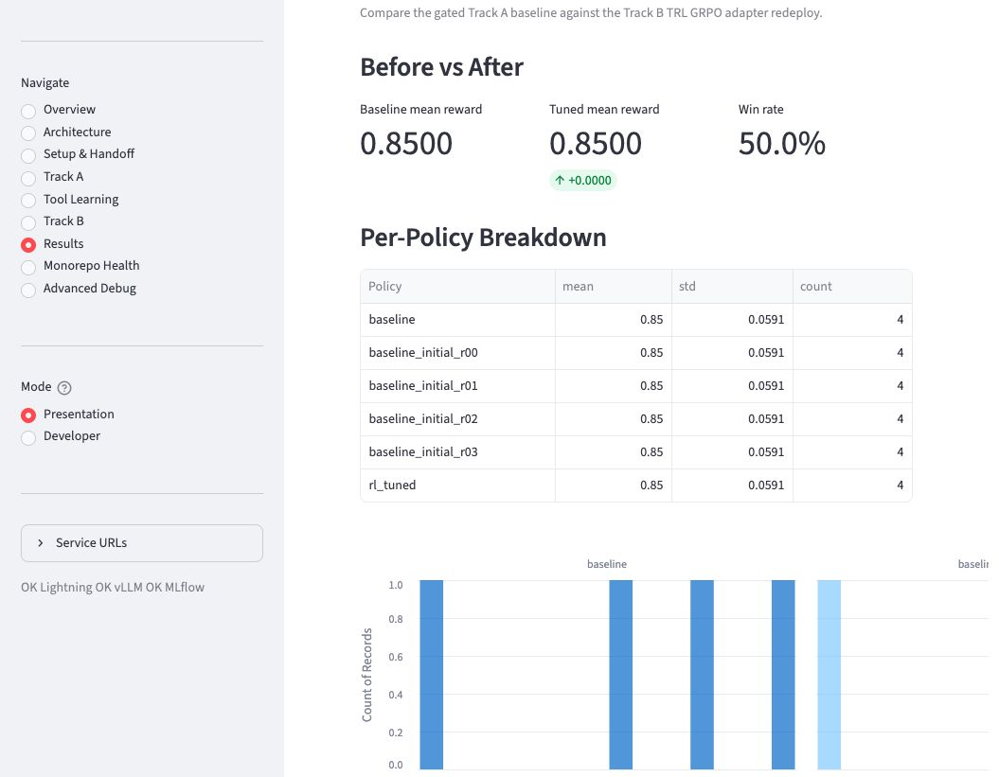
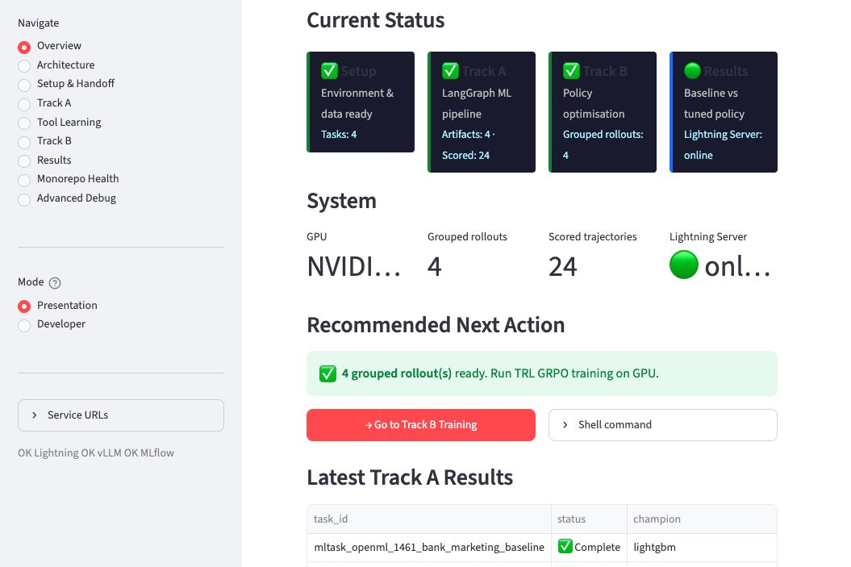
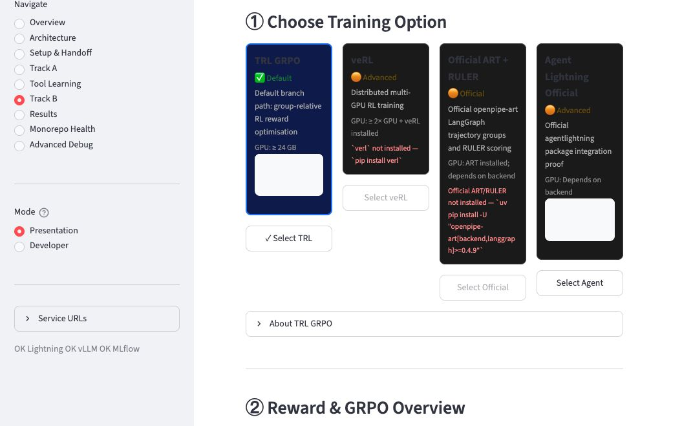
STREAMLIT EVIDENCE
Show the live dashboard as the final proof point
Use this slide in presentation mode when you transition from concepts to the running demo.
Talk points
1. Sidebar shows service health: Lightning, vLLM, MLflow.
2. Track B is configured as TRL GRPO, not SFT.
3. Results view compares initial, baseline live, and Track B redeploy.
4. Evidence screenshots are checked into the repo so a fresh checkout can render the same dashboard views.
repo evidence: docs/evidence/streamlit/*.jpg
Agentic ML RL concepts -> TRL GRPO demo
16

