Slide 1

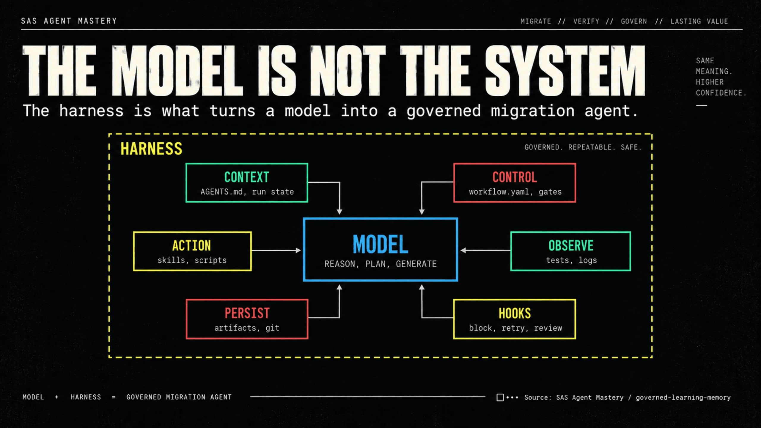
Notes:
Before I show Copilot execution, this is the most important framing. The model is not the system. The system is the harness around the model: instructions, workflow, skills, contracts, validators, gates, and reviews. That harness is what prevents a free-form code generator from becoming an uncontrolled migration process. In our SAS migration, humans still own meaning, evidence, and verdict.
So when I show Copilot chat in the next slides, remember: chat is only the interface. The repo is the control system.

Slide 2

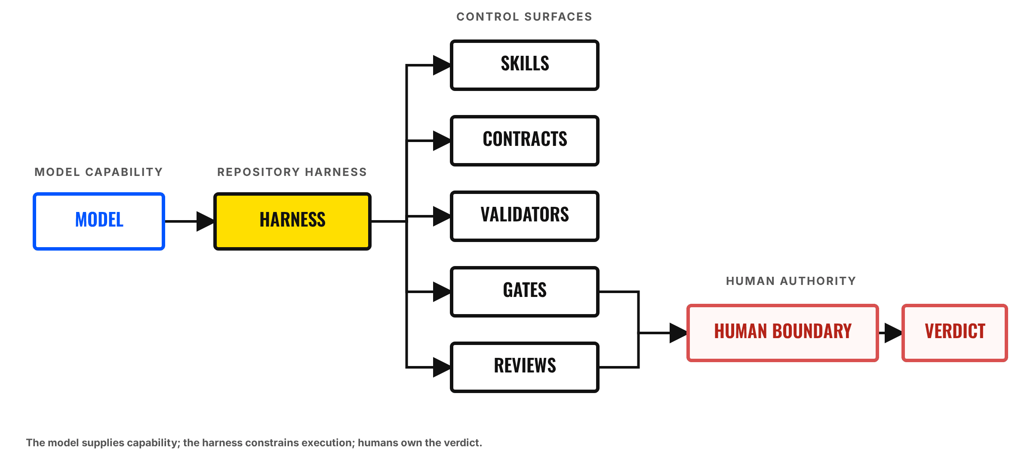
HOW THE HARNESS GOVERNS THE MODEL
Exact Mermaid flow: model → harness → controls → human boundary → verdict.

Slide 3
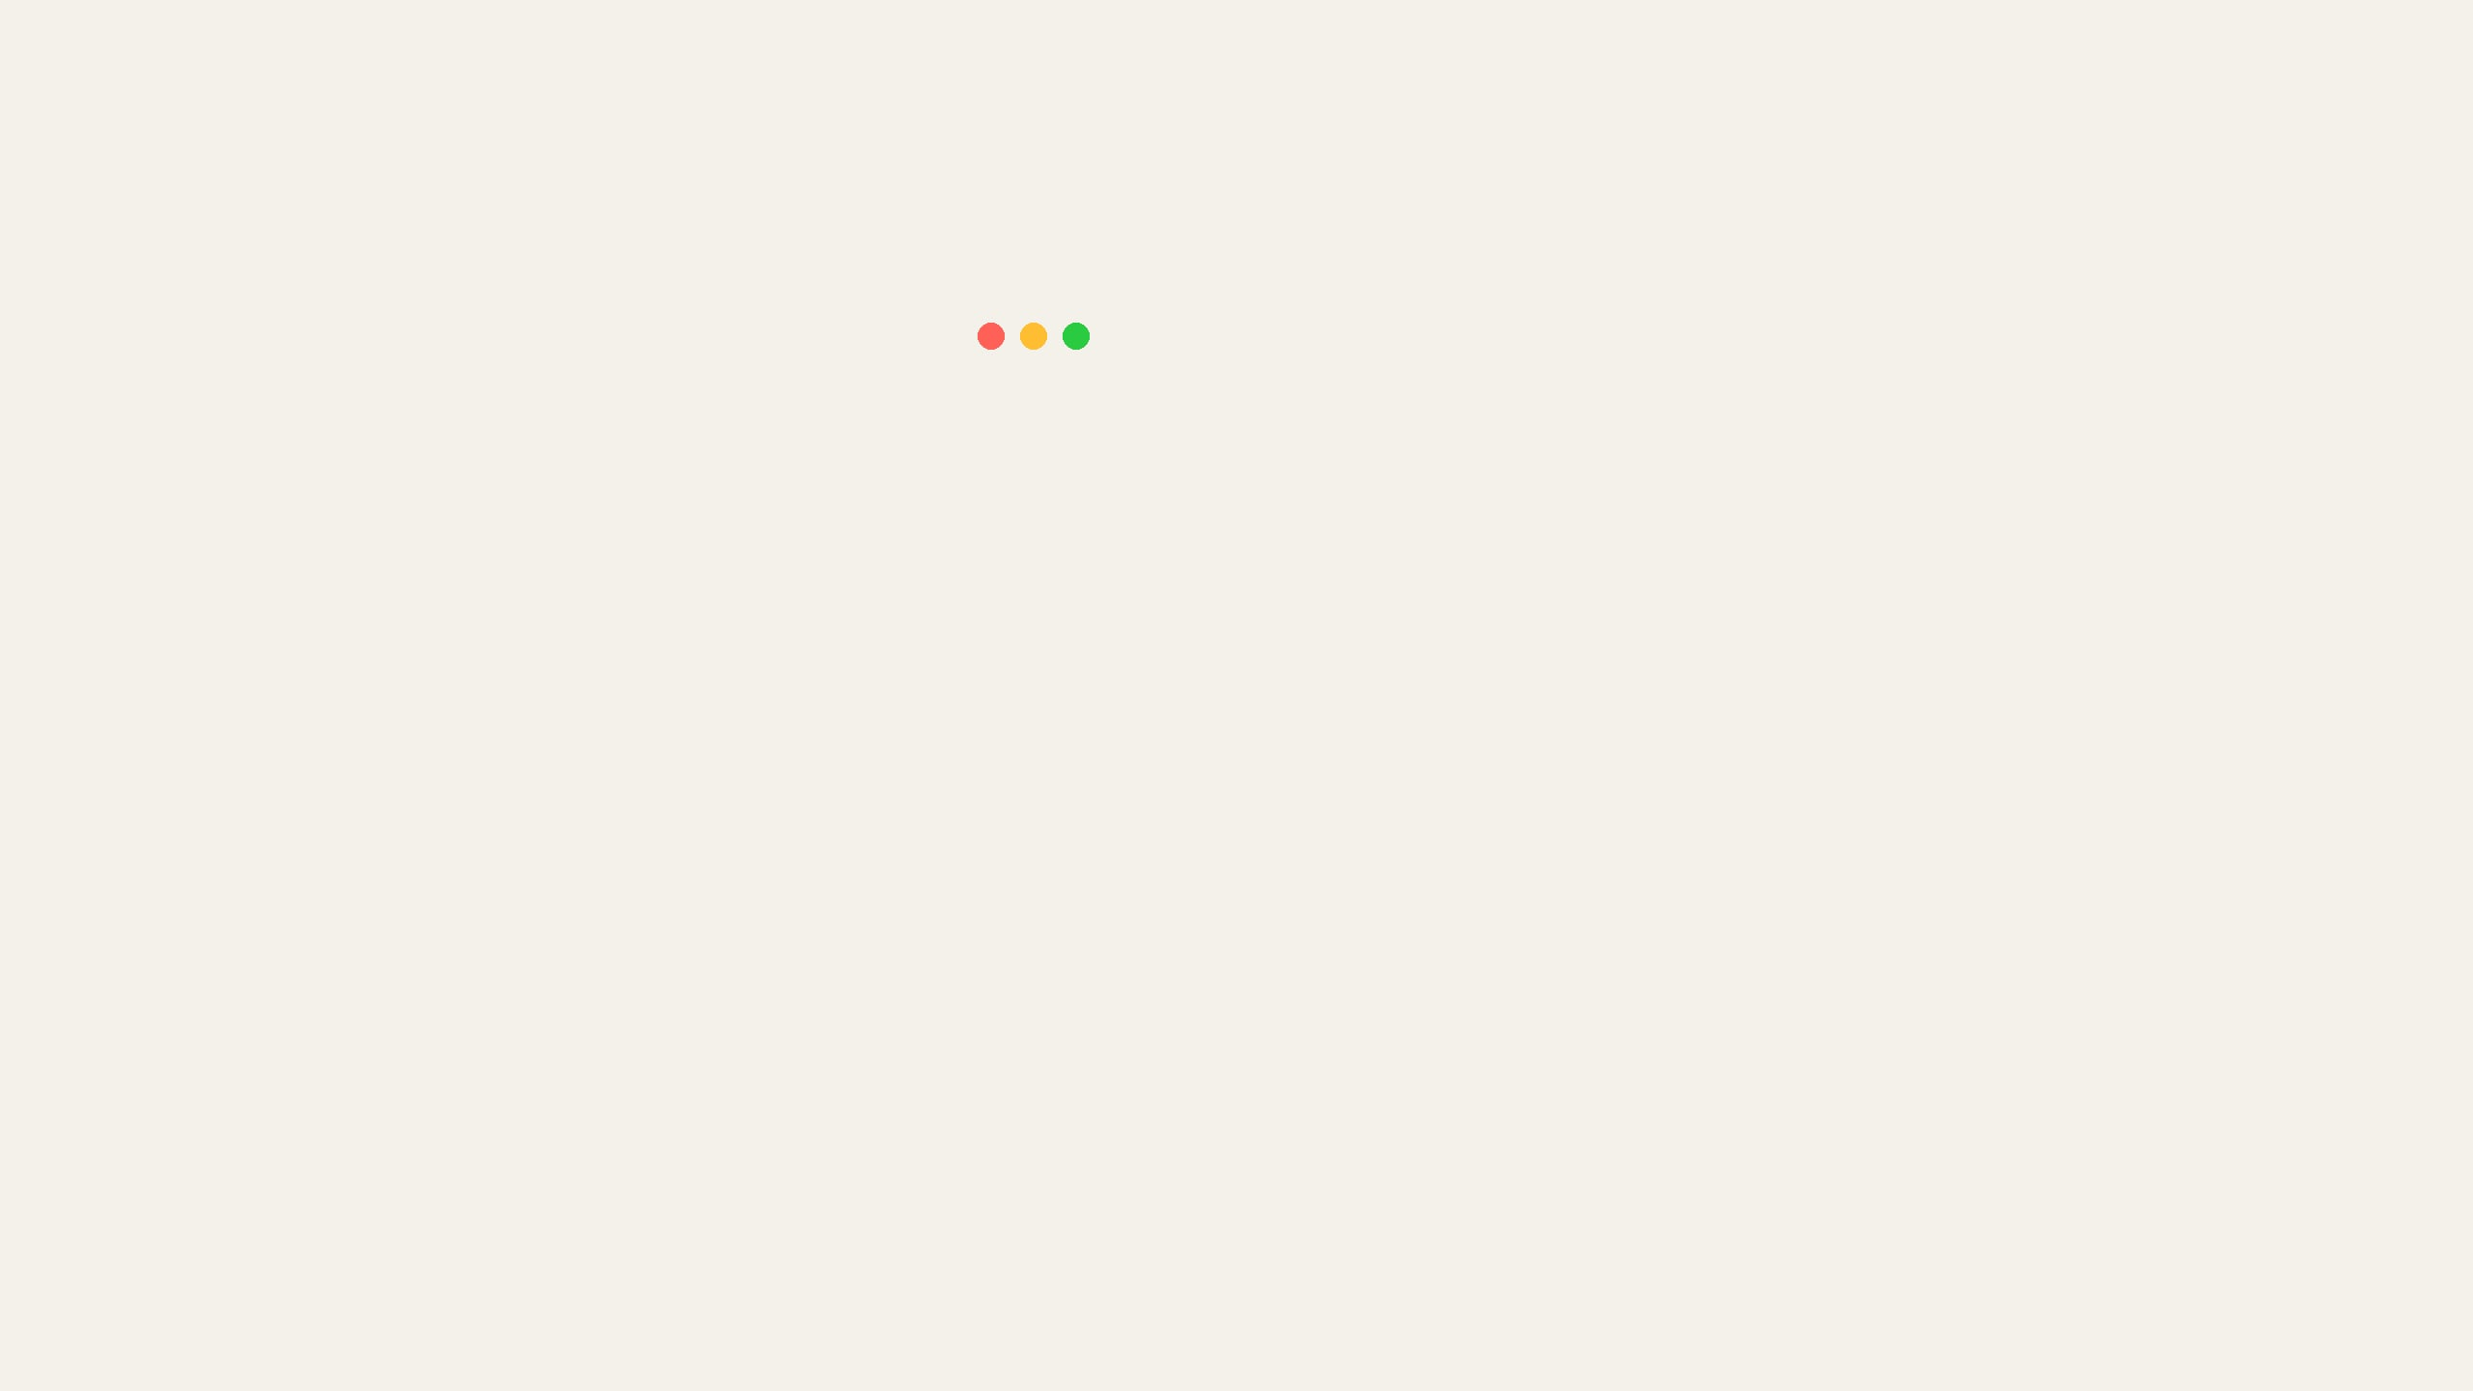
WHAT COPILOT READS FIRST
The instruction file forces AI into a governed loop.
.github/copilot-instructions.md
1
LOAD THE CONTRACTS
Copilot follows AGENTS.md and workflow.yaml as authority.
1
# Copilot Instructions
2
1
3
Follow root `AGENTS.md` and
2
PROVE, RECORD, STOP
4
`config/workflow.yaml` as the
5
authoritative contracts.
Each run invokes one authorized skill, produces evidence, and stops.
6
...
11
For every user-facing prompt:
12
2. Invoke `orchestrate`.
13
3. Select exactly one authorized skill.
2
14
5. Require canonical output and
15
`PASS/FAIL/BLOCKED` evidence.
16
7. Stop after one skill.
STEP 1: THE REQUEST
SOURCE: .GITHUB/COPILOT-INSTRUCTIONS.MD
Notes:
Here is exactly what the repo forces Copilot to do. This is the top-level instruction file. It does not say 'migrate code'. It says: follow the contract, check the run state, invoke exactly one authorized skill, produce evidence, and stop.

Slide 4

AGENTS.MD: THE OPERATING CONTRACT
What to read, what may run, and who owns each decision.
1
READ ORDER
AGENTS.md
MARKDOWN PREVIEW
Forces the AI to load the business constraints, run state, and exact stage rules.
Agent Operating Contract
1
Mandatory read order
2
SKILL SEQUENCE
1
config/project.yaml
Defines the only permitted order of execution.
2
config/workflow.yaml
3
active module SPEC + ADR
3
ROLES & AUTHORITY
4
artifacts/run_state/<run-id>.json
Separates analysis, building, diagnosis, checking, routing, and human approval.
5
.github/skills/<verb>/SKILL.md
2
Canonical skill sequence
interview → specify → decide
→ trace → map → model
→ generate → test → validate
→ review → release
3
Authority boundaries
ANALYST — define behavior
MAKER — build or repair
EXPLORER — diagnose only
CHECKER — verify only
ORCHESTRATOR — route and stop
HUMAN — approve and release
STEP 2: THE CONTRACT
SOURCE: AGENTS.MD
Notes:
This is the contract that the instructions refer to. It names what Copilot must read and the exact skill sequence it must follow. It also separates six roles: the analyst defines behavior, the maker builds, the explorer diagnoses, the checker verifies, the orchestrator routes, and the human approves. The next slide shows how those role boundaries become handoffs during execution.

Slide 5
WHAT CHANGED: FROM ONE AI TO GOVERNED HANDOFFS
The previous slide defined the roles. This slide shows how those roles become real during execution.
BEFORE: ONE OPAQUE ACTION
NOW: EXPLICIT ROLE HANDOFFS
Prompt → AI performs requirements + code + test + approval
→
›
›
›
ANALYST
MAKER
CHECKER
HUMAN
Defines intent
Builds
Verifies
Approves
No clear separation of responsibility or evidence ownership.
Every handoff produces an artifact, gate result, and durable state update.
HOW THE REPOSITORY MAKES THE CHANGE ENFORCEABLE
1
2
3
4
AGENTS.md
config/workflow.yaml
.github/skills/*/SKILL.md
artifacts/run_state/*.json
DEFINES
ENFORCES
EXECUTES
RECORDS
Names the roles and separates what each one may and may not do.
Controls order, gates, retries, and the one-skill-per-prompt rule.
Gives the active role one bounded procedure, output, and stop condition.
Preserves which skill ran, its result, and what role may act next.
Maker builds
Checker validates
Human approves
one_skill_per_prompt: true
self_approval_forbidden: true
Trigger → Inputs → Workflow
Output → Verify → Stop
status: PASS
next: review
Bottom line: Roles move from labels in a document to auditable handoffs in the running system.
THE OPERATING-MODEL CHANGE
DEFINED → ENFORCED → EXECUTED → RECORDED

Slide 6
BUSINESS REQUEST TO GOVERNED EXECUTION
A SAS migration prompt becomes one controlled stage, one artifact, and one gate.
1
BUSINESS REQUEST
“Migrate SAS scoring to Python.”
USER PROMPT
↓
2
Load repository rules, authority boundaries, and stop conditions.
copilot-instructions.md
+ AGENTS.md
OPERATING CONTRACT
↓
3
Determine which stages, gates, and recovery paths are allowed.
ROUTE MAP
config/workflow.yaml
↓
4
Find where this migration stopped and what evidence already exists.
artifacts/run_state/
<run-id>.json
CURRENT STATE
↓
5
Authorize exactly one permitted migration action.
orchestrate/
SKILL.md
NEXT SKILL
↓
6
HUMAN APPROVAL
WHEN REQUIRED
EVIDENCE GATE
Artifact + SHA-256 + PASS / FAIL / BLOCKED
ONE STAGE
ONE ARTIFACT
ONE GATE
ONE NEXT MOVE
No uncontrolled multi-step run
Named and hash-addressed
Explicit result and stop point
Derived from durable state
BUSINESS INTENT → CONTROLLED EXECUTION
ONE STAGE · ONE ARTIFACT · ONE GATE

Slide 7

INSIDE ORCHESTRATE: THE CONTROLLER
Its outline tells Copilot exactly how to route work and when to stop.
TRIGGERS & INPUTS
orchestrate/SKILL.md
MARKDOWN PREVIEW
1
Called by user prompts; requires explicit intent and the durable run state.
Orchestrate
1
3
Trigger
Boundaries
2
THE ROUTING LOOP
Use whenever a prompt requests
new
,
resume
,
restart
, stage
Do not perform specialist analysis, generate code, approve evidence, change protected artifacts, skip a stage, cross a human gate, or declare release.
Read state → Select exactly one skill → Update state → Stop at the gate.
continuation, failure recovery, or review.
Required inputs
Explicit user intent and module ID
A generated approval message is a proposed user action and must never be recorded as approval until the human sends it.
Latest durable run-state JSON
4
Workflow transition contract
Stop conditions
3
AGENT BOUNDARIES
Previous stage artifact, hash, and gate result
Forbidden to generate code, fake approval, or skip a stage.
2
Stop on missing or contradictory state, invalid transition, missing artifact, hash mismatch, dirty protected path, unavailable decision owner, repeated failure without new evidence, or exhausted attempt limit.
Workflow
Classify user intent (new, resume, restart, recover).
Read run state and verify against
workflow.yaml
.
Select exactly one permitted skill.
CANONICAL OUTPUTS & VERIFICATION
4
HARD STOP CONDITIONS
Require its named artifact and
PASS/FAIL/BLOCKED
.
OUTPUT
artifacts/run_state/<run-id>.json
Forces the agent to pause when human input or a valid state is required.
Update durable state atomically.
CHECKS
transition · exactly one skill · protected paths · next-action hashes
Stop after every skill invocation and at every human gate.
Write the complete copy/paste next message.
Bottom line: The orchestrator is the only thing the prompt actually invokes.
ACTUAL ORCHESTRATE/SKILL.MD OUTLINE
RENDERED MARKDOWN PREVIEW

Slide 8

WHAT ORCHESTRATE CONTROLS
It does not do the work. It authorizes one controlled turn.
USER PROMPT
→
ORCHESTRATE
reads the current run state
requests an outcome
ONE CONTROLLED TURN
↓
✓
Selects one next action—never the whole migration.
1
ROLE
Who is allowed to act?
2
✓
Requires a named artifact before progress.
SKILL
What single action may run?
3
ARTIFACT
✓
Records the verdict and updates durable state.
What durable evidence must return?
4
GATE
✓
Cannot cross a human approval boundary.
Did the step PASS, FAIL, or BLOCK?
5
RUN STATE
What move is permitted next?
NEXT PROMPT OR APPROVAL
returns control to orchestrate
STOP AFTER ONE SKILL
Orchestrate is the traffic controller: one role, one skill, one artifact, one gate, then stop.
Notes:
This is the connection from the previous slide. Orchestrate is not the worker. It is the traffic controller. It decides which role may act, which skill may run, what artifact must come back, which gate must pass, and what state gets recorded before stopping.

Slide 9

EVERY SKILL FOLLOWS THE SAME CONTRACT
One job, one artifact, one verification point, then stop.
BEFORE
DURING
AFTER
Check trigger
Follow ordered workflow
Write artifact
Check inputs
Stay inside boundary
Execute verification
Check assumptions
Produce only allowed output
Record evidence
Check gate
Hand off or stop
APPLIES TO: INTERVIEW · SPECIFY · TRACE · MAP · MODEL · GENERATE · TEST · VALIDATE · REVIEW
Repeatability comes from the contract, not from the model remembering what to do.
Notes:
This is why the workflow is repeatable. Interview, specify, trace, map, model, generate, validate - each skill follows the same contract. Before it runs, it checks inputs. During execution, it stays inside its boundary. Afterward, it writes evidence and stops.

Slide 10
THE FIVE-ACT MIGRATION JOURNEY
The repo moves from business intent to verified evidence in controlled acts.
ACT 1 · ALIGN
ACT 2 · RECONSTRUCT
ACT 3 · PROVE LOCALLY
ACT 4 · OPERATE
ACT 5 · LEARN
Adapt
Interview
Trace
Repeated Evidence
Generate
Ingest
Specify
Map
Candidate Pattern
Test
Review
Decide
Model
Human Promotion
Validate
Release
The sequence prevents discovery, implementation, checking, and approval from collapsing into one opaque AI action.
Notes:
Now the full migration flow becomes easier to understand. Act 1 aligns intent. Act 2 reconstructs SAS meaning. Act 3 builds and proves Python locally. Act 4 handles selected runtime proof and release. Act 5 learns only from repeated accepted evidence.

Slide 11
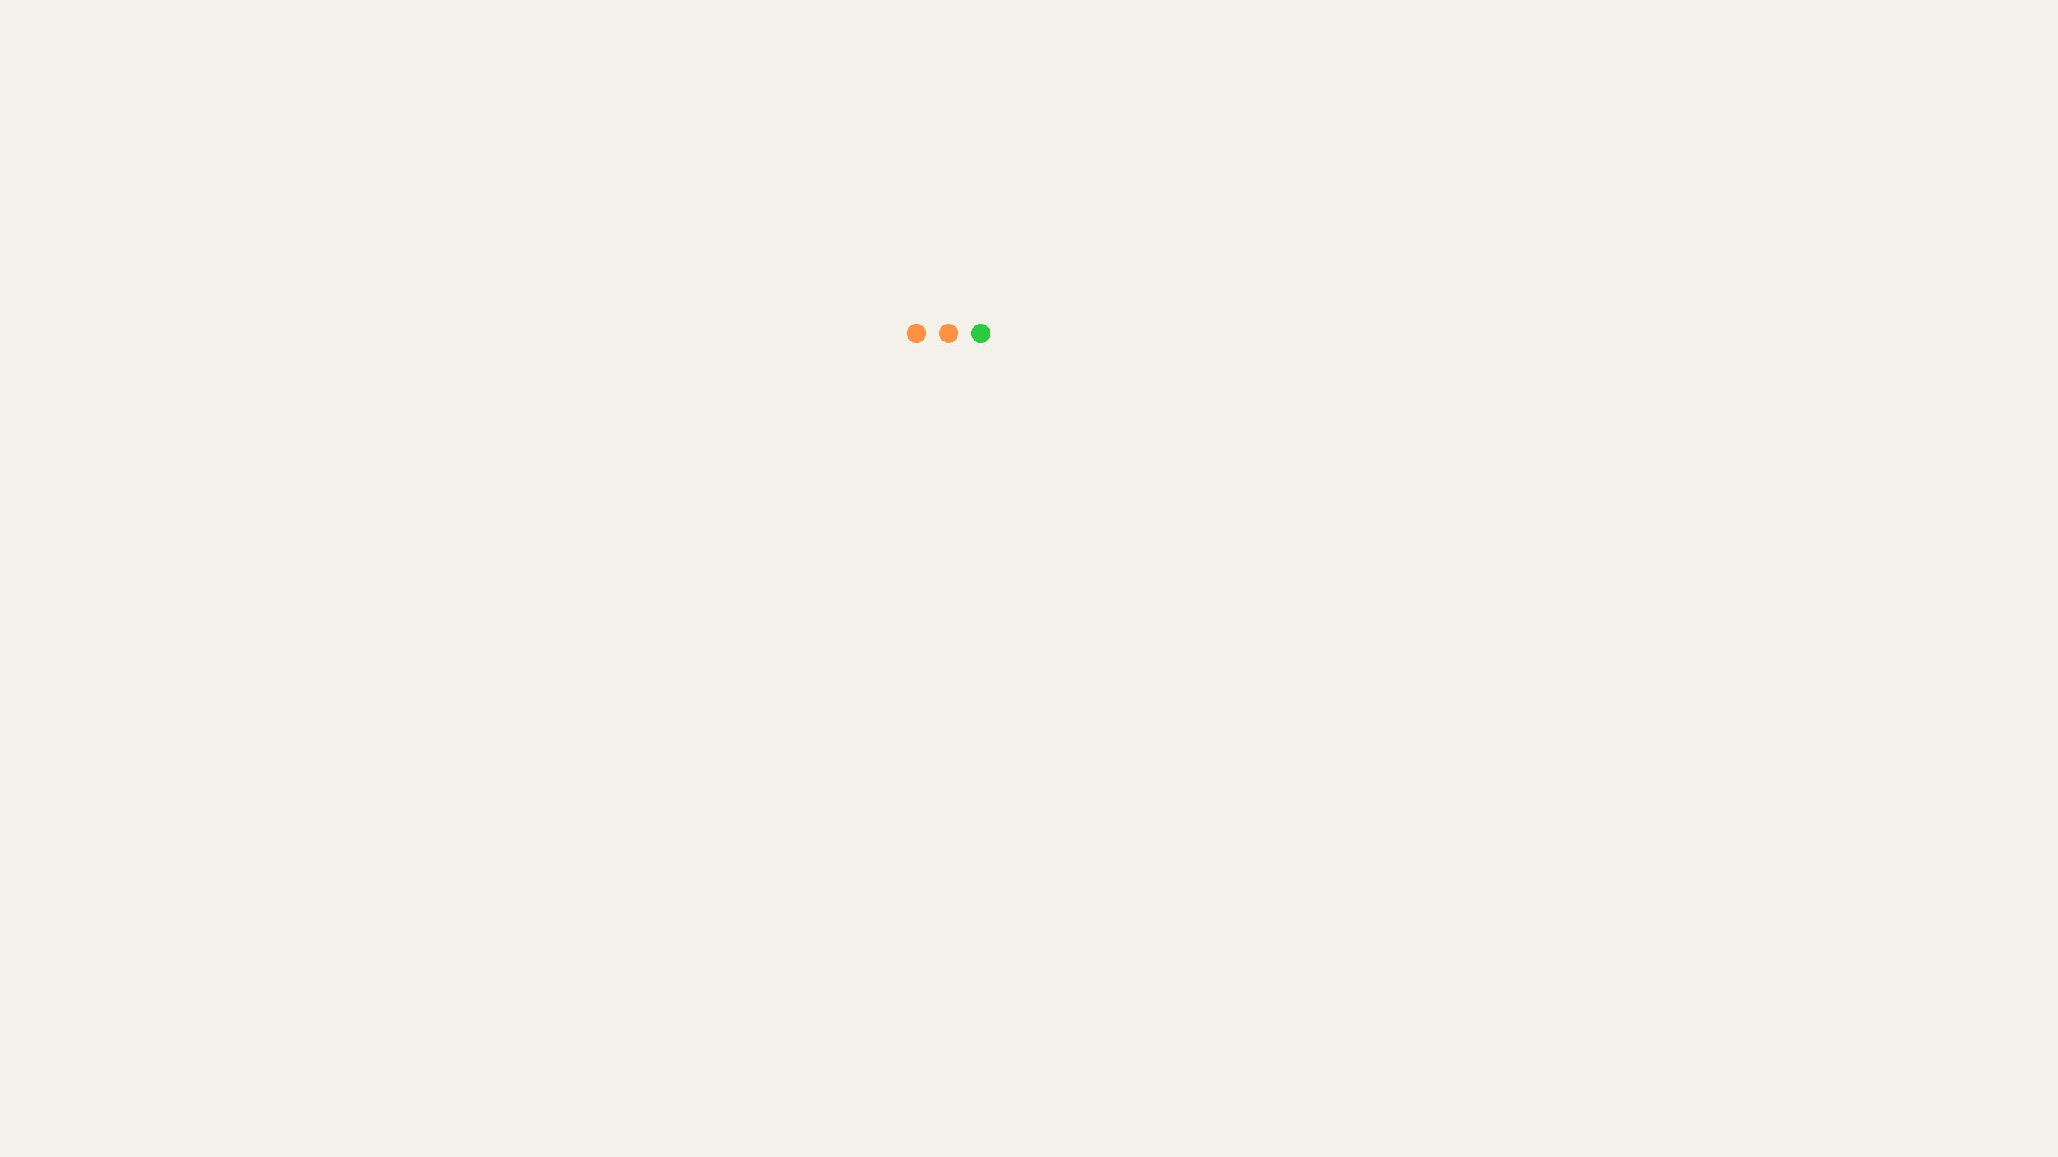
ACT 1: THE REQUEST ENTERS THE GOVERNED FLOW
WHAT THE REPO DOES
COPY-READY COPILOT MESSAGE
1
Understand the request
GITHUB COPILOT
USER
2
Create or resume a run
/start-migration new LC-LOGIT-01
Request a score-only SAS-to-Python migration with keyed tie-out.
Record only local_tieout_requested: true.
Present the population choices; do not choose one for me.
Invoke exactly one authorized skill.
Stop at the next human gate.
3
Read intake evidence
4
Route to interview
5
Stop before human decisions
Business meaning: Copilot receives the business intent, but the repo prevents it from jumping to code.
Notes:
On the right is the actual prompt I type into Copilot. On the left is what the repo forces Copilot to do. It does not start coding. It opens a governed run, reads the intake evidence, routes to interview, and stops before making decisions that belong to a human.

Slide 12

ACT 1: THE FIRST HUMAN DECISION
WHAT THE REPO DOES
COPILOT ASKS; HUMAN DECIDES
1
Present proof options
GITHUB COPILOT
2
COPILOT
Explain trade-offs
To proceed with keyed tie-out, select your proof boundary:
- GOVERNED_SAMPLE_50
- FULL_POPULATION
- PHASED_50_THEN_FULL
- CUSTOM_GOVERNED_SAMPLE
3
Human selects boundary
4
Record decision
5
Stop at next gate
USER
I select GOVERNED_SAMPLE_50.
Record it as the local semantic-core demonstration boundary.
Invoke exactly specify and stop at the PRD / SPEC approval gate.
Business meaning: The human chooses what the evidence is allowed to prove.
Notes:
This is important because the sample size is not a technical detail. It defines the proof boundary. If I choose 50 records, I cannot later claim full-population parity.

Slide 13
ACT 1: INTENT BECOMES A CONTRACT
WHAT THE REPO DOES
HUMAN APPROVALS SENT TO COPILOT
1
Write PRD
GITHUB COPILOT
2
Write module spec
USER
I approve the LC-LOGIT-01 interview decisions.
Invoke exactly specify.
Stop at the PRD, module SPEC, and draft tie-out contract approval gate.
3
Draft tie-out contract
4
Record architecture decision
5
USER
Ask for approval
I approve the PRD, module SPEC, and draft tie-out contract.
Invoke exactly decide.
Stop at the ADR approval gate.
CANONICAL ARTIFACTS CREATED
docs/PRD.md
docs/specs/LC-LOGIT-01.md
config/tieout.yaml
docs/adrs/ADR-0001...
Business meaning: Before implementation, the repo writes down scope, evidence, and architecture.
Notes:
Now the intent becomes a contract. The PRD says what problem we are solving. The spec defines behavior. The tie-out file defines evidence. The ADR records the architecture choice.

Slide 14
ACT 2: SAS BEHAVIOR BECOMES POLICY
WHAT THE REPO DOES
COPY-READY COPILOT MESSAGE
1
Take trace evidence
GITHUB COPILOT
USER
2
Identify behavior patterns
/run-next-stage LC-LOGIT-01
Use the approved canonical execution trace.
Invoke only map.
Write and validate policy/policy_registry.yaml.
Record its path and hash; stop.
Do not invoke model automatically.
3
Assign ownership
4
Mark unresolved runtime work
5
Write policy registry
CANONICAL ARTIFACT CREATED
policy/policy_registry.yaml
Business meaning: The repo converts legacy behavior into rules for safe Python implementation.
Notes:
Map turns the trace into implementation policy. It says which behavior belongs to the semantic core, which behavior is deferred to adapters, and which patterns must be preserved.

Slide 15
ACT 3: POLICY BECOMES PYTHON
WHAT THE REPO DOES
ONE MESSAGE PER SKILL
1
Invoke
model
to read policy
GITHUB COPILOT
2
Write semantic IR explicit contract
USER
/run-next-stage LC-LOGIT-01
Read durable state and run exactly one authorized skill.
model → write semantic IR → stop
generate → write Python → stop
test → build governed fixture → stop
Never run all three in one response.
3
Invoke
generate
to read IR
4
Write pure Python semantic core
5
Invoke
test
to build governed fixture
THE PATH TO CODE
policy/policy_registry.yaml
semantic_ir/LC-LOGIT-01.json
src/sas_logit/semantic/scoring.py
tests/fixtures/.../fixture.csv
Business meaning: Policy becomes semantic IR, semantic IR becomes Python, Python must still pass tie-out.
Notes:
You are right to expect one more execution step here. After Act 2 maps SAS behavior into policy, the repo still has to create the implementation path before validation can run.
This is where the model and generate skills come in. The model skill turns trace and policy into a semantic IR: an explicit, reviewable contract for the math, transformations, target event, and scoring behavior. Then the generate skill turns that semantic IR into Python code.
This bridge matters because we do not want Copilot to generate Python directly from a vague business request or from raw SAS alone. The repo forces an intermediate semantic layer first, so code generation is grounded in approved behavior.
Act 2 preserves meaning as policy. Act 3 turns that policy into a semantic model, generates Python from the model, and only then validates the result against SAS.
Now the validate stage can run because we have an approved behavior contract and generated Python output to test.

Slide 16
ACT 3: VALIDATE RUNS THE TIE-OUT
WHAT THE REPO DOES
HUMAN APPROVAL TO VALIDATE
1
Run approved Python producer
GITHUB COPILOT
2
Write actual.csv
USER
I approve the governed 50-record fixture, SAS oracle, and tie-out contract.
Use absolute tolerance 1e-10 for eta and probability.
Invoke exactly validate.
Write the result, summary, and evidence bundle.
Stop with PASS, FAIL, or BLOCKED.
Do not broaden the proof claim.
3
Compare against SAS oracle
4
Apply keys and tolerances
5
Write evidence bundle
CANONICAL ARTIFACTS CREATED
artifacts/evidence/.../tieout_result.json
artifacts/evidence/.../tieout_summary.md
artifacts/evidence/.../evidence.json
Business meaning: Parity is claimed only through generated evidence.
Notes:
The tie-out is the proof step. Python produces actual scores. The runner compares them to the SAS oracle under the approved contract. The result is not a feeling from chat. It is a structured evidence bundle.

Slide 17
TIE-OUT FAIL: ROUTE THE FAILURE
WHAT THE REPO DOES
ACTUAL RECOVERY ENTRY POINT
1
Preserve failed evidence
GITHUB COPILOT
USER
2
Normalize failure evidence
/analyze-failure artifacts/evidence/runs/<run-id>/evidence.json
Read the latest run state and failed gate.
If evidence is raw: invoke only ingest, then stop.
If normalized: invoke only diagnose, then stop for approval.
Never repair or review in this message.
3
Diagnose earliest failed gate
4
Repair one owning layer
5
Review independently
Business meaning: Failure becomes evidence, not a reason to loosen the proof.
Notes:
If tie-out fails, we do not patch the easiest visible symptom. The workflow routes the failure to the earliest failed gate. Maybe the issue is SAS behavior mapping. Maybe it is generated Python. Maybe it is fixture selection. Maybe it is the contract. The repair must name one hypothesis and one owning layer.

Slide 18
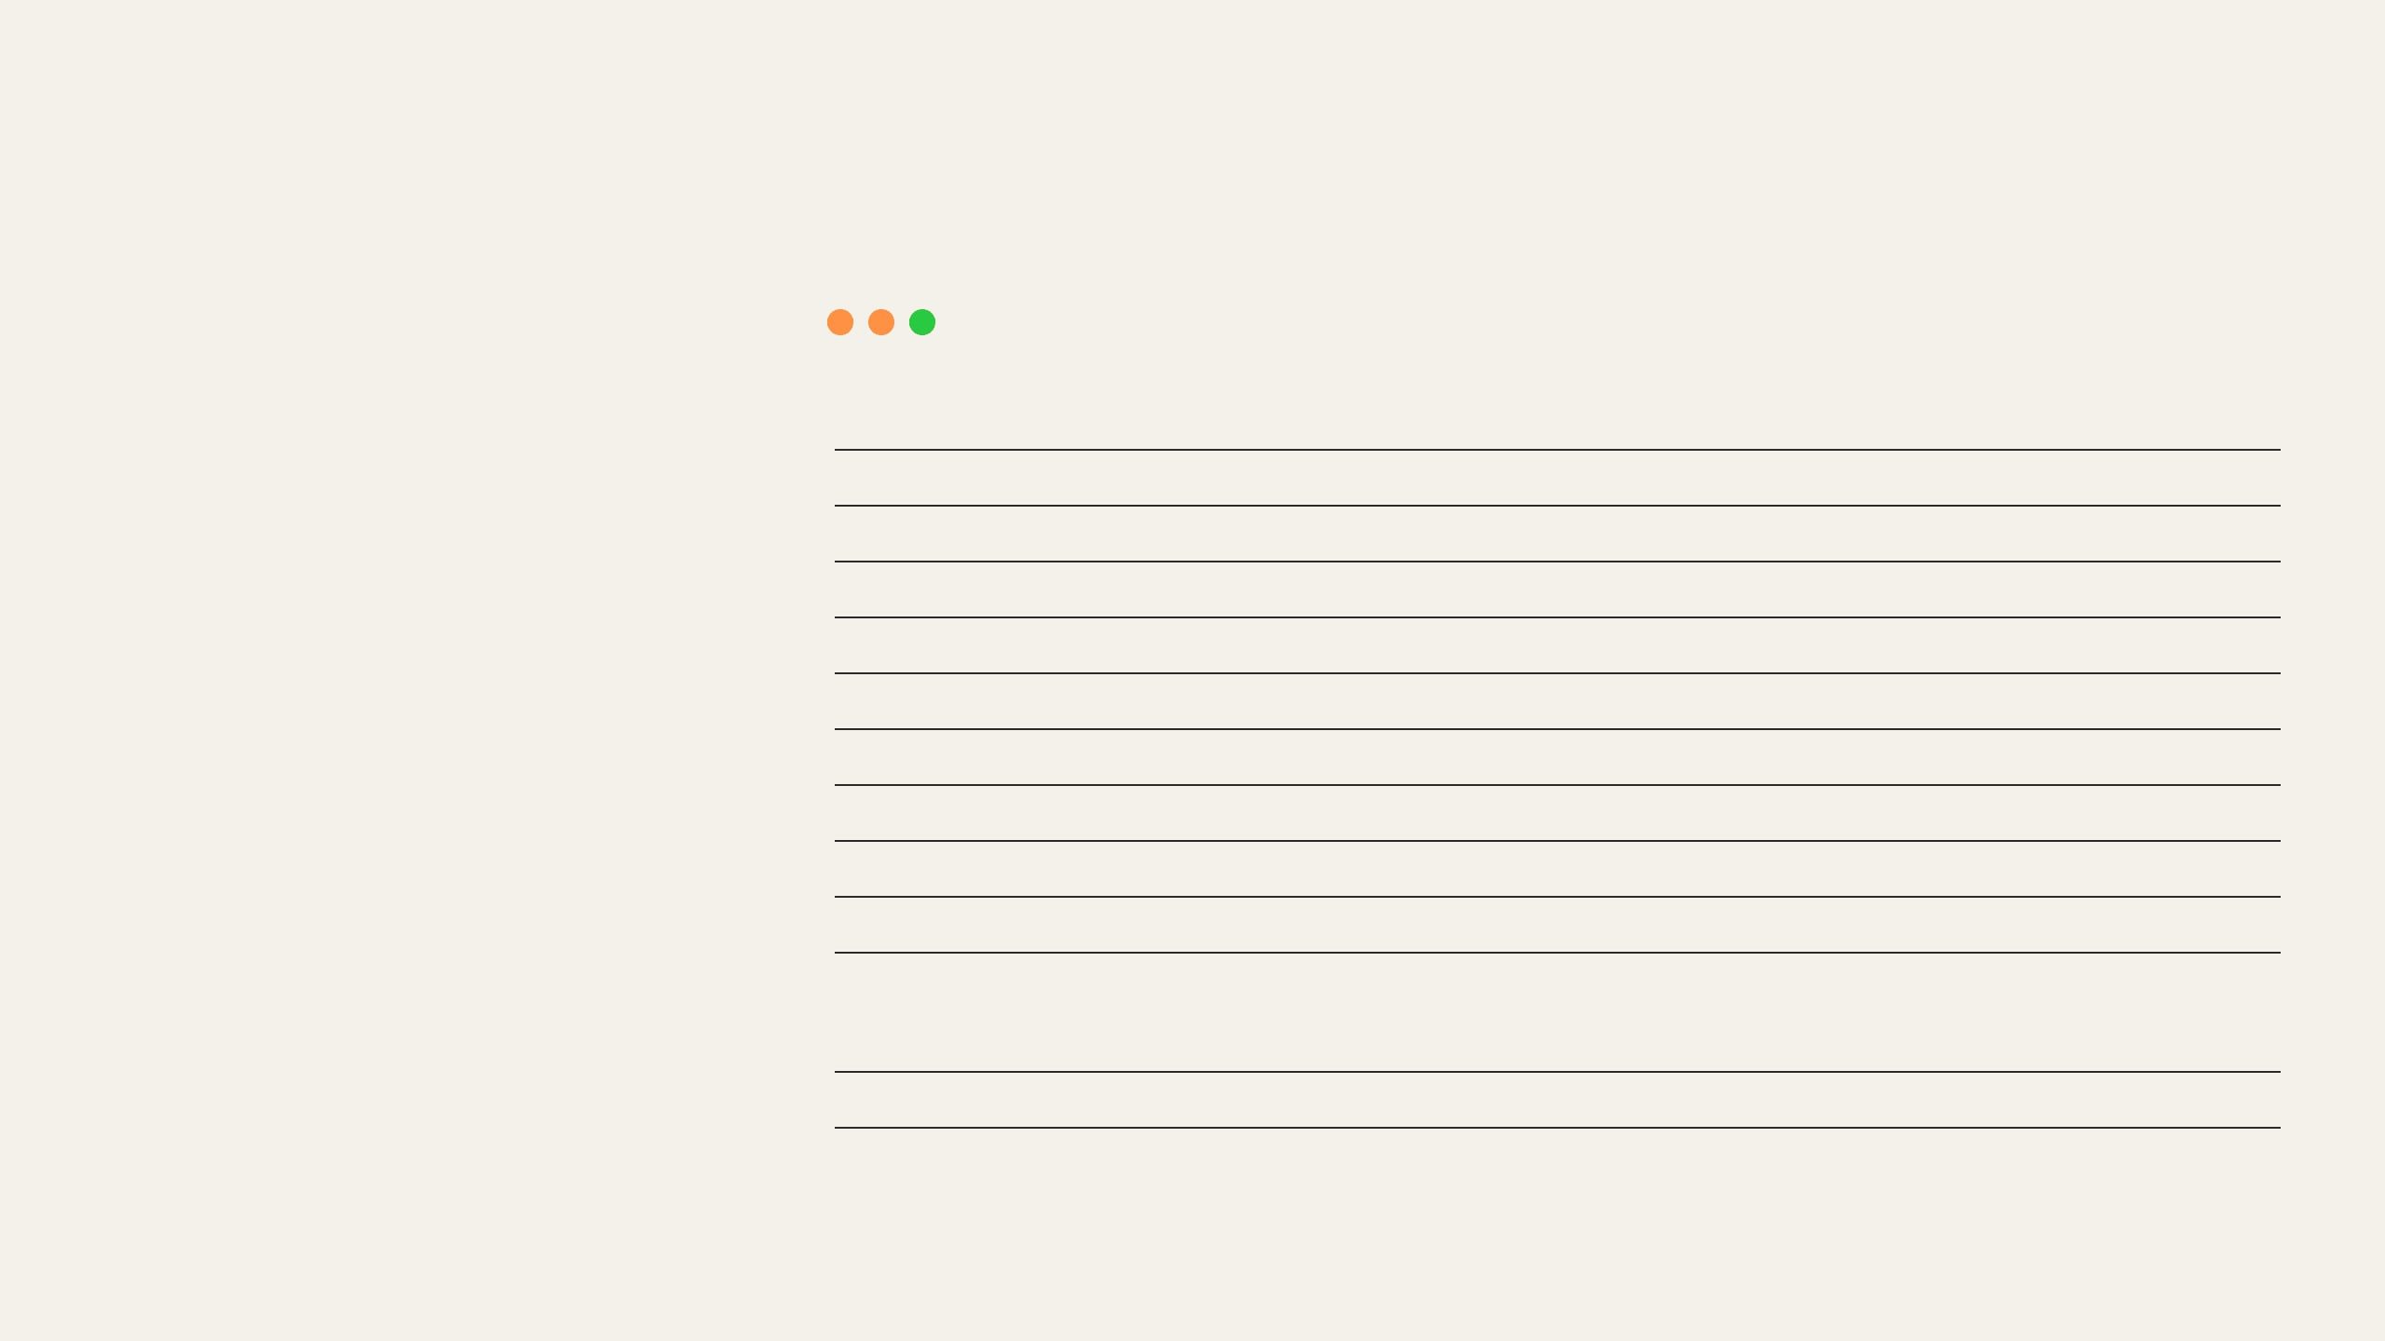
PROOF IN ACTION: THE EVIDENCE TRAIL
Step 1: Extract exactly what SAS executed.
execution_trace.json
ACTION
TRACE ARTIFACT
Copilot reads the SAS program and logs to reconstruct behavior without writing any Python.
1
{
2
"step_id": "S04",
3
"command": "PROC LOGISTIC",
4
"inputs": ["WORK.TRAIN_DATA"],
5
"outputs": {
ARTIFACT CREATED
6
"model_store": "WORK.LC_LOGIT_01",
The trace file records exactly which models ran and how they converged.
7
"target": "Default (Event='1')"
8
},
9
"log_evidence": {
stage1_extraction/output/execution_trace.json
10
"observations_read": "1265975",
11
"convergence": "Satisfied"
12
}
13
}
STEP 3: THE TRACE
SOURCE: STAGE1_EXTRACTION/OUTPUT/EXECUTION_TRACE.JSON
Notes:
Now let's see how that governance looks on a real SAS file. We start by extracting the behavior. Copilot reads the SAS program and log, and creates this trace. The trace records exactly which mathematical model ran—in this case, PROC LOGISTIC—and verifies that the model successfully converged.

Slide 19

PROOF IN ACTION: SEMANTIC MODEL
Step 2: Turn SAS behavior into a Python-ready contract.
LC-LOGIT-01.json
ACTION
SEMANTIC ARTIFACT
Copilot models the math and transformations explicitly, preserving ownership.
{
"step_id"
:
"T003"
,
"name"
:
"logistic_link_transformation"
,
"description"
:
"Calculate probability with stability guards"
,
"formula"
:
"phat = 1.0 / (1.0 + exp(-eta))"
,
ARTIFACT CREATED
"target_event"
:
"Default=1"
,
"direction"
:
"DESCENDING"
The semantic IR prevents the generator from improvising formulas.
}
artifacts/semantic_ir/LC-LOGIT-01.json
STEP 4: THE SEMANTIC MODEL
SOURCE: ARTIFACTS/SEMANTIC_IR/LC-LOGIT-01.JSON
Notes:
We do not jump from a trace to Python. We build an intermediate semantic model. Here, the behavior becomes an explicit math formula: the logistic link transformation. This preserves ownership of the logic and prevents the AI code generator from improvising formulas.

Slide 20
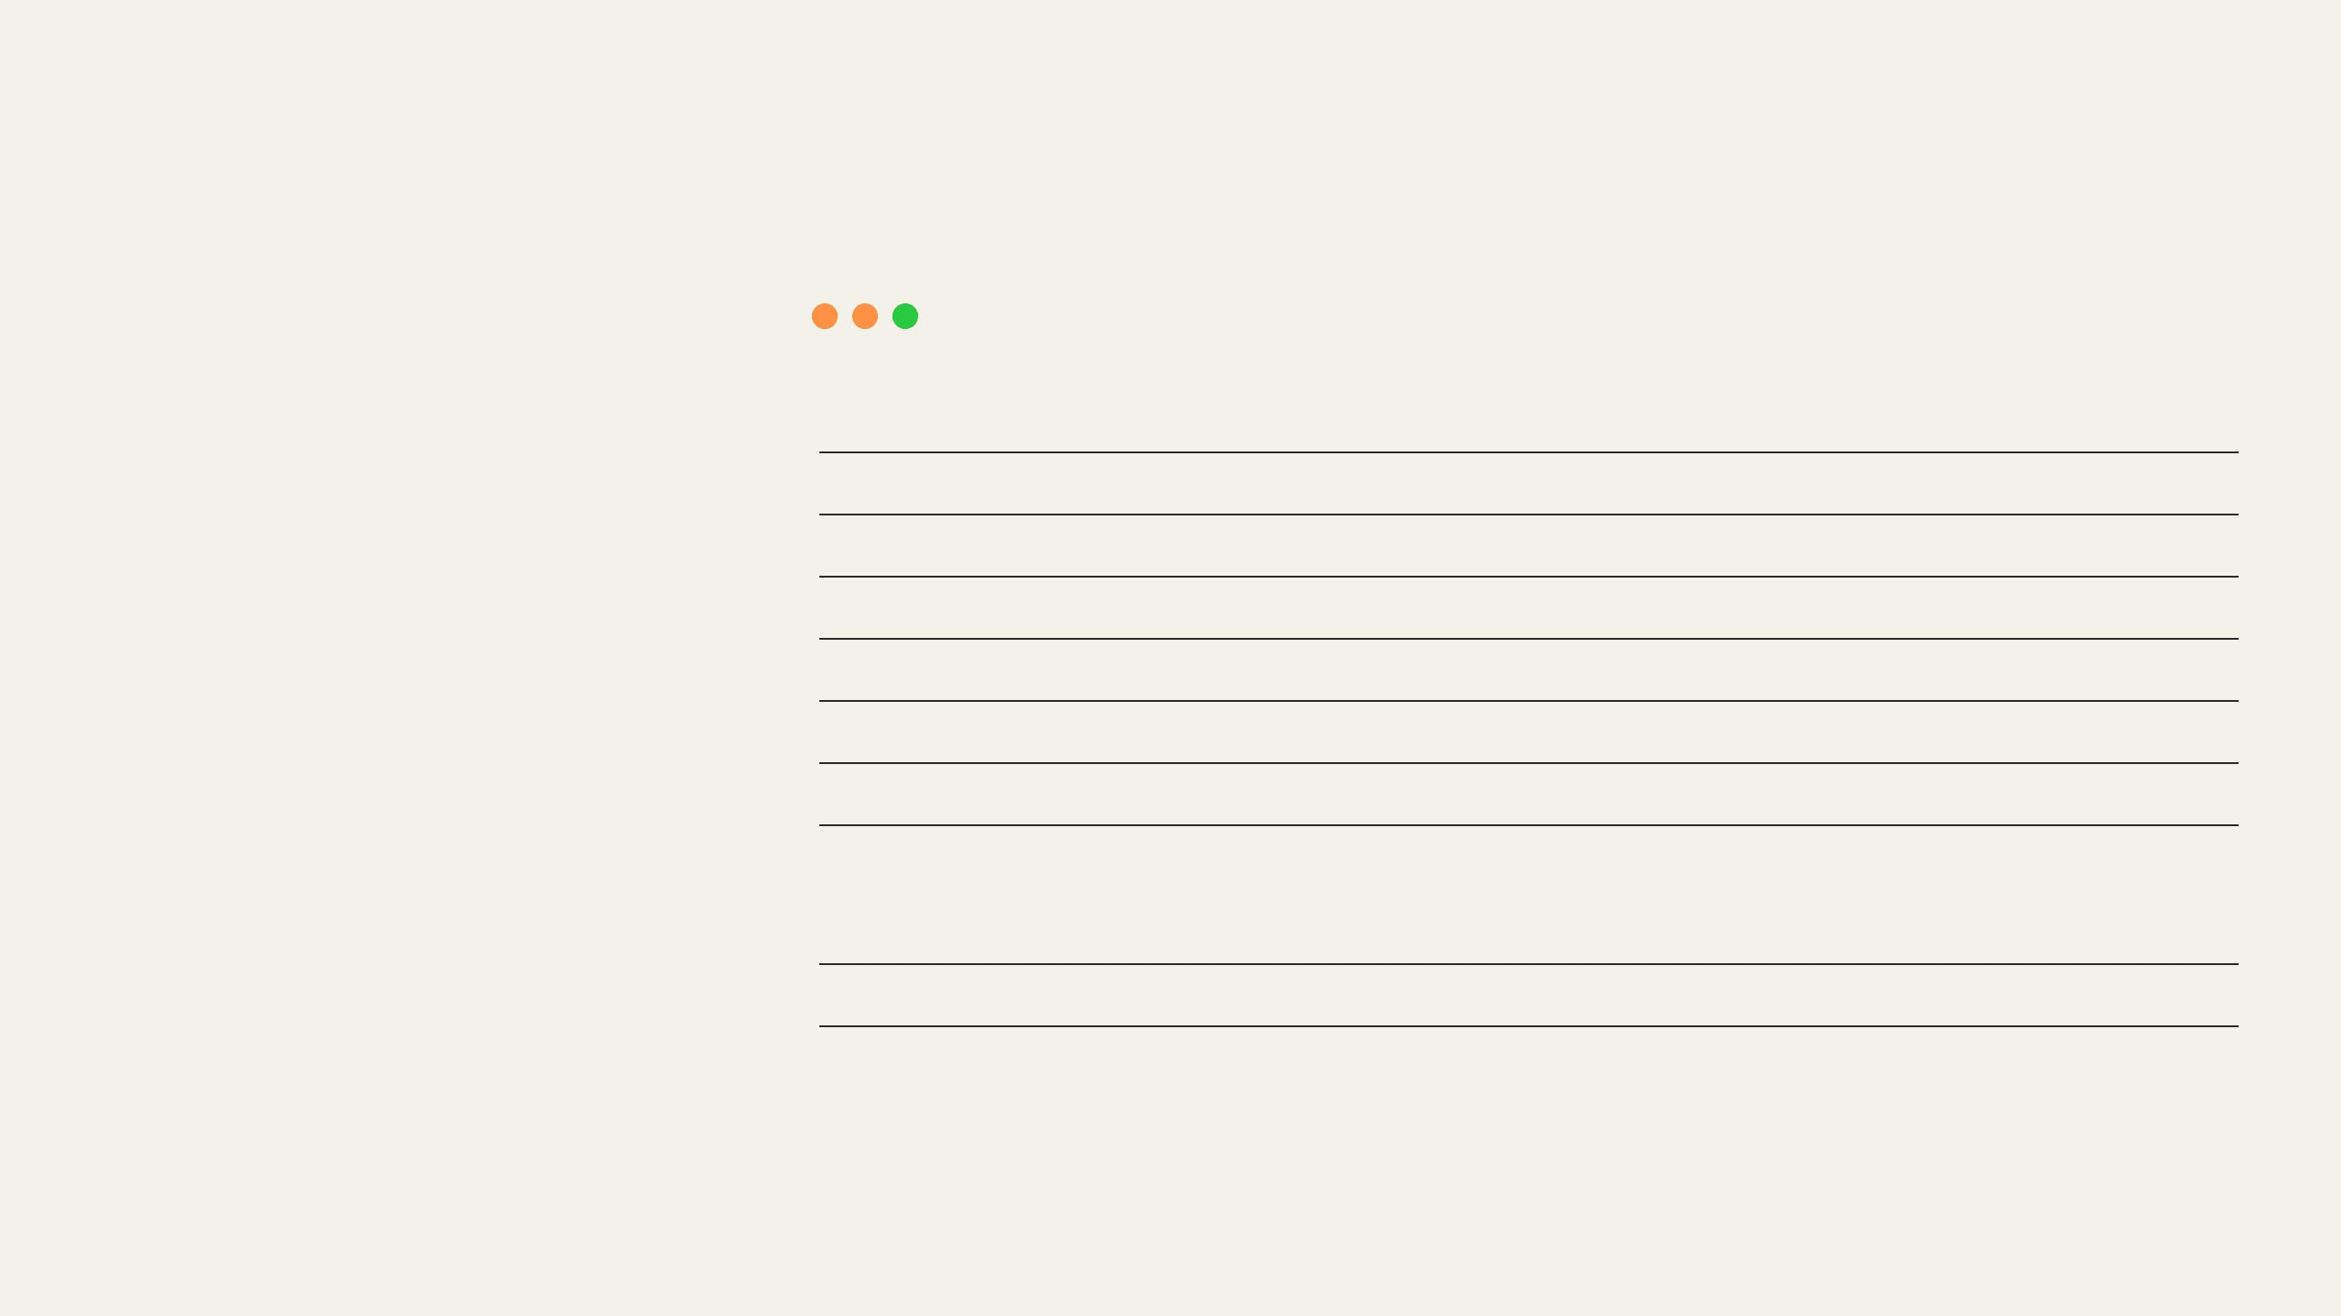
PROOF IN ACTION: PYTHON RESULT
Step 3: Generate code from the semantic rules.
scoring.py
ACTION
GENERATED OUTPUT
Copilot translates the semantic IR into pure Python and cites the original SAS.
1
def logistic(eta: float) -> float:
2
"""Return a numerically stable logistic probability.
3
Transforms eta to probability p in [0, 1].
4
SAS citation: intake/sas/log_reg_model.sas:423-441
ARTIFACT CREATED
5
"""
A deterministic scoring function ready for local parity testing.
6
if eta >= 0:
7
z = math.exp(-eta)
8
return 1.0 / (1.0 + z)
src/sas_logit/semantic/scoring.py
9
z = math.exp(eta)
10
return z / (1.0 + z)
STEP 5: THE PYTHON RESULT
SOURCE: SRC/SAS_LOGIT/SEMANTIC/SCORING.PY
Notes:
Now the semantic model becomes Python. Copilot generates the Python code, but notice the citation: it explicitly references the exact lines of the original SAS source. We are not just translating; we are building a deterministic producer that we can test against the original.

Slide 21
PROOF IN ACTION: TIE-OUT PROOF
Step 4: Replace "looks right" with deterministic validation.
evidence.json
ACTION
VALIDATION EVIDENCE
{
"module_id": "LC-LOGIT-01",
"gate": "local_coverage_tieout",
"status": "PASS",
"delta_summary": {
"rows": 50,
"missing_keys": 0,
"max_probability_delta": 6.777e-12,
"configured_tolerance": 1e-10
}
}
Copilot executes the generic tie-out runner against the SAS oracle and exact fixture.
ARTIFACT CREATED
An append-only bundle proving the exact row count and tolerance delta.
artifacts/evidence/.../evidence.json
STEP 6: THE TIE-OUT PROOF
SOURCE: ARTIFACTS/EVIDENCE/RUNS/.../EVIDENCE.JSON
Notes:
This is the final proof. We run the tie-out comparison between the generated Python and the SAS oracle. Look at the result on the right: it passes. But notice the delta summary. It proves that the probability difference across our 50 records is bounded to 10 to the negative 10. That is how we replace 'looks right' with deterministic validation.

Slide 22
TIE-OUT PASS: WHAT WE CAN CLAIM
PASS MEANS:
PASS DOES NOT MEAN:
1
Approved producer ran
×
Full population parity
2
50 selected records matched
×
Spark or cluster proof
3
Keys and counts passed
×
Performance proof
×
Production readiness
4
Metrics met tolerance
×
Release approval
5
Evidence was written
Business meaning: The claim is strong because it is narrow.
Notes:
If the tie-out passes, we can say local Python semantic behavior matched SAS for the governed 50-record sample within tolerance. We cannot say full population, cluster behavior, performance, or production readiness.

Slide 23
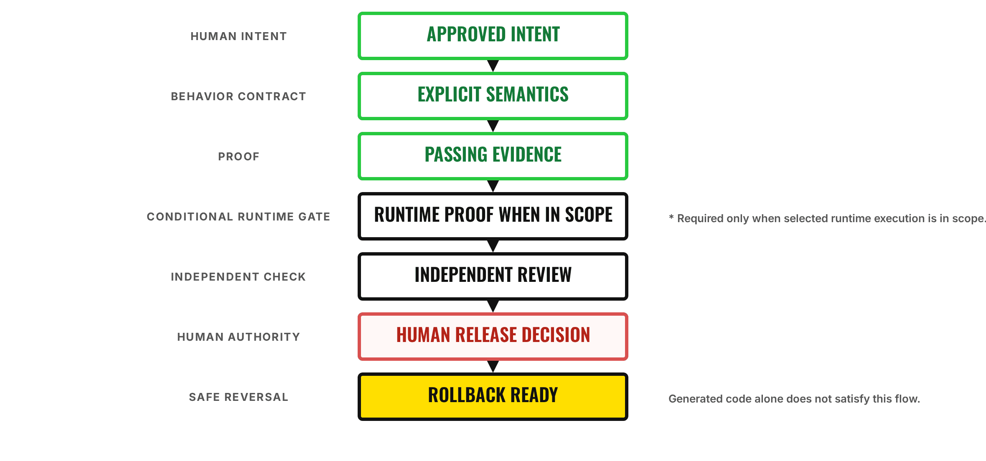
DEFINITION OF DONE: THE CONTROL FLOW
Exact Mermaid flow: every required gate leads to a release-ready, rollback-ready result.

