Slide 1





Engine-Agnostic ML Pipeline
Containerized • Secure • Scalable
A production-ready machine learning pipeline supporting Dask, Spark, and Ray frameworks with automated security scanning, model packaging, and deployment to Hugging Face Hub

Slide 2

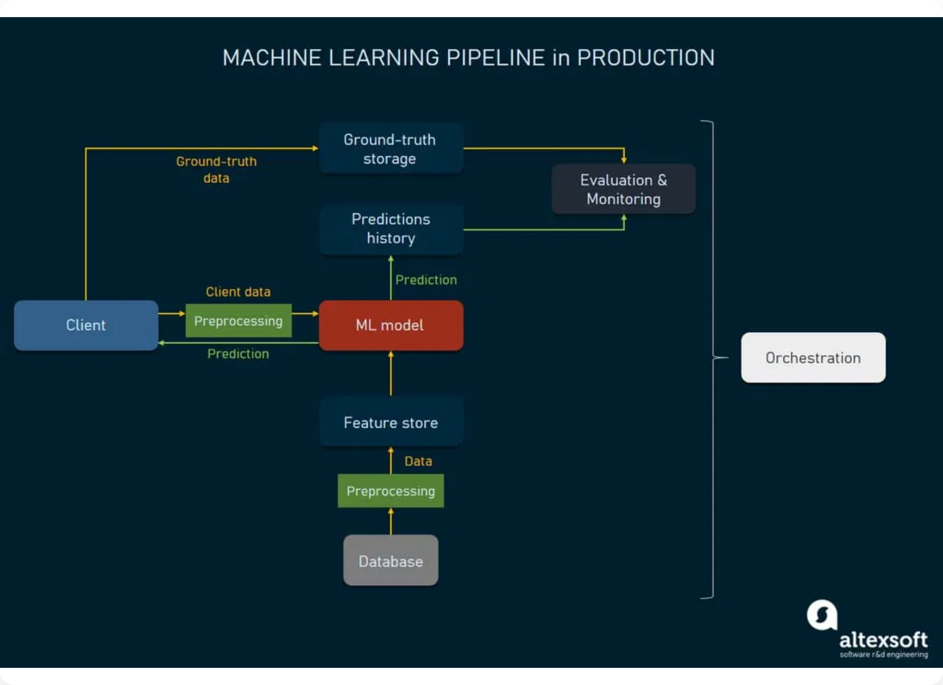






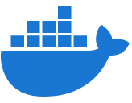





Architecture & Key Features
System Architecture
Key Features
Multi-Engine Support (Dask, Spark, Ray)
Containerized Training Environments
Automated Security Scanning
SBOM Generation for Compliance
Secure Model Packaging (skops)
Automated Deployment to HF Hub
Reproducible Workflows
Docker
Airflow
Dask/Spark/Ray
Hugging Face
Local Development Ready

Slide 3









Results & Demonstration
Successful Pipeline Execution
Key Achievements
All Engines Successfully Deployed
Production-Ready MLOps Pipeline
keshavnath1/ml-pipeline-model
Engine-Agnostic Architecture
model_dask.skops
2.4 MB
Security-First Implementation
model_spark.skops
2.4 MB
Containerized & Reproducible
model_ray.skops
2.4 MB
Automated Model Deployment
Pipeline Components Verified
Next Steps & Extensions
✓ Synthetic data generation (10,000 samples)
Add model monitoring and drift detection
✓ Multi-engine training environments
Implement A/B testing framework
✓ Security scanning with pip-audit
Integrate with cloud platforms (AWS/GCP/Azure)
✓ SBOM generation for compliance
Add real-time inference endpoints
✓ Model serialization with skops
✓ Automated deployment to Hugging Face Hub
Implement model versioning and rollback
Scale to production workloads

