Slide 1

FEDAI: FROM PASSIVE EVALUATION TO ACTIVE RELIABILITY
"DON'T JUST MEASURE FAILURES. FIX THEM BEFORE USERS SEE THEM."
How Golden Datasets + Reflection Transform AI Quality Assurance

Slide 2

THE LLM ANSWERS FAST BUT MISSES CRITICAL DETAILS — AND WITHOUT EVALUATION, NOBODY CATCHES IT
DEVELOPER QUESTION TO RAG SYSTEM
GOLDEN DATASET (GROUND TRUTH)
"How do I authenticate with our internal payments API?"
"Use Bearer token in the Authorization header. Token must be refreshed every 15 minutes via /auth/refresh endpoint. Include X-Request-ID header for traceability."
LLM OUTPUT (SINGLE-PASS, NO EVALUATION)
"Use a Bearer token in the Authorization header to authenticate with the payments API."
SCORE: 0.5 / 1.0
RUBRIC CRITERIA (HOW THE JUDGE SCORES)
Authentication method mentioned
Token refresh policy included
Traceability header documented
Incomplete answers erode developer trust and RAG adoption.

Slide 3

FEDAI CATCHES THE GAP, GENERATES SPECIFIC INSTRUCTIONS, AND CORRECTS THE OUTPUT BEFORE THE DEVELOPER SEES IT
1
VLLM_JUDGE CRITIQUE
THE 4-STEP PIPELINE
"Output is partially correct but INCOMPLETE. Missing: (a) token
GENERATE: LLM produces initial answer from RAG context
EVALUATE: vllm_judge scores against Golden Dataset rubric (temp=0)
refresh requirement via /auth/refresh, (b) X-Request-ID
traceability header."
2
TRANSFORMED INSTRUCTIONS
TRANSFORM: Critique explanation → specific correction instructions
REGENERATE: LLM retries with original output + instructions
"Add the 15-minute token refresh requirement with the
/auth/refresh endpoint. Add the X-Request-ID header requirement
for transaction traceability."
GATE: Re-score. Accept only if improved. Otherwise serve original.
3. CORRECTED OUTPUT (AFTER REFLECTION)
"Use a Bearer token in the Authorization header. Token must be refreshed every 15 minutes via the /auth/refresh endpoint. Include X-Request-ID header in every request for transaction traceability."
Key: The Golden Dataset defined that a complete answer MUST include: (1) auth method, (2) refresh policy, (3) traceability header. Without this ground truth, the judge has nothing to score against.
BEFORE: 0.5
AFTER: 0.91
ACCEPTED

Slide 4

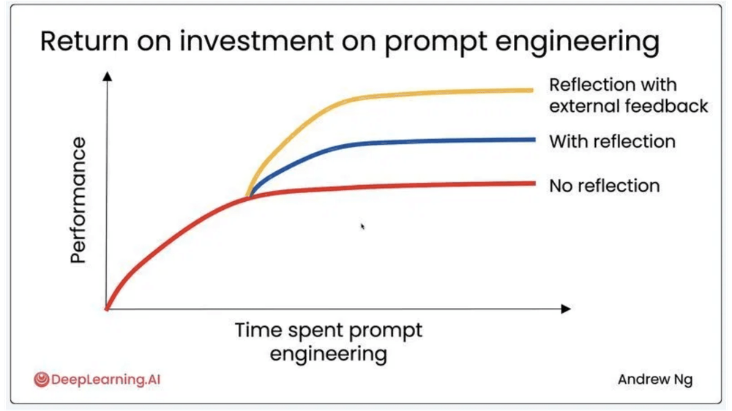
ONE REFLECTION PASS INCREASES ACCURACY FROM 87% TO 95% — AT ONLY 1.3X AVERAGE COST PER QUERY
1
ACCURACY JUMP
Andrew Ng's team observed accuracy increase from
87% to 95% with reflection + external feedback.
2
COST & LATENCY
Only 10-30% of queries trigger reflection. Average
cost is 1.3x (not 5x). P95 latency remains under 5
seconds.
3
OVER-CORRECTION PROTECTION
The "Accept-Only-If-Better" gate keeps the over-
THE OUTCOME
correction rate below 5%.
Andrew Ng's research shows three performance curves. Our architecture sits on the top curve (Reflection with external feedback) because the Golden Dataset provides the objective signal. We hard-cap at one pass because the economics are clear: one reflection is worth it; ten are not.
4
THE PROOF
Used in production at Zalando, documented by AWS,
and codified by O'Reilly (Generative AI Design
Patterns, 2025).

Slide 5
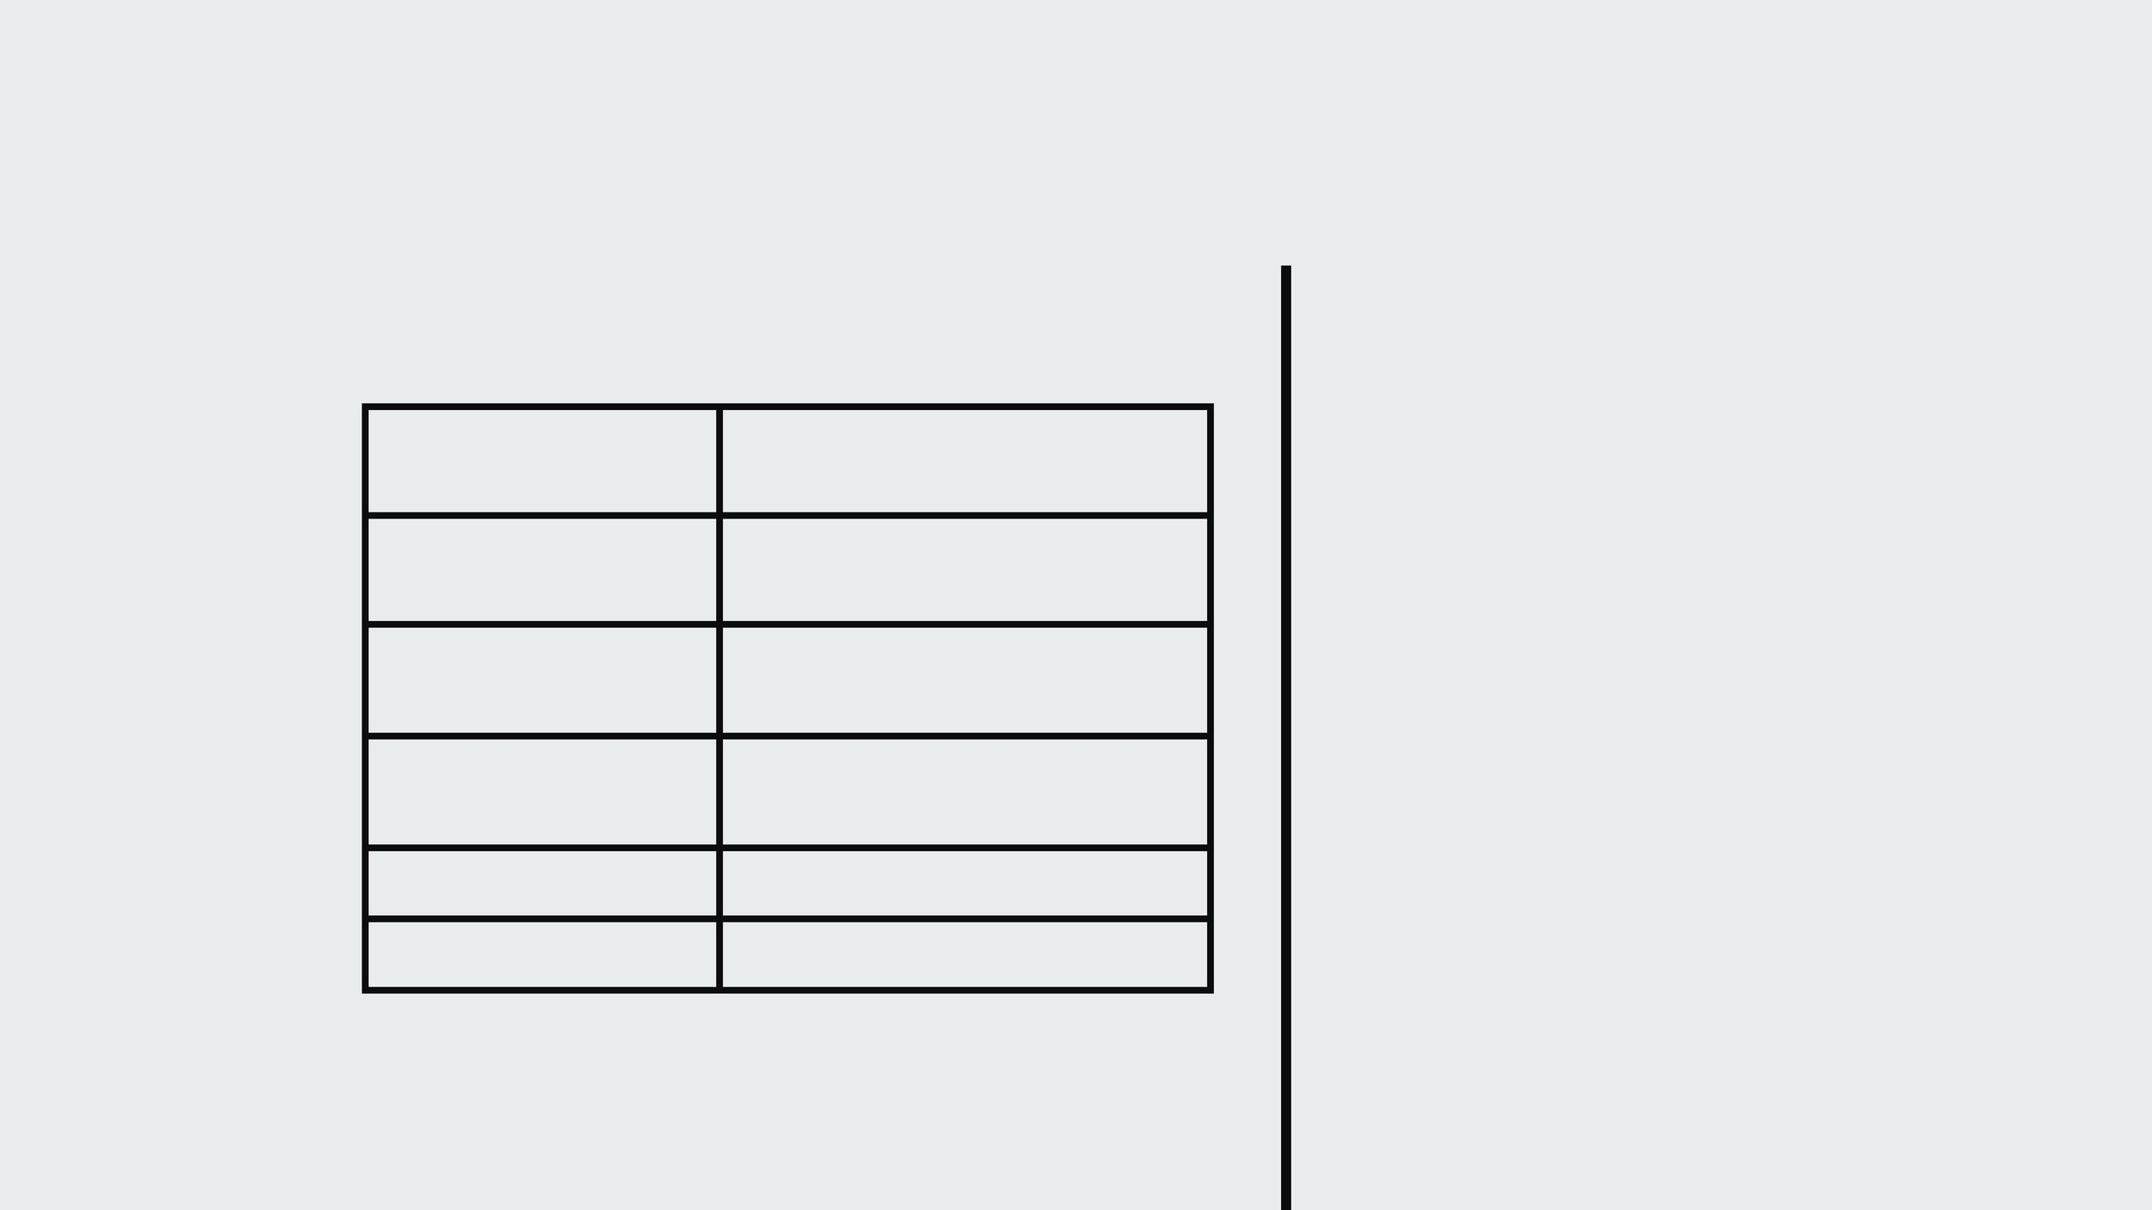
A BOUNDED, DETERMINISTIC FEEDBACK LOOP — NOT AN AUTONOMOUS AGENT
PROPERTY
AUTONOMOUS AGENT
FEDAI REFLECTION LOOP
KEY DISTINCTION
PLANNING
Open-ended, multi-step
None (fixed evaluate → refine)
This is the most important concept for architect buy-in. The system is NOT an agent. It has no planning, no tool selection, no autonomous decision-making. It is a fixed 2-step feedback loop: Evaluate → (conditionally) Refine.
TOOL USE
Dynamic tool selection
No tools (only LLM calls)
ITERATION LIMIT
Unbounded (10+)
Hard-capped at 1 retry
EXECUTION PATH
Non-deterministic
Deterministic (temp=0, fixed rubric)
CRITICAL DEFENSE
Research (Huang et al., ICLR 2024) proves LLMs cannot self-correct blindly. But our system uses EXTERNAL feedback (a different model + ground truth rubric). This is the pattern that works.
COST PROFILE
$5-8 per task
~1.3x single inference
LATENCY
10-60 seconds
< 5 seconds

Slide 6

FEDAI EVOLVES FROM A SCORECARD INTO A SELF-IMPROVING RELIABILITY ENGINE
MATURITY ROADMAP
CALL TO ACTION
LEVEL 1: NO EVALUATION
FOR DATA SCIENTISTS
Single-pass LLM, no quality checks, ~60-70% accuracy.
Start building domain-specific Golden Datasets for your use cases today. Define what "good" looks like.
LEVEL 2: PASSIVE EVALUATION
FedAI Today: vllm_judge scores output, detects failures offline.
FOR ARCHITECTS
Adopt this bounded, deterministic, and production-proven pattern (AWS, O'Reilly, Anthropic).
LEVEL 3: ACTIVE REFLECTION
This Proposal: vllm_judge drives real-time correction, bounded 1-retry loop, ~95% accuracy.
FOR EXECUTIVES
LEVEL 4: CONTINUOUS LEARNING
Reduce the "unreliability tax" — the hidden cost of bad AI answers reaching customers.
Future: Golden Dataset evolves continuously — production failures become new test cases, versioned with DVC.

Slide 7
APPENDIX A1: ARCHITECT Q&A
ADDRESSING PATTERN VIABILITY
"ISN'T REFLECTION JUST AN AGENT LOOP?"
"WHY COMPARE REFLECTION WITH RAG EVALUATIONS?"
"HOW DO YOU HANDLE LATENCY?"
BLUF: NO.
BLUF: ROUTING PATTERN.
BLUF: DIAGNOSTIC VS. CURE.
An agent has autonomy
70-90% of queries pass without
(planning, tool selection,
RAG eval tells us WHERE the
reflection. Only low-scoring
unbounded execution). This is
a bounded feedback control
pipeline failed (retrieval vs
outputs (10-30%) trigger one
loop with no autonomy —
generation). Reflection fixes
additional inference call
generation failures. If
(~800ms-2s). The average
architecturally equivalent to
a retry-with-feedback pattern
retrieval fails (recall <
latency impact is minimal.
40%), reflection cannot help —
in traditional software.
fix the retriever first.

Slide 8
TECHNICAL Q&A — IMPLEMENTATION DETAILS
Q: "RESEARCH SHOWS LLMS GET WORSE WHEN SELF-CORRECTING. WHY DO THIS?"
BLUF: That research (Huang et al.) applies to INTRINSIC self-correction (same model, no external
signal).
We use EXTERNAL feedback: a different model (vllm_judge) + ground truth (Golden Dataset). This is the
pattern that works — GPT-4 accuracy went from 95.5% to 97.5% with oracle-guided correction.
Q: "HOW DO WE PREVENT OVER-CORRECTION?"
BLUF: Accept-Only-If-Better gate.
The refined output is re-evaluated. If the new score is lower, we reject the refinement and serve the
original. We track Over-Correction Rate as a system health metric (target: < 5%).
Q: "WHAT METRICS PROVE THIS WORKS?"
Pre/Post Quality Delta
Over-Correction Rate
Reflection Trigger Rate
Cost-per-Improvement
Latency P95

Slide 9
APPENDIX A3: EXECUTIVE Q&A
BUSINESS Q&A — COST, RISK & ROI
"ISN'T THIS DOUBLING OUR API COSTS?"
"WHO ELSE DOES THIS IN PRODUCTION?"
"WHAT'S THE TIMELINE AND CONFIDENCE?"
BLUF: PROVEN PATTERN
BLUF: 2-4 MONTHS (M
BLUF: AVERAGE COST IS 1.3X
CONFIDENCE)
Zalando: Marketing content localization
Only 10-30% of queries
Level 3 implementation
trigger reflection. The
AWS: Official prescriptive guidance pattern
requires:
evaluation model is a
Golden Dataset curation (domain experts + data scientists)
smaller, cheaper model.
Compare this 1.3x cost to
Anthropic: Evaluator-Optimizer pattern
the business impact of one
compliance incident or one
O'Reilly: Codified as Pattern 17+18 in Generative AI Design Patterns (2025)
vllm_judge prompt calibration
lost customer due to a
hallucinated answer.
Threshold tuning
Monitoring dashboard

Slide 10

APPENDIX A4: THE CODE PATTERN & EVIDENCE BASE
IMPLEMENTATION REFERENCE
EVIDENCE BASE
Step 1 - Generate: Model A produces initial output Step 2 - Evaluate: vllm_judge scores against Golden Dataset rubric (temp=0) Step 3 - Transform: Convert critique into actionable instructions Step 4 - Regenerate: Model A retries with original output + instructions
SOURCE
WHAT IT PROVES
Kato (2026), arXiv:2606.20041v1
Model-Grounded RAG with audit lineage outperforms RAG-only in bank stress testing
O'Reilly: Generative AI Design Patterns (2025)
Reflection is a Reliability Pattern (Pattern 18), not experimental
# Step 2: Evaluate with rubric critique = evaluate_and_critique(output, rubric, golden_answer) # Step 3: Transform critique to instructions if critique.score() < threshold: instructions = generate_extra_instructions( critique.explanation) # Step 4: Regenerate with feedback refined = regenerate(original_output, instructions) # Accept-Only-If-Better gate refined_score = evaluate_and_critique( refined, rubric, golden_answer) final = refined if refined_score > critique.score() \ else output
O'Reilly: Hands-On RAG for Production
RAG evaluation is a business risk without structured measurement
Huang et al., ICLR 2024
Self-correction fails without external feedback; works WITH it
Self-RAG, ICLR 2024
Reflection is a native RAG pattern, not just agentic
AWS Prescriptive Guidance (2025)
Evaluator Reflect-Refine Loop is an official production pattern
Andrew Ng, DeepLearning.AI
Reflection with external feedback achieves highest ROI curve
Zalando (arXiv:2510.20653, 2025)
Production deployment proves 1 reflection round improves quality

