Slide 1
Micro Services
Monoliths
What are Micro Services
Need for Micro Services
  Characteristics of Micro services
Challenges with Micro Services
  Patterns in Microservices Architecture

Slide 2
MICROS SERVICES

Slide 3
Monolith Application
A monolithic application is a single-tiered software application
  Has user interface and data access code combined into a single program from a single platform.
Its characteristics are
  Doesn’t have Module but Modularized using object-based approach o be distributed across multiple computers
  Deployed together as a single deployment unit- EAR or WAR.
  Long Release Cycles
  Large Teams

Slide 4
Challenges to Monolith
Monolith applications also have certain Challenges
  Large codebases become mess over the time
  Multiple teams working on single codebase become tedious
  Scalability
  Difficult to Adapt to Modern Development Practices
  Adapting to Device Explosion
  It is not possible to scale up only certain parts of the application
  Technology updates/rewrites become complex and expensive tasks

Slide 5
Micro Services
An engineering approach focused on decomposing applications with well-defined interfaces
  They are independently deployed as services and operated by small teams who own the entire lifecycle of the service.
  Each service handles a specific business domain (logging, auth, orders, customers)
  Each Service provides the implementation for user interface, business logic, and connection to database.
  Each Service can be scaled up Individually

Slide 6
Micro Service
  class UserApp() {
  User getUser() {
  // 1. auth user
  // 2. get user data
  // 3. log user actions
  }
  }
  class UserApp() {
  void authUser(User user) { ... }
  User getUserData() { ... }
  void logUserActions() { ... }
  }

Slide 7
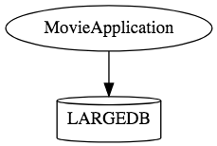
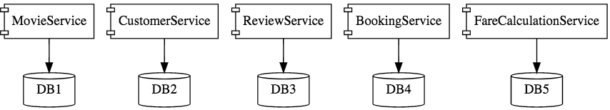
Micro Services

Slide 8
Characteristics of Micro Service
Single-function
  Each and every service has a specific function, or responsibility.
  A service can do many tasks, but all of them are relevant to a single function.
Well-defined interfaces
  Services must provide an interface that defines to communicate with it.
  Defines a list of methods, and their inputs and outputs.
Independent
  Services doesn’t know about each other implementation.
  They can get tested, deployed, and maintained independenly.
  Services may be implemented using different language stacks, and communicate with different databases.
    They can work together to complete a required operation.

Slide 9
Characteristics of Micro Service
Small Teams
  Split the work up and team across the services.
  Each team focuses on a specific service, they don’t need to know about internal workings of other teams.
  Teams can work efficiently, communicate easily,
  Each service can be deployed rapidly as soon as it’s ready.
Entire Lifecycle
  The team is responsible for the entire lifecycle of the service; from coding, testing, staging, deploying, debugging, maintaining.
  No separate team for coding, deployment. Etc

Slide 10
Characteristics of Micro Service
Minimizing Communication
  Only essential cross-team communication should be through the interface that each service provides.
  They all need to agree on the external interface, so that communication between services is clearly defined.
The scope and risk of change
  Services should be changed without breaking other services.
  And so long as we don’t change the external interface there will be no problem for other services.
  As a result of changes, the versions of services are updating individually, and there is no relationship between them.
Cloud Enabled
  Dynamic Scaling

Slide 11

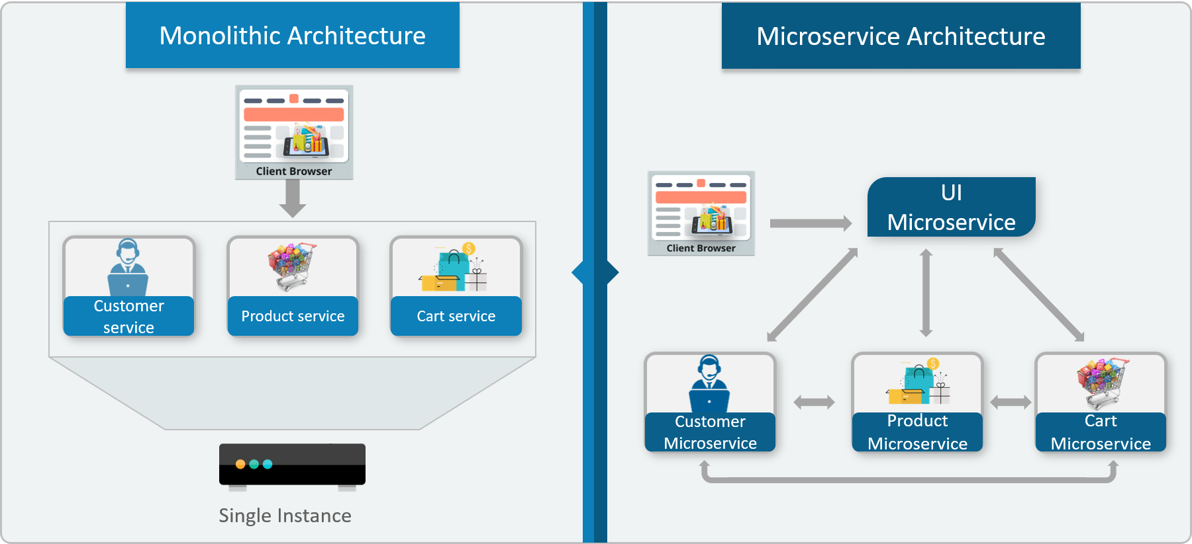
Monolithic vs Micro Service

Slide 12
Challenges with Micro service
Development has some inherent complexities
Quick Setup needed
  Should be able to create micro services quickly.
Automation
  Smaller component build ,deployment, monitoring etc should automated
Visibility :
  Should be able to monitor and identify problems automatically.
  Need great visibility around all the components.
Debugging
  Centralized Logging and Dashboards are essential to debug problems.

Slide 13
Challenges with Micro service
Configuration Management
  Need to maintain configurations for hundreds of components across environments.
  Should Have Configuration Management solution
Dynamic Scale Up and Scale Down
  Applications should be easily scaled up and down
Pack of Cards :
  If a Service at the bottom of the call chain fails, it can have knock on effects on all other services.
  Services should be fault tolerant by Design.
Consistency
  Should have some decentralized governance around the languages, platforms, technology and tools used for implementing/deploying/monitoring

Slide 14
Solutions to Challenges
Spring Boot
  Enable building production ready applications quickly
  Provide non-functional features
  embedded servers (easy deployment with containers)
  metrics (monitoring)
  health checks (monitoring)
  externalized configuration

Slide 15
Solutions to Challenges
Spring Cloud
  Cloud solutions open sourced by Netflix
Dynamic Scale Up and Down.
  Using a combination of Naming Server (Eureka)
  Ribbon (Client Side Load Balancing)
  Feign (Easier REST Clients)
Visibility and Monitoring
  Zipkin Distributed Tracing
  Netflix API Gateway
Configuration Management
  Spring Cloud Config Server
Fault Tolerance
  Hystrix

Slide 16
SPRING CLOUD

Slide 17
Topics
Netflix OSS
Using Netflix Eureka as Service Registry
Routing and filtering
Load Balancing with Netflix Ribbon
Using the Netflix Zuul edge service library for routing and filtering.
Fault Handling using Netflix Hystrix, Circuit Breaker

Slide 18
NETFLIX OSS

Slide 19
Netflix OSS
Netflix built several cloud infrastructure libraries and systems
  Its backend and mid-tier applications are built using Java
  Has Patterns for service discovery, load balancing, fault-tolerance, etc
Developing Micro services using Spring often equate Spring Cloud with Netflix OSS
Spring framework has adapted Netflix’s with its very own software
  Community solutions have evolved beyond Netflix’s original needs.

Slide 20
Netflix OSS and Spring
Provides libaries and systems that are open sourced
  Ribbon for load balancing,
  Eureka for service discovery,
  Hystrix for fault tolerance.
Spring provides the following
  Data access through spring-data
  Complex security management through spring-security
  Integration with cloud providers spring-cloud-aws
  and many many more.

Slide 21
Service Register and Discovery
Microservices architecture, application may consist of many number of microservices.
  Each deployed in different servers and different ports.
The microservices may need to communicate with each other to execute some tasks or operations.
  Using ip address and port number has many limitations on invoking the services
Microservices should register themselves in the centralized location with an identifier and server details.
  This is known as “Service Registration“.
Each microservice should be able to look up the list of registered services in the centralized location and it is known as “Service Discovery”

Slide 22
Implementations
Multiple implementations for the Service Registration and Discovery Server
  Netflix Eureka
  Consul
  Zookeeper

Slide 23
Netflix Eureka Server
An implementation for the “Service Registration and Discovery” pattern.
Keeps a track of registered micro sevices
  Hence knows as registry of micro services
Micro services should register with Eureka server by providing their details
  host name, ip address, port, and health indicators etc…
  Service will be registered with unique identifier known as serviceId.
  Other services can use this serviceId to access the particular service.

Slide 24
Netflix Eureka Server
Server maintains a registry of up and running micro services.
Services registers itself with Eureka, and pings Eureka server to notify that it’s alive.
If Eureka server didn’t receive any notification from a service.
  The service is unregistered from the Eureka server automatically.

Slide 25
Netflix Eureka Server
Create a Spring boot Starter project from with two dependencies
  Eureka server and Actuator.
@EnableEurekaServer
  Added to the main Spring Boot Application configuration class with @SpringBootApplicationannotation)
  @EnableEurekaServer
  @SpringBootApplicationpublic
  class EurekaServerApplication {
  public static void main(String[] args) {
  SpringApplication.run(EurekaServerApplication.class, args);
  }
  }

Slide 26
Server Config Properties
Update the application.properties with following entries
  server.port=8761
  eureka.client.register-with-eureka=false
  eureka.client.fetch-registry=false
  logging.level.com.netflix.eureka=OFF
  logging.level.com.netflix.discovery=OFF
  eureka.instance.leaseRenewalIntervalInSeconds=30

Slide 27
Server Configuration Properties
  Services should be registered themselves with Eureka server to make them discoverable
  spring.application.name=eureka-server
  Give a name for the sever
  server.port=8761
  default port for eureka server
eureka.client.register-with-eureka=false
  A server does not need to register itself
eureka.client.fetch-registry=false
  Server does not need to fetch the information of the registered services from itself

Slide 28
Discovery From Eureka Server
Micro services can register themselves as Discovery clients
  The Server will allow the discover clients to look up the other registered services and fetch their information.
  Discover client can fetch the information of the targeted service
  Services can communicate without IP addresses and port numbers manually.

Slide 29
Sample Service
Create another spring boot application with following dependencies.
  Eureka Discovery, Actuator,Web,Rest Repositories
Need to register this application in the Eureka server as a Eureka Discoverable Client.
@EnableDiscoveryClient
  To be added in the main spring boot configuration class to make the service as a Discoverable client.
  can work with any Discovery Client implementations like Eureka, Consul, Zookeeper
@EnableEurekaClient
  Works only with Eureka Discovery Client implementation.

Slide 30
Producer Application
  @RestController
  public class DonarService {
  @GetMapping("/donar")
  public String getDonar() {
  return "Ramesh - BPOS";
  }
  }

Slide 31
Discovery Service
  @SpringBootApplication
  @EnableEurekaClient
  public class BloodDonarServiceApplication {
  public static void main(String[] args) {
  SpringApplication.run(BloodDonarServiceApplication.class, args);
  }
  }

Slide 32
Producer Application Properties
  server.port=8088
  spring.application.name=donar-details-service
  eureka.client.serviceUrl.defaultZone = http://localhost:8761/eureka/
  eureka.client.healthcheck.enabled = true
  eureka.client.log-delta-diff=false
  eureka.client.register-with-eureka=true
  eureka.instance.prefer-ip-address=true
  logging.level.com.example.demo=DEBUG

Slide 33
Consumer Discovery Eureka Client
  @SpringBootApplication
  @EnableEurekaClient
  public class DiscoverDonarServiceApplication {
  public static void main(String[] args) {
  SpringApplication.run(DiscoverDonarServiceApplication.class, args);
  }
  }
  Eureka admin panel (http://localhost:8761/) check whether it is already registered.

Slide 34
Rest Controller Client
  @RestController
  public class DonarServiceController {
  @Autowired
  RestTemplate template;
  @Autowired
  private EurekaClient discoveryClient;
  @GetMapping(value = "/getDonarDetails")
  public String getDonars() {
  String response = template.getForObject("http://donar-details- service/donar/",String.class);
  return response;
  }
  @Bean
  @LoadBalanced
  public RestTemplate template() {
  return new RestTemplate(); }
  }

Slide 35
Discovery Client
application.properites
  server.port=9098
  spring.application.name=discover-donar-service
  logging.level.com.example.demo = DEBUG
  eureka.client.healthcheck.enabled=true
  eureka.client.serviceUrl.defaultZone = http://localhost:8761/eureka/
  eureka.instance.lease-expiration-duration-in-seconds=2
  eureka.instance.lease-renewal-interval-in-seconds=1

Slide 36
Discovery Client Properties
eureka.client.serviceUrl.defaultZone
  This is the URL of the Eureka deployment.
  You have to mention location of the Eureka Server by using defaultZone property.
leaseRenewalIntervalInSeconds
  you can change the Registration time.
  Registration takes up to 30 s because that is the default client refresh time (It is recommend not to change
leaseRenewalIntervalInSeconds
  and use the default value which is 30 sec).

Slide 37
SPRING ACTUATOR

Slide 38
Spring Boot Actuator
Exposes REST endpoints that can be consumed to manage and monitor application.
Monitor application health, application bean details, version details, thread dumps, logger details etc
Can restrict these endpoints to be consumed by authorized users only and Spring provides easy way to secure your REST endpoints.

Slide 39
actuator End Point
actuator
  It provides a hypermedia-based discovery page for the other endpoints.
  It is required to have Spring HATEOS on the classpath to enable it.
  By default it is sensitive and hence requires username/password for access or may be disabled if web security is not enabled.
Beans
  It displays complete beans configured in the app.
Configprops
  It displays a collated list of all @ConfigurationProperties.

Slide 40
actuator End Point
Health
    It shows application health information
Info
  It displays arbitrary application info.
Loggers
  It shows and modifies the configuration of loggers in the application.
metrics:
  It shows metrics information for the current application.
Mappings
  It displays a collated list of all @RequestMapping paths.

Slide 41
Actuator Endpoints
health and info can be accessed
  Other endpoints are disabled by default
management.endpoints.web.exposure.include=*.
  Will enable all of them
  Can also list endpoints which should be enabled
To expose all enabled endpoints except one (for example /loggers), we use:
  management.endpoints.web.exposure.include=*
  management.endpoints.web.exposure.exclude=loggers
  management.security.enabled=false

Slide 42
Securing Actuator Endpoint
  @Bean
  public SecurityWebFilterChain securityWebFilterChain(
  ServerHttpSecurity http) {
  return http.authorizeExchange()
  .pathMatchers("/actuator/**").permitAll()
  .anyExchange().authenticated()
  .and().build();
  }

Slide 43
Securing Spring Boot Actuator
Securing Spring Boot Actuator Endpoints with Spring Security
  management.security.enabled=true
  security.user.name=act
  security.user.password=act
  management.security.roles=ACTRADMIN

Slide 44
CONSUL

Slide 45
What is Consul
Consul provides multiple features like service discovery, configuration management, health checking and key-value store etc.
Consul Agent – Should be running on localhost acting as discovery/registry server functionality.

Slide 46
Install and Configure Consul
Down load from the Consul Portal
  https://www.consul.io/downloads.html
  A zip file which can be unziped
Execute exe file consul.exe.
Start the Consult with command
consul agent -server -bootstrap-expect=1 -data-dir=consul-data -ui -bind=192.168.6.1
Consul runs on default port and once agent started successfully
Can browse http://localhost:8500/ui

Slide 47
Micro Service
Create a Spring boot Starter project with following modules
  Actuator
  Web
  Rest Repositories
  Consul Discovery

Slide 48
Register With Consul
  @SpringBootApplication
  @EnableDiscoveryClient
  public class ToRegWithConsulApplication {
  public static void main(String[] args) {
  SpringApplication.run(ToRegWithConsulApplication.class, args);
  }}
Application.properties
  server.port=2020
  spring.application.name: card-service

Slide 49
Card Validation Service
  @RestController
  @RequestMapping("/card")
  public class CardValidationController {
  @GetMapping("/isvalid")
  public String cardStatus() {
  return "valid";
  }
  @GetMapping("/approve/{number}/{amount}")
  public boolean isApproved(@PathVariable long number, @PathVariable double amount) {
  return details.get(number) >amount;
  }
  }

Slide 50
Discovery Delegate
  @Repository
  public class CardServiceDelegate {
  @Autowired
  RestTemplate restTemplate;
  public String callCardService() {
  String response = restTemplate.getForObject("http://card-service/card/isvalid",String.class);
  return response + " - " + new Date();
  }

Slide 51
Discovery Delegate
  public boolean approveCredit(long cardNumber,double amount) {
  Map<String, Object> params = new HashMap<>();
  params.put("cardNumber", cardNumber);
  params.put("amount", amount);
  return restTemplate.getForObject("http://card-service/card/approve/{cardNumber}/{amount}", Boolean.class, params);
  }
  @Bean
  @LoadBalanced
  public RestTemplate restTemplate() {
  return new RestTemplate();
  } }

Slide 52
Consumer Service
  @RestController
  public class CardServiceController {
  @Autowired
  CardServiceDelegate service;
  @GetMapping("/details")
  public String getCardDetails() {
  return service.callCardService();
  }
  @GetMapping("/approve/{cardNumber}/{amount}")
  public boolean approve(@PathVariable long cardNumber,@PathVariable double amount) {
  return service.approveCredit(cardNumber, amount);
  }
  }

Slide 53
Main Application
  SpringBootApplication
  @EnableDiscoveryClient
  public class ConsulDiscoveryClientApplication {
  public static void main(String[] args) {
  SpringApplication.run(ConsulDiscoveryClientApplication.class, args);
  }}
  application.properties
  server.port=8098
  spring.application.name: card-client-service

Slide 54
SPRING CLOUD RIBBON
WITH EUREKA

Slide 55
Load Balancing on Server Side
Load Balancing on Server side is a manual effort
  Need to add/remove instances manually to the load balancer
  On demand scalability to auto-discover and configure are not available
  Don’t have a Fail-over policy to provide the client a seamless experience.
  Need a separate server to host the load balancer instance which has the impact on cost and maintenance.

Slide 56
Server side load balancing
Server side load balancing is involved in monolithic applications
Limited number of application instances behind the load balancer.
Load balancer has a public IP and DNS.
The client makes a request using that public IP/DNS.
Load balancer uses some algorithm to decide the internal application server request will be forwarded to.

Slide 57
Client side load balancing
They reside in the application as inbuilt component and bundled along with the application
No need to deploy them in separate servers.
In the Micro Services architecture there will be many microservice
  They need to communicate with another microservice
Eureka server returns all the instances of the target microservice to the caller service.
Then it is the responsibility of the Client side load balancer to delegate to proper instance in balanced fashion.

Slide 58
Netflix ribbon
Netflix ribbon from Spring Cloud family provides client side load balancing along with the service registry component.
Spring boot has very nice way of configuring ribbon client side load balancer with minimal effort. It provides the following features
  Load balancing
  Fault tolerance
  Multiple protocol (HTTP, TCP, UDP) support in an asynchronous and reactive model
  Caching and batching

Slide 59
Service Configuration
server.port=*
spring.application.name=donar-details-service
eureka.client.serviceUrl.defaultZone = http://localhost:8761/eureka/
eureka.client.healthcheck.enabled = true
eureka.client.log-delta-diff=false
eureka.client.register-with-eureka=true
eureka.instance.prefer-ip-address=true
logging.level.com.example.demo=DEBUG
eureka.instance.instanceId=3

Slide 60
Application
  @SpringBootApplication
  @EnableEurekaClient
  public class BloodDonarServiceApplication {
  public static void main(String[] args) {
  SpringApplication.run(BloodDonarServiceApplication.class, args);
  }
  }

Slide 61
Rest Controller
  @RestController
  public class DonarService {
  @GetMapping("/donar")
  public String getDonar() {
  return "Ramesh - BPOS";
  }
  }

Slide 62
Consumer Configuration
  @RestController
  public class ConsumeDonarRibbonClient {
  @Autowired
  RestTemplate template;
  @Autowired
  private LoadBalancerClient loadBalancer;
  @Bean
  public RestTemplate template() {
  return new RestTemplate();
  }
  }

Slide 63
Consumer Configuration
  @GetMapping("/ribbon")
  public String getEmployee() throws RestClientException, IOException {
  ServiceInstance serviceInstance= loadBalancer.choose("donar-details-service");
  System.out.println(serviceInstance.getUri());
  String baseUrl=serviceInstance.getUri().toString();
  baseUrl=baseUrl+"/donar/";
  String response = template.getForObject(baseUrl,String.class);
  return response;
  }

Slide 64
Consumer Configuration
  server.port=7070
  spring.application.name=ribbon-balanced-service
  logging.level.com.example.demo = DEBUG
  eureka.client.healthcheck.enabled=true
  eureka.client.serviceUrl.defaultZone = http://localhost:8761/eureka/

Slide 65
HYSTRIX FAULT TOLERENCE

Slide 66
Hystrix
Hystrix is a Netflix library.
"Hystrix is a latency and fault tolerance library designed to isolate points of access to remote systems, services and 3rd party libraries, stop cascading failure and enable resilience in complex distributed systems where failure is inevitable."
An application that entertains heavy user traffic in a distributed environment with a lot of dependencies.
Now if a certain service is down or is too slow to respond it could slow down or throttle the entire application.

Slide 67
Hystrix and fault-tolerance
Hystrix creates a pool of threads for each dependency in the application.
Even if a service is not behaving as expected, the application system continues to function.
It helps to isolate such points of access between services thereby, avoiding cascading failure across the different application layers.
It also provides fallback options, facilitates monitoring the system state and many other desirable features; thus, improving upon the application’s fault-tolerance and resiliency.

Slide 68
Hystrix and fault-tolerance
  @RestController
  public class HotelFinderController {
  @Autowired
  HotelRepository service;
  @GetMapping( "/getHotels/{city}")
  public String getHotels(@PathVariable String city) {
  System.out.println("Going to call Hotel find service to get data!");
  return service.callHotelFinderService(city);
  }
  }

Slide 69
Repository with Normal Flow
  public class HotelRepository {
  @HystrixCommand(fallbackMethod = "callHotel_Fallback")
  public String callHotelFinderService(String city) {
  System.out.println("Getting Hotel in " + city);
  List<String> response =
  restTemplate.getForObject("http://localhost:4040/foodBuddy/hotel/veg/chennai", java.util.List.class);
  System.out.println("Response Received as " + response + " - " + new Date());
return "NORMAL FLOW !!! - City Name - " + city + " ::: " +
“ Details " + response + " - " + new Date();
}

Slide 70
Repository with Fault Tolerance
  @SuppressWarnings("unused")
  private String callHotel_Fallback(String city) {
  System.out.println("Hotel Finder Service is down!!! fallback route enabled...");
  return "CIRCUIT BREAKER ENABLED!!! No Response From Hotel Finder Service at this moment. " +
  " Service will be back shortly - " + new Date();
  }
  @Bean
  public RestTemplate restTemplate() {
  return new RestTemplate();
  }
  }

Slide 71
Application
  @SpringBootApplication
  @EnableHystrixDashboard
  @EnableCircuitBreaker
  public class OrderFoodHystrixApplication {
  public static void main(String[] args) {
  SpringApplication.run(OrderFoodHystrixApplication.class, args);
  }
  }

Slide 72
Application.properties
server.port= 5050
spring.application.name=HystrixEnabled
server.servlet.context-path=/orderfood

Slide 73
REQUEST ROUTING WITH ZUUL

Slide 74
Zuul
It’s a proxy, gateway, an intermediate layer between the users and your services.
  Eureka server solved the problem of giving names to services instead of hardcoding their IP addresses.
Can have more than one service (instances) running on different ports
  Zuul Maps between a prefix path and a service
Uses Eureka server to route the requested service.
Load balances instances
Can filter requests, add authentication, etc.

Slide 75
Zuul
If any service/application need to access the any of the microservices deployed It has to come through the Zuul proxy.
Zuul will hide the identities of the server applications behind the proxy and serve the client applications exposing its identity on behalf of backend servers and sever applications.
Therefore Zuul is identified as a Reverse Proxy.
Difference between Proxy (forward Proxy) and Reverse Proxy.
One is for protecting/hiding clients and other one is for protecting/hiding servers.

Slide 76
Filter in Zuul
Can filter requests through proxy service.
Zuul has four standard filter types:
pre
  filters are executed before the request is routed,
route
  filters can handle the actual routing of the request,
post
  filters are executed after the request has been routed, and
error filters
  execute if an error occurs in the course of handling the request.

Slide 77
Filter Class Methods
Filter classes implement four methods:
filterType()
  returns a String that stands for the type of the filter---in this case, pre, or it could be route for a routing filter.
filterOrder()
  gives the order in which this filter will be executed, relative to other filters.
shouldFilter()
  contains the logic that determines when to execute this filter (this particular filter will always be executed).
run()
  contains the functionality of the filter.

Slide 78
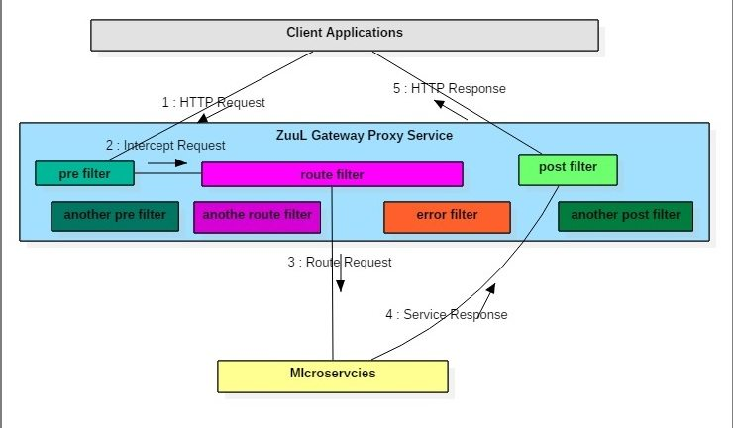
How Zuul Proxy Works

Slide 79
Rest Controller
  @RestController
  public class HospitalController {
  @Autowired
  private Hospital hospital;
  @GetMapping(value = "/getHospital")
  public Hospital getStudentDetails() {
  hospital.setHospitalCode(102);
  hospital.setHospitalName("Vijaya Hospital");
  hospital.setPhoneNumber(108);
  return hospital;
  }
  }

Slide 80
Application
  server.port=4040
  spring.application.name=hospitalService
  @SpringBootApplication
  public class ZuulHospitalServiceApplication {
  public static void main(String[] args) {
  SpringApplication.run(ZuulHospitalServiceApplication.class, args);
  }
  }

Slide 81
Zuul Proxy Server
  @EnableZuulProxy
  @SpringBootApplication
  public class ZuulGatewayProxyApplication {
  public static void main(String[] args) {
  SpringApplication.run(ZuulGatewayProxyApplication.class, args);
  }
  }

Slide 82
Zuul Filter
  public class MyPostFilter extends ZuulFilter {
  public boolean shouldFilter() {
  return true; }
  public Object run() throws ZuulException {
  System.out.println("INSIDE RESPONSE FILTER");
  return null;
  }
  public String filterType() {
  return "post";
  }
  public int filterOrder() {
  return 2;
  } }

Slide 83
Zuul Filter
  public class MyPreFilter extends ZuulFilter {
  public boolean shouldFilter() {
  return true; }
  public Object run() throws ZuulException {
  RequestContext ctx = RequestContext.getCurrentContext();
  HttpServletRequest request = ctx.getRequest();
  System.out.println("REQUEST METHOD: " + request.getMethod() + " Request URL : " + request.getRequestURL().toString());
  return null;
  }
  public String filterType() {
  return "pre"; }
  public int filterOrder() {
  return 1;
  } }

Slide 84
Application.properties
zuul.routes.hospitals.url=http://localhost:4040
ribbon.eureka.enabled=false
server.port=2020
Invoke the Hospital service with
http://localhost:2020/hospitals/getHospital
URL of the Hospital Rest Constroller

Slide 85
SPRING CLOUD CONFIG SERVER

Slide 86
Config Server
Cloud Applications requires a way to maintain and distribute the Configuration data to all services
One Solution is to consolidate all configuration into a single Git repository
Application Clients can connect to that server and manage configurations
Can configure properties for each environment
  dev, qa, prod -separately using profile specific configuration files
  application.properties, application-dev.properties, application-prod.properties etc.

Slide 87
Config Server
Spring Cloud Config Server provides an HTTP resource-based API for external configuration
@EnableConfigServer
  The server is embeddable in a Spring Boot application
  @SpringBootApplication
  @EnableConfigServer
  public class ConfigServer {
  public static void main(String[] args) { SpringApplication.run(ConfigServer.class, args);
  }
  }

Slide 88
Git Repository
config-client-dev.properties
  spring.datasource.jdbc-url=jdbc:mysql://localhost:3306/test
  spring.datasource.username=root
  spring.datasource.password=srivatsan
  spring.datasource.driver-class-name=com.mysql.cj.jdbc.Driver
application-dev.properties
  spring.jpa.hibernate.naming.physical-strategy=
  org.hibernate.boot.model.naming.PhysicalNamingStrategyStandardImpl
  spring.jpa.show-sql=true

Slide 89
Spring Cloud Configuration Server
spring.config.server.git.uri
  To point to git repository location with properties files
application.properties
  spring.cloud.config.server.git.uri=
  https://github.com/vatsank/config-info.git
  server.port =2020

Slide 90
Spring Cloud Configuration Client
Should add Spring Cloud Config Client module
It will take care of starting the application by fetching the application properties from Config Server.
@RefreshScope
  Added to the Beans that has to be re-initialized when configuration changes.

Slide 91
bootstrap.properties
The file that is loaded before application.properties file
This is a parent context for the main application it binds to the Config Server
spring.application.name
  On Startup Spring Cloud makes an HTTP(S) call to the Spring Cloud Config Server
  Uses the application name and retrieves back that application’s configuration.
  Should match with base filename in GIT Repository.
spring.cloud.config.name
  by default it is equal to spring.application.name property value

Slide 92
Config server client -1
boortstrap.properties
  spring.application.name=config-client
  spring.profiles.active=dev
  spring.cloud.config.uri=http://localhost:2020
    The Host Address of Config Server
application.properties
server.port=5050

Slide 93
Config server client -2
boortstrap.properties
  spring.application.name= config-client
  spring.profiles.active=dev
  spring.cloud.config.uri=http://localhost:2020
application.properties
  server.port=6060

Slide 94
SPRING CLOUD STREAM

Slide 95
Spring Cloud Stream
A framework for building message-driven microservice applications.
Without the need to specify the implementation details of the underlying messaging system we want to use.
Just need to specify the required binding dependencies
Cloud Stream will integrate the messaging systems to Spring Boot Application.
Spring Integration to provide connectivity to message brokers.
Kafka & Rabbit are currently supported

Slide 96
Cloud Stream
Transparent content-type negotiation and argument resolution
Ability to connect microservices to external systems
  Kafka
  Rabbit MQ
  JMS
  Etc. . .
Provides flexible programming model
  Built on familiar Spring idioms - Spring Messaging
  Supports pub/sub semantics, consumer groups, stateful partitions and other messaging paradigms
  Message centric
  Supports Imperative and Declarative programming models

Slide 97
Programming model
Spring Cloud Stream - Spring Boot app
Flexible configuration (i.e., Annotation, XML, hybrid)
Binders
  Streaming
    Kstream
  Channel-based
    Kafka
    Rabbit
Seamless integration with the rest of the Spring Cloud stack
  Metrics
  Sleuth
  Config
  Circuit Braker
  Etc.

Slide 98
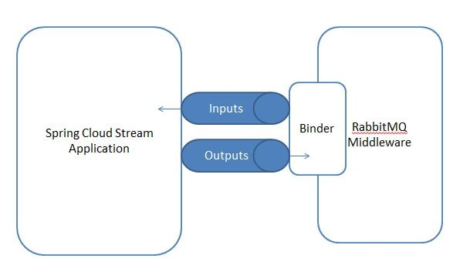
Cloud Stream

Slide 99
Introducing Spring Cloud Stream
@EnableBinding
  To get immediate connectivity to a message broker
  Takes one or more interfaces as parameters
@StreamListener
  To receive events for stream processing.

Slide 100
Sink
  public interface Sink {
  String INPUT = "input";
  @Input(Sink.INPUT)
  SubscribableChannel input();
  }
@Input
  Identifies an input channel, through which received messages enter the application.
@Output
  Identifies an output channel, through which published messages leave the application.
Both take a channel name as a parameter.
If a name is not provided, the name of the annotated method is used.

Slide 101
RabbitMQ
RabbitMQ is open source message broker software
The RabbitMQ server is written in the Erlang programming language
Built on the Open Telecom Platform framework for clustering and failover.
Need to install Erlang before installing RabiitMQ

Slide 102
Source, Sink, and Processor
Spring Cloud Stream provides three predefined interfaces
Source
  To be used for an application which has a single outbound channel.
Sink
  Sink is used to consume message from queue.
Processor
  can be used for an application which has both an inbound channel and an outbound channel.

Slide 103
Producing and Consuming Messages
Cloud Stream application can use either Spring Integration annotations or Spring Cloud Stream’s @StreamListener
@StreamListener
  annotation is modeled after other Spring Messaging annotations
  @MessageMapping, @JmsListener, @RabbitListener, etc.) but adds content type management and type coercion features.

Slide 104
Rabbit MQ Config Property
  server.port=7070
  spring.rabbitmq.host=localhost
  spring.rabbitmq.port=5672
  spring.rabbitmq.username=guest
  spring.rabbitmq.password=guest
  spring.cloud.stream.bindings.employeeRegistrationChannel.destination=employeeRegistrations

Slide 105
Application
  @SpringBootApplication
  @EnableBinding(Sink.class)
  public class CloudStreamWithRabbitApplication {
  public static void main(String[] args) {
  SpringApplication.run(CloudStreamWithRabbitApplication.class, args);
  }
  @StreamListener(target = Sink.INPUT)
  public void processRegisterEmployees(String employee) {
  System.out.println("Employees Registered by Client " + employee);
  } }

Slide 106
Message Channel
  public interface EmployeeRegistrationSource {
  @Output("employeeRegistrationChannel")
  MessageChannel employeeRegistration();
  }

Slide 107
Controller
  @RestController
  @EnableBinding(EmployeeRegistrationSource.class)
  public class EmployeeRegistrationController {
  @Autowired
  EmployeeRegistrationSource employeeRegistrationSource;
  @PostMapping("/register")
  public String orderFood(@RequestBody Employee employee) {
  employeeRegistrationSource.employeeRegistration().
  send(MessageBuilder.withPayload(employee).build());
  System.out.println(employee.toString());
  return "Employee Registered";
  }
  }

Slide 108
Stream Consumer
server.port=8090
spring.rabbitmq.host=localhost
spring.rabbitmq.port=5672
spring.rabbitmq.username=guest
spring.rabbitmq.password=guest
spring.cloud.stream.bindings.input.destination=employeeRegistrations
spring.cloud.stream.bindings.input.group=employeeRegistrationQueue

Slide 109
Consume Message
    @EnableBinding(Sink.class)
    @SpringBootApplication
    public class EmployeeRegistrationProcessingApplication {
    public static void main(String[] args) {
    SpringApplication.run(EmployeeRegistrationProcessingApplication.class, args);
    }
    @StreamListener(target = Sink.INPUT)
    public void processRegisterEmployees(String employee) {
    System.out.println("Employees Registered by Client " + employee); }
    }

Slide 110
SPRING CLOUD BUS

Slide 111
Spring Cloud Bus
The Spring Cloud Bus provides feature to refresh configurations across multiple instances.
Useful if we are having multiple microservice up and running.
This is achieved by connecting all microservices to a single message broker.
Whenever an instance is refreshed, this event is subscribed to all the microservices listening to this broker and they also get refreshed.
The refresh to any single instance can be made by using the endpoint /bus/refresh

Slide 112
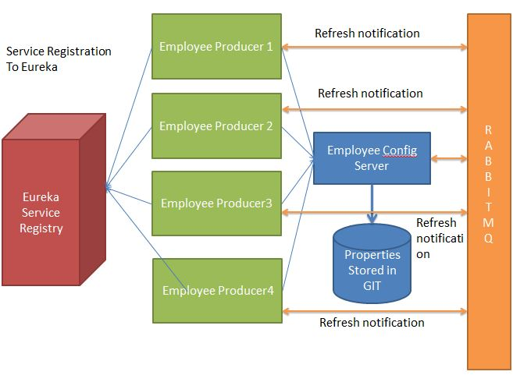
Cloud Bus

