Slide 1
INTRODUCTION TO REST

Slide 2

REST WebService
Roy Thomas Fielding

Slide 3
REST Overview
Resource Oriented Architecture
  Data and functionality are considered resources
  Accessed using Uniform Resource Identifiers (URIs), typically links on the Web.
A resource is accessed via a common interface based on the HTTP standard methods.
A REST server provides access to the resources and a REST client which accesses and modify the REST resources.
Resources are identified by global ID's (which are typically URIs).

Slide 4
Lightweight Web Services
REST is a lightweight alternative to Web Services and RPC.
REST services is:
  Platform-independent
  Language-independent
  Runs on top of HTTP Protocol
  Used in the Presence of firewalls too.
REST does not offer
  built-in security features
  encryption
  session management
These feature can be added by building on top of HTTP:

Slide 5
Root Resource
Root resource classes are POJOs annotated with @Path
  Can also have one method annotated with @Path
The annotation's value is a relative URI path.
Resource methods
  Methods of a resource class annotated with a resource method designator.
  Method designator with annotation such as @GET, @PUT, @POST, @DELETE

Slide 6
Root Resource Classes
  package com.training;
  import javax.ws.rs.GET;
  import javax.ws.rs.Path;
  import javax.ws.rs.Produces;
  import javax.ws.rs.core.MediaType;
  @Path("myresource")
  public class QuickStart {
  @GET
  @Produces(MediaType.TEXT_PLAIN)
  public String greetMessage() {
  return "Welcome to RESTful WebService !";
  }
  }

Slide 7
Richardson Maturity Model
Level 0 :
  Expose SOAP web services in REST style.
  Expose action based services
  (http://server/getPosts, http://server/deletePosts, http://server/doThis, http://server/doThat etc) using REST.
Level 1
  Expose Resources with proper URI’s (using nouns).
  Ex: http://server/accounts, http://server/accounts/10.
  However, HTTP Methods are not used.

Slide 8
Richardson Maturity Model
Level 2
  Resources use proper URI’s + HTTP Methods.
  To update an account PUT and create a POST
Level 3
  HATEOAS- Hypermedia As The Engine Of Application State
  Need to give the required response to the client
  Also need to give the next possible actions that he can perform
When requesting information about a facebook user,
REST service can return user details along with information about how to get his recent posts, how to get his recent comments and how to retrieve his friend’s list.

Slide 9
Using appropriate Request Methods
GET :
  Should not update anything.
  Should be idempotent (same result in multiple calls).
  Possible Return Codes 200 (OK) + 404 (NOT FOUND) +400 (BAD REQUEST)
POST :
  Should create new resource.
  Ideally return JSON with link to newly created resource.
  Same return codes as get possible.
  In addition : Return code 201 (CREATED) is possible.

Slide 10
Using appropriate Request Methods
PUT :
  Update a known resource. ex: update client details.
  Possible Return Codes : 200(OK)
DELETE :
  Used to delete a resource.
  Possible Return Codes : 200(OK) or a 204 - no content

Slide 11
SPRING - REST

Slide 12
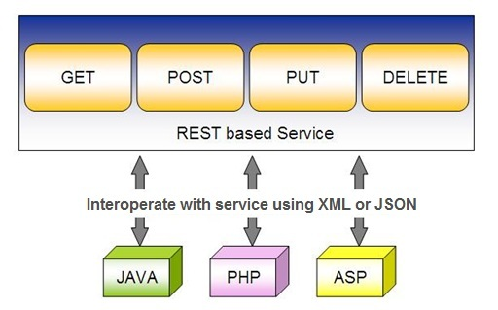
Spring RESTful Services
REST does not require the client to know anything about the structure of the API.
Server needs to provide whatever information the client needs to interact with the service.

Slide 13
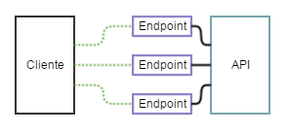
API and Endpoint

Slide 14
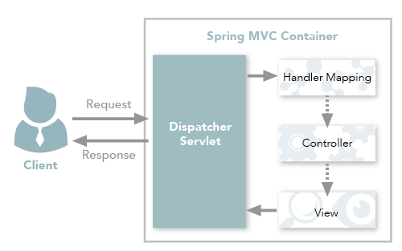
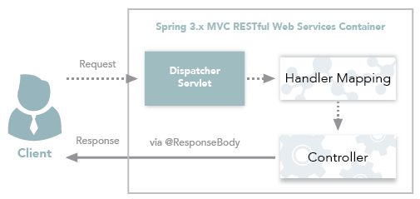
Spring MVC and Spring REST

Slide 15
Spring RESTful Services
A RESTful architecture may expose multiple representations of a resource.
From Spring 4 a @RestController annotation is added to controller
  A combination of @Controller and @ResponseBody
A Rest Controller method returns a domain object instead of a view.

Slide 16
REST Stereotypes
@RestController
  An implicit @ResponseBody is being added to the methods.
  Allows Spring to render the returned HttpEntity and its payload, directly to the response.
@GetMapping
  To map HTTP GET requests onto specific handler methods.
  Composed annotation for @RequestMapping(method = RequestMethod.GET).

Slide 17
REST Stereotypes
@PathVariable
  Indicates that the Method parameter should be bound to a URI template variable.
  @GetMapping("/members/{id}")
  public String getById(@PathVariable String id) { }
@PostMapping
  Combined shortcut for @RequestMapping(method = RequestMethod.POST).
  @PostMapping("/members“)
  public void addMember(@RequestBody Member member) { }

Slide 18
SPRING DATA REST WITH JPA

Slide 19
@Repository
There are three repository in Spring Data
CrudRepository
  Extends Repository
  provides CRUD functions
PagingAndSortingRepository
  Extends CrudRepository
  provides methods to do pagination and sort records
JpaRepository
  Extends PagingandSortingRepository
  Provides Methods such as flushing the persistence context and delete records in a batch
  Querying methods return List's instead of Iterable's

Slide 20
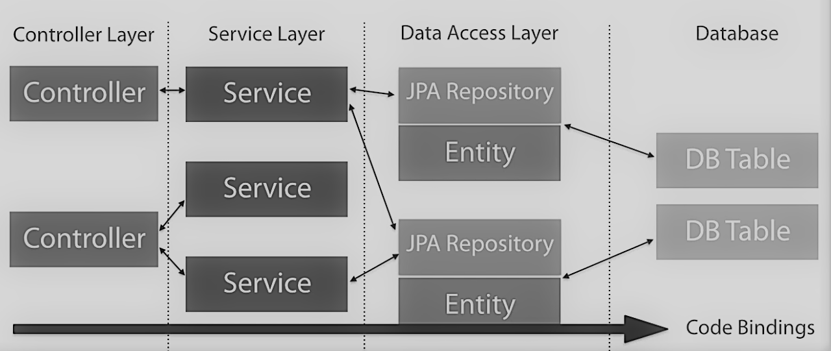
Repository
Controllers can be injected with services or repositories
Services can be injected with repositories,
Controller SHOULD NOT be injected into Services or repositories

Slide 21
Creating Spring Data Application
  Create a repository interface and extend one of the repository interfaces provided by Spring Data.
  If required add custom query methods to the created repository interface
  Inject the repository interface to another component and use the implementation that is provided automatically by Spring.

Slide 22
CRUD Repository
An interface extends Repository interface.
  public interface BookRepository extends CrudRepository<Book, Long> {}
Need NOT create an implementation class
  Spring will automatically create its implementation class at runtime.
The Repository class will be auto detected if suitably placed in the scan path

Slide 23
CrudRepository Interface
  <S extends T> S save(S entity)
  <S extends T> Iterable<S> saveAll(Iterable<S> entities);
  Optional<T> findById(ID primaryKey)
  Iterable<T> findAll()
  void delete(T entity)
  long count()
  boolean existsById(ID id);

Slide 24
Custom Repository Methods
  Can add custom methods to the interface
  Derived method names have two main parts separated by the first By keyword:
  Equality Condition Keywords
    List findByNameEquals(String name);
    List findByNameIsNot(String name);
  Similarity Condition Keywords
    List findByNameStartingWith(String prefix);
    List findByNameContaining(String infix);

Slide 25
Custom Repository Methods
  Comparison Condition Keywords
  List findByAgeLessThan(Integer age);
  List findByAgeLessThanEqual(Integer age);
  List findByAgeGreaterThan(Integer age);
Multiple Condition Expressions
  List findByNameOrBirthDate(String name, ZonedDateTime birthDate);
  List findByNameOrBirthDateAndActive(String name, ZonedDateTime birthDate, Boolean active);
Sorting the Results
  List findByNameOrderByName(String name);
  List findByNameOrderByNameAsc(String name);

Slide 26
Custom Repository Methods
findByStartDateBetween
findByStartDateAfter
findByStartDateBefore
findByAgeOrderByLastnameDesc.
findByFirstNameIgnoreCase

Slide 27
Custom Repository Method
  public interface BookRepository extends CrudRepository<Book, Long> {
  List<Book> findByAuthor(String author);
  List<Book> findDistinctByCategory(String category);
  List<Book> findByAuthorAndCategory(String author, String category);
  }

Slide 28
Repository
  @Repository
  public interface InvoiceRepository extends JpaRepository<Invoice, Integer> {
  public List<Invoice> findByCustomerName(String customerName);
  }

Slide 29
Service
  @Service
  public class InvoiceService {
  @Autowired
  private InvoiceRepository repo ;
  public List<Invoice> findAll(){
  return repo.findAll();
  }
  public Optional<Invoice> findById(int id) {
  return repo.findById(id);
  } }

Slide 30
Controller
  @RestController
  public class InvoiceController {
  @Autowired
  private InvoiceService service ;
  @GetMapping("/getAll”)
  public List<Invoice> findAll() {
  List<Invoice> details = service.findAll();
  return details;
  }

Slide 31
@Query
Used to write the more flexible query to fetch data.
Supports both JPQL and native SQL queries.
By default will be using JPQL to execute the queries.
  Using normal SQL queries, would get the query syntax error exceptions.
Can use native SQL queries by setting nativeQuery flag to true.
  Pagination and dynamic sorting for native queries are not supported in spring data jpa.

Slide 32
Custom Query Method
  @Query(value = "select name,author,price from Book b where b.price>?1 and b.price<?2")
  List<Book> findByPriceRange(long price1, long price2);
  @Query(value = "select name,author,price from Book b where b.name = :name AND b.author=:author AND b.price=:price")
  List<Book> findByNamedParam(@Param("name") String name, @Param("author") String author, @Param("price") long price);
  @Query(value = "select * from Book b where b.name=?1", nativeQuery = true)
  List<Book> findByName(String name);

Slide 33
ONE TO MANY RELATIONS

Slide 34
Entity
  @Entity
  @Table(name="vdsi_invoice")
  public class Invoice {
  @Id
  @GeneratedValue
  private int invoiceNumber;
  private String customerName;
  @OneToMany(mappedBy = "invoice", cascade = CascadeType.ALL,fetch=FetchType.EAGER,nullable=false)
  private Set<Item> itemList;
  }

Slide 35
Entity
  @Entity
  @Table(name="vdsi_item")
  public class Item {
  @Id
  private int intemNumber;
  private String itemName;
  private double ratePerUnit;
  @ManyToOne
  @JoinColumn(name="invoice_ref")
  private Invoice invoice;
  }

Slide 36
PAGING AND SORTING

Slide 37
PagingAndSortingRepository
findAll(Pageable pageable)
    Pageable object with following properties
      Page size
      Current page number
      Sorting
      findAll(Sort sort)
        Sort Object with the Property on Which the sorting is to be done
        Sort.by(propName)

Slide 38
Entity
@Data
@AllArgsConstructor
@NoArgsConstructor
@Entity
@Table(name = "STATEDOCTOR")
public class Doctor {
@Id
private int doctorCode;
private String doctorName;
private String specialization;
private long handPhone;
private String location;
private String qualification;
}

Slide 39
Repository
@Repository
public interface DoctorRepository extends PagingAndSortingRepository<Doctor,Integer> {
Iterable<Doctor> findAll(Sort sort);
Page<Doctor> findAll(Pageable pageable);
}

Slide 40
Service
@Service
public class DoctorService {
@Autowired
private DoctorRepository repo;
public Iterable<Doctor> findAll(String propName){
Sort sortBy = Sort.by (propName);
return this.repo.findAll (sortBy);
}

Slide 41
Service
public List<Doctor> findByPage(int page, int size, String propName){
Pageable paging =
PageRequest.of(page,size,Sort.by(propName).ascending ());
Page<Doctor> pagedResult = repo.findAll(paging);
if(pagedResult.hasContent()) {
return pagedResult.getContent();
} else {
return new ArrayList<Doctor> ();
}
}
}

Slide 42
Rest Controller
@RestController
public class DoctorController {
@Autowired
private DoctorService service;
@GetMapping("/doctor/sort/{prop}")
public Iterable<Doctor> findAll(@PathVariable("prop") String prop){
return this.service.findAll (prop);
}

Slide 43
Rest Controller
@GetMapping("/doctor/paging/{page}/{size}/{propName}")
public List<Doctor> findByPage(@PathVariable("page") int page, @PathVariable("size") int size, @PathVariable("propName") String propName){
return this.service.findByPage (page,size,propName);
}
}

Slide 44
HATEOAS

Slide 45
Hateos
Hypermedia As The Engine Of Application State.
When the browser loads a page
  Can see all the content that the page has to offer.
  Page also allows to perform a lot of actions around that data, :
Clicking on buttons
Clicking on tabs
Links to Other Resources

Slide 46
Hateos Request
A REST request, only get the data and not any actions around it.
A HATEOAS request allows to not only send the data but also specify the related actions
Hypertext Application Language
HAL is a simple format that gives an easy, consistent way to hyperlink between resources in your REST API.
Used as standard convention for defining hypermedia such as links to external resources within JSON
    @GetMapping(value="/reviews/{id}",produces = "application/hal+json")

Slide 47
Links
HAL has categories of representations:
Links: Specified as a combination of
  Target — Given as a URI
  Relation — A name
Embedded Resources: Other resources contained within a given REST resource
State: The actual resource data

Slide 48
Entity
  @Data
  @AllArgsConstructor
  @NoArgsConstructor
  public class Clinic {
  private long id;
  private String clinicName;
  private String location;
  }

Slide 49
Entity
  @Entity
  @Table(name="docsreview")
  @Data
  public class DoctorReview {
  @Id
  private long reviewId;
  private String reviewerName;
  private String message;
  private double rating;
  }

Slide 50
Clinic Controller
  @RestController
  public class ClinicController {
  @GetMapping(value = "/clinics")
  public Iterable<Clinic> findAll(){
  return Arrays.asList(new Clinic(101,"dr.lal","marol"));
  }
}

Slide 51
Repository
  @Repository
  public interface ReviewRepository extends CrudRepository<DoctorReview, Long> {
  }

Slide 52
Service
  @Service
  public class ReviewService {
  @Autowired
  private ReviewRepository repo;
  public DoctorReview add(DoctorReview entity) {
  return this.repo.save(entity);
  }
  public Iterable<DoctorReview> findAll(){
  return this.repo.findAll();
  }
  public DoctorReview findById(long id){
  return this.repo.findById(id).get();
  }
  }

Slide 53
Controller LinkBuilder
API Provides ControllerLinkBuilder and Link classes
  spring HATEOAS module.
Link
  Representation of link to be added in REST resource.
ControllerLinkBuilder
  helps in building the links using it’s methods
method links
  which can be followed to perform some operations on individual resource.
  Link link1 = ControlLinkBuilder.linkTo(methodOn(ReviewController.class).findAll()).
  withRel("findAllDoctors");
  Link link2 = linkTo(methodOn(ClinicController.class).findAll()).withRel("findAllClinics");

Slide 54
Return Hateos Response
Need to include related resources in the response.
The return type of the Method becomes a Representation of Resource.
Resource is a simple class wrapping a domain object and allows adding links to it.
Resources<DoctorReview> resource =
  new Resources<>(allReviews,link1,link2);

Slide 55
Controller
  import static org.springframework.hateoas.mvc.ControllerLinkBuilder.*;
  import org.springframework.hateoas.*;
  import org.springframework.hateoas.mvc.ControllerLinkBuilder;
  import org.springframework.hateoas.config.*;
  public class ReviewController {
  @Autowired
  private ReviewService service;
  @GetMapping(value = "/reviews")
  public Iterable<DoctorReview> findAll(){
  return this.service.findAll();
  }

Slide 56
Creating Links
  @GetMapping(value="/reviews/{id}",produces = "application/hal+json")
  public Resources<DoctorReview> getReviewById(@PathVariable("id") long id) {
  DoctorReview review = this.service.findById(id);
  Iterable<DoctorReview> allReviews = Arrays.asList(review);
  Link link1 = linkTo(methodOn(ReviewController.class).findAll()).withRel("findAllDoctors");
  Link link2 = linkTo(methodOn(ClinicController.class).findAll()).withRel("findAllClinics");
  Resources<DoctorReview> resource = new Resources<>(allReviews,link1,link2);
  return resource;
  }

Slide 57
Logging
  logging.level.org.springframework.web=DEBUG
  #JDBC Connection Related Parameters
  spring.datasource.username=sa
  spring.datasource.password=
  spring.datasource.driverClassName=org.h2.Driver
  spring.datasource.jdbc-url=jdbc:h2:file:C:/h2data/sample
  # H2 Database Related Parameters
  spring.h2.console.enabled=true
  spring.h2.console.path=/h2
  spring.jpa.show-sql=true
  # JPa Related
  spring.jpa.database-platform=org.hibernate.dialect.H2Dialect

Slide 58
SPRING REST CLIENT-REST TEMPLATE

Slide 59
Consuming REST with REST Template
REST web service can be comsumed programmatically.
Spring convenient template class is called RestTemplate.
  one-line that can bind the data to custom domain types.
It leverages the same marshallers that the server uses.
Can use JAXB marshaller,as well as JSON marshaller

Slide 60
Rest Template
Rest Template is used to create applications that consume REST
Its Autowired to the controller class.
exchange()
  Returns ResponseEntity containing an object mapped from the response body
  Can Communicate with any HTTP Method
  Takes the following arguments
    URL,
    HttpMethod,
    Return type for Exchange() method.

Slide 61
Rest Template
  getForObject(url, java.lang.Class<T>)
    Retrieve a representation by doing a GET on the specified URL.
    Class<T> is the response class Type
getForEntity(url, java.lang.Class<T>)
  Retrieve a representation by doing a GET on the URL
  Class<T> is the response class Type

Slide 62
Rest Template
headForHeaders() :
  Retrieves all headers
delete()
  Deletes the resources at the given URL.
put()
  Creates the new resource for the given URL.
postForEntity():
  Creates a news resource using HTTP POST method.

Slide 63
Rest Template -Exchange
  HttpHeaders headers = new HttpHeaders();
  headers.setAccept(Arrays.asList(MediaType.APPLICATION_JSON));
  HttpEntity <String> entity = new HttpEntity<String>(headers);
  restTemplate.exchange(" http://localhost:8080/products",
  HttpMethod.GET, entity, String.class).getBody();

Slide 64
getForObject
  @Autowired
  RestTemplate restTemplate;
  String obj =
  restTemplate.getForObject("http://localhost:4040/person/all", String.class);
  System.out.println(obj);

Slide 65
getForEntity
Server Side Code
  @RequestMapping("/fetch/{name}/{village}")
  public Person getPersonDetail(@PathVariable(value = "name") String name, @PathVariable(value = "village") String village) {
  Address address = new Address("Varanasi", "UP");
  return new Person(100,name, address);
  }

Slide 66
getForEntity
Client Side Code
  String url = "http://localhost:8080/spring-rest/data/fetch/{name}/{village}";
  Map<String, String> map = new HashMap<String, String>();
  map.put("name", “Ramesh");
  map.put("village", “Tirupur");
  ResponseEntity<Person> personEntity = restTemplate.getForEntity(url, Person.class, map);
  System.out.println("Name:"+personEntity.getBody().getName());

Slide 67
getForObject
  @Autowired
  RestTemplate restTemplate;
  String obj =
  restTemplate.getForObject("http://localhost:4040/person/all", String.class);
  System.out.println(obj);

Slide 68
headForHeaders
Used to Retrieve Headers
  Has overloaded Methods
HttpHeaders httpHeaders = restTemplate.headForHeaders(url);
System.out.println(httpHeaders.getDate());
System.out.println(httpHeaders.getContentType());

Slide 69
PostForObject
Used to create a new Resource
postForLocation()
  returns the URI of the newly created Resource
postForObject()
  Returns the Resource itself.
RestTemplate restTemplate = new RestTemplate();
HttpEntity<Book> request = new HttpEntity<>(new Book(“Java"));
Book bk = restTemplate.postForObject(url, request,Book.class);

Slide 70
PostForLocation
Returns the Location of that newly created Resource:
  HttpEntity<Book> request = new HttpEntity<>(new Book("bar"));
  URI location = restTemplate.postForLocation(url, request);

Slide 71
Put
  RestTemplate restTemplate = new RestTemplate();
  String url = "http://localhost:8080/spring-rest/data/putdata/{id}/{name}";
  Map<String, String> map = new HashMap<String, String>();
  map.put("id", "100"); map.put("name", "Ram");
  Address address = new Address(“Tiurpur,”TN");
  restTemplate.put(url, address, map);

Slide 72
Delete
Used to remove an existing Resource
  String url = "http://localhost:8080/spring-rest/data/delete/{name}/{village}";
  Map<String, String> map = new HashMap<String, String>();
  map.put("name", "Mahesh");
  map.put("village", “Madipakkam");
  restTemplate.delete(url, map);

Slide 73
Using Rest Template-With Security
  @Bean
  public RestTemplate template() {
  RestTemplate template = new RestTemplate();
  template.getInterceptors().add(interceptor());
  return template;
  }
  @Bean
  public BasicAuthenticationInterceptor interceptor() {
  return new BasicAuthenticationInterceptor("india", "india");
  }

Slide 74
Using Rest Template-With Security
  @Bean
  public HttpHeaders headers() {
  HttpHeaders headers = new HttpHeaders();
  headers.setAccept(Arrays.asList(MediaType.APPLICATION_JSON));
  return headers;
  }
  @Bean
  public HttpEntity entity() {
  HttpEntity <String> entity = new HttpEntity<String>(headers());
  return entity;
  }

Slide 75
Using Rest Template-With Security
  @Bean
  public MedicalServiceClient client() {
  return new MedicalServiceClient();
  }
  @Bean
  public Medicine medicine() {
  return new Medicine(899L,"Glycomet",45.00,35);
  }
  }

Slide 76
Using Rest Template-With Security
  public class MedicalServiceClient {
  @Autowired
  private RestTemplate template;
  @Autowired
  private HttpEntity entity;
  @Autowired
  private Medicine medicine;
  private final String url = "http://localhost:8080/medicines";

Slide 77
Using Rest Template-With Security
  public String useGetAll() {
  return this.template.exchange(url,HttpMethod.GET,entity,String.class).getBody();
  }
  public Medicine usePostMethod() {
  return this.template.postForEntity(url,medicine,Medicine.class).getBody();
  }

Slide 78
CORS- CONFIGURATION

Slide 79
CORS configuration
Annotation enables cross-origin requests
Can be added at the Method or controller Class level
@CrossOrigin(origins = "http://localhost:9000")
By default, its allows all origins, all headers, the HTTP methods specified in the @RequestMapping annotation
It can be customized specifying the value of one of the annotation attributes:
  origins,
  methods,
  allowedHeaders,

Slide 80
SWAGGER

Slide 81
Swagger
An Application that helps in documenting RESTful services easy.
@EnableSwagger2
  To enable Swagger support
  Applied to '@Configuration' annotative class.
  Its invoked http://localhost:8080/swagger-ui.html

Slide 82
Configuring Swwager
Docket
  Docket instance provides the primary API for configuration
  To configure Swagger 2 for the application.
  Has e defaults and convenience methods for configuration.

Slide 83
Adding Swagger
    <dependency>
    <groupId>io.springfox</groupId>
    <artifactId>springfox-swagger2</artifactId>
    <version>2.9.2</version>
    </dependency>
    <dependency>
    <groupId>io.springfox</groupId>
    <artifactId>springfox-swagger-ui</artifactId>
    <version>2.9.2</version>
    </dependency>

Slide 84
Swagger Annotations
@Api
  Marks a class as a Swagger resource.
@ApiModel
  Provides additional information about Swagger models.
@ApiModelProperty
  Adds and manipulates data of a model property.

Slide 85
Swagger Annotations
@ApiOperation
  Describes an operation or typically an HTTP method against a specific path.
@ApiParam
  Adds additional meta-data for operation parameters.
@ApiResponse
  Describes a possible response of an operation.
@ApiResponses
  A wrapper to allow a list of multiple ApiResponse objects.

Slide 86
Swagger Configuration
  @EnableSwagger2
  public class AppConfig {
  @Bean
  public Docket apiDocket() {
  return new Docket(DocumentationType.SWAGGER_2).apiInfo(apiInfo()).
  select().
  apis(
  RequestHandlerSelectors.
  basePackage("com.example.demo.controllers")).
  paths(PathSelectors.any()).build();
  }

Slide 87
Swagger Configuration
  @Bean
  public ApiInfo apiInfo() {
  return new ApiInfoBuilder().title("Store Manager").
  description("Rest API to Find and Query Popular Shopping Malls in Chennai").
  version("1.2").build();
  }
  }

Slide 88
Documenting Model
  public class Store {
  @ApiModelProperty("Store ID in 6 Digit")
  private long storeId;
  @ApiModelProperty("Store Location as Pincode")
  private String location;
  @ApiModelProperty("Name of the Store Incharge")
  private String storeIncharge;
  @ApiModelProperty("yearly income target in Thousands")
  private double yearlyTarget;
  }

Slide 89
Documenting Methods
  @ApiOperation(value="Fetch the Details of All Global")
  @ApiResponses({
  @ApiResponse(code=200,message="Resource Found - Success")
  })
  @GetMapping("/allStores")
  public List<Store> getStores(){
  return this.repo.getAll();
  }

Slide 90
Documenting API Methods
  @ApiParam(value="Takes the Store Id in 6 Digit")
  @GetMapping("/allStores/{storeId}")
  public Store findStoreById(@PathVariable("storeId") long id) {
  return this.repo.findById(id);
  }

Slide 91
SECURING REST

Slide 92
Spring Security
Highly customizable authentication and access-control framework.
Focuses on providing both authentication and authorization
“Authentication”
  The process of establishing a user, device or some other system which can perform an action in the application
“Authorization”
  The process of deciding whether a principal is allowed to perform an action within the application.
  authorization is done after authentication process.
  Once the user is authenticated they may have one or more “roles”

Slide 93
@EnableWebSecurity
Should be always added the application will fail to start.
Can also be used to disable the default security configuration.
  Allows to customize by adding external properties
  A Bean of type WebSecurityConfigurerAdapter is created
  Spring finds bean with @Configuration and automatically apply Security

Slide 94
Spring Security Modules
  <dependency>
    <groupId>org.springframework.boot</groupId>
    <artifactId>spring-boot-starter-security</artifactId>
  </dependency>
  <dependency>
    <groupId>org.springframework.security</groupId>
    <artifactId>spring-security-test</artifactId>
    <scope>test</scope>
  </dependency>

Slide 95
Disabling the Auto-Configuration
Can discard the security auto-configuration and add custom
  @SpringBootApplication(exclude = { SecurityAutoConfiguration.class })
  public class SpringBootSecurityApplication {
  public static void main(String[] args) {
  SpringApplication.run(SpringBootSecurityApplication.class, args);
  }
  }

Slide 96
WebSecurityConfigurerAdapter
A base class for creating a WebSecurityConfigurer instance.
Can do customization by overriding methods
configure(HttpSecurity)
  Defines the mapping of secured URLs or path that will determine if the user can access specific pages.
configure(AuthenticationManagerBuilder).
  Defines how the security will handle the retrieval of user information commonly in the database.

Slide 97
HTTP Security
authorizeRequests()
  Provided by HttpSecurity
  To Define custom requirements for URLs
  Can add multiple children to this method.
  The matchers are considered in the order they were declared.
  http.authorizeRequests()
  .anyRequest().authenticated()
  .and().httpBasic();

Slide 98
AuthenticationManagerBuilder
AuthenticationManagerBuilder
  Used to create an Authentication Manager
Authentication Manager
  Used to authenticate the passed Authentication object,
  Allows building in memory authentication
  Can also use LDAP authentication
  Can also use JDBC based authentication,

Slide 99
Security Configuration
  @Configuration
  @EnableWebSecurity
  public class BasicConfiguration extends WebSecurityConfigurerAdapter {
  @Override
  protected void configure(AuthenticationManagerBuilder auth)
  throws Exception {
  auth.inMemoryAuthentication()
  .withUser("user")
  .password("password")
  .roles("USER“);
  }

Slide 100
Form Login
  @Configuration
  public class SecurityConfig extends WebSecurityConfigurerAdapter {
  @Override
  protected void configure(HttpSecurity http) throws Exception {
  http.authorizeRequests().antMatchers("/first").authenticated().and().formLogin();
  }
  @Override
  protected void configure(AuthenticationManagerBuilder auth) throws Exception {
  auth.inMemoryAuthentication().withUser("ramesh").password("{noop}ramesh").roles("USER");
  }

Slide 101
Controller
  @RestController
  public class ProjectController {
  @GetMapping("/first")
  public String getSecuredMessage(Principal user) {
  return "Welcome to Secured Page"+user.getName();
  }
  @GetMapping("/second")
  public String getUnSecuredMessage() {
  return "Welcome to UN-Secured Page";
  }
  }

Slide 102
Security Configuration
  protected void configure(HttpSecurity http) throws Exception {
  http
  .authorizeRequests()
  .anyRequest()
  .authenticated()
  .and()
  .formLogin();
  }
  }
    http
    .authorizeRequests().antMatchers("/first")
    .authenticated()
    .and()
    .formLogin();

Slide 103
Sample Security Config
  http.authorizeRequests()
  .antMatchers("/","/*.html","/h2/**")
  .permitAll().
  antMatchers("/trips")
  .authenticated().and()
  .httpBasic().and()
  .csrf().
  disable();

Slide 104
Sample Security Configurations
  http.authorizeRequests()
  .antMatchers("/","/*.html","/h2/**")
  .permitAll().
  antMatchers("/trips")
  .authenticated().and()
  .formLogin().and().logout().logoutSuccessUrl("/trips")
  .invalidateHttpSession(true)
  .deleteCookies("JSESSIONID").and().csrf().
  disable();

Slide 105
Method Level Security
Spring Security supports authorization semantics at the method level.
Service layer can be secured by which roles are able to execute a particular method – and test it using dedicated method-level security test support.

Slide 106
Method Level Security
  @Configuration
  @EnableGlobalMethodSecurity( securedEnabled = true,)
  public class SecurityConfig extends WebSecurityConfigurerAdapter {
  protected void configure(HttpSecurity http) throws Exception {
  http.httpBasic(); }
  protected void configure(AuthenticationManagerBuilder auth) throws Exception {
  auth.inMemoryAuthentication() .withUser("user").password("password").roles("USER") .and() .withUser("admin").password("password").roles("ADMIN");
  } }

Slide 107
@Secured
Used to specify a list of roles on a method.
  User with only role can access that method
  @GetMapping(“/srch")
  @Secured("ROLE_ADMIN")
  public String message() {
  return "Hello, World!";
  }
  }

Slide 108
Example
  @RestController
  @RequestMapping("book")
  public class BookController {
  @GetMapping("anonymous")
  @Secured("ROLE_ANONYMOUS")
  public String anonymously() { return "Hello, World!"; }

Slide 109
Method Security
  Adding an annotation to a method (on a class or interface) limits the access to that method accordingly.
  @PermitAll and @RolesAllowed annotations.
  @RestController
  @RequestMapping("/user")
  public class UserController {
  @GetMapping("anonymous")
  @PermitAll public String anonymously() {
  return "Hello, World!"; }
  @GetMapping("has-role")
  @RolesAllowed({"ROLE_ADMIN"})
  public String hasRole() {
  return "Hello, World!";
  }
  }

Slide 110
SECURITY WITH JDBC

Slide 111
Security Configuration
Spring security Default Configuration expects following two tables
Users
  Used for Storing username, passwords
Authorities
  Used for storing the associated roles.
data.sql and schema.sql are added in the resources folder

Slide 112
data.sql
  insert into users (username, password,enabled) values ('india','$2a$10$P.9MaemE6x38wnZer4qauO8Dl9pixQEZ27.yEQglTtyjdmJBRtTFS',true);
  insert into authorities (username, authority) values ('india', 'ROLE_USER');
  insert into test.users (username, password, enabled) values ('nepal','$2a10$t4kkrerTgJlcvTj7QresWuBqAsnxVxMxaJ6UzlXCaP/HSdDraO5QC',true);
  insert into authorities (username, authority) values ('nepal', 'ROLE_ADMIN');

Slide 113
schema.sql
  CREATE TABLE `test`.`users` ( `username` varchar(50) NOT NULL, `password` varchar(200) NOT NULL, `enabled` tinyint(1) NOT NULL, PRIMARY KEY (`username`))
  CREATE TABLE `test`.`authorities` ( `username` varchar(50) NOT NULL, `authority` varchar(50) NOT NULL, KEY `fk_authorities_users` (`username`), CONSTRAINT `fk_authorities_users` FOREIGN KEY (`username`) REFERENCES `users` (`username`))

Slide 114
Application.properties
  spring.datasource.url=jdbc:mysql://localhost:3306/test
  spring.datasource.username=root
  spring.datasource.password=srivatsan
  spring.datasource.driver-class-name=com.mysql.cj.jdbc.Driver
  spring.jpa.hibernate.ddl-auto=update
  spring.jpa.hibernate.naming.physical-strategy
  =org.hibernate.boot.model.naming.PhysicalNamingStrategyStandardImpl

Slide 115
Pass Word Encoder
  public static void main(String[] args) {
  BCryptPasswordEncoder encoder = new BCryptPasswordEncoder();
  String encoded = encoder.encode("india");
  System.out.println(encoded);
  encoded = encoder.encode("nepal");
  System.out.println(encoded);
  }

Slide 116
Rest Controller
  @RestController
  public class ProjectController {
  @GetMapping("/first")
  @Secured(value="ROLE_USER")
  public String getSecuredMessage(Principal user) {
  return "Welcome to Secured Page"+user.getName();
  }
  }
  }

Slide 117
Security Config
  @Configuration
  @EnableGlobalMethodSecurity( securedEnabled = true)
  public class SecurityConfig extends WebSecurityConfigurerAdapter {
  @Autowired
  private DataSource customDataSource;
  @Override
  protected void configure(HttpSecurity http) throws Exception {
  http.authorizeRequests().antMatchers("/first").authenticated().and().formLogin();
  }

Slide 118
Security Config
  @Override
  protected void configure(AuthenticationManagerBuilder auth) throws Exception {
  auth.jdbcAuthentication().passwordEncoder(new BCryptPasswordEncoder()).dataSource(this.customDataSource);
  }
  }

Slide 119
Custom Security Configuration
  @Override
  protected void configure(AuthenticationManagerBuilder auth) throws Exception {
  String query1 = "select userName,password,enabled from users where userName = ?";
  String query2 = "select userName,authority from authorities where userName=?";
  auth.jdbcAuthentication()
  .dataSource(this.customDataSource)
  .authoritiesByUsernameQuery(query1)
  .authoritiesByUsernameQuery(query2)
  .passwordEncoder(new BCryptPasswordEncoder());
  }

Slide 120

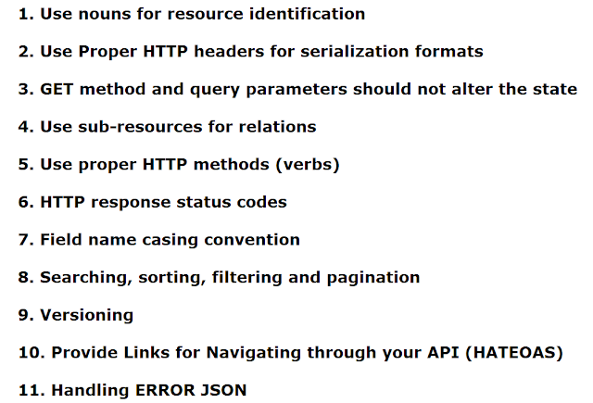
Restful API Design Best Practices

Slide 121
Nouns For Resources
GET - /users - Returns a list of users
GET - users/100 - Returns a specific user
POST - /users - Create a new user
PUT - /users/ - Updates a specific user
DELETE - /users/711 - Deletes a specific user
Do not use verbs:
GET /getAllUsers/getUserById

Slide 122
Proper HTTP Headers
Both client and server, need to know which format is used for the communication.
The format has to be specified in the HTTP-Header.
Content-Type defines the request format.
Accept defines a list of acceptable response formats.

Slide 123
Get Method and Query Parameters Should Not Alter the State
Use PUT, POST and DELETE methods instead of the GET method to alter the state.
Do not use GET for state changes:
GET /users/711?activate
GET /users/711/activate

Slide 124
Sub-Resources for Relations
If a resource is related to another resource using subresources.
GET /cars/711/drivers/
Returns a list of drivers for car 711
GET /cars/711/drivers/4
Returns driver #4 for car 711

Slide 125
Sub-Resources for Relations
One more example:
These messages can be logically mapped to the /tickets endpoint as follows:
GET /tickets/12/messages - Retrieves a list of messages for ticket #12
GET /tickets/12/messages/5 - Retrieves message #5 for ticket #12
POST /tickets/12/messages - Creates a new message in ticket #12
PUT /tickets/12/messages/5 - Updates message #5 for ticket #12

Slide 126
Restful API Versioning
Make the API Version mandatory and do not release an unversioned API. Use a simple ordinal number and avoid dot notation such as 2.5.
We are using the URL for the API versioning starting with the letter "v"
Examples:
/blog/api/v1 http://api.yourservice.com/v1/companies/34/employees

