Slide 1


SPRING 5

Slide 2
http://bit.ly/spring5_01_vatsan

Slide 3
Spring Framework
Light-weight comprehensive framework for building Java SE and Java EE applications
Created by Rod Johnson
Java Bean-based configuration management,
Uses Inversion-of-Control principles, specifically using the Dependency Injection technique

Slide 4
Key Features
Suite for Both Java SE and EE
IoC Container
Integration with persistence frameworks.
MVC web application framework
Java Transaction API and a single JDBC Data Source
  This removes the dependency on a Java EE environment for transaction support.
Aspect-oriented programming (AOP) framework

Slide 5
History of Spring Framework
The Spring Framework was first released in 2004
Spring 2.0
  provided XML namespaces and AspectJ support;
Spring 2.5
  embraced annotation-driven configuration;
Spring 3.0
  Support for Java 5+ across the framework codebase,
  Java-based @Configuration model.
Spring 4.0
  Fully support Java 8 features.
  The minimum requirement is Java SE 6
  Spring 5.0
  Full compatibility with JDK 9 for development and deployment.

Slide 6
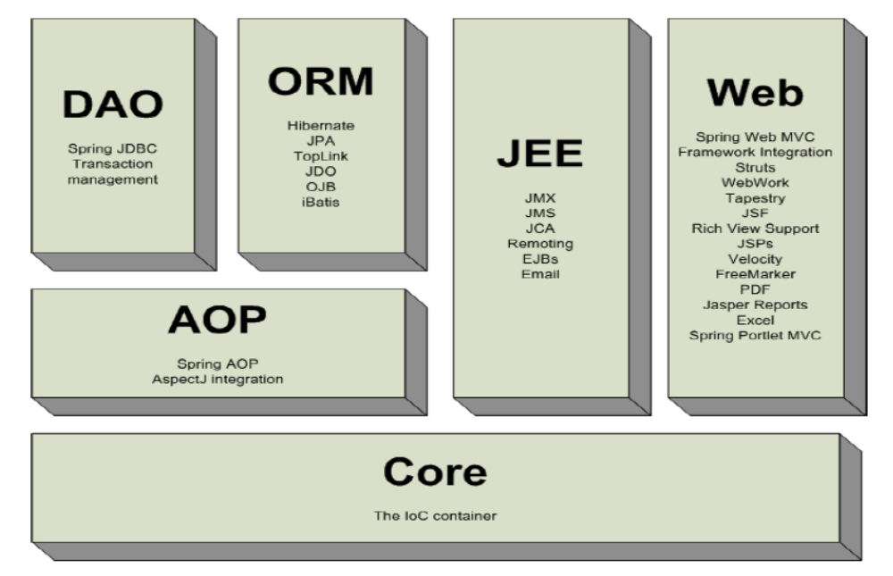
Spring Framework

Slide 7
IoC Container
Introduction
Basic Containers and Beans
Dependencies
Bean Scope
The Application Context
Quick Start Spring Application Using Eclipse IDE

Slide 8
Dependency Injection
A pattern of injecting a class’s dependencies into it at runtime.
Achieved by defining the dependencies and then injecting in a concrete class
Can swap in different implementations without having to modify the main class.
Promotes high cohesion by promoting the Single Responsibility Principle (SRP)

Slide 9
Dependency Inversion Principle
  High level modules should not depend upon low level modules.
  Low and High Modules should depend upon abstractions.
  Low modules should NOT define a interface that Higher Level module depend on
  Higher Level Module should define an interface that lower level module must implement
This gives the flexibility at the cost of increased effort.

Slide 10
Dependency Inversion Principle
public class Messaging {
MessageService service;
public void sendMssage(){
service.sendMessage();
} }
public interface MessageService {
public String sendMessage();
}
public class Email implements MessageService {
public String sendMessage() { }
}
High-level modules should not depend on low-level modules.
Both should depend on abstractions.
High Level Module
Abstraction
Low Level Module

Slide 11
Inversion of Control Container(IoC)
A container that supports Dependency Injection.
No Need to create objects but describe how they should be created.
Describe which services are needed by which components in a configuration file.
Objects are given their dependencies at creation time by the IoC
IoC - inversion of responsibility with regard to how an object obtains references to collaborating objects.

Slide 12

The Container

Slide 13
Container and Beans
org.springframework.beans.factory.BeanFactory is the representation of the Spring IoC container
  containing and managing beans,
  instantiating or sourcing application objects
  configuring such objects
  assembling the dependencies between objects.
A bean is an object that is instantiated, assembled, and otherwise managed by a Spring IoC container.
Beans, and the dependencies among them, are reflected in the configuration metadata used by a container

Slide 14
Application Context
ApplicationContext is a complete superset of the BeanFactory
Containers gets its instructions on what objects to instantiate, configure, and assemble by reading configuration metadata.
There are many Implementations of the ApplicationContext

Slide 15
Implementation of Application Context
ClassPathXmlApplicationContext:
  Loads a context definition from an XML file located in the classpath,
  context definition files as classpath resources.
FileSystemXmlApplicationContext
  Loads a context definition from an XML file in the file system.
XmlWebApplicationContext
  Loads context definitions from an XML file contained within a web application.

Slide 16
Bean Factory and Application Context
Application Context
Bean Factory
Can have more than one config files
Publish events to beans that are registered as listeners
Support internationalization (I18N) messages
Support application lifecycle events, and validation.
Support for JNDI , EJB, remoting
In this only one config file or .xml file
Doesn’t support.
Doesn’t support
Doesn’t support.
Doesn’t support.

Slide 17
Beans
The term “bean” is used to refer any component managed by the BeanFactory
The “beans” are in the form of JavaBeans (in most cases)
  Present in a Named Package
  No Argument constructor
  getter and setter methods for the properties
  Can be controlled for scope, life cycle and callbacks.
Beans are singletons by default
Properties the beans may be simple values or references to other beans

Slide 18
Configuration Meta Data
Instructs IoC Container to instantiate, configure, and assemble the objects
Can be done in XML format
  Supported from Spring 2.0
Can be done with Annotation
  Supported from Spring 2.5
Can be done with Just Java
  Supported from Spring 3.0

Slide 19
DEPENDENCY INJECTION

Slide 20
Dependency Injection
Spring could inject dependencies between the beans by following way of injection types:
  Setter Injection
  Constructor Injection
  Field Injection (@Autowired at field)
  Method Injection
Dependency can be wired in three ways
  XML Based Configuration
  Annotation Based Configuration
  Java Based Configuration

Slide 21
Setter Injection
All dependencies injected via setter methods
  No need for constructors
Allows flexible initialization
  Any set of properties can be initialized
Named properties allow for readable configuration data
  Clear what is being injected
Requires Java Bean conventions to be followed
  Non standard method names are problematic
Can result in invalid object configurations
  Need post initialization checking methods

Slide 22
Configuration File
@Configuration
  indicates that the class can be used by the Spring IoC container as a source of bean definitions.
Classes annotated are bootstrapped using
  AnnotationConfigApplicationContext
  AnnotationConfigWebApplicationContext.

Slide 23
@Bean
Method-level annotation
Supports following attributes
  init-method
  destroy-method
  autowiring
Can be used in Class annotated with
  @Configuration
  @Component

Slide 24
Customizing Bean Naming
@Bean method’s name is the name of the resulting bean.
It Can be overridden with the name attribute
  @Bean(name = “javaBook")
  public Book java() {
  return new Book();
  }
  }

Slide 25
Setter Dependency Injection
  @Configuration
  public class AppConfig {
  @Bean
  public Hospital malar() {
  Hospital malar = new Hospital();
  malar.setId(101);
  malar.setHospitalName("Malar Hospitals");
  malar.setPhoneNumber(24482727L);
  return malar;
  }
  }

Slide 26
AnnotationConfigApplicationContext
Class that extends GenericApplicationContext
Provides many methods for handling beans
Has methods Inherited from AbstractApplicationContext
AnnotationConfigApplicationContext(Class<?>... annotatedClasses)
  Create a new AnnotationConfigApplicationContext
  Derives bean definitions from the given annotated classes
  Also automatically refreshes the context.
  Can also Use Zero argument constructor and register and refresh bean

Slide 27
Application
  public static void main(String[] args) {
  AnnotationConfigApplicationContext ctx = new
  AnnotationConfigApplicationContext(AppConfig.class);
  Hospital malar= ctx.getBean(Hospital.class);
  log.info(malar);
  }

Slide 28
Pom.xml
  <build>
  <plugins>
  <plugin>
  <groupId>org.apache.maven.plugins</groupId>
  <artifactId>maven-compiler-plugin</artifactId>
  <version>3.6.1</version>
  <configuration>
  <source>1.8</source>
  <target>1.8</target>
  </configuration>
  </plugin>
  </plugins>
  </build>

Slide 29
Pom.xml
  <dependency>
  <groupId>org.springframework</groupId>
  <artifactId>spring-core</artifactId>
  <version>5.1.3.RELEASE</version>
  </dependency>
  <dependency>
  <groupId>org.springframework</groupId>
  <artifactId>spring-context</artifactId>
  <version>5.1.3.RELEASE</version>
  </dependency>

Slide 30
Pom.xml
  <dependency>
  <groupId>javax.annotation</groupId>
  <artifactId>javax.annotation-api</artifactId>
  <version>1.3.2</version>
  </dependency>

Slide 31
Constructor Dependency Injection
Container invokes a class constructor with a number of arguments, each representing a dependency on the other class
Dependency can be one of the following
  primitive and String-based values
  Dependent object (contained object)
  Collection values

Slide 32
Constructor Dependency Injection
  @Bean(name = "apollo")
  public Hospital apollo() {
  return new Hospital (102,"Apollo Hospital",4747472);
  }

Slide 33
Constructor-based or setter-based DI?
Constructor arguments for mandatory dependencies and setters for optional dependencies.
Constructor dependency , disadvantage is that the object becomes less amenable to reconfiguration and re-injection.
A legacy class may not expose any setter methods, and so constructor injection is the only available DI.

Slide 34
LOMBOK

Slide 35
Introduction
A java library that automatically plugs into editor and build tools
Helps reduce the boiler plate code.
Has various annotations which can be used within our code that is be processed during the compile time and appropriate code expansion would take place based on the annotation used.
Does the code reduction in view time, after the compiling the byte code is injected with all the boiler plate.
This helps keeping our codebase small, clean and easy to read and maintain.

Slide 36
Adding Lombok
  <dependency>
    <groupId>org.projectlombok</groupId>
    <artifactId>lombok</artifactId>
    <version>1.18.8</version>
    <scope>provided</scope>
  </dependency>
Provided
  Expect JDK or a container to provide the dependency at runtime.
  Example :
    Servlet API and related Java EE APIs are to scope provided

Slide 37
Lombok Annotation
To generate Setters and Getters
  @Getter
  @Setter
To generate constructors,
  @NoArgsConstructor
  @RequiredArgsConstructor
Other Annotations
  @ToString
  @EqualsAndHashCode
  @Data
  @Slf4j

Slide 38
Reference to Other Beans
@Configuration
public class AppConfig {
  @Bean
  public Manager mgr() {
  return new Manager(emp());
  }
  @Bean
  public Employee emp() {
  return new Employee();
  }
  }

Slide 39
Bean Dependencies
Bean-annotated method can have an arbitrary number of parameters
  Each Parameter describe the dependencies required to build that bean.
  @Bean()
  public Catalog catalog() {
  return new Catalog(101,"Classical Menu",address());
  }
  @Bean
  public Address address() {
  return new Address("Gandhi Street","behru Nagar","chennai",600040);
  }

Slide 40
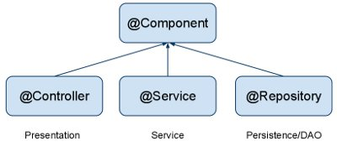
Auto Component Scan Types
@Component
  Indicates a auto scan component.
@Repository
  Indicates DAO component in the persistence layer.
@Service
  Indicates a Service component in the business layer.
@Controller
  Indicates a controller component in the presentation layer.

Slide 41
Auto Wiring of Bean
@Autowired :
  Used to auto wire bean on the setter method, constructor or a field.
  It uses auto wire bean by matching data type.

Slide 42
Auto Wiring of Bean
@Autowired :
  Used to auto wire bean on the setter method, constructor or a field.
  It uses auto wire bean by matching data type.
Can be Used on a typed collection instance
  Container Injects all beans in the application context that satisfy the type
Can Work with an array also

Slide 43
AutoWired
@Qualifier
  Is used to control which bean should be autowired on a field.
  If the bean configuration file has two similar beans, can specify the bean to be wired by giving the bean name
  @Required
  . When matching bean to wire is not found , it will throw an exception.
  To disable this checking setting the “required” to false.
  it will leave the property unset.

Slide 44
Auto Wiring of Beans
byName
  public class Manager{
  @Autowired
  public Employee employee;
  }

Slide 45
Auto Wiring of Beans
byType
  @Configuration
  @Import({Employee.class})
  public class NewEmployeeConfig {
  @Autowired
  public Employee emp;
  @Bean(autowire=Autowire.BY_TYPE)
  public Employee employee() {
  return emp;
  }
  }

Slide 46
Wiring Collections
<list>
  Wiring a list of values, allowing duplicates
<set>
  Wiring a set of values, ensuring no duplicates
<map>
  Wiring a collection of name-value pairs where name and value can be of any type
<props>
  Wiring a collection of name-value pairs where the name and value are both Strings

Slide 47
Wiring Collections
  @Data
  @NoArgsConstructor
  @AllArgsConstructor
  @ToString
  @Component(value="first")
  public class FoodItem {
  private long itemCode;
  private String itemName;
  private String itemType;
  private String category;
  private double unitPrice;
  }

Slide 48
Wiring Collection
  public class Catalog {
  private long code;
  private String catalogName;
  private Address address;
  @Autowired(required=false)
  private List<FoodItem> itemList;
  public Catalog(long code, String catalogName, Address address) {
    super();
    this.code = code;
    this.catalogName = catalogName;
    this.address = address;
  }
  }

Slide 49
Configuration File
  @Bean
  @Order(2)
  public FoodItem italian() {
  return new FoodItem(103,"Pasta","lunch","italian",150.00);
  }
  @Bean
  @Order(1)
  public FoodItem mexican() {
  return new FoodItem(105,"panCake","breakfast","mexican",140);
  }
  }

Slide 50
Collection DI
  package com.training.entity;
  @Resource
  public class EmployeeResource {
  @Autowired
  private List<Employee> empList;
  public List<Employee> getEmpList() {
  return empList;
  }
  public EmployeeResource() {
  super();
  }
  }

Slide 51
Configuration
  @Configuration
  @ComponentScan("com.training.entity")
  public class AppConfig {
  private Employee emp;
  public Employee getEmp() {
  return emp; }
  @Autowired
  @Qualifier("emp")
  public void setEmp(Employee emp) {
  this.emp = emp;
  emp.setEmployee_Id(202);
  emp.setEmployee_Name("Suresh");
  }

Slide 52
Configuration
  @Bean(name="emp2")
  public Employee emp2(){
  Employee emp2=new Employee();
  emp2.setEmployee_Id(102);
  emp2.setEmployee_Name("Ganesh");
  return emp2;
  }
  @Bean
  public EmployeeResource empRes(){
  EmployeeResource res=new EmployeeResource();
  return res;
  }
  }

Slide 53
Configuration File
  @Configuration
  public class CustomConfig {
  @Bean()
  public Catalog catalog() {
  return new Catalog(101,"Classical Menu",address());
  }
  @Bean
  public Address address() {
  return new Address("Gandhi Street","behru Nagar","chennai",600040);
  }

Slide 54
Disambuguation options
getBean()
  accepts both a class and a bean name
  bean ids must be unique, this call guarantees that the ambiguity cannot occur.
Service service = context.getBean(Service.class, "myService");

Slide 55
Disambuguation options
getBean() would thrown an exception indicating an ambiguity if more than one bean is defined
Can Indicate one Bean as primary bean with @Bean
  @Configuration
  public class MyConfig {
  @Bean(primary=Primary.TRUE)
  public Service myService() {
  return new Service();
  }
  @Bean
  public Service backupService() {
  return new Service();
  }
  }
getBean(Service.class) will return the primary bean

Slide 56
Retrieve all beans of a given type
getBeansOfType()
To return all beans that implement a given interface:
Map matchingBeans = context.getBeansOfType(Service.class);
The returned Map is not parameterized.

Slide 57
Composing Java Based Configuration
Spring’s Java-based configuration feature lets you compose annotations, which can reduce the complexity of your configuration.
Useful in case scanning, a configuration classes as entry points
@Import
  Loading @Bean definitions from another configuration class
  @Configuration
  public class ConfigA {
  @Bean public A a() {
  return new A();
  } }

Slide 58
Configurations
  @Configuration
  @Import(ConfigA.class)
  public class ConfigB {
  @Bean public B b() {
  return new B();
  }
  }

Slide 59
Life Cycle Methods Annotation Driven
  @Component
  public class Annot_Invoice {
  @PostConstruct
  public void myInit()
  {
  System.out.println("Inside init Method");
  }
  @PreDestroy
  public void myDestroy()
  {
  System.out.println("Inside Destroy Method");
  }
  }

Slide 60
Life Cycle Java Based Configuration
  public class Employee {
  public void start() { Initialization Work }
  public void close() {
  Destruction Work
  }
  }
  @Bean(initMethod="start",destroyMethod="close")
  public Employee myBean() {
  return new Employee(employee_Id,employee_Name);
  }

Slide 61
Life Cycle Methods
  import org.springframework.core.env.Environment;
  public class DeliveryExecutive {
  @Autowired
  private Environment env;
  public DeliveryExecutive{
  env.getActiveProfiles() -> Will throw Null Pointer Exception
  }
  public void init() {
  log.info("Init Method called");
  log.info(env.getActiveProfiles().toString());
  System.out.println(Arrays.asList(env.getDefaultProfiles().toString()));
  }
  }

Slide 62
Lazy-initialized beans
ApplicationContext implementations eagerly create and configure all singleton beans as part of the initialization process.
A lazy-initialized bean tells the IoC container to create a bean instance when it is first requested, rather than at startup.
  @Bean()
  @Lazy(value=true)
  public Employee myBean() {
  System.out.println("Loading LazyBean bean");
  return new Employee(employee_Id,employee_Name);
  }

Slide 63
Bean Scope
The Bean Score for Standard Java SE Beans are singleton:
Scopes a single bean definition to a single object instance per Spring IoC container, per container and per bean.
prototype:
  Prototype results in the creation of a new bean instance every time a request for that specific bean is made
  Can change the Scope by
@Scope(value=ConfigurableBeanFactory.SCOPE_PROTOTYPE)

Slide 64
Bean Scope
The Bean Scope for Standard Java SE Beans are singleton:
@Scope(scopeName=ConfigurableBeanFactory.SCOPE_SINGLETON)
  Scopes a single bean definition to a single object instance per Spring IoC container, per container and per bean.
  Single instance will be stored in a cache and all subsequent requests and references will result in cached object being returned.
@Scope(value=ConfigurableBeanFactory.SCOPE_PROTOTYPE)

Slide 65

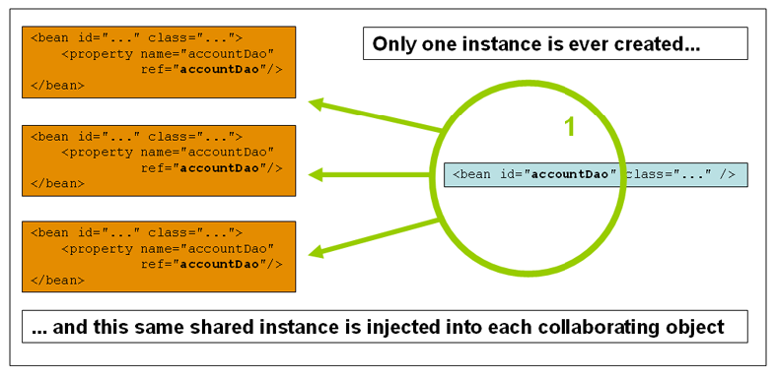
Singleton

Slide 66
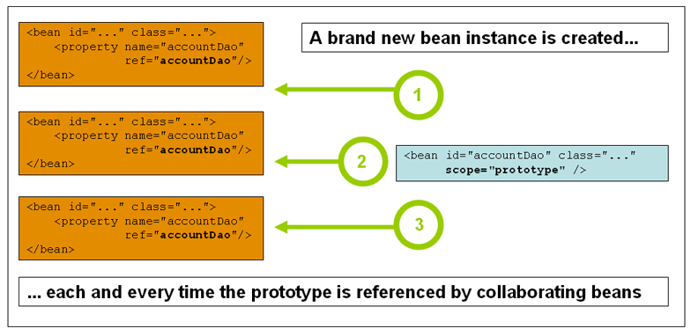
Prototype Scope

Slide 67
SPRING BOOT 2.1

Slide 68
Spring Boot
Extension of the Spring framework
  A faster and more efficient development
Eliminates the boilerplate configurations required for setting up a Spring application.
  Opinionated ‘starter’ dependencies to simplify build and application configuration
  Embedded server to avoid complexity in application deployment
  Metrics, Health check, and externalized configuration
  Automatic configuration whenever possible

Slide 69
Spring Boot Starters
Set of convenient dependency descriptors
Eliminates the need to hunt through sample code
No need to copy-paste loads of dependency descriptors.
Contains lot of the dependencies that are required to get a project up and running
Also has support of managed transitive dependencies.

Slide 70
Creating a Spring Boot Project
In the Eclipse IDE Right-click in the package explorer and select New -> Spring Starter Project
A screen opens with some details which can be changed or can accept the default values for a simple project
The entry point of a Spring Boot application is the class which is annotated with @SpringBootApplication:
Uses this class with public static void main entry-point to launch an embedded web server.

Slide 71
Spring Boot Bootstrap
  @SpringBootApplication
  public class Application {
  public static void main(String[] args) {
  SpringApplication.run(Application.class, args);
  }
  }
Spring Boot can scan all the classes in the same package or sub packages of Main-class for components.
Equivalent to using @Configuration, @EnableAutoConfiguration, and @ComponentScan with their default attributes,

Slide 72
Application
  @SpringBootApplication
  public class FirstExampleApplication {
  public static void main(String[] args) {
  ConfigurableApplicationContext ctx =
  SpringApplication.run(FirstExampleApplication.class, args);
  Invoice ramInvoice= ctx.getBean(Invoice.class);
  System.out.println(ramInvoice);
  }

Slide 73
PROFILES

Slide 74
Profiles
A way to segregate parts of application configuration and make it only available in certain environments.
Used to load different types or sets of classes
Spring profiles are Created with @Profile annotation.
Profile-specific variants of can be set in the application.properties
Create Profile Specific Propertety files

Slide 75
Spring Boot Profiles
Can define default configuration in application.properties.
Environment specific overrides can be configured in specific files:
  application-dev.properties
  application-qa.properties
  application-stage.properties
  application-prod.properties

Slide 76
Using Profiles in Code
A profile can be used in code to define your beans.
  @Bean
  @Profile("prod")
  public Hospital malar2() {
  Hospital malar = new Hospital();
  malar.setId(10122);
  malar.setHospitalName("Malar Hospitals-Bangalore");
  return malar;
  }
Application.properties
  spring.profiles.active=prod
  server.port=4040

Slide 77
EXTERNALIZE THE CONFIGURATION

Slide 78
Externalize the configuration
@ConfigurationProperties
  provides a very clean way to load properties for an application.
  An easy and manageable way to externalized configurations
@PropertySource
  Declared directly on the configuration class
  Can also be declared on the Class where properties are Refered.

Slide 79
application.properties
  app.error.code=800
  app.name=ConfigurationPropertiesDemoApp
  app.error.message=value not bound properly from ${app.name}
  #Mapping single properties
  app.mail.to=sunil@example.com
  app.mail.host=mail.example.com
  #Mapping list or array
  app.mail.cc=mike@example.com,david@example.com
  app.mail.bcc=sumit@example.com,admin@example.com

Slide 80
Binding from property file
  @PropertySource("classpath:application.properties")
  public class ExtConfigComponent {
  @Value("${app.error.code}")
  private String code;
  @Value("${app.error.message}")
  private String message;
  }
  }

Slide 81
Binding from property file
  @PropertySource("classpath:application.properties")
  public class MailComponent {
  @Value("${app.mail.to}")
  private String to;
  @Value("${app.mail.host}")
  private String host;
  @Value("${app.mail.cc}")
  private String[] cc;
  @Value("${app.mail.bcc}")
  private List<String> bcc;
  }

Slide 82
Configuration
  @Bean
  @ConfigurationProperties(prefix="app.error")
  public ExtConfigComponent comp() {
  return new ExtConfigComponent();
  }
  @Bean
  @ConfigurationProperties(prefix="app.mail")
  public MailComponent mailComp() {
  return new MailComponent();
  }

Slide 83
JDBC

Slide 84
Working With SQL
Has extensive support for working with SQL databases
  Direct JDBC access using JdbcTemplate
  Using “object relational mapping” like Hibernate.
  Has Number of Starters for Working with data sources
Has a functionality for creating Repository implementations
  From interfaces using conventions to generate queries from method names.

Slide 85
Spring JDBC
Spring Task
  Connection Management
  Statement Management
  ResultSet Management
  Transaction Management
  Exception Handling
Developer Task
  SQL
  Row Data Retrieval
  Parameter Setting

Slide 86
Spring JDBC – Template pattern
Defines the skeleton of an algorithm in an operation, deferring some steps to subclasses.
Template Method lets subclasses redefine certain steps of an algorithm without letting them to change the algorithms structure.
In Spring JDBC development, it’s always recommended to use JdbcTemplate
Register the Dao Implementation class and add the JdbcTemplate as Dependency

Slide 87
Configuring a Data Source
spring.datasource.*.
  Configurations are controlled by external configuration properties
  Defined application.properties:
  spring.datasource.jdbc-url=jdbc:mysql://localhost:3306/test
  spring.datasource.driver-class-name=com.mysql.cj.jdbc.Driver
  spring.datasource.username=root
  spring.datasource.password=srivatsan
Should specify the URL else Spring Boot tries to auto-configure an embedded database.
Specifying the driver-class-name is optional

Slide 88
spring.datasource.jdbc-url
If Hikari Data Source is on the classpath should this property
  spring.datasource.jdbc-url=jdbc:mysql://localhost:3306/test
Hikari has no url property but has a jdbcUrl property
Alternatively can use the following path
  spring.datasource.url=jdbc:mysql://localhost:3306/test

Slide 89
Entity Class & DAO Interface
  @Data
  @NoArgsConstructor
  public class Customer {
  private long id;
  private String first_name;
  private String last_name;
  }
    public interface Crud<T> {
    public List<T>findAll();
    }

Slide 90
@Repository
A repository is a mechanism for encapsulating storage, retrieval, and search behavior which emulates a collection of objects.
@Repository
  Indicates that the decorated class is a repository.
  A specialization of the @Component annotation
  Will be auto detected through classp ath scanning.

Slide 91
DAO Implementation
  @Repository
  public class CustomerDAOImpl implements Crud<Customer> {
  @Autowired
  private JdbcTemplate template;
  @Override
  public List<Customer> findAll() {
  List < Customer > customers = new ArrayList <> ();
  List < Map < String, Object >> rows = template.queryForList("SELECT * FROM CUSTOMER");

Slide 92
DAO Implementation … contd
  for (Map < String, Object > row: rows) {
  Customer customer = new Customer();
  customer.setId((long) row.get("Id"));
  customer.setFirst_name((String) row.get("first_name"));
  customer.setLast_name((String) row.get("last_name"));
  customers.add(customer);
  }
  return customers;
  }
  }

Slide 93
Data Source Builder
  Used for building a DataSource with common implementations and properties.
  If HikariCP, Tomcat or Commons DBCP are on the classpath one of them will be selected (in that order with Hikari first).
  @ConfigurationProperties(prefix = "spring.datasource")
  public DataSource dataSource() {
  return DataSourceBuilder.create().build();
  }

Slide 94
Configuration
  @Configuration
  public class AppConfig {
  @Bean
  @Primary
  @ConfigurationProperties(prefix = "spring.datasource")
  public DataSource dataSource() {
  return DataSourceBuilder.create().build();
  }
  @Bean
  public JdbcTemplate jdbcTemplate(DataSource dataSource) {
  return new JdbcTemplate(dataSource);
  }

Slide 95
Application
  @SpringBootApplication
  public class BootJdbcTemplateApplication {
  public static void main(String[] args) {
  ConfigurableApplicationContext ctx =SpringApplication.run(BootJdbcTemplateApplication.class, args);
  CustomerDAOImpl dao = ctx.getBean(CustomerDAOImpl.class);
  List<Customer> custList = dao.findAll();
  custList.forEach(System.out::println);
  }
  }

Slide 96
DAO
  package com.example.demo.ifaces;
  import java.util.List;
  import java.util.Map;
  public interface Dao<T> {
  long add(T t);
  long remove(T t);
  List<Map<String,Object>> findAll();
  int update(T t);
  }

Slide 97
Add Method
  @Override
  public long add(Tour t) {
  String sql = "insert into Tours values(?,?,?,?)";
  return this.template.update(sql,t.getTourId(),t.getTourName(),t.getDuration(),t.getPrice());
  }

Slide 98
Delete
  @Override
  public long remove(Tour t) {
  String sql = "delete from Tours where tourId =?";
  return this.template.update(sql,t.getTourId());
  }

Slide 99
Update
  @Override
  public int update(Tour t) {
  String sql = "update Tours set "
  + "tourName=?, price=?,duration=? where tourId =?";
  return this.template.update(sql,t.getTourName(),t.getPrice(),t.getDuration(),t.getTourId());
  }

Slide 100
MVC

Slide 101
Spring MVC
Web application framework that takes advantage of design principles of Spring framework
  Dependency Injection – Simplified Testing
  Interface-driven design
  POJO without being tied up with a framework
Flexible and extensible via component’s interfaces
Simplifies form handling through its parameter binding, validation and error handling
Abstracts view technology (JSP, Velocity, FreeMarker Excel , PDF)

Slide 102
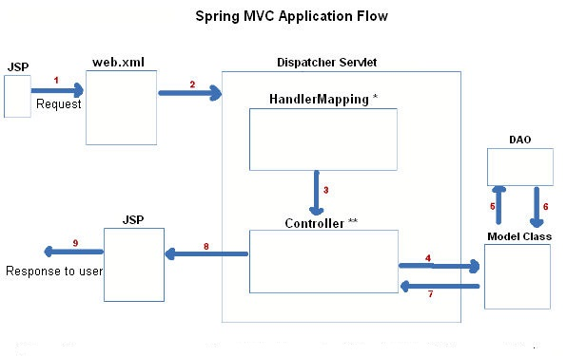
The requesting processing workflow

Slide 103
ModelAndView object
Encapsulates both model and view that is to be used to render model
Model is represented as a java.util.Map
Objects can be added to without name:
  addObject(String, Object) – added with explicit name
  addObject(Object) – added using name generation (Convention over Configuration)
View is represented by String or View object
Analogous to Struts Action

Slide 104
@Controller
Used to indicates that a particular class serves the role of a controller.
The dispatcher scans such annotated classes for mapped methods and detects @RequestMapping annotations
Autodetection by detecting component classes in the classpath and auto-registering bean definitions for them.

Slide 105
Spring Boot Web Project
  Create a Spring Boot Starter Project
  Select the packaging as WAR
  It Creates a WebApp Folder
  Can add Web Artifacts into that Folder

Slide 106
Update the pom.xml
  <dependency>
  <groupId>org.apache.tomcat.embed</groupId>
  <artifactId>tomcat-embed-jasper</artifactId> <scope>provided</scope>
  </dependency>
  <dependency>
  <groupId>javax.servlet</groupId>
  <artifactId>jstl</artifactId>
  <scope>provided</scope>
  </dependency>

Slide 107
Controller
  @Controller
  public class WelcomeController {
  @Autowired
  ModelAndView mdlView;
  @GetMapping("/")
  public ModelAndView greet() {
  mdlView.addObject("msg", "Welcome to Spring MVC");
  mdlView.setViewName("welcome");
  return mdlView;
  }
  }

Slide 108
View Resolver
  Treats view name as a application-relative path to a JSP file.
InternalResourceViewResolver
    The default view resolver
    It creates view of type JstlView.
Application.properties
  spring.mvc.view.prefix=/WEB-INF/views/
  spring.mvc.view.suffix=.jsp

Slide 109
Static Resources
  src/main/resources/static/css
  <link href="css/style.css"
  rel="stylesheet">
  src/main/resources/static/images
  <img src="images/logo.png">

Slide 110
Model
A model is a map object that is used to store attribute value pairs
A model is created before invoking a handler method if the method has an argument type Model.
The handler uses the model to store attribute values that convey information to render dynamic views such as JSP.
The method Model.addAttribute(String name, Object obj) is used to map attribute names to object as attribute vales.

Slide 111
@ModelAttribute
When Used as method parameter, maps a model attribute to the specific, annotated method parameter
The controller gets a reference to the object holding the data entered in the form.
When used at method level provides reference data for the model
The @ModelAttribute annotated methods are executed before the chosen @RequestMapping annotated handler method.
This helps in pre-populating the implicit model with specific attributes,

Slide 112
@RequestMapping
Used to map URLs onto an entire or a class or a particular handler method.
Class-level annotation maps a specific request path or pattern to a controller
Method-level annotations are used to narrow the primary mapping or HTTP request ("GET"/"POST") or to HTTP request parameters.

Slide 113
Controller
  @Controller
  public class TripController {
  @Autowired
  TripDetail detail;
  @GetMapping("/")
  public String init() {
  return "index";
  }
  @ModelAttribute("location")
  public String[] loadPlaces() {
  return new String[]{"Bessy Beach","Mahabs","Mayajal"};
  }

Slide 114
Controller
    @GetMapping("/addTrip")
    public String initForm(Model model) {
    model.addAttribute("command",detail);
    return "addTripDetails";
    }
    @PostMapping("/addTrip")
    public String onSubmit(@ModelAttribute("data") TripDetail details) {
    System.out.println(details);
    return "success";
    }
    }

Slide 115
Model
  @Data
  @AllArgsConstructor
  @NoArgsConstructor
  @ToString
  public class TripDetail {
  private long tripId;
  private String source;
  private String destination;
  private double amount;
  }

Slide 116
Using Spring's form tag library
Spring's form tag library gives the tags access to the command object and reference data of the controller
The form tag library comes bundled in spring-webmvc.jar.
The library descriptor is called spring-form.tld.
<%@ taglib prefix="form" uri="http://www.springframework.org/tags/form" %>
A Form tag puts the command object in the PageContext

Slide 117
View
  <form:form action="/addTrip" method="post">
  <form:input path="tripId"/>
  <form:select path="source" items="${location}">
  </form:select>
  <form:input path="destination"/>
  <form:input path="amount"/>
  <input type="submit" value="Add">
  </form:form>

Slide 118
SpringBootServletInitializer
Used to run a SpringApplication from a WAR on a web container.
  Binds the following beans from application context to the server
  Servlet, Filter and ServletContextInitializer
Done by extending SpringBootServletInitializer
  overriding the configure() method.
configure()
  Uses SpringApplicationBuilder to simply register as a configuration class of the application
  Method to point to itself, to make Spring find the main configuration.

Slide 119
ServletInitializer
  @SpringBootApplication
  public class WarInitializerApplication extends SpringBootServletInitializer {
  @Override
  protected SpringApplicationBuilder configure(
  SpringApplicationBuilder builder) {
  return builder.sources(WarInitializerApplication.class);
  }
  public static void main(String[] args) {
  SpringApplication sa = new SpringApplication(
  WarInitializerApplication.class);
  sa.run(args);
  } }

Slide 120
JPA

Slide 121
Spring Data JPA
Spring Data JPA is a library/framework that adds an extra layer of abstraction on the top of our JPA provider (like Hibernate).
Implementation of data access layers by reducing the effort
Developer you write your repository interfaces, including custom finder methods, and Spring will provide the implementation automatically.

Slide 122
Spring Data JPA
Makes it easy to easily implement JPA based repositories.
Module deals with enhanced support for JPA based data access layers.
It makes it easier to build Spring-powered applications that use data access technologies.
Too much boilerplate code has to be written to execute simple queries as well as perform pagination, and auditing.

Slide 123
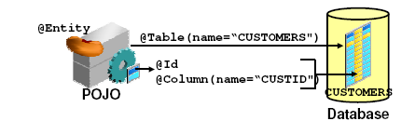
JPA Entity

Slide 124
A simple Entity- Customer.java
  @Entity
  @Table(name=“CUSTOMERS")
  public class Customer {
  @Id
  private long customerId;
  private String name;
  }

Slide 125
Primary Key Generation
Has Four different primary key generation strategies
Added to the Primary Key property
@Id
@GeneratedValue(strategy = GenerationType.AUTO)
Selects a generation strategy based on the database specific dialect.
  For most popular databases, GenerationType.SEQUENCE

Slide 126
Primary Key Generation
AUTO
  Selects the generation strategy based on the used dialect,
IDENTITY
  Relies on an auto-incremented database column to generate the primary key,
SEQUENCE
  Requests the primary key value from a database sequence,
TABLE
  Uses a database table to simulate a sequence.

Slide 127
@Repository
There are three repository in Spring Data
CrudRepository
  Extends Repository
  provides CRUD functions
PagingAndSortingRepository
  Extends CrudRepository
  provides methods to do pagination and sort records
JpaRepository
  Extends PagingandSortingRepository
  Provides Methods such as flushing the persistence context and delete records in a batch
  Querying methods return List's instead of Iterable's

Slide 128
Creating Spring Data Application
  Create a repository interface and extend one of the repository interfaces provided by Spring Data.
  If required add custom query methods to the created repository interface
  Inject the repository interface to another component and use the implementation that is provided automatically by Spring.

Slide 129
CRUD Repository
An interface extends Repository interface.
  public interface BookRepository extends CrudRepository<Book, Long> {}
Need NOT create an implementation class
  Spring will automatically create its implementation class at runtime.
The Repository class will be auto detected if suitably placed in the scan path

Slide 130
CrudRepository Interface
  <S extends T> S save(S entity)
  <S extends T> Iterable<S> saveAll(Iterable<S> entities);
  Optional<T> findById(ID primaryKey)
  Iterable<T> findAll()
  void delete(T entity)
  long count()
  boolean existsById(ID id);

Slide 131
Custom Repository Methods
  Can add custom methods to the interface
  Derived method names have two main parts separated by the first By keyword:
  Equality Condition Keywords
    List findByNameEquals(String name);
    List findByNameIsNot(String name);
  Similarity Condition Keywords
    List findByNameStartingWith(String prefix);
    List findByNameContaining(String infix);

Slide 132
Custom Repository Methods
  Comparison Condition Keywords
  List findByAgeLessThan(Integer age);
  List findByAgeLessThanEqual(Integer age);
  List findByAgeGreaterThan(Integer age);
Multiple Condition Expressions
  List findByNameOrBirthDate(String name, ZonedDateTime birthDate);
  List findByNameOrBirthDateAndActive(String name, ZonedDateTime birthDate, Boolean active);
Sorting the Results
  List findByNameOrderByName(String name);
  List findByNameOrderByNameAsc(String name);

Slide 133
Custom Repository Methods
findByStartDateBetween
findByStartDateAfter
findByStartDateBefore
findByAgeOrderByLastnameDesc.
findByFirstNameIgnoreCase

Slide 134
Custom Repository Method
  public interface BookRepository extends CrudRepository<Book, Long> {
  List<Book> findByAuthor(String author);
  List<Book> findDistinctByCategory(String category);
  List<Book> findByAuthorAndCategory(String author, String category);
  }

Slide 135
Custom Repository Method
  @Repository
  public interface MyRepository extends JpaRepository<CibilScore,Long> {
  public CibilScore findCibilScoreByPanCardNumber(String pancardNumber);
  }

Slide 136
Controller
  @Controller
  public class CibilController {
  @Autowired
  private MyRepository repo;
  @GetMapping("/findAll")
  public String findAll(Model model){
  model.addAttribute("list", this.repo.findAll());
  return "showScores";
  }
  }

Slide 137
Model
  @Data
  @AllArgsConstructor
  @NoArgsConstructor
  @Component
  @Entity
  @Table(name = "JPCIBIL")
  public class CibilScore {
  @Id
  private long customerId;
  private String customerName;
  private String panCardNumber;
  private int cibilScore;
  }

Slide 138
Application.properties
  #mvc Related Configuration
  spring.mvc.view.prefix=/WEB-INF/views/
  spring.mvc.view.suffix=.jsp
  server.port=3030
  logging.level.root=WARN
  # JPA Related Configurations
  spring.datasource.password=srivatsan
  spring.datasource.username=root
  spring.datasource.driver-class-name=com.mysql.cj.jdbc.Driver
  spring.datasource.url=jdbc:mysql://localhost:3306/test
  spring.jpa.hibernate.ddl-auto=update
  spring.jpa.show-sql=true
  spring.jpa.hibernate.naming.physical-strategy=org.hibernate.boot.model.naming.PhysicalNamingStrategyStandardImpl

Slide 139
View
  <c:forEach items="${list}" var="item">
  <tr>
  <td> <c:out value="${item.customerId}"/></td>
  <td> <c:out value="${item.customerName}"/></td>
  <td> <c:out value="${item.cibilScore}"/></td>
  </tr>
  </c:forEach>

Slide 140
JPQL
JPQL queries are defined based on domain model.
JPA implementation handles the different database dialects so that the JPQL query is database agnostic.
JPQL only supports a subset of the SQL standard.
  Not a great fit for complex queries.
Spring Data JPA provides the required JPA code to execute that query.
  @Query("FROM Author WHERE firstName = ?1")
  List<Author> findByFirstName(String firstName);

Slide 141
@Query
Used to write the more flexible query to fetch data.
Supports both JPQL and native SQL queries.
By default will be using JPQL to execute the queries.
  Using normal SQL queries, would get the query syntax error exceptions.
Can use native SQL queries by setting nativeQuery flag to true.
  Pagination and dynamic sorting for native queries are not supported in spring data jpa.

Slide 142
Custom Query Method
  @Query(value = "select name,author,price from Book b where b.price>?1 and b.price<?2")
  List<Book> findByPriceRange(long price1, long price2);
  @Query(value = "select name,author,price from Book b where b.name = :name AND b.author=:author AND b.price=:price")
  List<Book> findByNamedParam(@Param("name") String name, @Param("author") String author, @Param("price") long price);
  @Query(value = "select * from Book b where b.name=?1", nativeQuery = true)
  List<Book> findByName(String name);

Slide 143
Examples:
  SELECT o1 FROM Order o1, Order o2 WHERE o1.quantity > o2.quantity
  SELECT p FROM Person p WHERE p.age BETWEEN 15 and 19
  SELECT a FROM Address a WHERE a.country IN ( ‘UK’, ‘US’ , ‘France’ )
  SELECT o FROM Order o WHERE o.lineItems IS EMPTY
  SELECT a FROM Address a WHERE a.phone LIKE ‘12%3’

Slide 144
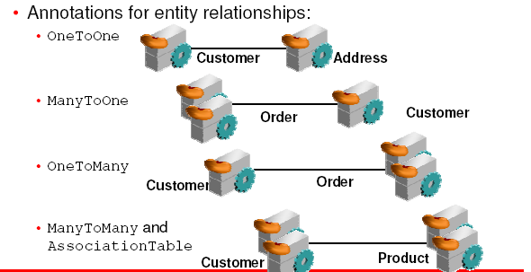
Mapping Relationship Between Entities

Slide 145
Fetch Types
Depends on the cardinality of the relationship.
FetchType.EAGER
  Fetch immediately
  To get all elements of a relationship when selecting the root entity.
FetchType.LAZY.
  fetch when needed
  The elements of a relationship are fetched only when its requested for

Slide 146
JPA Relationships
Relationships can be either unidirectional or bidirectional.
Defining the direction of the relationship between entities has no impact on the database mapping.
  It only defines the directions in domain model.
Bidirectional relationship requires
  The owning side
  inverse or the referencing side

Slide 147
@JoinColumn
The annotation is used specify the column used for joining an entity association or element collection.
  Indicates that this entity is the owner of the relationship
mappedBy attribute is used to define the referencing side
  non-owning side of the relationship.
  the value of mappedBy is the name of the association-mapping attribute on the owning side.
  the owning side is usually defined on the ‘many’ side of the relationship.
  It’s usually the side which owns the foreign key.

Slide 148
ONE TO MANY RELATIONS

Slide 149
Entity
  @Entity
  @Table(name="vdsi_invoice")
  public class Invoice {
  @Id
  @GeneratedValue
  private int invoiceNumber;
  private String customerName;
  @OneToMany(mappedBy = "invoice", cascade = CascadeType.ALL,fetch=FetchType.EAGER,nullable=false)
  private Set<Item> itemList;
  }

Slide 150
Entity
  @Entity
  @Table(name="vdsi_item")
  public class Item {
  @Id
  private int intemNumber;
  private String itemName;
  private double ratePerUnit;
  @ManyToOne
  @JoinColumn(name="invoice_ref")
  private Invoice invoice;
  }

Slide 151
Entity Relationship
  @Data
  @AllArgsConstructor
  @NoArgsConstructor
  @Entity
  @Table(name = "JPCatalog")
  public class Catalog {
  @Id
  private int id;
  private String catalogName;
  @OneToMany(mappedBy = "catalog",
  cascade = CascadeType.ALL,
  fetch = FetchType.EAGER)
  private Set<Product> productList;
  }

Slide 152
Entity Relationship
  @Data
  @AllArgsConstructor
  @NoArgsConstructor
  @Entity
  @Table(name = "JPItem")
  public class Product {
  @Id
  private int productId;
  private String productName;
  private double ratePerUnit;
  private String imageRef;
  @ManyToOne
  @JoinColumn(name = "catalogRef")
  private Catalog catalog;
  }

Slide 153
SPRING AOP

Slide 154
Aspect Oriented Programming
It’s a Programming technique that promotes separation of concerns within a software system
It is not a replacement for Object Oriented Programming.
AOP is another way of organizing Program Structure
An aspect of a program which affect (crosscut) other concerns.
Cross Cutting Concerns
  Transaction management
  Security
  Auditing
  Event handling

Slide 155
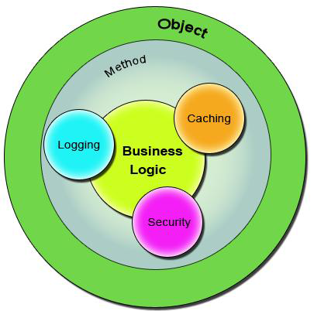
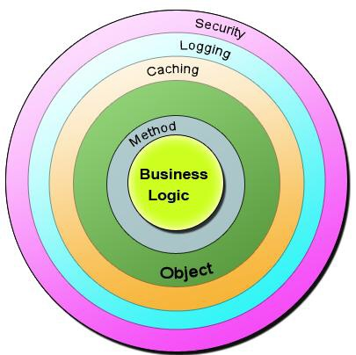
Bean in Spring container

Slide 156
Sample Code
  public class Account {
  public long deposit(long depositAmount){
  newAmount = existingAccount + depositAccount;
  currentAmount = newAmount;
  return currentAmount;
  }
  public long withdraw(long withdrawalAmount){
  if (withdrawalAmount <= currentAmount){
  currentAmount = currentAmount – withdrawalAmount;
  }
  return currentAmount;
  }
  }

Slide 157
The Challenge ?
Requirment -1
  Add security to the Account class - only users with BankAdmin privilege is allowed to do the operations.
Requirement-2
  Account class is to provide some kind of Logging
Requirement-3
Account class need to provide Transaction Management Facility.
New requirements forces the methods and the logic to change a lot which is against the Software Design.
The code has to undergo the Software Development Lifecycle of Development, Testing, Bug Fixing, Development, Testing,

Slide 158
The Solution !
public void deposit(){
// Transaction Management
// Logging
// Checking for the Privileged User
// Actual Deposit Logic comes here
}
public void withdraw(){
// Transaction Management
// Logging
// Checking for the Privileged User
// Actual Withdraw Logic comes here
}
The above logic that cross-cuts or overlaps the existing business logic as Concerns or Cross-Cutting Concerns.
These cross-cutting concerns from the application code can be modularized as different entities.

Slide 159
AOP Terminologies-Aspect
An Aspect is a functionality or a feature that cross-cuts over objects.
Logging and Transaction Management are the aspects.
public void businessOperation(BusinessData data)
{
// Logging logger.info("Business Method Called");
// Transaction Management Begin transaction.begin();
// Do the original business operation here transaction.end();
}

Slide 160
AOP Terminologies-Joint Point
Join Points defines the various Execution Points where an Aspect can be applied.
In Spring AOP, a join point always represents a method execution.
  public void someBusinessOperation(BusinessData data){
  //Method Start - > Possible aspect code here like logging.
  try{
  // Original Business Logic here.
  } catch(Exception exception) {
  // Exception -> Aspect code here when some exception is raised. }
  finally{
  // Finally -> Even possible to have aspect code at this point too.
  }
  // Method End -> Aspect code here in the end of a method.
  }

Slide 161
AOP Terminologies-JoinPoints
Points in the execution of the program
  Start of the Method,
  End of the Method,
  Exception Block,
  Finally Block
In these points an Aspect can be made to execute.
These Execution Points embedding Aspects are called Join Points.
An Aspect need not be applied to all the possible Join Points.

Slide 162
AOP Terminologies-Pointcut
Join Points refer to the Logical Points wherein a particular Aspect or a Set of Aspects can be applied.
A Pointcut or a Pointcut Definition will exactly tell on which Join Points the Aspects will be applied.
pointcut method_start_end_pointcut(){
// This point cut applies the aspects, logging and transaction, before the beginning and the end of the method.
}
pointcut catch_and_finally_pointcut(){
// This point cut applies the aspects, logging and transaction, in the catch block (whenever an exception raises) and the finally block.
}

Slide 163
Advice
Advice is the code that implements the Aspect.
Aspect defines the functionality in a more abstract manner.
Advice provides a Concrete code Implementation for the Aspect.
Creating Advices in Spring
Spring provides support only for Method Aspect and not for Field Aspect

Slide 164
Advices
  Before advice :@Before
  Executes before a join point,
  Does not have the ability to prevent execution flow proceeding to the join point (unless it throws an exception).
After returning advice : @AfterReturning
  Executed after a join point completes normally:
After throwing advice : @AfterThrowing
  Executed if a method exits by throwing an exception.
  After advice :@After
  Executed when normal or exceptional return by which a join point exits
  Around advice : @Around
  Advice that surrounds a join point

Slide 165
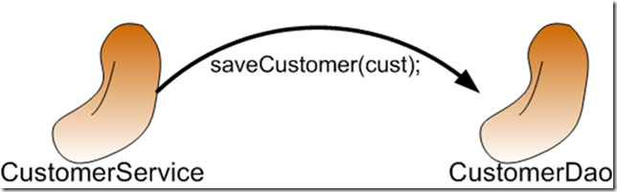
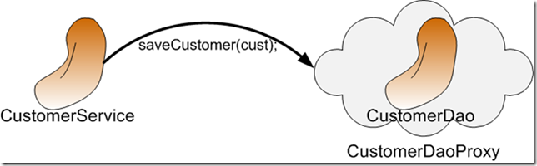
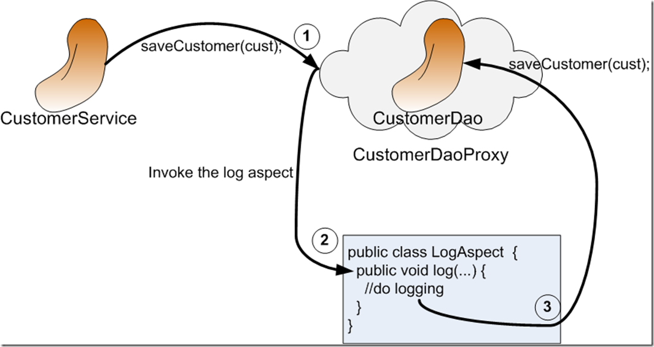
AOP Proxy Mechanism

Slide 166
Using Auto Proxy
Can create proxies automatically for selected bean definitions.
Built on Spring "bean post processor" infrastructure,
Need for ProxyFactoryBean is eliminated
  @Configuration
  @EnableAspectJAutoProxy
  public class AppConfig { }

Slide 167
Proxy Creating
Can control the type of proxy that gets created
proxyTargetClass()
  Enables CGLIB-style 'subclass' proxies as opposed to the default interface-based JDK proxy approach.
@EnableAspectJAutoProxy(proxyTargetClass=false)
  Indicates that JDK dynamic proxy will be created to support aspect execution on the object.
  Proxy requires a class to implement an interface
@EnableAspectJAutoProxy(proxyTargetClass=true)
  To use CGLIB proxy which is able to create proxy for a class without an interface.

Slide 168
Format of an execution expression
execution(
  modifiers-pattern
  returning-type-pattern
  declaring-type-pattern
  name-pattern(param-pattern)
  throws-pattern
)
execution(public * *(..)) or within(com.xyz.service.*)
execution – for matching method execution join points
within – execution of a method declared within a matching type

Slide 169
Declaring a pointcut
execution(public * *(..))
the execution of any public method:
execution(* set*(..)) -
the execution of any methods beginning with "set":
execution(* com.xyz.service.AccountService.*(..))
the execution of any method defined by the named interface:
execution(* com.xyz.service.*.*(..))
the execution of any method defined in the service package:
within(com.xyz.service.*)
any join point within the service package:

Slide 170
Currency Converter
  public class CurrencyConverter implements MyInterface {
  public double dollorToRupess(double dlrAmt) {
  return dlrAmt * 49.0d;
  }
  public double dollorToEuro(String dlrAmt)
  {
  double val =Double.parseDouble(dlrAmt);
  return val * 70.00d;
  }

Slide 171
@Around Advice
@Aspect
public class MyAroundAdvice {
@Around("execution(* com.training.CurrencyConverter.*(..))")
public Object aroundLog(ProceedingJoinPoint pjp) throws Throwable {
System.out.println("Called Before Method Invocation");
Object ret =pjp.proceed();
System.out.println("I am Around ");
return ret;
}
}

Slide 172
After returning advice
  @Aspect
  public class BankAspect {
  @AfterReturning( pointcut="execution(* get*(..))",
  returning="retVal")
  public void logAfter(JoinPoint joinPoint, Object retVal) {
  //to do something
  }
  }

Slide 173
Before advice
  @Aspect
  public class BankAspect {
  @Pointcut("execution(public * * (..))")
  public void anyPublicMethod() {}
  @Before("anyPublicMethod()")
  public void logBefore(JoinPoint joinPoint) {
  //to do something
  }
  }

Slide 174
After throwing advice
  @Aspect
  public class BankAspect {
  @AfterThrowing(
  pointcut = "execution(* bank..*ServiceImpl.add*(..))",
  throwing = "exception")
  public void afterThrowing(Exception exception) {
  //to do something
  }
  }

Slide 175
Aspect and advice ordering
order of advice in the same aspect
  before
  around
  after finally
  after returning or after throwing
Spring interface for ordering aspects
  org.springframework.core.Ordered
  Spring annotation
    org.springframework.core.annotation.Order

Slide 176
Java Based Configuration
  @Configuration
  @EnableAspectJAutoProxy
  public class AOPJavaConfig {
  @Bean
  public CurrencyConverter convService() {
  return new CurrencyConverter();
  }
  @Bean
  public MyAroundAdvice myAspect() {
  return new MyAroundAdvice();
  }
  }

