Slide 1
Java –Spring – Micro Services

Slide 2

K.Srivatsan
IT Trainer Since 1991
Conducting Java Training Since 2004
About 40+ Corporate Clients

Slide 3
Software Required
JDK 8.0+
Eclipse 3.6+
Spring Tool Suite
Maven
Oracle or MySQL
Ms-Office
Acrobat Reader

Slide 4
Agenda
Java 8 Features
  Introduction to Annotations
  Java 8 New Features
  Lambda
  Interface Features
  Introduction to Streams

Slide 5
Agenda
Introduction to Maven
  Introduction to Maven & its objectives
  Install and setting up Maven
  Maven project structure
  POM.xml description
  Built an Application

Slide 6
Agenda
GIT
  Introduction to Source Code Management
  Git Introduction and Basics
  Reviewing and Editing the Commit History
  Branching
  Merging
  Remote Repositories
  Centralizing and Controlling Access
  Reviewing Branching and Merging

Slide 7
ANNOTATIONS

Slide 8
Annotations
Adding META-DATA to the Java Elements.
  Data about data. adding some additional flags and in runtime either developer or JVM understands these flags
  Use these metadata information to make appropriate decisions based on context.
It Can be applied to several elements.
Tools will read and interpret the Annotations and add lot of functionalities

Slide 9
Annotation Placement
What Can be Annotated
  Class, Interface,
  Method, Constructor, Field,
  Method parameter
  Local Variable declaration

Slide 10
Need for Annotations
Used for the following purposes:
  Compiler instructions
  Build-time instructions
  Runtime instructions

Slide 11
Annotations Use Cases
Used in EJB, Web Services and other Java Frame Works
  Replace or supplement descriptors with annotations
  Annotated Web Service implementation to generate Servlet binding, JAX-RPC interfaces, etc.
  JavaBeans, Logger utilities, Debugging classes, etc.
  Test methods
  AOP crosscuts

Slide 12
Simple Annotations
Override annotation:
  To Ensure the annotated method is used to override the method in the super class.
  The compiler will generate a error if there is improper Overriding.
Deprecated annotation:
  To warn when using the deprecated element of the program.
Suppresswarning annotation:
  To ensure that the compiler will shield the warning message in the annotated elements and also in all of its sub-elements

Slide 13
Defining Annotations
Start with the symbol @ followed by keyword interface and annotation name.
  Method declaration should not throw any exception.
  Method declaration should not contain any parameter.
  Methods can have default values.
Method using annotations should return a value or an collection of one of the types given below:
  String
  Primitive
  Enum
  Object

Slide 14
Example
  @interface MyAnnotation {
  String stringValue();
  int intValue();
  }
  public class MainClass {
  @MyAnnotation(stringValue = "Annotation Example", intValue = 100)
  public static void myMethod() {
  }
  }

Slide 15
META -Annotations
Target annotation:
  the usage of new annotation on certain java elements such as class, interface or methods..
@Target(ElementType.TYPE)
  Class, interface (including annotation type), or enum declaration
@Target(ElementType.FIELD)
  applicable to field or property.
@Target(ElementType.PARAMETER)
  applicable to the parameters of a method.
@Target(ElementType.LOCAL_VARIABLE)
  applicable to local variables.
@Target(ElementType.METHOD)
  applicable to method level annotation.
@Target(ElementType.CONSTRUCTOR)
  applicable to constructors.

Slide 16
Defining Annotation
  package com.training;
  import java.lang.annotation.ElementType;
  import java.lang.annotation.Target;
  @Target(ElementType.METHOD)
  public @interface Example {
  public String show();
  }

Slide 17
Using Annotation
  package com.training;
  public class UsingAnnotation {
  @Example(show="Hello World")
  public void show() {
  System.out.printf("Using Method Annotation");
  }
  public static void main(String arg[]) {
  UsingAnnotation obj = new UsingAnnotation();
  obj.show();
  }
  }

Slide 18
Retention Annotation
These annotation specify where and how long annotation with this types are to be retained.
RetentionPolicy.SOURCE:
  This type of annotation will be retained only at source level and the compiler will ignore them.
RetentionPolicy.CLASS:
  This type of annotation will be retained at the compile time the virtual machine (VM) will ignore them.
RetentionPolicy.RUNTIME:
  Virtual machine will retain the annotation of this type and they can be read only at run-time.

Slide 19
annotation processing
can happen on 3 levels
Introspectors
  process runtime-visible annotations of their own program elements
  use reflection and read annotations with RUNTIME retention
Byte code analyzers
  process annotations in .class files
  e.g. stub generators
Source code analyzers
  process annotations in Java source code
  e.g. compilers, documentation generators, class browsers

Slide 20
Element Default Values
Can specify default values for an element.
Element becomes optional and can be left out.
  @interface Example{
  String itemName() default “Product";
  int amount() default 100;
  }

Slide 21
Example
  import java.lang.annotation.Retention;
  import java.lang.annotation.RetentionPolicy;
  import java.lang.reflect.Method;
  @Retention(RetentionPolicy.RUNTIME)
  @interface Example{
  String str() default "Testing";
  int val() default 9000;
  }

Slide 22
Example
  @Example()
  public static void myMeth() { }
  Demo ob = new Demo();
  Class c = ob.getClass();
  Method m = c.getMethod("myMeth");
  MyAnno anno = m.getAnnotation(Example.class);
  System.out.println(anno.str() + " " + anno.val());

Slide 23
Reading All the Annotations
  MainClass ob = new MainClass();
  Method m = ob.getClass( ).getMethod("myMethod");
  Annotation[] annos = m.getAnnotations();
  System.out.println("All annotations for myMeth:");
  for(Annotation a : annos)
  System.out.println(a);
  }

Slide 24
Annotation
  import static java.lang.annotation.ElementType.TYPE;
  import static java.lang.annotation.RetentionPolicy.RUNTIME;
  import java.lang.annotation.Retention;
  import java.lang.annotation.Target;
  @Retention(RUNTIME)
  @Target(TYPE)
  public @interface DataTable {
  String tableName() ;
  }

Slide 25
Annotations
  @DataTable(tableName=“PersonalLoan")
  public class PersonalLoan {
  }
  Class<?> c =loan.getClass();
  DataTable ano = (DataTable) c.getAnnotation(DataTable.class);
  String tableName = ano.tableName();
  String sql = "insert into " +tableName + " values (?,?,?,?)";

Slide 26
Java 8 – Significant New Features
Java SE 8 is a revolutionary release of the development platform
Lambda expression
  Adds functional processing capability to Java.
Method references
  Using functions as parameter.
  Referencing functions by their names instead of invoking them directly
Default method
  Interfaces to have default method implementation.
Date Time API
  Improved date time API.

Slide 27

LAMBDAS

Slide 28
Functional vs Object Oriented Programming
Anything that can be done with one style, can be done the other
  one may be better than the other depending on the problem
Object Oriented Programming
  Building blocks are objects.
  Objects contain both data and the functionality that operates on that data
  It has Four Building Blocks
    Abstraction
    Encapsulation
    Inheritance
    Polymorphism

Slide 29
Functional vs Object Oriented Programming
Functional Programming
  Composing functions rather than objects.
Functions are first class.
  Passed around, dynamically created, stored in data structures
Use pure functions.
  A pure function is a function with no side effects.
  An increase in modularity which makes code easier to test, reuse, parallelize, generalize, and reason about.

Slide 30
Functional vs Object Oriented Programming
Functions can be composed.
  A kind of encapsulation as in OOP.
  Can build larger functions by combining smaller functions together.
Data is transformed, not modified.
  Data is immutable, it has to be transformed.
  When data structure is passed to a function, a new one comes out and the one passed in is left unmodified

Slide 31
OOP vs FP
Cons of object oriented programming
  Functions depend on the class that is using them
  It is hard to use some functions with another class.
  Object oriented designs are made to model large architectures and can become extremely complicated.
Cons of functional programming
  A different mindset to approach code from a functional standpoint.
  Its all about data manipulation.
  Converting a real world scenario to just data can take some extra thinking.

Slide 32
Functional Programming
Java always remained Object first language.
Functions are not important for Java.
  cannot live on their own in Java world.
JavaScript is one of the best example of an FP language.
There is no way of passing a method as argument or returning a method body
invList.forEach((inv)->{System.out.println(inv);});
Lambda expression adds that missing link of functional programming to Java.

Slide 33
Benefits of Lambda Expression
Fewer Lines of Code
  It reduced amount of code.
Sequential and Parallel Execution
  Support by passing behavior in methods
Higher Efficiency
  Utilizing Multicore CPU’s using Streams
Streams API
  Handling Collection of data much efficiently

Slide 34
Where to use Lambda expressions
Lambda expressions can be used where there is a target type.
The following are the target type in Java
  Variable declarations and assignments
  Return statements
  Method or constructor arguments

Slide 35
FUNCTIONAL INTERFACES

Slide 36
Lambda Expressions
Lambda Expressions are:
Anonymous
  It doesn’t have an explicit name like a method
Function
  Not associated with a particular class like a method
  Has a list of parameters, a body, a return type, and list of exceptions that can be thrown.
Passed around
  Can be passed as argument to a method or stored in a variable.
Concise
  No need to write a lot of boilerplate like anonymous classes.

Slide 37
Lambda Expressions
A lambda expression is composed of three parts.
  Argument List (int x, int y)
  Arrow Token ->
  Body x + y

Slide 38
Lambda – Argument List
Can have zero, one or more parameters.
  (int x, int y)
Parameters can be explicitly declared or it can be inferred
  (int a) is same as just (a)
Parameters are separated by commas.
  (a, b) or (int a, int b) or (String a, int b, float c)
Empty parentheses to represent an empty set
  () -> 42
It is not mandatory to use parentheses.
  a -> return a*a

Slide 39
Lambda Expression - Body
  The body of the lambda expressions can contain zero, one or more statements.
Lambdas may return a value.
The type of the return value will be inferred by compiler.
  Body is evaluated like a method body
  return statement returns control to the caller of the anonymous method.
The return statement is not required if the lambda body is just a one-liner.
If the return is an expression curly braces are required

Slide 40
Lambda with Built-in Functional Interface
    public static void main(String[] args) {
    Thread t1 =new Thread( () -> {
      for(int i=0;i<10;i++)
      {
      System.out.println("Hello World");
      }
    }
    );
  t1.start();
  }
    }

Slide 41
Example
  public static List<Customer> getCustomers(){
  List<Customer> customerList = new ArrayList<>();
  customerList.add(new Customer(101,"Ramesh", 9454562L));
  customerList.add(new Customer(212,"Chand", 73454562L));
  return customerList;
  }

Slide 42
Functional Interfaces and Lambda
  public interface GenericFunction<T> {
  public void showValues(List<T> t);
  }
  GenericFunction<Invoice> funcRef = (list) -> {
  list.forEach(
  (eachElement)->System.out.println(eachElement));
  };
  funcRef.showValues(getCustomers());

Slide 43
Functional Interface
  public interface InvoiceFactory {
  public Invoice createInvoice(long number, String name, double amount);
  }
  InvoiceFactory factory =
  (number,name,amount)->{return new Invoice(number,name,amount);};
  System.out.println(factory.createInvoice(101,"Ramesh",899.00));

Slide 44
Functional Interface
    interface Converter<T,R>{
    public R calculate(T frm);
    }
  public static void doConvert(Converter<Double,Double> conv,Double frm){
  System.out.println(conv.calculate(frm));
  }
  public static void main(String[] args) {
  Converter<Double,Double> currencyConverter = (val)->{return val * 45.0;};
  doConvert(currencyConverter, 100.00);
  Converter<Double,Double> farenToCel = (faren)->{return (faren-32) * 5/9;};
  doConvert(farenToCel, 84.00);
  }

Slide 45
Types of Lambda Expressions - Boolean
A Boolean expression
  public interface CheckSize{
  public boolean isEmpty(List<String> names);
  }
  public void booleanLambda(){
  List<String> nameList = HandleCustomers.getCustomerNames();
  CheckSize size=(list) -> list.isEmpty();
  System.out.println("Is Name List Empty :="+showSize.isNameEmpty(nameList));
  }

Slide 46
Types of Lambda Expressions
Compare two objects
  public void sortCustomers(List<Customer> custList)
  {
  custList.sort((Customer c1, Customer c2)->
  c1.getCustomerName().compareTo(c2.getCustomerName()));
  System.out.println(custList);
  }
exp.sortCustomers(HandleCustomers.getCustomers());

Slide 47
Scope in Lambda
Lambdas are allowed to capture instance variables and static variables without restrictions.
  They are effectively final.
  Can also be explicitly declared final
Effectively Final.
  An effectively final variable is one whose value does not change after it is first assigned.

Slide 48
Effectively Final
  @FunctionalInterface
  public interface EFConverter<T,R> {
  public R convertToString(T from);
  }
  int num = 1;
  EFConverter<Integer, String> stringConverter =
  (from) -> String.valueOf(from + num);
  String result = stringConverter.convertToString(new Integer(45));
  // num++;
  System.out.println(result.length());

Slide 49
Restrictions on local variables
Instance variables are stored on the heap, whereas local variables live on the stack.
Lambdas have access to Local Variable from Threads ,
  Thread could try to access the variable after the thread that allocated the variable had de allocated it.
Java implements access to a free local variable as access to a copy of it rather than access to the original variable.
If the local variable is assigned only once – the problem cease to exist

Slide 50
METHOD REFERENCES

Slide 51
Method References
Used to store a reference on the function
  But don't want to invoke it right away.
Lambda expressions are for passing parameter to an instance method
Points to existing methods by their names.
  Described using :: (double colon) symbol.
When Used With Lambdas expressions, creates a compact and concise code.

Slide 52
Method References
Method reference to an instance method of an object
  object::instanceMethod
  Method reference to a static method of a class
  Class::staticMethod
Method reference to a constructor
  Class::new

Slide 53
Method References
List names = new ArrayList();
  names.add("Mahesh");
  names.add("Suresh");
names.forEach((e)->System.out.println(e));
  Passes parameter as an argument to the println method
names.forEach(System.out::println);
  Can replace the pass-through lambda with a method reference.
  A method reference names the method to which the parameter is passed

Slide 54
referenceToInstance::methodName.
Common Parts are removed to Change Lambda to a Method reference
  The parameter
  The argument
  Dot is replaced with a colon on the method call.
  String[] nameList =
  { "Ramesh", "anand", "Suresh", "Anand", "Magesh" };
  Arrays.sort(nameList, String::compareToIgnoreCase);
  for(String name:nameList) {
  System.out.println(name);
  }

Slide 55
Streams
An Interface defined in java.util.stream package.
Streams are a sequence of elements from a source that supports aggregate operations.
  filter, map, reduce, find, match, sort.
  Operations can be executed in series or in parallel.
The source can be a Collection, IO Operation or Arrays
Java collections has methods that return Stream.
  These Methods are added as default methods.

Slide 56
Characteristics of Streams
Not related to InputStreams, OutputStreams, etc.
These are NOT data structures
  Wrappers around Collection that carry values from a source through a pipeline of operations.
More powerful, faster and more memory efficient than Lists
Designed for lambdas
Employ lazy evaluation
Streams are parallelizable

Slide 57
Collections vs Streams
Collections are in-memory data structures which hold elements within it.
  Each element in the collection is computed before it actually becomes a part of that collection.
  On the other hand Streams are fixed data structures which computes the elements on-demand basis.
Streams are lazily constructed Collections, where the values are computed when user demands for it.
Collections are eagerly computed values

Slide 58
STREAMS

Slide 59
Streams
The Streams also support Pipelining and Internal Iterations.
Streams operations returns Streams only.
  Helps creating chain of various stream operations.
  This is called as pipelining.
The pipelined operations looks similar to a sql query.
In Java, we traditionally use for loops or iterators to iterate through the collections.
  These iterations are called as external iterations and they are clearly visible in the code.
Java 8 Stream uses internal Iterations which are not visible in the code

Slide 60
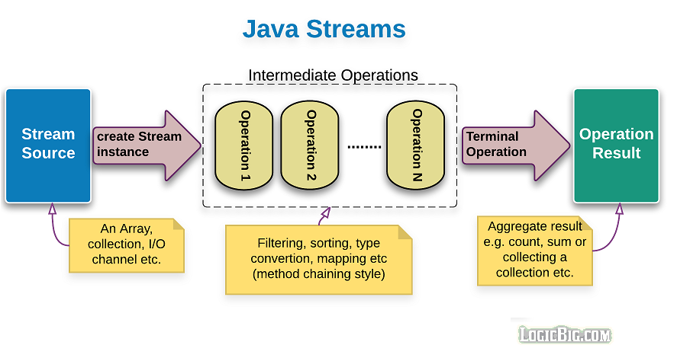
Structure of Java 8 Stream Operations
The three important components to make it work.
  A source
  one or more intermediate operations
  A terminal operation.
The three are pipelined in a sequence to make a stream work.

Slide 61
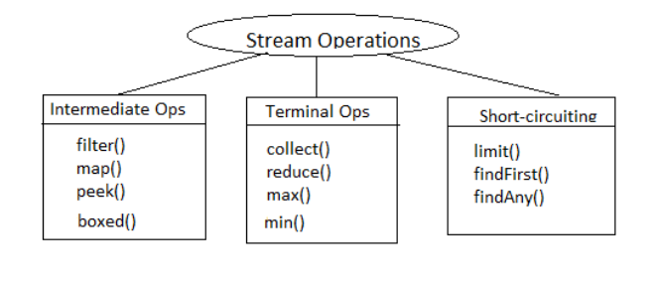
Stream Operations

Slide 62
Operation Categories
Two types of Operations
  Intermediate operations
  Terminal Operations.
Intermediate operations
  intermediate operations are lazy.
    They will not be invoked until the terminal operation is invoked.
    Streams become accessible when intermediate operations were called.
  Return streams can pipeline of operations.
    map, filter, and limit

Slide 63
INTERMEDIATE OPERATIONS

Slide 64
Filter()
Takes predicate as an argument
Applies to the whole stream and returns a filtered stream
  Containing elements which match the Predicate.
  List<Customer> filteredList= customerList.stream().filter((Customer cust ) -> cust.getCustomerId() >200).collect(toList());
  System.out.println("After applying filter method");
  filteredList.forEach(System.out::println);

Slide 65
Map()
Takes an instance of Function <T, R> as parameter
Converts the type of elements in the stream from the current type T to the new type R.
Returns as output a stream of type R or Stream<R>
  List<Customer> customerList = HandleCustomers.getCustomers();
  List<Long> phoneBook = customerList.stream().
  map((eachCust)->eachCust.getPhoneNumber()).collect(toList());
  phoneBook.forEach(System.out::println);

Slide 66
TERMINAL OPERATIONS

Slide 67
Stream Reduction
count(), max(), min(), sum()
  Predefined Terminal Operation implementation.
  Used to aggregate a stream to a type or to a primitive
Can create a custom Stream’s reduction mechanism by using two methods
reduce()
collect()

Slide 68
Max , Min ,Count
count()
  returns the count of elements of a stream.
max()
  returns the maximum element of a stream according to the provided Comparator.
min()
  returns the minimum element of a stream according to the provided Comparator.

Slide 69
Min
  List<Product> catalog = new ArrayList<>();
  Comparator<Product> priceComparator = Comparator.comparing(Product::getRatePerUnit);
  String itemType="TV";
  Optional<Product> minresult = catalog.stream().
  filter((Product prod ) -> prod.getProductName().equalsIgnoreCase(itemType)).
  min(priceComparator);
  double leastPriced=0;
  if(minresult.isPresent())
  {
  leastPriced= minresult.get().getRatePerUnit();
  }

Slide 70
Max
  Optional<Product> maxresult= catalog.stream().
  filter((Product prod ) -> prod.getProductName().equalsIgnoreCase(itemType)).
  max(priceComparator);
  double highPriced=0;
  if(maxresult.isPresent())
  {
  highPriced= maxresult.get().getRatePerUnit();
  }
  System.out.println("Highest Priced :="+itemType + highPriced);

Slide 71
Count()
  long countresult= catalog.stream().
  filter((Product prod ) -> prod.getProductName().equalsIgnoreCase(itemType)).count();
  System.out.println(countresult);

Slide 72
collect()
A terminal operation
It accepts an argument of the type Collector
  Specifies the mechanism of reduction.
Predefined collectors for most common operations.
Accessed with the help of the Collectors type.
Collectors.toList()
  Used for collecting all Stream elements into a List instance.
  Can have more control with toCollection instead.
Collectors.toSet()
  Used for collecting all Stream elements into a Set instance.

Slide 73
collect()
Collectors.toCollection()
  To use a custom implementation
  List<String> result = givenList.stream()
  .collect(toCollection(LinkedList::new))
Collectors.toMap()
  Used to collect Stream elements into a Map instance.
  Map<Long, String> map = customerList.stream()
  .collect(Collectors.toMap(Customer::getPhoneNumber, Customer::getCustomerName));
  map.forEach((x, y) -> System.out.println("Key: " + x +", value: "+ y));

Slide 74
BUILDING WITH MAVEN

Slide 75
Building with Maven
  Introduction to Maven & its objectives
  Install and setting up Maven
  Maven project structure
  POM.xml description

Slide 76
Maven
A Java build tool
  “project management and comprehension tool”
    It means - accumulator of knowledge,
An Apache Project
  Mostly sponsored by Sonatype
Developers Need not move from one build tool to another

Slide 77
Project ManagementTool
  Standard way to build the projects
  Easy way to publish project information
  To share JARs across several projects.
  Run reports, generate a web site,
  Communication among members of a working team.

Slide 78
Installing Maven
Download Maven :http://maven.apache.org/download.html
Unzip the installation archive
Set the M2_HOME and Path environment variables in the following way:
      M2_HOME=C:\apache-maven-2.2.1
      Path=%M2_HOME%\bin
mvn –version
  Will print out installed version of Maven, indicating successful installation .

Slide 79
Dependency Management
Maven revolutionized Java dependency management
    No more checking libraries into version control
Introduced the Repository concept
    Established Maven Central
Created a module metadata file (POM)
Introduced concept of transitive dependency

Slide 80
Dependencies
Used to store Dependencies and then download
  Via http
Downloaded dependencies are cached in a local repository
  Usually found in ${user.home}/.m2/repository
Maven Central is primary community repo
  http://repo1.maven.org/maven2
  Maven will always look for the artifact in the local repository before looking elsewhere.

Slide 81
Pom.xml
Stands for Project Object Model
Maven take a POM file and execute the command on the resources
Uses XML by Default
Describes a project
  Name and Version
  Artifact Type
  Dependencies
  goals
  Plugins
  Profiles (Alternate build configurations)

Slide 82
Pom.xml
    <project>
    - - - - schema definations ---
    <groupId>com.mycompany.app</groupId>
    <artifactId>my-app</artifactId>
    <version>1.0-SNAPSHOT</version>
    </project>

Slide 83
Content of Pom.xml
“Project” are the top-level element in all pom.xml files.
They are identified using:
  groupId:
  Arbitrary project grouping identifier (no spaces or colons
  Loosely based on Java package name
artfiactId:
  Arbitrary name of project (no spaces or colons)
  Usually base name of the primary artifact
  Typically files like a JAR or war
  version
  Version of project
  Format {Major}.{Minor}.{Maintanence}
  Add ‘-SNAPSHOT ‘ to identify in development

Slide 84
Snap Shot Dependencies
Snapshot dependencies are dependencies (JAR files) which are under development.
They are always downloaded to have the latest version in local repository, for every build.
Version number is added at the beginning followed by -SNAPSHOT
        <version>1.0-SNAPSHOT</version>

Slide 85
Dependencies
  <project>
  ...
  <dependencies>
  <dependency>
  <groupId>javax.servlet</groupId>
  <artifactId>servlet-api</artifactId>
  <version>2.5</version>
  <scope>provided</scope>
  </dependency>
  </dependencies>
  </project>
  Scope: compile, test, provided (default=compile)
  provided
    When J2EE containers have the jar., its required only for compilation

Slide 86
Packaging
  <?xml version="1.0" encoding="UTF-8"?>
  <project>
      <groupId>com.mycompany.app</groupId>
      <artifactId>my-app</artifactId>
      <version>1.0-SNAPSHOT</version>
  <packaging>jar</packaging>
  </project>
Build type identified using the “packaging” element
Tells Maven how to build the project
Example packaging types:
  pom, jar, war, ear, custom
  Default is jar

Slide 87
Quick Start Maven Project
Install Maven
Create Maven Home Environment Variable
Create a new directory in the local system
  Becomes the root directory for Maven project.
Create a pom.xml File in that directory
Test the POM File with command “mvn clean”
  Since the project is all new, there will be no previous build files to delete.
  The command will succeed.
  Shows success output Info

Slide 88
Minimal Pom.xml
  <project>
  <modelVersion>4.0.0</modelVersion>
  <groupId>com.training</groupId>
  <artifactId>first-example</artifactId>
  <version>1.0.0</version>
</project>

Slide 89
Minimal Pom.xml
  <project xmlns="http://maven.apache.org/POM/4.0.0"
  xmlns:xsi="http://www.w3.org/2001/XMLSchema-instance"
  xsi:schemaLocation="http://maven.apache.org/POM/4.0.0
  http://maven.apache.org/xsd/maven-4.0.0.xsd">
  <modelVersion>4.0.0</modelVersion>
  <groupId>com.training</groupId>
  <artifactId>first-example</artifactId>
  <version>1.0.0</version>
</project>

Slide 90
Quick Start Maven Project
Creating a Java Source Directory
  Create a ”src” directory inside the project root directory.
  Inside the src directory create a main directory.
  Inside the main directory create a java directory.
  src
    Main
      java

Slide 91
Quick Start Maven Project
Create a new directory mapping to package
Add a .java source file into it
In the project root directory. From command prompt
  mvn package
  Instructs Maven to run the package build phase which is part of the default build life cycle
Will compile the Java source file and create a JAR file containing the compiled Java class.
Maven creates a target subdirectory with the Jar File

Slide 92
Quick Start Maven Project
Execute the Java file with the following command
java -cp target/my-app-1.0-SNAPSHOT.jar com.mycompany.app.App

Slide 93
Setting Compiler
  <properties>
  <maven.compiler.target>1.8</maven.compiler.target>
  <maven.compiler.source>1.8</maven.compiler.source>
  </properties>
  <plugins>
  <plugin>
  <artifactId>maven-compiler-plugin</artifactId>
  <configuration>
  <source>1.8</source>
  <target>1.8</target>
  </configuration>
  </plugin>
  </plugins>

Slide 94
BUILD PROCESS

Slide 95
Build Process
The build process has following parts
  build life cycles
  phases
  Goals
  A build life cycle consists of a sequence of build phases
  Each build phase consists of a sequence of goals.

Slide 96
Build Life Cycle
Maven has 3 built-in build life cycles.
  Executed independently of each other.
  Can be executed sequentially too
default
  compiling and packaging project.
  Not executed directly
clean
  removing temporary files from the output directory, including generated source files, compiled classes, previous JAR files etc.
Site
  generating documentation for your project.
  Can generate a complete website with documentation for the project.

Slide 97
Build Phases
Compile
  Compiles the source code of the project.
Test
  Runs the tests against the compiled source code using a suitable unit testing framework.
  These tests should not require the code be packaged or deployed.
Package
  Packs the compiled code in its distributable format, such as a JAR.
Install
  Install the package into the local repository, for use as a dependency in other projects
  for sharing with other developers and projects.

Slide 98
Default lifecycle
The Default Build Life cycle may have the following build phases
  generate-sources/generate-resources
  compile
  test
  Package
  Install
  Deploy

Slide 99
Goals
To invoke a build Phase Invoke a lifecycle “goal”
mvn install
  Invokes generate* and compile, test, package, integration-test, install
mvn clean
  Invokes just clean
mvn clean compile
  Clean old builds and execute generate*, compile
mvn compile install
  Invokes generate*, compile, test, integration-test, package, install
mvn test clean
  Invokes generate*, compile, test then cleans

Slide 100
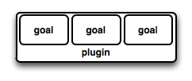
Maven Using Plugin
Maven is a plugin execution framework
  Plugin is a collection of one or more goals.
Plugins are used to :
  create jar file
  create war file
  compile code files
  unit testing of code
mvn [plugin-name]:[goal-name]
mvn compiler:compile

Slide 101
Types of Plugins
Build plugins
  Executed during the build and s configured in the <build/> element
  Executed during the site generation
Reporting plugins
  Executed during the site generation and configured in the <reporting/> element

Slide 102
Common plugins
Clean
  clean up target after the build. Deletes the target directory.
Compiler
  Compiles Java source files.
Jar
  Builds a JAR file from the current project.
War
  Builds a WAR file from the current project

Slide 103
Compiling and Creating a Jar
  Jar plugin
    contains goals for creating JAR files
    Apache Maven JAR Plugin
    This plugin provides the capability to build jars.
mvn package
The 'package' phase responsible for bundling all the files in the artifact
The resulting 'jar' file contains the compiled java class files as well as the files from src/main/resources.

Slide 104
Adding a Jar Plugin
  <build>
  <plugins>
  <plugin>
  <groupId>org.apache.maven.plugins</groupId>
  <artifactId>maven-jar-plugin</artifactId>
  <version>3.1.2</version>
  <configuration>
  <archive>
  <manifest>
  <addClasspath>true</addClasspath>
  <classpathPrefix>lib/</classpathPrefix>
  <mainClass>com.training.HelloWorld</mainClass>
  </manifest>
  </archive>
  </configuration>
  </plugin>
  </plugins>
  </build>

Slide 105
Maven Compile Plugin
  <dependencies>
  </dependencies>
  <build>
  <plugins>
  <plugin>
  <groupId>org.codehaus.mojo</groupId>
  <artifactId>exec-maven-plugin</artifactId>
  <version>1.5.0</version>
  <executions>
  <execution>
  <goals>
  <goal>java</goal>
  </goals>
  </execution>
  </executions>
  <configuration>
  <mainClass>com.mycompany.app.App</mainClass>
  </configuration>
  </plugin>
  </plugins>
  </build>

Slide 106
Archetype
Maven uses archetype plugins to create projects.
The Archetype plug-in
  runs outside of a Maven project build life cycle
  used for creating Maven projects.
Once these archetypes are created and deployed in repository they are available for use by all developers within organization.
When referring to a plugin goal, we frequently use the shorthand notation: pluginId:goalId
When referring to the generate goal in the Archetype plugin, we write archetype:generate.

Slide 107
Project Using Archetype
Can use the Maven Archetype plugin from the command line.
  mvn archetype:generate
Select default archetype
This will use the archetype
  org.apache.maven.archetypes:maven-archetype-quickstart.
Will Build a Simple Project
Complete the Coding
Add the exec-maven-plugin in the pom.xml

Slide 108
Installing Package
mvn install
    install the package into the local repository, for use as a dependency in other projects locally
It executes a series of phases like
  Validate
  generate-sources
  compiled
  tested,
  packaged,
Can execute multiple build life cycles or phases by passing more than one argument
mvn clean install;
  this deletes the target directory and recreates all jars in that location.

Slide 109
Configuring in Pom
  <plugin>
  <groupId>org.codehaus.mojo</groupId>
  <artifactId>exec-maven-plugin</artifactId>
  <version>1.2.1</version>
  <executions>
  <execution>
  <goals>
  <goal>java</goal>
  </goals>
  </execution>
  </executions>
  <configuration> <mainClass>com.example.Main</mainClass>
  <arguments>
  <argument>Ram</argument>
  <argument>Shyam</argument> </arguments>
  </configuration>
  </plugin>

Slide 110
Executions
mvn clean install
mvn exec:java -Dexec:mainClass=com.training.demo.App -Dexec:args="ram"

Slide 111
Resolving Dependency
During the build process dependencies are resolved with dependency management engine.
Specified in <dependencies> elements within a pom.xml file.
They are resolved in the following order:
  Local repository is checked for the dependency.
  A list of remote repositories is checked for the dependency.
  In Case 1 and 2 fail and error is reported

Slide 112
Variables
Don't repeat yourself.
To assist in ensuring the value is only specified once,
Maven allows variables in the POM.
    <properties>
    <mavenVersion>2.1</mavenVersion>
    </properties>
  <dependency>
    <groupId>org.apache.maven</groupId>
    <artifactId>maven-artifact</artifactId>
    <version>${mavenVersion}</version>
  </dependency>

Slide 113
Project Inheritance
To define an inheritance style relationship between POMs.
POM files at the bottom of the hierarchy declare that they inherit from a specific parent POM.
The parent POM can then share certain properties and details of configuration.
Motivation for Project Inheritance :
  shared dependencies and common configuration for a group of projects which are logically related.

Slide 114
Parent POM
  <modelVersion>4.0.0</modelVersion>
  <groupId>com.training</groupId>
  <artifactId>module1</artifactId>
  <packaging>pom</packaging>
  <version>1.0-SNAPSHOT</version>
  <dependencies>
  <dependency>
  <groupId>junit</groupId>
  <artifactId>junit</artifactId>
  <version>4.0</version>
  <scope>test</scope>
  </dependency>
  </dependencies>
  </project>

Slide 115
Parent Pom
  <parent>
    <groupId>com.training</groupId>
    <artifactId>module1</artifactId>
    <version>1.0-SNAPSHOT</version>
    <relativePath>../module1/pom.xml</relativePath>
  </parent>
  <modelVersion>4.0.0</modelVersion>
  <groupId>com.training</groupId>
  <artifactId>module2</artifactId>
  <packaging>jar</packaging>
  <version>1.0-SNAPSHOT</version>

Slide 116
Pom.xml
  <dependency>
  <groupId>org.springframework.boot</groupId>
  <artifactId>spring-boot-starter-tomcat</artifactId> <scope>provided</scope>
  </dependency>
  <packaging>war</packaging>

Slide 117
Maven in Eclipse
Create a Maven Project, it creates a Maven Project with pom.xml
Right-click the pom.xml file and select Run As Maven build.
Enter "clean install" as Goal and enter finish.
It starts the build, Once the build finishes, a target folder, with build artifacts is created

Slide 118
GIT
Configuration Management

Slide 119
Topics
  Basics of Software Configuration Management
  Basics of Version Control System
    Centralized version control system
    Distributed/Decentralized version control system
  How to install, configure and create repository
  Working copy and check out
  Review, Commit & Update
  How to merge code and avoid conflict

Slide 120
Software Configuration Management
Multiple people have to work on software that is changing
More than one version of the software has to be supported:
    Released systems
    Custom configured systems (different functionality)
    System(s) under development
    Software on different machines & operating systems
Need for coordination
Software Configuration Management
  manages evolving software systems
  controls the costs involved in making changes to a system.

Slide 121
All Software Has Multiple Versions
Different releases of a product
Variations for different platforms
    Hardware and software
Versions within a development cycle
    Test release with debugging code
    Alpha, beta of final release
Every time when the program is edited

Slide 122
Version Control
Version control tracks multiple versions
In particular, allows
  old versions to be recovered
  multiple versions to exist simultaneously
  can recreate project history
Can revert a file or project to a previous version, track modifications and modifying individuals, and compare changes.

Slide 123
Centralized Version Control
  A single server storing all changes and file versions
  Can be accessed by various clients.
  Knowledge of team members activities with certain files
  Administrators can control privileges.

Slide 124
GIT
  Git is a Distributed Version Control System that stores data in a file system made up of snapshots.
  Creates a snapshot of the file and stores a reference to it.
  When changes are saved its called commit
  If the file has not changed, stores a reference to the already-stored identical version of it.

Slide 125
History of Git
  Git traces its roots to the open source software project Linux kernel.
  Linus Torvalds, the chief architect of the Linux kernel, began creating Git.
  Since its inception in 2005, Git has become one of the most utilized Version Control Systems in the world.

Slide 126
Local Operations
  Git mostly relies on local operations because most necessary information can be found in local resources.
  Projects history resides on the local disk, eliminating the need to fetch history information from the server
  Can continue work on a project even when not online or on a VPN.

Slide 127
GIT-Features
Tracking Changes
  Every single change applied to any file or directory is tracked by Git.
States
  Files in Git can reside in three main states: committed, modified and staged.
  Committed
    Data is securely stored in a local database
  Modified
    File has been changed but not committed to the database
  Staged
    Flagged a file changed version to be committed in the next snapshot

Slide 128
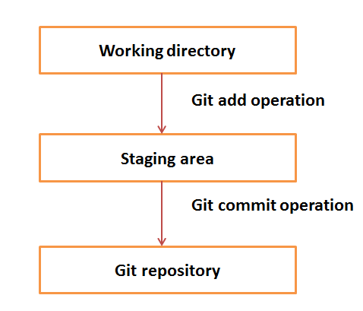
Working Directory and Staging Area

Slide 129
Download GIT
Git can be installed by downloading
Git Website
http://git-scm.com/download/win
GitHub
Install Git as part of the GitHub for Windows install.
http://windows.github.com

Slide 130
Initial Customization
  Identity Setting
  Can set the user name and email address, to be used for every Git commit.
  To SET
    git config --global user.name “Ramesh Kumar"
    git config --global user.email ram@abc.com
  To View
    git config --global user.name
    git config --global user.email

Slide 131
Default Text Editor
  Git will use the gitPad has the text Editor
    Can configure a different text editor
  $ git config --global core.editor wordpad
  Check Settings
    git config --list command.
  Getting Help
    git help command
    git command –help

Slide 132
Setting up a Git Repository
  To import an existing project or directory into Git,
  Switch to the target project directory
  $ cd test
    Use the git init command
  Can start tracking repository files, and initial commit

Slide 133
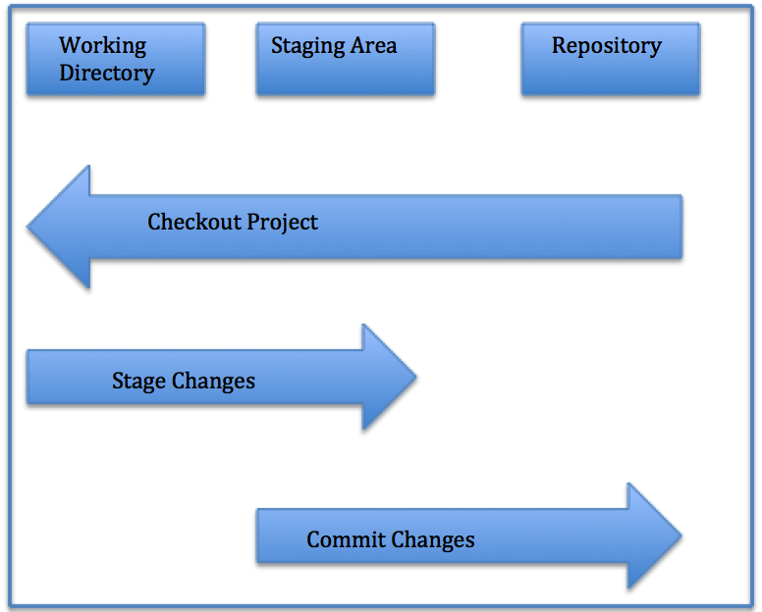
Local Repository Structure
The local Git repository has three components:
Working Directory: The actual files reside here.
Index: The area used for staging
Head: Points to the most recent commit

Slide 134
Saving Changes
All files in a checked out (or working) copy of a project file are either in a tracked or untracked state.
Tracked
  Files can be modified, unmodified, or staged; they were part of the most recent file snapshot.
Untracked
  Untracked files were not in the last snapshot and do not currently reside in the staging area.
  After cloning a repository, files have tracked status and are unmodified because they have been checked out but not edited.

Slide 135
Check File Status
To determine the state of files,
$ git status
Gives information of branch and state of working directory

Slide 136
Tracking and Staging a New File
  files are tracked and staged for committing.
Single File
  git add filename
All Files
  $ git add
$ git status

Slide 137
Committing a File
should commit the changes and record commit message:
  $ git commit –m made change x,y,z
Committing All Changes
  $ git commit -a*

Slide 138
GitHUB
  GitHub is a is the largest existing host for Git repositories and is used by millions of developers worldwide.
  A high percentage of Git repositories reside on GitHub, and this resource is used by many open source projects.
  Can set up a free user account.
  Done by visiting https://github.com.

Slide 139
GITHUB - General Workflow
GitHub collaboration workflow revolves around Pull Requests.
  Create a topic branch from master.
  Commit changes for the project.
  Push the topic branch to the GitHub project.
  Open a Pull Request.
  Confer with team and perform additional commits, if applicable.
  The project owner closes or merges the Pull Request.

Slide 140
Repositories
Remote
  Versions of a project residing online or on a network.
  Teams can use remote repositories to push information to and pull data from.
Cloned Repositories
    Versions of a project residing in local machine.
Seeing Your Remotes
  git remote -v,
  you can view all the remote
  git remote -v remote1

Slide 141
Pushing Changes
  To push changes to a remote repository.
  $ git push origin master
  pushes changes from the local master branch to the remote repository named origin
  For cloned repositories,
    Git will automatically give the name origin  to the server from which you cloned and the name master to your local repository.
  However, names can be changed by the user.

Slide 142
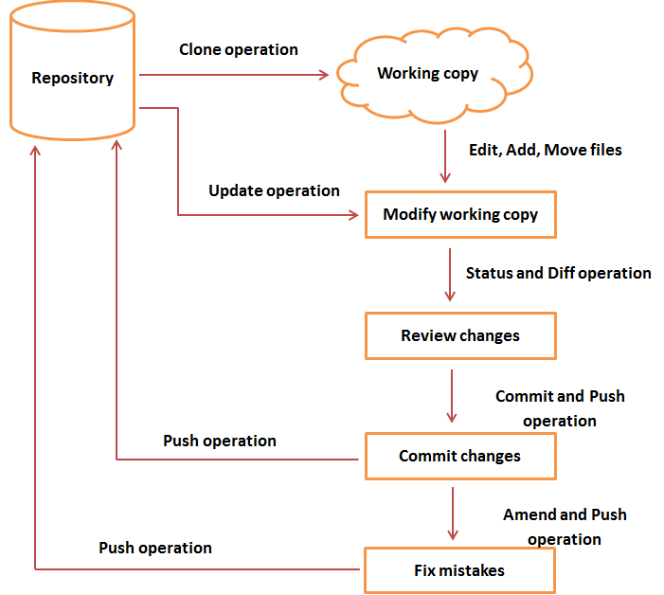
Git Life Cycle

Slide 143
Fetching
  Fetching entails pulling data you don t have from a remote project.
  git fetch [remote-name]
  Cloned Repositories
    git fetch origin
    to pull down any new changes that were pushed to the server since you cloned or last fetched from it.
  git fetch solely pulls new data to a local repository;
  it does not merge changes with or modify your local work.

Slide 144
Pushing
To push your changes upstream for sharing,
  git push [remote-name][branch-name]
$ git push origin master
  pushes committed changes from local master branch upstream to the origin server.

Slide 145
Cloning
To create a copy of an existing Git repository from a particular server
$ git clone https://github.com/test
  Copies all versions of all files for a project.
  creation of a directory called test,
  Has copies of all versions of all files for the specified project.
  automatically checks out or retrieves for editing a copy of the newest version of the project.
$ git clone https://github.com/test mydirectory
  It create a copy of the target repository in a directory named mydirectory

Slide 146
Cloning
After the clone,
git fetch : will update all the remote-tracking branches,
git pull
  Will update all the remote tracking branches
  In addition merge the remote master branch into the current master branch,

Slide 147
Branching
Branches of a central repository are created
Collaborators are able to work on a project simultaneously via multiple branches, without affecting this main repository.
A collaborator can create a branch, work on it and save commit snapshots within it,
Can switch between various branches, and merge changes.

Slide 148
Branching
A Git branch is basically a movable pointer that always points to the most recent commit, or snapshot.
Git uses the default local branch name master, which can be changed.
Just because the default name is master does not imply that it is higher in importance or has more functionality than other branches.
The head is a special pointer which indicates which branch you are currently working within.

Slide 149
creating a New Branch
  $ git branch test
  Switching Branches
  To switch to another branch,
  $ git checkout test
  This command moves the HEAD pointer to the test branch
  If you make a commit while on the test branch, only this branch will point to the most recent commit.
  The master branch will still point at the commit it was pointing to when you checked out to the test branch.

Slide 150
Create a Branch and Checkout
To simultaneously create a new branch and switch to it,
  $ git checkout -b test2
Creates a new branch test2  and switches you to it.
List Branches
    $ git branch
Deleting Branches
  $ git branch -d test

Slide 151
Merging
  To merge changes from one branch into your current one
  Current branch pointer moves forward to the most recent commit for the branch being merged in
  $ git checkout master
  $ git merge test
    merges in changes from test branch

Slide 152
Merge Conflicts
  When the two files being merged both have changes in identical sections of a file,
  Git will not be able to complete the merge cleanly.
  These conflicts must be dealt with manually.
  Portions of files with unresolved merge conflicts will be labeled unmerged
  You can easily locate areas of merge conflict via Git conflict resolution markers,

Slide 153
Merge Conflicts
  My name is
  <<<<<<< HEAD
  Jane
  ======= Mary >>>>>>>
  branch-test Here,
  HEAD indicates the branch you checked out before running the merge command.
  The content above the ======= resides within this branch,
  while everything below it is within the test branch.
  git add command on fixed files to mark them as resolved.
  $ git status will show the merge resolved

Slide 154
Using Constructors with Arguments
java.lang.reflect.Constructor. newInstance(Object... initargs)
public static void use() throws Exception {
Class<?> c = Class.forName("com.training.sets.Doctor") ;
Class<?>[] argClass = new Class[]{ long.class, String.class } ;
Object[] args = new Object[]{new Long(12),new String("Ramesh")} ;
Constructor<?> ctor = c.getConstructor(argClass) ;
Doctor r = (Doctor) ctor.newInstance(args) ;
System.out.println(r);
}

