Slide 1



WHAT'S NEXT ON YOUR BUCKET LIST?
WELCOME TO PYPY TRAVEL ASSISTANT!
A presentation by Group 14
Keshav Saboo(A030) | Mayika M(A033) | Mugdha(A034) | Ruchika Mohla(A052) | Vijendher Reddy Gurram(A074)

Slide 2
<DATA IS BEAUTIFUL>
We’re surrounded by so much information, that finding a meaning to it often becomes a challenge.
For this project, we’ve used the data of 30 International Airports of India and tried to make it more meaningful. Airport Name, Airport code, the city, and state of the airport were all collected from different Wikipedia pages and the latitude-longitude of these airports were collected from Google Maps.
This dataset is used for providing a complete package of information to travelers to make their interstate travel easy and comfy. The following information will be provided:
Suggests the nearest airport based on the user's location.
Approximate fly time based on distance and average aircraft speed(mid-sized aircraft).
The temperature of the destination to make packing easier
Suggests a list of things to do at the destination like famous restaurants to visit, hotels to stay.

Slide 3
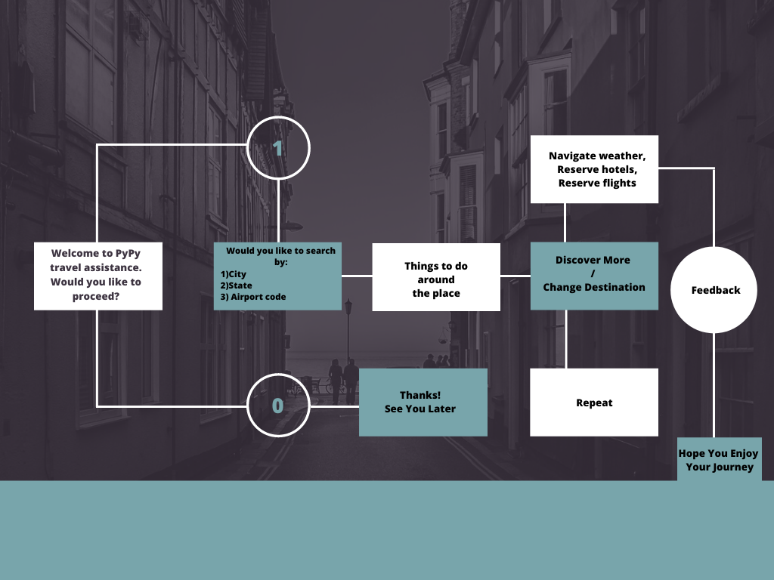
<Flowchart>
Choose the destination from the available list

Slide 4
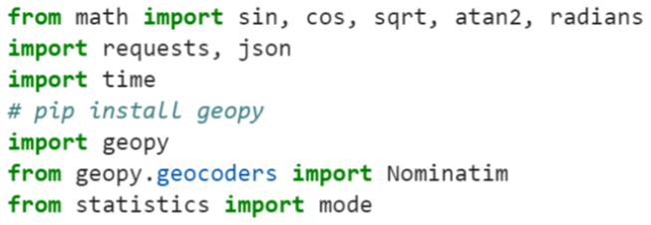


<LIBRARIES USED>

Slide 5
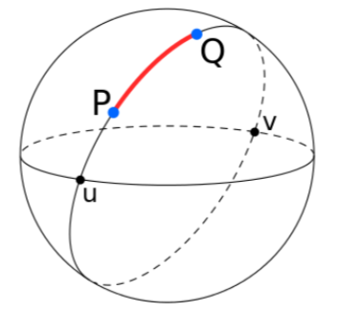
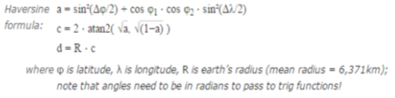
<HOW WE CALCULATED NEAREST AIRPORT AND FLY TIME?>
As soon as the user types the nearest landmark to his/her location, geopy(gets location from “openstreetmap”) gives out the coordinates of the users location.
The coordinates then pass through a defined function in the code, which converts it to longitudinal and latitudinal distance in radians. In this function we have used the “Great circle method” to find the distance between any two given locations along the surface of the sphere, i.e. the users location and the airport.
We have used the Haversine formula, for this calculation(as shown in the right).
To calculate the fly time, we have used the distance calculated and the average speed of a mid-sized commercial jet. The fly time calculated is an approximate time which only depends on the distance and speed, but in reality the scheduled flight time depends on many other factors like air-traffic control, flight operations and etc.

Slide 6
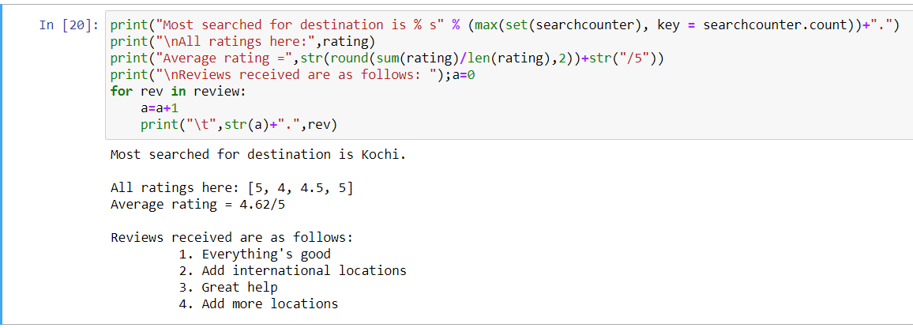
<Analysis>

Slide 7
<Our Findings>
Nearest airport from the user's location.
Address search from user's approximate location.
Google map route from the user's location to the nearest airport.
Assistance in trip planning with weather report of the destination.
Approximate fly time based on distance and average aircraft speed(mid-sized aircraft).
System rating and feedback mechanism for further improvements.
The most searched for city.

Slide 8

THANK YOU!

