Slide 1
Prefix, Postfix, Infix Notation

Slide 2
Infix Notation
To add A, B, we write
A+B
To multiply A, B, we write
A*B
The operators ('+' and '*') go in between the operands ('A' and 'B')
This is "Infix" notation.

Slide 3
Prefix Notation
Instead of saying "A plus B", we could say "add A,B " and write
+ A B
"Multiply A,B" would be written
* A B
This is Prefix notation.

Slide 4
Postfix Notation
Another alternative is to put the operators after the operands as in
A B +
and
A B *
This is Postfix notation.
Notes:
"A,B are multiplied"
"A,B are added"

Slide 5
Pre A In B Post
The terms infix, prefix, and postfix tell us whether the operators go between, before, or after the operands.

Slide 6
Parentheses
Evaluate 2+3*5.
+ First:
(2+3)*5 = 5*5 = 25
* First:
2+(3*5) = 2+15 = 17
Infix notation requires Parentheses.

Slide 7
What about Prefix Notation?
+ 2 * 3 5 =
= + 2 * 3 5
= + 2 15 = 17
* + 2 3 5 =
= * + 2 3 5
= * 5 5 = 25
No parentheses needed!

Slide 8
Postfix Notation
2 3 5 * + =
= 2 3 5 * +
= 2 15 + = 17
2 3 + 5 * =
= 2 3 + 5 *
= 5 5 * = 25
No parentheses needed here either!

Slide 9
Conclusion:
Infix is the only notation that requires parentheses in order to change the order in which the operations are done.

Slide 10
Fully Parenthesized Expression
A FPE has exactly one set of Parentheses enclosing each operator and its operands.
Which is fully parenthesized?
( A + B ) * C
( ( A + B) * C )
( ( A + B) * ( C ) )

Slide 11
Infix to Prefix Conversion
Move each operator to the left of its operands & remove the parentheses:
( ( A + B) * ( C + D ) )
Notes:
Start with Fully parenthesized expression. Move each operator to the left of its operands and remove the set of parentheses.

Slide 12
Infix to Prefix Conversion
Move each operator to the left of its operands & remove the parentheses:
( + A B * ( C + D ) )
Notes:
Start with Fully parenthesized expression. Move each operator to the left of its operands and remove the set of parentheses.

Slide 13
Infix to Prefix Conversion
Move each operator to the left of its operands & remove the parentheses:
* + A B ( C + D )
Notes:
Start with Fully parenthesized expression. Move each operator to the left of its operands and remove the set of parentheses.

Slide 14
Infix to Prefix Conversion
Move each operator to the left of its operands & remove the parentheses:
* + A B + C D
Order of operands does not change!
Notes:
Start with Fully parenthesized expression. Move each operator to the left of its operands and remove the set of parentheses.

Slide 15
Infix to Postfix
( ( ( A + B ) * C ) - ( ( D + E ) / F ) )
A B + C * D E + F / -
Operand order does not change!
Operators are in order of evaluation!

Slide 16
Computer Algorithm
FPE Infix To Postfix
Assumptions:
Space delimited list of tokens represents a FPE infix expression
Operands are single characters.
Operators +,-,*,/

Slide 17
FPE Infix To Postfix
Initialize a Stack for operators, output list
Split the input into a list of tokens.
for each token (left to right):
if it is operand: append to output
if it is '(': push onto Stack
if it is ')': pop & append till '('

Slide 18
FPE Infix to Postfix
( ( ( A + B ) * ( C - E ) ) / ( F + G ) )
stack: <empty>
output: []

Slide 19
FPE Infix to Postfix
( ( A + B ) * ( C - E ) ) / ( F + G ) )
stack: (
output: []

Slide 20
FPE Infix to Postfix
( A + B ) * ( C - E ) ) / ( F + G ) )
stack: ( (
output: []

Slide 21
FPE Infix to Postfix
A + B ) * ( C - E ) ) / ( F + G ) )
stack: ( ( (
output: []

Slide 22
FPE Infix to Postfix
+ B ) * ( C - E ) ) / ( F + G ) )
stack: ( ( (
output: [A]

Slide 23
FPE Infix to Postfix
B ) * ( C - E ) ) / ( F + G ) )
stack: ( ( ( +
output: [A]

Slide 24
FPE Infix to Postfix
) * ( C - E ) ) / ( F + G ) )
stack: ( ( ( +
output: [A B]

Slide 25
FPE Infix to Postfix
* ( C - E ) ) / ( F + G ) )
stack: ( (
output: [A B + ]

Slide 26
FPE Infix to Postfix
( C - E ) ) / ( F + G ) )
stack: ( ( *
output: [A B + ]

Slide 27
FPE Infix to Postfix
C - E ) ) / ( F + G ) )
stack: ( ( * (
output: [A B + ]

Slide 28
FPE Infix to Postfix
- E ) ) / ( F + G ) )
stack: ( ( * (
output: [A B + C ]

Slide 29
FPE Infix to Postfix
E ) ) / ( F + G ) )
stack: ( ( * ( -
output: [A B + C ]

Slide 30
FPE Infix to Postfix
) ) / ( F + G ) )
stack: ( ( * ( -
output: [A B + C E ]

Slide 31
FPE Infix to Postfix
) / ( F + G ) )
stack: ( ( *
output: [A B + C E - ]

Slide 32
FPE Infix to Postfix
/ ( F + G ) )
stack: (
output: [A B + C E - * ]

Slide 33
FPE Infix to Postfix
( F + G ) )
stack: ( /
output: [A B + C E - * ]

Slide 34
FPE Infix to Postfix
F + G ) )
stack: ( / (
output: [A B + C E - * ]

Slide 35
FPE Infix to Postfix
+ G ) )
stack: ( / (
output: [A B + C E - * F ]

Slide 36
FPE Infix to Postfix
G ) )
stack: ( / ( +
output: [A B + C E - * F ]

Slide 37
FPE Infix to Postfix
) )
stack: ( / ( +
output: [A B + C E - * F G ]

Slide 38
FPE Infix to Postfix
)
stack: ( /
output: [A B + C E - * F G + ]

Slide 39
FPE Infix to Postfix
stack: <empty>
output: [A B + C E - * F G + / ]

Slide 40
Problem with FPE
Too many parentheses.
Establish precedence rules:
My Dear Aunt Sally
We can alter the previous program to use the precedence rules.

Slide 41
Infix to Postfix
Initialize a Stack for operators, output list
Split the input into a list of tokens.
for each token (left to right):
if it is operand: append to output
if it is '(': push onto Stack
if it is ')': pop & append till '('
if it in '+-*/':
while peek has precedence ≥ it:
pop & append
push onto Stack
pop and append the rest of the Stack.

Slide 42
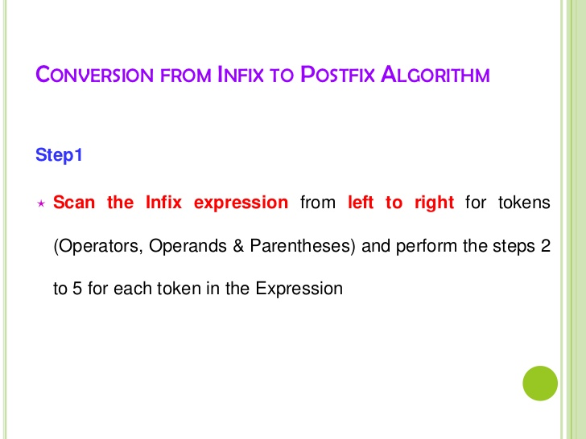

Slide 43
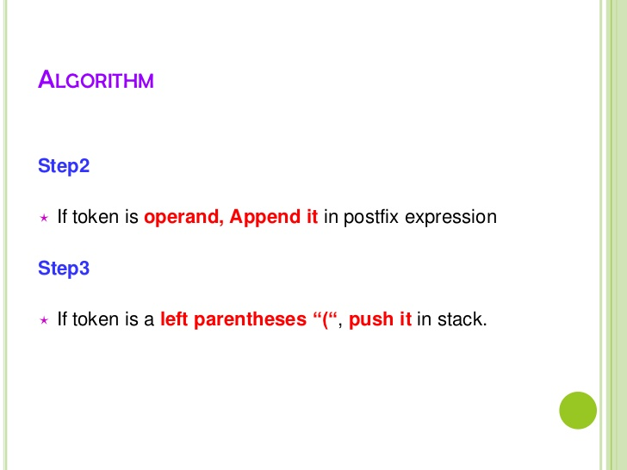

Slide 44
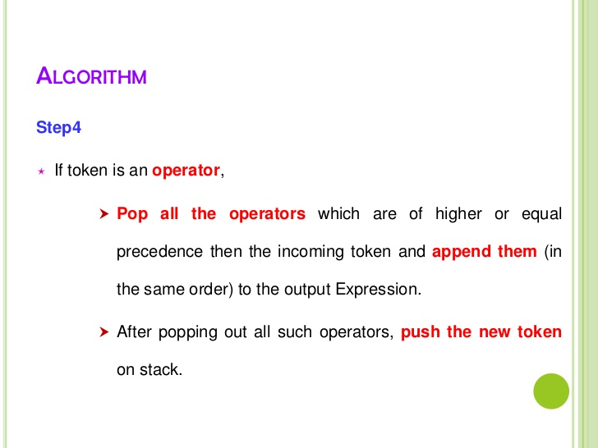

Slide 45
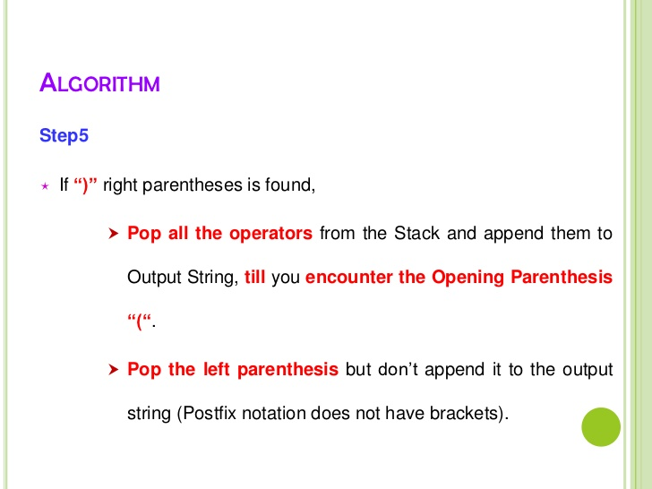

Slide 46
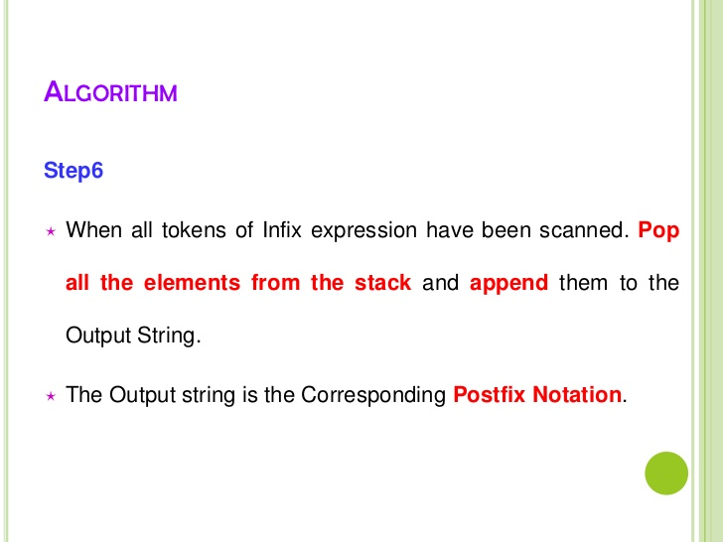

Slide 47
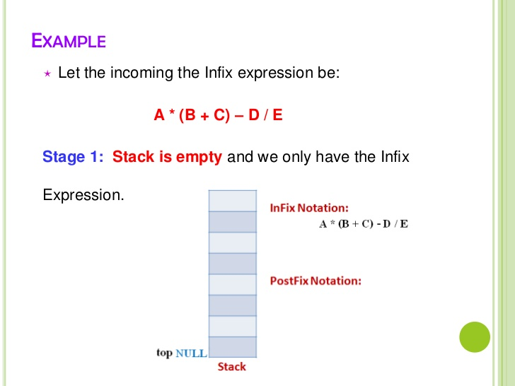

Slide 48
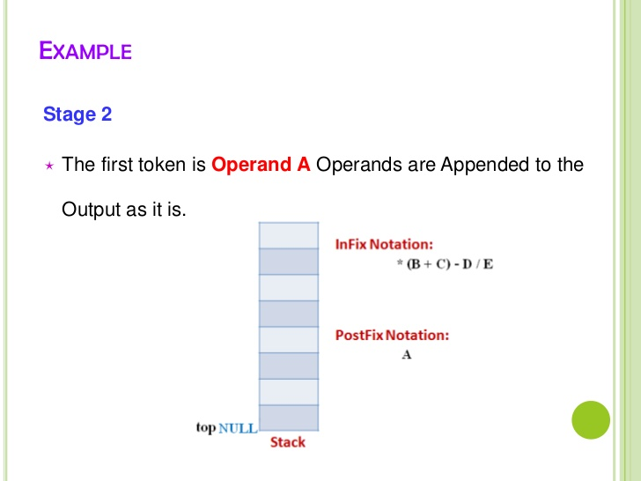

Slide 49
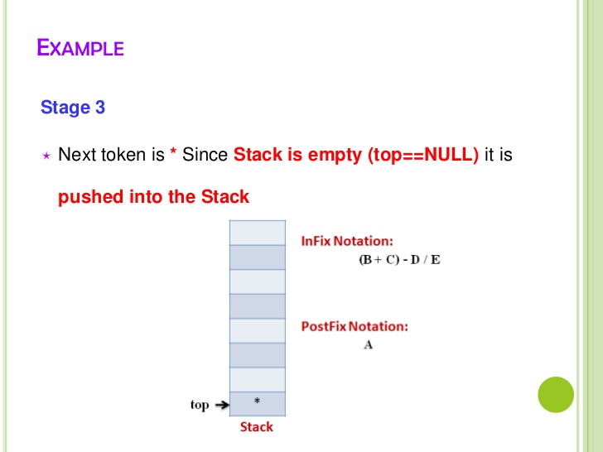

Slide 50
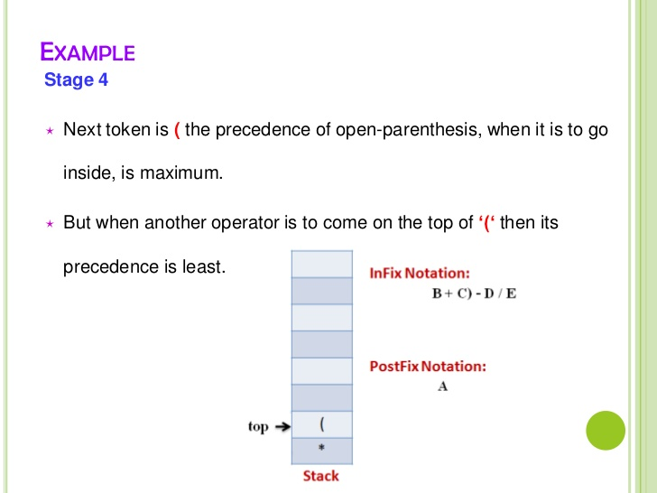

Slide 51
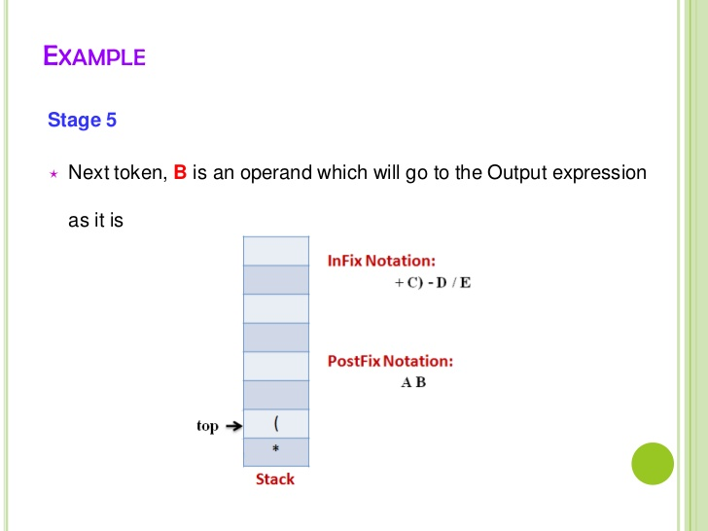

Slide 52
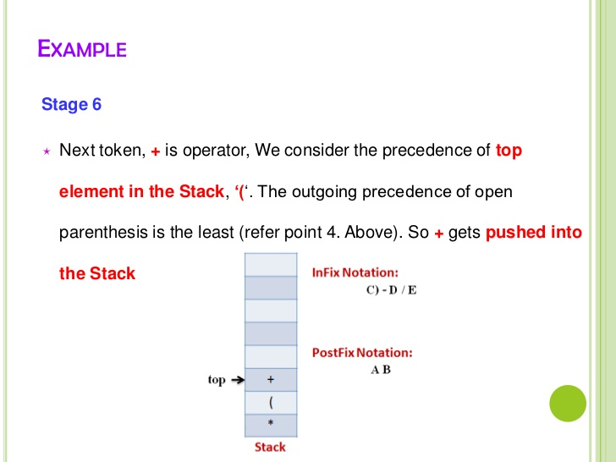

Slide 53
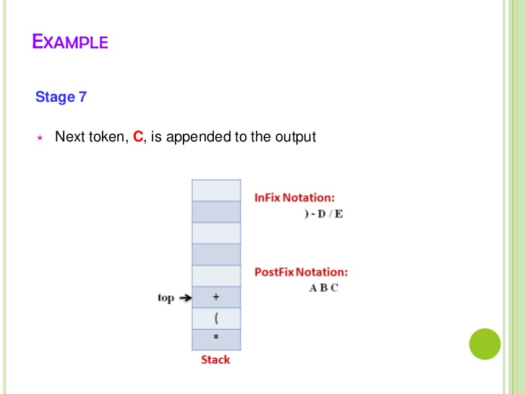

Slide 54
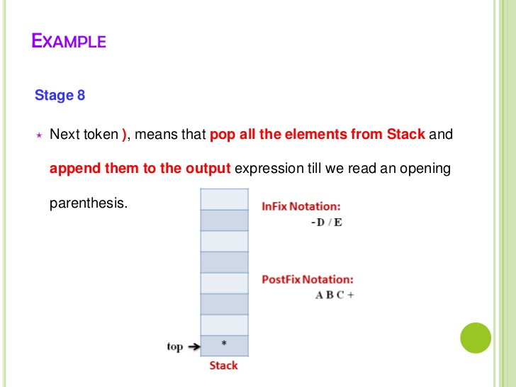

Slide 55
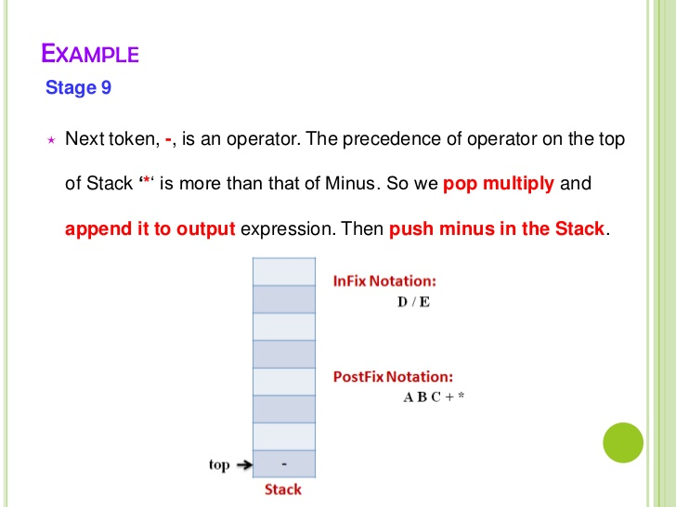

Slide 56
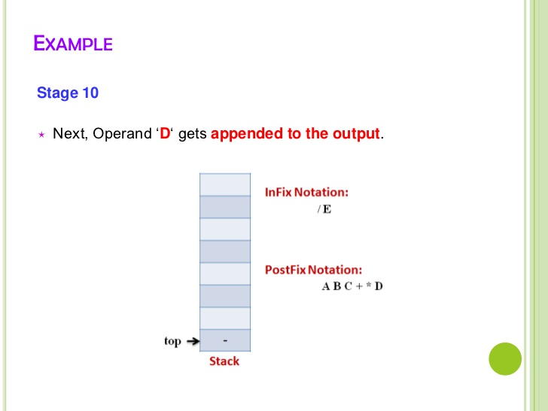

Slide 57
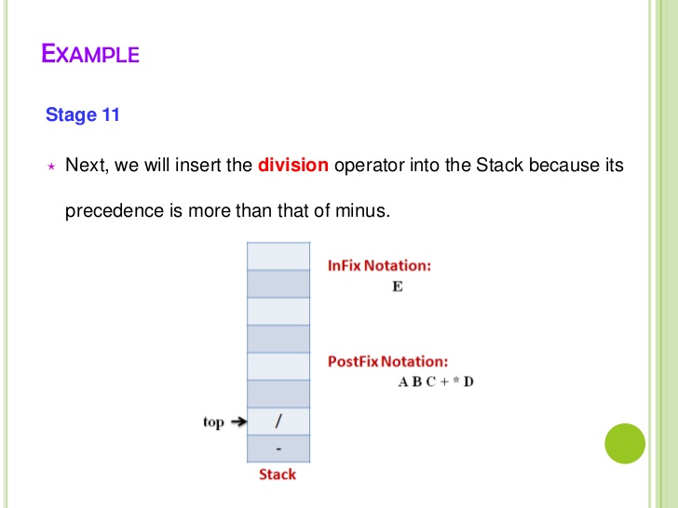

Slide 58
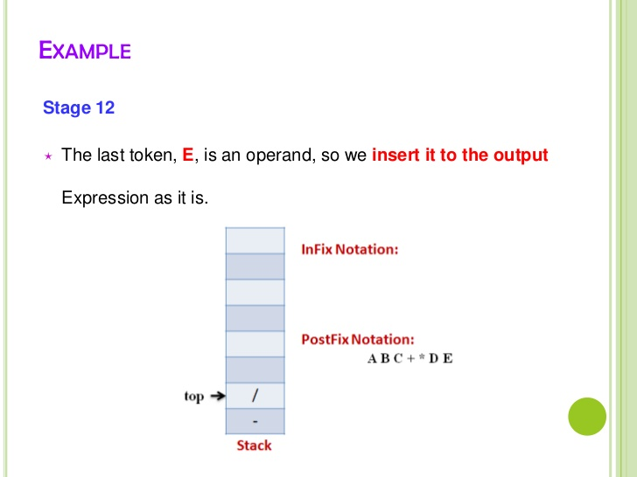

Slide 59
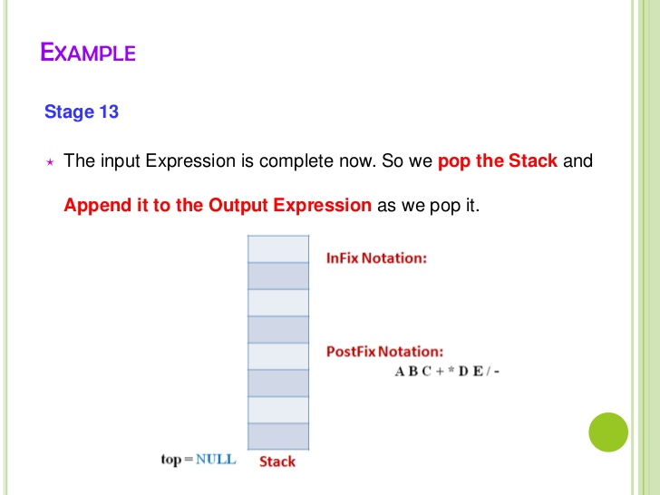

Slide 60
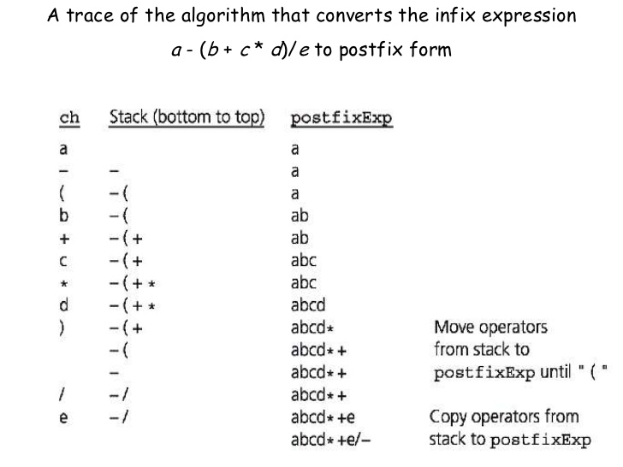


Slide 61
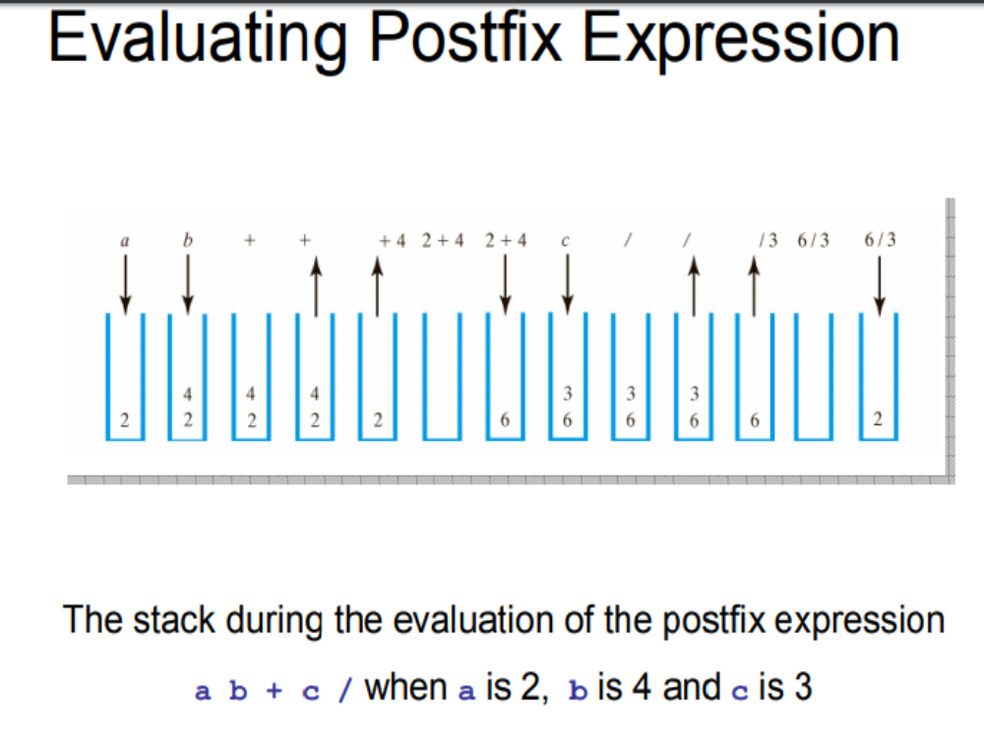

Slide 62
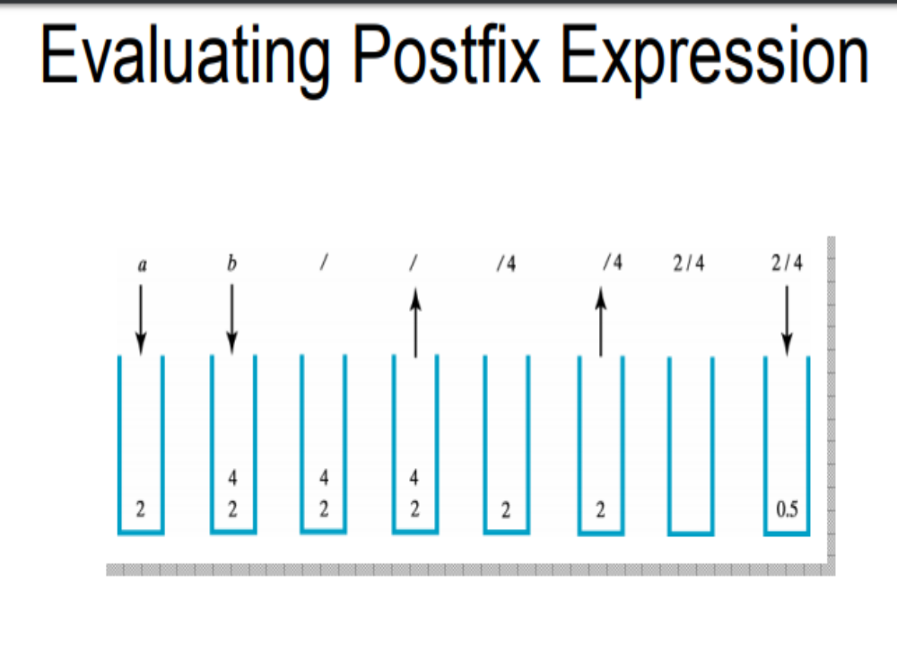

Slide 63
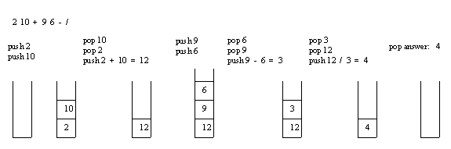
Evaluating Postfix Expression
Example: Consider the postfix expression, 2 10 + 9 6 - /, which is (2 + 10) / (9 - 6) in infix, the result of which is 12 / 3 = 4.
The following is a trace of the postfix evaluation algorithm for the postfix expression:

Slide 64
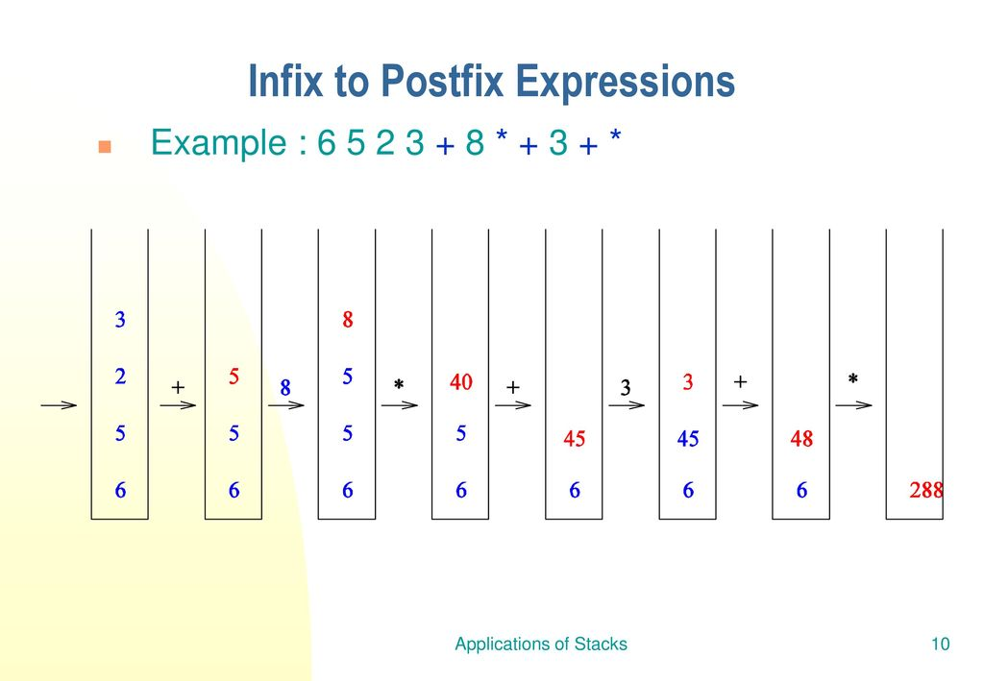

Slide 65
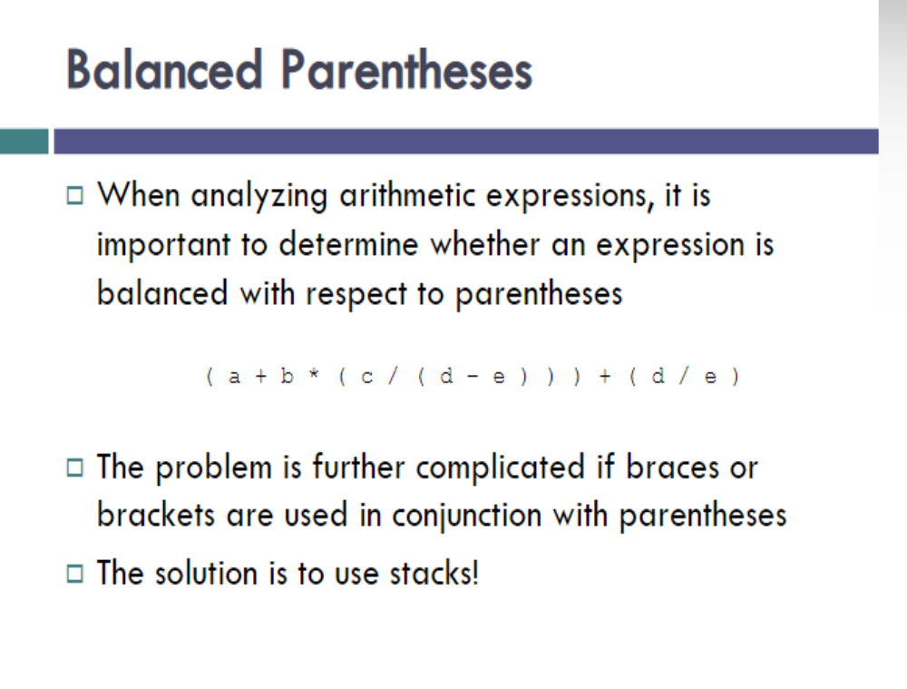

Slide 66
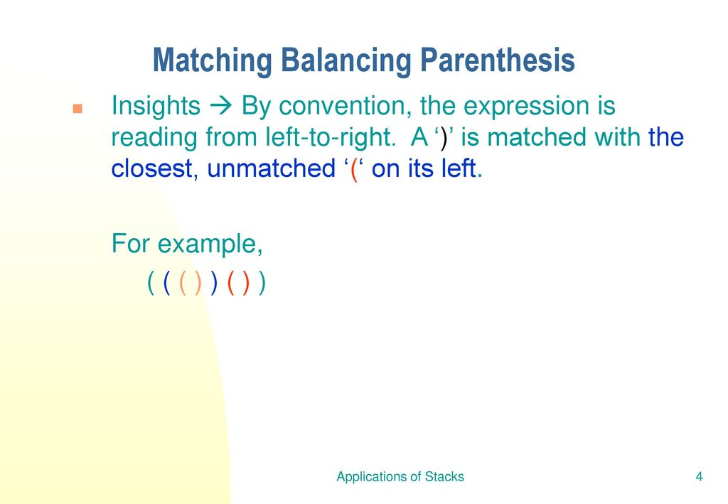

Slide 67
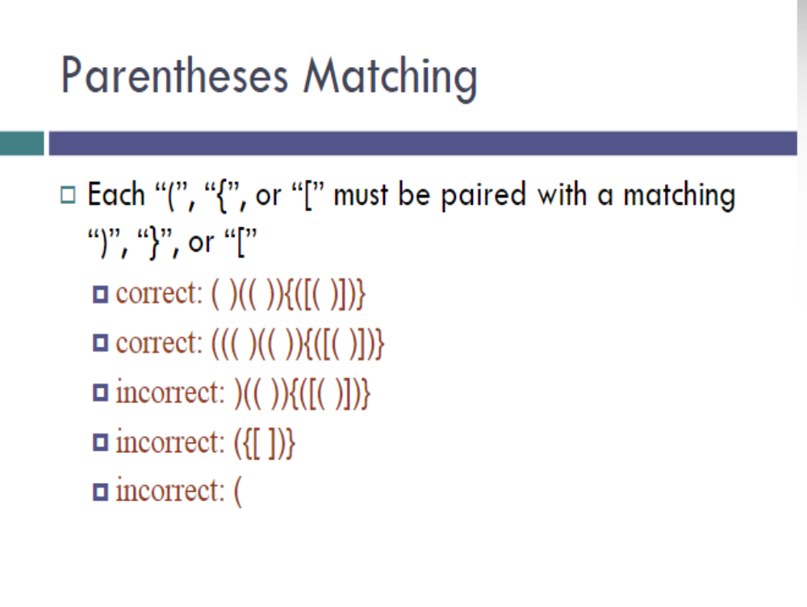


Slide 68
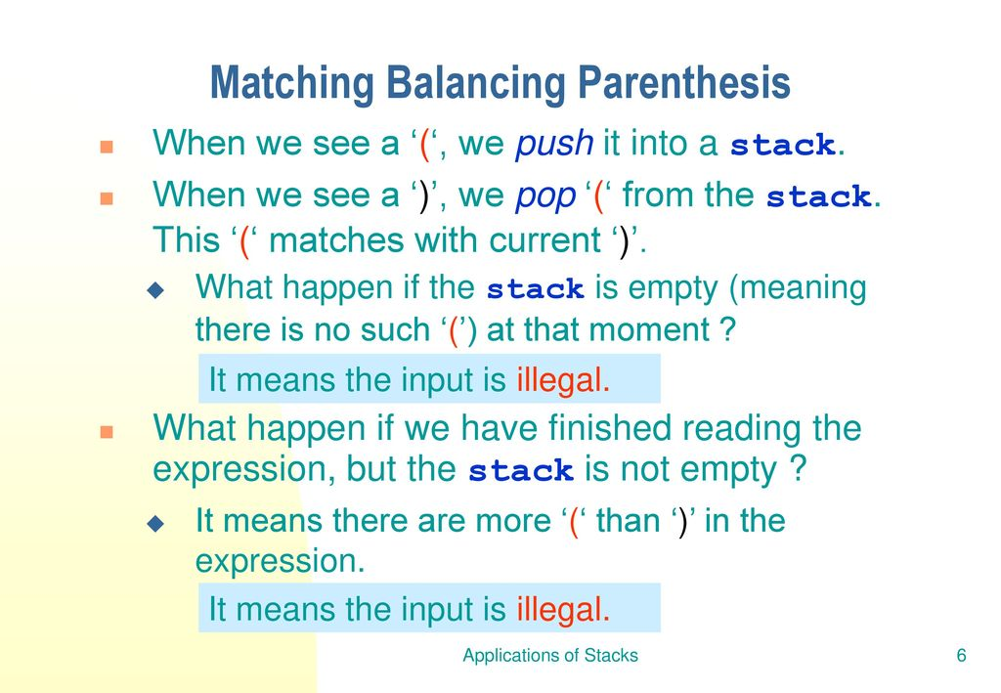

Slide 69
