Slide 1
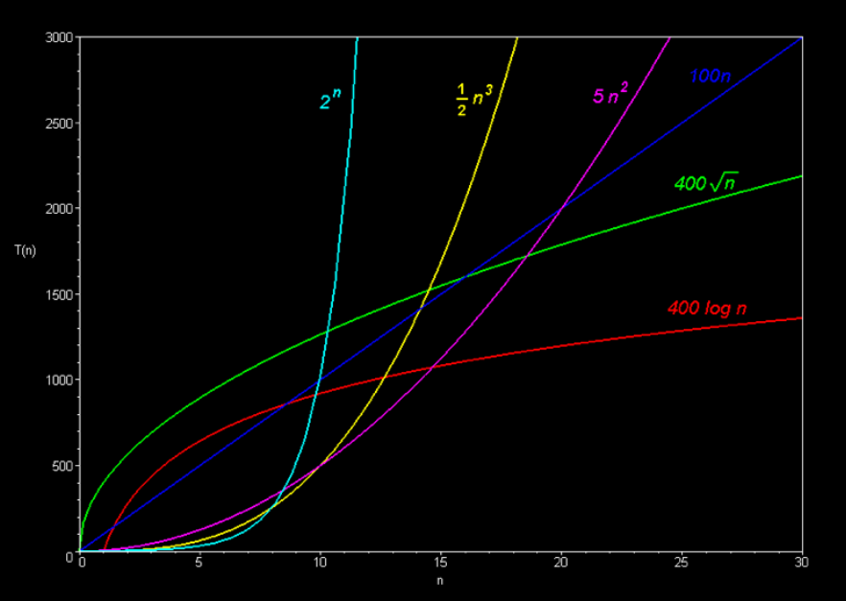
Asymptotic Notations
Dr. K. Santhi,
Associate Professor,
Department of Analytics,
School of Computer Science & Engineering,
VIT University, Vellore.
Mobile : 9789777676

Slide 2
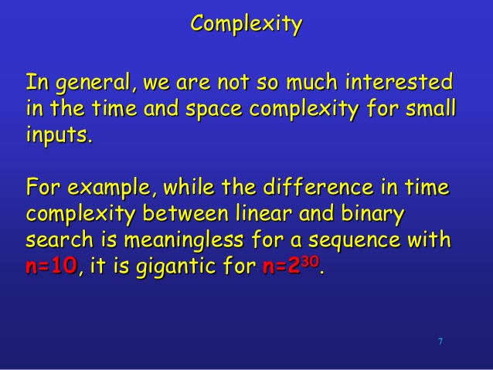

Slide 3
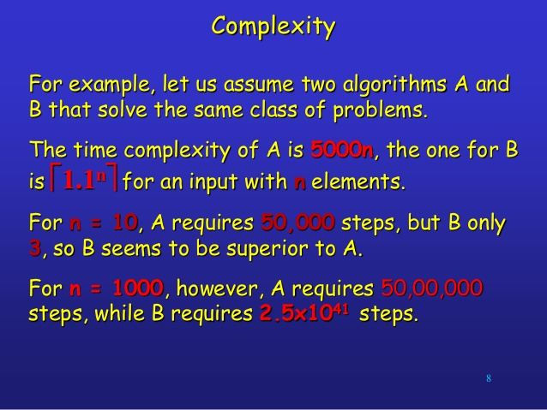

Slide 4
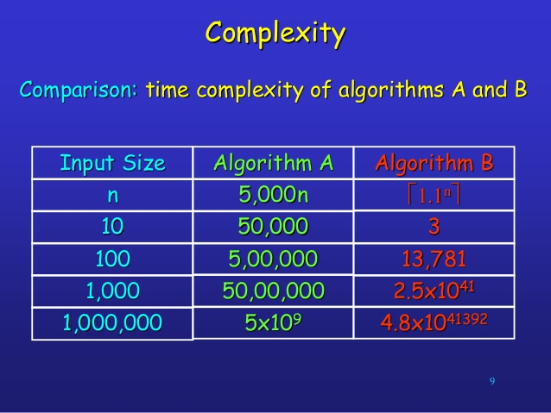

Slide 5
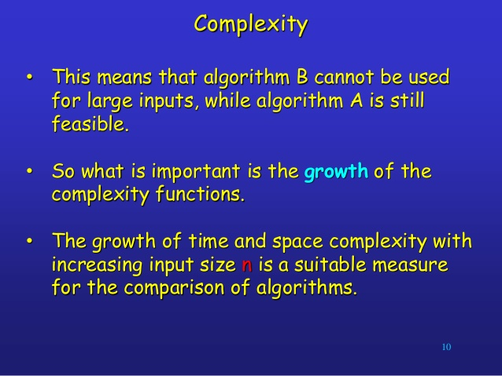

Slide 6
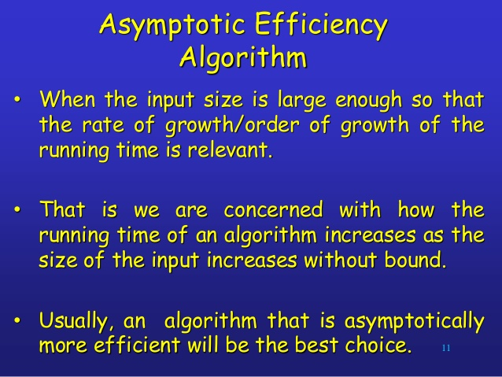

Slide 7
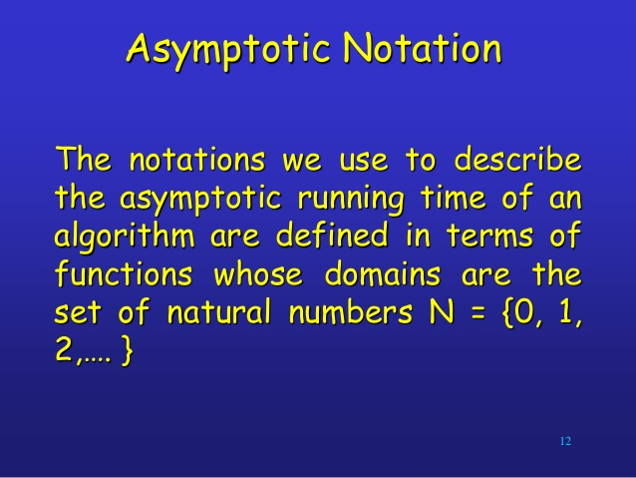

Slide 8
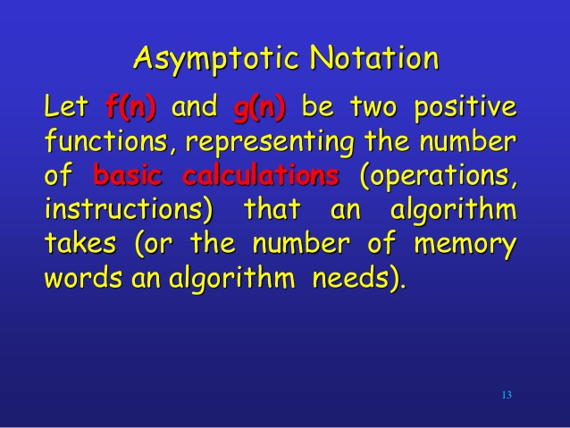

Slide 9
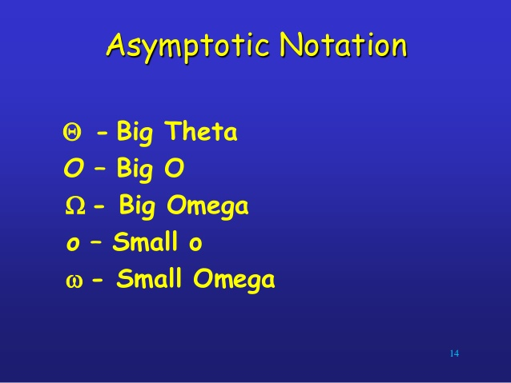

Slide 10
Asmptotic Notation
1. Big-O Notation (Ο) – Big O notation specifically describes worst case scenario.
2. Omega Notation (Ω) – Omega(Ω) notation specifically describes best case scenario.
3. Theta Notation (θ) – This notation represents the average complexity of an algorithm.

Slide 11
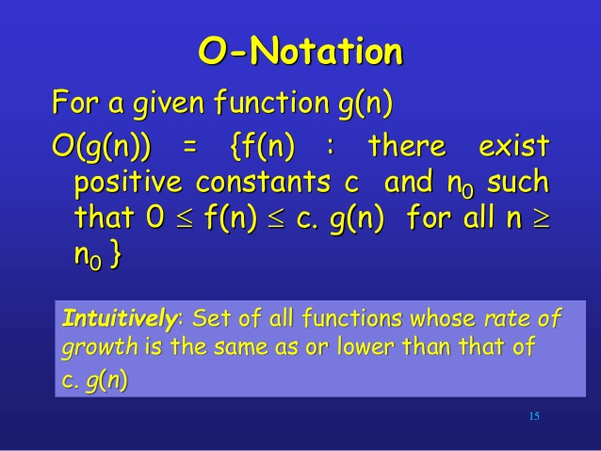

Slide 12
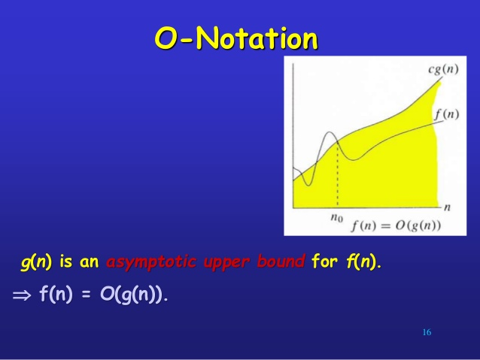

Slide 13
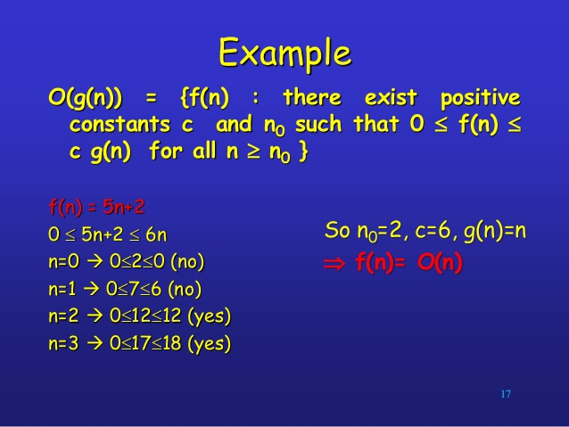

Slide 14
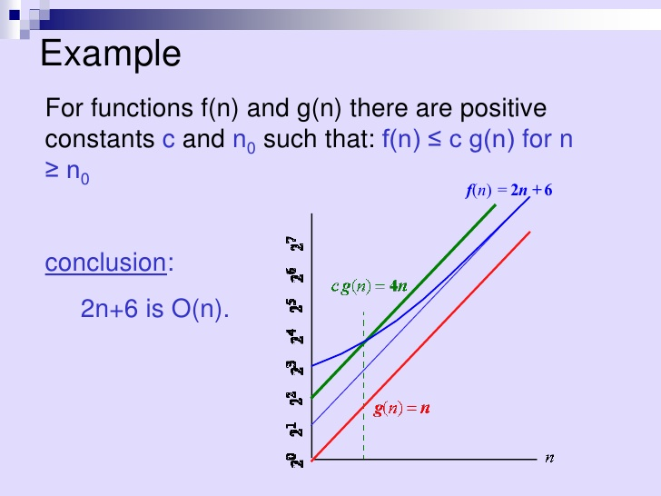

Slide 15
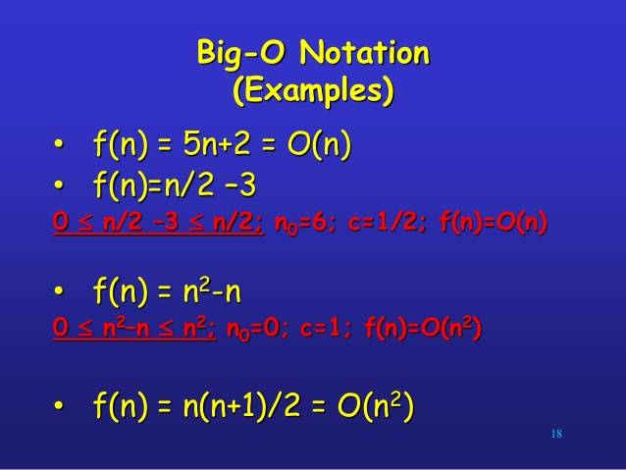

Slide 16
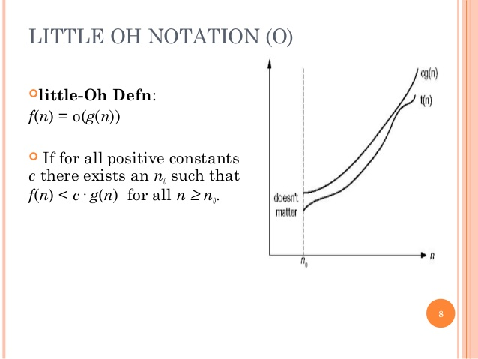

Slide 17
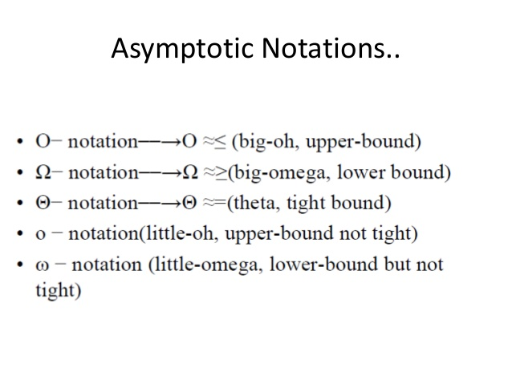

Slide 18
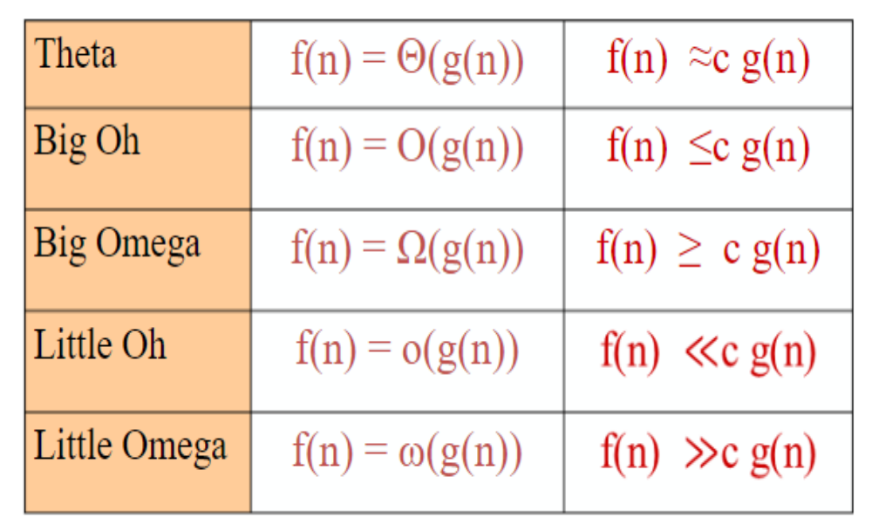
Asymptotic notation

Slide 19
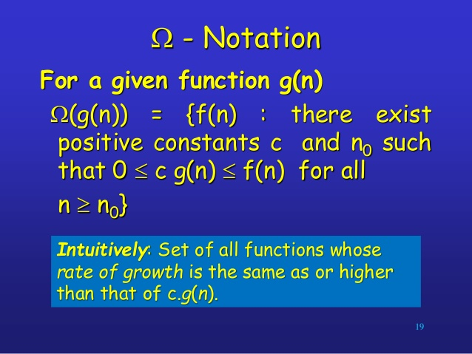

Slide 20
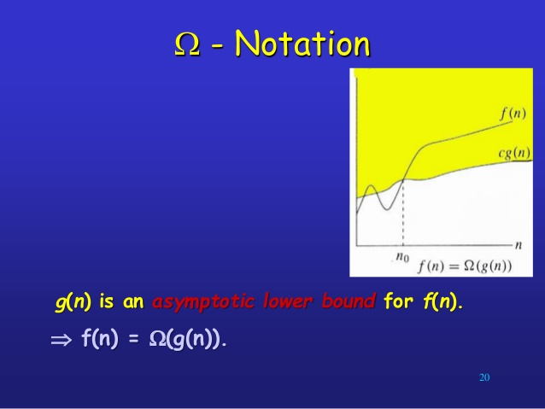

Slide 21
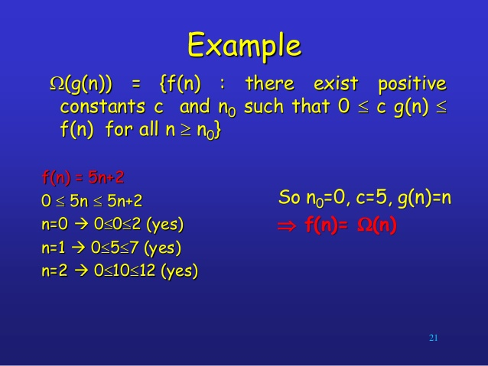

Slide 22
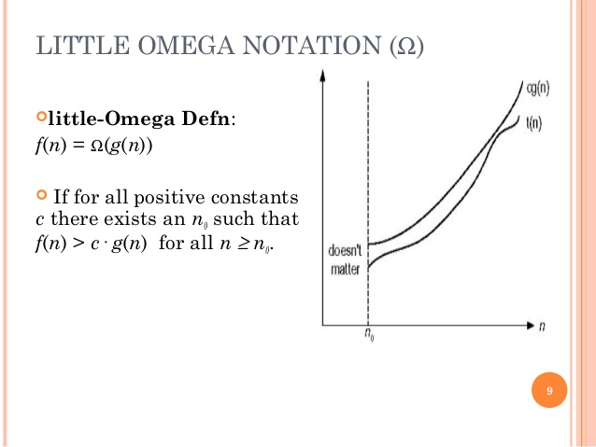

Slide 23
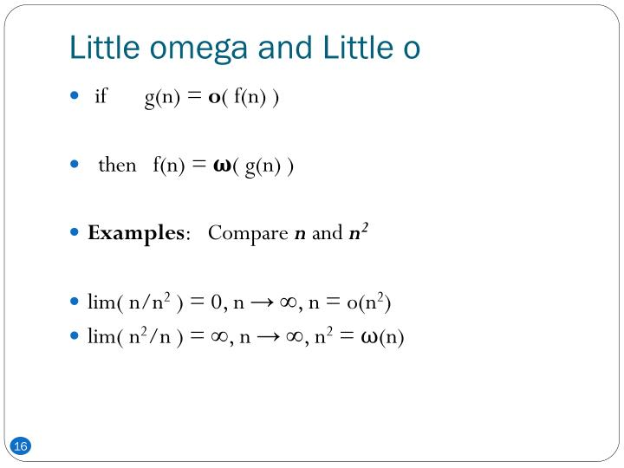


Slide 24
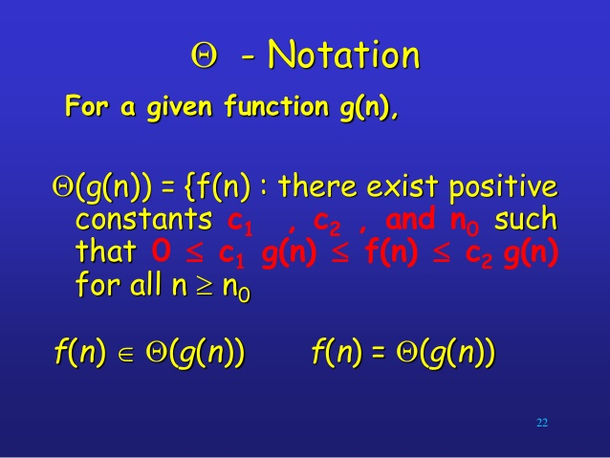

Slide 25
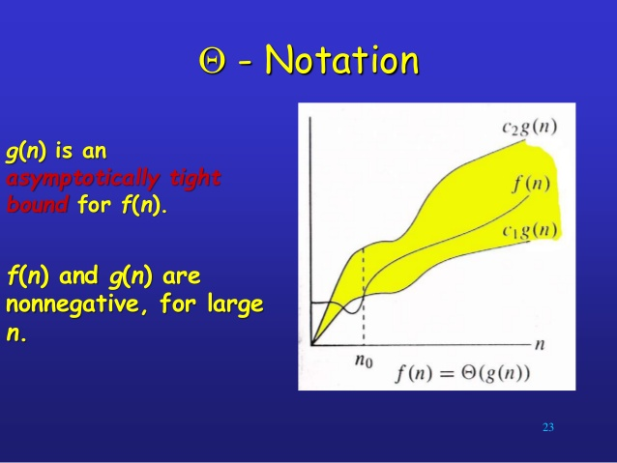

Slide 26
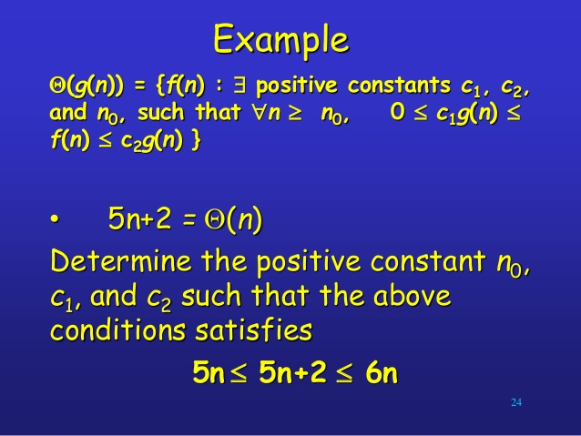

Slide 27
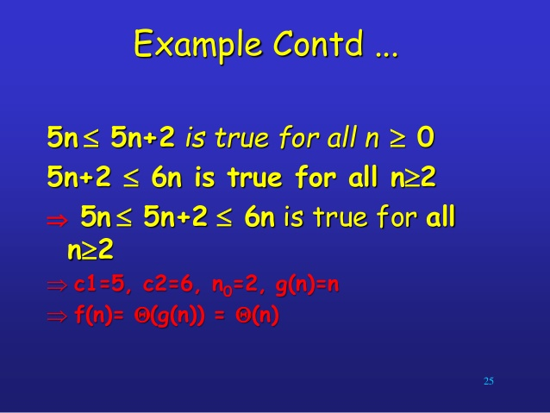

Slide 28
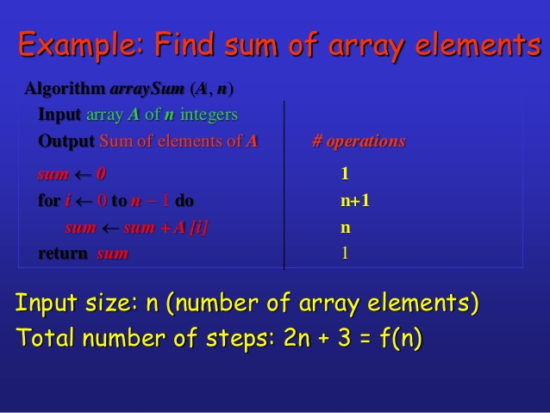

Slide 29
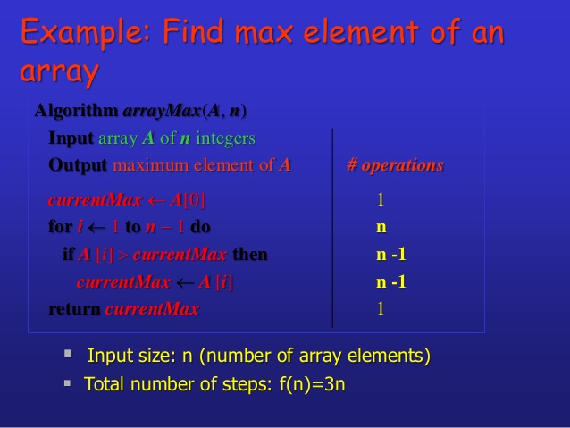

Slide 30
Relatives of Big-Oh
big-Omega
  f(n) is Ω(g(n)) if there is a constant c > 0
  and an integer constant n₀ ≥ 1 such that
  f(n) ≥ c•g(n) for n ≥ n₀
big-Theta
  f(n) is Θ(g(n)) if there are constants c’ > 0 and c’’ > 0 and an integer constant n₀ ≥ 1 such that c’•g(n) ≤ f(n) ≤ c’’•g(n) for n ≥ n₀

Slide 31

Example Uses of the Relatives of Big-Oh
5n² is Ω(n²)
  f(n) is Ω(g(n)) if there is a constant c > 0 and an integer constant n₀ ≥ 1 such that f(n) ≥ c•g(n) for n ≥ n₀
  let c = 5 and n₀ = 1
5n² is Ω(n)
  f(n) is Ω(g(n)) if there is a constant c > 0 and an integer constant n₀ ≥ 1 such that f(n) ≥ c•g(n) for n ≥ n₀
  let c = 1 and n₀ = 1
5n² is Θ(n²)
  f(n) is Θ(g(n)) if it is Ω(n²) and O(n²). We have already seen the former, for the latter recall that f(n) is O(g(n)) if there is a constant c > 0 and an integer constant n₀ ≥ 1 such that f(n) < c•g(n) for n ≥ n₀
  Let c = 5 and n₀ = 1

Slide 32
Analyzing Search Algorithm
Operations to count: how many times Num is compared to member of array
  One after the loop each time plus ...
  Best-case: find the number we are looking for at the first position in the array (1 + 1 = 2 comparisons) O(1)
  Average-case: find the number on average half-way down the array (sometimes longer, sometimes shorter)
  (N/2+1 comparisons) O(N)
  Worst-case: have to compare Num to very element in the array (N + 1 comparisons) O(N)

Slide 33
Examples
O(g(n)) = {f(n) : ∃ positive constants c and n₀, such that ∀n ≥ n₀, we have 0 ≤ f(n) ≤ cg(n) }
Any linear function an + b is in O(n²). How?
Show that 3n³=O(n⁴) for appropriate c and n₀.

Slide 34
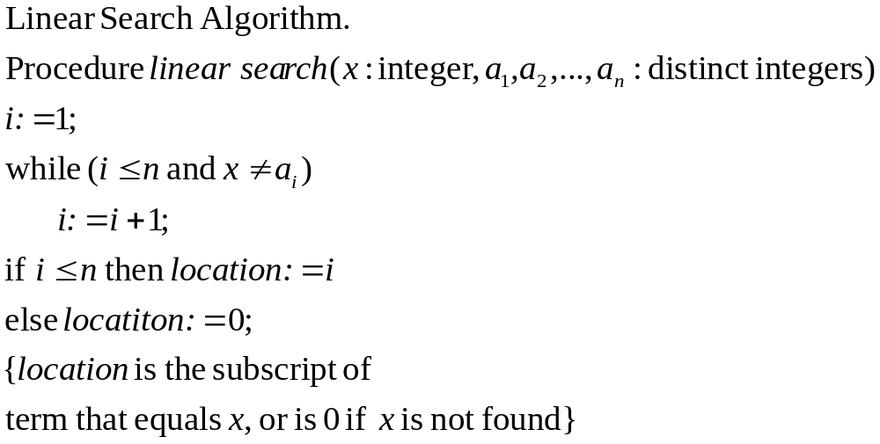
Analyze the time complexities of linear search algorithm and binary search algorithm
1
2(n+1)
n
2
3n+5

Slide 35
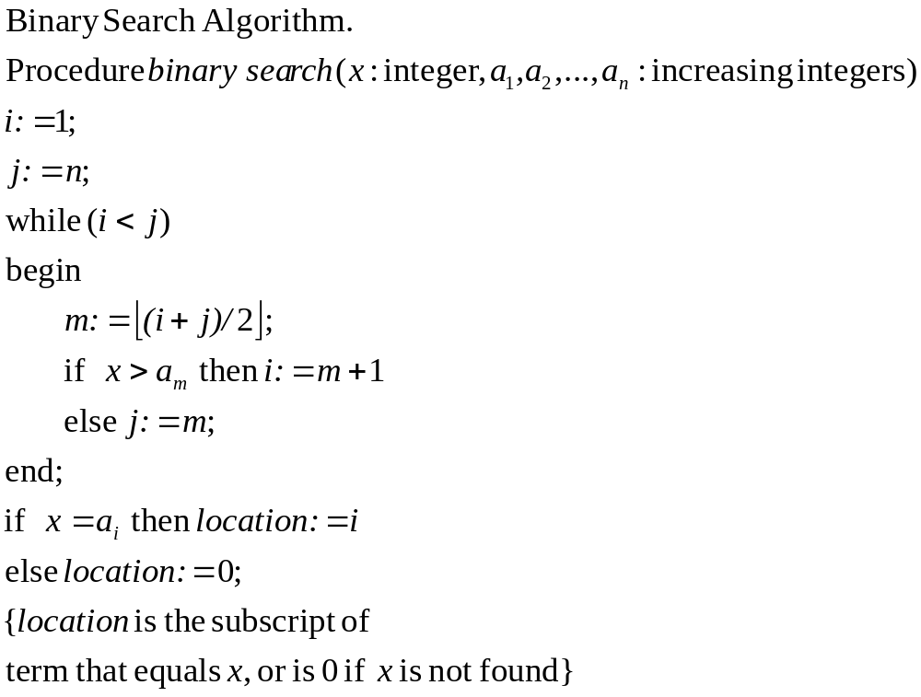
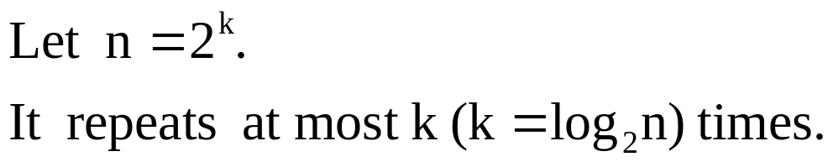
1
1
1
1
2
2
Number of operations = 4 log n+4
2

Slide 36

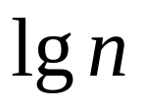




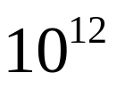

Orders of Growth
Running time for a problem with size
Running Time |  | necessary | operations
Operation Per second
 | instant | 1 second | 11.5 days | Never end days
 | instant | Instant | 1 second | Never end days
Using silicon computer, no matter how fast CPU will be you can never solve the problem whose running time is exponential !!!

Slide 37

Asymptotic Analysis of algorithms (using O-notation)
Analyze the time complexities of linear search algorithm and binary search algorithm asymptotically.
Totally(addition): O(n)

Slide 38
Totally(comparison): O(log n)

Slide 39

Analyze the time complexities of following algorithm asymptotically.
Matrix addition algorithm
Procedure MatricAddition(A[0..n-1,0..n-1],B[0..n-1,0..n-1])
for i=0 to n-1 do
for j=0 to n-1 do
C[i,j] = A[i,j] + B[i,j];
return C;
Repeat n times
Repeat n times
Totally(addition):

Slide 40
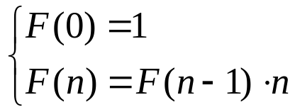
Recursive Algorithms
Example 9 Computing the factorial function F(n)=n!.
F(n) can be defined recursively as follows:
Factorial Algorithm
Procedure factorial(n)
if n = 0 return 1
else return factorial(n-1) * n;
Algorithm factorial calls itself in its body!
Time complexity(multiplication): T(0) = 0
T(n) = T(n-1) +1 when n>0
recurrence

Slide 41
Searching
Given a collection and an element (key) to find…
Output
  Print a message (“Found”, “Not Found)
  Return a value (position of key )
Don’t modify the collection in the search!

Slide 42
Searching Example
(Linear Search)

Slide 43
Linear Search: A Simple Search
A search traverses the collection until
  The desired element is found
  Or the collection is exhausted
If the collection is ordered, I might not have to look at all elements
  I can stop looking when I know the element cannot be in the collection.

Slide 44
Un-Ordered Iterative Array Search
procedure Search(my_array Array,
target Num)
i Num
i <- 1
loop
exitif((i > MAX) OR (my_array[i] = target))
i <- i + 1
endloop
if(i > MAX) then
print(“Target data not found”)
else
print(“Target data found”)
endif
endprocedure // Search
Scan the array

Slide 45
procedure Search(my_array Array,
target Num)
i isoftype Num
i <- 1
loop
exitif((i > MAX) OR (my_array[i] = target))
i <- i + 1
endloop
if(i > MAX) then
print(“Target data not found”)
else
print(“Target data found”)
endif
endprocedure // Search
my_array
7
12
5
22
13
32
target = 13
1
2
3
4
5
6

Slide 46
procedure Search(my_array isoftype in NumArrayType,
target isoftype in Num)
i isoftype Num
i <- 1
loop
exitif((i > MAX) OR (my_array[i] = target))
i <- i + 1
endloop
if(i > MAX) then
print(“Target data not found”)
else
print(“Target data found”)
endif
endprocedure // Search
my_array
7
12
5
22
13
32
target = 13
1
2
3
4
5
6

Slide 47
procedure Search(my_array isoftype in NumArrayType,
target isoftype in Num)
i isoftype Num
i <- 1
loop
exitif((i > MAX) OR (my_array[i] = target))
i <- i + 1
endloop
if(i > MAX) then
print(“Target data not found”)
else
print(“Target data found”)
endif
endprocedure // Search
my_array
7
12
5
22
13
32
target = 13
1
2
3
4
5
6

Slide 48
procedure Search(my_array isoftype in NumArrayType,
target isoftype in Num)
i isoftype Num
i <- 1
loop
exitif((i > MAX) OR (my_array[i] = target))
i <- i + 1
endloop
if(i > MAX) then
print(“Target data not found”)
else
print(“Target data found”)
endif
endprocedure // Search
my_array
7
12
5
22
13
32
target = 13
1
2
3
4
5
6

Slide 49
procedure Search(my_array isoftype in NumArrayType,
target isoftype in Num)
i isoftype Num
i <- 1
loop
exitif((i > MAX) OR (my_array[i] = target))
i <- i + 1
endloop
if(i > MAX) then
print(“Target data not found”)
else
print(“Target data found”)
endif
endprocedure // Search
my_array
7
12
5
22
13
32
target = 13
1
2
3
4
5
6

Slide 50
procedure Search(my_array isoftype in NumArrayType,
target isoftype in Num)
i isoftype Num
i <- 1
loop
exitif((i > MAX) OR (my_array[i] = target))
i <- i + 1
endloop
if(i > MAX) then
print(“Target data not found”)
else
print(“Target data found”)
endif
endprocedure // Search
my_array
7
12
5
22
13
32
target = 13
1
2
3
4
5
6

Slide 51
procedure Search(my_array isoftype in NumArrayType,
target isoftype in Num)
i isoftype Num
i <- 1
loop
exitif((i > MAX) OR (my_array[i] = target))
i <- i + 1
endloop
if(i > MAX) then
print(“Target data not found”)
else
print(“Target data found”)
endif
endprocedure // Search
my_array
7
12
5
22
13
32
target = 13
1
2
3
4
5
6

Slide 52
procedure Search(my_array isoftype in NumArrayType,
target isoftype in Num)
i isoftype Num
i <- 1
loop
exitif((i > MAX) OR (my_array[i] = target))
i <- i + 1
endloop
if(i > MAX) then
print(“Target data not found”)
else
print(“Target data found”)
endif
endprocedure // Search
Target data found
my_array
7
12
5
22
13
32
target = 13
1
2
3
4
5
6

Slide 53
procedure Search(my_array isoftype in NumArrayType,
target isoftype in Num)
i isoftype Num
i <- 1
loop
exitif((i > MAX) OR (my_array[i] = target))
i <- i + 1
endloop
if(i > MAX) then
print(“Target data not found”)
else
print(“Target data found”)
endif
endprocedure // Search
my_array
7
12
5
22
13
32
target = 13
1
2
3
4
5
6

Slide 54
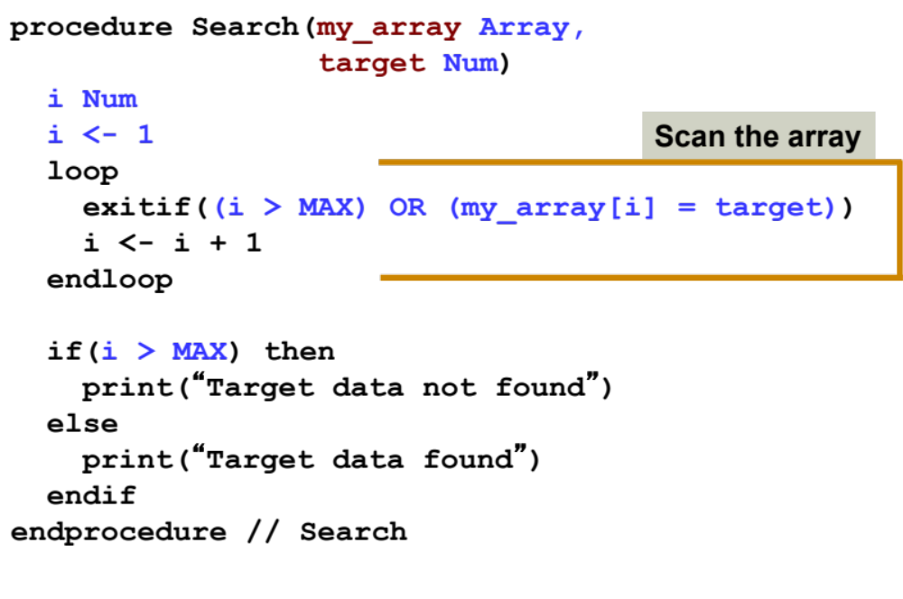
Linear Search Analysis: Best Case
Best Case:
1 comparison
Best Case: match with the first item
7
12
5
22
13
32
target = 7

Slide 55
Linear Search Analysis: Worst Case
Worst Case:
N comparisons
Worst Case: match with the last item (or no match)
7
12
5
22
13
32
target = 32

Slide 56
Searching Example
(Binary Search on Sorted List)

Slide 57
The Scenario
We have a sorted array
We want to determine if a particular element is in the array
  Once found, print or return (index, boolean, etc.)
  If not found, indicate the element is not in the collection
7 12 42 59 71 86 104 212

Slide 58
A Better Search Algorithm
Of course we could use our simpler search and traverse the array
But we can use the fact that the array is sorted to our advantage
This will allow us to reduce the number of comparisons

Slide 59
Binary Search
Requires a sorted array or a binary search tree.
Cuts the “search space” in half each time.
Keeps cutting the search space in half until the target is found or has exhausted the all possible locations.

Slide 60
Binary Search Algorithm
look at “middle” element
if no match then
look left (if need smaller) or
right (if need larger)
1 7 9 12 33 42 59 76 81 84 91 92 93 99
Look for 42

Slide 61
The Algorithm
look at “middle” element
if no match then
look left or right
1 7 9 12 33 42 59 76 81 84 91 92 93 99
Look for 42

Slide 62
The Algorithm
look at “middle” element
if no match then
look left or right
1 7 9 12 33 42 59 76 81 84 91 92 93 99
Look for 42

Slide 63
The Algorithm
look at “middle” element
if no match then
look left or right
1 7 9 12 33 42 59 76 81 84 91 92 93 99
Look for 42

Slide 64
The Binary Search Algorithm
Return found or not found (true or false), so it should be a function.
When move left or right, change the array boundaries
  We’ll need a first and last

Slide 65
The Binary Search Algorithm
calculate middle position
if (first and last have “crossed”) then
“Item not found”
elseif (element at middle = to_find) then
“Item Found”
elseif to_find < element at middle then
Look to the left
else
Look to the right

Slide 66
Looking Left
Use indices “first” and “last” to keep track of where we are looking
Move left by setting last = middle – 1
7 12 42 59 71 86 104 212
F
L
M
L

Slide 67
Looking Right
Use indices “first” and “last” to keep track of where we are looking
Move right by setting first = middle + 1
7 12 42 59 71 86 104 212
F
M
F
L

Slide 68
Binary Search Example – Found
7 12 42 59 71 86 104 212
F
M
L
Looking for 42

Slide 69
Binary Search Example – Found
7 12 42 59 71 86 104 212
F
M
L
Looking for 42

Slide 70
Binary Search Example – Found
7 12 42 59 71 86 104 212
F
M
L
42 found – in 3 comparisons

Slide 71
Binary Search Example – Not Found
7 12 42 59 71 86 104 212
F
M
L
Looking for 89

Slide 72
Binary Search Example – Not Found
7 12 42 59 71 86 104 212
F
M
L
Looking for 89

Slide 73
Binary Search Example – Not Found
7 12 42 59 71 86 104 212
F
L
M
Looking for 89

Slide 74
Binary Search Example – Not Found
7 12 42 59 71 86 104 212
L
F
89 not found – 3 comparisons

Slide 75
Binary Search Function
Function Find return boolean (A Array, first, last, to_find)
middle <- (first + last) div 2
if (first > last) then
return false
elseif (A[middle] = to_find) then
return true
elseif (to_find < A[middle]) then
return Find(A, first, middle–1, to_find)
else
return Find(A, middle+1, last, to_find)
endfunction

Slide 76
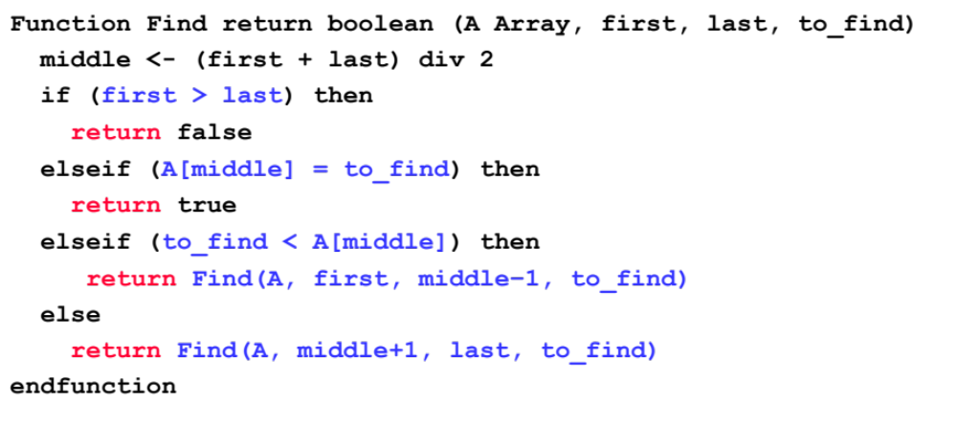
Binary Search Analysis: Best Case
Best Case:
1 comparison
Best Case: match from the firs comparison
1 7 9 12 33 42 59 76 81 84 91 92 93 99
Target: 59

Slide 77

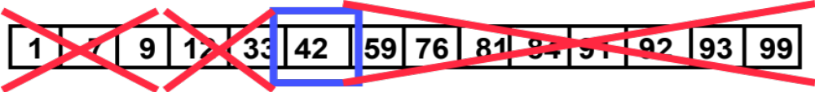
Binary Search Analysis: Worst Case
How many comparisons??
Worst Case: divide until reach one item, or no match.

Slide 78
Binary Search Analysis: Worst Case
With each comparison we throw away ½ of the list
N
…………
1 comparison
N/2
…………
1 comparison
Number of steps is at
most ➔Log₂N
N/4
…………
1 comparison
N/8
…………
1 comparison
.
.
.
1
…………
1 comparison

Slide 79
Summary
Binary search reduces the work by half at each comparison
If array is not sorted ➔ Linear Search
  Best Case O(1)
  Worst Case O(N)
If array is sorted ➔ Binary search
  Best Case O(1)
  Worst Case O(Log₂N)

