Slide 1
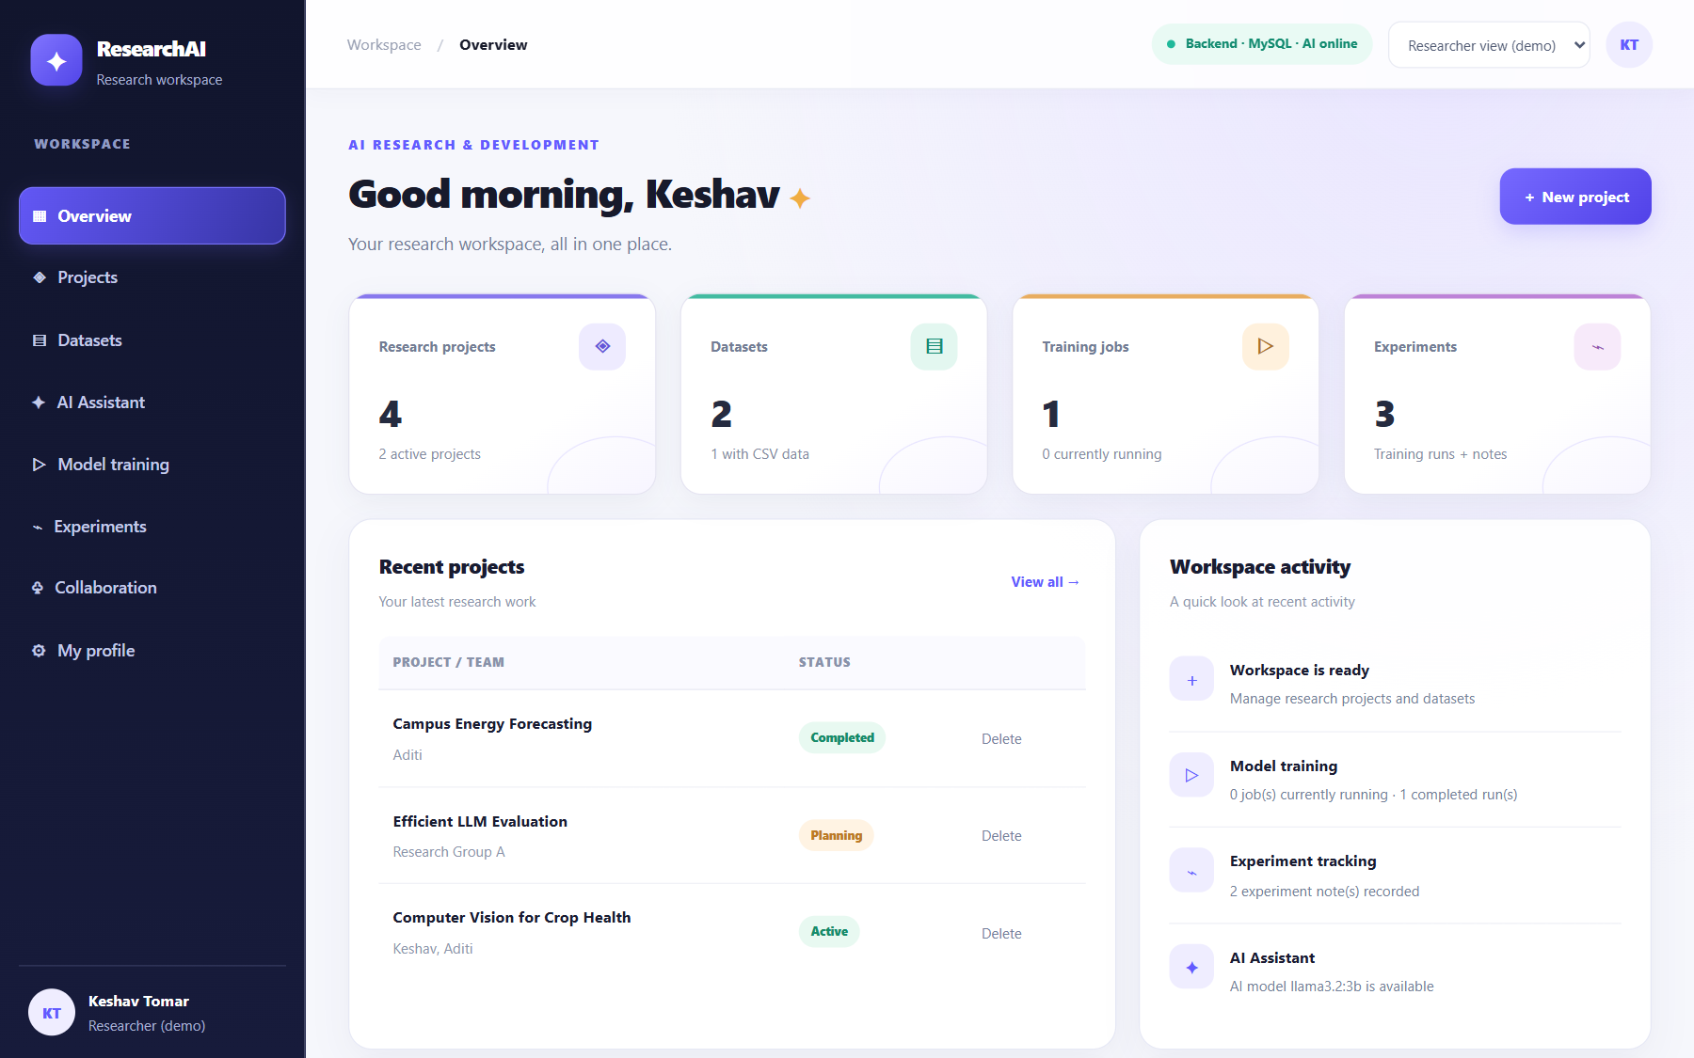
✦
GUVI PROJECT · REVIEW 1
ResearchAI
AI Research & Development Platform
Manage research projects and datasets, train a real ML model, and get help from an AI assistant.
Keshav Tomar
Live: fantastic-pavlova-37ef51.netlify.app
Code: github.com/keshavtomar1606-gif/AI_Research_Plateform

Slide 2
WHY THIS PROJECT
Problem & objectives
The problem
What ResearchAI delivers
• Scattered work projects, datasets and results live in different files and chats
• No reproducibility ML results are hard to repeat or compare
• Expensive AI tools students need help without paid API subscriptions
• Fake progress many demos only show a progress bar, not real training
• One dashboard for projects, datasets, training and experiments
• MySQL database every project, dataset and run is saved (full CRUD)
• Real ML training linear regression with train/test split, MAE, RMSE, R²
• AI assistant free: local Ollama, or Groq online; history is saved
• Responsive, safe UI works on phones; inputs validated, HTML escaped
ResearchAI · 2/8

Slide 3
HOW IT FITS TOGETHER
System architecture & tech stack
MySQL database
Local MySQL / Aiven cloud
JPA / JDBC (SSL)
Frontend
HTML · CSS · JavaScript
Netlify (online)
Spring Boot REST API
Java 21 · Maven
Render (online)
JSON over HTTPS
AI model
Ollama (local) / Groq (cloud)
REST
ML engine
Linear regression in Java
Java 21
Spring Boot 3.4
Spring Data JPA
MySQL 8
HTML/CSS/JS
Ollama / Groq
JUnit + Playwright
Docker
Secrets (DB password, API key) are read from environment variables, never stored in code.
ResearchAI · 3/8

Slide 4
ORGANISED AND MODULAR
Project structure
Layered backend (each layer has one job)
AI_Research_Platform/
├─ frontend/ UI (index.html, app.js, style.css)
├─ backend/ Spring Boot API
│ └─ src/main/java/com/aiplatform/
│ ├─ controller/ REST endpoints
│ ├─ dto/ request/response + validation
│ ├─ service/ AI providers, rate limit
│ ├─ ml/ CSV, regression, metrics
│ ├─ repository/ database access
│ ├─ model/ JPA entities (tables)
│ └─ config/ CORS, security, errors
├─ database/schema.sql
├─ scripts/ · docs/
└─ README.md · DEPLOY.md
Controller
receives HTTP requests, returns JSON
DTO + Validation
checks input before it reaches the database
Service / ML
business logic, training, AI calls
Repository
Spring Data JPA queries
Entity → MySQL table
Hibernate maps classes to tables
ResearchAI · 4/8

Slide 5
MYSQL SCHEMA (3 TABLES)
Database design
1 dataset → many runs
research_project
dataset
training_job
PK id BIGINT
title VARCHAR NOT NULL
description VARCHAR(2000)
team VARCHAR
status VARCHAR
PK id BIGINT
name VARCHAR NOT NULL
owner VARCHAR
file_name VARCHAR
status VARCHAR
csv_content LONGTEXT
column_names VARCHAR
row_count INT
created_at DATETIME
PK id BIGINT
FK dataset_id BIGINT
job_type ML_TRAINING/RECORD
status Queued…Completed
progress INT
target_column VARCHAR
feature_columns VARCHAR
mae / rmse / r2 DOUBLE
coefficients_json VARCHAR
started_at / finished_at DATETIME
• Entities → tables via JPA/Hibernate
• Validation NOT NULL, length limits, allowed status values
• Results stored metrics + learned coefficients per run
• Link training_job.dataset_id → dataset.id (logical key: runs keep their results if a dataset is deleted)
• Script database/schema.sql (verified against the code)
ResearchAI · 5/8

Slide 6
FROM BUTTON CLICK TO MYSQL ROW
Database connectivity
Browser
fetch() POST /api/projects
Controller
@RestController + @Valid DTO
Repository
Spring Data JPA save()
Hibernate + HikariCP
SQL + connection pool
MySQL Connector/J
JDBC, SSL to cloud
MySQL
row stored in table
Configuration (no passwords in code)
Proof: health check
spring.datasource.url=${DB_URL}
spring.datasource.username=${DB_USERNAME}
spring.datasource.password=${DB_PASSWORD}
spring.jpa.hibernate.ddl-auto=update
hikari.maximum-pool-size=5
GET /api/health
{"status":"UP",
"database":"UP",
"ai":"UP"}
• Tested create → read → update → delete against real MySQL
• Errors DB down shows a clear message, never a fake “saved”
Locally: backend/config/local.properties (git-ignored).
Online: Render environment variables.
ResearchAI · 6/8

Slide 7
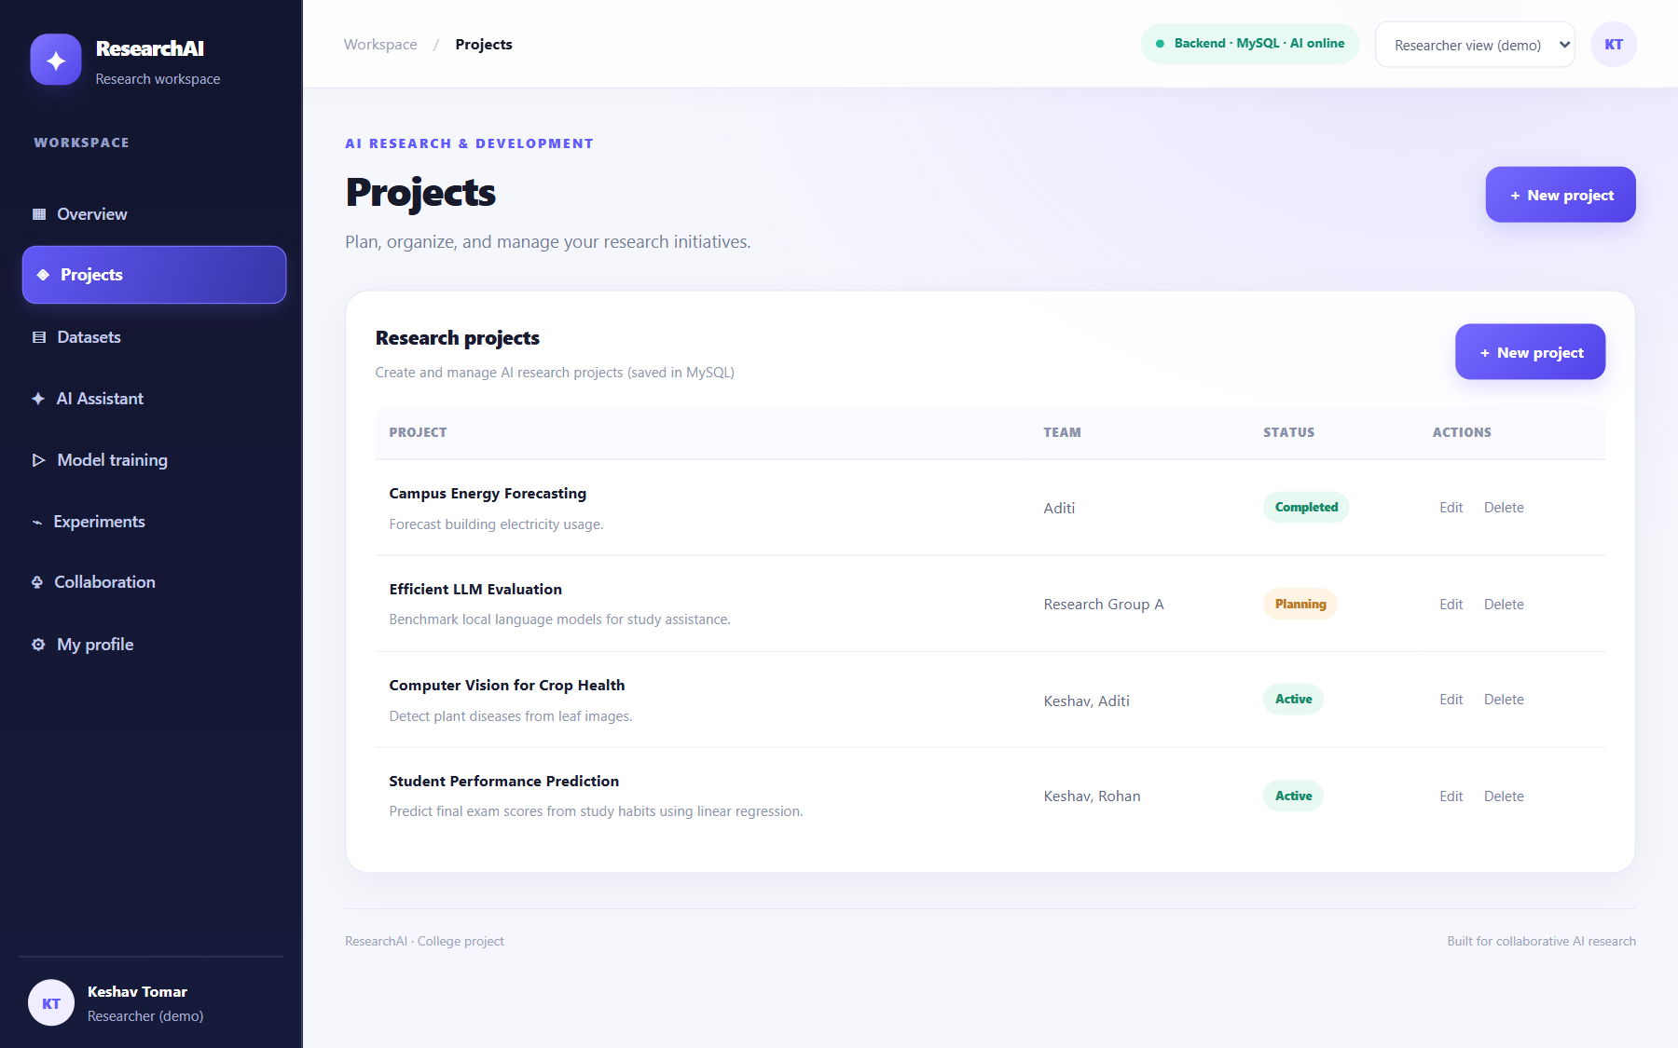
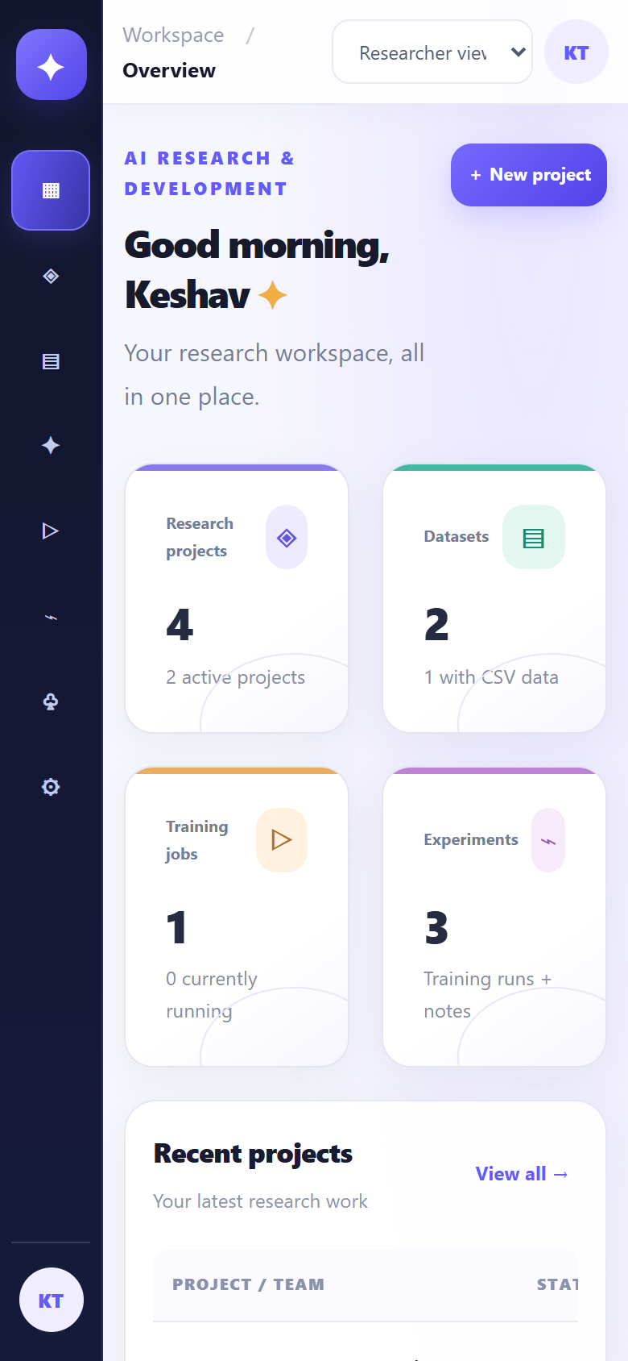
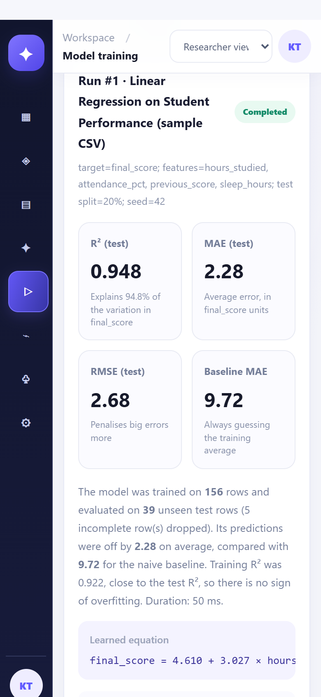
AESTHETICS AND USABILITY
UI design & responsiveness
Desktop: Projects page (data loaded from MySQL)
• Consistent theme purple palette, cards
• Clear status coloured tags
• Feedback loading, success/error
• Safe forms Cancel never saves
• Responsive icon sidebar on phones
• Accessible labels, keyboard support
Phone: Overview
Phone: Training result
ResearchAI · 7/8

Slide 8
WHERE THE PROJECT STANDS
Progress, testing & next steps
33
43
0.95
Live
backend tests
passing
browser test
checks passing
R² on sample
test data
Netlify + Render
+ Aiven + Groq
Completed for Review 1
Next steps
• Project structure modular frontend + layered backend
• Database design 3 tables, schema script, validation
• Database connectivity JPA + MySQL, local and cloud
• UI/UX consistent design, responsive layout
• Extra real ML training and AI assistant working
• Real login Spring Security with hashed passwords
• Admin pages users & resources stored in MySQL
• More models classification, model comparison
• Charts visualise predictions vs actual values
Live demo: fantastic-pavlova-37ef51.netlify.app · Code: github.com/keshavtomar1606-gif/AI_Research_Plateform
ResearchAI · 8/8

