Slide 1

END-TO-END DATA ANALYST PORTFOLIO CASE STUDY
Customer Shopping
Behavior Analysis
From Raw Retail Data to Business Insights
PYTHON | MYSQL / SQL | POWER BI | CUSTOMER ANALYTICS
01 / PROJECT INTRODUCTION

Slide 2
02
From Raw Data to Business Insights
BUSINESS GOAL
Understand purchasing, products, subscriptions, discounts, shipping and repeat-purchase patterns.
CUSTOMER
SHOPPING DATA
PYTHON
DATA PREPARATION
MYSQL / SQL
ANALYSIS
POWER BI
DASHBOARD
CUSTOMER BEHAVIOR
INSIGHTS
OUTCOME
Decision-ready metrics and interactive business reporting
02 / OVERVIEW

Slide 3
03
What Business Questions Are We Answering?
01
02
03
Which customer groups generate the most revenue?
Which products and categories are ordered most often?
How does subscription status relate to spending and revenue?
04
05
06
How does purchasing vary across age groups?
What is the mix of new, returning and loyal customers?
What patterns exist around discounts and shipping?
03 / BUSINESS QUESTIONS

Slide 4
04
Understanding the Dataset
3,900
18
CUSTOMER
PRODUCT
Customer ID • Age • Gender • Location
Item Purchased • Category • Size • Color
CUSTOMER PURCHASE RECORDS
SOURCE COLUMNS
TRANSACTION
CUSTOMER BEHAVIOR
Purchase Amount • Season • Payment Method
Previous Purchases • Purchase Frequency
PROMOTION & SHIPPING
FEEDBACK + SUBSCRIPTION
Discount • Promo Code • Shipping Type
Review Rating • Subscription Status
04 / DATASET

Slide 5
05
Data Cleaning & Feature Engineering with Python
01 DATA INSPECTION
02 MISSING VALUES
03 STANDARDIZATION
04 FEATURE ENGINEERING
05 REDUNDANCY CHECK
Loaded CSV with Pandas; inspected structure and null counts.
37 missing review ratings; category-median imputation.
Lowercase snake_case; simplified purchase_amount name.
Age quartiles; purchase_frequency_days mapping.
Verified discount / promo match; removed promo_code_used.
Python transformed the raw CSV into an analysis-ready dataset.
05 / IMPLEMENTED WORK

Slide 6
06
Turning Business Questions into SQL
GROUP BY
Revenue comparisons
SUBQUERIES
Above-average discounts
CTEs
Customer segmentation
SELECT CASE WHEN subscription_status = 'Yes'
THEN 'Subscriber' ELSE 'Non-Subscriber' END AS segment,
COUNT(*) customers, AVG(purchase_amount) avg_spend
FROM customers GROUP BY segment;
CASE
New / Returning / Loyal
WINDOW FUNCTIONS
Top 3 by category
AGGREGATIONS
Revenue • orders • spend
QA NOTE
Notebook exports customer (singular); queries reference customers (plural). Standardize before execution.
06 / SQL ANALYSIS

Slide 7
07
Executive KPI Snapshot
3.9K
$59.76
3.75
TOTAL CUSTOMERS
AVG PURCHASE
AVG REVIEW RATING
$233,081
1,053
2,847
TOTAL PURCHASE VALUE
SUBSCRIBERS
NON-SUBSCRIBERS
07 / EXECUTIVE SNAPSHOT

Slide 8
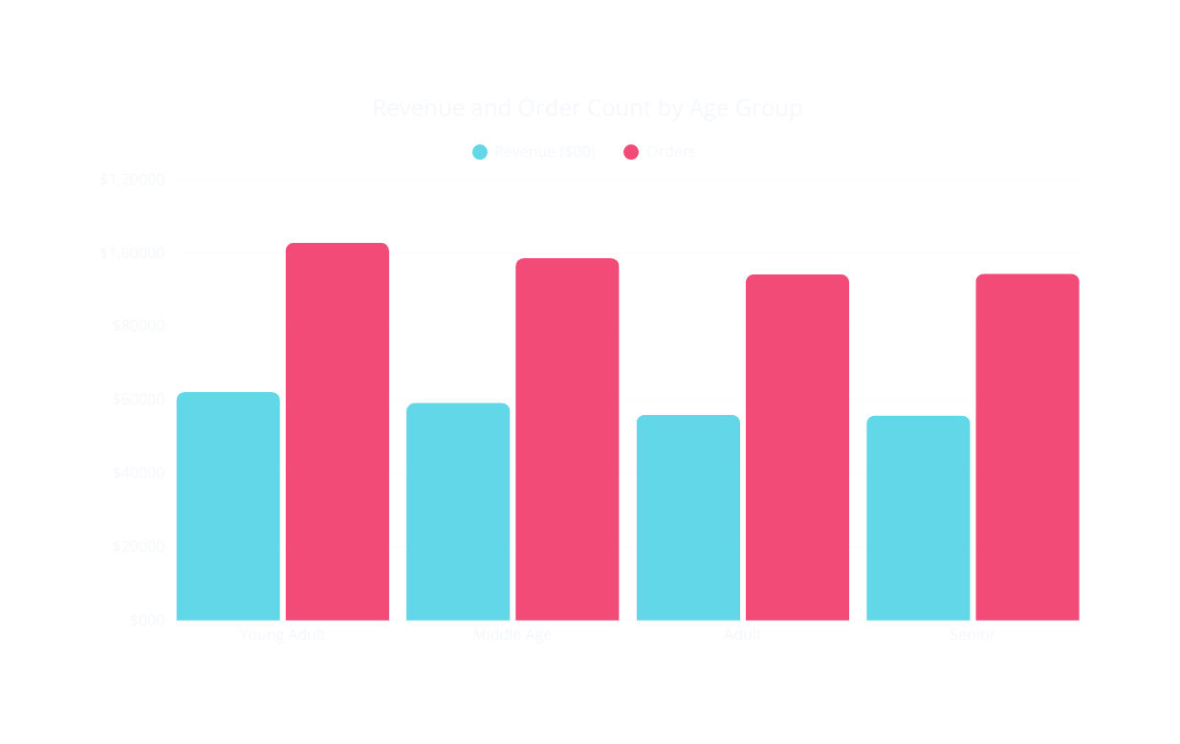
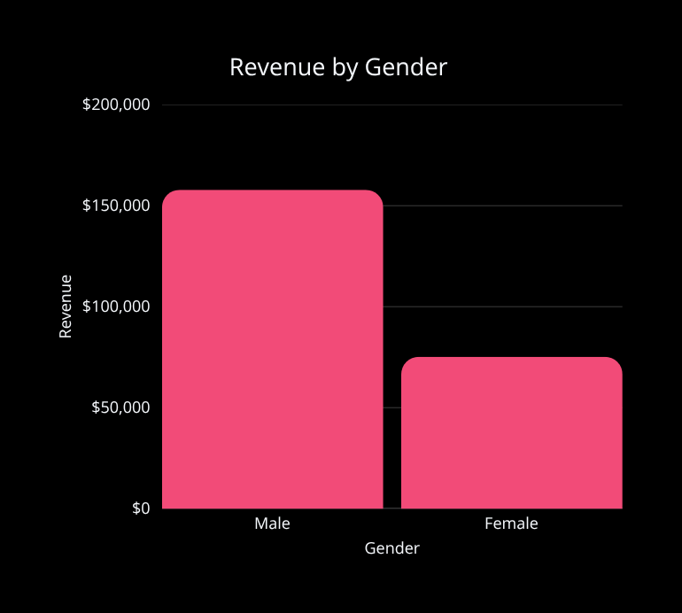
08
Who Drives Revenue?
Young Adults lead the four age groups in both revenue and order count.
08 / OBSERVED COMPARISON — NO CAUSAL CLAIM

Slide 9
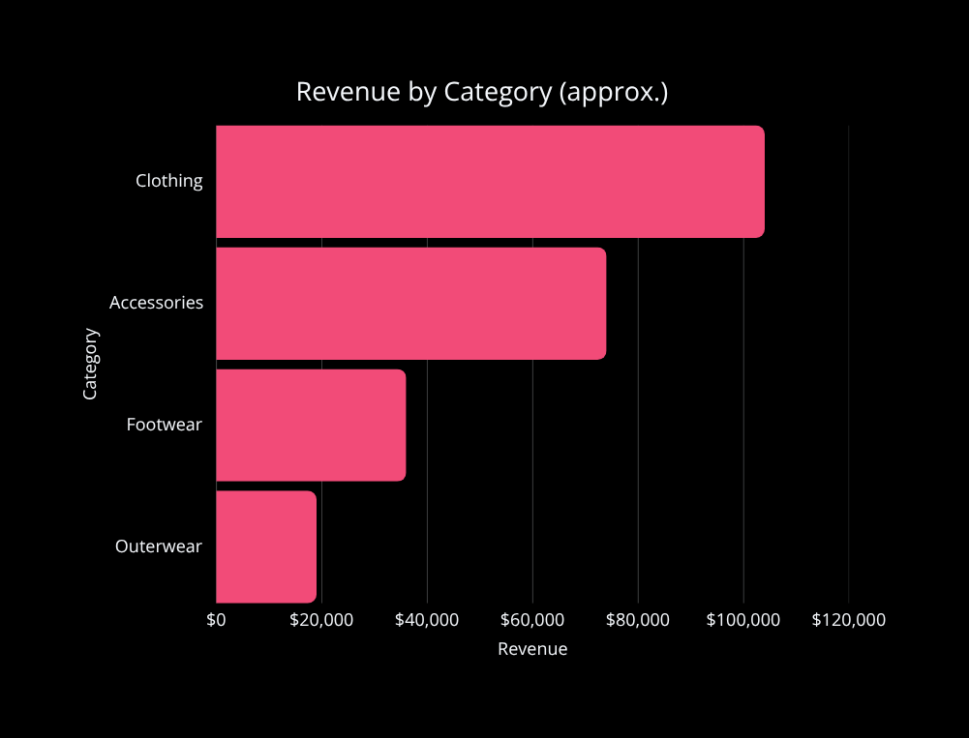
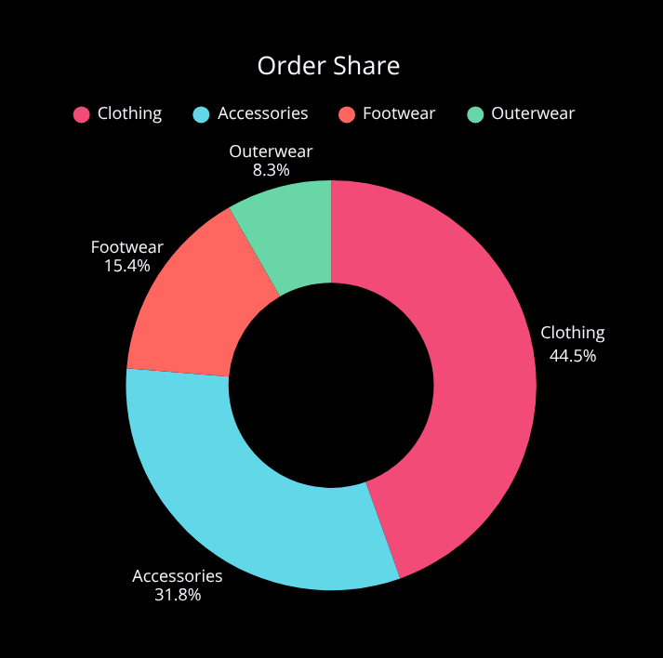
09
Category-Level Performance
Clothing is the largest category by both revenue and order share.
09 / CATEGORY PERFORMANCE

Slide 10
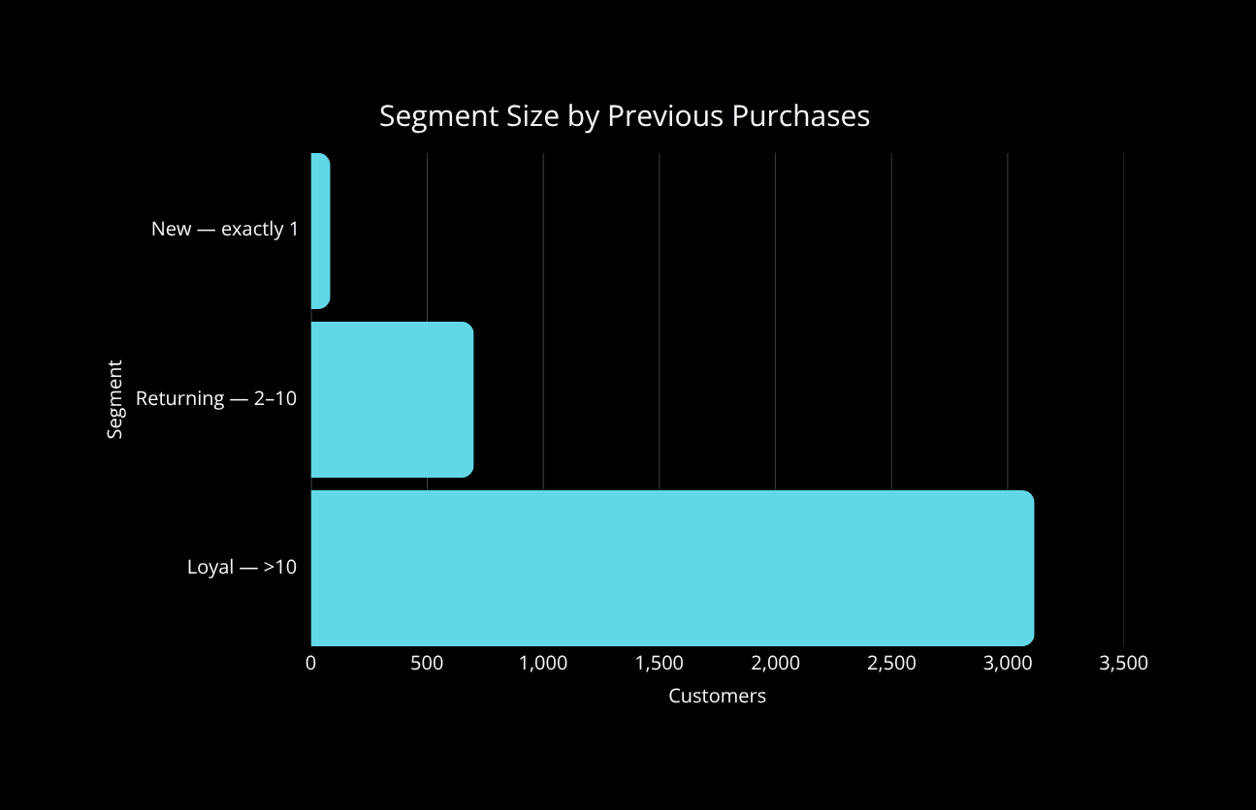
10
Customer Segmentation by Purchase History
79.9%
OF CUSTOMERS FALL IN THE LOYAL SEGMENT BY COUNT
Scope note
This analysis identifies segment size. It does not calculate segment revenue or customer lifetime value.
10 / COUNT-BASED SEGMENTATION

Slide 11
11
What Products Are Customers Ordering?
TOP ORDER VOLUME
HIGHEST AVG RATING
HIGHEST DISCOUNT RATE
ACCESSORIES
Jewelry 171 • Sunglasses 161 • Belt 161
CLOTHING
Pants 171 • Shirt 169 • Blouse 158
FOOTWEAR
Sandals 160 • Shoes 150 • Sneakers 145
OUTERWEAR
Jacket 163 • Coat 161
Gloves 3.86
Sandals 3.84
Boots 3.82
Hat 3.80
Skirt 3.78
Hat 50.00%
Sneakers 49.66%
Coat 49.07%
Sweater 48.17%
Pants 47.37%
11 / VOLUME • QUALITY • PROMOTION

Slide 12
12
Subscription Behavior
SUBSCRIBERS
NON-SUBSCRIBERS
27%
73%
1,053 customers
2,847 customers
$62,645 revenue
$170,436 revenue
$59.49 avg spend
$59.87 avg spend
Larger total revenue aligns with the much larger non-subscriber population; average purchase amounts are nearly identical.
12 / DESCRIPTIVE COMPARISON — NO CAUSAL CLAIM

Slide 13
14
What Does the Analysis Tell Us?
01
02
03
04
05
CATEGORY
AGE GROUP
SUBSCRIPTION
CUSTOMER LOYALTY
SHIPPING
Clothing leads revenue and order share.
Young Adults lead revenue and orders.
The customer base is predominantly non-subscribed.
Customers with >10 previous purchases form the largest segment by count.
Express has a modestly higher average purchase amount; causation is not established.
13 / EVIDENCE-BASED TAKEAWAYS

Slide 14
16
Technical Skills Demonstrated
PYTHON
SQL / MYSQL
POWER BI
ANALYTICS
Pandas • NumPy
Data Cleaning
Feature Engineering
Missing-Value Treatment
GROUP BY • Aggregations
Subqueries • CTEs
CASE Statements
Window Functions
KPI Design
Slicers
Interactive Dashboards
Business Visualization
Customer Segmentation
Revenue Analysis
Product Analysis
Subscription Analysis
Customer Behavior Analysis
14 / TOOLKIT

Slide 15
17
From Data to Decisions
RAW CUSTOMER DATA
An end-to-end customer analytics project demonstrating how raw retail data can be transformed into structured, decision-ready business insights.
PYTHON DATA PREPARATION
SQL BUSINESS ANALYSIS
POWER BI VISUALIZATION
BUSINESS INSIGHTS
GITHUB | LINKEDIN | PORTFOLIO
15 / THANK YOU

