Slide 1


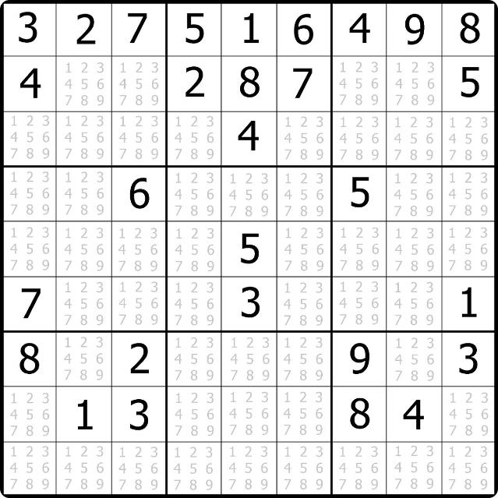
Sudoku Solver Visualizer
Explore the power of a Sudoku solver algorithm with this interactive visualizer. Watch as the program efficiently finds solutions to even the most challenging Sudoku puzzles.
Keshav Kumar Yadav
Reg No: 12214049
Lovely Professional University, Phagwara, Punjab

Slide 2

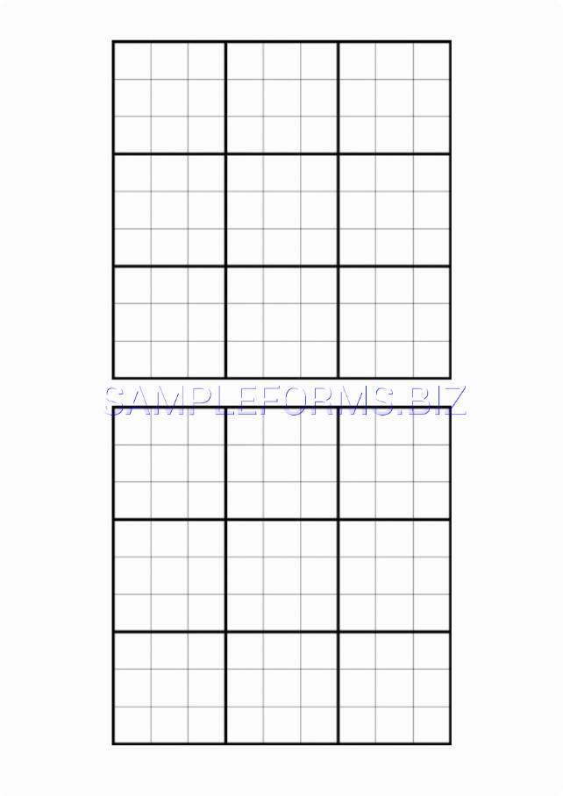
The Sudoku Grid
9x9 Grid
The Sudoku puzzle consists of a 9x9 grid, divided into 9 smaller 3x3 subgrids.
Unique Numbers
Each row, column, and 3x3 subgrid must contain the digits 1 through 9 without repeating any numbers.
Empty Cells
The puzzle starts with some cells filled, and the goal is to fill the remaining empty cells.

Slide 3
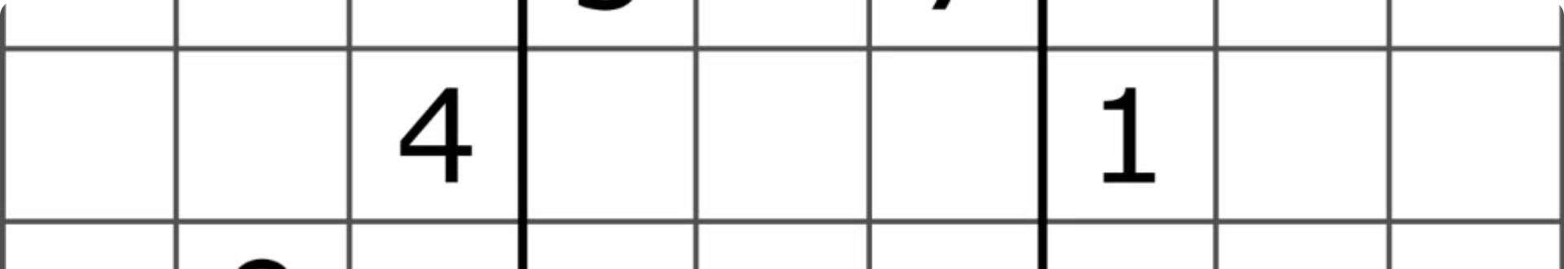
The Solving Algorithm
Check Subgrids
Check Rows
Ensure each 3x3 subgrid contains unique numbers 1-9.
Ensure each row contains unique numbers 1-9.
1
2
3
Check Columns
Ensure each column contains unique numbers 1-9.

Slide 4

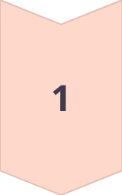
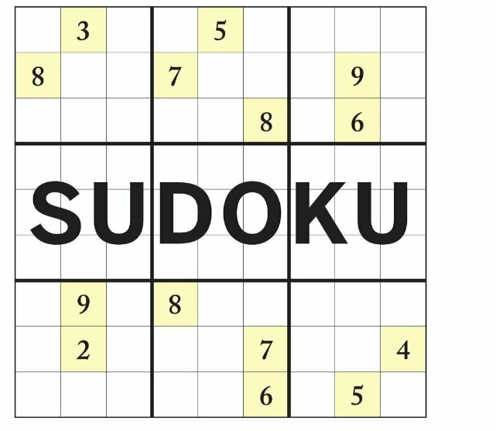
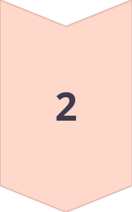

Backtracking Approach
Try a Number
Place a number in an empty cell and check if it's valid.
Backtrack
If the number is invalid, remove it and try a different number.
Solve Recursively
Repeat the process until a valid solution is found.

Slide 5

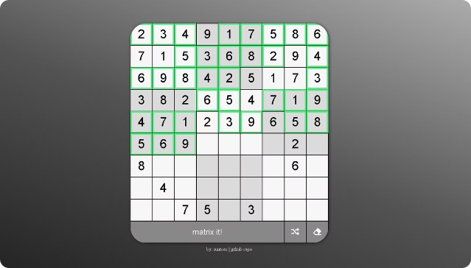
Visualizing the Solution
1
Highlighting
The visualizer highlights the current cell being processed.
2
Color Coding
Cells are color-coded to indicate valid and invalid placements.
3
Step-by-Step
The solver demonstrates the step-by-step process of finding the solution.

Slide 6
Algorithm Implementation
There are several ways to implement the Sudoku solving algorithm. One common approach is to use a recursive function that iterates through each cell, trying possible numbers, backtracking when necessary. Another approach is to use a stack or a queue to store the cell positions and their potential values. The algorithm then iterates through the stack or queue, updating the board until a valid solution is found. Functions used:
isSafe() Method
findSolution() Method
solveSudoku() Method
Algorithms used:
Backtracking Algorithm

Slide 7
isSafe() method
The isSafe() method is used to check whether a particular number can be safely placed in a given cell or not. It checks if the number already exists in the current row, current column, or current 3x3 subgrid.
If the number is not found in any of those locations, it is considered safe to be placed in the given cell. The isSafe() method returns a boolean value indicating the validity of the placement. This method is crucial for ensuring that the Sudoku puzzle follows the rules of the game.
If the number is not found in any of these places, the method returns true indicating that it is safe to place the number in the cell. Otherwise, it returns false indicating that the number is not safe to be placed in the cell.

Slide 8
isSafe() method
static boolean isSafe(int row, int col, int num) {
try {
Thread.sleep(1);
} catch (InterruptedException e) {
e.printStackTrace();
} for (int x = 0; x N; x++) {
if (board[row][x] == num) { return false; } } for (int x = 0; x N; x++) { if (board[x][col] == num) { return false; } } int startRow = row - row % 3, startCol = col - col % 3; for (int i = 0; i 3; i++) { for (int j = 0; j 3; j++) { if (board[i + startRow][j + startCol] == num) { return false; } } } return true; }

Slide 9
findSolution() Method:
The findSolution() method is responsible for finding a solution to the Sudoku puzzle. It may use a backtracking algorithm to explore all possible combinations of numbers until a valid solution is found. This method could be called recursively, trying different numbers in each empty cell until a complete solution is found, or until it determines that no valid solution exists.
Once a valid solution is found, the findSolution() method would update the board with the correct numbers. It would start by finding an empty cell on the board and try filling it with a number from 1 to 9. If the number is valid according to the Sudoku rules, it would recursively call findSolution() again to continue solving the remaining empty cells.
In each recursive call, if findSolution() determines that no valid number can be placed in the current cell, it would backtrack by undoing the previous assignment and trying a different number. This process continues until a complete solution is found or all possible combinations have been exhausted.

Slide 10
findSolution() method
static boolean findSolution(int row, int col) {
if (row == N - 1 && col == N) {
return true;
}
if (col == N) {
row++;
col = 0;
}
if (board[row][col] != 0) {
return findSolution(row, col + 1);
}
for (int num = 1; num = N; num++) {
if (isSafe(row, col, num)) {
board[row][col] = num;
jLabel[row][col].setText(String.valueOf(num));
jLabel[row][col].setBackground(Color.CYAN);
if (findSolution(row, col + 1)) {
return true;
}
board[row][col] = 0;
jLabel[row][col].setText("0");
jLabel[row][col].setBackground(Color.RED);
}
}
return false;
}

Slide 11
solveSudoku() method:
The "solveSudoku()" method is responsible for calling the "findSolution()" method to recursively solve the Sudoku puzzle. It starts by iterating through each cell of the board and checking if it is empty. If an empty cell is found, it tries to fill it with a number from 1 to 9.
If a valid number is found, it sets the corresponding label text and background color, and then calls the "findSolution()" method for the next cell. If no valid number is found, it backtracks by setting the current cell and label back to the initial values and continues the iteration. Finally, if all cells are successfully filled and no empty cells are found, the method returns true, indicating that the Sudoku puzzle has been solved.
If all cells are successfully filled and no empty cells are found, the "solveSudoku()" method returns true, indicating that the Sudoku puzzle has been solved. If at any point during the iteration an empty cell is found and a valid number cannot be found to fill it, the method backtracks by setting the current cell and label back to their initial values. This backtracking process continues until a valid solution is found for the puzzle.

Slide 12
solveSudoku() method
static void solveSudoku() {
try {
Thread.sleep(200);
} catch (InterruptedException e) {
e.printStackTrace();
}
for (int i = 0; i N; ++i) {
for (int j = 0; j N; ++j) {
try {
Thread.sleep(10);
} catch (InterruptedException e) {
e.printStackTrace();
}
jLabel[i][j].setText(board[i][j] == 0 ? "0" : String.valueOf(board[i][j]));
jLabel[i][j].setBackground(Color.LIGHT_GRAY);
}
}
if (!findSolution(0, 0)) {
System.out.println("No Solution.\n");
} else {
printSolution();
}
}

Slide 13
Efficiency and Performance
Backtracking
Pruning
Optimization
The algorithm uses a backtracking approach to efficiently explore all possible solutions.
The solver quickly identifies and discards invalid placements, reducing the search space.
The code is optimized for speed, ensuring fast and responsive puzzle solving.

Slide 14

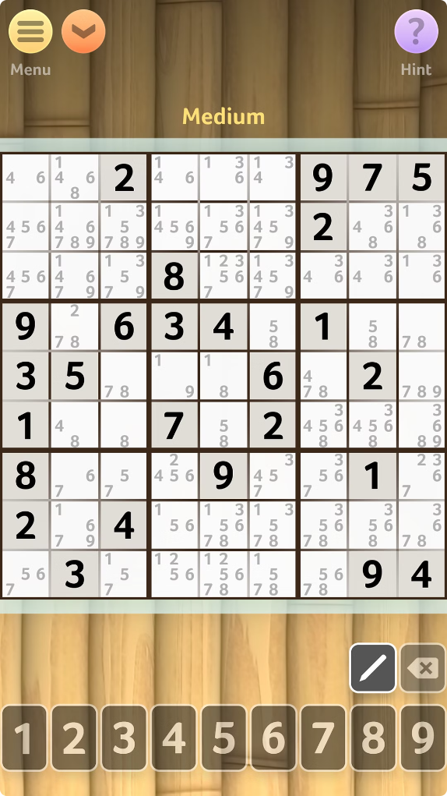



Real-World Applications
Puzzle Solving
The solver can be used to solve Sudoku puzzles of varying difficulty levels.
Logic Training
The visualizer can be used as an educational tool to teach logical thinking.
Algorithm Demonstration
The program showcases the power of backtracking algorithms in problem-solving.

Slide 15
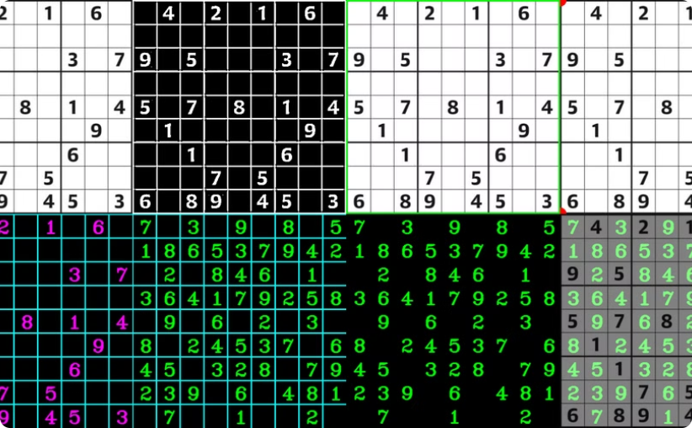
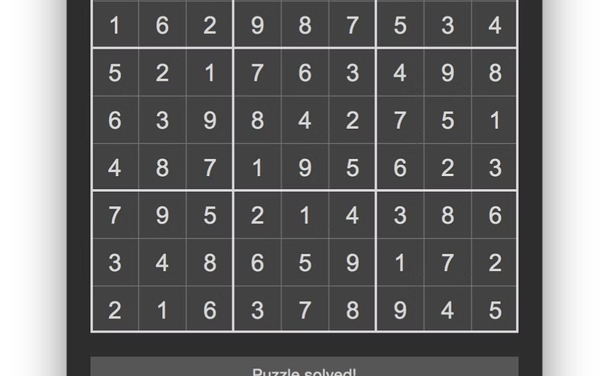
Explore and Enjoy
Interactive Interface
Engaging Visuals
Interact with the Sudoku solver and watch it find solutions in real-time.
Enjoy the captivating visuals and animations as the solver works its magic.

