Slide 1

ZELORA
An E-Commerce Mobile Application for Customers, Sellers, Delivery Riders and Administrators
CT-MAD 213 Mobile Application Development · Final Project
Bulacan Polytechnic College · BSIS-2C
Group 9
Notes:
Introduce the group and the project. Category: Business Applications (E-Commerce), intermediate complexity. Built in Java with Android Studio and SQLite.

Slide 2
Project introduction
Zelora is an Android e-commerce app written in Java. It brings buying, selling, delivery and administration into one app, with a local SQLite database.
Category
Platform
Team
Business Applications
(E-Commerce)
Intermediate complexity
Android (minSdk 26)
Java 17, Android Studio
SQLite, works offline
BSIS-2C
Cabuz · Espino · Eva
Isidro · Pascual
Notes:
Zelora is a Java Android app for online shopping with four roles. Category: Business Applications (E-Commerce), intermediate complexity. Data is stored locally in SQLite.

Slide 3
Problem addressed
The problem
Our solution
Browsing and buying in person is slow.
Sellers manage orders, payments and deliveries by hand or across separate platforms.
Buyers can’t easily follow or cancel an order.
No single place connects buyers, sellers, riders and admins.
One Android app with four roles.
Buyers shop, pay and follow their order.
Sellers accept and prepare orders.
Riders take and deliver jobs.
Admins manage users, disputes and vouchers.
Notes:
Shopping and selling are often split across separate tools. Zelora puts the buyer, seller, rider and admin in one app.

Slide 4
Target users
Customer
Seller
Rider
Admin
Browse, wishlist, cart, vouchers, checkout, track, cancel, review
Overview with sales chart, accept orders, mark ready, manage products and shop
Go online, accept jobs, confirm pickup, mark delivered, wallet
Users, orders, disputes, vouchers, platform overview
Notes:
The role is chosen at sign-up for Customer, Seller and Rider. Admin is created automatically on first launch.

Slide 5
Major features
Customer: search, filters, photo slider, wishlist, cart, Card / GCash-Maya / Cash on Delivery, vouchers, cancel while Processing, rate and review, report a problem
Seller: sales overview, accept order, mark ready, product and stock management
Rider: online switch, first rider to accept takes the job, confirm pickup before delivery, ₱40 earnings per delivery
Admin: enable or disable accounts, resolve disputes (refund or reject), create vouchers
Everyone: secure login (salted PBKDF2), order status notifications
Notes:
Highlight the features that go beyond basic CRUD: voucher rules, stock handling, first-rider-wins, pickup before delivery.

Slide 6
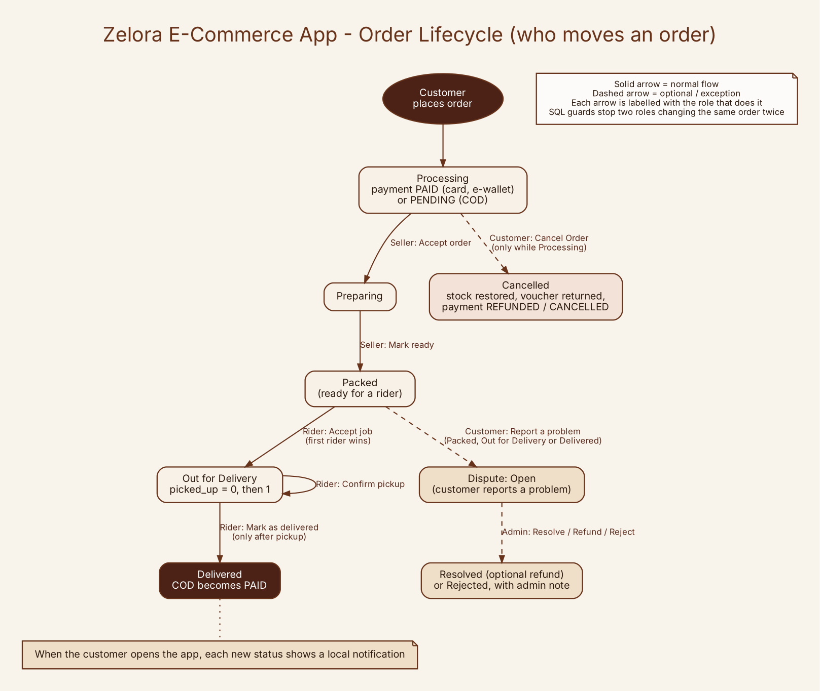
Major features: order lifecycle
Customer cancels only while Processing (stock restored, voucher returned).
Seller: Accept order, then Mark ready.
Rider: first to accept takes the job, must confirm pickup before delivery.
Cash on Delivery becomes PAID when delivered.
Problems can be reported on Packed, Out for Delivery or Delivered orders.
Notes:
Walk through: Processing, seller accepts (Preparing), seller marks ready (Packed), rider accepts (Out for Delivery), rider confirms pickup, delivered. COD becomes PAID at delivery. Cancel is only allowed while Processing.

Slide 7
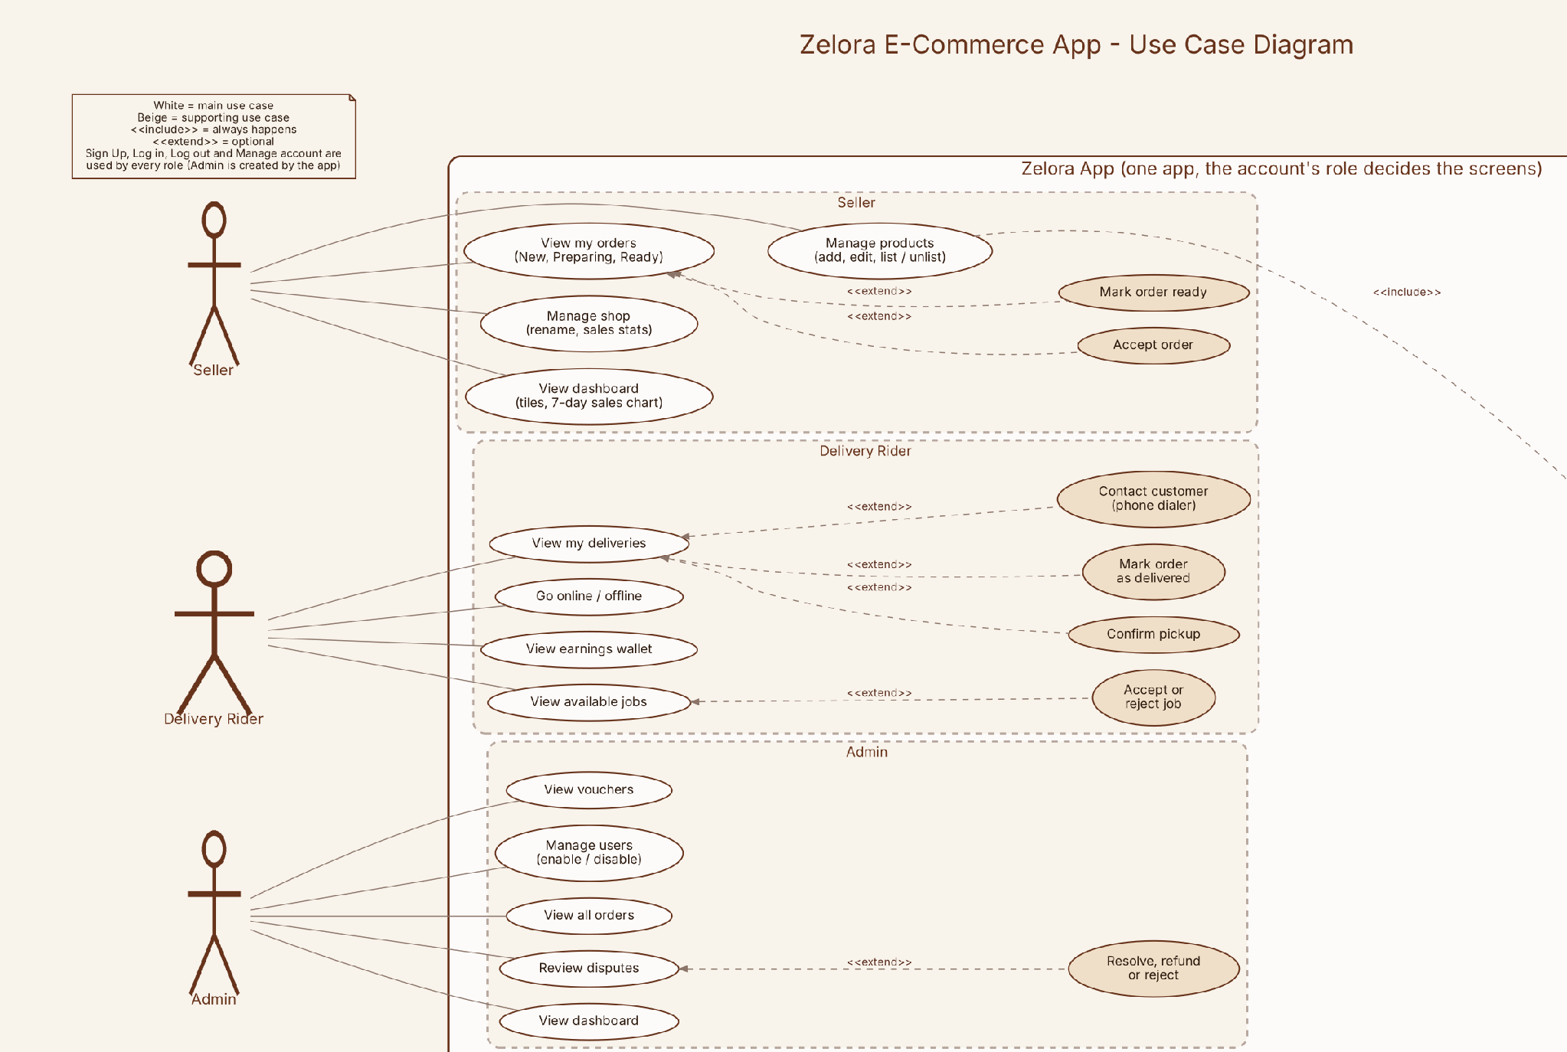
Major features: Seller, Rider, Admin
Notes:
Seller, rider and admin use cases.

Slide 8
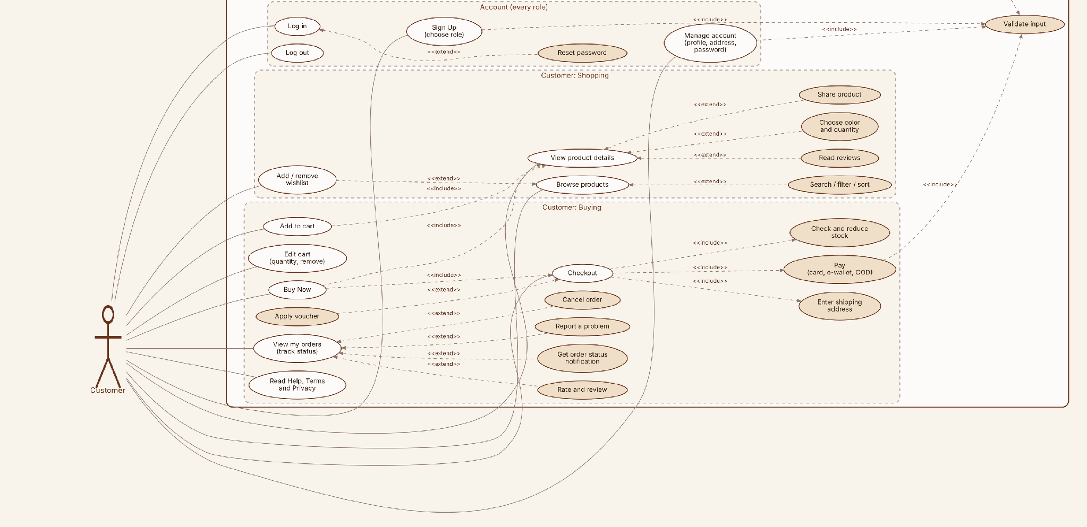
Major features: Customer
Notes:
Customer use cases and the account functions shared by every role.

Slide 9
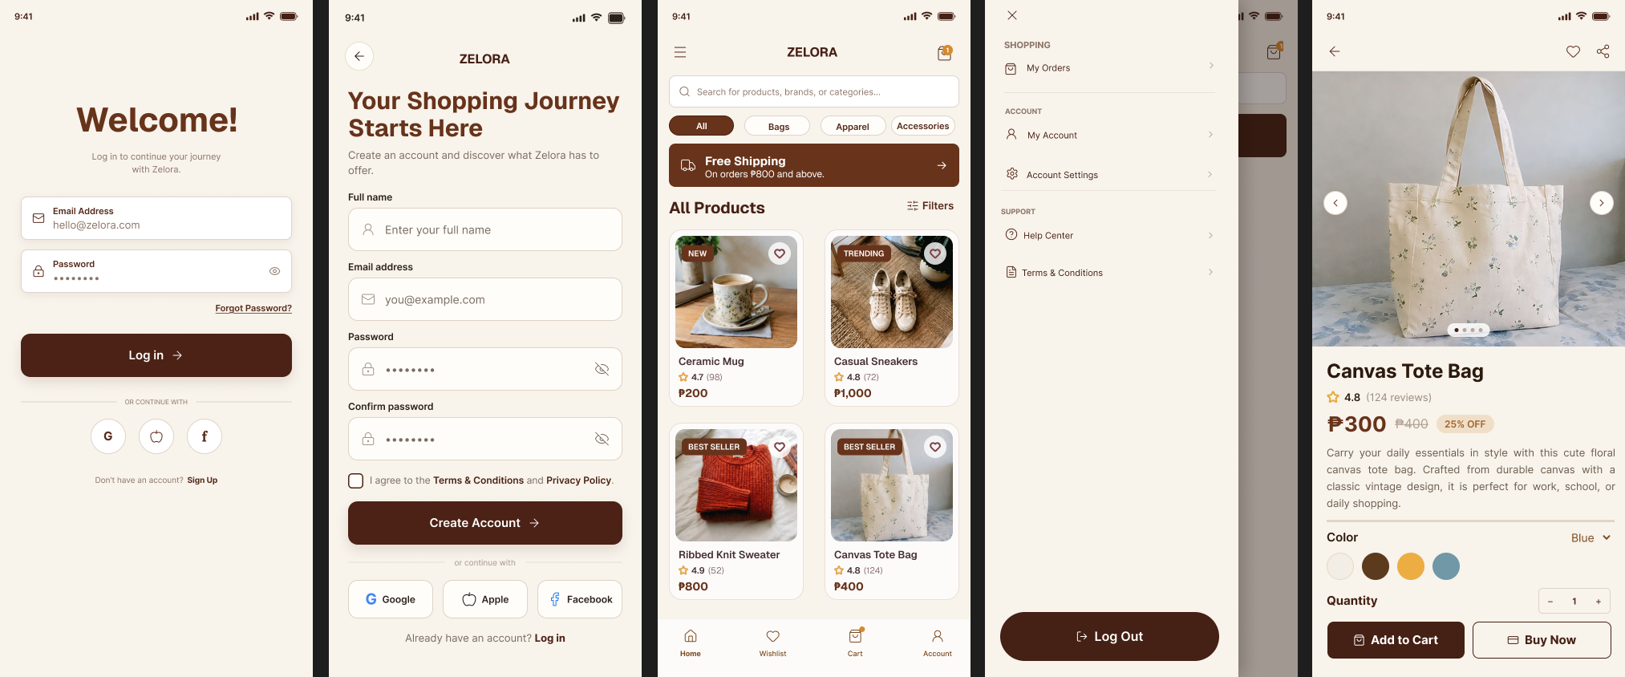
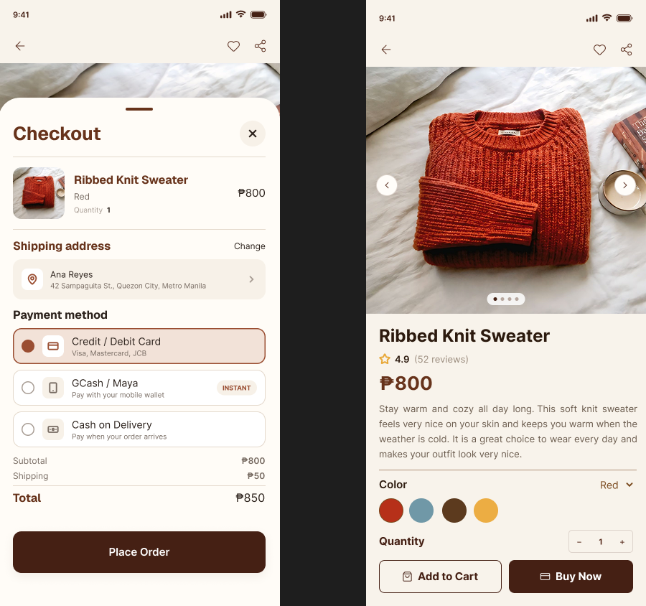
UI/UX design
Cream
Brand brown
Dark brown
Beige
Orange
Consistency · Usability · Visual hierarchy · Accessibility · Responsive layout · Feedback
Customer: Home, Wishlist, Cart, Account
Seller: Overview, Orders, Products, Shop
Rider: Home, Tasks, Wallet, Profile
Admin: five tabs
Notes:
Warm cream backgrounds and dark brown accents. Same colors, fonts and card style across all four roles. Fonts: Bricolage Grotesque for headings, Inter for body.

Slide 10
Application demonstration
Demo flow
Demo accounts
1 Customer signs up and places an order
2 Seller accepts, then marks ready
3 Rider goes online, accepts, confirms pickup, delivers
4 Customer gets the notification and reviews
5 Admin resolves a reported problem
seller@zelora.com / Seller1234
rider@zelora.com / Rider1234
admin@zelora.com / Admin1234
Vouchers
WELCOME10 · SAVE100 · FREESHIP
Notes:
Show one full order: customer places COD order, seller accepts and marks ready, rider accepts, picks up and delivers, customer sees the notification and can review.

Slide 11
Technologies used
Tools
Technologies
Android Studio
Gradle 8.9, AGP 8.7.3
Emulator / physical phone
Git and GitHub
draw.io and Graphviz
Figma
Java 17, XML layouts
Android SDK (min 26, target 34)
SQLite with DAO classes
SharedPreferences
AppCompat, RecyclerView, ViewPager2, Material
PBKDF2 password hashing
Local notifications
Notes:
Be ready to explain each choice. AI tools were used as a development and learning resource, as allowed by the project instructions; disclose this in the defense.

Slide 12
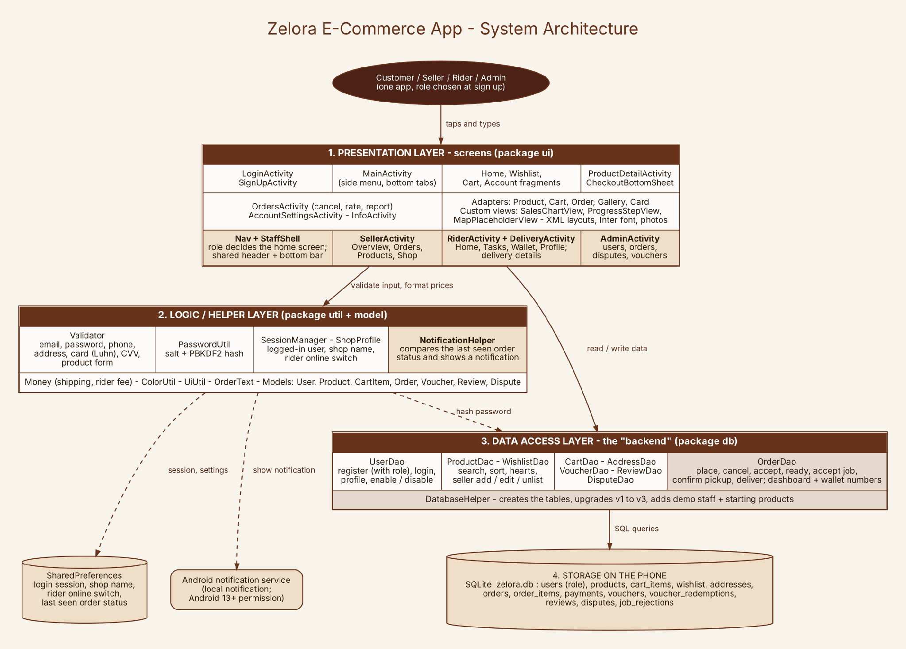
Technologies used: system architecture
Presentation: activities, fragments, adapters
Logic: validation, password hashing, sessions, notifications
Data access: DAO classes + DatabaseHelper
Storage: SQLite (13 tables) and SharedPreferences
Notes:
Four layers: screens, logic helpers, DAO classes with DatabaseHelper, and SQLite. All SQL is parameterized and lives in the DAO classes.

Slide 13
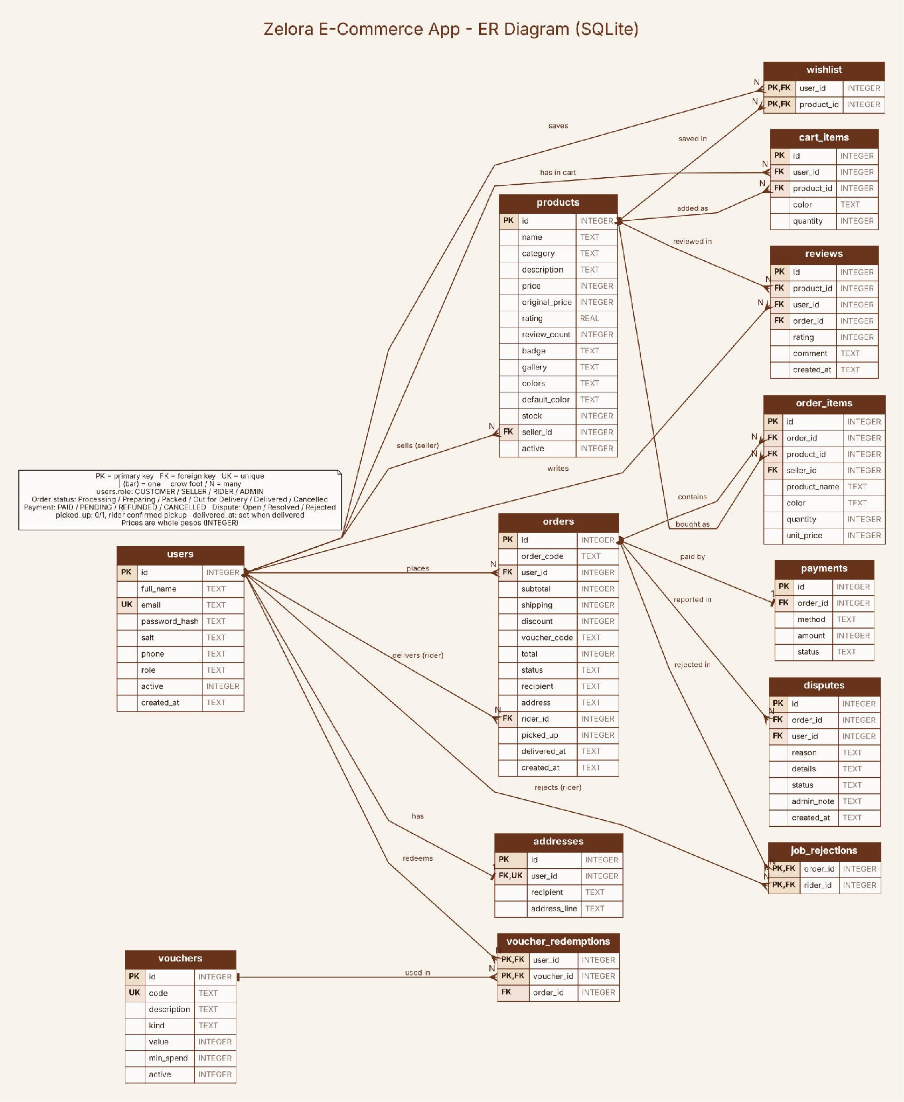
Technologies used: database design
13 tables
users hold all four roles
products belong to a seller
orders belong to a customer and, once accepted, a rider
order_items keep the name and price at purchase
Upgrades from older versions keep existing data
Notes:
13 tables in zelora.db (version 3). order_items stores name and price at purchase time. Migrations keep old data.

Slide 14
Challenges encountered
Data not saved, registration errors
Order marked Delivered at checkout
Accounts were not kept reliably during development. Fixed with a SQLite database and a saved login session.
Fixed: an order starts as Processing and each step is done only by the right role.
Gradle build errors
Syntax errors
Build setup errors on a low-spec laptop made building and debugging slow.
Comments mixed into code caused compile errors. The code is now compiled regularly to catch them early.
Notes:
Describe the real problems and how you fixed them. Only keep items that really happened to the group.

Slide 15
Testing results
24 test cases covering sign up, login, cart, checkout, vouchers, cancellation, seller, rider, admin, notifications and upgrade.
Checks already done
Results on the device
Full Java source compiled against Android API 34.
Database tests: 13 tables, upgrade keeps data, COD becomes PAID, no duplicate reviews.
Layouts and view ids checked.
oppo a 98 android 15
all passed
Notes:
Fill in the real results after running the 24 test cases on a device. Do not present results you have not run.

Slide 16
Future improvements
Current limitations
Next steps
Data stays on the phone, no shared server
Payments are simulated
The map is a placeholder; no real tracking
A multi-seller order moves as one order
Online backend for multiple devices
Real payment gateway
Real map, navigation and tracking
Configurable rider rates
Automated tests
Notes:
Limitations first, then what you would build next.

Slide 17
Thank you
Questions?
GitHub: [https://github.com/keshidesu/Zelora]

