Slide 1
Scalable Path Planning Algorithms for Drone Systems
Keshish Kumar | M.Tech CSE | IIT (ISM) Dhanbad

Slide 2
Introduction
Autonomous drones are transforming delivery systems, especially for last-mile logistics.
Their ability to avoid road traffic and reach hard-to-access locations makes them ideal for modern logistics.
However, challenges arise due to limited battery life, varying payloads, and the complexity of planning optimal delivery paths.

Slide 3
Objectives
Design and implement multiple path planning algorithms.
Model energy constraints realistically using payload weight and travel distance.
Evaluate algorithms on energy efficiency, scalability, and computational time.
Provide a comparative framework that guides algorithm selection for practical deployment.

Slide 4
Algorithms Compared
Brute Force: Checks all possible routes. Best for ≤ 10 nodes due to factorial time complexity.
Sort-Based Heuristic: Quickly builds feasible routes by sorting nodes based on payloads.
Genetic Algorithm: Simulates evolution to find near-optimal solutions through generations.
Reinforcement Learning (PPO): Uses neural networks to learn best delivery strategies by trial-and-error.

Slide 5
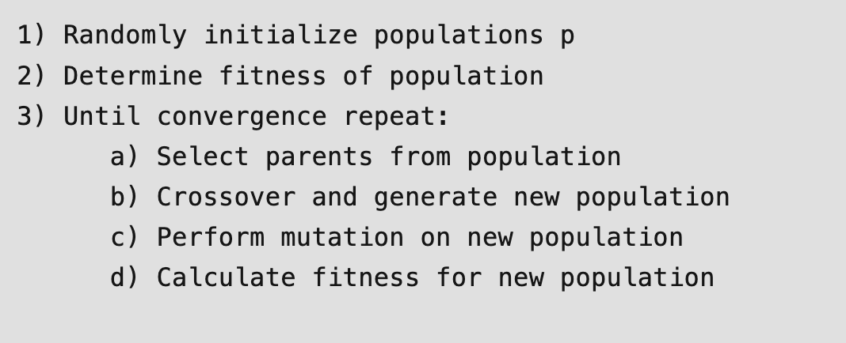
What is Genetic Algorithm?
Genetic algorithms are based on the ideas of natural selection and genetics. These are intelligent exploitation of random searches provided with historical data to direct the search into the region better performance in solution space.

Slide 6
How It Works In My Thesis?
Initialization: Generate a population of random routes (each route is a possible delivery order).
Evaluation: For each route, calculate the fitness (total energy used, considering payload and distance).
Selection: Select the best-performing routes to be parents (using tournament selection ).
Crossover: Combine parts of two parent routes to create new child routes.
Mutation: Randomly swap or alter nodes in some routes to maintain diversity.
Replacement: Form a new population with the best routes from parents and children.
Repeat: Continue steps 2–6 for a set number of generations or until improvement stops.
Best Solution: The route with the lowest total energy is selected as the optimal or near-optimal path.

Slide 7
What is Proximal Policy Optimization (PPO) ?
Proximal Policy Optimization (PPO) is a model-free, on-policy RL algorithm that optimizes decision-making strategy by iteratively updating it while preventing drastic changes.
The key idea behind PPO is to balance two conflicting goals:
Maximizing the objective.
2. Constraining the policy update.
Features:
Clipped Surrogate Objective: Limits policy updates to a "trust region," avoiding unstable training.
Adaptive Exploration: Balances exploration (trying new actions) and exploitation (using known strategies).
Sample Efficiency: Reuses training data through multiple epochs of optimization.

Slide 8
How It Works In My Thesis?
State: At each step, the drone observes its current location, remaining battery, which nodes have been visited, and the payload.
Action: The drone selects the next delivery node to visit from the set of unvisited nodes.
Reward: The agent receives a reward based on energy efficiency-using less energy gives a higher reward. Penalties are given for exceeding battery limits or skipping deliveries.
Policy Update: PPO updates the drone’s decision-making policy using the clipped surrogate objective function . This ensures the policy improves steadily without making sudden, unstable changes.

Slide 9
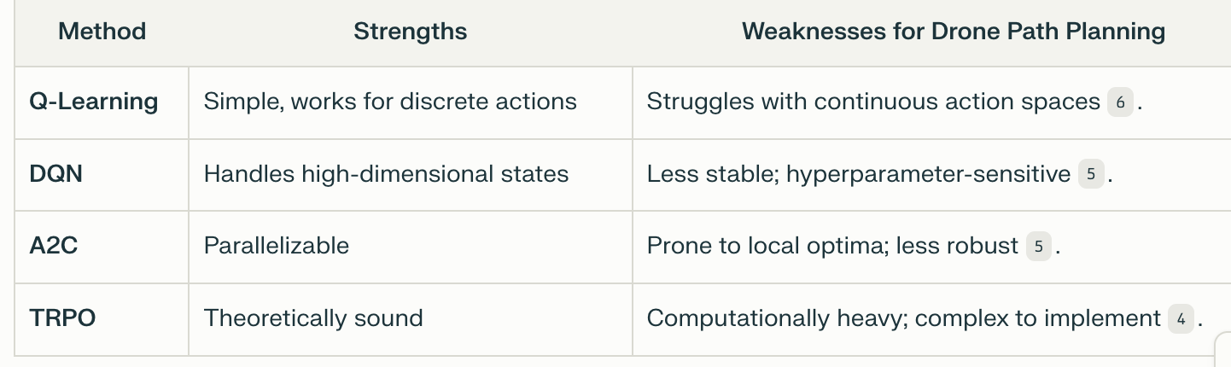
Why PPO Over Other RL Methods?
PPO Advantages:
Stability: Uses clipping to avoid large policy updates, reducing training instability.
Scalability: Works well with continuous action spaces (critical for drone navigation).
Dynamic Adaptation: Ideal for environments requiring real-time adjustment

Slide 10
Simulation Environment
Custom Python-based simulation system.
Modules used: NumPy, Pandas, Matplotlib, Stable Baselines3, itertools, random.
Allows consistent testing of all algorithms across identical delivery scenarios.
Metrics tracked: total energy, execution time, route feasibility, scalability.

Slide 11
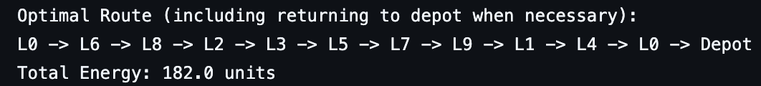
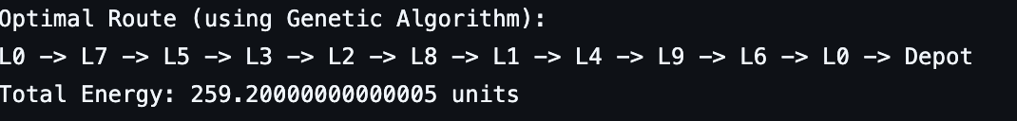
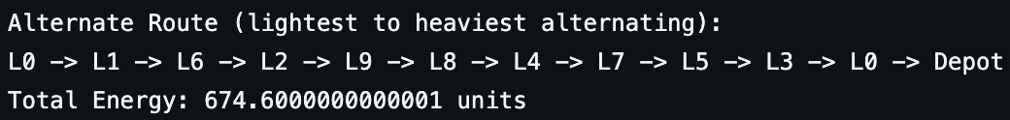
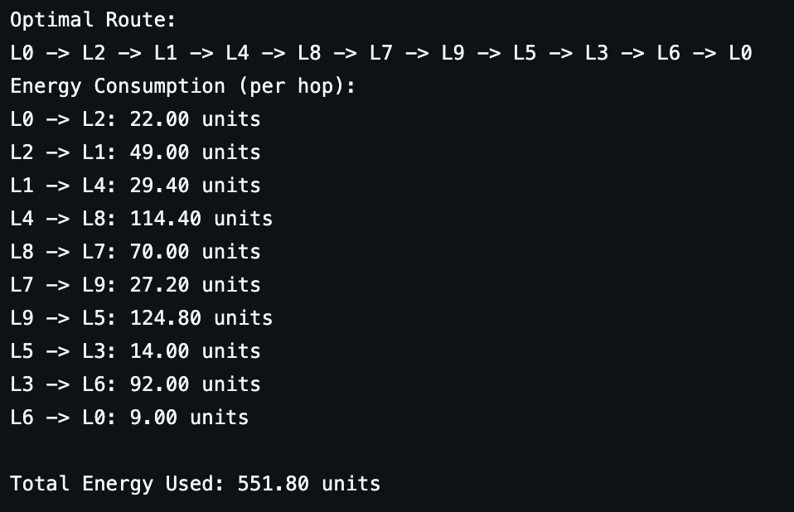
Results: 10-Node Scenario
Brute Force: Time = 1.54s .
Genetic Algorithm: Time = 0.05s .
Sort-Based Heuristic: Time = 0.00s .
Reinforcement Learning (PPO): Time =6s.

Slide 12
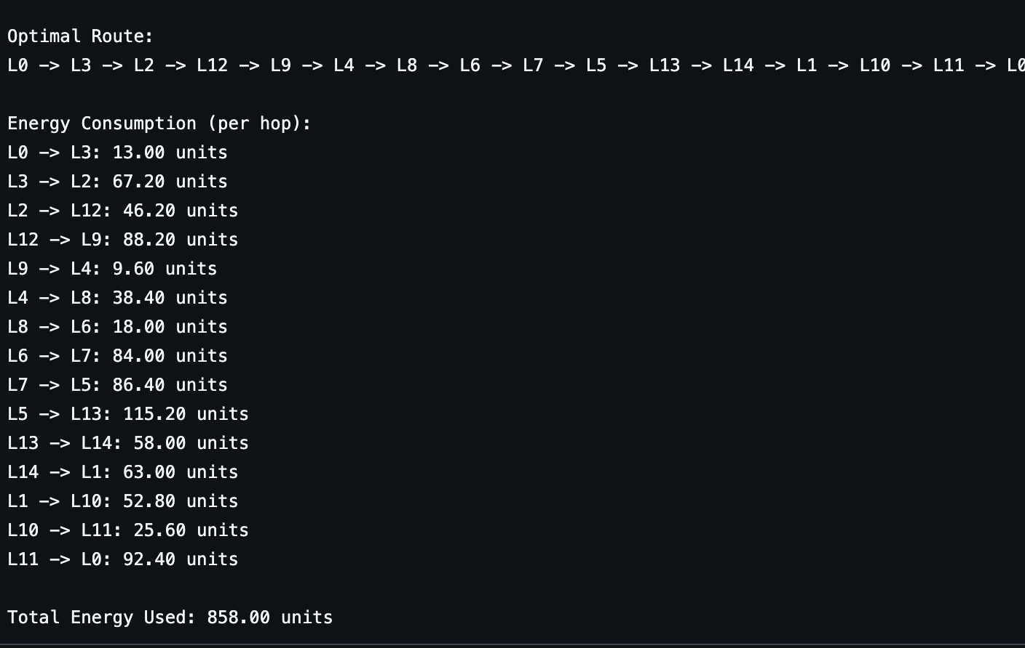
Results: 15-Node Scenario
Brute Force: Larger Complexity (No output)
Genetic Algorithm: Time = 0.05s.
Sort-Based Heuristic: Time = 0.000289s
Reinforcement Learning (PPO): Time = 6s.

Slide 13

Results: 17-Node Scenario
Brute Force: Larger Complexity (No output)
Sort-Based Heuristic: Time = 0.00281s.
Genetic Algorithm: Time = 0.067s.
Reinforcement Learning (PPO): Time = 6s.

Slide 14
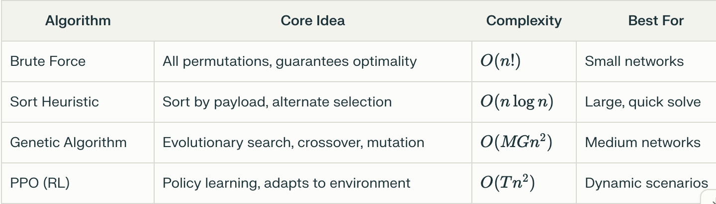
Algorithm Complexity
M -> The population size-the number of candidate solutions (routes) maintained in each generation of the genetic algorithm.
G -> The number of generations-how many times the population is evolved (through selection, crossover, and mutation).
T -> The number of training steps (episodes or timesteps)-how many times the RL agent (the drone) interacts with the environment during training.

Slide 15
Analysis
Brute Force: Ideal for small systems (n≤12) requiring guaranteed optimality (182 energy units for 10 nodes).
Genetic Algorithm: Best balance for medium systems (0.05s execution, 259.2 energy units) with 12 <n≤50.
Sort-Based Heuristic: Optimal choice for large systems (n > 50) needing instant solutions (0.00s execution).
PPO: Superior for dynamic environments despite higher training costs (6s for 20k steps), adapting to real-time changes.

Slide 16
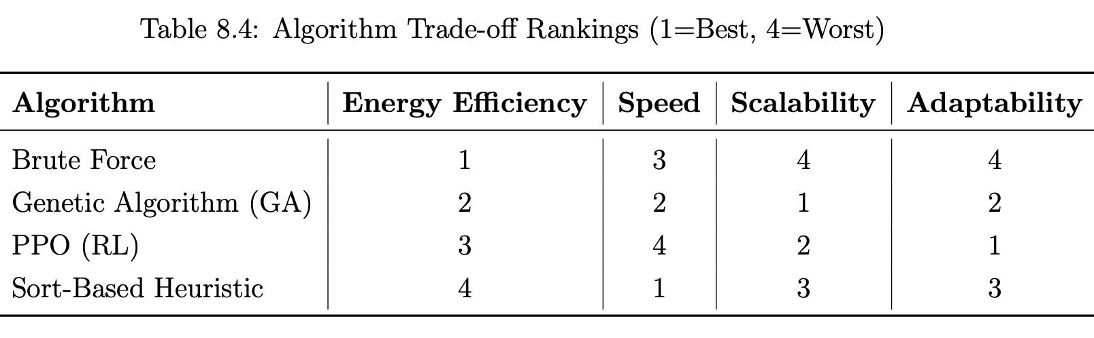
Trade-offs

Slide 17
Recommendations
Algorithm Selection Depends On:
Energy constraints: Brute Force > GA > PPO > Sort-based
Time constraints: Sort-based > GA > PPO > Brute Force
Dynamic needs: PPO > GA > Sort-based > Brute Force
Limitations
Brute force not scalable beyond 12–15 nodes.
Sort-based can be suboptimal in energy use(<Energy).
PPO requires significant training and tuning.
Experiments mostly on static, single-drone scenarios

Slide 18
Conclusion
The research proves that drone delivery path planning with energy awareness becomes possible through strategic combinations of classical approaches and metaheuristic and learning-based techniques.
The comparative analysis generates practical findings about selecting which algorithm best meets different scenario features including size and computational capability and adjustable factors.

