Slide 1
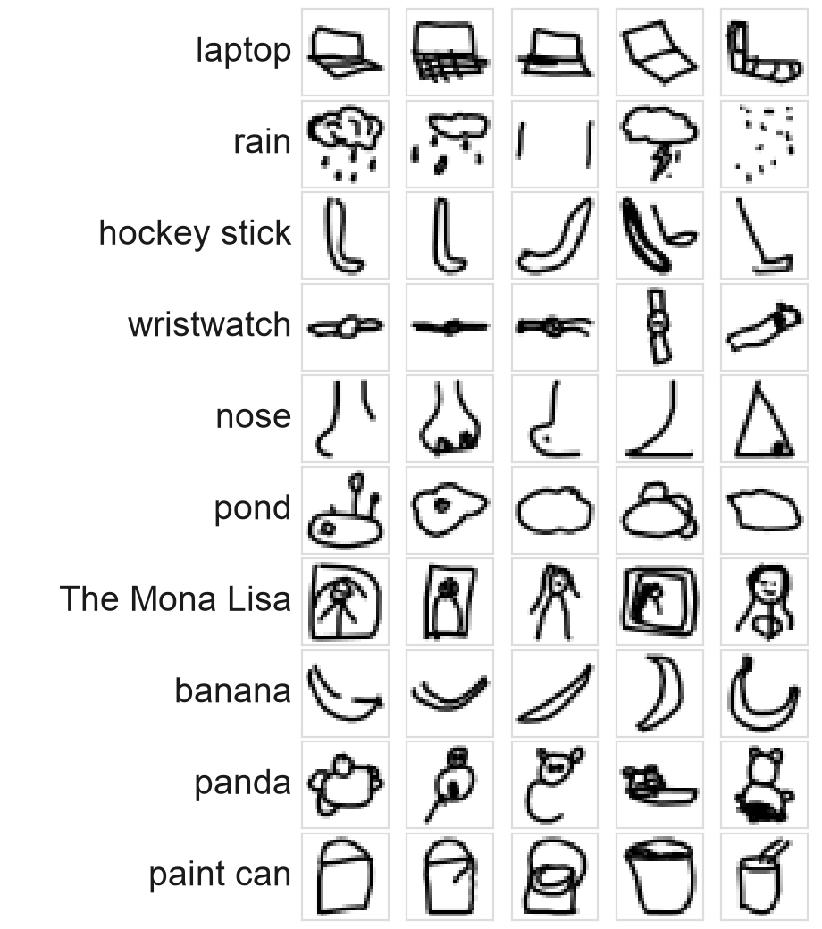
Can a computer recognise quick doodles?
TEAM -08
Shobhit Rachit Keshri PES2UG24CS475
Sanjith R PES2UG24CS445
Our task: reproduce the paper's results, then add one new model.
Problem: name the object in a quick hand drawing
Why it matters: drawing could become a search interface
Data: Google QuickDraw, 28×28 grayscale; 3 / 10 / 50 classes, 20,000 each
Split per class: 16,000 train / 2,000 validation / 2,000 test
Takeaway: same simple drawings, but harder as the number of classes grows.
Drawing: A New Way To Search — Reproduce & Extend
1
Notes:
Our project asks a simple question: can a computer recognise quick doodles? The reference report argues that if it can, drawing could become a way to search. The data is Google QuickDraw: tiny 28 by 28 grayscale drawings. We use 3, 10 and 50 classes, with 20,000 drawings per class, split into 16,000 for training, 2,000 for validation and 2,000 for testing. Our job was to reproduce the paper, then add one new model.
(about 34 s)

Slide 2
The original team tried four model families, from simple to complex
 | Logistic Regression | SVM | CNN | Transfer learning
How it works | Draws straight-line boundaries between classes on raw pixels | Finds the widest margin between classes; kernels allow curved boundaries | Small filters slide over the image to detect strokes and shapes | Reuses networks pre-trained on 1.2 M photos (ImageNet); trains only a small new head
Why they used it | Fast baseline | Tests if non-linear boundaries help | Learns spatial patterns | Tests if photo knowledge helps doodles
Key settings | 100 iterations | 4 kernels, 500 iterations; 3 and 10 classes only | V1 = 2 conv + 2 pooling layers; V2–V4 = simpler versions; 100 epochs; raw and black/white input | VGG19, InceptionV3, ResNet50, MobileNet; 3 classes
Measured: validation accuracy and training time.
Takeaway: does a more complex model really help on simple drawings?
Drawing: A New Way To Search — Reproduce & Extend
2
Notes:
The original team compared four model families, from simple to complex. Logistic regression draws straight lines between classes and is the fast baseline. An SVM looks for the widest gap between classes, and its kernels allow curved boundaries. A CNN slides small filters over the image to find strokes and shapes; V1 is their full network and V2 to V4 are simpler versions. Transfer learning reuses networks trained on over a million photos.
(about 34 s)

Slide 3
We rebuilt their exact pipeline
QuickDraw
20,000 per class
One fixed split
16k / 2k / 2k,
shared by every model
Same preprocessing
raw / black-white /
scaled [−1, 1] / resized
Same models
and settings
Measure
validation accuracy
+ training time
What differed
Newer hardware (RTX 4070 laptop GPU) and newer library versions
Transfer learning: frozen-network features computed once, identical result
30.9 min instead of about 15.7 h with their method
We read the authors' original code to explain any gaps
Takeaway: same experiment, so any difference must have a cause.
Drawing: A New Way To Search — Reproduce & Extend
3
Notes:
We rebuilt their pipeline step by step. The same QuickDraw data, one fixed split shared by every model, the same preprocessing for each model, the same models and settings, and the same two measurements. What differed: we used a newer laptop GPU and newer libraries. For transfer learning we computed the frozen networks' outputs once and trained only the new head, which gives the same result in 30.9 minutes instead of about 15.7 hours.
(about 34 s)
--- Reference, not spoken ---
Their time = report Table 6 seconds per epoch × epochs in their logs: VGG19 207 s × 20 + MobileNet 103 s × 100 + ResNet50 152 s × 100 + InceptionV3 540 s × 50 = 56,640 s = 15.7 h. Ours = sum of transfer-learning training times in cross_model_ours.csv (feature extraction + head) = 1,852 s = 30.9 min.

Slide 4
Most results reproduce; three don't
Model (classes) | Reported | Ours | Status
Logistic Regression (3 / 10 / 50) | 79.5 / 64.6 / 43.9 | 79.3 / 65.8 / 43.3 | Matches: within 1.2 points
CNN V1 (50) | 81.8 | 81.2 | Matches
VGG19 transfer learning (3) | 95.6 | 95.4 | Matches
SVM RBF (3) | 62.7 | 84.0 | Differs: ours higher
CNN "V2" (50) | 81.8 | 75.1 | Differs: ours lower
ResNet50 / InceptionV3 / MobileNet (3) | 62.7 / 45.7 / 75.4 | 95.4 / 93.1 / 94.6 | Differs: ours much higher
Validation accuracy (%), as in the paper.
Takeaway: the reproduction works; three gaps needed explaining.
Drawing: A New Way To Search — Reproduce & Extend
4
Notes:
Here is the scorecard, all in validation accuracy. Logistic regression matches at every class size, within 1.2 points. Our CNN V1 matches their V1 on 50 classes, and VGG19 transfer learning matches almost exactly. So the pipeline is right. But three results differ. Our SVM with the RBF kernel scores much higher than theirs. Their CNN called V2 scores much higher than our V2. And three of the four transfer-learning networks score far higher for us. Because the setup is the same, each of these gaps needs a cause, which is the next slide. The full tables are in the repository.
(about 47 s)
--- Reference, not spoken ---
LR: Logistic regression raw 3 cls 79.5 vs 79.3; Logistic regression raw 10 cls 64.6 vs 65.8; Logistic regression raw 50 cls 43.9 vs 43.3
SVM: Linear scaled 3 cls 40.8 vs 43.3; RBF scaled 3 cls 62.7 vs 84.0; Polynomial scaled 3 cls 51.7 vs 66.7; Sigmoid scaled 3 cls 33.1 vs 32.5; Linear scaled 10 cls 22.2 vs 23.4; RBF scaled 10 cls 61.0 vs 74.6; Polynomial scaled 10 cls 50.9 vs 73.9; Sigmoid scaled 10 cls 11.7 vs 13.4
CNN: V1 raw 3 cls 91.4 vs 90.8; V2 raw 3 cls 91.3 vs 91.7; V1 binarized 3 cls 89.0 vs 89.6; V2 binarized 3 cls 89.1 vs 90.1; V3 binarized 3 cls 88.2 vs 88.8; V4 binarized 3 cls 89.1 vs 89.2; V1 raw 10 cls 89.3 vs 88.8; V2 raw 10 cls 89.2 vs 88.5; V1 binarized 10 cls 87.2 vs 86.6; V2 binarized 10 cls 86.7 vs 85.1; V3 binarized 10 cls 86.6 vs 84.1; V4 binarized 10 cls 85.6 vs 84.7; V1 raw 50 cls 81.8 vs 81.2; V2 raw 50 cls 81.8 vs 75.1; V2 (test set) raw 50 cls 81.9 vs 75.1; V1 binarized 50 cls 77.5 vs 76.8; V2 binarized 50 cls 77.4 vs 70.4; V3 binarized 50 cls 70.3 vs 65.1; V4 binarized 50 cls 70.3 vs 70.5
TL: VGG19 resized 3 cls 95.6 vs 95.4; MobileNet resized 3 cls 75.4 vs 94.6; ResNet50 resized 3 cls 62.7 vs 95.4; InceptionV3 resized 3 cls 45.7 vs 93.1

Slide 5
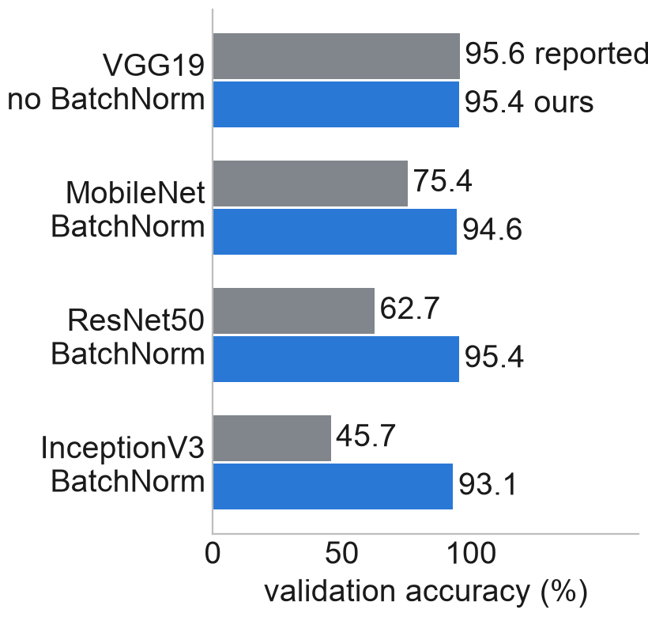
Why the three differences happen
What we saw | Why | Our evidence
SVM scores higher than reported | Their runs used ~70,000 drawings per class with the same 500-step limit: less converged | Our 70,000 rerun: RBF 84.0 → 75.0 (3 classes), 74.6 → 64.3 (10); theirs 62.7 / 61.0
Their "V2" equals our V1 | A script bug trained V1 under every V2–V4 label | Our V1 81.2 vs their "V2" 81.8; our real V2 75.1
Transfer learning far higher for 3 of 4 networks | Frozen BatchNorm layers behaved differently in 2018 Keras | VGG19 (no BatchNorm) matches: 95.4 vs 95.6; their Inception log: 99.99% train vs 45.7% validation
CNN V3 is 2.5 / 5.2 points lower at 10 / 50 classes: unexplained, likely seed or library differences.
Takeaway: the paper's claim that complex networks don't help doodles is likely an artefact.
Drawing: A New Way To Search — Reproduce & Extend
5
Notes:
Each gap has a cause we could check. First, the SVM. Their logs show about 70,000 drawings per class, with the same 500-step limit. More data under the same limit means a less finished model. When we reran with 70,000 drawings, RBF dropped from 84.0 to 75.0, close to theirs. Second, their script had a bug that trained V1 under the V2 label, so their V2 is really our V1. Third, BatchNorm layers behaved differently in 2018 Keras. VGG19, the only network without them, matches. So the claim that complex networks don't help is likely wrong.
(about 44 s)
--- Reference, not spoken ---
Inception training accuracy 99.99% is from the authors' GitHub README log.

Slide 6
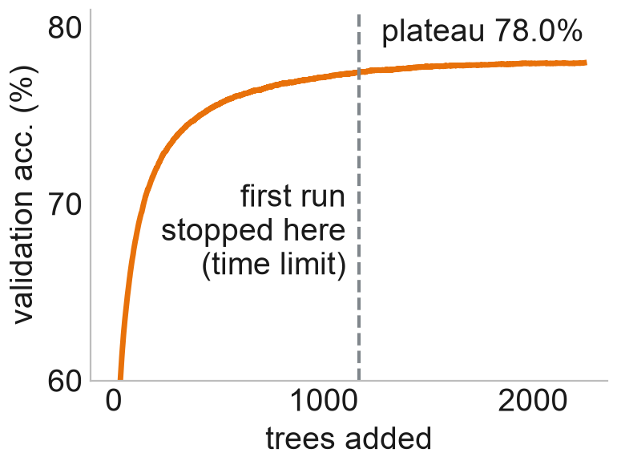
Our extension: XGBoost, a model family the paper never tried
Tree 1
Why: the reference had no tree-based model; it trains fast on a GPU
Tuned 7 settings with Optuna Bayesian search, on validation only
Test set used once; first run was time-limited, so we retrained fully
Tree 2
…
Classes | First run (time-limited) validation / test | Fully trained validation / test
3 | 91.7 / 90.8 | 91.7 / 90.8
10 | 89.8 / 89.7 | 89.8 / 89.8
50 | 77.4 / 77.4 | 78.0 / 77.9
Tree N
Each new tree fixes the mistakes of the previous ones; their votes are added up.
Takeaway: more training gained only +0.5 points (test); XGBoost hits a ceiling around 78%.
Drawing: A New Way To Search — Reproduce & Extend
6
Notes:
For our extension we added XGBoost, because the paper never tried a tree-based model. XGBoost builds trees one after another; each new tree fixes the mistakes of the ones before, and their votes are added up. We tuned seven settings with Optuna, a Bayesian search, using only the validation set. Our first run was time-limited, so we retrained until the model stopped improving. On 50 classes that gained only half a point: the curve flattens around 78 percent.
(about 36 s)

Slide 7
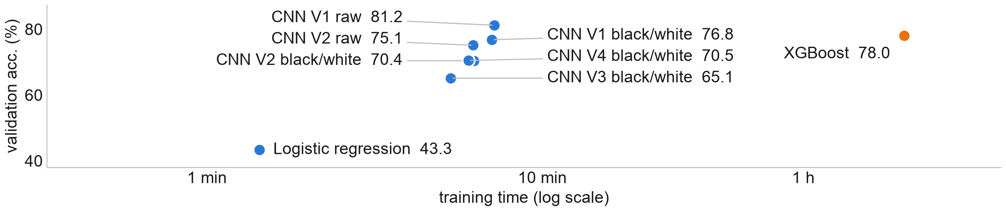
All models compared: the CNN wins on 50 classes, accurately and fast
Classes | Logistic Regression | SVM | CNN | Transfer learning | XGBoost
3 | 79.3% · 20 s | 84.0% · 41 s | 91.7% · 38 s | 95.4% · 3.5 min | 91.7% · 57 s
10 | 65.8% · 20 s | 74.6% · 10.9 min | 88.8% · 1.8 min | — | 89.8% · 8.1 min
50 | 43.3% · 86 s | — | 81.2% · 7.2 min | — | 78.0% · 119.9 min
Best model per family, validation %. — = not run in the reference (SVM: 3 and 10 classes; transfer learning: 3 classes).
Takeaway: simple models fall off as classes grow; CNNs scale best.
Drawing: A New Way To Search — Reproduce & Extend
7
Notes:
This chart shows all our models on 50 classes: accuracy upwards, training time to the right on a log scale. The CNNs sit top left: accurate and quick. The best, CNN V1, reaches 81.2 percent in about 7.2 min. XGBoost reaches 78.0 percent but needs about 119.9 min. The table below gives the best model per family at each class size: every family does well on 3 classes, and the gaps open as the number of classes grows.
(about 36 s)

Slide 8
What we learned
CNN is best on 50 classes: 81.2%, about 16.7× faster than XGBoost (78.0%)
XGBoost matches CNNs on 3 and 10 classes; trees judge pixels, CNNs learn shapes
Three surprising paper results traced to their setup: data size, script bug, BatchNorm
Future work: feed transfer-learning features into XGBoost
Takeaway: yes: a small CNN names the right doodle out of 50 classes 81.2% of the time.
Drawing: A New Way To Search — Reproduce & Extend
8
Notes:
To sum up. The CNN is the best model on 50 classes, at 81.2 percent, and it trains about 16.7 times faster than tuned XGBoost. XGBoost keeps up with CNNs on 3 and 10 classes, 91.7 against 91.7 and 89.8 against 88.8, but stalls on 50, because trees judge single pixels while CNNs learn shapes. The three surprising results in the paper come from their setup, not from the models. So yes, a computer can recognise doodles. Thank you.
(about 36 s)

