Slide 1

AI-Powered spam classifier
By:
MA.A.Harinesh
v.NANDHA KUMAR
A.RUBAN CHAKRAVARTHI
S.THOWFIQ
S.KESHORE

Slide 2
PROJECT TITLE/Problem Statement
As there is a gradual rise in getting spam mails in this current decade.The problem here is to classify the mails that we obtain.An AI powered spam classifier is needed to be built to accurately distinguish spam mails an non-spam mails from the total mails.The goal is to reduce the number of false negatives(classifying legitimate messages as spam) and false negatives(missing actual spam messages) while achieving a high level of accuracy.

Slide 3
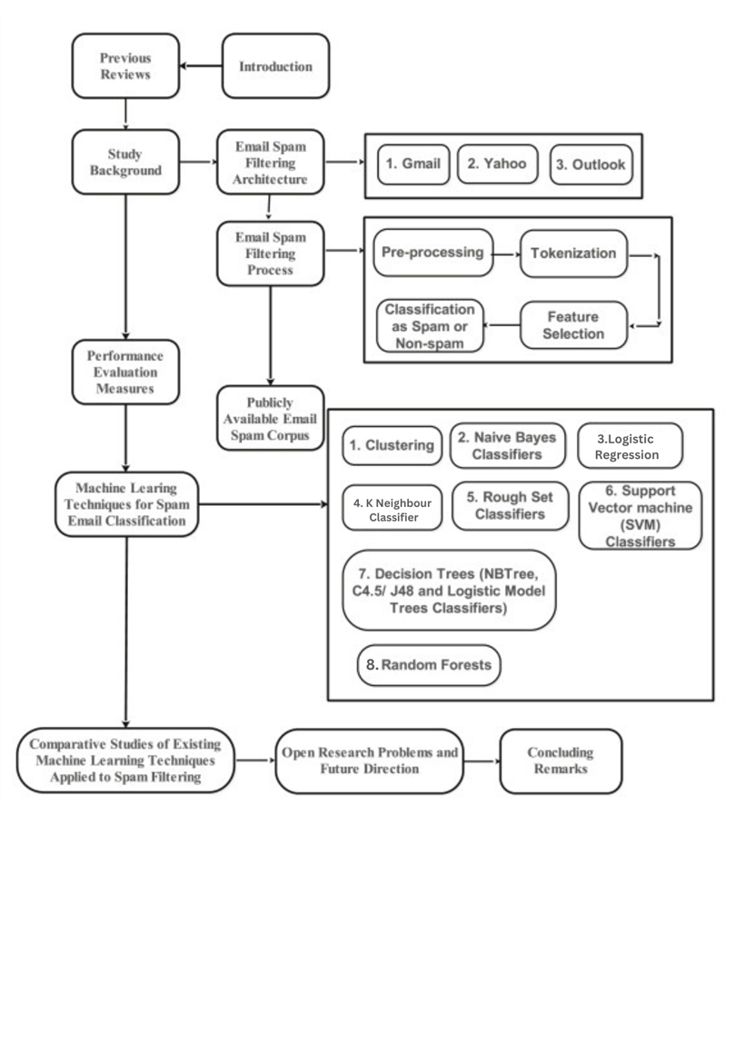
Design thinking process

Slide 4
PHASES OF DEVELOPMENT
Phase1- Defining problem statement
Phase2-Innovation and Design thinking
Phase3-Development part 1
Phase4-Development part 2
Phase5-Development part 3

Slide 5
Dataset used
In this dataset there is a mixture 5573 various messages that contains both spam and harm messages.Each and every message is a raw message and none of the data is preprocessed.Each and every message is in the form of sentence with some punctuations present in it.

Slide 6
Data preprocessing steps
We have used natural language toolkit and wordcloud libraries for the process of preprocessing the dataset that is provided to build an AI powered spam classifier.
We have removed some unnecessary words and punctuations from the dataset to obtain and classify the words that comes under spam and harm.
Then we have deleted the attributes that contains no values
https://colab.research.google.com/drive/1dSxo6BocDGhNwyUAsUqT0OcKwZ-Sahjd?usp=sharing

Slide 7
Model training
In the process of training the model we have splitted the dataset in the form of 85% as training data and 15% as testing data to obtain proper accuracy.
We have used Scikit learn library to build the model for this spam classifier.

Slide 8
Choice of Algorithm
As our data should be classified eith er as spam message or harm message we have used the following algorithms with its respected accuracy score.
Logistic Regression-0.953
SVC-0.978
MultinomialNB-0.988
DecisionTreeClassifier-0.960
RandomForestClassifier-0.979
KNeighboursClassifier-0.933
https://colab.research.google.com/drive/1VE_EOprQU1vyHrCrLIf4fT6QUmoq94eA?usp=sharing

Slide 9
Evaluation metrics
We have used Scikit Learn & seaborn libraries and used confusion matrix to obtain true negative,true positive,false negative and false positive values with the help of predicted values
https://colab.research.google.com/drive/1bYMwlfvbAmSPKMuc7ZJQ9nxgC2109XrQ?usp=sharing

