Slide 1
MATLAB Based System
Kesh Rao, Juwan Hong

Slide 2
REX, MEX, VEX, Spike2 System
Pros:
Works well
Fast
Familiar
Cons:
Archaic (from 80’s)
Difficult Coding Language (SPOT)
Hard to tweak
Malfunctions
Decided it was worth it to create a new system.

Slide 3
Criteria for New System
Fast
Easy to add-on new features
Flexible
Malfunctions easy to fix
Familiar Language

Slide 4
Options Explored
Presentation – Spike2 System
Spike2 stand-alone
MATLAB stand-alone
Spike2’s MATLAB Library
MATLAB – Spike2 Integration

Slide 5
MATLAB + Spike2 Integration
Pros:
Spike2 can be used the same way to acquire data using 1401
Coding much easier with MATLAB
Signal from 1401 can be forked into both Spike2 and MATLAB for independent processing
Divided Tasks: MATLAB runs paradigm, Spike2 gathers data
Cons:
MATLAB can be slow
Time syncing MATLAB and Spike2
Communication between MATLAB and Spike2
Decided it was worth it to create a new system.

Slide 6
Hardware Setup
PCI – 4020/12 DAQ card
4 Analog Inputs
Digital I/O
MATLAB
With Psychtoolbox
32-bit Version

Slide 7
DAQ Card Setup
AI 1
Horizontal Eye Position from 1401
AI 2
Vertical Eye Position from 1401
AI 3
Spike Triggers from Spike2 via 1401
AI 4
Photodiode Triggers
DO 1
Reward Switch
DO 2
Event Trigger to Spike2 via 1401

Slide 8
Spike2 Setup
The settings are the same. Channels are:
Eye position
Neural data
Photodiode
New channels:
Event triggers from MATLAB via 1401
Spike Triggers to MATLAB via 1401

Slide 9
MATLAB Coding
Divided into parts:
GUI
Paradigms
Supporting functions

Slide 10
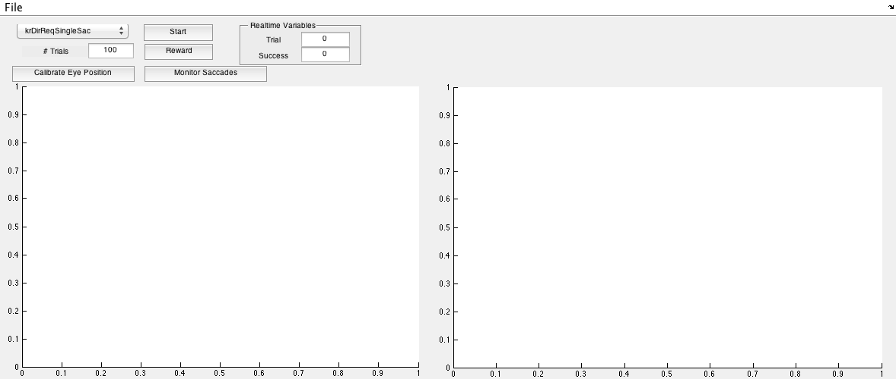
GUI

Slide 11
Paradigms

Slide 12
Supporting functions
PeekEyePos
CheckPhotoOn/Off

Slide 13
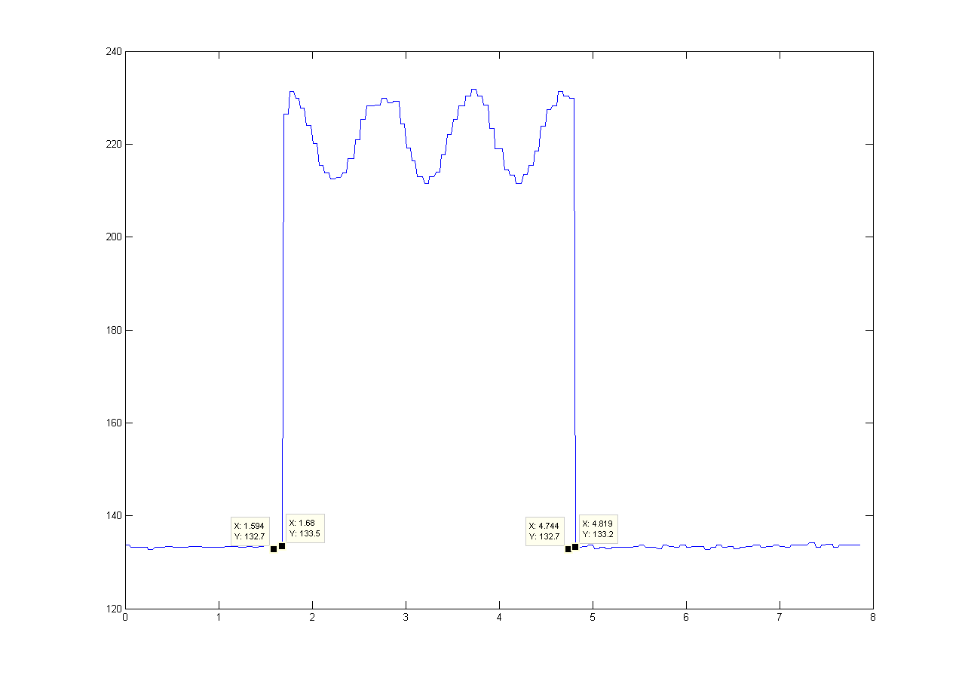
Photodiode Speed Issue

Slide 14
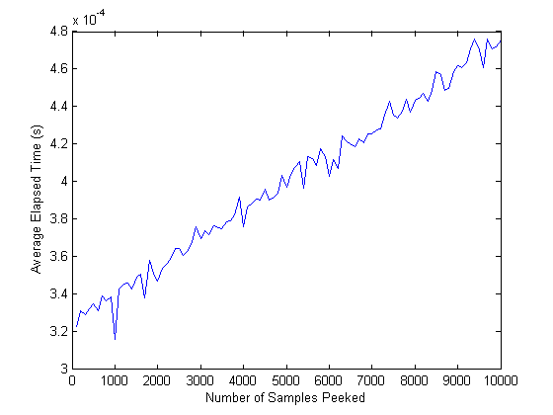
Data Acquisition Speed Issue

Slide 15

FwdCorrelation_Freemap

