Slide 1

Basic Details of the Team and Problem Statement
Registration No:
Problem Statement Title: AI Doctor
Team Name: Hustler
Team Leader Name: Anurag Kumar
Institute Code: 1023
Institute Name: Poornima College of Engineering
Theme Name: Health Tech

Slide 2
Problem Statement
Problem description:
Patient are increasing as per the doctors availability: The increasing number of patients per available doctor can have several implications for healthcare systems and patient care.
Lack of doctor and hospital availability due to time constraints and location constraints: Longer wait times for patients including Increased workload for doctors have seen now a days.
Limited financial and time resources: As demand for healthcare services increases, healthcare costs may also increase, which can be a significant financial burden for patients.
Lack of Report Prescription Reading: When medical reports and prescriptions are not read or interpreted accurately, it can lead to misdiagnosis, delayed treatment, or inappropriate treatment.
Lack of diversity in data: Most disease prediction and doctor recommendation systems are developed using data from a specific population, which may not be representative of the broader population.
Time Consuming Waiting Queue : The process of appointment till test report and non availability of doctors can lead to time consuming issue
Ethical Concern: There are ethical concerns surrounding the use of patient data in disease prediction and doctor recommendation systems, particularly with regards to privacy and security.
Accuracy of the model: Need a generalized solution for the best accuracy.

Slide 3
Problem Statement
Business Oriented Future Scope:

Slide 4
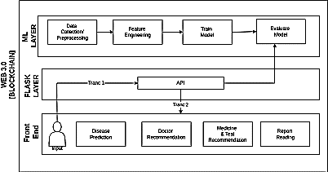
Idea/Approach Details
A web-based platform that uses machine learning algorithms and natural language processing to analyze patient health data and recommend appropriate doctors and prescriptions including medical report reading, based on the symptoms and reports of a patient.
The platform would integrate with electronic health records and other medical databases to collect patient data to train the model for better accuracy.
Once a disease is predicted, the platform would recommend appropriate doctors specialization, test and medicine prescription in a secure shell using blockchain technology.
The platform will provide the medical report reading in the common language along with the severity.
The algorithms used in the platform would be regularly updated and refined based on new data and feedback from healthcare providers and patients.
Describe your Technology stack here:
Back-end: Machine Learning Model
Front-end: React-JS
APIs: Flask
Framework: Web 3.0

Slide 5
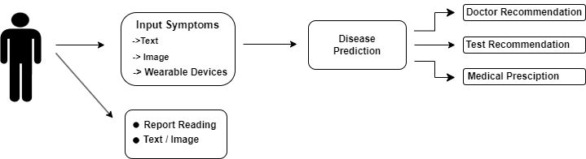
Idea/Approach Details
Working :-
User can login into the system.
Symptoms can be entered by the user in the form of text, image and can be collected from wearable device directly.
User can input the medical report for the better clarity of the reading.
System will predict the disease , give option to check for doctor recommendations , prescribe relevant test and medicine.
1. User enter the symptoms:-text, images , wearable devices.
2. Now user gets description of the diseases.
3. After that , the model will recommend ‘Doctor’ , ‘Tests’ and ‘Medicines’ .

Slide 6
Idea/Approach Details
Working :-
User can login into the system.
Symptoms can be entered by the user in the form of text, image and can be collected from wearable device directly.
User can input the medical report for the better clarity of the reading.
System will predict the disease , give option to check for doctor recommendations , prescribe relevant test and medicine.

Slide 7
Team Member Details
Team Leader Name: Anurag Kumar
Computer Science (Btech) Stream (CSE) Year (III)
Team Member 1 Name: Ayush Baluni
Computer Science (Btech): Stream (CSE ) Year (III)
Team Member 2 Name: Ayush Jain
Computer Science (Btech): Stream (CSE) Year (III)
Team Member 3 Name: Bhavya Lohami
Computer Science (Btech): Stream (CSE) Year (III)

