Slide 1


Sramify
Empowering Work, Simplifying Workforce Solutions

Slide 2
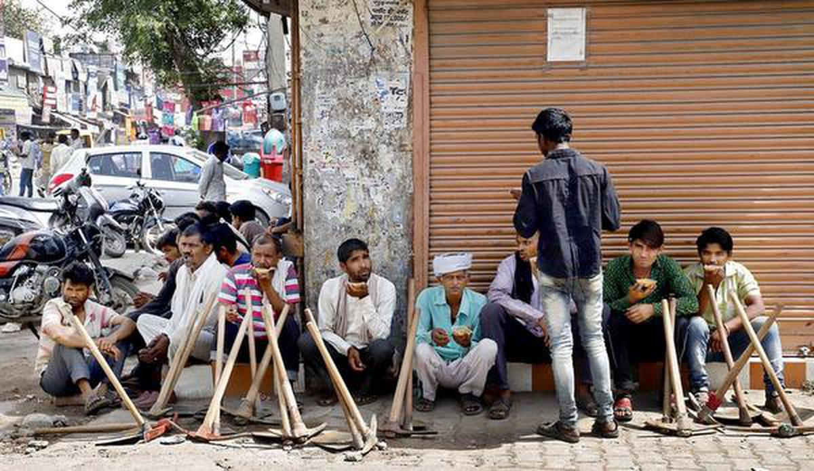
Labor chowk!!
Contractor
Ramu

Slide 3
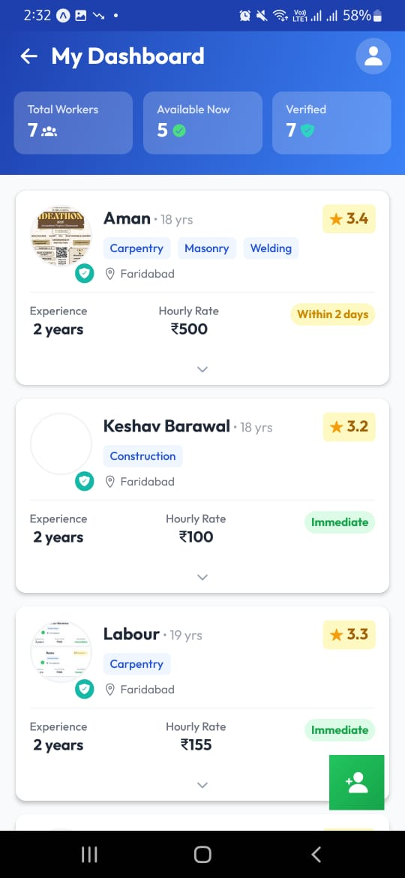
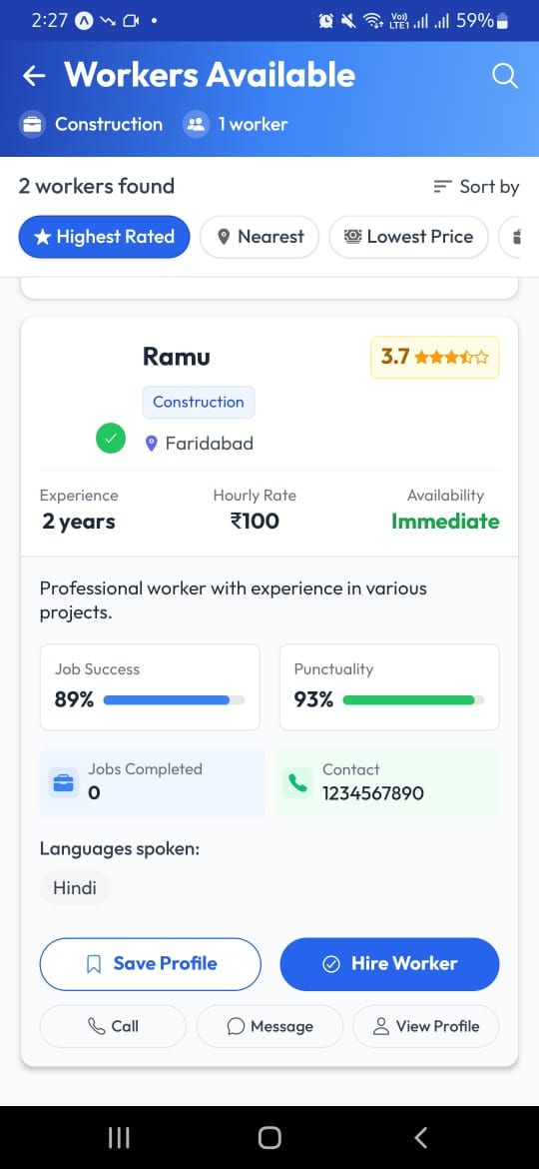
Sramify Labour chowk!!
Contractor workers!
Here is Ramu now in one click!

Slide 4

old way of heiring labors!
Bhai koi construction labor btaa ?
By reference
To hack tick to handle
No satisfaction
What if no neighbour?
Bhai uss thakedar se baat kr

Slide 5
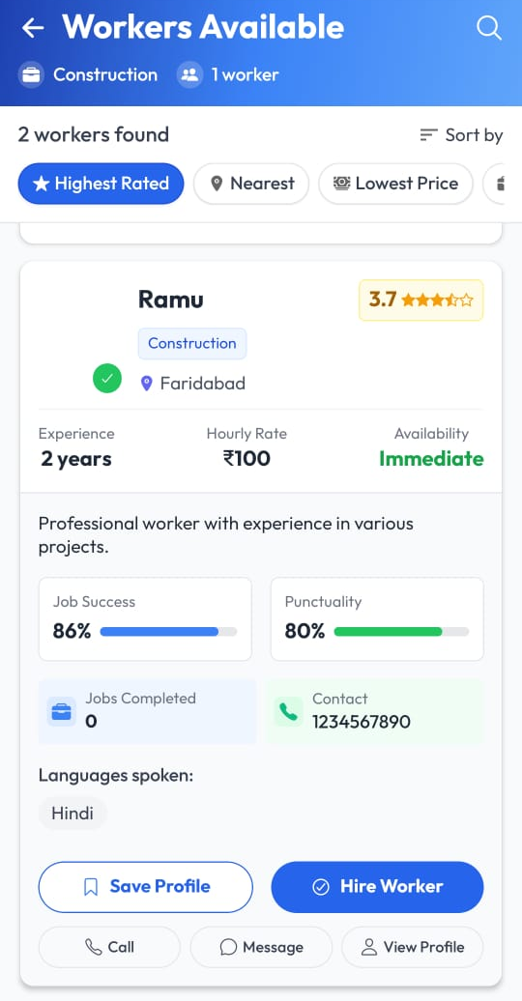
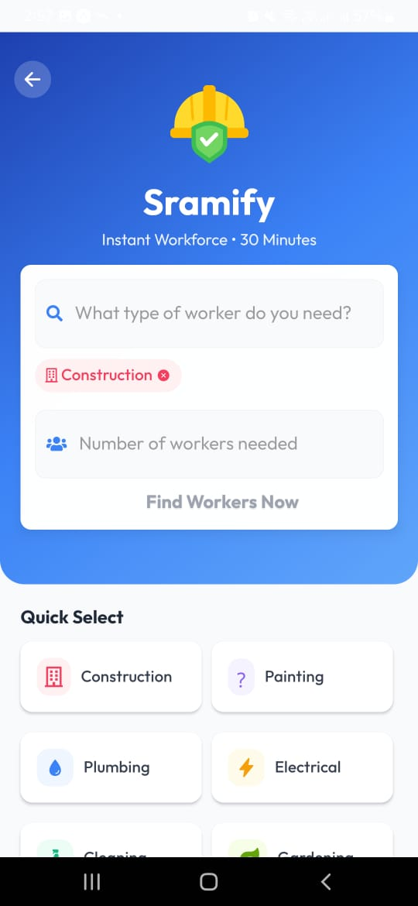
Sramify simplify the process in two three clicks!

Slide 6

Kya h ye Sramify??

Slide 7
Sramify?
Derived from the Sanskrit word "Śrama" (श्रम) meaning labor or effort, and the English suffix "-ify", which implies transformation, Sramify represents the evolution of the labor market through technology and accessibility.

Slide 8
What it do?
At Sramify, we bridge the gap between unskilled labour workers and job providers, making labor hiring fast, seamless, and efficient. Our platform empowers workers by providing them with better job opportunities while ensuring businesses and individuals get reliable manpower effortlessly.

Slide 9
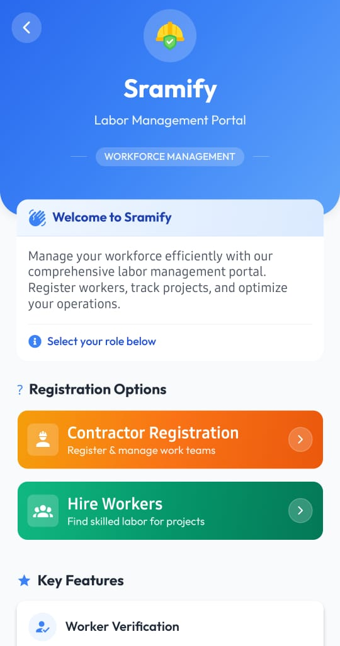
How we get labor?
Anyone can be contractor and register labor and get margin.
Contractor
Contractor registration
Labors

Slide 10
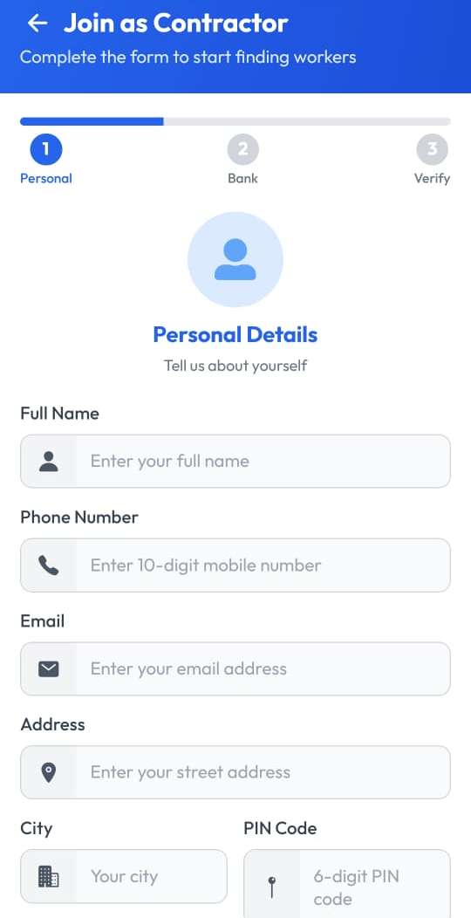
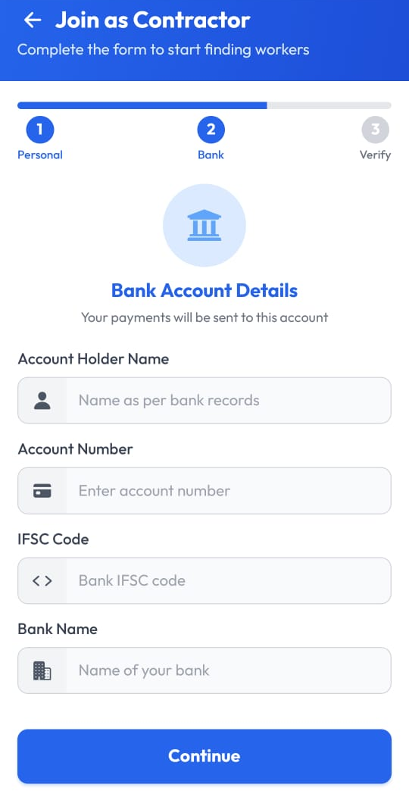
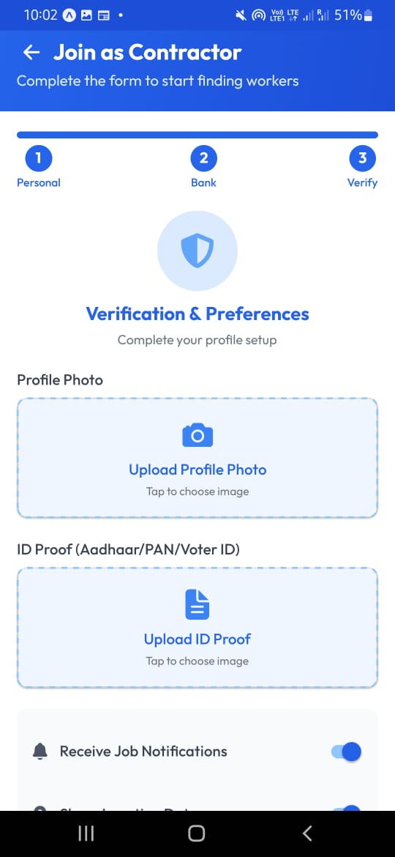
Effective joining in 3 steps?

Slide 11
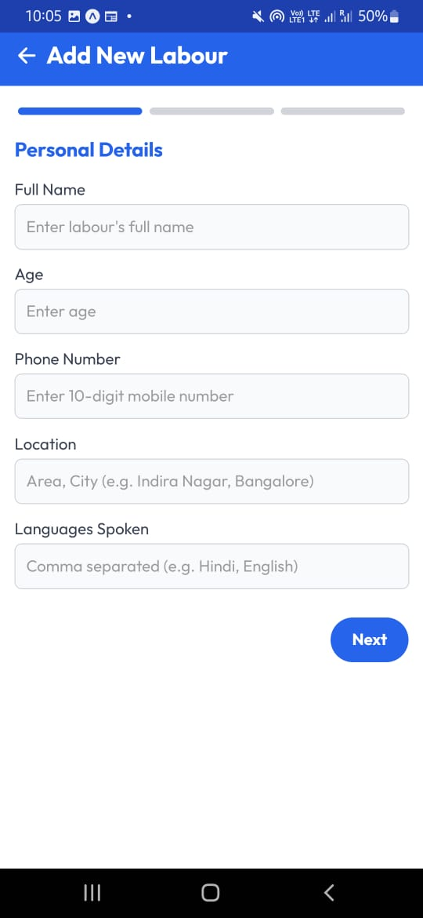

Contractor dashboard
Add new labors(contractor dashboard)

Slide 12
Market Penetration Playbook
Digital Marketing & Online Presence
Referral & Word-of-Mouth Marketing
Hyperlocal Marketing (Targeting Specific Areas)
B2B & Corporate Partnerships
Trust & Brand Building Strategies
Offline & On-Ground Activation
Influencer & Content Marketing
WhatsApp & Direct Marketing
Unique Launch Campaigns

Slide 13
Revenue model
Commission-Based Model (Core Revenue Stream)
Subscription Plans for Customers (Recurring Revenue)
Lead Generation Fees from Workers (Freemium Model)
B2B & Corporate Contracts (Bulk Hiring)
Ad Revenue & Featured Listings (Monetizing Visibility)
Training & Certification Fees (Upskilling Workers)
Microfinance, Loans & Insurance Partnerships (FinTech Play)
Tool & Equipment Rentals for Workers
Loyalty & Rewards Program (Retention & Upselling)
Surge Pricing During Peak Demand (Dynamic Pricing)

Slide 14
trust issues
Referral-Based Trust System: Let users hire based on recommendations from neighbors or friends within the platform.
Video Verification & Ratings: Allow customers to see a brief video introduction of workers to build trust.
Loyalty Points for Workers: Reward good workers with points they can redeem for discounts on medical checkups, transport, or food.
In-App Worker Tracking & Live Updates
Worker Insurance & Liability Coverage
Strict Worker Verification & Background Checks : workers associated to some shop or contractor

Slide 15
How we see ourselves as in better position as compared to competitors :-
Referral-Based Trust System: Let users hire based on recommendations from neighbors or friends within the platform.
Flexible Work Model & Subscription Plans
On-Demand & Subscription-Based Services: Unlike Urban Company, you can offer flexible work—one-time, part-time, or full-time hiring options.
Household Staff Subscription: Monthly plans for regular housemaids, cooks, or babysitters with automated replacements in case of absenteeism.
WhatsApp Booking & Voice Search: Make booking seamless via simple messages or voice commands.
Government Collaboration & CSR Partnerships: Work with municipal bodies to provide verified workers, creating an added trust factor : for building trust among customers

Slide 16
Replacement Guarantee: Quick replacements if the worker doesn’t meet expectations.
Exclusive Tie-Ups with Apartment Societies: Collaborate with housing societies to provide pre-verified workers.
On-Ground Activation: Local Events, Job Fairs & Registration Drives
Lower Commission & Higher Earnings for Workers

