Slide 1
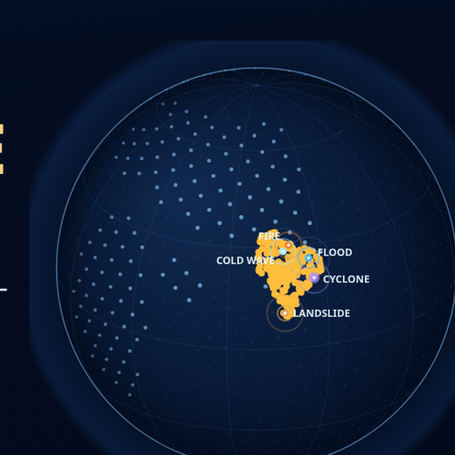
SPACE OUT — SPACE INNOVATION IDEATHON 2026 · ROUND 1
EARTHPULSE
INDIA
One Portal. Five Disasters. Live, Verified — In Your Language.
A live disaster-information platform for India — five dedicated websites, official data, speaking assistants and a safety system that never sleeps.
TEAM PROJECT SENTINEL
LIVE 3D GLOBE — ROTATING MODEL

Slide 2
THE PROBLEM
When Disaster Strikes, Information Saves Lives
▸
Scattered sources. Every hazard's official data lives on a different portal, in a different format — fire, flood, cyclone, landslide and cold wave are never seen together.
▸
Language gap. Warnings are published in one or two languages, while the people at risk speak many more — so alerts often never truly reach them.
▸
Old news, shared as live. Outdated reports are forwarded as if they were happening now, creating panic in one place and silence in another.
▸
No single live picture. There is no one place that shows what is happening across India right now — verified, dated and in your language.
5
13
1
major hazards, every year
languages on the platform
portal for all of India

Slide 3
THE IDEA
EarthPulse India — One Portal, Five Dedicated Websites
A single sign-in opens a portal of five focused websites — one per hazard — each with its own live data, maps, verified history and a speaking assistant that knows only its own disaster, deeply.
EARTHPULSE INDIA PORTAL
▼
🔥
🌊
⛰
❄
🌀
FOREST FIRE
FLOOD
LANDSLIDE
COLD WAVE
CYCLONE
Assistant: Agni
Assistant: Jal
Assistant: Bhumi
Assistant: Him
Assistant: Vayu
Live satellite hotspots
River levels & warnings
Risk forecasts & alerts
IMD cold-wave warnings
Storm tracking & landfall

Slide 4
INSIDE THE PLATFORM
What Each Website Carries
Agni — Forest Fire
Live NASA satellite hotspots on a 3D globe, fire history since 1979, spread awareness.
Jal — Flood
Central Water Commission river levels, warning and danger stations, flood archive since 1908.
Bhumi — Landslide
GSI risk forecasts with rainfall triggers, district alerts, verified landslide records.
Him — Cold Wave
IMD cold-wave warnings, minimum-temperature tracking, protection guidance.
Vayu — Cyclone
IMD / RSMC storm tracking, landfall forecasts, cyclone history since 1971.
275 VERIFIED HISTORICAL RECORDS · EVERY RECORD CITES ITS SOURCE · LIVE 3D GLOBE + 2D ARCHIVE MAPS

Slide 5
THE LIVING GLOBE
A Globe That Shows Only What Is Happening Now
▸
Live means live. The home globe shows only the present — for forest fire, detections from the last 24 hours, each with its date, time and age.
▸
Calm when safe. When nothing is happening, the globe stays calm. Old records never appear on it — a quiet globe itself is information.
▸
History lives elsewhere. The past is preserved on a separate 2D archive map, so 'now' and 'then' are never confused.

Slide 6
ASSISTANCE & SAFETY
Assistants That Speak Your Language
▸
Five specialists. Each website has its own assistant — Agni, Jal, Bhumi, Him and Vayu — trained on its own hazard's data.
SOS — SAFETY FIRST
▸
Glows ONLY on a genuine, live, life-risk signal — and names the place at risk.
▸
13 languages. The whole website and the assistant switch instantly — including right-to-left Urdu.
▸
One tap opens big helpline numbers — tapping a number calls immediately.
▸
Voice, both ways. Ask by speaking; answers are read aloud, with a mute control always in reach.
▸
112 · 108 · 101 · 100 · 1078 — with a siren and a clear mute control.
▸
Real conversations. Follow-up questions are understood, and records arrive as tappable chips.

Slide 7
DATA SOURCES
Where the Data Comes From
FOREST FIRE
NASA FIRMS — satellite hotspots from VIIRS & MODIS instruments
FLOOD
Central Water Commission — river-level bulletins, warning & danger stations
CYCLONE
IMD / RSMC New Delhi — cyclone tracks, forecasts and landfall warnings
LANDSLIDE
Geological Survey of India forecasts, combined with IMD rainfall
COLD WAVE
India Meteorological Department — cold-wave warnings
Honesty rule: every record is verified against its source before it is added, and every record panel carries a “Source — read the original report” button. Event media is credited, or honestly noted when none exists.

Slide 8
AUTOMATION
How the Website Updates Itself
1
2
3
4
5
OFFICIAL
SOURCES
›
AUTOMATIC FETCH
›
VALIDATION
›
PUBLISH
›
LIVE WEBSITE
NASA · CWC · IMD · GSI
Every 6 hours, on schedule
Checked before publishing
Live layers refreshed
Always current, always dated
▸
Only live layers refresh. The historical archive is never auto-edited — new records are added only after source verification.
▸
Failure-safe. If a source is down, the previous data stays — with its date clearly shown. Nothing is ever guessed or fabricated.

Slide 9
USER ACCOUNTS
Sign Up Once — Built to Scale to Millions
▸
One account, every device. Sign up once with an email and password — the same account works on phone, laptop and desktop.
WHY IT SCALES
▸
Runs on Google's cloud infrastructure — the same system serves a hundred users or millions, with no redesign.
▸
Where the data lives. Firebase Authentication manages sign-ins; profiles are stored in Cloud Firestore, region asia-south1 (Mumbai).
▸
Private by design. Security rules guarantee every user can access only their own account data — accounts stay private even with millions of users.
▸
Starts on the free tier; capacity grows automatically with demand.
▸
Effortless recovery. Forgot your password? A reset link arrives by email — no support desk needed.

Slide 10
ACCESS FOR ALL
Built for Every Phone in India
▸
Installable app, zero cost. EarthPulse installs as an app (PWA) from the browser — no Play Store, no fees, straight to the home screen.
▸
Android and desktop. One tap on the dashboard's Download App button installs it on Android phones and desktop Chrome alike.
▸
13 languages. Every screen and every assistant speaks the user's language — including right-to-left Urdu.
▸
Honest on slow networks. If map data hangs on a weak connection, the map retries by itself instead of staying blank.
▸
Help in one tap. From the SOS screen, helpline numbers are large and tappable — one touch starts the call.

Slide 11
IMPACT & ROAD AHEAD
Why It Matters
TODAY
ROAD AHEAD
▸
In a disaster, minutes decide outcomes — verified information must arrive first.
▸
More hazards — earthquake and heatwave editions of the same platform.
▸
One trusted, always-current place for every Indian, in their own language, free forever.
▸
District-level personalised alerts for signed-in users.
▸
Built and verified on real phones, on real networks — not just in a lab.
▸
Offline alert caching for areas with the weakest connectivity.

Slide 12
THANK YOU
Team Project Sentinel
Keshav Yadav
Jay Agrawal
Gagan Laur
Kapil Kumar
Team Leader
Team Member
Team Member
Team Member
EARTHPULSE INDIA — LIVE NOW
keshuyadav0946.github.io/earthpulse-india
SPACE OUT — Space Innovation Ideathon 2026

