Slide 1
Bike Sharing Demand Analysis Project
Kinjal Joshi
Next hikes IT Solutions
Automated Dashboard & AI Forecasting in Excel

Slide 2
1. Project Overview
The project analyzes and forecasts bike-sharing demand using Excel-based automation. It combines data cleaning, dashboard creation, macro scripting, and AI-driven forecasting to deliver a dynamic, auto-updating business intelligence tool.

Slide 3
2. Objectives
Clean and prepare raw data
Create pivot-based dashboards with KPIs
Automate slicers, refresh, and export
Forecast demand using Excel AI tools
Deliver a dynamic report with insights
Apply VLOOKUP, INDEX, MATCH to link and extract data from tables.
 |  | Instant | atemp
 |  | 500 | 0.1061

Slide 4
3. Data Cleaning & Preparation
- missing value via average formula
- Filtered invalid entries
- Created derived columns: hour, weekday, season
- Ensured consistent data types
- COUNTIF, SUMIF, STDEV, CORREL functions for statistics.
Result: Clean dataset ready for analysis
summary sheet
Advanced Analysis or Statistics
countif(cnt>100) | 170
sumif(weekend cnt) | 16571
stdv of cnt | 50.9855579
correlation(temp vs cnt) | 0.19244115

Slide 5
4. Dashboard Design
- Developed on 'Live Dashboard' sheet
- Interactive slicers: season, weather, weekday
- Charts: Hourly, user-type demand
- KPI Cards: Total Rentals, Avg/Day, Top Hour
- AI-based forecast chart

Slide 6
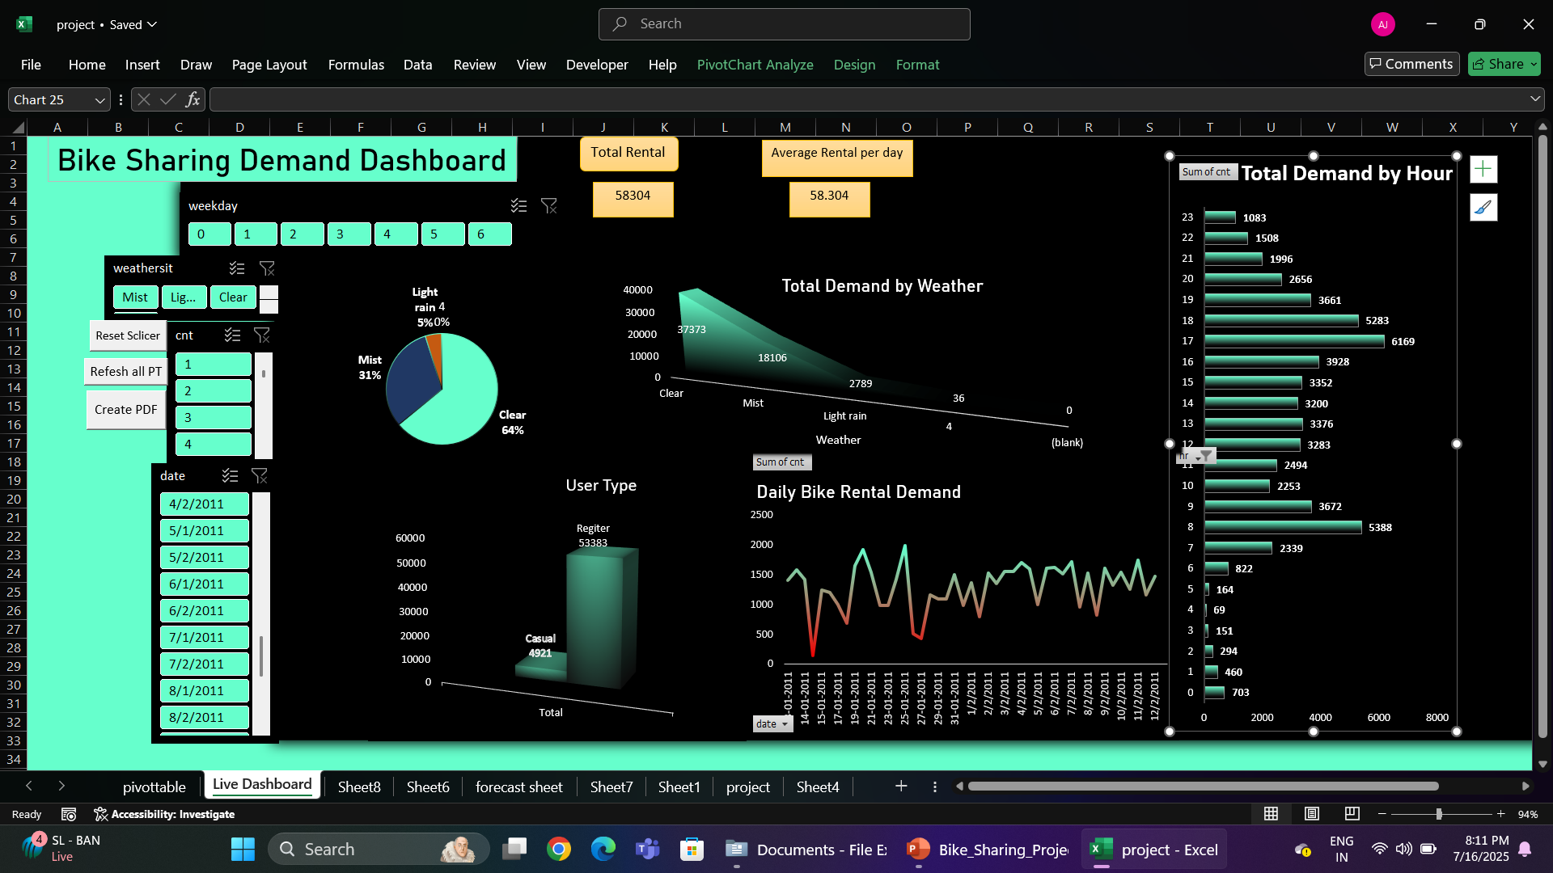

Slide 7
5. Key Metrics and Insights
- Total Rentals: 58,304
- Avg/Day: ~58.3
- Registered users: peak weekdays
- Casual users: dominate weekends
Weather & Season impact observed clearly

Slide 8
6. Forecasting & AI Analysis
Tool: Excel Forecast Sheet (AI-based)
Forecasted demand for future dates
Auto-generated: Trendline, Confidence interval
Seasonal trend detected: higher rentals in spring/summer

Slide 9
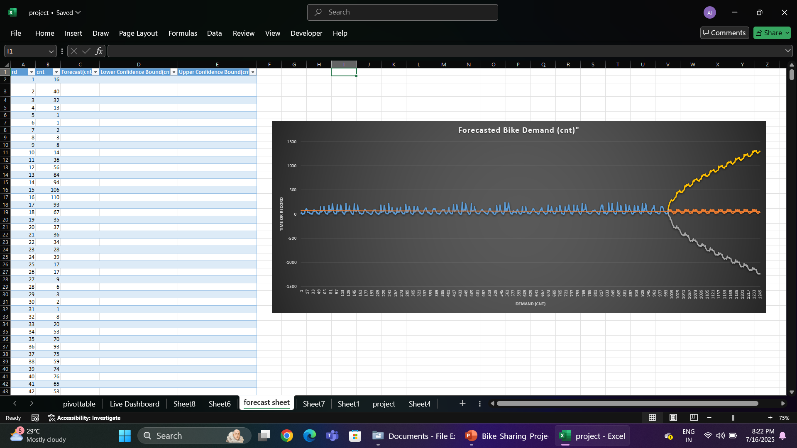

Slide 10
7. Automation with VBA
Three main macros:
1. ResetSlicers – resets all filters
2. RefreshAllPivots – updates pivots automatically
3. ExportDashboardAsPDF – saves dashboard as PDF
All buttons added for single-click execution

Slide 11
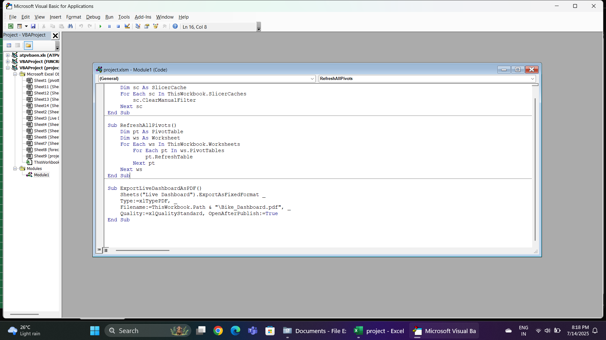

Slide 12
8. Anomaly Detection
- Visual anomaly detection via:
- Forecast bounds
-Conditional formatting
- Spike/dip monitoring
- Supports smarter decision making

Slide 13
9.Challenges & Fixes
Macros disabled: Trust settings required
Sheet freeze issue: fixed using object model correction
KPI link break: fixed using GETPIVOTDATA
Automation error: fixed using On Error block in VBA

Slide 14
10. Final Output Files
project.xlsm: Final Excel file (dashboard & macros)
Dashboard.pdf: Auto-generated report
Forecast Sheet: AI-generated future demand
VBA Code: Included inside the file/module

Slide 15
11. Recommendations
- Incentivize off-peak ride usage
- Target casual users on weekends
- Expand during Spring/Summer
- Monitor anomalies with dashboards

Slide 16
12. Conclusion
Excel can act as a complete BI tool combining:
- Data Cleaning
- Visualization
- Automation with VBA
- AI-driven Forecasting
Final project Ready for automotation mode
Result: Interactive, auto-updating, decision-making tool

