Slide 1





2014 Accelerator Rankings
YAEL HOCHBERG
SUSAN COHEN
DANIEL FEHDER
Entrepreneurship Professor, Rice University
Research Scientist, MIT Innovation Initiative
Management Professor, University of Richmond
PhD Candidate, Massachusetts Institute of Technology
Notes:
Who is SARP?vvv
former entrepreneurs, now academics
Yaelvwvv
Entrep prof at Rice U., formerly Kellogg, Johnson/Cornellw
Academic director of Rice alliance
Research associate MIT Sloan
Susan
Management prof at U. Richmondwv
Co-director of entrep and innovation program at Urich
Dan
PhD candidate at MIT

Slide 2
“ The goal of
is to start a larger conversation about the accelerator phenomenon, its effects, and its prospects for the future…”
#sEEDRANK
YAEL HOCHBERG
SUSAN COHEN
DANIEL FEHDER
@YAELHOCHBERG
@SUSLEEC
@DFEHDER
Notes:
Who is SARP?vvv
former entrepreneurs, now academics
Yaelvwvv
Entrep prof at Rice U., formerly Kellogg, Johnson/Cornellw
Academic director of Rice alliance
Research associate MIT Sloan
Susan
Management prof at U. Richmondwv
Co-director of entrep and innovation program at Urich
Dan
PhD candidate at MIT

Slide 3

AC·CEL·ER·A·TOR
fixed-term, cohort-based program, including mentorship and educational components, that culminates in a public pitch event or demo-day.
Many, though not all, provide a stipend or small seed investment, and some receive an equity stake in the portfolio company
Most offer co-working space and other services in addition to mentorship, educational and networking opportunities
Some also offer a larger, guaranteed investment
≠
INCUBATOR
Notes:
Emphasize COHORT BASED – start-ups enter and exit together.
Verbal – usually 3 – 4 months long
Incubator ad hocv
Shelter startups from harsh realityv
Accelerators focus more on early adaptation to the environment – finding fit is key, short programs force entrepreneurs into the real world quickly

Slide 4
2014 criteria for inclusion
Meet the definition of accelerator
Have graduated at least one cohort
Have at least 10 graduates
U.S.–based
Willing to provide full transparency
WE INVITED WELL OVER 150 PROGRAMS TO PARTICIPATE
Notes:
Ultimately, we evaluated XX programs that meet the qualification criteria, and could provide data on the performance of their portfolio companies
** something about confidentiality? Data that was provided as input?

Slide 5
Some Interesting things stand out

Slide 6


Established programs transitioning to other models
EVOLVING INTO SEED FUNDS
Notes:
*** Need better transition from data collection / program inclusion to here.
***Maybe a title slide that says something like, why you won’t see yc … and others … on the list? “Or before we get to the data …
Redefining as seed funds
w

Slide 7
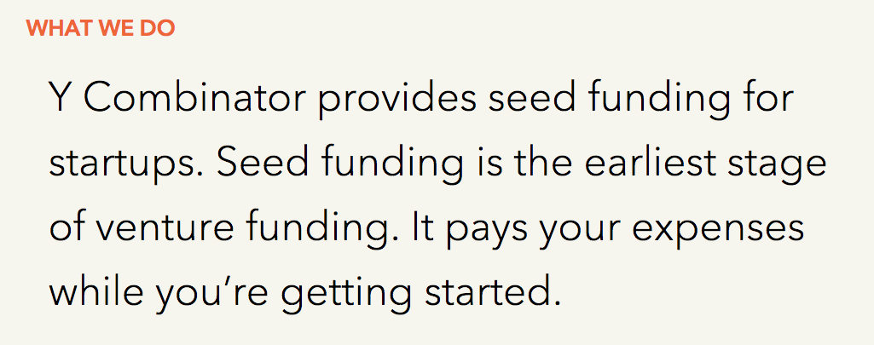
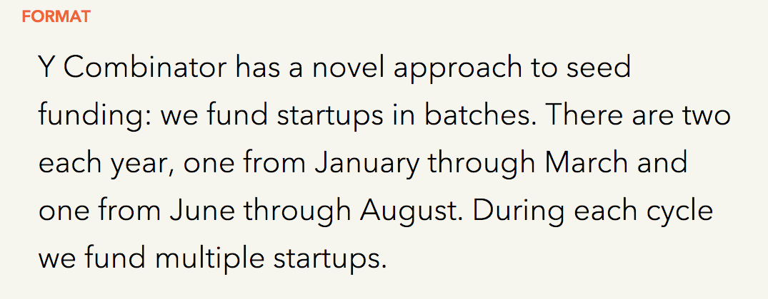
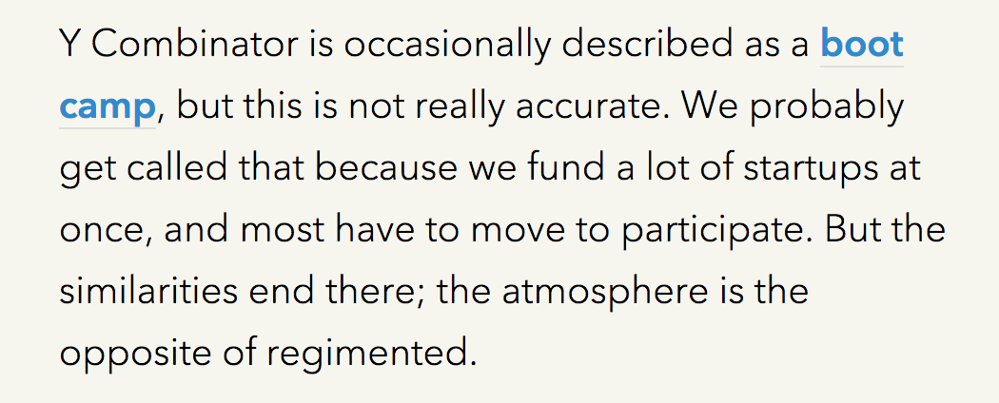
Notes:
LEIGH: Try and use captures from the website rather than re-typing – makes it more legit. www.ycombinator.com/about/
The point of the slide is that Y Combinator is a seed fund and not an accelerator or boot camp. Sample screen grabs are inserted here, but
- Could you try to add legitimacy, maybe showing a pull out from a full webpage? (pop out)

Slide 8
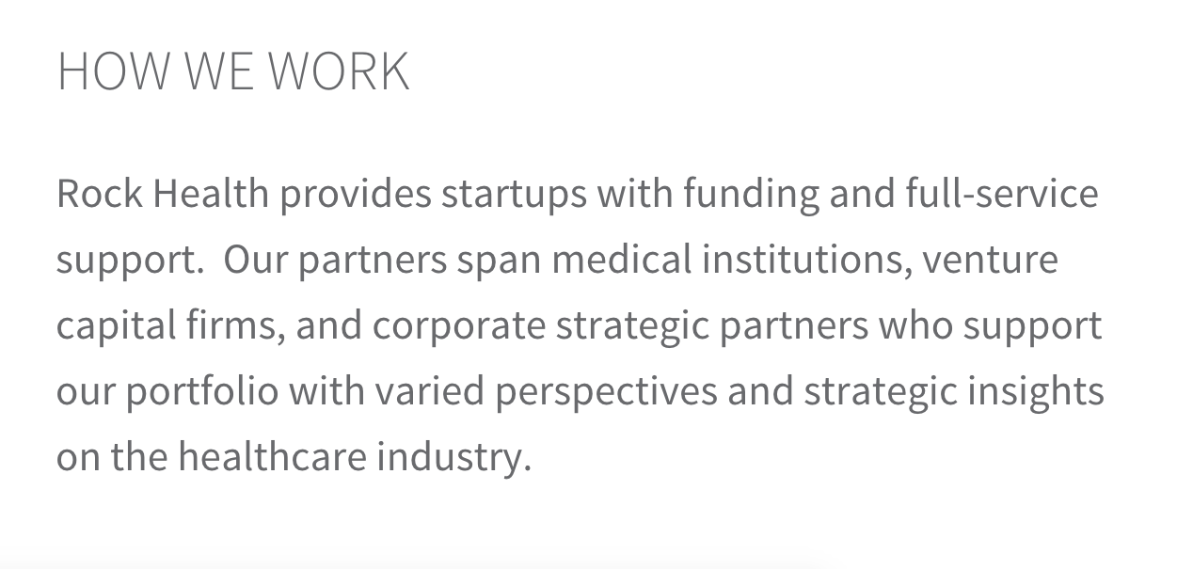
“Rock Health is not an accelerator. We're a seed fund focused on making investments and supporting early stage digital health founders.”
-MITCHELL MOM, ROCKHEALTH
Notes:
LEIGH: Same as previous slide, website is www.rockhealth.com vwvvvv

Slide 9

This isn’t a statement about efficacy!
YC STILL HAS HIGHEST SATISFACTION SCORES AMONG ITS PRIOR GRADUATES OF ALL PROGRAMS IN OUR SURVEY OF ENTREPRENEURS
Notes:
Based on 2013 data, YC would still top the list if they had kept the accelerator model.
Plus a Capital factory quote
Just because our programs…v

Slide 10
EXPANDING SCOPE
POWERED BY “TECHSTARS”
ESTABLISHMENT OF SIDE-FUNDS
COMPLIMENTARY SERVICES, SUCH AS CODE ACADEMIES, INCUBATORS
Notes:
This could be under variation w/in the model …
More than just accelerators
Sidefund: established alongside
Service organizationsvv

Slide 11





MANY PROGRAMS DON’T LAST FOR MORE THAN ONE OR TWO COHORTS
Lots of deaths…
and many more…
Notes:
- Names of programs, logos:
WIM
I/O ventures
Nextstart
Joystick labsvw
KYNv
NextStart
- “and many more”w

Slide 12





Network Expansion
THROUGH PROGRAM ACQUISITION OR MERGER
THROUGH FRANCHISING/ORGANIC EXPANSION
Notes:
Logos instead of names
Tecchstars acquired excelerate and springboard
Multiple locations
IronYard
v

Slide 13








Vertical Specialization
STANDALONE ACCELERATORS
WITHIN NETWORKS
ENERGY
HEALTH
HARDWARE
REAL ESTATE
AGRICULTURE
Notes:
-replace w/ logos
Standalone acceleratorsw
Surge (Energy)
Healthbox (Health)
Highway1 (Hardware)
REach (real estate)
Yield Lab (agriculture)
ZeroTo510 (Medical Device)
Within networks
DreamIt Health
Techstars Cloud
AlphaLab Gear (hardware, robotics, connected devices and physical products )

Slide 14






Corporate Accelerators
INTERNAL ACCELERATORS
OUTSOURCED ACCELERATORS
PARTNERED ACCELERATORS
Notes:
No logos, just words
Internal accelerators
MSFT, Wayra
Outsourced accelerators
Disney, Barclays, Kaplan EdTech
Partnered acceleratorsv
Citrix & RedHat

Slide 15
So, ABOUT THOSE RANKINGS…
DATA, DATA, DATA….
….provided at a detailed level by the programs under strict confidentiality
We have one of the most comprehensive and detailed datasets on accelerators to date.

Slide 16
How do we rank programs?
VALUATION
FUNDRAISING
EXITS
SURVIVAL
SATISFACTION
1.
2.
3.
4.
5.
QUANTITATIVE MEASURES IN 5 CATEGORIES
Notes:
XX quantitative measures in 6 categories
Valuation
Fundraising
Exits
Survival
Satisfaction
Network

Slide 17
Valuations
AVERAGE AND MEDIAN VALUATIONS
1. CONDITIONAL ON RAISING A PRICED ROUND OR EXIT
Of course, this does not fully reflect the valuation the average or median entrepreneur entering the program eventually achieves…
2. ACROSS ALL PORTFOLIO COMPANIES
This, of course, treats companies that raised money through a convertible note, or companies that never raised, as if they have zero valuation… which is not necessarily true…
TO MAKE AN APPLES-TO-APPLES COMPARISON, WE MEASURE VALUATIONS AT 1, 2, AND 3 YEARS OUT FROM GRADUATION
Notes:
But if we take the number of firms into consideration, either by looking at the average or the median, the results change.
YAEL>>> another way to do this is to divide by the number of ventures, and then the number of years (average valuation per firm/year – we’d expect a 4 year old firm to be valued higher).
Average valuation at 1, 2, 3 years out from program, conditional on being alive and having a valuation
Average valuation at 1, 2, 3 years out from program, unconditional across the portfolio (including zeros and dead companies).
Reverse order

Slide 18
Exits
Everyone has
their Eyes
on the prize…
But is it
too soon
to tell?
Notes:
And do a few big exits really mean that the accelerator is best?
Do you want to explain about endogeneity??????
In lay man terms, I’d say, might be that some start-ups are so great, that it is their greatness that matters – not the accelerator that they attend.
- 6-7 years

Slide 19
Exits
Historically, average seed stage VC investment takes 7-9 YEARS to achieve successful exit
Most accelerators were founded in the last 6 YEARS
Average accelerator in the sample is less than 4 YEARS OLD
Notes:
Time will tell….
…..but let’s see what we’ve got to date

Slide 20
MEANINGFUL EXITS
% of Companies with meaningful exit ($5M+)
AVERAGE VALUATION (ACROSS ALL EXITED COMPANIES)
Notes:
What is success? Selling for more capital than you raised? Selling for an amount that has a significant effect on founders’ wealth? Are Acquihires a “successful exit?”
ADD AVERAGE START-UP AGE AT EXIT?

Slide 21
Not every startup needs external investors…
But mOST of the ones that go through an accelerator do.
Notes:
And do a few big exits really mean that the accelerator is best?
Do you want to explain about endogeneity??????
In lay man terms, I’d say, might be that some start-ups are so great, that it is their greatness that matters – not the accelerator that they attend.

Slide 22
fundraising
Average $$ Raised
% That Raised $$
Median $$ Raised
Raised significant financing (> 250K)
Doesn’t include guaranteed funding from accelerator or affiliated fund
1, 2, 3 YEARS AFTER PROGRAM
CONDITIONAL ON RAISING, AND UNCONDITIONAL

Slide 23
Survival
% Still Operating (or ACQuired)
ACCELERATORS
STARTUP
TRAJECTORY
BUT IF YOU ARE GOING TO FAIL, MAYBE IT IS BETTER TO FAIL FAST…
…AND AN ACCELERATOR MAY HELP YOU IDENTIFY FAILURE FASTER.
INCUBATORS
TIME
ACCELERATE TO ESCAPE VELOCITY…. OR FAIL/PIVOT FAST

Slide 24
SO IS IT WORTH IT?
Alumni satisfaction
WE ASKED THE ENTREPRENEURS WHAT THEY THINK.

Slide 25
WOULD YOU REPEAT?
WOULD YOU RECOMMEND TO OTHERS?
NET PROMOTER SCORE = % PROMOTERS - % DETRACTORS
HOW LIKELY IS IT YOU WOULD RECOMMEND THE PROGRAM TO A FRIEND/ANOTHER ENTREPRENEUR?
10 | 9 | 8 | 7 | 6 | 5 | 4 | 3 | 2 | 1 | 0
PROMOTERS
PASSIVES
DETRACTORS

Slide 26
Next Step:
Standardize measures along a normal distribution
Score within categories
Weight the categories
Compute a composite score
We do further adjustments for stage of companies at entrance to the accelerator and preciseness of measurement (confidence intervals)

Slide 27
SOME OVERALL STATS
ACROSS ALL THE STARTUPS IN OUR SAMPLE
92.2% would repeat the same program
Only 2.1% have had a MEANINGFUL exit
76.4% have raised significant $$ TO DATE
Notes:
And do a few big exits really mean that the accelerator is best?
Do you want to explain about endogeneity??????
In lay man terms, I’d say, might be that some start-ups are so great, that it is their greatness that matters – not the accelerator that they attend.

Slide 28
SOME OVERALL STATS
28% OF COMPANIES WERE ACCEPTED TO MULTIPLE ACCELERATOR PROGRAMS
Notes:
Becoming more competitive for accelerators ….

Slide 29
SO WHO’S ON TOP?
Notes:
- Notable programs within verticals

Slide 30

AND THE WINNERS ARE….
11 | Surge
12 | MassChallenge
12 | The Brandery
14 | Gener8tor
15 | ZeroTo510
16 | AlphaLab
17 | BlueStartups
18 | ERA
19 | BetaSpring
20 | IronYard
Notes:
20 logos and #s

Slide 31
10
LOCATION: VARIOUS
#COHORTS/YEAR: 3
DIFFERENTIATORS
ALUMNI SATISFACTION
VALUATIONS
ALUMNI SAY
“ EXCELLENT COMMUNITY BUILDING, NETWORKING AND SKILL DEVELOPMENT. OVERALL A PHENOMENAL EXPERIENCE.”
Notes:
ADD LOGO OF #10 ON SLIDE.

Slide 32
LOCATION: ST. LOUIS
#COHORTS/YEAR: 2
DIFFERENTIATORS
ALUMNI SATISFACTION
SURVIVAL
ALUMNI SAY
“ THIS FAR EXCEEDED ANY OF MY EXPECTATIONS, THE MENTORS, THE TRAINING, AND THE EXPERTISE WERE AMAZING. MY VALUATION TRIPLED AT THE END OF THE PROGRAM.”
9
Notes:
ADD LOGO OF #10 ON SLIDE.

Slide 33
LOCATION: MOUNTAIN VIEW
#COHORTS/YEAR: 2
DIFFERENTIATORS
ALUMNI NETWORK
VALUATIONS
ALUMNI SAY
“ 500 STARTUPS IS VERY BENEFICIAL TO STARTUPS NEW TO THE US STARTUP ECOSYSTEM. THEY HAVE A LARGE NETWORK AND THE 500 STARTUPS MODEL HELPS TEAMS MAKE THE CONNECTIONS THEY NEED.”
8
Notes:
ADD LOGO OF #10 ON SLIDE.

Slide 34

LOCATION: LOS ANGELES
#COHORTS/YEAR: 3
DIFFERENTIATORS
EXIT SIZE
VALUATIONS
ALUMNI SAY
“ THE TEAM BEHIND AMPLIFY LA HAS BEEN INSTRUMENTAL IN ALL ASPECTS OF THE BUSINESS, FROM HELPING US CLOSE THE FINANCING ROUND TO ESTABLISHING A CORE TEAM AND HELPING US DRIVE PRODUCT DEVELOPMENT EFFICIENTLY.”
7
Notes:
ADD LOGO OF #10 ON SLIDE.

Slide 35

LOCATION: PALO ALTO
#COHORTS/YEAR: 2
DIFFERENTIATORS
ALUMNI SATISFACTION
FUNDING
ALUMNI SAY
“ STARTX WAS AWESOME IN EV­ERY WAY: GREAT SUPPORT, GREAT MENTORSHIP, FREE OFFICE SPACE, CASH STIPEND, GREAT COMMUNITY, TONS OF CONNECTIONS TO POTEN­TIAL INVESTORS.”
6
Notes:
ADD LOGO OF #10 ON SLIDE.

Slide 36

LOCATION: SANTA CLARA
#COHORTS/YEAR: 1
DIFFERENTIATORS
SURVIVAL
VALUATIONS
ALUMNI SAY
“ MASSIVELY IMPROVED ABILITY TO FUNDRAISE AND SELL TO ENTERPRISES. VERY HELPFUL, GREAT CLASSMATES, GREAT CONNECTIONS TO INVESTORS, CUSTOMERS AND INDUSTRY EXPERTS.”
5
Notes:
ADD LOGO OF #10 ON SLIDE.

Slide 37

LOCATION: CHICAGO
#COHORTS/YEAR: 1
DIFFERENTIATORS
EXIT SIZE
ALUMNI SAY
“ VERY STRONG MENTORSHIP, ECOSYSTEM AND EXPOSURE TO CUSTOMERS AND POTENTIAL INVESTORS.”
4
Notes:
ADD LOGO OF #10 ON SLIDE.

Slide 38
LOCATION: VARIOUS
#COHORTS/YEAR: 12
DIFFERENTIATORS
SURVIVAL
VALUATIONS
ALUMNI SAY
“ TECHSTARS PROVIDED US WITH EXCELLENT OPPORTUNITIES TO LEARN FROM KNOWLEDGEABLE FOLKS. IT ALSO PROVIDES US WITH CONNECTIONS AND CREDIBILITY TO FUNDRAISE QUICKLY AND PAINLESSLY.”
3
Notes:
ADD LOGO OF #10 ON SLIDE.

Slide 39

LOCATION: LOS ANGELES
#COHORTS/YEAR: 1
DIFFERENTIATORS
ALUMNI SATISFACTION
FUNDING
ALUMNI SAY
“ DELIVERS DEMONSTRABLE VALUE TO THEIR PORTFOLIO COMPANIES IN THE AREAS OF PRODUCT-MARKET FIT, TRACTION, AND FUNDRAISING.”
2
Notes:
ADD LOGO OF #10 ON SLIDE.

Slide 40

LOCATION: SAN FRANCISCO, NYC
#COHORTS/YEAR: 2
DIFFERENTIATORS
FUNDING
VALUATIONS
ALUMNI SAY
“ IF YOU WANT TO LEARN HOW TO FUNDRAISE, AND HOW THE SILICON VALLEY WORKS, THIS IS A FANTASTIC PLACE TO DO IT. COUPLE THIS WITH A GREAT GROUP OF PEOPLE AND YOU’VE GOT A WINNING MIX.”
1
Notes:
ADD LOGO OF #10 ON SLIDE.

Slide 41
AND THE WINNERS ARE….
1 | Angelpad | 11 | Surge
2 | MuckerLab | 12 | MassChallenge
3 | Techstars | 12 | The Brandery
4 | University of Chicago NVC | 14 | Gener8tor
5 | Alchemist | 15 | ZeroTo510
6 | StartX | 16 | AlphaLab
7 | Amplify.LA | 17 | BlueStartups
8 | 500 Startups | 18 | ERA
9 | Capital Innovators | 19 | BetaSpring
10 | Dreamit | 20 | IronYard
Notes:
20 logos and #s

Slide 42
IMPACT ON ECOSYSTEM
Our research shows that accelerator arrival in a region leads, on average, to a DOUBLING of VC funding events and a 13X INCREASE in the $$ amount of funding over the following 3 YEARS
2/3 of this increase goes to non-accelerator start-ups!

Slide 43
TOP 10 REGIONS WITH THE MOST-IMPROVED STARTUP FUNDING DUE TO ACCELERATORS
1. NEW YORK
2. LOS ANGELES
3. CHICAGO
4. PHILADELPHIA
5. PORTLAND
6. PITTSBURGH
7. DETROIT
8. ST. LOUIS
9. BOULDER
10. AUSTIN
Notes:
*** MAP IT?AND COMBINE WITH LAST SLIDE?

Slide 44
SOME PARTING THOUGHTS
PROGRAM EVALUATION IS A NON-TRIVIAL TASK
DATA, DATA, AND EVEN MORE DATA IS THE ONLY WAY WE WILL BE ABLE TO DETERMINE THE CONTRIBUTION OF ACCELERATORS
PROGRAMS SHOULD TRACK A WIDER SET OF OUTCOME VARIABLES
THERE IS NOT ONE SINGLE ULTIMATE WAY TO MEASURE SUCCESS
FIT IS IMPORTANT!!
Notes:
Thank you
To the MDs who provided the data and helped us understand their programs
To all of the accelerated companies that answered our survey

Slide 45
THANK YOU
TO ALL OF THE MDS AND THEIR STAFF WHO PROVIDED THE DATA AND HELPED US UNDERSTAND THEIR PROGRAMS
TO ALL OF THE STARTUPS THAT ANSWERED OUR SURVEY
Notes:
Data collection required herculean efforts from many, many people

Slide 46
More detail as well as these slides can be found at:
HTTP://SEEDRANKINGS.COM
YAEL HOCHBERG
SUSAN COHEN
DAN FEDHER
HOCHBERG@RICE.EDU
@YAELHOCHBERG
SCOHEN2@RICHMOND.EDU
@SUSLEEC
DFEHDER@MIT.EDU
@DFEHDER

