Slide 1
IKEV2(Strongswan)
Strongswan 5.6.0
RFC 7296 Internet Key Exchange Version 2
Adem Keskin

Slide 2
Insalliation
Download the source of strongswan
wget https://download.strongswan.org/strongswan-5.6.0.tar.gz
Extract tar file
tar -xvzf strongswan-5.6.0.tar.gz; cd strongswan-5.6.0
Build your source (if you encounter with any compile error fix it!)
./configure --prefix=/usr/local --enable-openssl
make ; make install
configure your ipsec.conf file (below is sample)

Slide 3
Insalliation
For further configuration please visit https://wiki.strongswan.org/projects/strongswan/wiki/connsection
Configure your ipsec.secrets file (below is content of whole file)
# ipsec.secrets - strongSwan IPsec secrets file
192.168.50.4 192.168.50.5 : PSK congkma
ipsec.secrets file is going to be used in Authentication in second message IKE_AUTH
Repeat all steps for another peer. (do not forget to switch IP’s in ipsec.conf and ipsec.secrets file!!)
Your executable(actually shell script) will be created named as ipsec

Slide 4
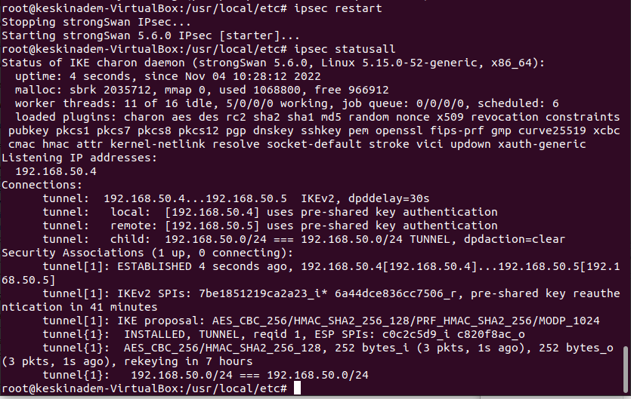
Execution
After installiation run ipsec start or ipsec restart to start communication. Then check if tunnel established via ipsec statusall. You would see as this output below:

Slide 5
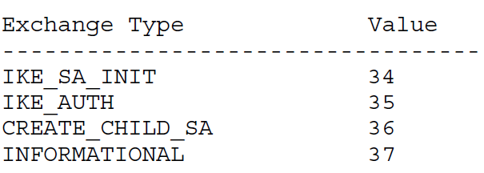
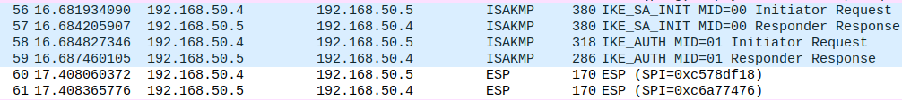
Wireshark Analyse
Exchange Types
Four ISAKMP(Internet Security Association and Key Management Protocol) protocol messages indicates ike communication. ESP protocol messages shows encrypted communication messages.

Slide 6
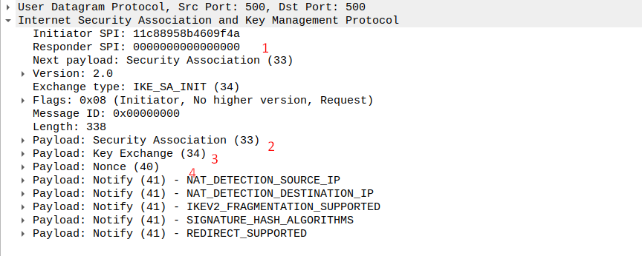




IKE_SA_INIT
IKE_SA_INIT messages are open for man in the middles and the whole others encpryted according the exchanged data in IKE_SA_INIT
SPI(num 1) is used to identify communication tunnel and it is unique. Responder SPI is 0 since it is not yet filled by responder.
Security Association(SA num. 2) is used to indentify algorithms that will be used in ESP.
IKE_SA_INIT(i) capture

Slide 7

IKE_SA_INIT
Key Exchange Payload (num. 3) indicates key value that is going to use in DH calculation.
Nonce Payload(num. 4) indicates The Nonce payload contains random data used to guarantee liveness during an exchange and protect against replay attacks.

Slide 8
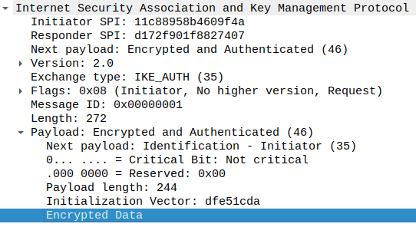
IKE_AUTH
After IKE_SA_INIT messages, rest of all messages are ancrypted, payload of IKE_AUTH as well.
Only visible data is Initialization Vector. It is used to randomize encrypted data.

Slide 9

ESP Capture
Capture below belong ESP of ICMP message(ping)
Only visible data is ESP header data which include ESP SPI and ESP Sequence

Slide 10
Log/Code Analyse

