Slide 1
IPSEC
IPSEC (based on Tunnel Mode)
Prepared by Adem Keskin

Slide 2
Qualification of Security
Confidentiality (Privacy)
Integrity
Authentication
Non-repudiation

Slide 3
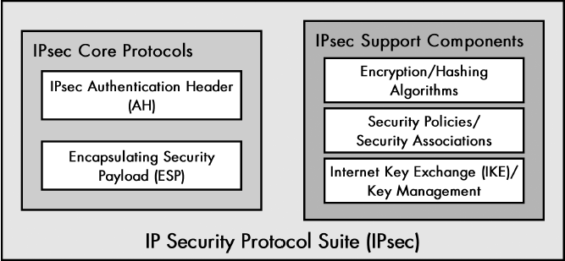
Protocol Suite

Slide 4
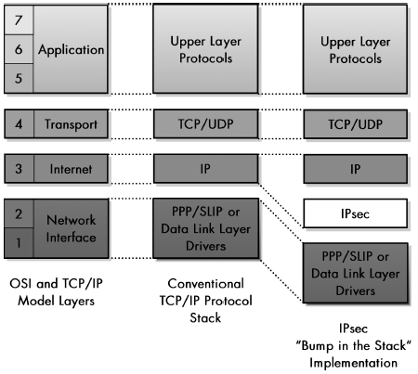
IPsec Architectures
Integrated Architecture
Integrate IPsec’s protocols and capabilities directly into IP itself.
Bump in the Stack (BITS) Architecture

Slide 5
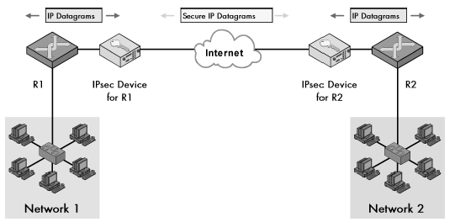
IPsec Architectures
Bump in the Wire (BITW) Architecture

Slide 6
Tunnel Mode vs Transport Mode
In general, the transport mode is employed to protect the host-to-host IPsec tunnel, whereas the tunnel mode is implemented to protect the gateway-to-gateway IPsec tunnel.
In transport mode the payload of the packet is encapsulated by the transport-mode IPsec implementation; however, the IP header remains unchanged. The new IP packet includes the processed packet payload as well as the old IP header once the packet is processed with IPsec. The transport mode does not have the capability to shield the information carried in the IP header, which lets an attacker identify the source and destination of the packet.
In tunnel mode the IPsec implementation encapsulates the whole IP packet. The whole packet turns into the packet's payload that is processed using IPsec. The newly created IP header contains two IPsec gateway addresses. Use of the tunnel mode prevents an attacker from inspecting the information and decoding it, and it also hides the source and destination of the packet.

Slide 7
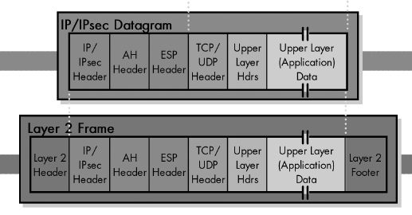
Transport Mode

Slide 8
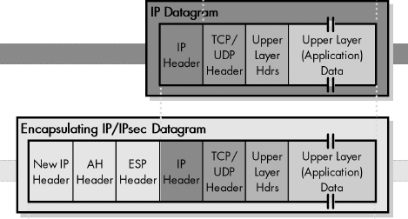
Tunnel Mode

Slide 9
Encapsulating Security Payload (ESP)
Ensures privacy. We want to not only protect against intermediate devices changing the datagrams, but also to protect against them examining their contents as well. For this level of private communication, AH is not enough; we need to use the ESP protocol. An encryption algorithm combines the data in the datagram with a key to transform it into an encrypted form
Encrypts the payload of the IP datagram.
ESP headers:
ESP Header: This contains two fields, SPI and Sequence Number, and comes before the encrypted data.
ESP Trailer: This section is placed after the encrypted data. It contains padding that is used to align the encrypted data through a Padding and Pad Length field. Interestingly, it also contains the Next Header field for ESP.
ESP Authentication Data: This field contains an ICV that’s computed in a manner that’s similar to how the AH protocol works. The field is used when ESP’s optional authentication feature is employed.

Slide 10
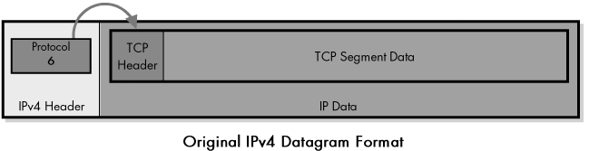
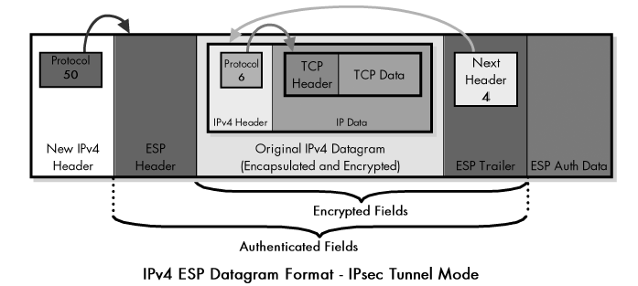
IPV4 datagram format with Ipsec ESP

Slide 11
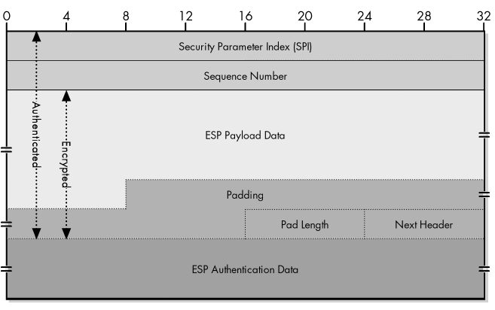
ESP Format

Slide 12
Authentication Header(AH)
Ensures integrity but not privacy.
It allows the recipient of a message to verify that the supposed originator of a message was actually fact the one that sent it.
Allows the recipient to verify that intermediate devices en route haven’t changed any of the data in the datagram.
It also provides protection against so-called replay attacks.

Slide 13
IPsec Security Constructs
Security Associations(SA)
Security Association Database(SAD)
Security Policies(SP)
Security Policy Database(SPD)
Selectors
Security Parameter Index(SPI)
The main difference between SA and SP is that security policies are general, while security associations are more specific. To determine what to do with a particular datagram, a device first checks the SPD. The security policies in the SPD may reference a particular SA in the SAD.

Slide 14
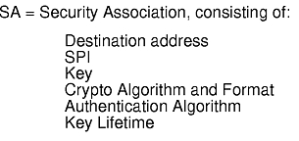
Security Association(SA)
A security association consists of features like traffic encryption key, cryptographic algorithm and mode, and also parameters required for the network data.
With SAs, enterprises can manage specifically which resources can securely communicate as per the security policy.
The framework for establishing security associations is provided by the Internet Security Association and Key Management Protocol (ISAKMP).

Slide 15
Internet Key Exchange (IKE)
The purpose of IKE is to allow devices to exchange information that’s required for secure communication.
Defined in RFC 2409

Slide 16
Short Explanations – ICV in ESP
The ESP ICV, according to RFC 2406, is computed on the entire ESP packet, excluding the Authentication Data field. This includes the SPI, Sequence Number, Payload Data, Padding (if present), Pad Length, and Next Header; the last four fields will be in ciphertext form, since encryption is performed prior to authentication.
When the packet is received, its content, excluding some fields, is hashed by the receiver and the result is compared with the ICV. If they are the same, the packet is declared authentic.
Hashing algorithms include MD5 and SHA-1.

Slide 17
Short Explanations – Initialization Vector(IV)
An initialization vector (IV) is an arbitrary number that can be used with a secret key for data encryption to foil cyber attacks.
This number, also called a nonce (number used once), is employed only one time in any session to prevent unauthorized decryption of the message by a suspicious or malicious actor.
Plain Text
Secret Key
AES
Initialization Vector(IV)
Cipher Text

Slide 18
Initialization Vector(IV)
The use of an IV prevents the repetition of a sequence of text in data encryption.
Specifically, during encryption, an IV prevents a sequence of plaintext that's identical to a previous plaintext sequence from producing the same ciphertext.
If an attacker can view the same encrypted data multiple times, they get clues to decrypt and interpret the original values.
IV and nonce are often used interchangeably. Essentially though, an IV is a nonce with an additional requirement: it must be selected in a non-predictable way. This would eliminate all sequential nonces, an IV must be random.

