Slide 1
Network
Adem Keskin Probation Series I

Slide 2
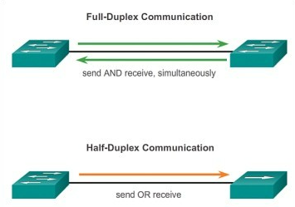
Transfer Ways
Half Duplex: A half-duplex transmission could be considered a one-way street between sender and receiver.
Full Duplex: Full-duplex, on the other hand, enables two-way traffic at the same time.

Slide 3
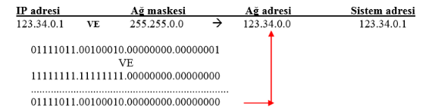
IP Adress & Subnet Mask
Each host device has unique IP adress. i.e: 192.168.1.1
Network ID: 192.168.1
Host ID: 1
A device should know which part describes network and which part describes devices. To find network data we should AND with subnet-mask.

Slide 4
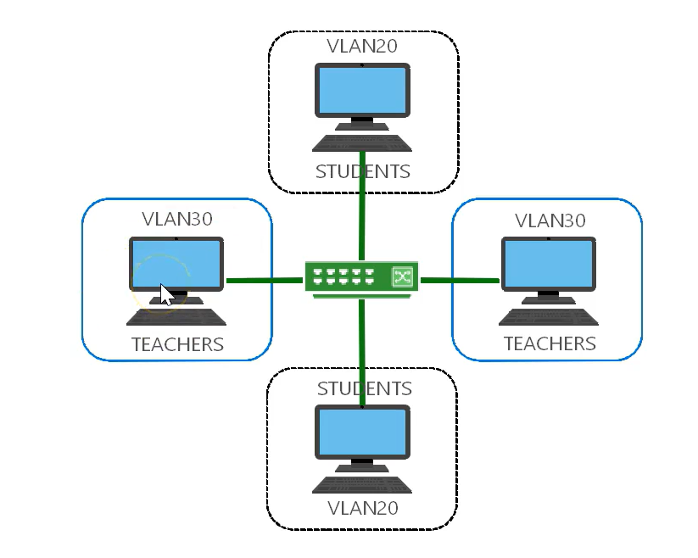
LAN Connection Types
Wireless: Via WAP(Wireless Access Point)
Wired: Via Copper Wire
VLANs: Increase the performancer, provide secure connections.

Slide 5
Peer-To-Peer
In its simplest form, a peer-to-peer (P2P) network is created when two or more PCs are connected and share resources without going through a separate server computer. (i.e.Torrent)

Slide 6
OSI Layers
Layer | Defines
Application | A few examples of application layer protocols are the Hypertext Transfer Protocol (HTTP), File Transfer Protocol (FTP) , Simple Mail Transfer Protocol (SMTP)
Presentation | How two devices should encode, encrypt, and compress data so it is received correctly on the other end.
Session | Creates communication channels, called sessions, between devices.
Transport | Transmits data using transmission protocols inculuding TCP. T akes data transferred in the session layer and breaks it into “segments” on the transmitting end. flow control, checking if data was received incorrectly and if not, requesting it again.
Network | Breaking up segments into network packets, and reassembling the packets on the receiving end. The other is routing packets by discovering the best path across a physical network.(IP, Routers)
Data Link Layer | Establishes and terminates a connection between two physically-connected nodes on a network. Breaks up packets into frames and sends them from source to destination. (Switch that use MAC adress)
Physical Layer | The physical layer is responsible for the physical cable or wireless connection between network nodes.

Slide 7
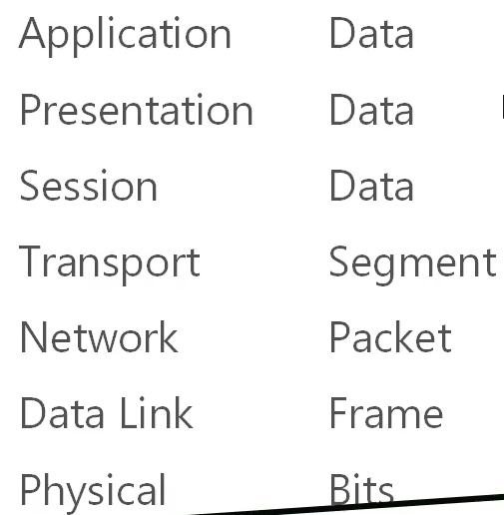
Protocol Data Unit(PDU)

Slide 8
TCP-UDP(Layer-4)
Connection-Oriented Communications: TCP
Web Browser, File Transfer
Connectionless-Oriented Communications: UDP
Streaming media(Video-VoIP)

Slide 9
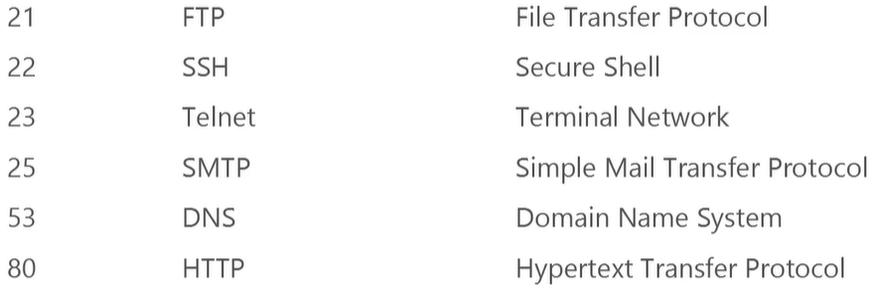
Ports
A port is a virtual point where network connections start and end. Ports are software-based and managed by a computer's operating system. Each port is associated with a specific process or service.
Range for port numbers are 0-65,535
Assigned by IANA

Slide 10
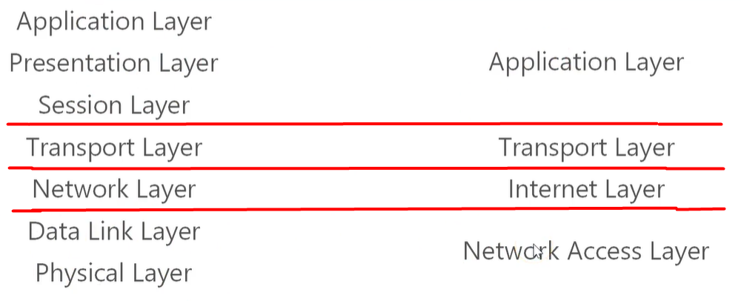
TCP/IP vs OSI
Internet Protocol

Slide 11
Transmission of IP Packages
Unicast: Transmission between hosts. Transmitter creates a path and destination IP address then receiver takes it in. (one to one)
Multicast: There are a groups in network. This method transmits packages to the specified group. (one to many)
Broadcast: All recipients receive the message, there is no path selection. (one to all)

Slide 12
Multicast
Multicast is a technique for delivering a message to many people using minimal bandwidth. If we want to broadcast to many people in TCP/IP , we have three choices:
Broadcasting in all directions, and those who are not interested in the broadcast have to trash the messages of that broadcast. This process can be costly in situations with many broadcasts.
Broadcast in one direction towards every interested person . In this case, the server will need just as much extra bandwith for each new user . This strategy is also a very expensive strategy.
The server sends the message once, and the router copy the message to other routers if necessary. In this way, the server sends the message once, the receiver does not receive unwanted messages; On the other hand, it is necessary to add a little more "intelligence" to routers.

Slide 13
NAT (Network Address Translation)
To access the Internet, one public IP address is needed, but we can use a private IP address in our private network. The idea of NAT is to allow multiple devices to access the Internet through a single public address. To achieve this, the translation of a private IP address to a public IP address is required. Network Address Translation (NAT) is a process in which one or more local IP address is translated into one or more Global IP address and vice versa in order to provide Internet access to the local hosts.

