Slide 1
IKEV2(Strongswan)
Strongswan 5.6.0
RFC 7296 Internet Key Exchange Version 2
Adem Keskin

Slide 2
Insalliation
Download the source of strongswan
wget https://download.strongswan.org/strongswan-5.6.0.tar.gz
Extract tar file
tar -xvzf strongswan-5.6.0.tar.gz; cd strongswan-5.6.0
Build your source (if you encounter with any compile error fix it!)
./configure --prefix=/usr/local --enable-openssl
make ; make install
configure your ipsec.conf file (below is sample)

Slide 3
Insalliation
For further configuration please visit https://wiki.strongswan.org/projects/strongswan/wiki/connsection
Configure your ipsec.secrets file (below is content of whole file)
# ipsec.secrets - strongSwan IPsec secrets file
192.168.50.4 192.168.50.5 : PSK congkma
ipsec.secrets file is going to be used in Authentication in second message IKE_AUTH
Repeat all steps for another peer. (do not forget to switch IP’s in ipsec.conf and ipsec.secrets file!!)
Your executable(actually shell script) will be created named as ipsec

Slide 4
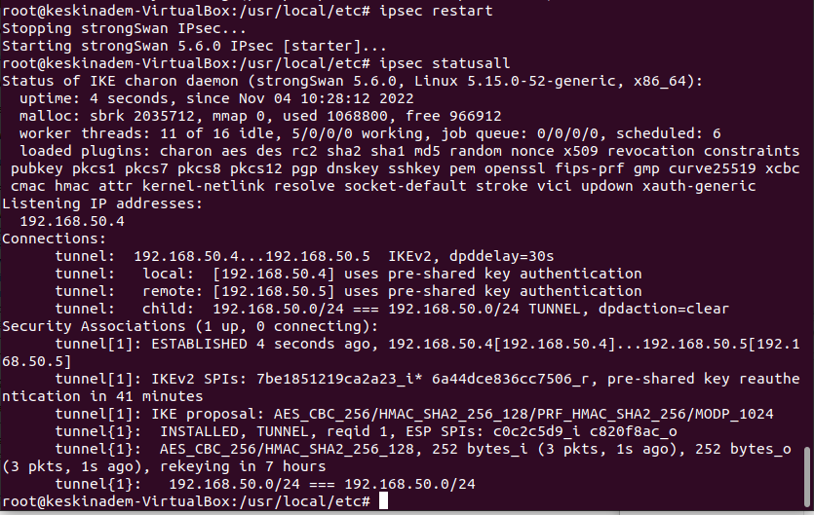
Execution
After installiation run ipsec start or ipsec restart to start communication. Then check if tunnel established via ipsec statusall. You would see as this output below:

Slide 5
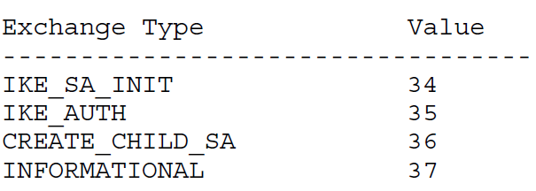
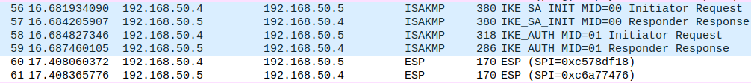
Wireshark Analyse
Exchange Types
Four ISAKMP(Internet Security Association and Key Management Protocol) protocol messages indicates IKE communication. ESP protocol messages shows encrypted communication messages.

Slide 6
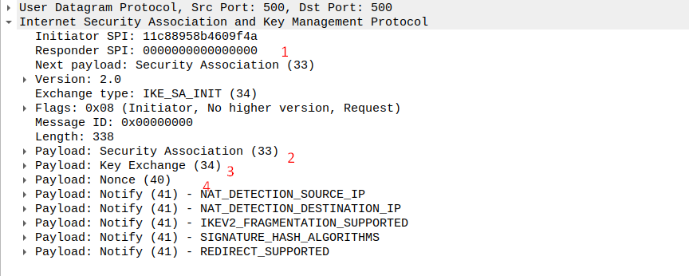




IKE_SA_INIT
IKE_SA_INIT messages are open for man in the middles and the whole others encpryted according the exchanged data in IKE_SA_INIT
SPI(num 1) is used to identify communication tunnel and it is unique. Responder SPI is 0 since it is not yet filled by responder.
Security Association(SA num. 2) is used to indentify algorithms that will be used in ESP.
IKE_SA_INIT(i) capture

Slide 7

IKE_SA_INIT
Key Exchange Payload (num. 3) indicates key value that is going to use in DH calculation.
Nonce Payload(num. 4) indicates The Nonce payload contains random data used to guarantee liveness during an exchange and protect against replay attacks.

Slide 8
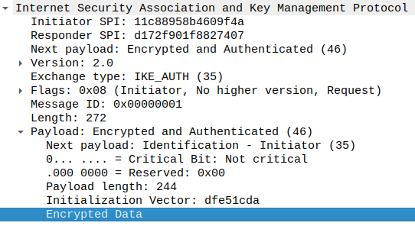
IKE_AUTH
After IKE_SA_INIT messages, rest of all messages are encrypted, payload of IKE_AUTH as well.
Only visible data is Initialization Vector. It is used to randomize encrypted data.

Slide 9

ESP Capture
Capture below belong ESP of ICMP message(ping)
Only visible data is ESP header data which include ESP SPI and ESP Sequence

Slide 10
Configuration (ipsec.conf)
There are 3 different section
config setup defines general configuration parameters
conn <name> defines a connection
ca <name> defines a certification authority
config setup
charondebug=”all”
uniqueids=yes
strictcrlpolicy=no
conn %default
conn tunnel #
left=192.168.50.5
leftsubnet=192.168.50.0/24
right=192.168.50.4
rightsubnet=192.168.50.0/24
ike=aes256-sha2_256-modp1024!
esp=aes256-sha2_256!
keyingtries=0
ikelifetime=1h
lifetime=3m
dpddelay=30
dpdtimeout=120
dpdaction=clear
authby=secret
auto=start
keyexchange=ikev2
type=tunnel
Communucation interfaces
D-H value & encryption method
Ends connection
Renews CHILD_SA
Dead-peer- detection
Authentication method

Slide 11
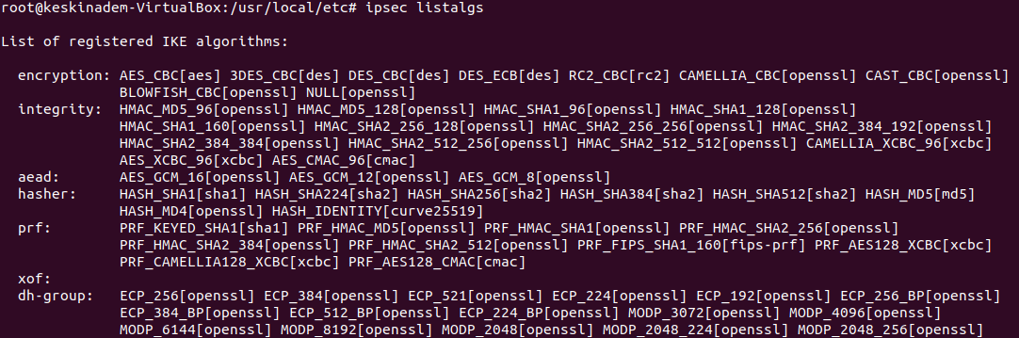
List of IKE Algorithms

Slide 12
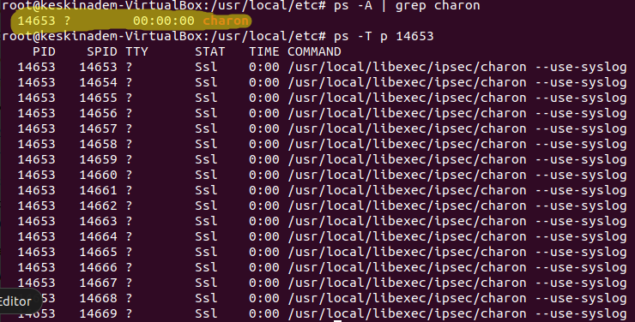
Running Process and Threads
The process after IPsec starts and all worker threads(16):
Threads stand for job scheduling. The aim is giving priority for critical tasks.
Thread and job mechanism committed in processor.c/h file.

Slide 13
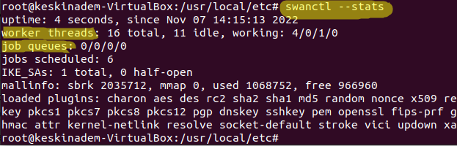
Job Management
To see jobs and queues: swanctl --stats
Priorities are defined in enum of job_priorit.y_t and structure is worker_thread_t.
Each priority has its own thread that is assigned at the beginning in the function set_threads.
Checking liveness and vici message processing is high priority.
IKE_SA_INIT messages are not encrypted and authenticated. They ae open for Dos attacks. Eva can attack by sending continuous IKE_SA_INIT messages. Charon has prevention by limiting half-open count as user configuration. (charon.init_limit_half_open)

