Slide 1
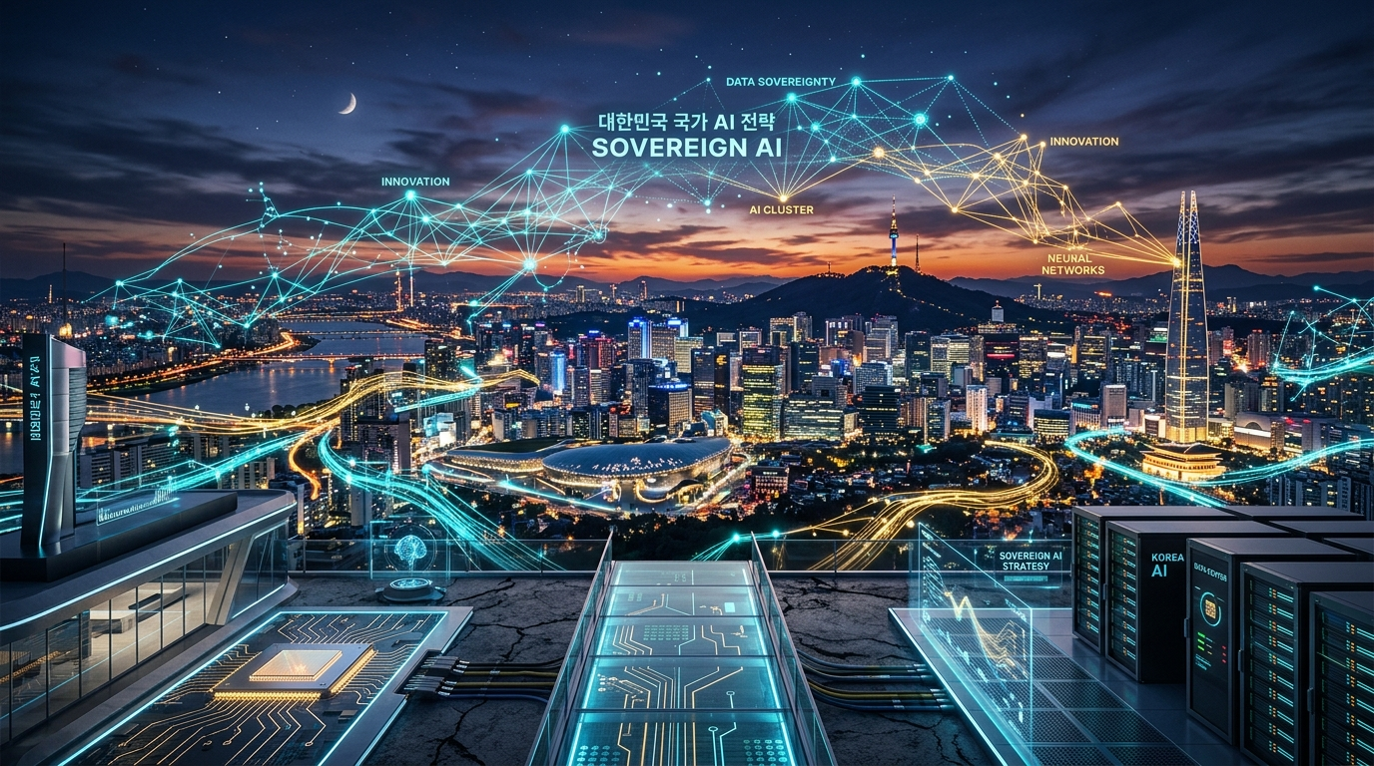
UCLA ANDERSON EXECUTIVE MBA DELEGATION VISIT | SEOUL 2026
Korea's Sovereign AI Strategy: From Silicon to Enterprise Applications
Unlocking Strategic Autonomy, Native Infrastructure, and Scalable Enterprise Transformation
Session: Session 3 - Korea Sovereign AI Strategy (English Presentation)
Speaker: Andy | ISV Business Unit & AI Architecture Group, MegazoneCloud
Date & Venue: Friday, September 11, 2026 | MegazoneCloud Gwacheon HQ (2F Grand Room)
Notes:
[PACING: 0:00 - 0:30]
Good morning, faculty, staff, and distinguished executives of the UCLA Anderson Executive MBA delegation. On behalf of MegazoneCloud, welcome to our Gwacheon Headquarters. Today, I am thrilled to share South Korea's sovereign AI playbook—how our nation is navigating the global AI race by building independent silicon, specialized models, and full-stack enterprise solutions.

Slide 2
2. Welcome UCLA Anderson EMBA: Objectives & Agenda
PART 1: MACRO CONTEXT & IMPERATIVE
Today's 15-Minute Executive Briefing & Collaborative Exchange
1. Strategic Understanding
Deconstruct the geopolitical, financial, and technical forces driving Sovereign AI in 2026.
2. The 4-Pillar Playbook
Deep-dive into Infrastructure, Models, Software Solutions, and Enterprise Services.
3. MegazoneCloud's Role
Scaling from Korea's #1 Cloud Unicorn to the master orchestrator of domestic and global ISVs.
4. Connecting Your Itinerary
Direct synergy with your Seoul immersion: Samsung, DEEPX, Amorepacific, and Invest Seoul.
VISUAL CONCEPT: Flow diagram showing 3-stage presentation breakdown and interactive Q&A roadmap.
UCLA Anderson Executive MBA Delegation Visit | Session 3: Korea Sovereign AI Strategy | Speaker: Andy
2 / 30
Notes:
[PACING: 0:30 - 1:00]
Over the next 15 minutes, we will unpack why sovereign AI is an urgent commercial reality and how Korea provides an actionable template for global enterprise leaders.

Slide 3
3. The Geopolitics of AI: Why 'Sovereignty' Matters in 2026
PART 1: MACRO CONTEXT & IMPERATIVE
From AI Experimentation to Strategic Operational Autonomy
1. The AI Duopoly Threat
Over-reliance on foreign hyperscalers exposes enterprises to price volatility, unexpected outages, and deep vendor lock-in.
2. Sovereign AI 2.0 Defined
Moving beyond 'owning a model' to 'Operational Sovereignty' and 'Access Autonomy'—ensuring mission-critical workflows run offline.
3. Regulatory Compliance Mandates
Strict cross-border data residency mandates (EU AI Act, Korea PIPA, Financial Cloud Directives).
VISUAL CONCEPT: Comparison matrix: Cloud SaaS API Risks vs. Air-Gapped Sovereign AI Enterprise Benefits.
UCLA Anderson Executive MBA Delegation Visit | Session 3: Korea Sovereign AI Strategy | Speaker: Andy
3 / 30
Notes:
[PACING: 1:00 - 1:30]
In 2026, the question is no longer 'Which API is smartest?' but 'Who owns our intelligence? If cross-border connections drop, can our business still operate?'

Slide 4
4. South Korea’s Unique Position: The World’s 3rd AI Powerhouse
PART 1: MACRO CONTEXT & IMPERATIVE
A Rare Convergence of Semiconductor, Software, and Heavy Industry
1. Elite Global Trio
Alongside the US and China, South Korea possesses the complete physical and digital vertical stack.
2. Hardware Dominance
Global leader in memory and HBM manufacturing (Samsung Electronics, SK Hynix).
3. Digital Platforms & Models
Domestic tech giants (Naver, Kakao) beating global platforms locally with native search engines.
4. The 'G3 Ambition'
Formal presidential roadmap targeting Global Top 3 AI leadership by 2027.
VISUAL CONCEPT: Global map highlighting US, China, and Korea with 4-layer full-stack capability indicators.
UCLA Anderson Executive MBA Delegation Visit | Session 3: Korea Sovereign AI Strategy | Speaker: Andy
4 / 30
Notes:
[PACING: 1:30 - 2:00]
Korea possesses the entire physical and digital vertical stack. We build the memory chips, host native search engines, and manufacture ships, cars, and consumer electronics.

Slide 5
5. The Enterprise Trilemma: Capex, Power, and Data Sovereignty
PART 1: MACRO CONTEXT & IMPERATIVE
The Hard Physical Bottlenecks Stalling On-Premises Deployments
1. Financial Shock (Capex)
8-GPU high-density servers cost $400K-$500K each with unpredictable delivery cycles.
2. Physical Power Cap
90% of corporate datacenter racks are limited to 8-10kW; standard 8-GPU servers draw 10.2kW peak.
3. Data Exfiltration Risk
Defense, banking, and semiconductor fabs strictly forbid transmitting IP to public clouds.
VISUAL CONCEPT: Trilemma diagram: High Capex vs. 10kW Rack Power Limit vs. Air-Gapped Security Requirements.
UCLA Anderson Executive MBA Delegation Visit | Session 3: Korea Sovereign AI Strategy | Speaker: Andy
5 / 30
Notes:
[PACING: 2:00 - 2:30]
When enterprise CTOs attempt to run 250B parameter models on-premises, they hit an electrical brick wall. Overcoming this physical trilemma is our primary engineering focus.

Slide 6
6. The 4-Pillar Framework: Infra, Model, Solution, Service
PART 1: MACRO CONTEXT & IMPERATIVE
The Unified Architecture of National & Enterprise AI Independence
1. Pillar 1 (Infrastructure)
Compute clusters, public AI highway, and native NPU semiconductors.
2. Pillar 2 (Model)
Sovereign Korean foundation models, domain sLLMs, and Mixture-of-Experts (MoE).
3. Pillar 3 (Solution)
Full-stack orchestration, air-gapped security, and model optimization compilers.
4. Pillar 4 (Service)
Cross-industry deployment across Chaebols, SMEs, and public administrative sectors.
VISUAL CONCEPT: 4-Layer architectural pyramid highlighting synchronized execution across government and private sector.
UCLA Anderson Executive MBA Delegation Visit | Session 3: Korea Sovereign AI Strategy | Speaker: Andy
6 / 30
Notes:
[PACING: 2:30 - 3:00]
Sovereignty fails if any single layer is missing. Korea's strategy coordinates all 4 pillars synchronously to deliver commercial and operational success.

Slide 7

7. National AI Computing Center: The Public-Private 'AI Highway'
PART 2: PILLAR 1 - INFRASTRUCTURE & SILICON
A Multi-Billion Dollar Sovereign Compute Megaproject
1. Solaseado Datacenter Park
Officially broken ground in August 2026 in Haenam, South Jeolla Province.
2. Public-Private Consortium
Spearheaded by MSIT and Samsung SDS via a dedicated Special Purpose Company (SPC).
3. National Compute Bedrock
Subsidizing massive compute access for universities, startups, and domestic industry.
VISUAL CONCEPT: Architectural rendering of Haenam Solaseado datacenter campus with green energy grid connections.
UCLA Anderson Executive MBA Delegation Visit | Session 3: Korea Sovereign AI Strategy | Speaker: Andy
7 / 30
Notes:
[PACING: 3:00 - 3:30]
Pillar 1 begins with compute. In August 2026, Korea broke ground on the National AI Computing Center in Haenam, ensuring domestic industry is protected from international GPU supply crunches.

Slide 8
8. Compute Capacity Scaling: 15,000 GPUs to 50,000 GPUs
PART 2: PILLAR 1 - INFRASTRUCTURE & SILICON
The Exponential Trajectory of Public Compute Infrastructure
1. Phase 1 (2026 - 2028)
Initial deployment of 15,000 top-tier AI accelerators (H100/B200 tier).
2. Phase 2 (2029 - 2030+)
Expansion to 50,000+ accelerators integrated with coastal offshore wind power.
3. Sovereign Resource Allocation
Tiered vouchers enabling rapid model training without predatory cloud pricing.
VISUAL CONCEPT: Growth chart showing GPU capacity scaling from 15K to 50K units by 2030 with power efficiency curves.
UCLA Anderson Executive MBA Delegation Visit | Session 3: Korea Sovereign AI Strategy | Speaker: Andy
8 / 30
Notes:
[PACING: 3:30 - 4:00]
Reaching 15,000 accelerators by 2028 and 50,000 by 2030 establishes a fortress of compute capacity that underpins national digital sovereignty.

Slide 9
9. The Rise of K-NPU: The 'K-Cloud' Initiative & NPU Farms
PART 2: PILLAR 1 - INFRASTRUCTURE & SILICON
Disrupting the AI Inference Landscape with High-Efficiency Silicon
1. K-Cloud Initiative
Over $600M in national backing to develop ultra-low-power AI semiconductors.
2. The 80/20 Rule
While model training requires GPUs, over 80% of operational enterprise TCO is inference.
3. NPU Farms in Action
Live multi-petaflop clusters deployed across Naver, KT, and NHN Cloud datacenters.
VISUAL CONCEPT: Inference TCO comparison: K-NPU vs. Traditional GPU showing power and cost savings.
UCLA Anderson Executive MBA Delegation Visit | Session 3: Korea Sovereign AI Strategy | Speaker: Andy
9 / 30
Notes:
[PACING: 4:00 - 4:30]
Up to 80% of enterprise AI costs are inference. Korea's K-Cloud project deploys native NPUs specifically engineered to execute inference at a fraction of standard GPU power.

Slide 10
10. Korea's Fabless Champions: Rebellions, FuriosaAI, DEEPX, Mobilint
PART 2: PILLAR 1 - INFRASTRUCTURE & SILICON
Purpose-Built Silicon Across Datacenter, Edge, and Robotics
1. Rebellions (ATOM / ATOM-MAX)
High-throughput datacenter inference and financial algorithmic trading.
2. FuriosaAI (WARBOY / RENEGADE)
High-efficiency computer vision and Transformer model acceleration.
3. DEEPX (All-in-4 AI Series)
Ultra-low-power on-device NPU for smart mobility, IoT, and industrial robotics (On UCLA Itinerary!).
4. Mobilint (ARIES / REGULUS)
Edge AI solutions for industrial automation.
VISUAL CONCEPT: Silicon ecosystem landscape mapping Korean fabless startups across Datacenter, Edge, and On-Device tiers.
UCLA Anderson Executive MBA Delegation Visit | Session 3: Korea Sovereign AI Strategy | Speaker: Andy
10 / 30
Notes:
[PACING: 4:30 - 5:00]
Many of you are visiting DEEPX this week. DEEPX, Rebellions, and FuriosaAI are not mimicking GPUs; they are building purpose-driven architectures that win on efficiency.

Slide 11
11. Enterprise Hybrid Cloud & GPUaaS: Dell, NVIDIA, and Akamai
PART 2: PILLAR 1 - INFRASTRUCTURE & SILICON
Balancing Tier-1 Global Standards with Modular Sovereign Clouds
1. Mainstream Enterprise Track
Dell PowerEdge R760 + NVIDIA GPUs for on-premise high performance.
2. Cost-Optimized GPUaaS
Partnership with Akamai Distributed Cloud for sub-millisecond edge inferencing at 40% lower egress.
3. Hybrid Topology
Sensitive proprietary IP kept strictly on-premises; public workloads burst to sovereign cloud.
VISUAL CONCEPT: Hybrid network architecture showing Dell On-Premises core connected to Akamai GPUaaS edge nodes.
UCLA Anderson Executive MBA Delegation Visit | Session 3: Korea Sovereign AI Strategy | Speaker: Andy
11 / 30
Notes:
[PACING: 5:00 - 5:30]
Sovereignty is not isolation. MegazoneCloud delivers certified Dell and NVIDIA enterprise stacks while leveraging distributed GPUaaS partnerships like Akamai to optimize client TCO.

Slide 12
12. Overcoming Data Center Bottlenecks: 10kW Rack Power & Cooling
PART 2: PILLAR 1 - INFRASTRUCTURE & SILICON
Engineering Feasibility in Existing Corporate Server Rooms
1. The Datacenter Bottleneck
Retrofitting legacy server rooms with liquid cooling costs millions and causes downtime.
2. Dense 2-GPU Form Factor
High-efficiency 2U dual-GPU architecture delivering enterprise-grade throughput.
3. Power Feasibility
Operating power capped at 3.2kW, safely within standard 10kW datacenter rack limits.
VISUAL CONCEPT: Server rack diagram showing 3.2kW 2-GPU server fitting comfortably into standard 10kW rack space.
UCLA Anderson Executive MBA Delegation Visit | Session 3: Korea Sovereign AI Strategy | Speaker: Andy
12 / 30
Notes:
[PACING: 5:30 - 6:00]
Our dual-GPU dense form factor caps power draw at 3.2kW. Enterprises can deploy sovereign AI in their existing server rooms tomorrow without electrical rewiring.

Slide 13
13. Korea's Foundation Model Landscape
PART 3: PILLAR 2 - FOUNDATION MODELS
Native Linguistic Mastery and Frontier Enterprise Intelligence
1. Naver HyperCLOVA X
Dominant commercial hyper-scale model trained on 6,500x more Korean data than GPT-3.
2. LG AI Research EXAONE 3.0
High-performance bilingual open-weight model engineered for chemistry, patents, and manufacturing.
3. Upstage Solar
Globally acclaimed sLLM leading HuggingFace benchmarks via innovative Depth-Up Scaling (DUS).
VISUAL CONCEPT: Logo and performance matrix comparing HyperCLOVA X, EXAONE 3.0, and Solar across enterprise benchmarks.
UCLA Anderson Executive MBA Delegation Visit | Session 3: Korea Sovereign AI Strategy | Speaker: Andy
13 / 30
Notes:
[PACING: 6:00 - 6:30]
Pillar 2: Models. Korea does not rely solely on translated foreign LLMs. Naver, LG, and Upstage engineer native models with deep linguistic and contextual nuance.

Slide 14
14. The Shift from Frontier Monoliths to Domain-Specific sLLM & MoE
PART 3: PILLAR 2 - FOUNDATION MODELS
Why Smaller, Specialized Models are Winning the Enterprise War
1. The Death of Monoliths
1-Trillion parameter models are too slow and costly for private on-premises hosting.
2. Mixture-of-Experts (MoE)
Activating only 20B-30B parameters out of 250B per token query.
3. Enterprise Advantages
Deterministic latency (<50ms), lower compute overhead, and complete lifecycle ownership.
VISUAL CONCEPT: Diagram contrasting Monolithic Dense Activation vs. Efficient Mixture-of-Experts (MoE) Routing.
UCLA Anderson Executive MBA Delegation Visit | Session 3: Korea Sovereign AI Strategy | Speaker: Andy
14 / 30
Notes:
[PACING: 6:30 - 7:00]
While public headlines celebrate trillion-parameter models, enterprise CFOs look at transaction costs. Domain sLLMs and MoE architectures deliver higher accuracy at a fraction of the cost.

Slide 15
15. Cultural, Linguistic & Regulatory Alignment: The Sovereign Moat
PART 3: PILLAR 2 - FOUNDATION MODELS
The Severe Cost of Cultural Hallucination in Corporate Workflows
1. Honorific Precision (Jondaetmal)
Korean corporate communication requires exact contextual politeness.
2. Statutory Exactness
Korean Commercial Code, labor laws, and tax regulations require precise citation.
3. Compliance Verification
Sovereign models achieve 99.2% regulatory accuracy vs. ~71% for off-the-shelf global APIs.
VISUAL CONCEPT: Side-by-side comparison of cultural and legal output accuracy: Global API vs. Sovereign Korean Model.
UCLA Anderson Executive MBA Delegation Visit | Session 3: Korea Sovereign AI Strategy | Speaker: Andy
15 / 30
Notes:
[PACING: 7:00 - 7:30]
In corporate Korea, an inappropriate honorific can jeopardize client relationships. Sovereign models are trained natively in Korean corporate etiquette and statutory legal codes.

Slide 16
16. Model Optimization: INT4/NVFP4 Quantization & Pruning
PART 3: PILLAR 2 - FOUNDATION MODELS
Compressing Frontier Models into Compact Workstation Footprints
1. Lossless Quantization
Compressing FP16 weights down to INT4 and NVFP4 with under 1.5% perplexity loss.
2. Non-Uniform Pruning
Surgically eliminating inactive attention heads tailored to specific enterprise domains.
3. Measurable Impact
Memory footprint slashed by 70%, token generation increased from 18 to 65+ tokens/second.
VISUAL CONCEPT: Performance graph showing throughput jump (tokens/sec) and VRAM reduction across INT4/FP16 formats.
UCLA Anderson Executive MBA Delegation Visit | Session 3: Korea Sovereign AI Strategy | Speaker: Andy
16 / 30
Notes:
[PACING: 7:30 - 8:00]
By applying INT4 and NVFP4 quantization, we shrink model memory requirements by 70% and triple throughput, allowing large models to run on affordable dual-GPU servers.

Slide 17
17. Physical & Edge AI: Small Vision-Language-Action (VLA) Models
PART 3: PILLAR 2 - FOUNDATION MODELS
Extending Sovereign Intelligence into Manufacturing and Smart Cities
1. SmolVLA & Compact Multimodal
Enabling robotic arms and AGVs to interpret physical environments locally.
2. Intelligent Transport Systems (ITS)
Nota.ai smart traffic edge controllers deployed across 200 intersections in Daejeon and Dubai RTA.
3. Zero Cloud Latency
Real-time visual defect detection and signal optimization at 30 FPS.
VISUAL CONCEPT: Case illustration: Edge AI controller in smart factory robotic arm and smart city intersection.
UCLA Anderson Executive MBA Delegation Visit | Session 3: Korea Sovereign AI Strategy | Speaker: Andy
17 / 30
Notes:
[PACING: 8:00 - 8:30]
Sovereign AI extends into the physical world. By embedding Small Vision-Language-Action models into edge hardware, we automate factory robotics and smart city traffic in real time.

Slide 18
18. The Enterprise Missing Link: Why 85% of AI PoCs Stall
PART 4: PILLAR 3 - SOLUTIONS & ORCHESTRATION
Bridging the Chasm Between Prototype Demos and Production Workflows
1. Hardware Mismatch
Cloud-built prototypes fail when transitioned to corporate datacenter servers.
2. Data Silos
Fragmented corporate data locked in legacy ERPs, internal PDFs, and legacy databases.
3. Security Void
Absence of enterprise-grade hallucination guardrails, audit logging, and role-based access control.
VISUAL CONCEPT: Pipeline diagram showing PoC failure points and MegazoneCloud's end-to-end bridge to production.
UCLA Anderson Executive MBA Delegation Visit | Session 3: Korea Sovereign AI Strategy | Speaker: Andy
18 / 30
Notes:
[PACING: 8:30 - 9:00]
85% of enterprise AI projects stall in prototype phase because integrating chips, models, databases, and compliance is overwhelming. That is the missing link MegazoneCloud resolves.

Slide 19

19. MegazoneCloud's 4-Layer Enterprise AI Full-Stack Architecture
PART 4: PILLAR 3 - SOLUTIONS & ORCHESTRATION
The Standardized, Modular Operating Blueprint for Enterprise AI
1. Layer 4 (Applications)
Air-Gapped RAG, AI Coding Agents, Executive Decision Portals.
2. Layer 3 (Model Serving)
Nota NetsPresso optimization engine, vLLM, and Triton inference.
3. Layer 2 (Platform)
Red Hat OpenShift AI (RHOAI) and Nutanix Cloud Infrastructure (NCI).
4. Layer 1 (Hardware)
Dell PowerEdge R760, NVIDIA H100 GPUs, and certified K-NPU servers.
VISUAL CONCEPT: Detailed 4-Layer architectural diagram displaying software logos and interface protocols.
UCLA Anderson Executive MBA Delegation Visit | Session 3: Korea Sovereign AI Strategy | Speaker: Andy
19 / 30
Notes:
[PACING: 9:00 - 9:30]
Our 4-Layer Full-Stack architecture integrates certified hardware, virtualization, optimization compilers, and business applications into a single turnkey solution with one enterprise SLA.

Slide 20
20. Deep-Dive: From Nutanix/RHOAI (L2) to vLLM & Nota (L3)
PART 4: PILLAR 3 - SOLUTIONS & ORCHESTRATION
The Engine Room of Low-Latency, High-Density Model Serving
1. Layer 2 Virtualization
Nutanix AHV and OpenShift AI automate GPU resource slicing (vGPU) across departments.
2. Layer 3 Compilation
Nota NetsPresso profiles hardware and optimizes execution graphs automatically.
3. Continuous Batching
vLLM PagedAttention ensures sub-second multi-tenant response times under high concurrency.
VISUAL CONCEPT: Dataflow diagram tracing user query through Nutanix hypervisor to vLLM paged attention cache.
UCLA Anderson Executive MBA Delegation Visit | Session 3: Korea Sovereign AI Strategy | Speaker: Andy
20 / 30
Notes:
[PACING: 9:30 - 10:00]
At Layers 2 and 3, Nutanix and OpenShift virtualize GPU power across departments, while Nota and vLLM maximize inference density, extracting peak performance from minimum hardware.

Slide 21
21. Air-Gapped Security & Advanced Graph RAG (Mem0 + Graphify)
PART 4: PILLAR 3 - SOLUTIONS & ORCHESTRATION
True Data Moats: Zero Exfiltration Meets Deep Structural Context
1. 100% Air-Gapped Isolation
Zero external bytes transmitted; internal HSM key encryption.
2. Mem0 Memory Architecture
Multi-session personalized context tracking user security clearance levels.
3. Graphify AST RAG
Abstract Syntax Tree semantic parsing of enterprise source code and complex manuals.
VISUAL CONCEPT: Security architecture diagram: Air-Gapped perimeter shield surrounding Mem0 context engine and Graph RAG.
UCLA Anderson Executive MBA Delegation Visit | Session 3: Korea Sovereign AI Strategy | Speaker: Andy
21 / 30
Notes:
[PACING: 10:00 - 10:30]
For banking and defense clients, we build completely air-gapped systems. Using Mem0 memory layers and Graphify knowledge graphs, our AI reasons across corporate manuals without hallucination.

Slide 22
22. The ISV Ecosystem: Orchestrating Global & Domestic Innovators
PART 4: PILLAR 3 - SOLUTIONS & ORCHESTRATION
The Power of the MegazoneCloud Multi-Vendor Aggregator Model
1. Global Category Leaders
Articul8 (Autonomous GenAI) and Cohere (Multilingual Enterprise Embeddings).
2. Domestic Specialist Champions
Nota.ai (Edge Optimization), PuzzleData (Process Mining), QuantumAI (Air-Gapped AICC).
3. Single Enterprise SLA
Clients get multi-vendor best-of-breed software without contract chaos.
VISUAL CONCEPT: Partner ecosystem wheel showing MegazoneCloud at center orchestrating global and domestic ISVs.
UCLA Anderson Executive MBA Delegation Visit | Session 3: Korea Sovereign AI Strategy | Speaker: Andy
22 / 30
Notes:
[PACING: 10:30 - 11:00]
We curate the world's finest ISVs. Whether bringing in Silicon Valley's Articul8 and Cohere or domestic champions like Nota and PuzzleData, we orchestrate them into one harmonious platform.

Slide 23
23. Korea Inc. in Action: Enterprise AI Adoption Across Chaebols
PART 5: PILLAR 4 - SERVICE & ENTERPRISE ADOPTION
Real-World Deployments Across South Korea's Industrial Giants
1. Semiconductor & High-Tech
Yield prediction, wafer defect inspection, and fab telemetry analytics.
2. Financial Services
On-premise credit underwriting, automated compliance checks, and private analyst copilots.
3. Consumer Goods & Beauty (Amorepacific Context)
Hyper-personalized beauty formulation compliant with PII laws.
4. Heavy Industry & Automotive
Assembly line predictive maintenance and CAD engineering assistance.
VISUAL CONCEPT: Industry mosaic illustrating live deployments across Manufacturing, Banking, Beauty, and Automotive.
UCLA Anderson Executive MBA Delegation Visit | Session 3: Korea Sovereign AI Strategy | Speaker: Andy
23 / 30
Notes:
[PACING: 11:00 - 11:30]
Pillar 4: Real enterprise adoption. In chip manufacturing, AI inspects wafers at line speed. In banking, private LLMs parse regulatory audits. In cosmetics, beauty algorithms run locally on customer data.

Slide 24
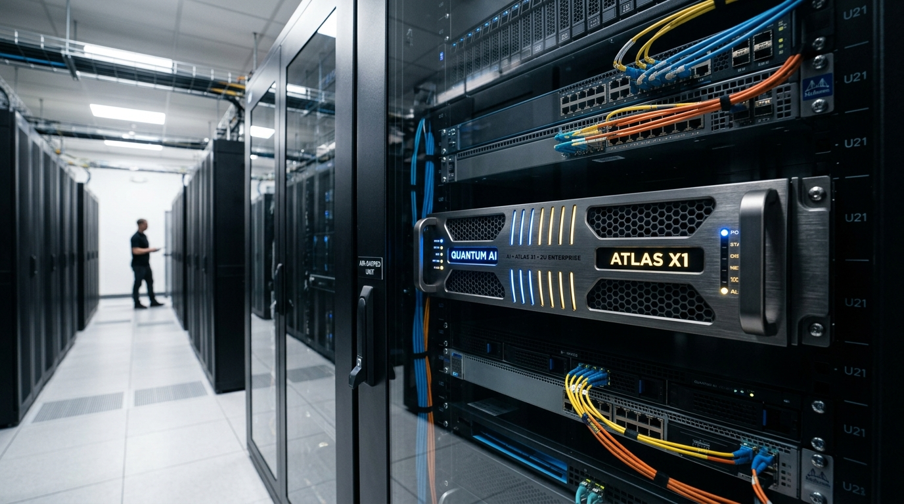
24. Sovereign AI Turnkey Appliance: 1-Click On-Premises Deployment
PART 5: PILLAR 4 - SERVICE & ENTERPRISE ADOPTION
Delivering Enterprise AI as a Pre-Integrated, Plug-and-Play Appliance
1. Pre-Integrated Hardware
Pre-racked Dell R760 2U server with certified NVIDIA GPUs or K-NPUs.
2. Rapid Time-to-Value
From power-on to first internal query in under 2 hours (vs. 6 months of consulting).
3. Built-In Governance
Pre-loaded with Nutanix AHV, Nota NetsPresso INT4, and sovereign domain models.
VISUAL CONCEPT: Product rendering of the 2U rack appliance showing pre-installed software layers and plug-in setup.
UCLA Anderson Executive MBA Delegation Visit | Session 3: Korea Sovereign AI Strategy | Speaker: Andy
24 / 30
Notes:
[PACING: 11:30 - 12:00]
We package sovereign AI into a plug-and-play 2U appliance. Arrives pre-tested; you connect power and ethernet, and your company has an air-gapped private intelligence platform running in 2 hours.

Slide 25
25. Measurable Business ROI: 75% Capex Cut & 3.2kW Power Feasibility
PART 5: PILLAR 4 - SERVICE & ENTERPRISE ADOPTION
The Hard Financial and Operational Metrics of Success
1. Capex Slashed by 75%
$120,000 USD dual-GPU appliance replaces standard $480,000 USD 8-GPU cluster.
2. Power Draw at 3.2kW
Safely fits standard 10kW datacenter racks, eliminating costly room retrofits.
3. Latency Reduced 3x
Deterministic sub-50ms token generation for seamless user experience.
4. Zero Data Exfiltration
100% compliance with strict national banking and defense security mandates.
VISUAL CONCEPT: Executive ROI scorecard with side-by-side metric tables and large callout badges (75% SAVINGS).
UCLA Anderson Executive MBA Delegation Visit | Session 3: Korea Sovereign AI Strategy | Speaker: Andy
25 / 30
Notes:
[PACING: 12:00 - 12:30]
These are the metrics that win boardroom approval: 75% Capex savings, 3.2kW power consumption that avoids facility reconstruction, and sub-50ms latency with zero data leakage.

Slide 26
26. Public Sector & 'AI for All Citizens': National Transformation
PART 5: PILLAR 4 - SERVICE & ENTERPRISE ADOPTION
Democratizing Artificial Intelligence Across Civil Administration and Healthcare
1. AI Civil Servants
Automating routine civic administration, tax filings, and municipal inquiries.
2. Universal AI Compute Vouchers
Subsidizing AI compute for 10,000+ domestic SMEs and technology startups.
3. Healthcare & Rural Equity
Deploying sovereign diagnostic assistants to regional clinics to bridge medical gaps.
VISUAL CONCEPT: Infographic showing government civic portal, regional hospital diagnostic network, and SME grant flow.
UCLA Anderson Executive MBA Delegation Visit | Session 3: Korea Sovereign AI Strategy | Speaker: Andy
26 / 30
Notes:
[PACING: 12:30 - 13:00]
Sovereign AI is also a public good. Korea's 'AI for All' initiative delivers AI assistants to municipal offices and regional clinics, ensuring technological advancement benefits all citizens.

Slide 27
27. MegazoneCloud's Growth Story: From Cloud Pioneer to AI Unicorn
PART 6: MZC PLAYBOOK & GLOBAL VISION
The Operational Architect Behind Korea's Digital Infrastructure
1. 1998 to Present
Early digital agency evolved into Korea's first AWS Premier Consulting Partner in 2012.
2. Official Unicorn (2022)
Valuation exceeded $1.8B USD, leading the Korean cloud MSP market.
3. Scale Today
Over 2,700 enterprise clients, 1,500+ specialized engineers, and multi-cloud market dominance.
4. The Strategic Evolution
Cloud MSP -> AI MSP -> Global Full-Stack Sovereign AI Orchestrator.
VISUAL CONCEPT: Milestone timeline spanning 1998, 2012, 2022, and 2026 showing revenue and client expansion trajectory.
UCLA Anderson Executive MBA Delegation Visit | Session 3: Korea Sovereign AI Strategy | Speaker: Andy
27 / 30
Notes:
[PACING: 13:00 - 13:30]
MegazoneCloud pioneered cloud computing in Korea over a decade ago as the country's first AWS Premier Partner. Today, as a multi-billion dollar tech unicorn, we are leading the AI transformation wave.

Slide 28
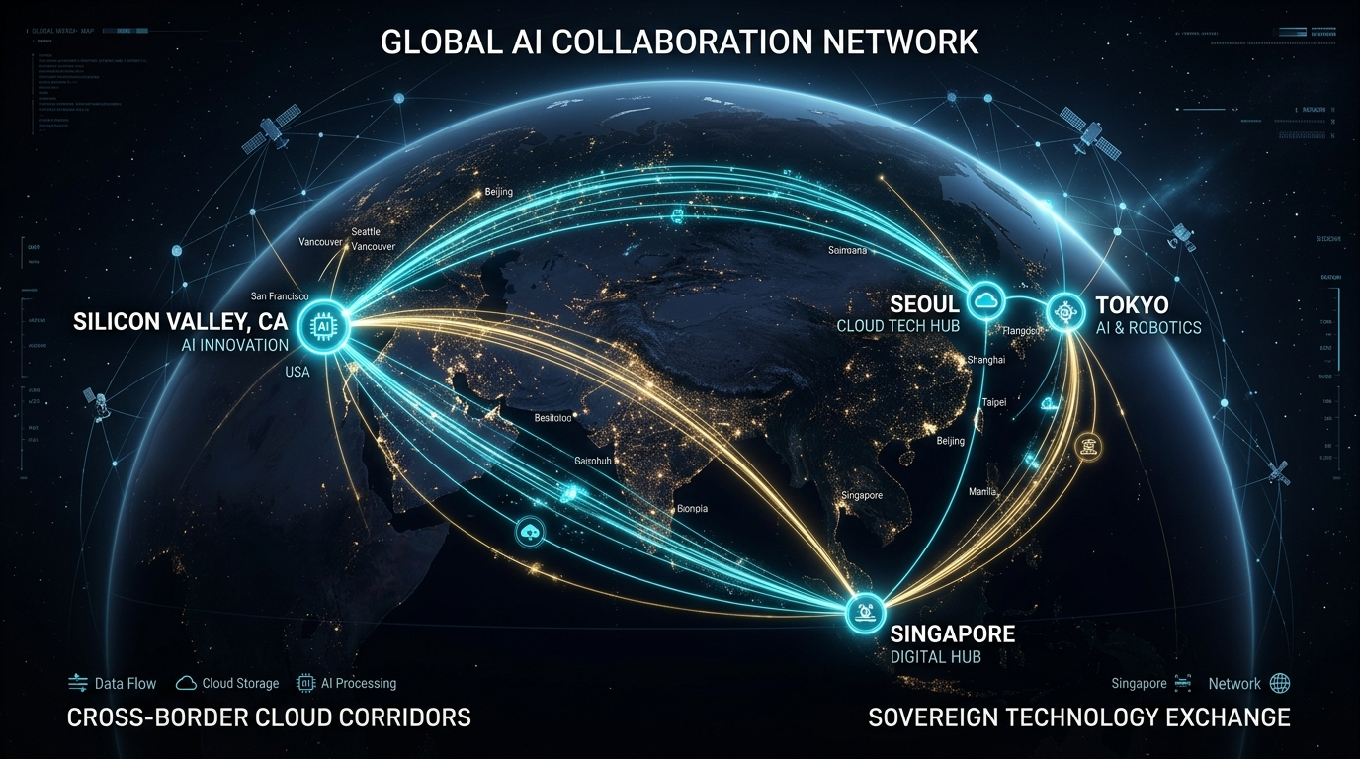
28. Global Expansion Playbook: Bridging Korea, US, Japan & SE Asia
PART 6: MZC PLAYBOOK & GLOBAL VISION
Exporting Sovereign AI Methodologies to High-Growth Asian Markets
1. Silicon Valley Hub (Palo Alto)
Venture partnerships, co-innovation with frontier AI ISVs.
2. Japan Expansion (Tokyo)
Delivering sovereign on-premise AI to Japanese financial and enterprise leaders.
3. Southeast Asia (Singapore, Vietnam)
Scaling low-power NPU inference appliances and cloud software.
4. The Strategic Bridge
Connecting Western software innovation with Asian enterprise operational execution.
VISUAL CONCEPT: Global map linking Silicon Valley, Seoul, Tokyo, and Singapore with active business flows.
UCLA Anderson Executive MBA Delegation Visit | Session 3: Korea Sovereign AI Strategy | Speaker: Andy
28 / 30
Notes:
[PACING: 13:30 - 14:00]
We are expanding globally. Through offices in Palo Alto, Tokyo, and Singapore, we export the sovereign AI methodologies proven in Korea to enterprises across the Asia-Pacific region.

Slide 29
29. Strategic Takeaways for Global Business Leaders
PART 6: MZC PLAYBOOK & GLOBAL VISION
Key Insights for UCLA Anderson Executive MBA Delegates
1. 1. Sovereignty != Isolation
True strategic autonomy combines global technological standards with local control.
2. 2. Datacenter Physics Rule
Power, rack limits, and thermal constraints dictate AI feasibility faster than ambition.
3. 3. Defend Your Proprietary Moat
Internal domain knowledge and proprietary data graphs are your core balance sheet assets.
4. 4. Modular Architectural Agility
Decouple silicon, foundation models, and middleware to prevent future vendor lock-in.
VISUAL CONCEPT: 4 quadrant strategic framework summarizing executive recommendations for global leaders.
UCLA Anderson Executive MBA Delegation Visit | Session 3: Korea Sovereign AI Strategy | Speaker: Andy
29 / 30
Notes:
[PACING: 14:00 - 14:30]
As you return to your executive roles, remember: true sovereignty is about agility, not isolation. Respect datacenter physics early, guard your corporate data, and build modular systems.

Slide 30
30. Conclusion & Open Q&A Discussion
PART 6: MZC PLAYBOOK & GLOBAL VISION
Shaping the Future of Enterprise AI Together
1. Presenter
Andy | ISV Business Unit & AI Architecture Group, MegazoneCloud
2. Official Email
andy@megazone.com | contact@megazone.com
3. Headquarters
MegazoneCloud Gwacheon Smart Tower, Gwacheon-si, Gyeonggi-do, Korea
4. Open Floor Discussion
Comparative regulatory policies, NPU vs. GPU economics, scaling across global subsidiaries.
VISUAL CONCEPT: Collaborative closing slide with MegazoneCloud and UCLA Anderson logos and live Q&A floor open banner.
UCLA Anderson Executive MBA Delegation Visit | Session 3: Korea Sovereign AI Strategy | Speaker: Andy
30 / 30
Notes:
[PACING: 14:30 - 15:00]
Thank you for your time, leadership, and attention. The future of AI will be shaped by strategic autonomy and global collaboration. The floor is now open for your questions.

