Slide 1


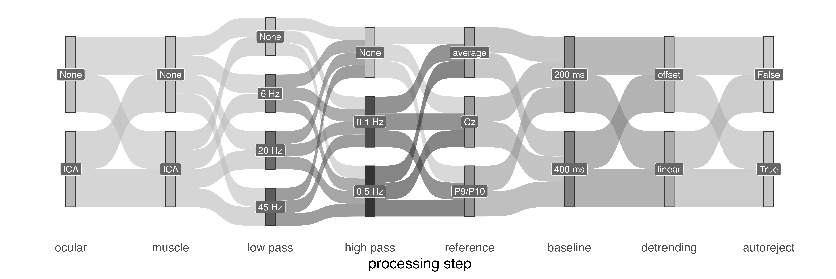
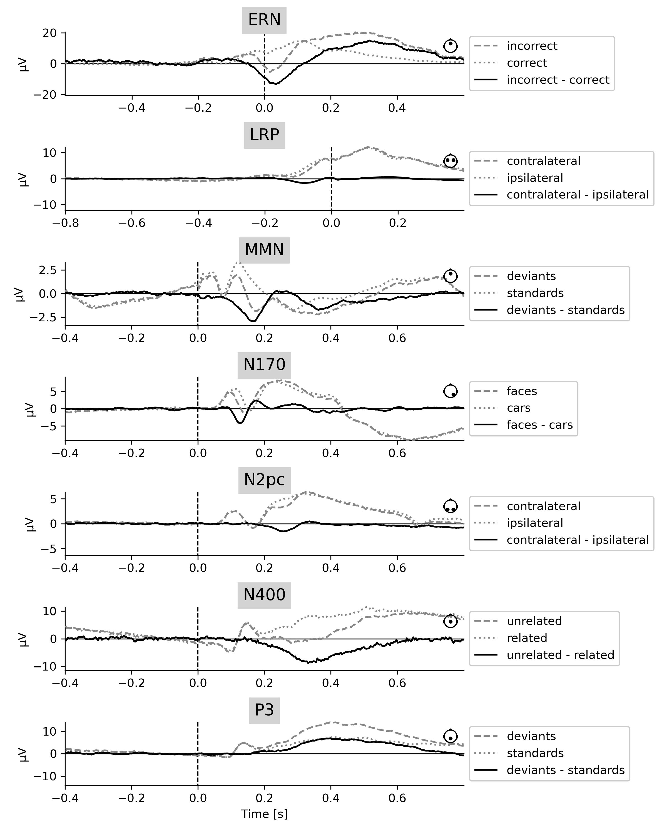
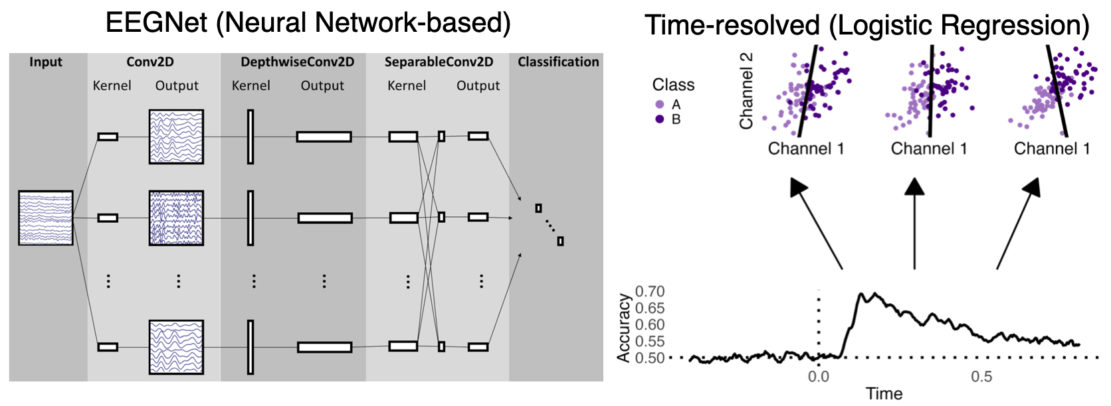
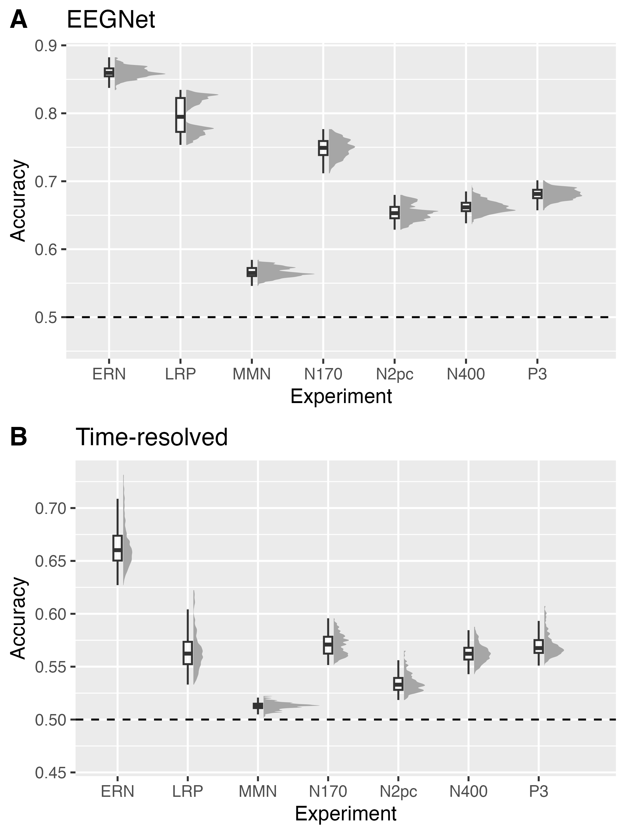
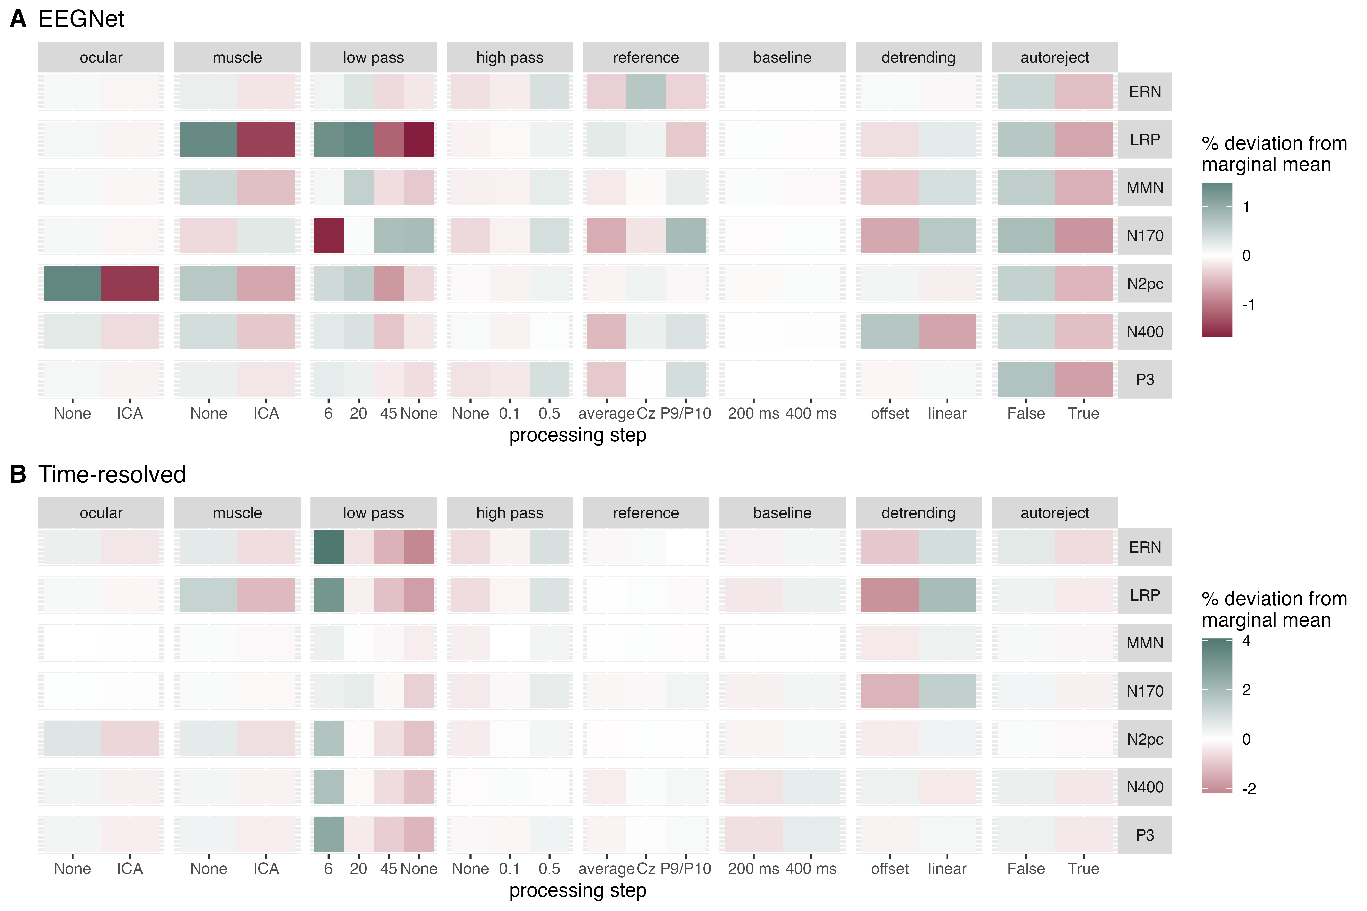
Is EEG better left alone for decoding?
Roman Kessler, Alexander Enge, Michael A. Skeide
Max Planck Institute for Human Cognitive and Brain Sciences, Leipzig, Germany
kessler@cbs.mpg.de
Introduction
Methods
Each experiment was preprocessed using 1,152 unique forking paths.
The aim of this study is to investigate the effect of preprocessing decisions on the performance of decoding algorithms using multiverse preprocessing.
EEG decoding leverages the high dimensionality of data corresponding to specific cognitive processes to provide insights into how neural representations of categories differ or evolve over time¹.
In multiverse preprocessing, pipelines are systemically varied, and the outcomes are compared between forking paths². Using multiverse preprocessing, it has already been shown how single data preprocessing decisions impact ERP amplitude and latency^{2,3}. The findings provide insights into the stability, generalisability, and influence of researchers' degrees of freedom on the outcomes of downstream analyses.
Here, we investigate the impact of preprocessing choices onto decoding accuracy.
The open ERP CORE dataset was analysed⁴
(40 participants, each 7 experiments).
Two different approaches to binary classification were employed^{3,5}.
Test accuracy was modelled as a function of analysis choices.
Results
Decoding accuracy of each forking path was calculated for each experiment and decoding model type, and then averaged across participants. All forking paths resulted in decoding accuracies above chance. The variability observed within each distribution can be attributed to the choice of the forking path.
Main effects of each processing choice on decoding accuracy. The changes are relative to the average decoding accuracy of each experiment. The majority of artifact correction steps resulted in a decrease in decoding accuracy.
A: For EEGNet, the optimal choice of filters and detrending method varied per experiment, with the N170 showing opposite influence of low-pass filter settings on decoding accuracy. In LRP, muscle artifacts are highly predictive. In N2pc, ocular artifacts are highly predictive.
B: For time-resolved decoding, the optimal processing paths were rather independent of the experiment.
Discussion
References
Leave EEG alone for plain decoding.
If the objective is to maximize decoding accuracy, particularly in BCI applications, minimal preprocessing proves beneficial since artifacts are systematic and predictive. Moreover, artifact correction also carries the risk of removing neuronal signals. However, narrow bandpass filters (e.g., 0.5 Hz to 6 Hz) increased decoding accuracy over most experiments and models.
Despite performance differences, decoding accuracies of all models were above chance level in these experiments, independent of the forking path. Only a few interactions between processing steps were consistently observed (not shown), such as between low-pass filter and muscle artifact correction, or between high-pass filter and detrending.
If you interpret timing, relax the narrow filters.
If the time course of prediction is of interest, both low low-pass filter and high high-pass filter cutoffs will likely obscure temporal information^{6,7}. As such, they should be used with caution.
If you interpret spatial features, correct for artifacts.
If the objective is to interpret spatial features, such as the topography of feature importance, artifact correction may still be conducted to avoid contamination with features from non-neural origin.
Ashton, K. et al. Time-resolved multivariate pattern analysis of infant EEG data: A practical tutorial. Developmental Cognitive Neuroscience 54, 101094 (2022).
Clayson, P. E., Baldwin, S. A., Rocha, H. A. & Larson, M. J. The data-processing multiverse of event-related potentials (ERPs): A roadmap for the optimization and standardization of ERP processing and reduction pipelines. NeuroImage 245, 118712 (2021).
Šoškić, A., Styles, S. J., Kappenman, E. S. & Kovic, V. Garden of Forking Paths in ERP Research – Effects of Varying Pre-Processing and Analysis Steps in an N400 Experiment. PsyArXiv (2022).
Kappenman, E. S., Farrens, J. L., Zhang, W., Stewart, A. X. & Luck, S. J. ERP CORE: An open resource for human event-related potential research. NeuroImage 225, 117465 (2021).
Lawhern, V. J. et al. EEGNet: a compact convolutional neural network for EEG-based brain–computer interfaces. J. Neural Eng. 15, 056013 (2018).
Zhang, G., Garrett, D. R. & Luck, S. J. Optimal filters for ERP research II: Recommended settings for seven common ERP components. Psychophysiology 61, e14530 (2024).
Tanner, D., Morgan-Short, K. & Luck, S. J. How inappropriate high-pass filters can produce artifactual effects and incorrect conclusions in ERP studies of language and cognition. Psychophysiology 52, 997–1009 (2015).
Psychologie und Gehirn (PuG), Hmaburg, 2024

