Slide 1


Is EEG better left alone for decoding?
Roman Kessler
Alexander Enge
Michael A. Skeide
May 30, 2024
Notes:
Hey, I'm Roman. Welcome to my talk titled ......

Slide 2
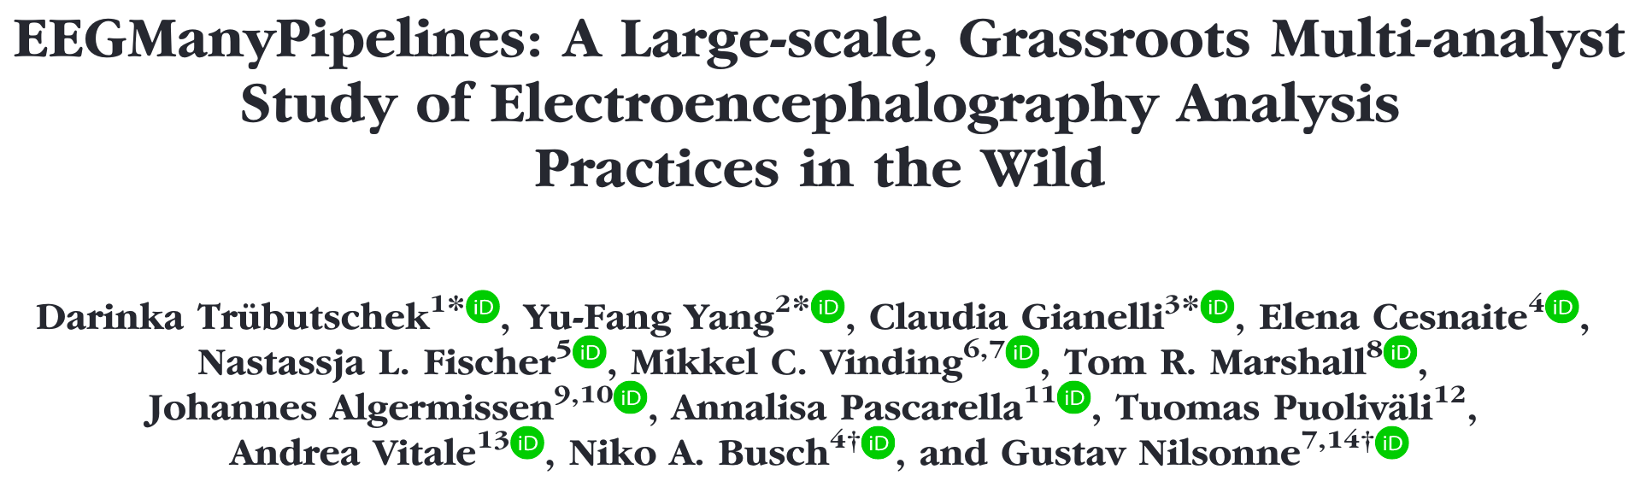
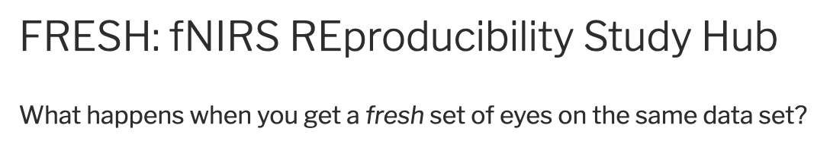
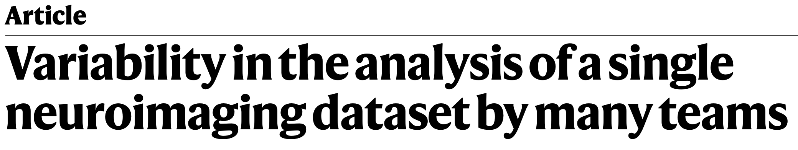
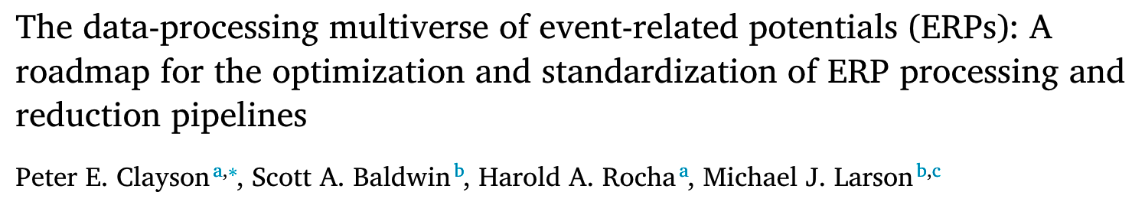
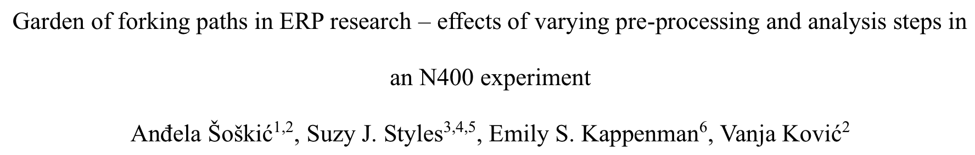

Motivation
Preprocessing is highly variable across researchers.
Preprocessing choices have an impact on ERP results.
Which processing steps increase or decrease decoding performance?

Slide 3
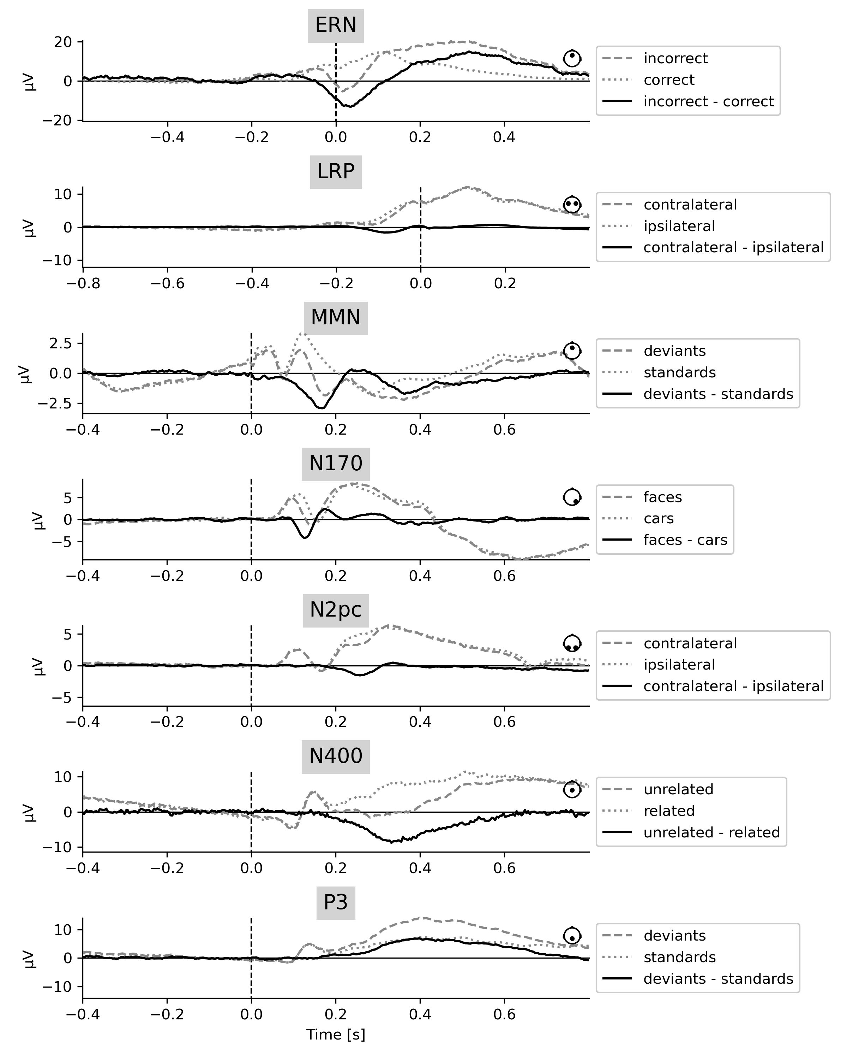
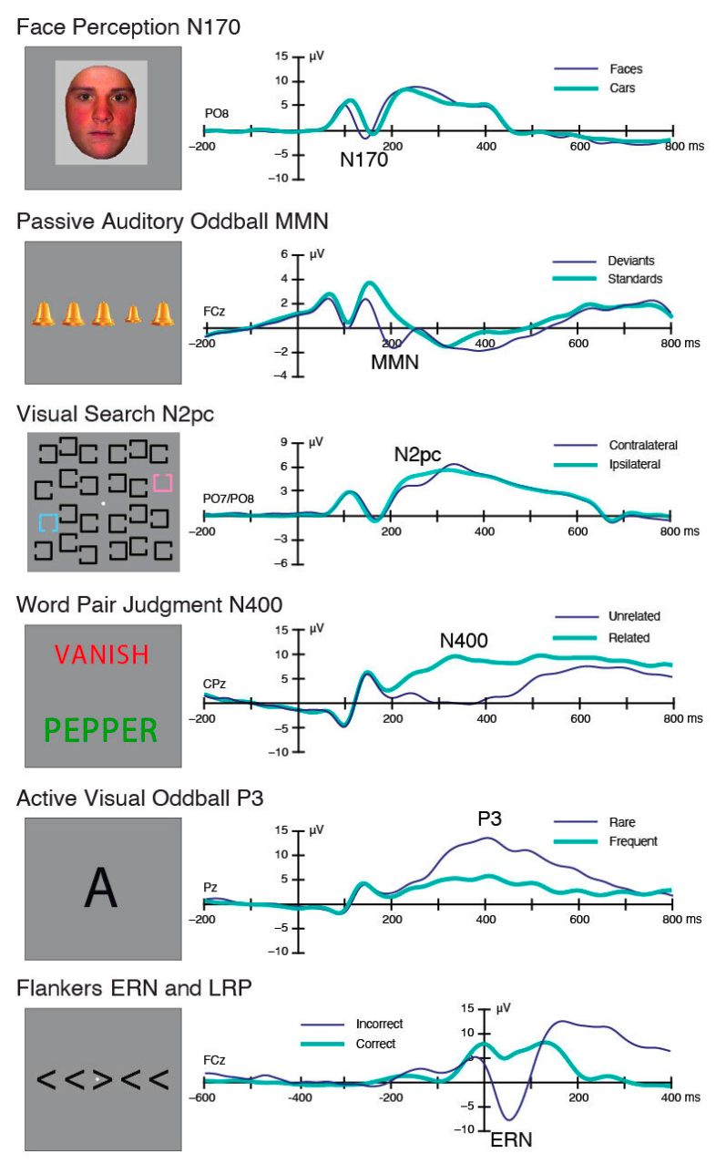
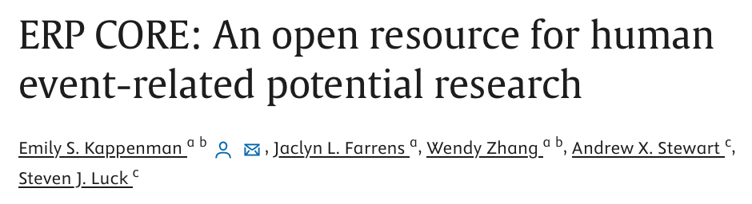
We analysed
7 experiments
https://erpinfo.org/erp-core
Notes:
always 2 cond
erp: 1-2 electrodes, decoding: all electrodes

Slide 4
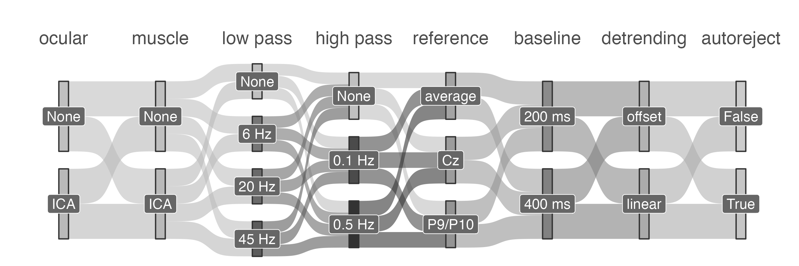

A multiverse for preprocessing
Notes:
multiverse
> 1000 repl

Slide 5
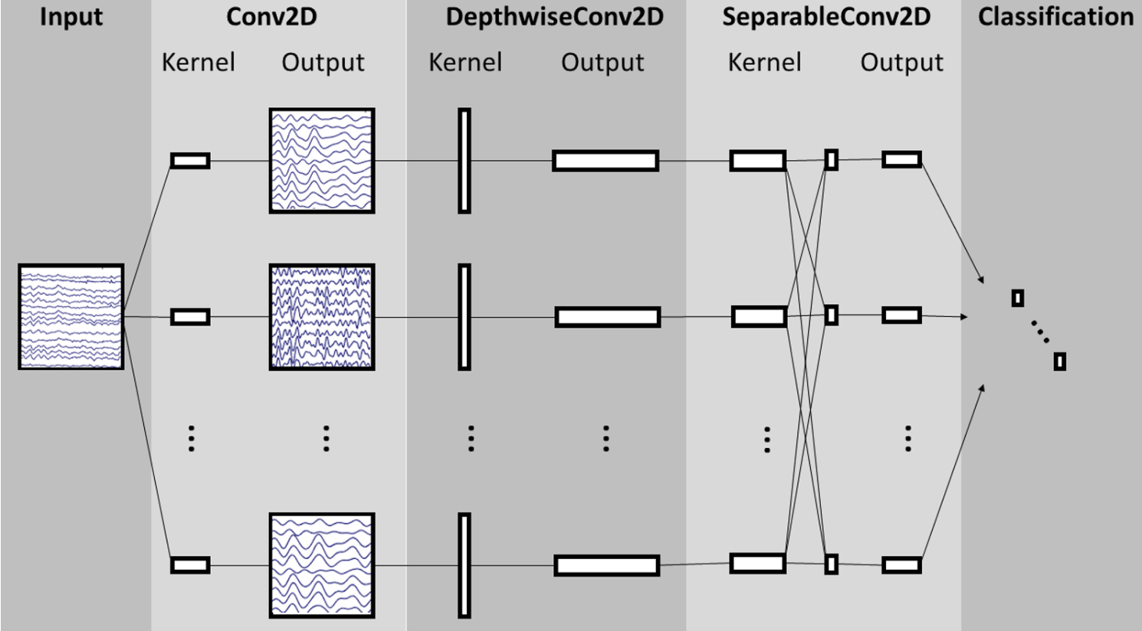
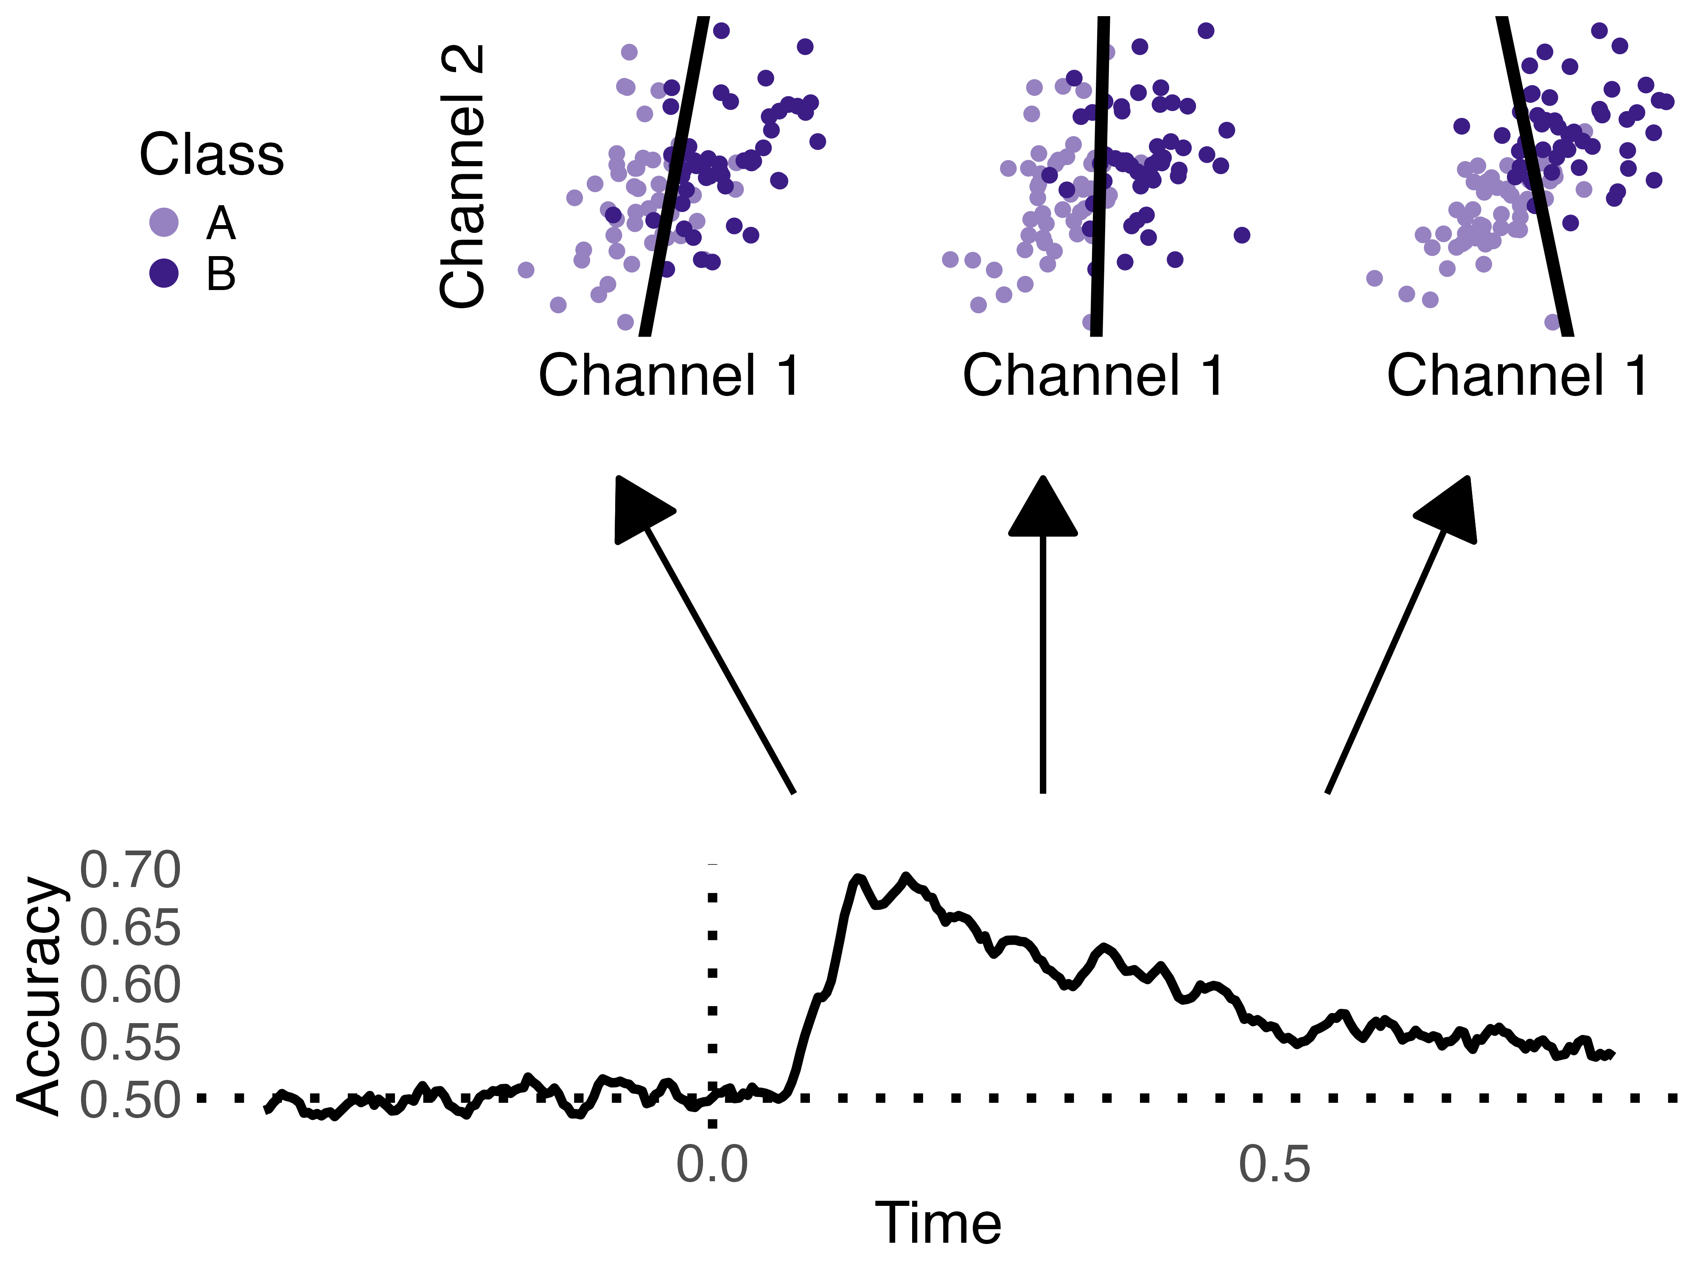
Decoding
EEGNet (Convolutional Neural Network-based)
Time-resolved (Logistic Regression)
Lawhern et. al 2018 J.NeuralEng
Notes:
2 approaches
CNN
TR --> average accuracy

Slide 6
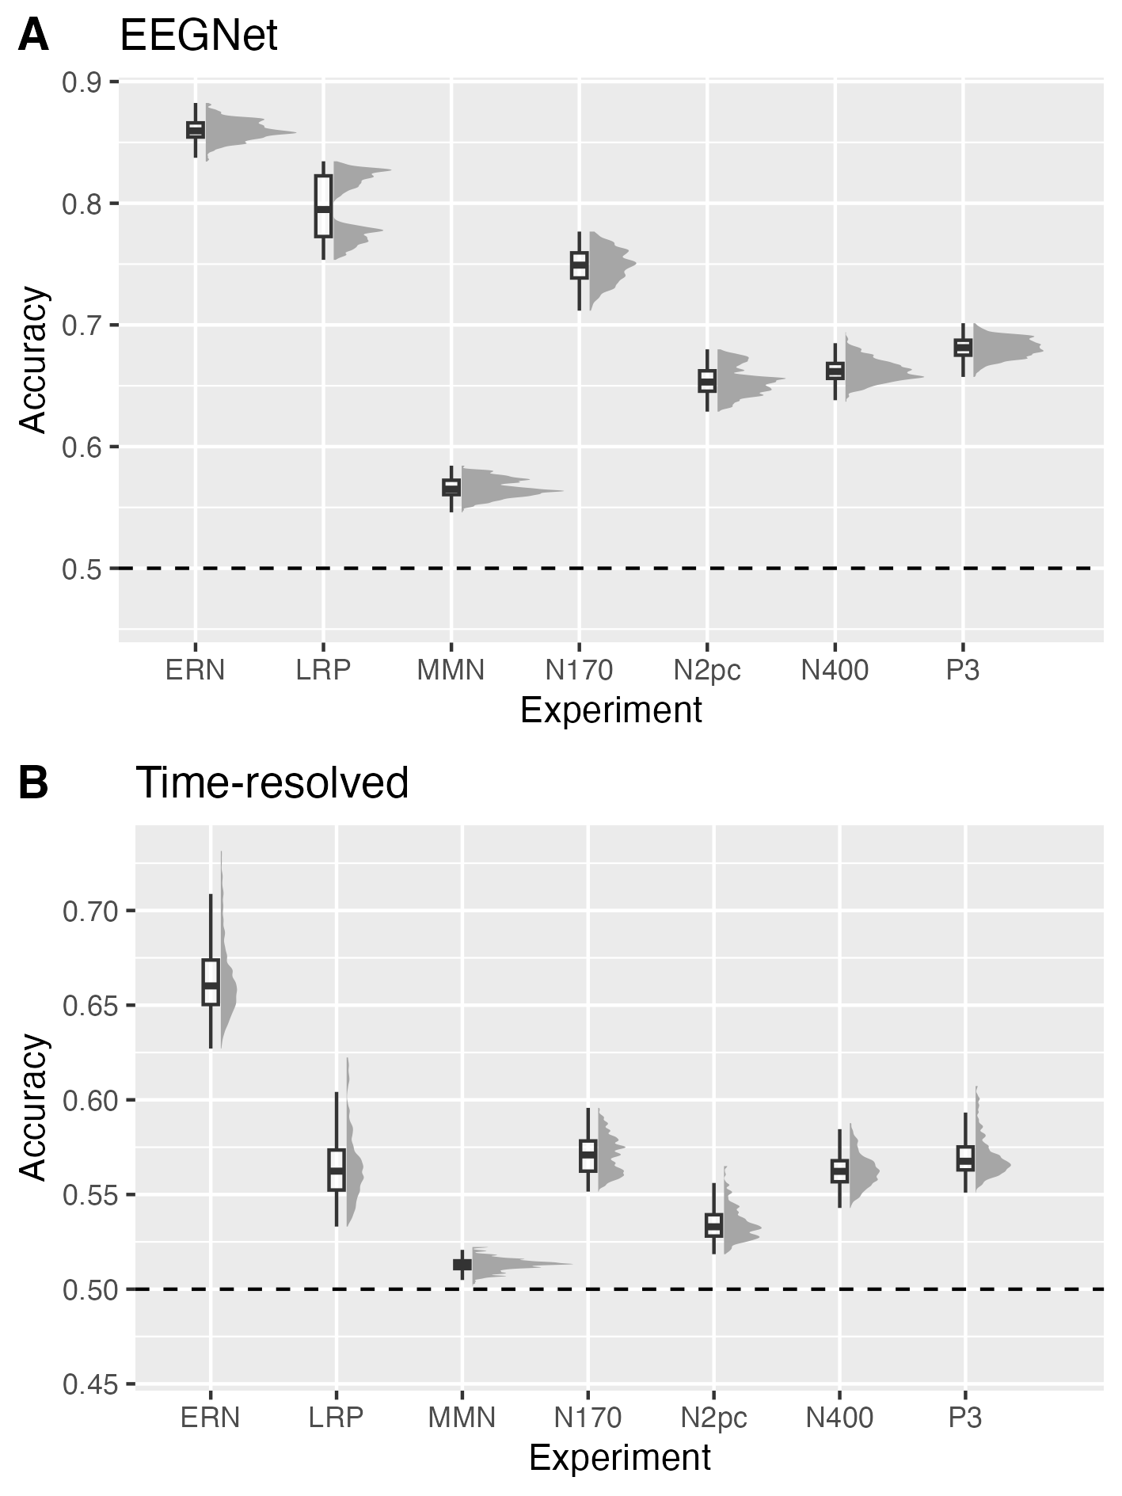
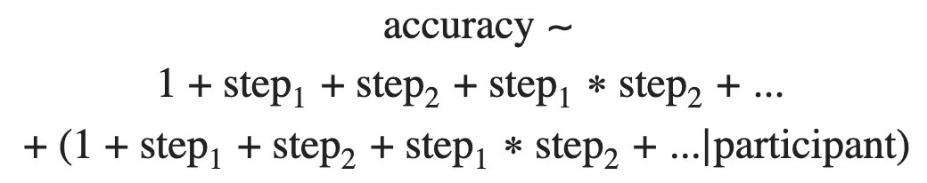
Decoding accuracies
Notes:
remaining variability --> processing

Slide 7
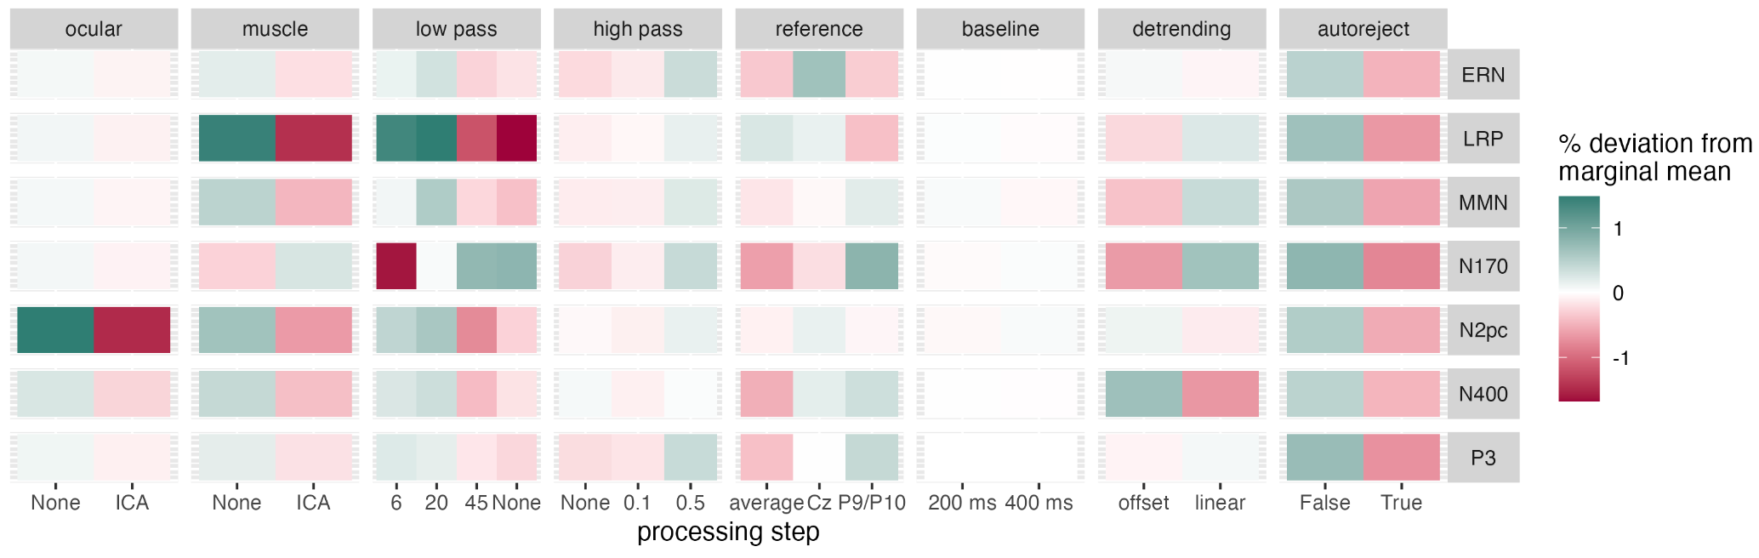
Which steps enhance decoding accuracy?
main effects - EEGNet
Notes:
2 specialties

Slide 8
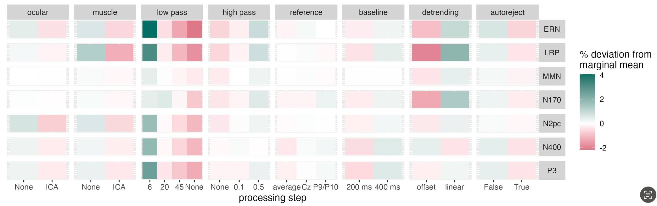
Which steps enhance decoding accuracy?
main effects - Time-resolved decoding
Notes:
similar across exp

Slide 9
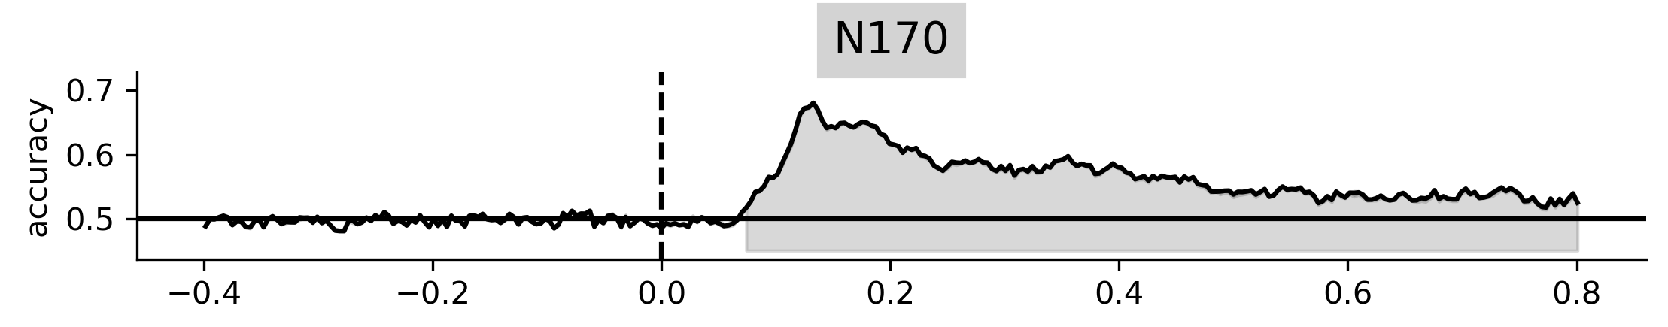
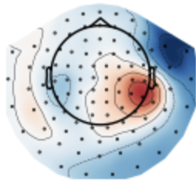

Is EEG better left alone for decoding?
It depends.
Comments & questions:
write me!
rkesslerx@gmail.com
Visit my poster: Friday 16:30-18:00
Maximise decoding performance ?
narrow filter,
no artifact correction
Interpret timing ?
relax the narrow filter
cbs.mpg.de/independent-research-groups/learning-in-early-childhood
Interpret spatial feature importance ?
carefully select artifact correction steps
x.com/skeidelab

